Slide 1

Frequency shift and Q of disordered superconducting RF cavities
TTC2022 Aomori, WG-1: Progress of High Q and High Gradient activities
Department Physics & Astronomy, Louisiana State University, Baton Rouge LA
Hikaru Ueki, Mehdi Zarea, and J. A. Sauls
PHY-1734332

Slide 2
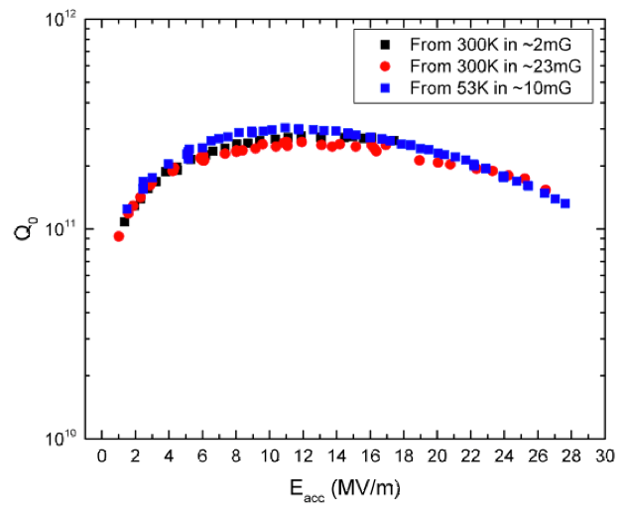
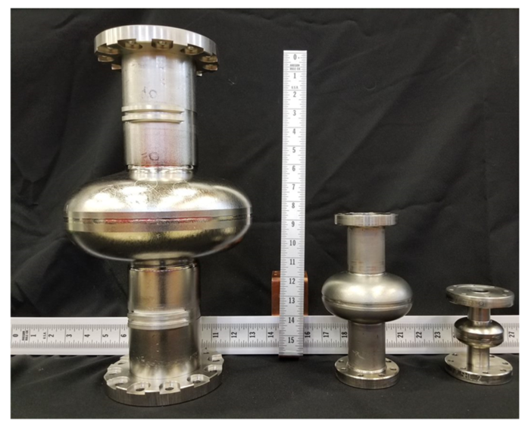
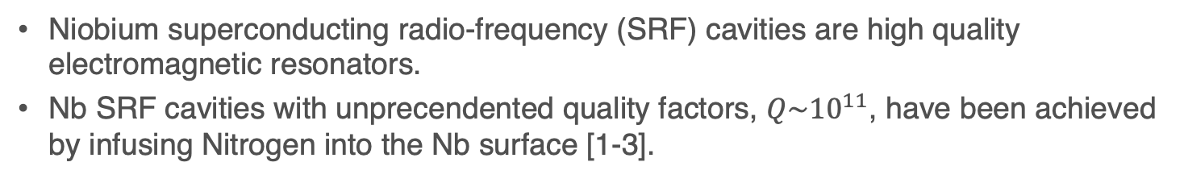
Introduction
Niobium superconducting radio-frequency (SRF) cavities are high quality electromagnetic resonators.
Nb SRF cavities with unprecendented quality factors, $Q\sim {10}^{11}$, have been achieved by infusing Nitrogen into the Nb surface [1-3].
Mechanism of the improvement has not yet fully understood
[1] A. Grassellino et al., Supercond. Sci. Technol. 26, 102001 (2013). [2] A. Romanenko et al., Appl. Phys. Lett. 105, 234103 (2014). [3] A. Romanenko et al., Phys. Rev. Applied 13, 034032 (2020).

Slide 3
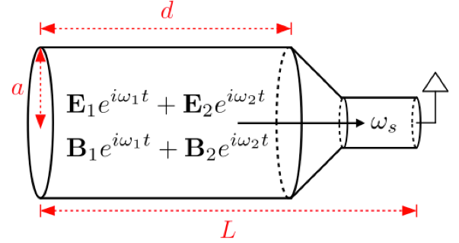
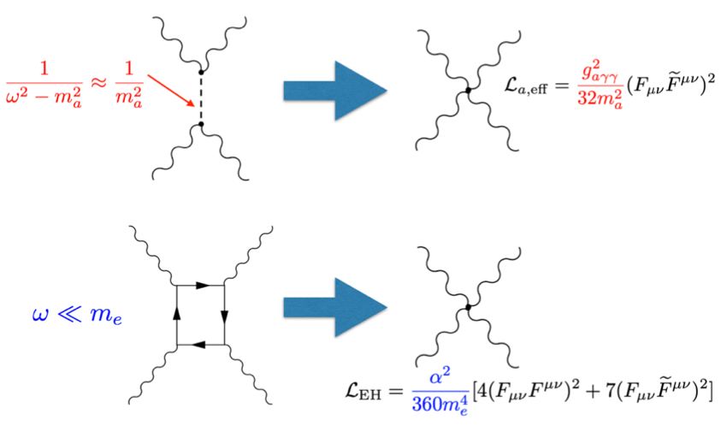
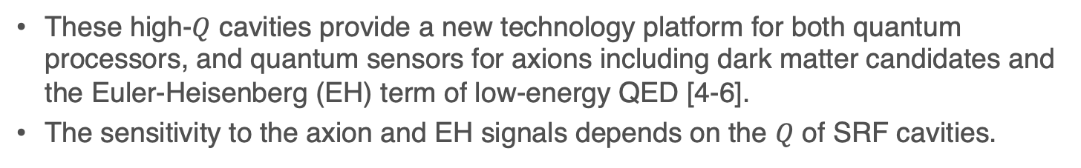
Introduction
These high-$Q$ cavities provide a new technology platform for both quantum processors, and quantum sensors for axions including dark matter candidates and the Euler-Heisenberg (EH) term of low-energy QED [4-6].
The sensitivity to the axion and EH signals depends on the $Q$ of SRF cavities.
Light-by-light scattering mediated by axion and electrons!
Intermodulation due to the nonlinearity in a cavity pumped with two resonance modes
[4] Z. Bogorad et al., Phys. Rev. Lett. 123, 021801 (2019). [5] Y. Kahn et al., Proc. SPIE 12016, 1201606 (2022). [6] A. Berlin et al., J. High Energ. Phys. 2020, 88 (2020).

Slide 4
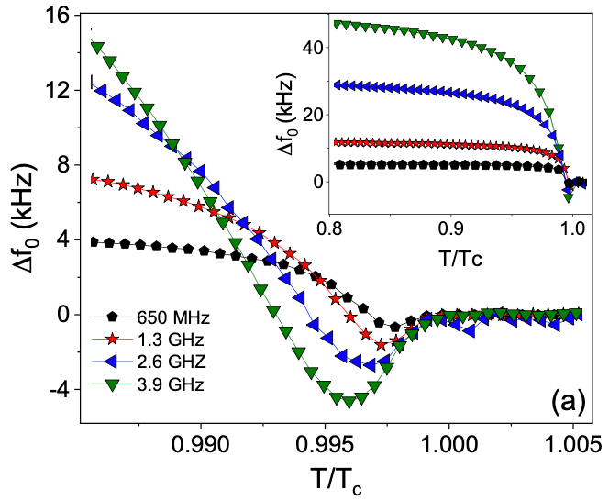
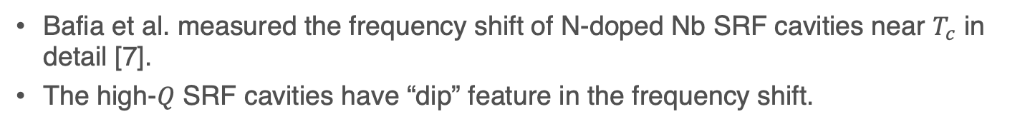
Introduction
Bafia et al. measured the frequency shift of N-doped Nb SRF cavities near $T_{c}$ in detail [7].
The high-$Q$ SRF cavities have “dip” feature in the frequency shift.
Important to study the N impurity effects on the cavity wall
[7] D. Bafia et al., arXiv:2103.10601.

Slide 5
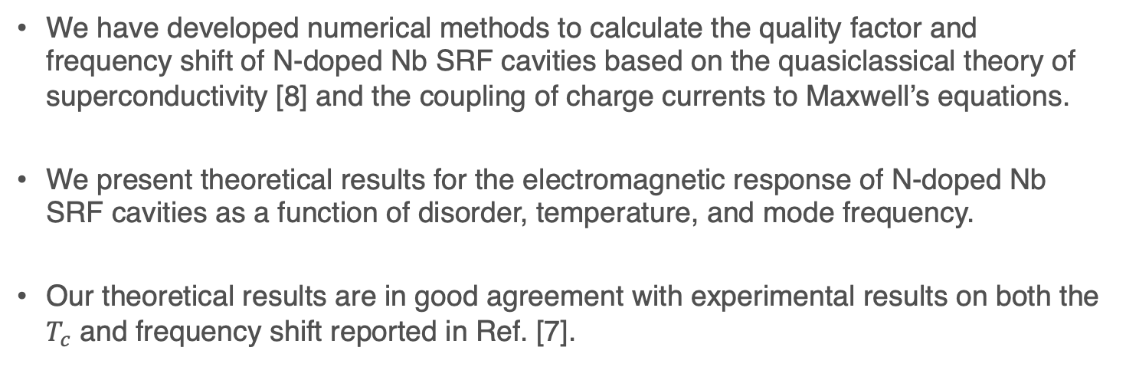
Introduction
We have developed numerical methods to calculate the quality factor and frequency shift of N-doped Nb SRF cavities based on the quasiclassical theory of superconductivity [8] and the coupling of charge currents to Maxwell’s equations.
We present theoretical results for the electromagnetic response of N-doped Nb SRF cavities as a function of disorder, temperature, and mode frequency.
Our theoretical results are in good agreement with experimental results on both the $T_{c}$ and frequency shift reported in Ref. [7].
[7] D. Bafia et al., arXiv:2103.10601. [8] D. Rainer and J. A. Sauls, “Superconductivity: From Basic Physics to New Developments”, ch. 2, pp. 45–78, World Scientific, Singapore (1994).

Slide 6

Formalism
Conductivity $σ=σ_{1}+iσ_{2}$ calculated based on the quasiclassical theory of superconductivity: [8]
$σ_{D}:$Drude conductivity.
[8] D. Rainer and J. A. Sauls, “Superconductivity: From Basic Physics to New Developments”, ch. 2, pp. 45–78, World Scientific, Singapore (1994).

Slide 7

Formalism
Surface impedance $Z_{s}=R_{S}+iX_{s}$ obtained by solving Maxwell's equations on interface between vacuum and superconductor:
Normal-state resistance $R_{n}$, reactance $X_{n}$, and conductivity $σ_{n1}$:
$ω_{p}:$ plasma frequency.
Quality factor $Q$ and frequency shift $δf$ of the SRF cavities calculated from Maxwell’s equations in a hollow cavity based on the Slater method: [9]
[9] J. C. Slater, Rev. Mod. Phys. 18, 441 (1946).

Slide 8
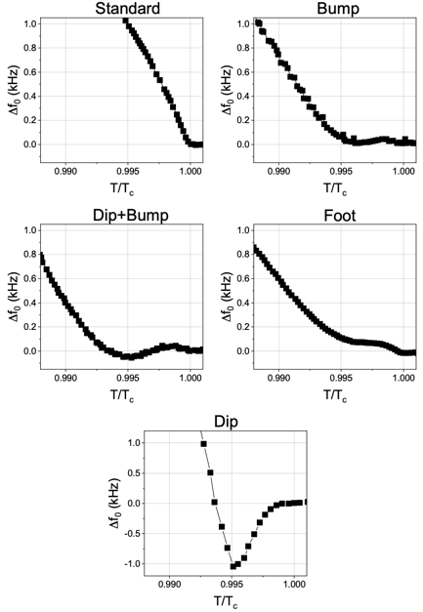
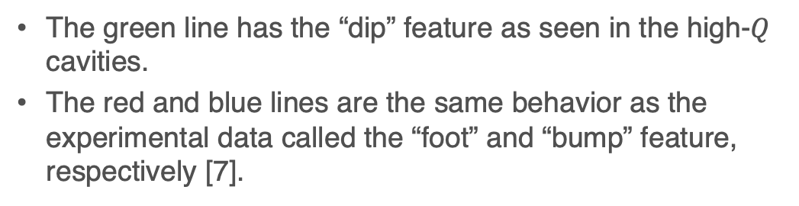
Theoretical Calculation of Frequency Shift
[7] D. Bafia et al., arXiv:2103.10601.
The green line has the “dip” feature as seen in the high-$Q$ cavities.
The red and blue lines are the same behavior as the experimental data called the “foot” and “bump” feature, respectively [7].

Slide 9
Theoretical Calculation of Quality Factor
The quality factor in cavities with intermediate disorder is the largest.
It becomes rather small in the too dirty cavities due to the pair breaking.

Slide 10
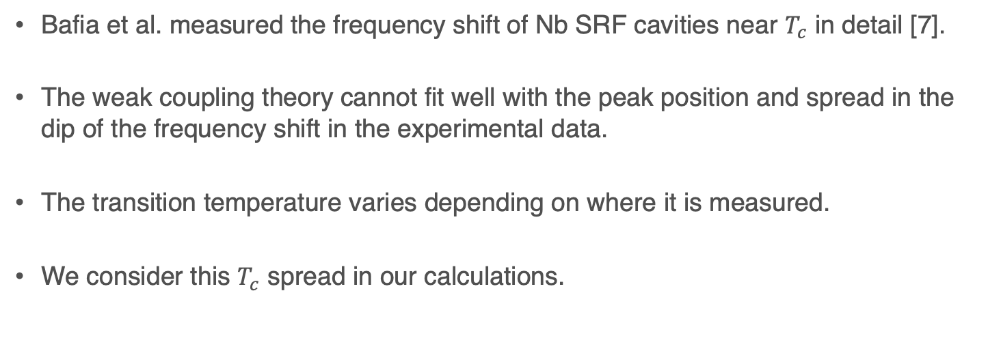
Comparison & Analysis of N-doped Nb SRF Cavities
Bafia et al. measured the frequency shift of Nb SRF cavities near $T_{c}$ in detail [7].
The weak coupling theory cannot fit well with the peak position and spread in the dip of the frequency shift in the experimental data.
The transition temperature varies depending on where it is measured.
We consider this $T_{c}$ spread in our calculations.
[7] D. Bafia et al., arXiv:2103.10601.

Slide 11
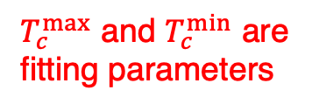
Superconducting Gap with Spread in $T_{c}$
Gap energy with spread in $T_{c}:$ [11]
Gaussian distribution of $T_{c}:$ [11]
Average of $T_{c}$: $T_{c}^{ave}={(T}_{c}^{max}−T_{c}^{min})/2$.
$T_{c}^{max}$ and $T_{c}^{min}$ are fitting parameters
Standard deviation of $T_{c}$: $T_{c}^{SD}={(T}_{c}^{ave}−T_{c}^{min})/3$.
[11] HU, M. Zarea, and J. A. Sauls, arXiv:2207.14236.

Slide 12
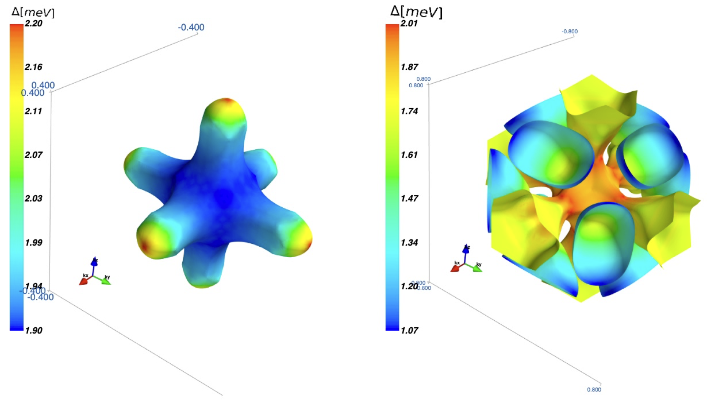
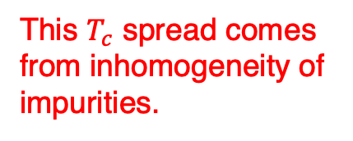
Spread in $T_{c}$ and Inhomogeneity of Impurities
$T_{c}$ equation:
Transition temperature for pure Nb: $T_{c_{0}}=9.33$ K.
Gap anisotropy factor: $A=0.037$.
This $T_{c}$ spread comes from inhomogeneity of impurities.
These parameters are obtained from the LDA calculation [12].
[12] M. Zarea, HU, and J. A. Sauls, arXiv:2201.07403.

Slide 13
Comparison & Analysis of N-doped Nb SRF Cavities
Frequency shift of the N-doped Nb SRF cavities with the different frequency: [7]
Our theoretical lines are fitted well with the experimental data!
[7] D. Bafia et al., arXiv:2103.10601.

Slide 14
Comparison & Analysis of N-doped Nb SRF Cavities
Gap energy near $T_{c}$ and Gaussian distributions of $T_{c}$ and $1/τ$:
Used $T_{c}^{max}$, $T_{c}^{min}$, $R_{n}$, and the corresponding experimental data: [7]
Our theory is in good agreement with the experimental data!
[7] D. Bafia et al., arXiv:2103.10601.

Slide 15
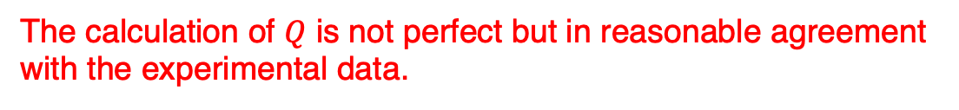
Comparison & Analysis of N-doped Nb SRF Cavities
Quality factor and frequency shift of the Nb SRF cavity: [7]
The calculation of $Q$ is not perfect but in reasonable agreement with the experimental data.
[7] D. Bafia et al., arXiv:2103.10601.

Slide 16
Summary
We showed that the quality factor has a peak of upper convexity as a function of the quasiparticle-impurity scattering rate, with the largest 𝑄 in cavities with intermediate disorder.
We presented theoretical results for the effects of inhomogeneous disorder on the transition temperature and frequency shift of SRF cavities and our calculations are in good agreement with the experimental results [7].
We provide a new tool for characterization of high-𝑄 SRF cavities.
We thank D. Bafia, A. Grassellino, A. Romanenko, and J. Zasadzinski for many discussions on their experimental work on SRF cavities.
[7] D. Bafia et al., arXiv:2103.10601.

Slide 17
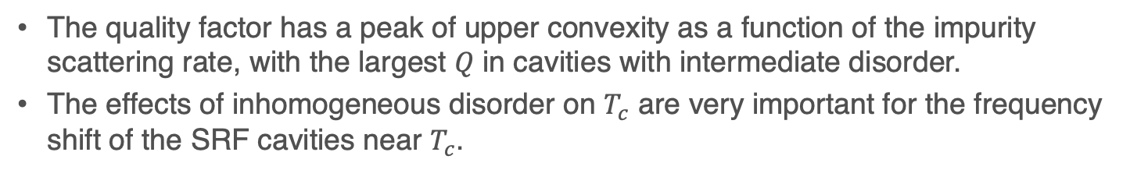
Main Message
The quality factor has a peak of upper convexity as a function of the impurity scattering rate, with the largest 𝑄 in cavities with intermediate disorder.
The effects of inhomogeneous disorder on $T_{c}$ are very important for the frequency shift of the SRF cavities near $T_{c}$.
Taking Points
Why is Q the largest at intermediate levels of disorder?
Why do the Nb SRF cavities with intermediate levels of disorder have the dip feature in the frequency shift?

Slide 19
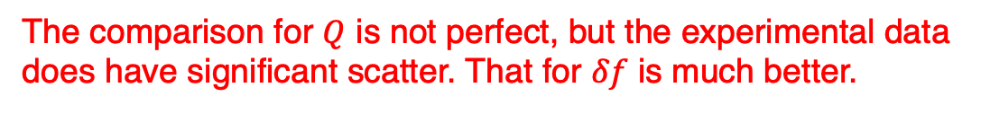
Comparison & Analysis of a Nb Sample in a Cooper Cavity
Frequency shift and quality factor of a Nb sample in a cooper cavity: [10]
The comparison for $Q$ is not perfect, but the experimental data does have significant scatter. That for $δf$ is much better.
[10] O. Klein et al., Phys. Rev. B 50, 6307 (1994).

Slide 20
Frequency Shift Anomaly Near $T_{c}$
To understand the dip in the frequency shift, we express the conductivity as [11]
$δσ_{1}$ and $δσ_{2}$ are the small deviations from $σ_{1n}$ and $σ_{2n}$, respectively.
Assuming $σ_{1n}≫σ_{2n}$, we obtain the frequency shift near $T_{c}$ as
$δσ_{1}−δσ_{2}<0$ is now satisfied since $δσ_{2}$ is larger in dirty superconductors, and then the frequency shift becomes negative near $T_{c}$.
[11] HU, M. Zarea, and J. A. Sauls, arXiv:2207.14236.

