Slide 1


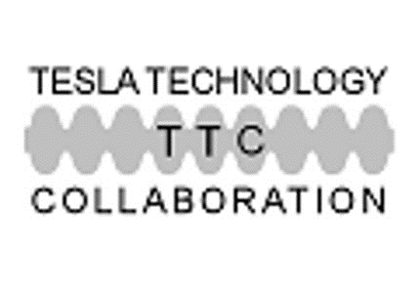
Thin film QWRs performance for ALPI-SPES upgrade at INFN-LNL: first results
G. Keppel, on behalf of SRF LNL groups
Link Station Hall Aomori​
October 11-14, 2022

Slide 2
Outline
Thin film QWR @LNL
  Introduction: ALPI evolution over the years
  The SPES Project @LNL
  ALPI Upgrade for SPES project
  The TANDEM – PIAVE – ALPI Complex
QWR Status @LNL
  Sputtering and Chemistry Facility Upgrade
  Back extrusion cavities
  Results
Conclusion

Slide 3
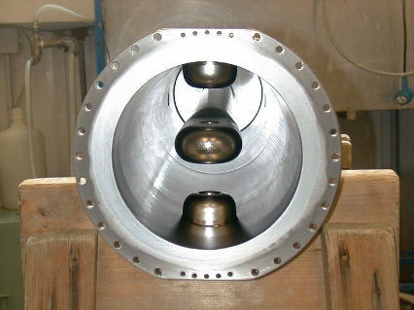
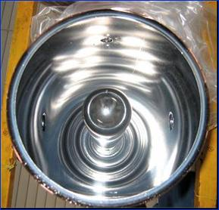
Outlook - Introduction
ALPI’s design started in 1990
ALPI started operation in 1994-98 with Pb/Cu technology
Meanwhile from 1993:
  R&D on low β (0,055) 80 MHz bulk Nb resonators (thanks A. Facco)
  R&D on Nb/Cu medium β (0,11) 160 MHz resonators
  (thanks V. Palmieri, S. Stark, A. Porcellato)
$$E_{a}=\left(2.7→4.4\right){MV}/m$$

Slide 4
Outlook - Introduction
Nb/Cu resonators are definitively a mainstay of this facility, given the performance and stability over the years.
We have faced a generation transition in the recent years, which has represented a new challenge

Slide 5
Outlook - Introduction
LNL Nb/Cu experience specially in terms of
Reliability
  Repeatability
  Stability
  Cost Reduction
  Performance
Demonstrate the suitability of the technology for large-scale production
ISOLDE - CERN

Slide 6
Medium $β$ cavity test 2007 -> 2021
FC 40 cavity from CR7
2007 vs. 2021
Same Q₀
Same RF performance
Difference at high filed due to low conditioning in 2021

Slide 7




ALPI-SPES upgrade
Selective Production of Exotic Species
Cyclotron
Second generation ISOL facility for nuclear physics: Production & re-acceleration of exotic beams
Research and Production of Radio-Isotopes for Nuclear Medicine
Accelerator-based neutron source (Proton and Neutron Facility for Applied Physics)
ISOL RIBs+
Post-Acc.
Nuclear Medicine
Nuclear Applications
Notes:
Four-leaf clover first phase

Slide 8
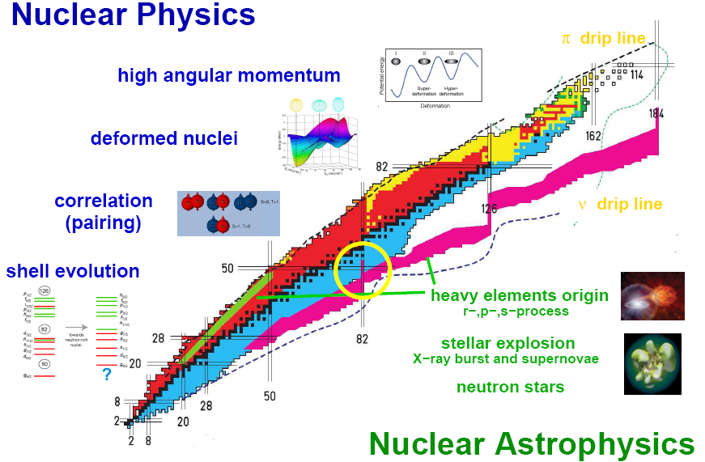
SPES Facility @ LNL
New High power compact CYCLOTRON 70 MeV 750 microA (BEST company)
New configuration of High power ISOL System (8 kW Target ion source)
ALPI superconductive LINAC (up-graded) for RIB’s reacceleration

Slide 9
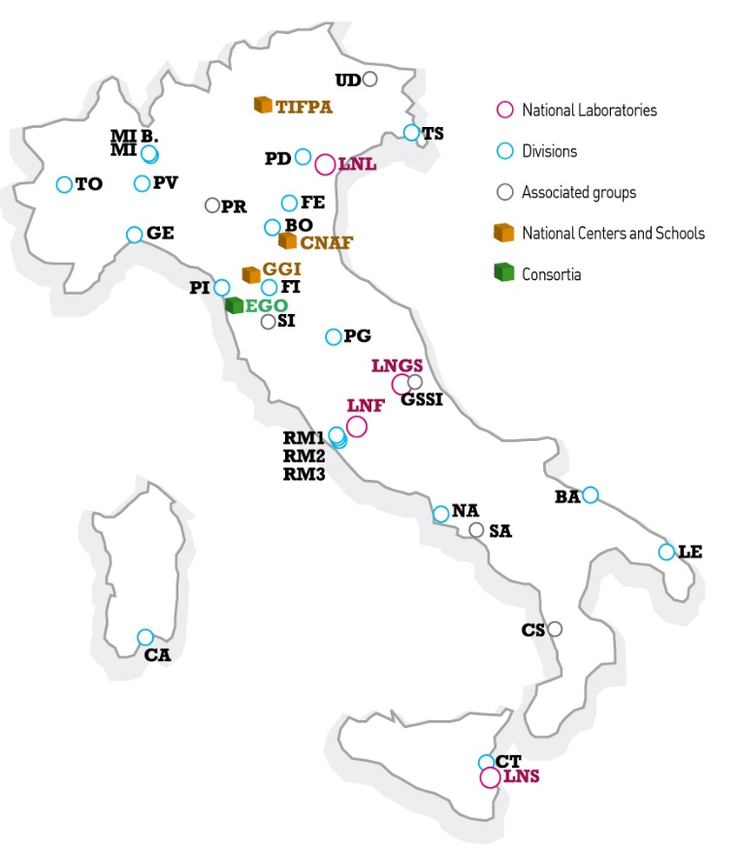
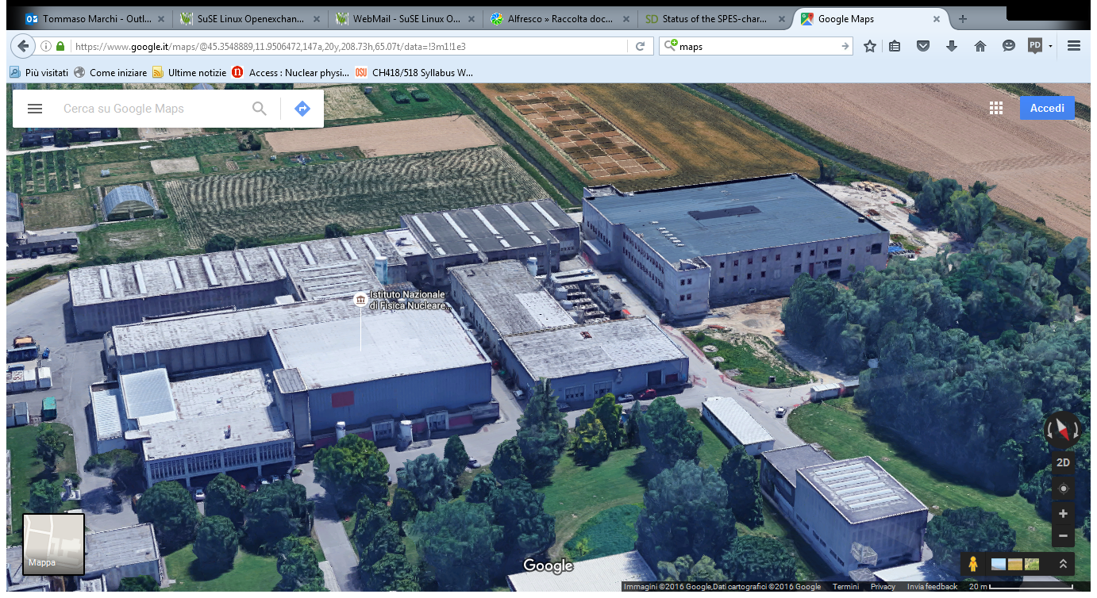
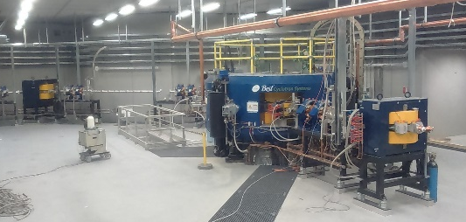
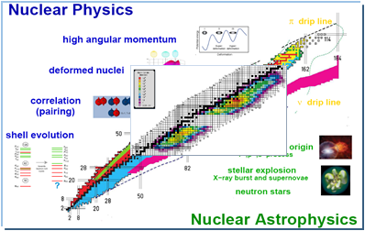
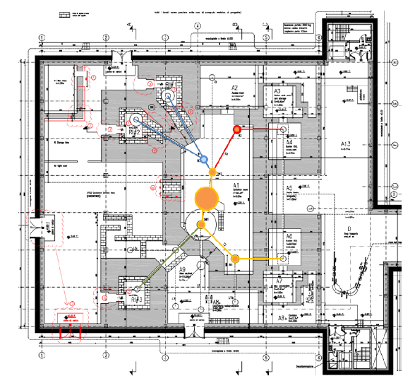
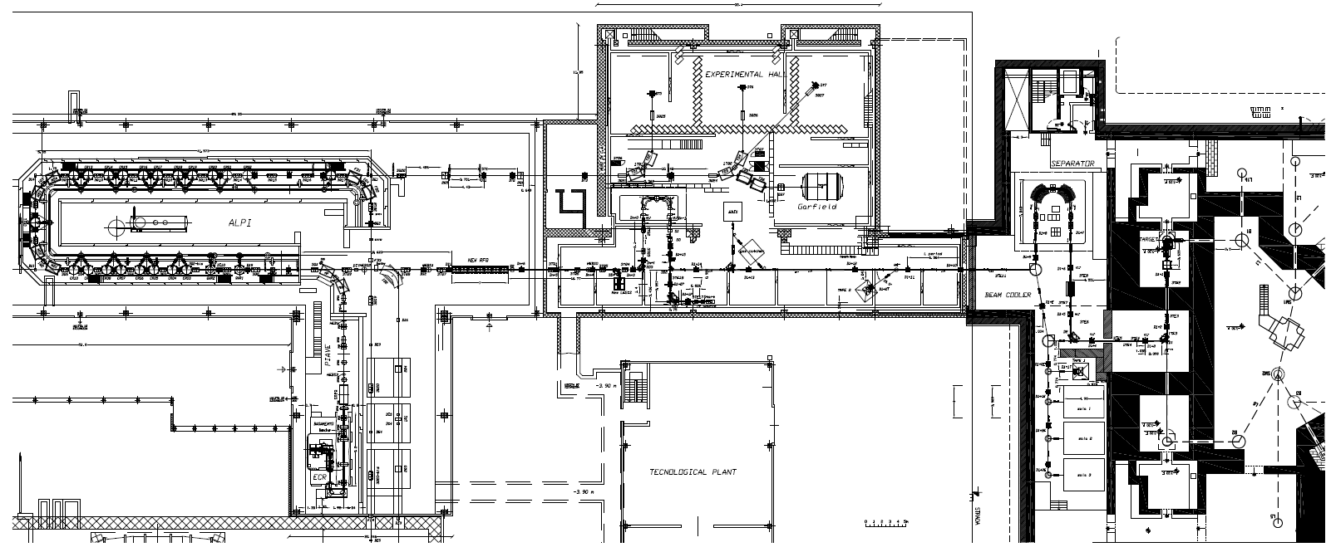
INFN-Legnaro: a lab for stable and presently unstable heavy ion beams, and RI production
SC_LINAC (ALPI)
XTU Tandem
HRMS
ISOL1
Applications
ALPI SC_linac
RFQ
1+ area
cyclotron
CB - MRMS
ISOL2
ISOL FACILITY and reacceleration

Slide 10
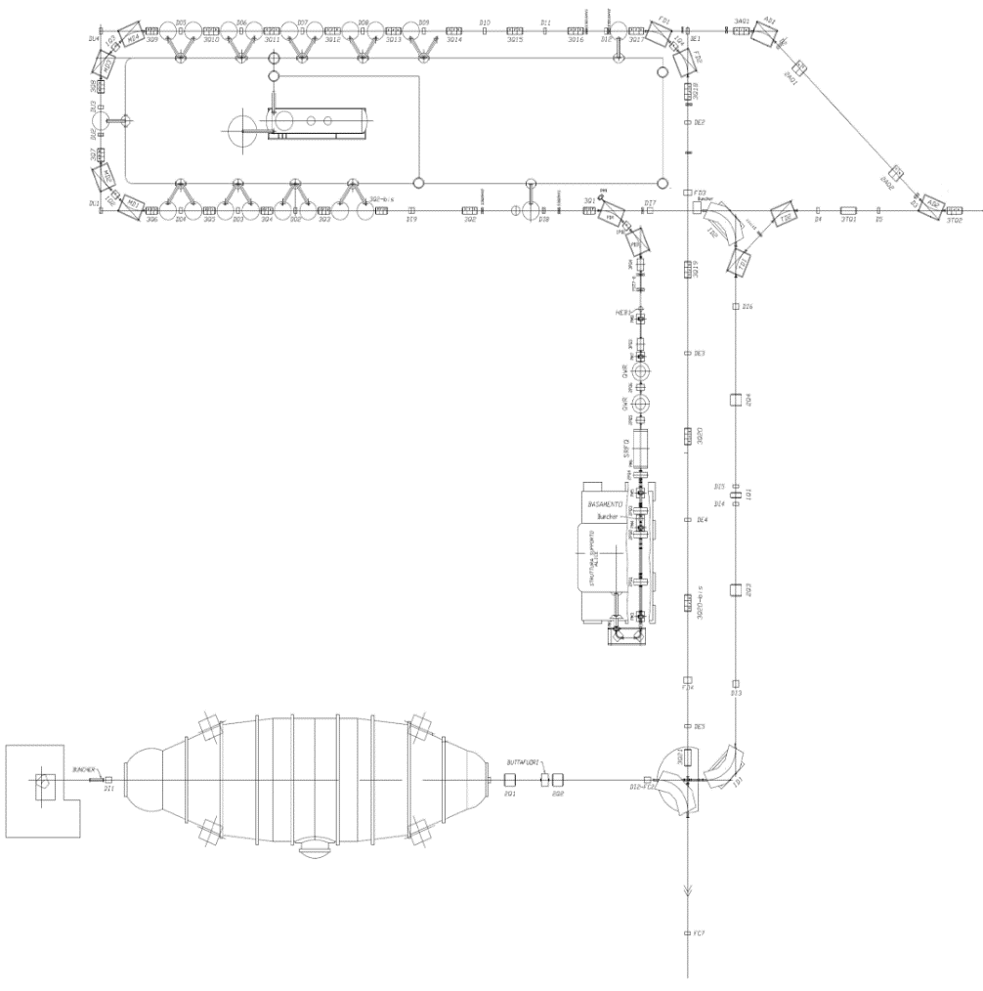
SPES layout
Neutron production area (NEPIR)
STABLE BEAM FACILITY
RIB transfer and selection
HRMS
ISOL1
Low Energy area
CYCLOTRON
ISOL2
RIB reacceleration:
New RT RFQ
ALPI to 10 MeV/A
1/20.000 mass separator (Beam Cooler + HRMS)
Elettrostatic beam transport
Charge Breeder (n+)
1/1000 mass separator
ISOL bunkers
1/200 mass separator
low energy experimental area
Radioisotopes production area (LARAMED)

Slide 11
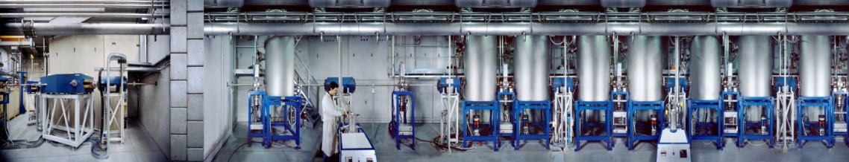

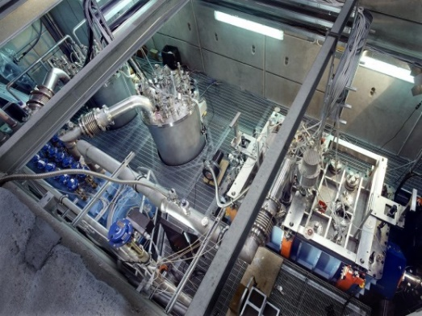
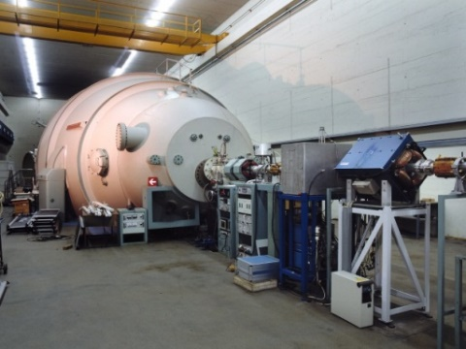
TANDEM – PIAVE – ALPI complex
SC Linac with 68 QWRs (Nb, Nb/Cu) working @ 4,2 K
in 19 cryostats V_{eq} ~ 48 MeV/q,
beams from ¹²C to ²⁰⁶Pb,
injected by Tandem or PIAVE
(1994)
SC Linac
ALPI
Hall 3
Supernanogan ECR on 350 kV platform
SC-RFQs and QWRs, V_{eq} ~ 8 MV
¹²C – ²⁰⁶Pb (higher q and I_{beam})
(2006)
PIAVE
15 MV VdG Tandem (HV Corp),
H-¹⁰⁰Mo beams, E = 30 ÷ 1.5 MeV/A,
CW or pulsed (1984)
XTU-Tandem
Halls 1 and 2

Slide 12
Beam Energies with full SPES Upgrade for Piave-Tandem-ALPI

Slide 13
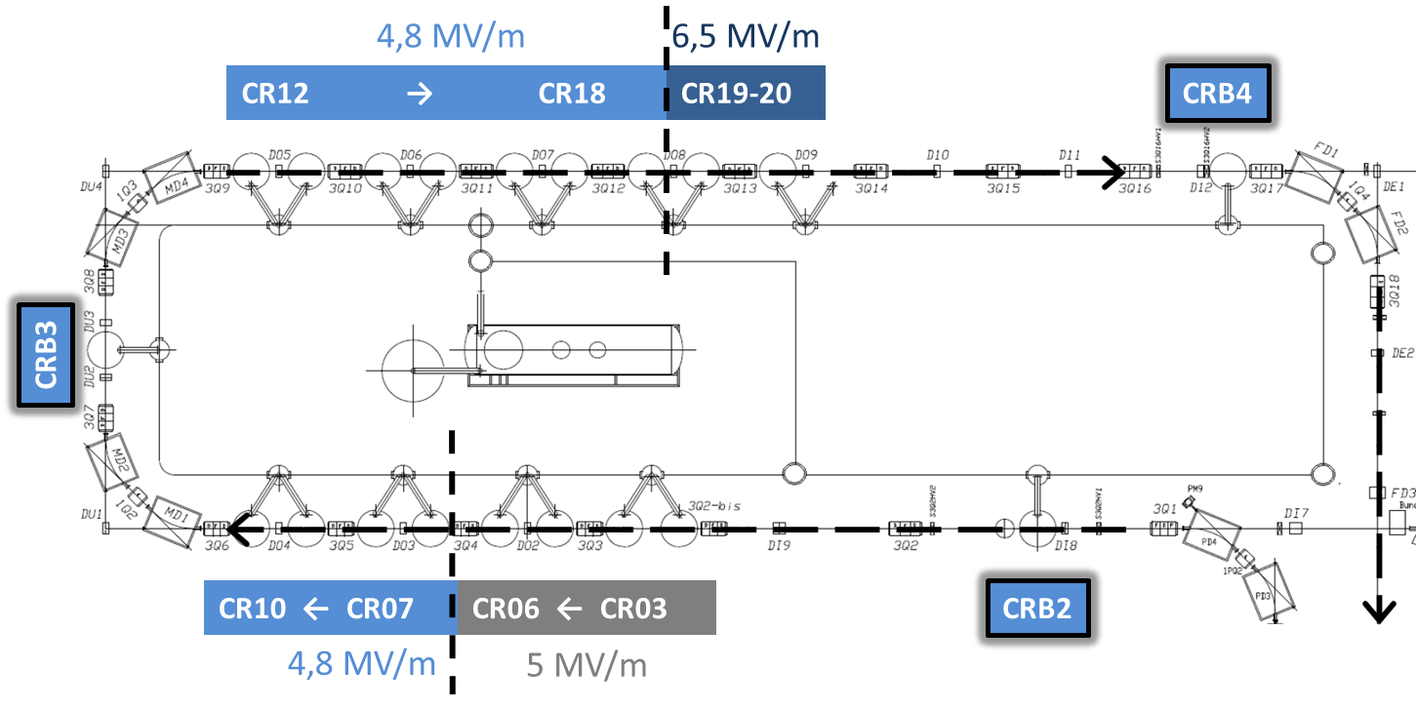
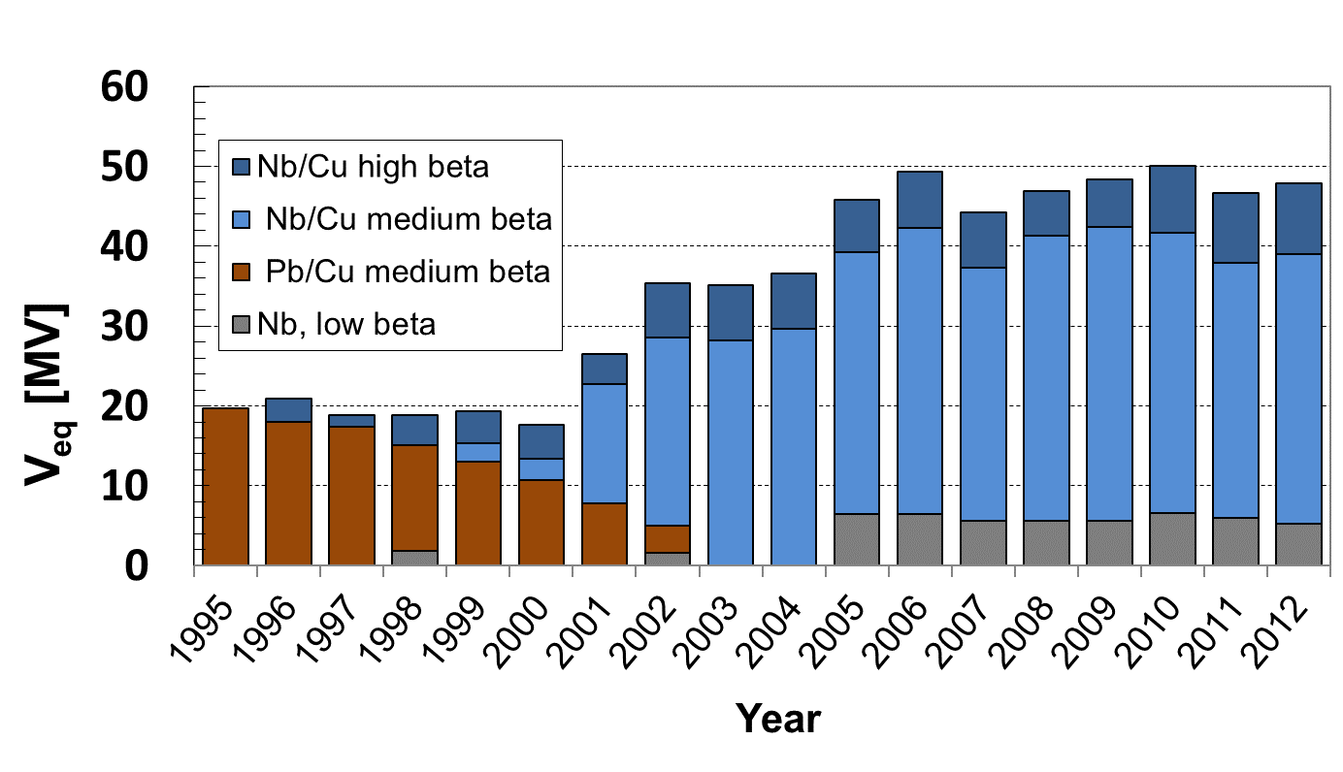
Matching into ALPI SC linac
Additional 8 cavities
10 MeV/n
for A=130-140
Re-positioned low β cavities
Notes:
The superconductive linac ALPI was improved during the years. A refurbishment of the low beta cavities and of the cryogenic system was performed.
An upgrade is going on with the installation of 2 more cryostats to reach the design goal of SPES to have reaccelerated radioactive beams at energies of 10-11 MeV/n

Slide 14
QWR Status @LNL

Slide 15
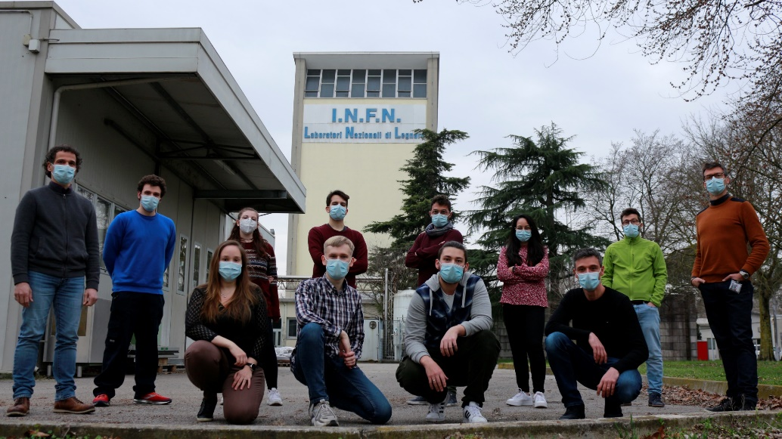
R&D activity for ALPI upgrade
After > 15 years Nb/Cu with a new team…
Vacuum systems refurbishing and upgrade:
  QWR and plates sputtering systems.
  Cryostat for off-line test.
Re-definition on coating parameters for Nb/Cu high-β QWRs and plates (for QWR and RFQ) due to:
  Upgrade of the system (new pumps, mass flow implementation, software control, DC and BIAS power supplies etc.).

Slide 16
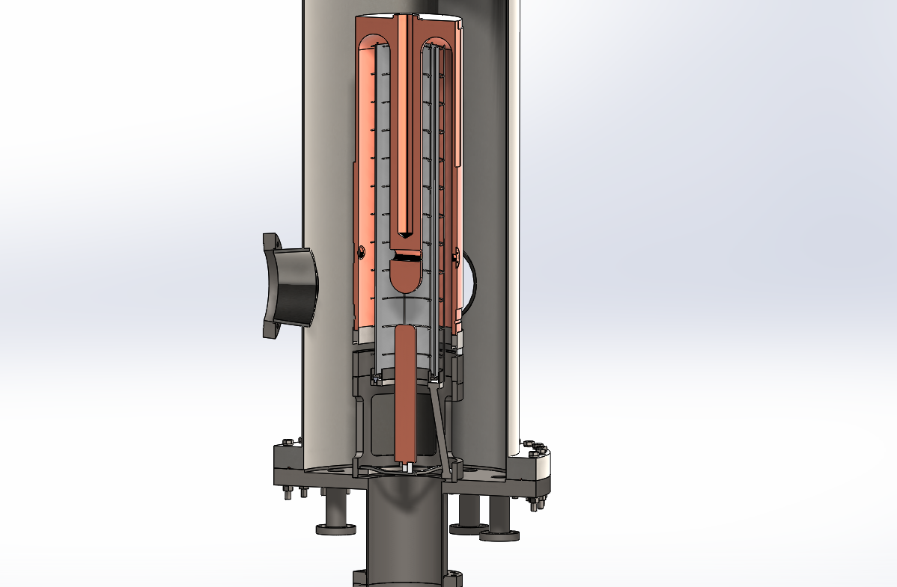
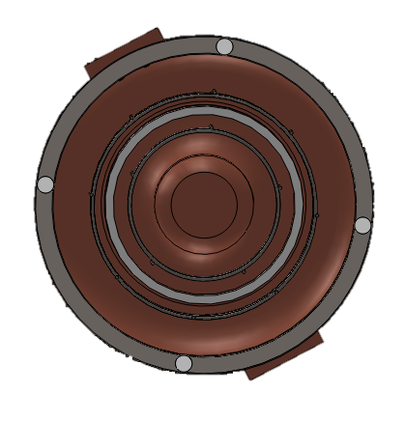
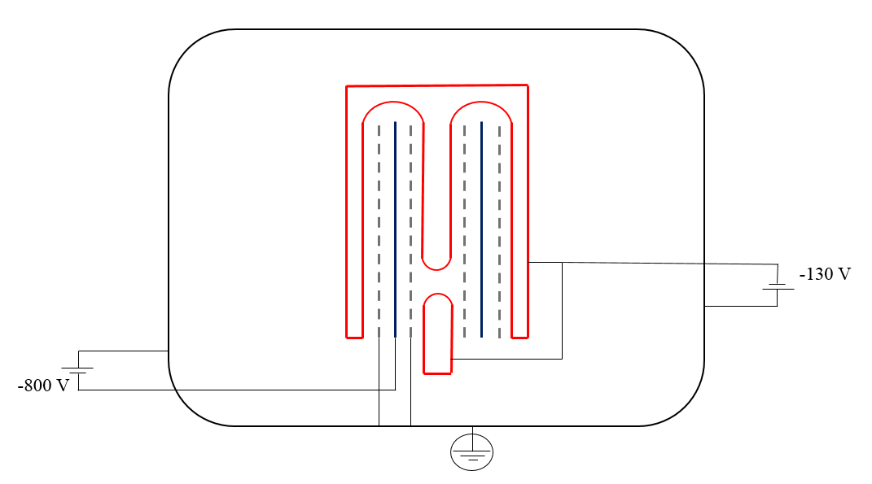
QWR diode sputtering re-engineering
№ | System compound
1 | Niobium cathode
2 | QWR cavity
3 | Titanium ground nets
4 | Copper counter electrode
Upgrades started from facility re-modelling using 3D software
Re-engineering of:
Vacuum system.
Vacuum electric connections.
Thermocouple design and connection.
Process gasses.
Control system.
2
1
1
2
3
3
1
2
4
4
3
5
(b)
(a)
Scheme of the QWR diode sputtering system.
3D model of the QWR sputtering system: (a) – side view, (b) – bottom view.

Slide 17
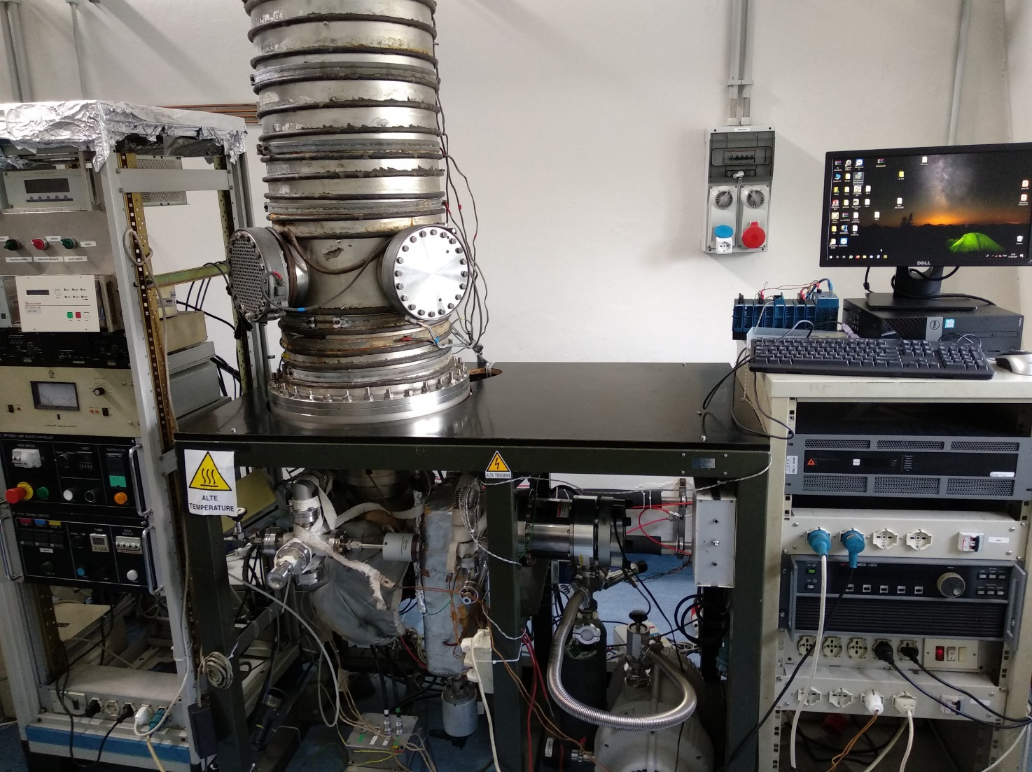
QWR diode sputtering system upgrade
Refurbishing of LNL QWR coating system. Major upgrade on:
Vacuum pumps
Ar Mass flow controller
Power supplies (sputtering and BIAS)
Backing controls and cavity heating
NI PLC-PC control System

Slide 18
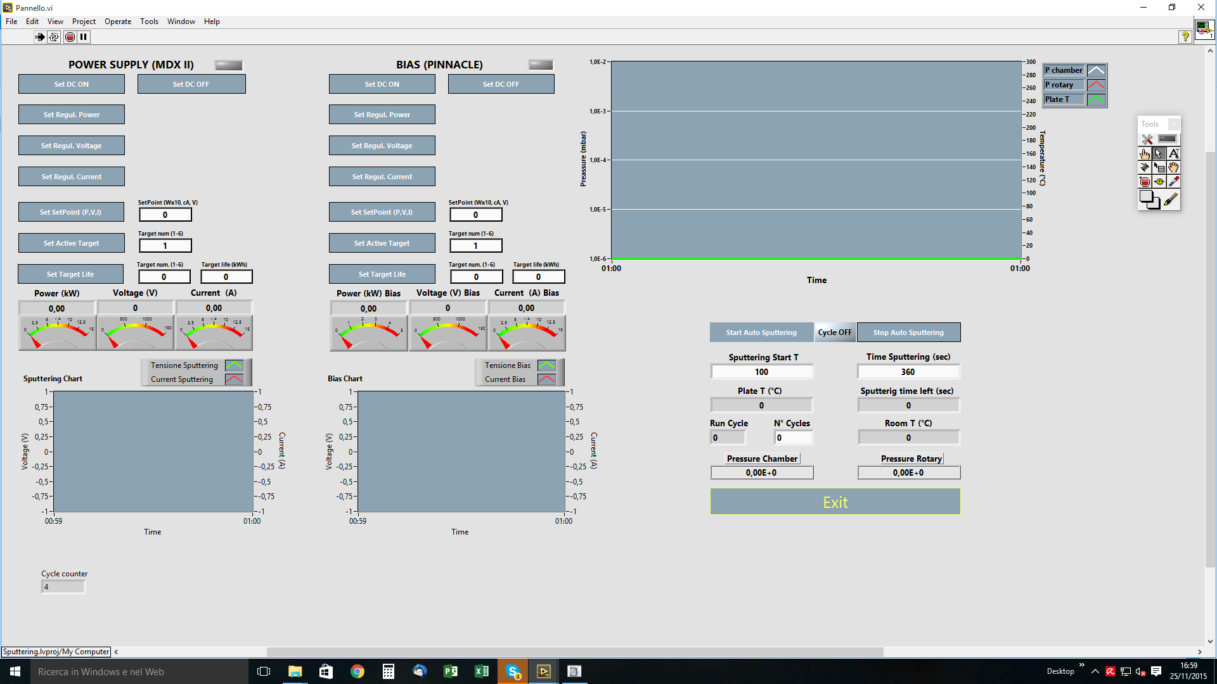
Automatic sputtering control and data acquisition

Slide 19
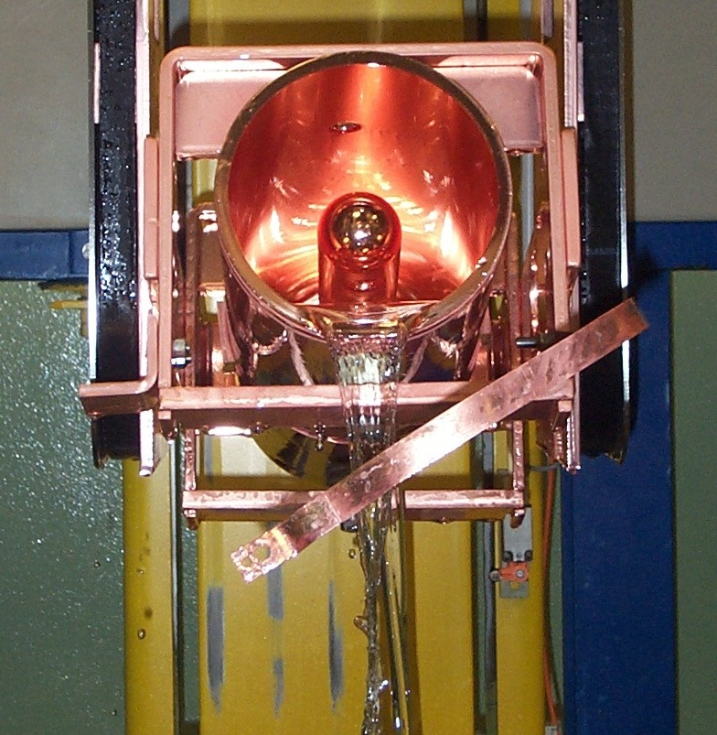
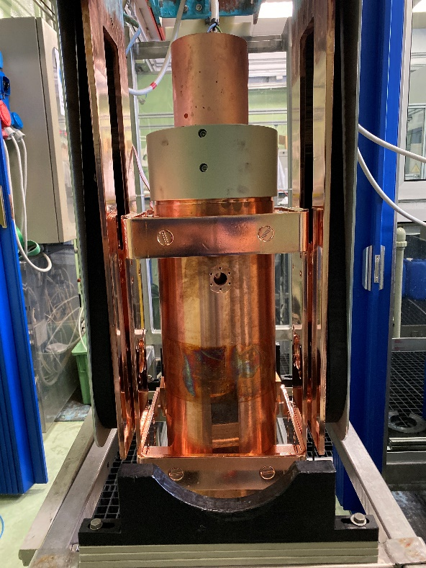
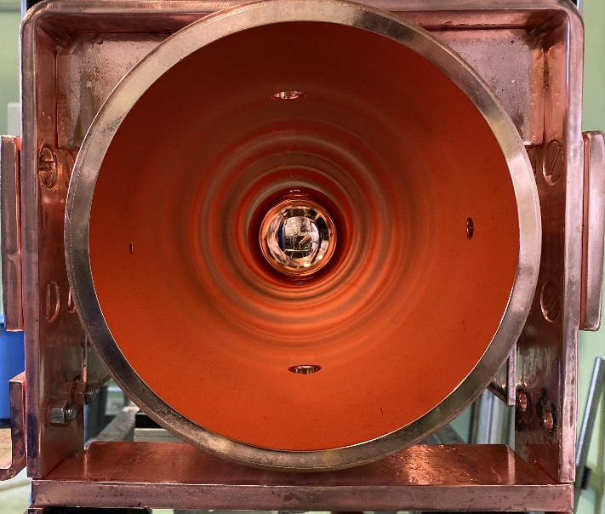
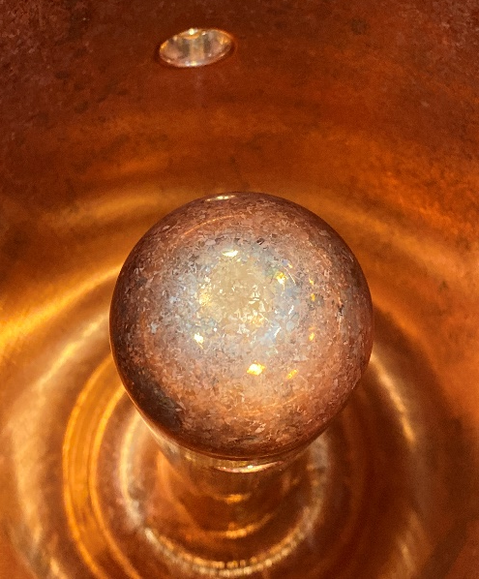
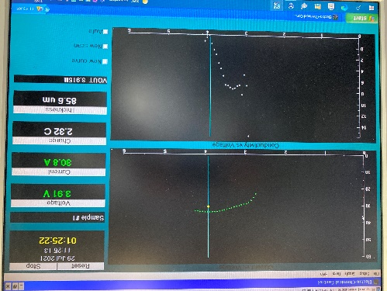
Tumbling and Chemistry plant upgrade
Tumbling system maintenance
Chemistry plant upgrade (new PLC control system)
New stripping facility
EP facility
Nb stripping tools
Cavity EP
EP software

Slide 20
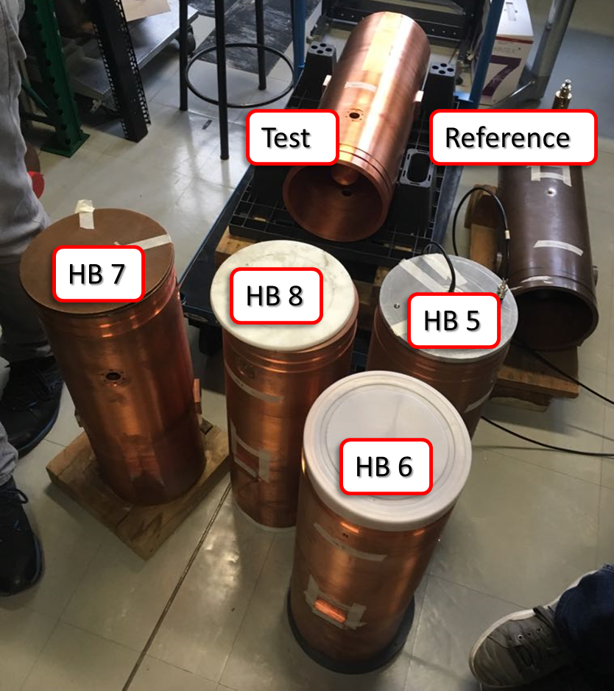
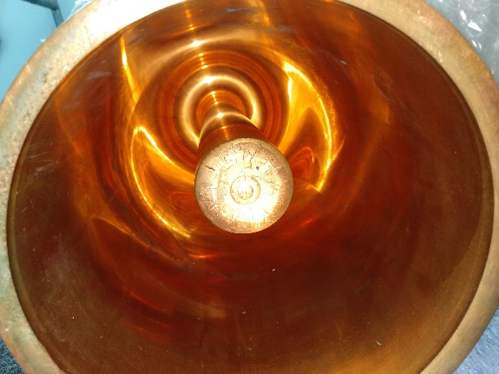
QWR Production for CR21 and CR22
8 QWR for ALPI upgrade
4 cavities machined from bulk Cu
2 cavities back extrusion
 | f₀ [MHz] | Δ f₀ [MHz]
Reference | 159.390
HB5 | 159.388 | 0.005
HB6 | 159.335 | 0.055
HB7 | 159.328 | 0.062
HB8 | 159.330 | 0.063
Test (DD0) | 159.455 | 0.205
Innovative approach
Classical production tecnology

Slide 21
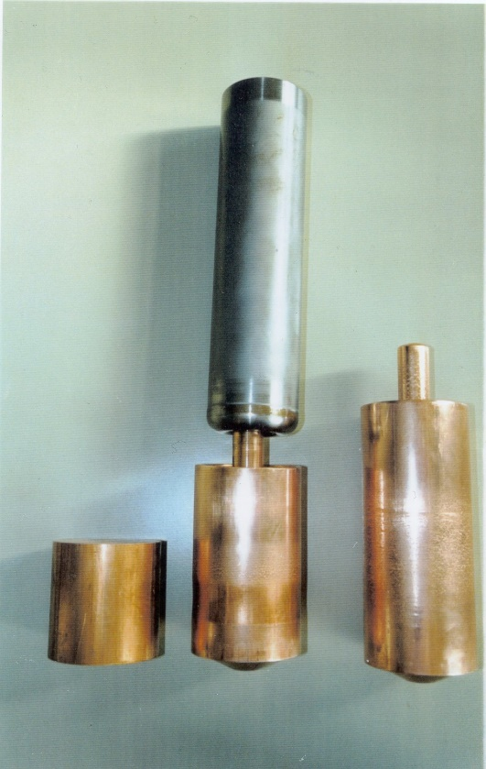
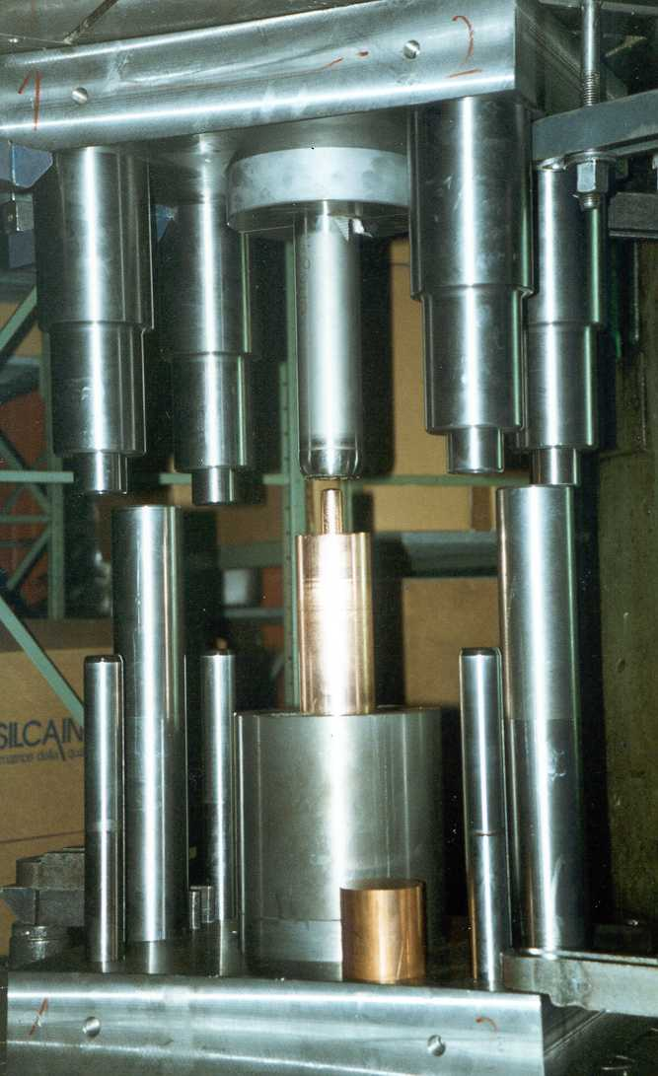
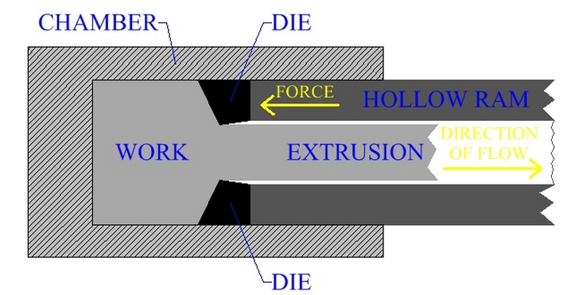
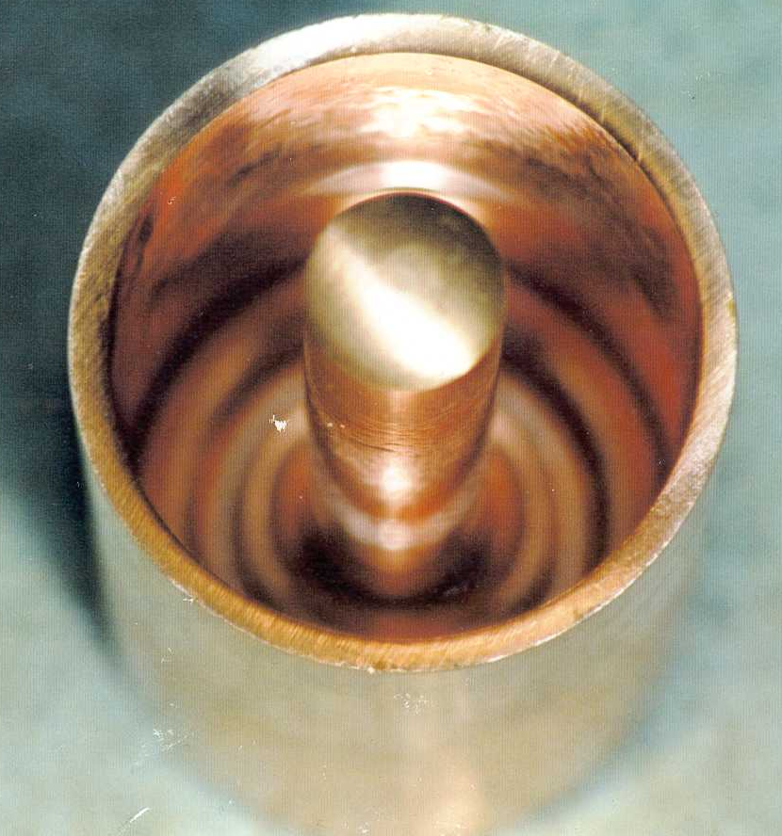
Cold back extrusion applied to QWR resonators
QWR preformed ready for machining
DD0 test cavity and DD1 produced with this technique

Slide 22
Cold back extrusion applied to QWR resonators
Back extrusion techniques advantages:
Reduction on copper usage
Surface finishing close to EP finishing
Cheaper machining procedure
  Machining of top and inner part of antenna
  Machining of beam ports
Good material performance
Back extrusion observed disadvantage:
Imperfection on cavity bottom

Slide 23
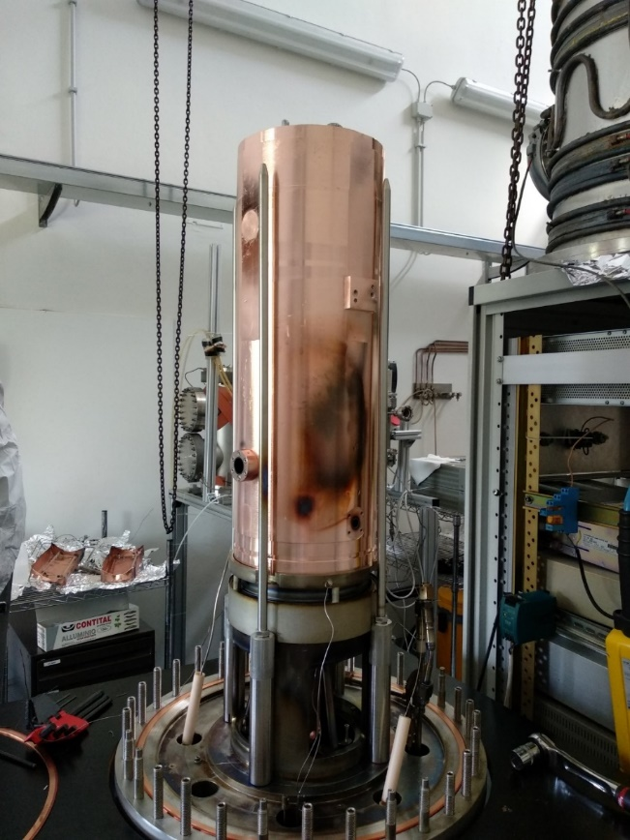
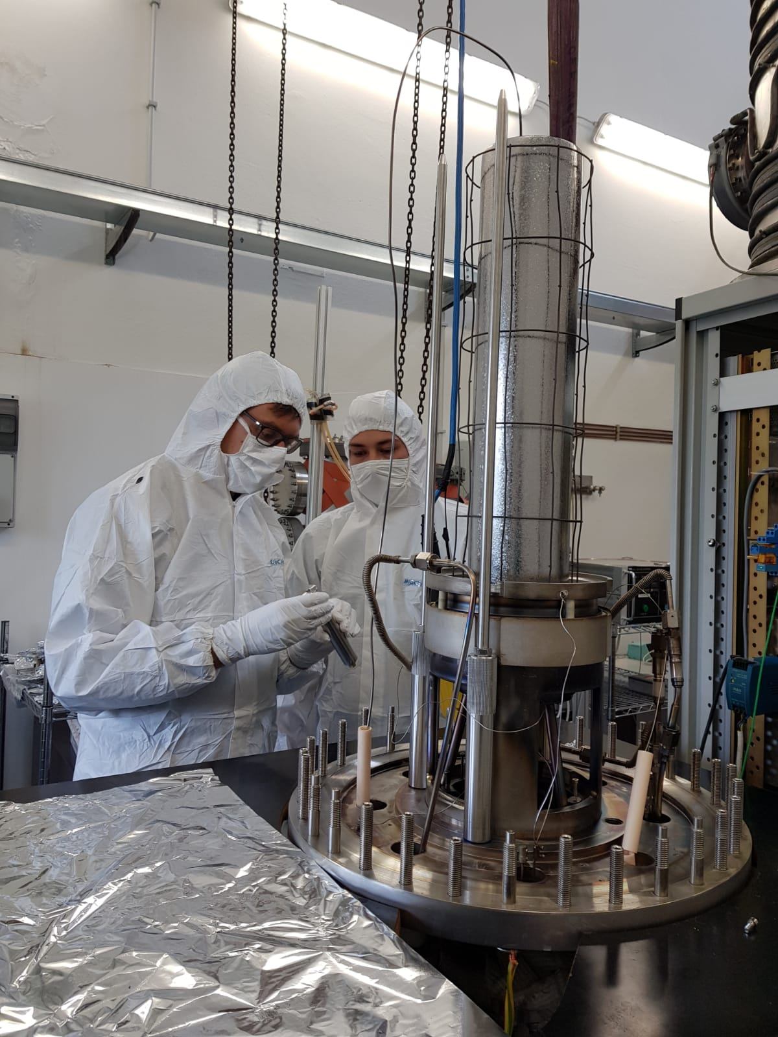
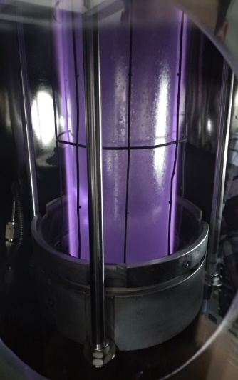
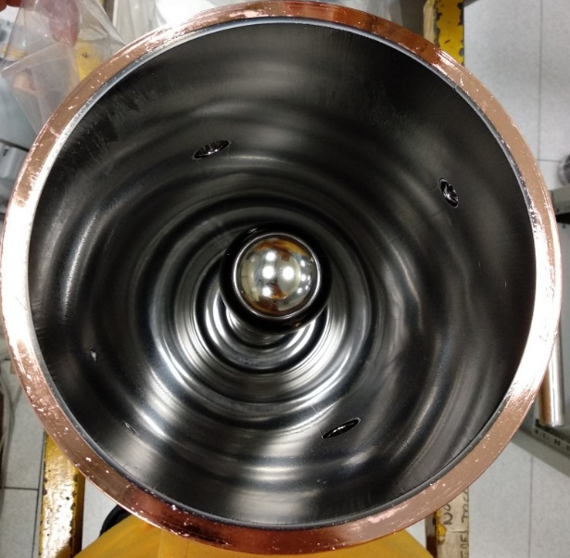
Cavity Coating
Baking procedure
Chamber temperature [°C] | 120 - 220
Substrate temperature [°C] | 400
Baking time [h] | 48 - 96
Sputtering procedure
Sputtering pressure [mbar] | 0,08 – 0,2
Cycle time [min] | 15
Number of cycles | 16 – 20
Cathode current [A] | 3,25 – 3,5
Bias voltage [V] | -130
Cavity assembled on coating system
System maintenance
Nb cathode plasma cleaning
Coated Cavity

Slide 24
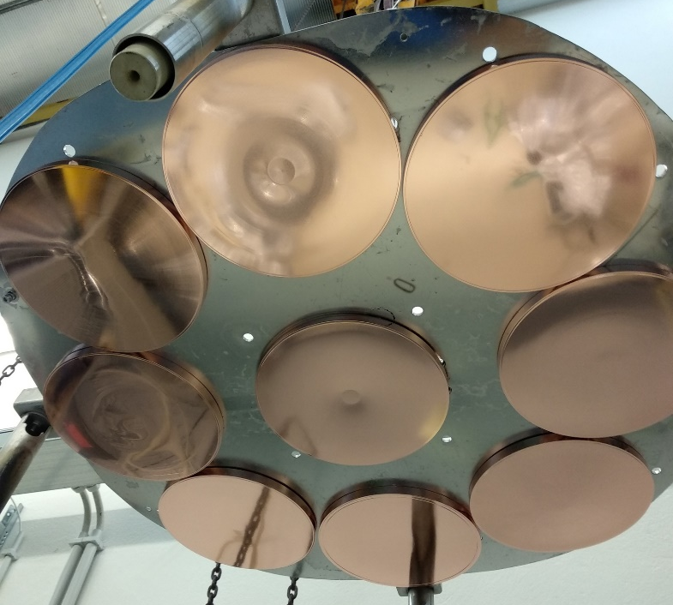
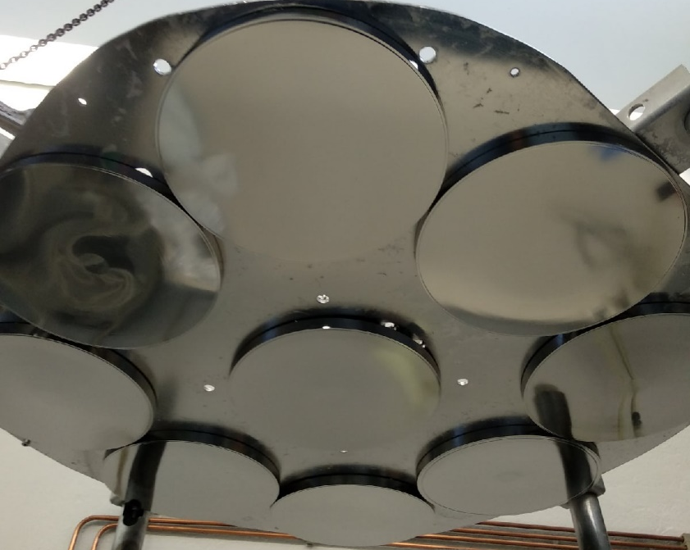
Cavity Plates coating
Procedure | Parameters
Chemical preparation
Ultrasound cleaning | In soap solution at 60 °C for 60 min;
Surface activation | In (NH₄)₂S₂O₈ solution at 20 ºC for 20 min;
SUBU | SUBU at 72 ºC for 4 – 6 min.
Passivation | H₃NO₃S for 5 min.
Water rinsing, drying, packaging.
Deposition process
Baking | Chamber temperature: 100 – 120 °C; Substrate temperature: 300 °C; Time: 48 – 96 hours.
Sputtering | Argon pressure: 0,2 mbar; Cycle time: 6 min; Number of cycles: 10; Substrate temperature: 200 °C; Cathode current: 12 A; Bias voltage: -130 V;
QWR plates before coating
Coated Plates

Slide 25
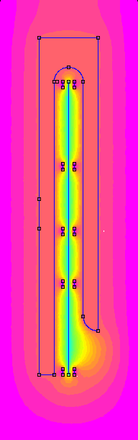
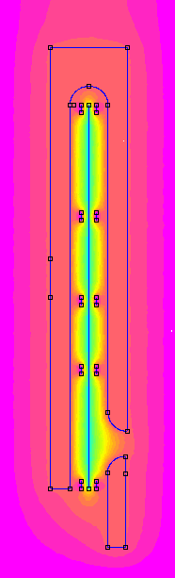
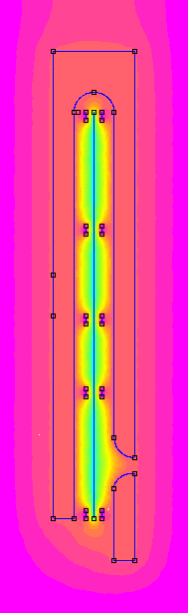
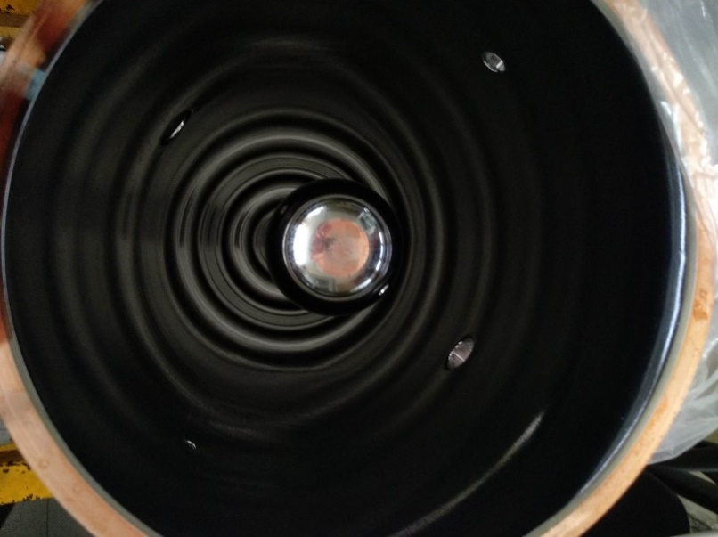
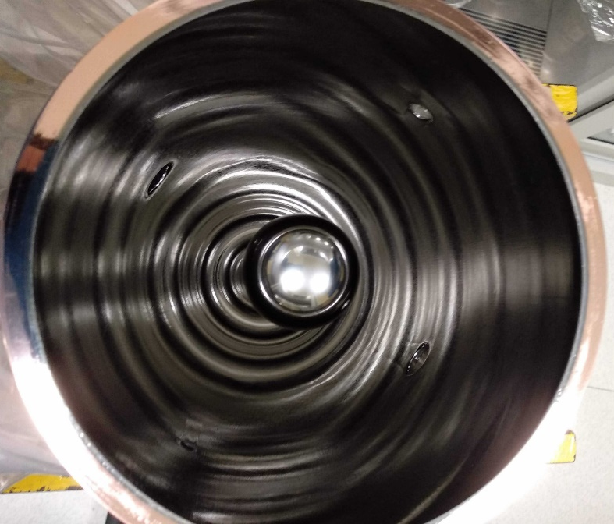
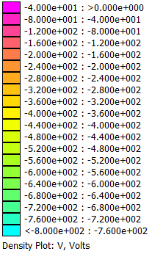
QWR antenna delamination
Correct positioning of the electrode uniforms electric field distribution in the top antenna area;
Optimal QWR – electrode distance to avoid delamination seems between 30–40 mm.
QWR (-130 V)
net (0 V)
Delaminated cavity
cathode (-800 V)
electrode (-130 V)
(a)
(b)
(c)
Electric field simulation with QWR – electrode distance: (a) – without electrode; (b) – 40 mm.; (c) – 30 mm.
No delamination

Slide 26
LNL cavity performance – 160 MHz @4.2K
Cavity № | Q0 | Q [7W] | E_{acc} [7W], MV/m | Rs, [nΩ]
ALPI Baseline |  | ≥ 1 · 10⁸ | ≥ 4,5
DD 0 | 2,1 · 109 | 4,3 · 10⁸ | 6,5 | 14
HB 7 | 4,5 · 108 | 1,4 · 10⁸ | 3,7 | 90
HB 8 | 1,5 · 108 | 1,4 · 10⁸ | 3,8 | 195
HB 6 | 7,6 · 107 | 6,7 · 10⁷ | 2,6 | 383
HB 5 | 7,6 · 108 | 1,8 · 10⁸ | 5,5 | 38
First cycle RF cold test measurements result.

Slide 27
LNL cavity performance - 160 MHz @4.2K
7W
after stripping

Slide 28
DD back extruded cavity – 160 MHz @4.2K

Slide 29
Sputtering parameters vs QWR performance
Q vs. sputtering pressure
Q vs. electrode distance

Slide 30
Conclusions
A major refurbishment of the sputtering systems and cavity tests facility were carried out at LNL.
Improvements and upgrades were made in substrate preparation (mechanical and chemical).
Intense R&D was carried out so to redefine the deposition parameters necessary to obtain cavities respecting ALPI requirements.
3 cavities (of the 8 needed) were ready to be installed in the cryostats
the back extrusion technique for cavity production was explored and proved to be efficient, cost-effective and promising.

Slide 31

Special thanks
… to the LNL coating group and RF LNL service: O. Azzolini, G. Bisoffi, D. Bortolato, E. Chyhyrynets, E. Fagotti, E. Munaron, C. Pira, F. Stivanello, A. Tsymbaliuk.

Slide 32
Thanks​ for your attention
keppel@lnl.infn.it

