Slide 1

Development of Oxygen Doping Treatment for High Q₀
Hannah Hu, Daniel Bafia, Young-Kee Kim
TTC 2022, Aomori, Japan
11 October 2022

Slide 2
Motivation
Superconducting radiofrequency (SRF) cavities
  High quality factors (Q0)
  High accelerating gradients (Eacc)
Performance is largely governed by the first ~100 nm (rf layer)
Baking and chemical treatments alter the composition of the rf layer
Nitrogen doping
Tailoring of the impurity profile via oxygen doping
O doping and N doping yield similar performance.
What precise roles are O and N and playing?

Slide 3
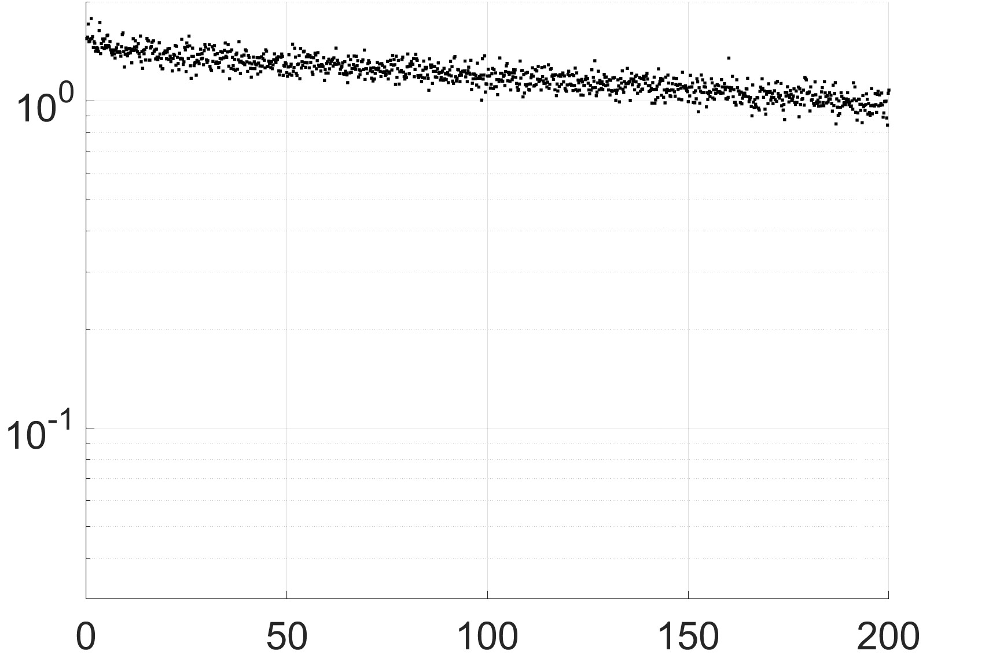

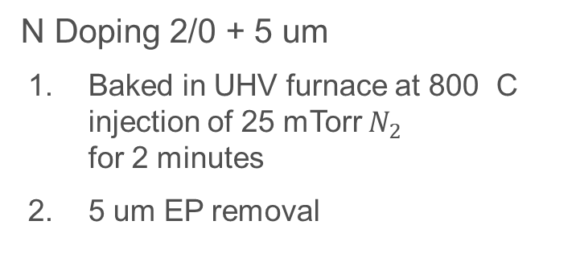
Nitrogen Doping vs Oxygen Doping
N Doping 2/0 + 5 um
Baked in UHV furnace at 800 C injection of 25 mTorr $N_{2}$ for 2 minutes
5 um EP removal
O Doping
Baked in-situ at 200 C for 20 hours
  Maintains $1×{10}^{−6}$ Torr
  Utilizes thermal diffusion without any subsequent chemistry
°
°
Both yield uniform concentration of impurities within the rf layer.
NbN SIMS: D. Bafia. PhD Thesis, IIT, 2020
O/Nb SIMS: A. Romanenko et al., THP014, SRF’19 (2019).

Slide 4
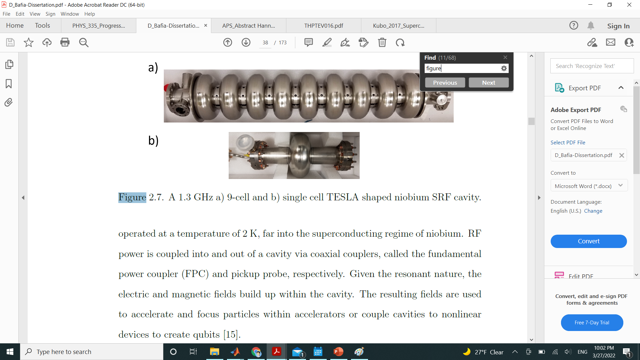
Cavity Treatment
Single cell, tesla shaped Nb cavities
1.3 GHz resonant frequency
Continuous wave (CW) operation
N doped
Treatment
200°C x 20 hrs
HF Rinse 1
HF Rinse 2
HF Rinse: A. Romanenko et al., Phys. Rev. ST Accel. Beams 16 (2013).

Slide 5
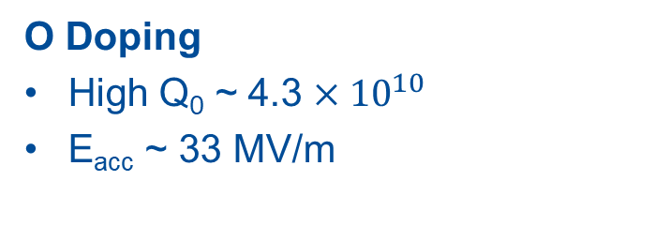
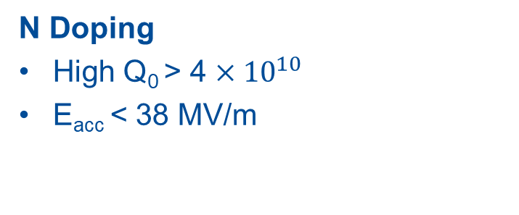
Quality Factor (Q₀) vs Accelerating Gradient (E_{acc})
Multipacting induced quench which
trapped flux
N Doping
High Q₀ > 4 $×{10}^{10}$
E_{acc} < 38 MV/m
O Doping
High Q₀ ~ 4.3 $×{10}^{10}$
E_{acc} ~ 33 MV/m

Slide 6
Anti-Q Slope and BCS Resistance
Anti-Q slope phenomenon
Decrease in R_{BCS} with field
R_{BCS} is not affected by HF rinse changing the oxide → impurity profile is mostly unchanged
Compared to N doped: High field losses

Slide 7
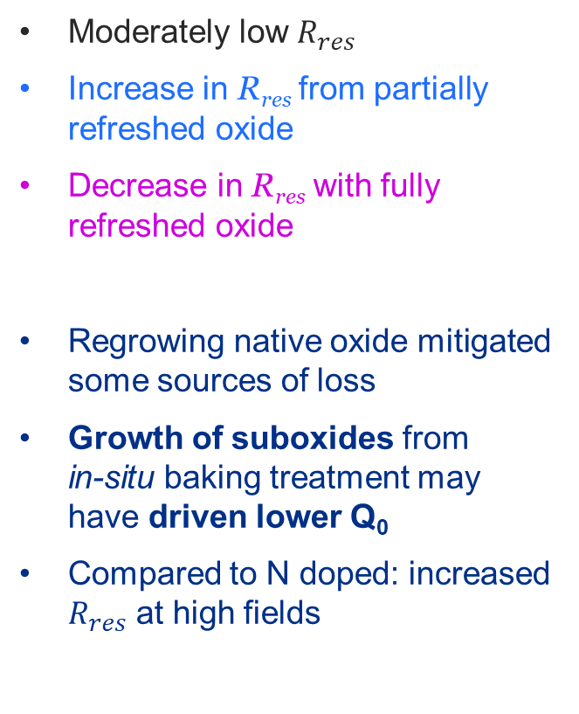

Residual Resistance R_{res}
$$R_{s}\left(E_{acc}, T\right)=R_{BCS}\left(E_{acc}, T\right)+R_{res}\left(E_{acc}\right)$$
Moderately low $R_{res}$
Increase in R_{res} from partially refreshed oxide
Decrease in R_{res} with fully refreshed oxide
Regrowing native oxide mitigated some sources of loss
Growth of suboxides from in-situ baking treatment may have driven lower Q₀
Compared to N doped: increased $R_{res}$ at high fields
Drives difference in Q₀

Slide 8
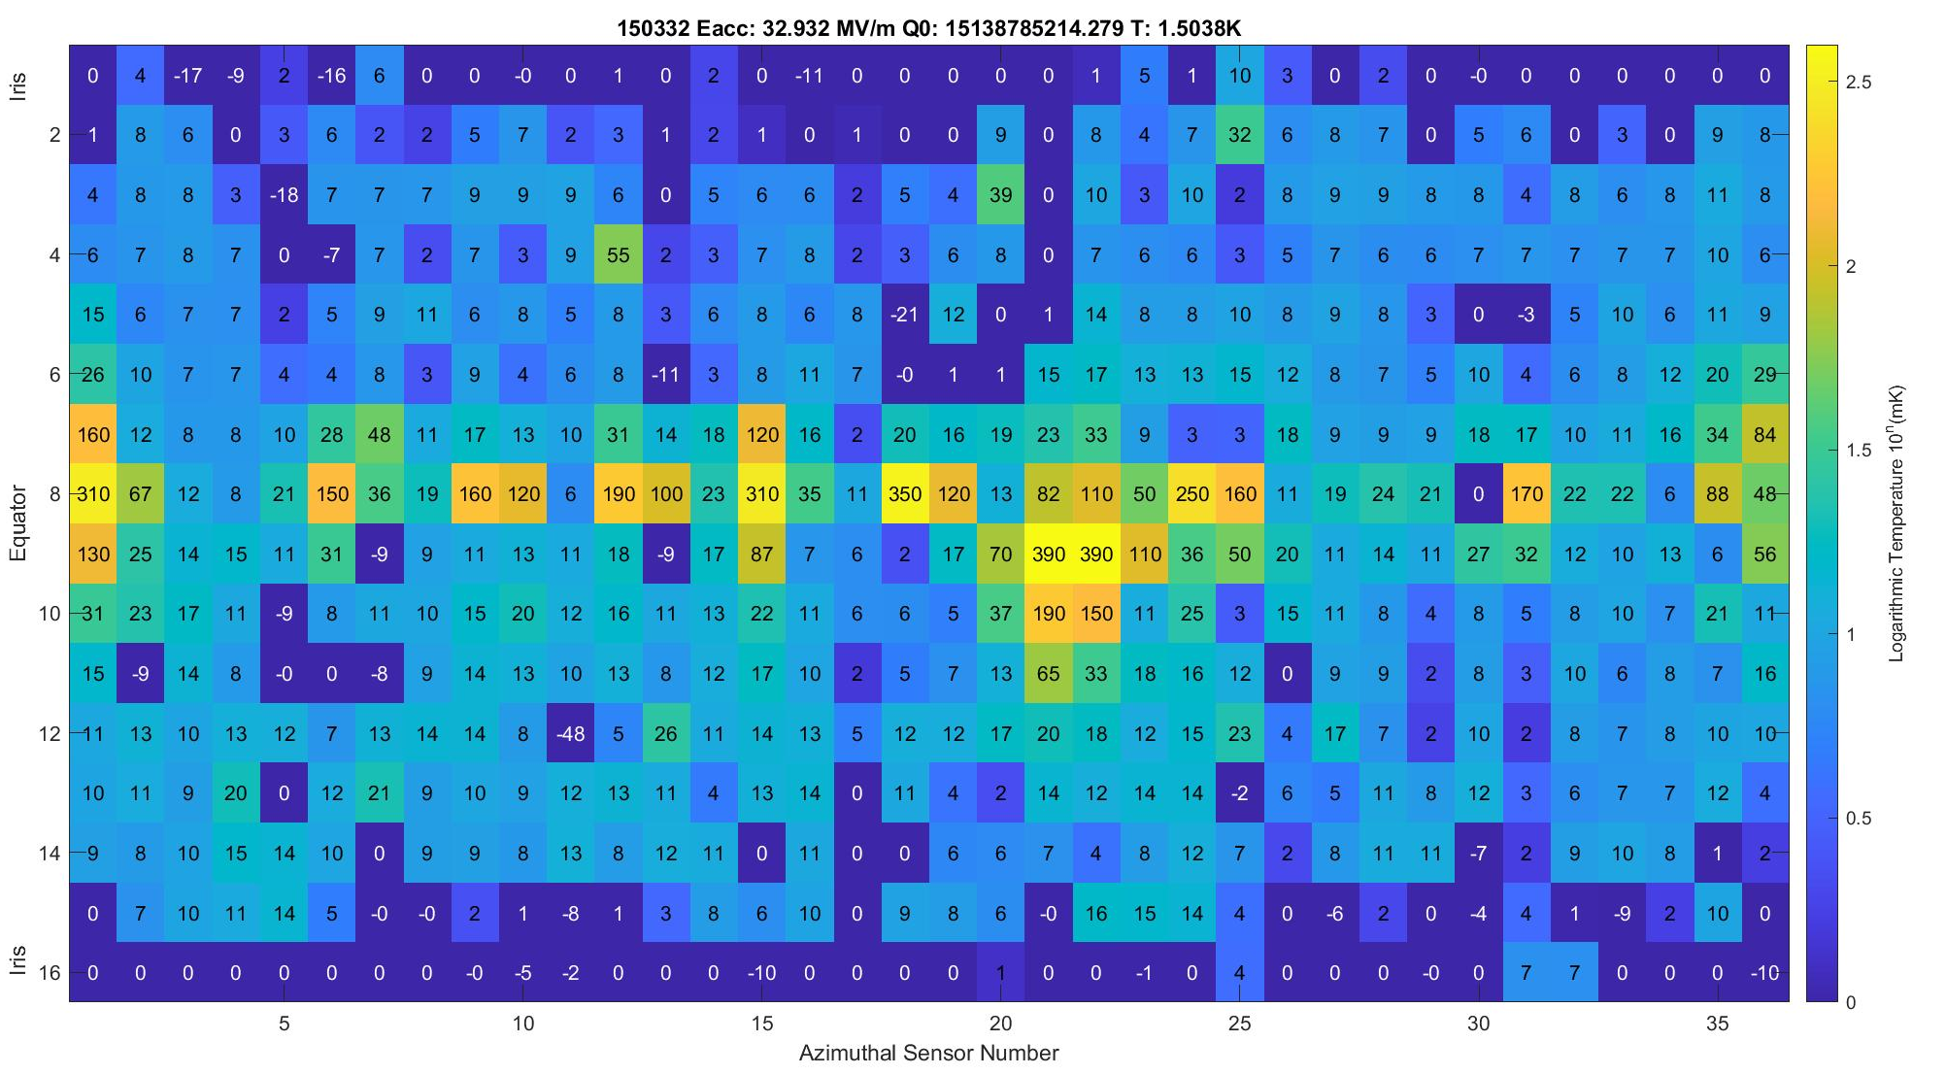
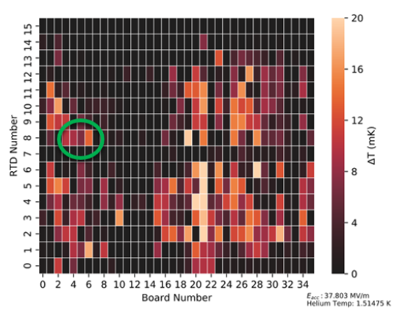
TMAP
O doped + 2 HF Rinses TMAP at low T (~1.5 K) taken just before quench (~33 MV/m)
Quench Location
N doped 2/0 + 5
N doped TMAP: D. Bafia, PhD Thesis, IIT, 2020

Slide 9
Heating Profile
slope: 9.36
slope: 2.18
O doped
slope: 4.49
N doped
Change in temperature at quench location with peak magnetic field
Pure Joule heating – slope of 2 according to Ohm’s law
O doped: Turning on of additional loss mechanisms at higher fields
Might be one reason why resistance in O doped is much stronger compared to N doped

Slide 10
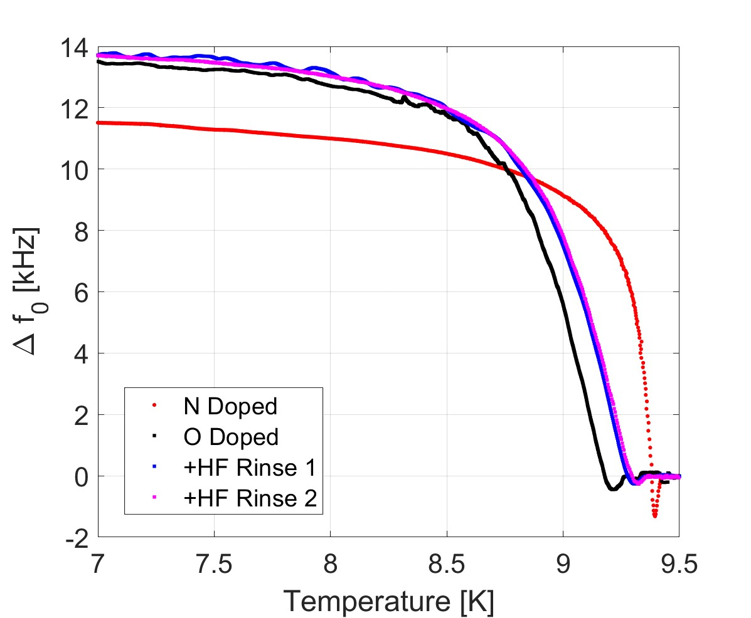
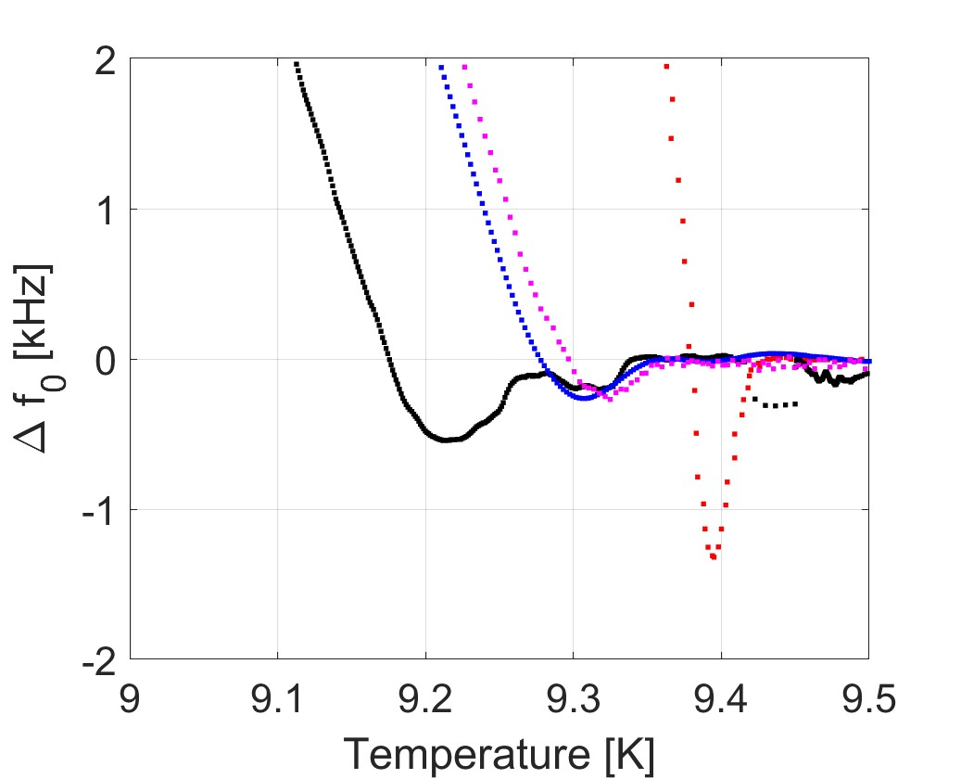
Anomalous Dip in Resonant Frequency Before T_{c}
T_{c}
 | T_{c} [K]
N doped | 9.42
O doped | 9.34
+HF Rinse 1 | 9.36
+HF Rinse 2 | 9.36
T_{c} suppression in oxygen doped cavity: weakened superconductivity may be source of high field losses

Slide 11
Anomalous Dip in Resonant Frequency Before T_{c}
Two types of dip behavior:
  O doped: “dip+bump” characteristic behavior observed in some N infused cavities
  O doped + HF rinse: “dip” feature observed in N doped cavities
Magnitude of “bump” = Magnitude of “dip” after HF rinse
  2nd HF rinse has no additional effect
Δ f_{dip}
Could this be a double effect?
Two localized effects: different Nb₂O₅/Nb interface → different dip behavior
Larger dip from the suboxide interface
  Eliminated when oxide is refreshed
Smaller dip from the interstitial oxygen that thermally diffused
 | Δ f_{dip} [kHz]
N doped | 1.31
O doped | 0.54
+HF Rinse 1 | 0.26
+HF Rinse 2 | 0.25

Slide 12
Summary
Oxygen and nitrogen doping yield similar rf performance
Performance of oxygen doped cavities limited by high field losses generating substantial heating
T_{c} suppression in oxygen doped cavity: weakened superconductivity may be source of high field losses
Both O and N doped cavities display frequency dip before T_{c}
  O doped shows a localized double effect in dip features
Next Steps
Tailor oxygen doping impurity profile to match nitrogen doping impurity profile
Exploring sources of loss mechanisms that turn on at higher fields

Slide 13
Thank you!

Slide 14
Supplemental Slides

Slide 15
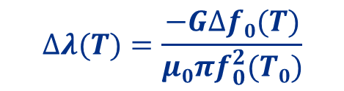
Superconducting gap Δ, mean free path
$$∆λ(T)=\frac{−G∆f0(T)}{μ0πf_{0}^{2}(T0)}$$
 | Δ [meV] | mfp [nm]
N doped | 2.10 ± 0.08 | 125.1 ± 37.8
O doped | 2.18 ± 0.04 | 17.99 ± 1.12
+HF Rinse 1 | 1.69 ± 0.02 | 14.52 ± 0.56
+HF Rinse 2 | 1.98 ± 0.03 | 16.79 ± 0.79
Comparable average superconducting gap Δ
  Oxygen doping reduces QP introduced losses
Smaller mfp: higher concentration of impurities on the surface of an oxygen doped cavity
  Confirmed with SIMS
  Effects of tailoring oxygen doping treatment to have same mfp as nitrogen doping?
D. Bafia, PhD Thesis, IIT, 2020

