Slide 1
Dynamic flux trapping measurements in Nb samples
F. Kramer, S. Keckert, O. Kugeler, J. Knobloch
TTC Meeting in Aomori, Japan, 10.10. – 14.10.2022
TTC
Aomori, Japan

Slide 2
Brief recap: Why do we care about trapped flux?
Introduction
Trapped flux reduces Q₀ in SRF cavities
Trapped flux is currently believed to be the predominant limitation for Q₀
Double magnetic shielding reduces ambient Earth magnetic field from 50 µT to < 1 µT
But it is impossible to completely shield off all magnetic fields
Shielding does not reduce intrinsic fields caused by thermo currents
ambient Earth magnetic field = 50 µT
10 µT

Slide 3
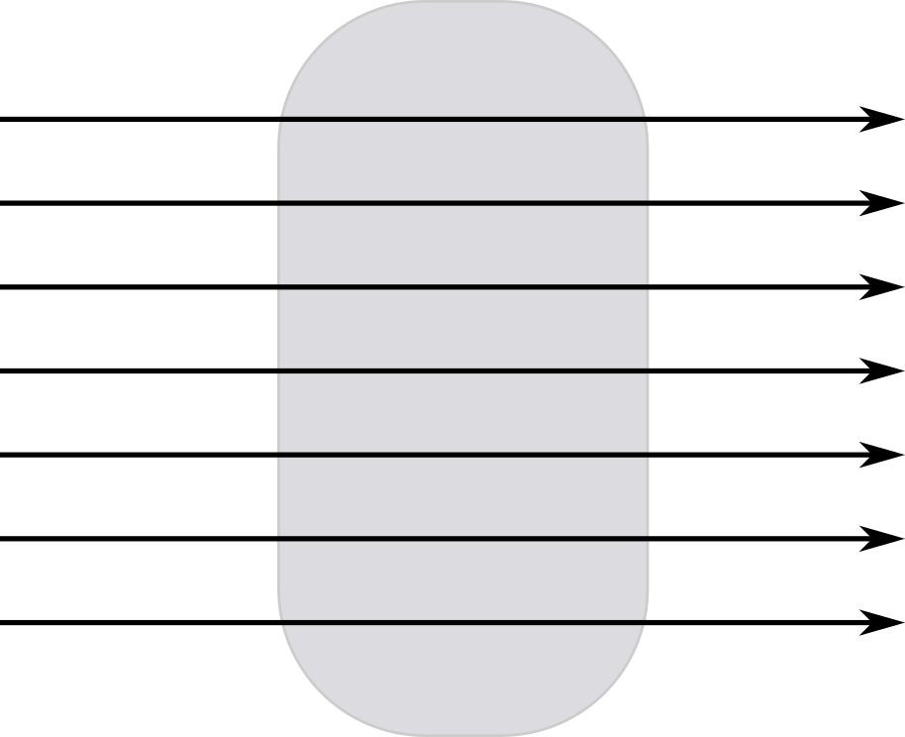
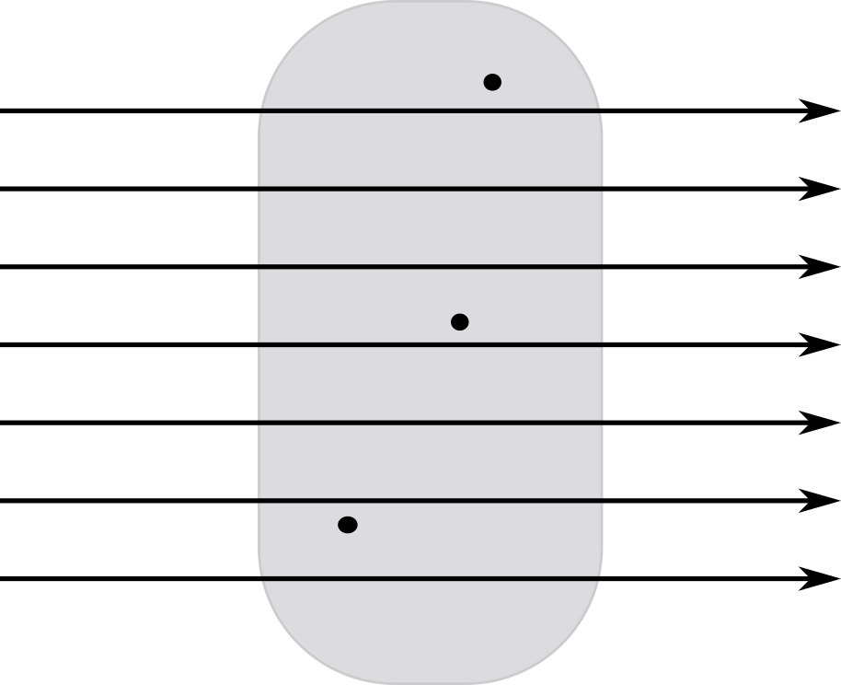
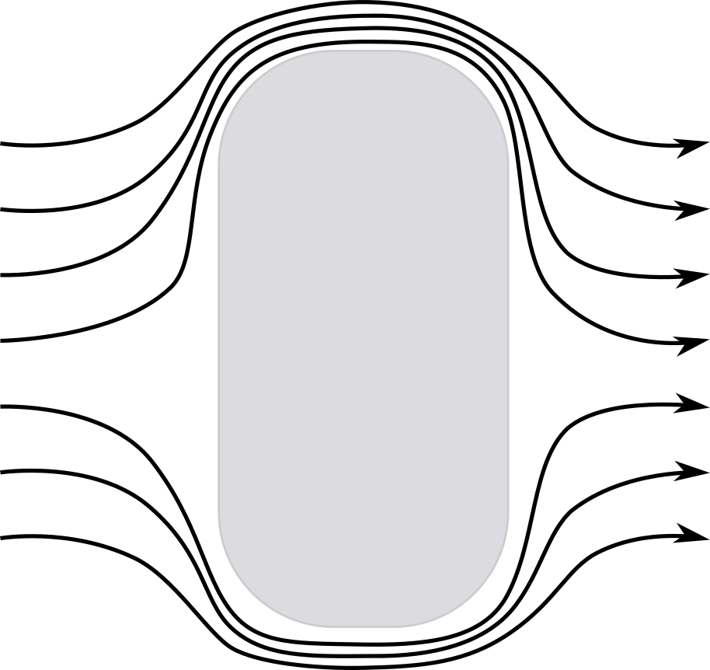
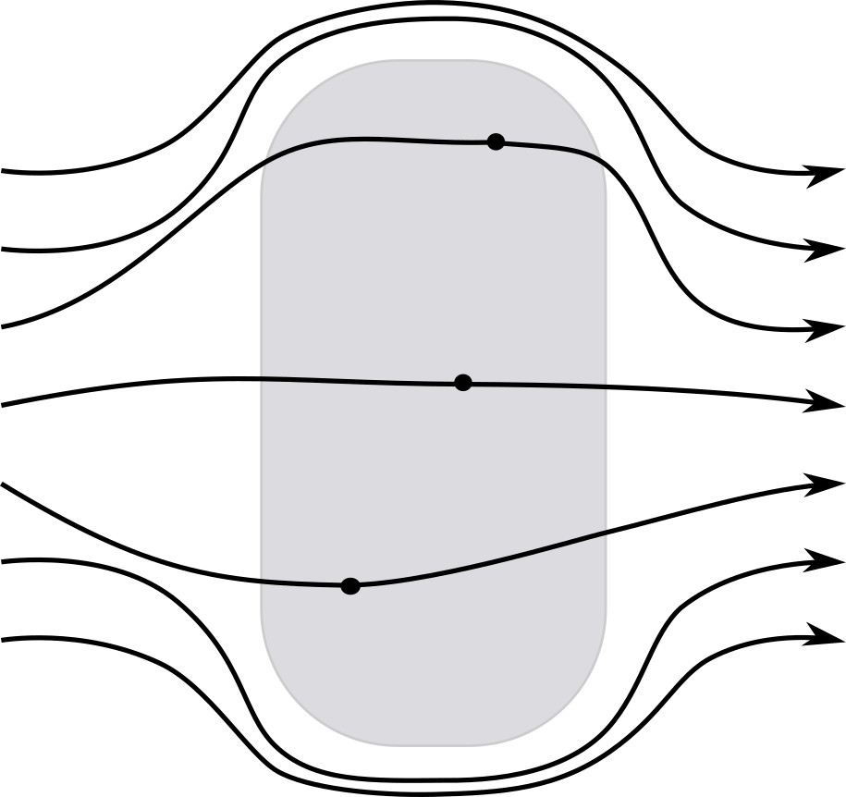

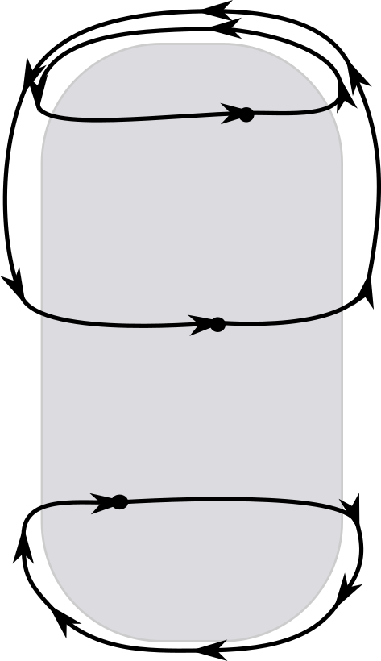





Trapped Flux: What is it?
Introduction
$$\vec{B}$$
Ideal
$$\vec{B}$$
Not ideal
When cooling down a Type I superconductor in an external magnetic field, it will transition into the Meissner state. In this state all magnetic field is expelled.
However, there are small defects in the material which pin the quantized magnetic field lines and prevent them from being pushed out
The pinned flux lines oscillate in the RF field and cause losses in the cavity wall*
NC
Field
$$\vec{B}$$
$$\vec{B}$$
SC
Field
$$\vec{B}$$
SC
No Field
*Gurevich, A. and Ciovati, G., Effect of vortex hotspots on the radio-frequency surface resistance, Phys. Rev. B, 2013

Slide 4
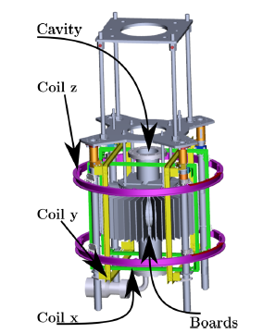
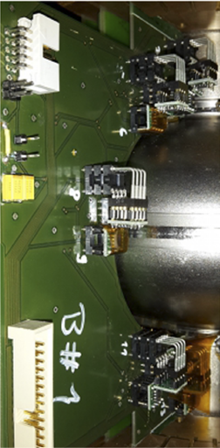

Concept – revert to flat samples
Experiment
We want to understand trapped flux in more detail, before trying to minimize it
To understand trapped flux, we need control parameters which might have an influence on it:
  Temperature gradient
  Cooldown speed
  Ambient magnetic field
  Impact of geometry (demagnetization factor, shape anisotropy)
  Material & treatment
AMR based magnetometry system developed
at HZB for cavities in 2017 – 1 cycle per day
Use samples instead of cavities
Better Control of the parameters
More cooling cycles possible (~300/day instead of ~1/day)
Less material needed and treatments are easier to apply
Easier geometry
60 mm
100 mm
Investigate Nb sheets
~300 cycles per day

Slide 5
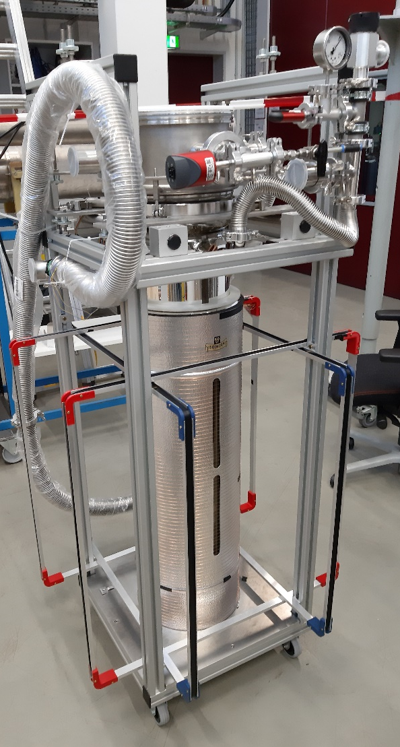
Experimental Infrastructure
Experiment
Small glass cryostat
Filled from helium Dewar
No magnetic shielding
Active field compensation with two Helmholtz coils and one solenoid
Minimum field at location of reference sensors: < 15 nT (Earth magnetic field ~ 50 µT)
Maximum field: 200µT

Slide 6
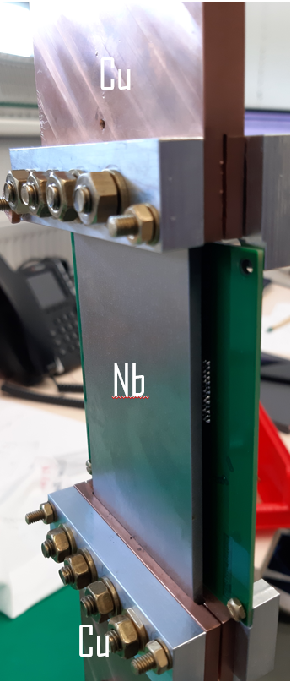
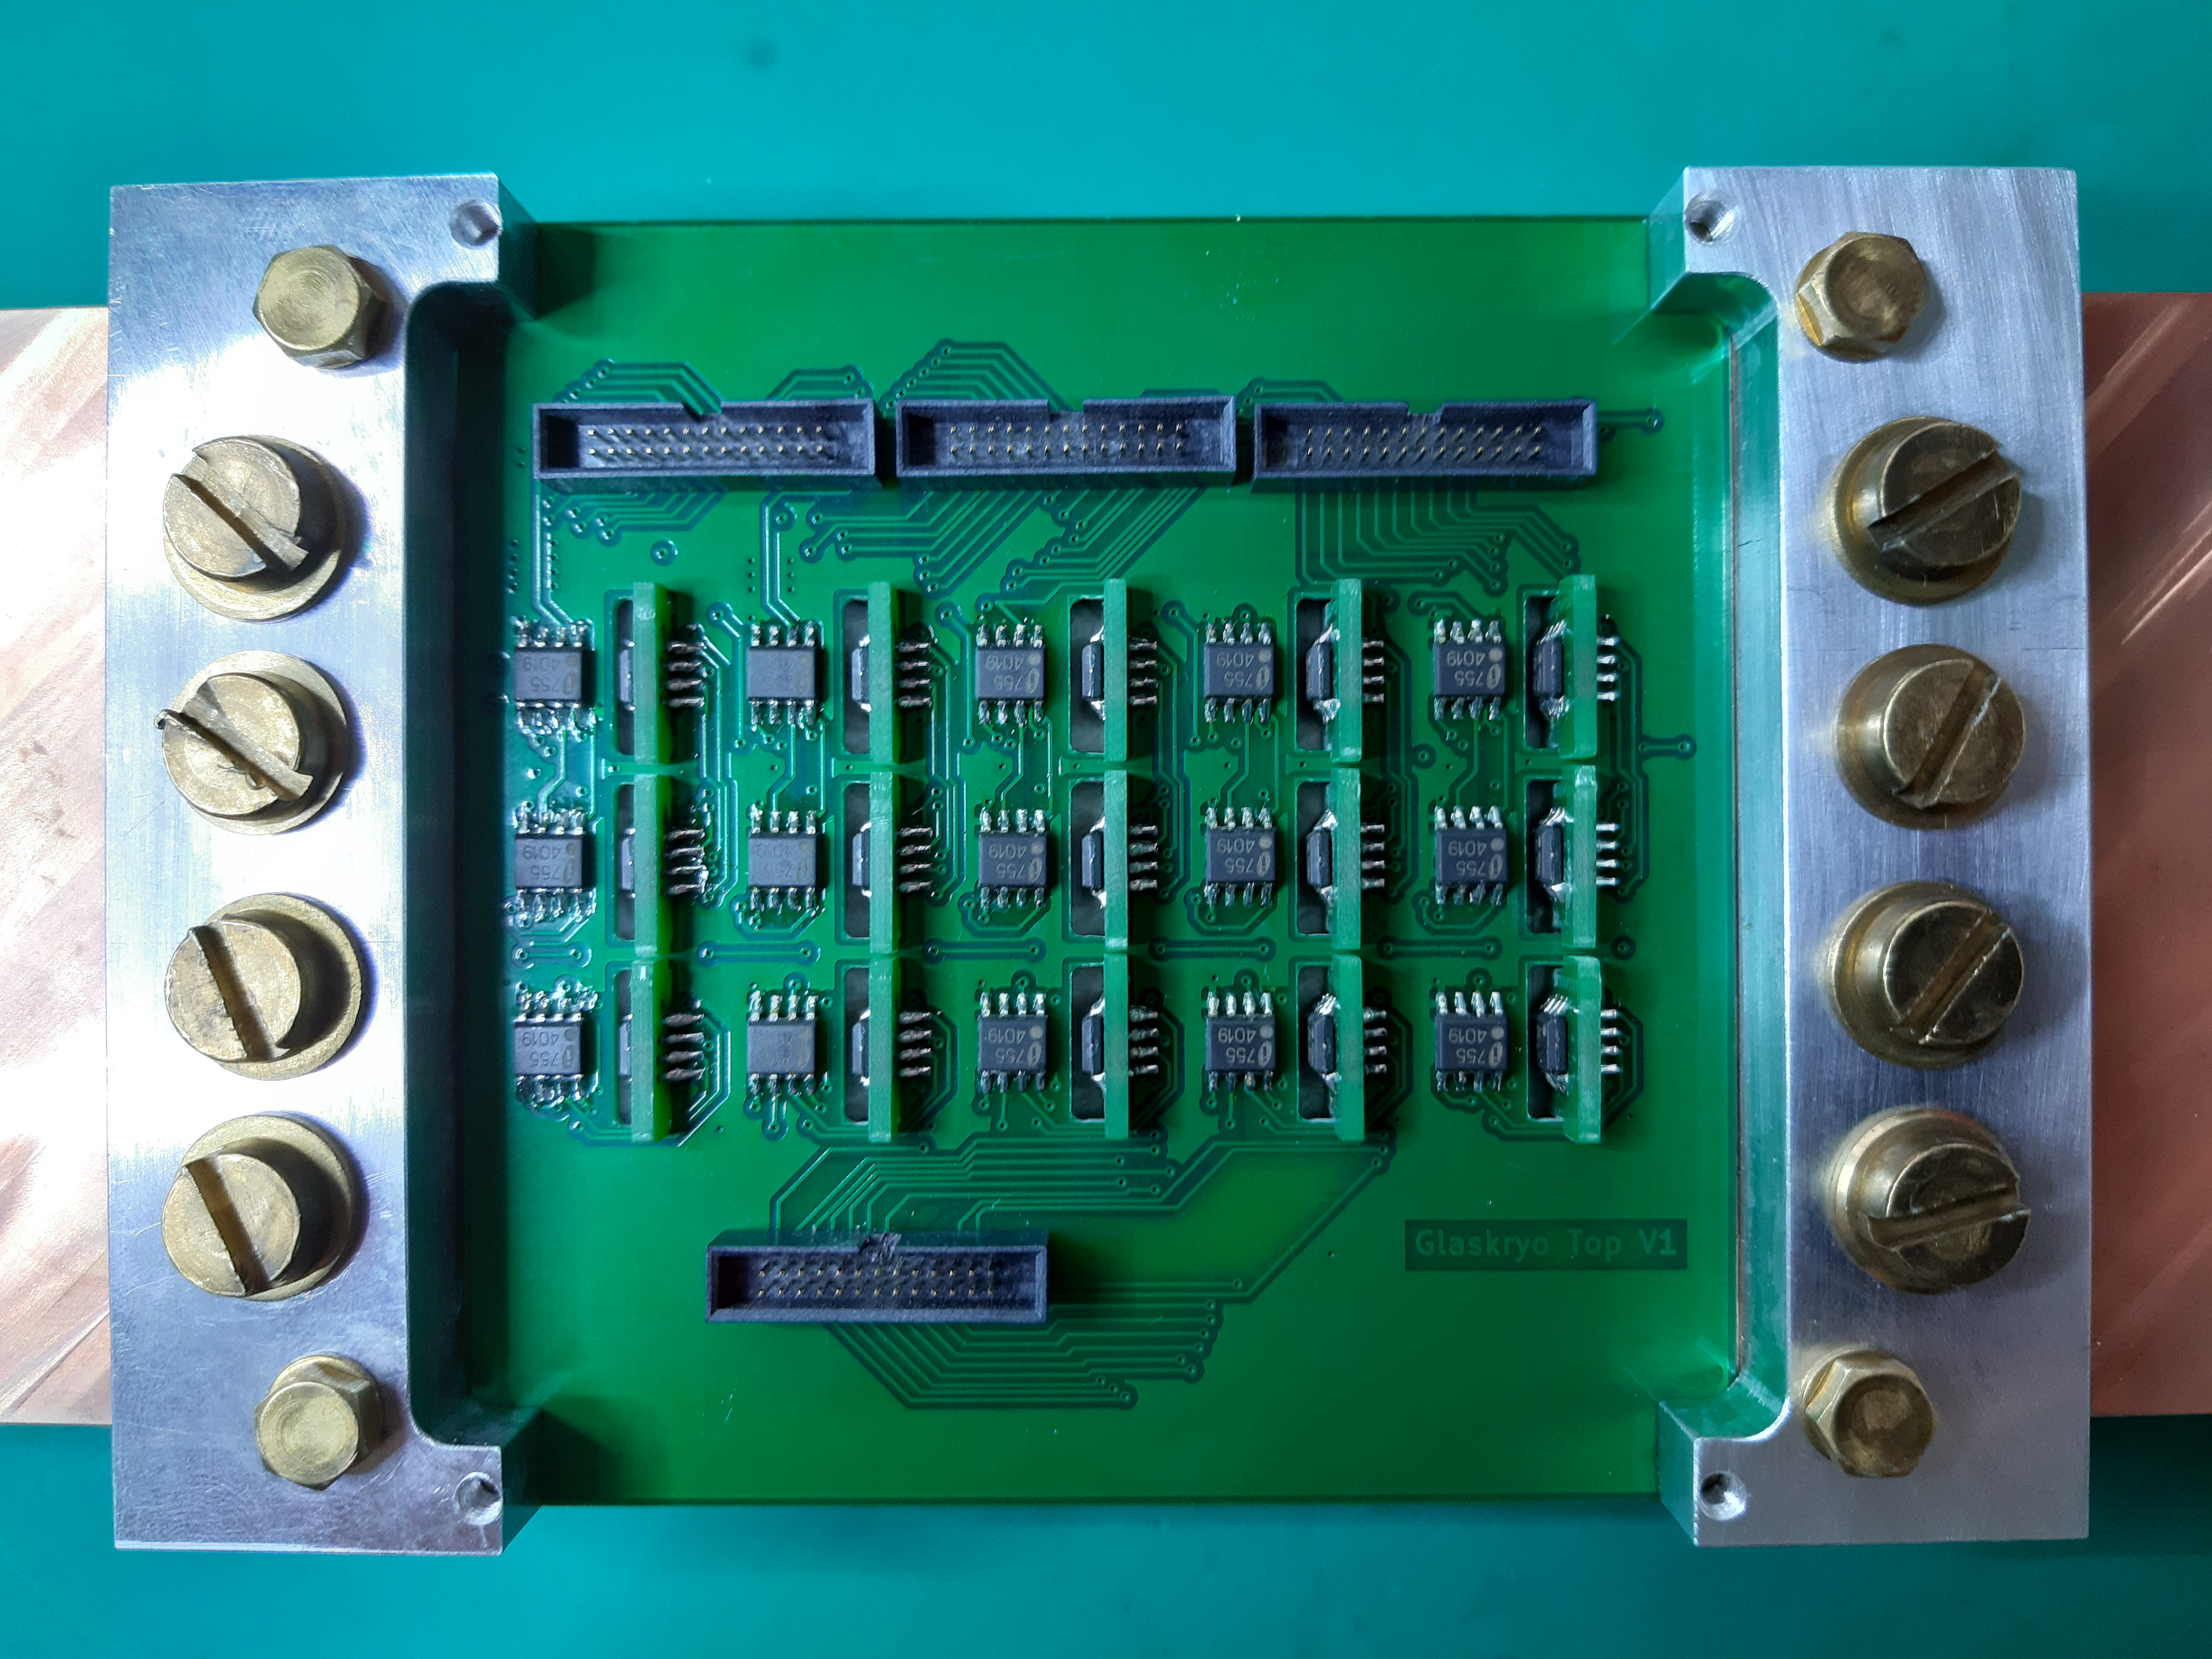
Experimental setup
Experiment
Sample (100x60x3)mm, clamped in copper blocks at either end
Setup is suspended above liquid helium bath
Heater in helium is used to control helium gas flow
Dual heaters on the end of the blocks allow for precise control of temperature gradient and cooldown speed
Blocks move electric heaters away from sample, this reduces magnetic fields from the heaters at the sample
8 Cernox sensors measure temperature distribution across sample
Multiple AMR sensors for magnetic field measurements
grouping of 3 sensors to measure field vector in 3d
15 AMR sensor groups measure magnetic field just above the sample
Heater
Cu blocks
Cernox
Nb
PCB with AMR sensors
LHe
Heater

Slide 7
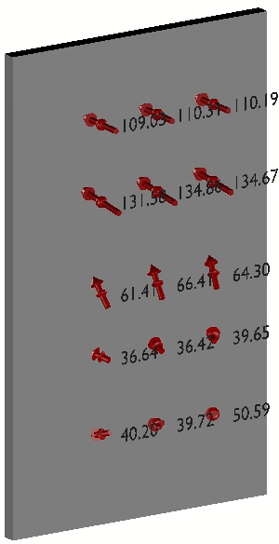
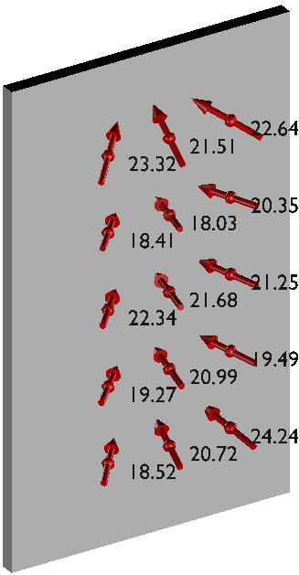
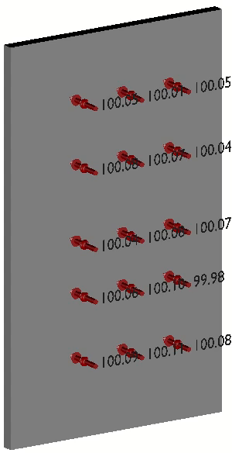
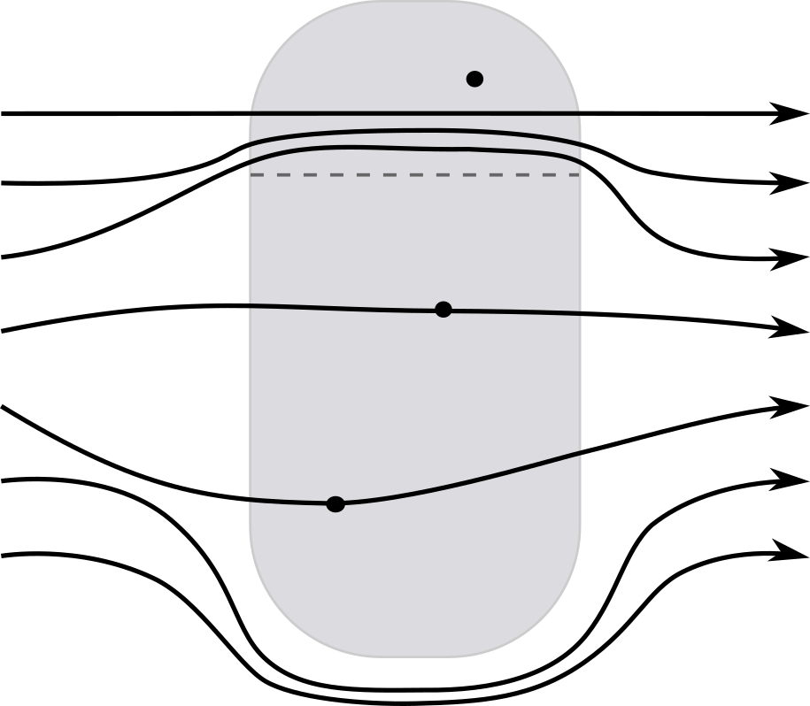

A typical Cooldown
Results
9.5K
10.1 K
Apply external field B_{ext} = 100 µT
Set Temperature gradient across sample (∇T = 0.06 K/cm)
Lower Sample temperature at top and bottom simultaneously
After Sample is fully superconducting, remove external field B_{ext} = 0 µT
Measure trapped flux
$$\vec{B}$$
nc
sc
8.9K
9.5K

Slide 8
Trapped flux vs Temperature Gradient
Results
Vary temperature gradient while keeping external magnetic field and cooldown speed constant
  B_{ext} = 100 µT
  dT/dt = 0.07 K/s
Comparison between fine grain sample and large grain sample (both untreated)
Less trapped flux with higher temperature gradient
Large grain material allows near 100% flux expulsion
Data disagrees with model proposed by Kubo*
  Reason might be a too high field level
100% trapping
Fine Grain
Large Grain
Kubo Model
* Kubo, T., Flux trapping in superconducting accelerating cavities during cooling down with a spatial temperature gradient, Prog. Theor. Exp. Phys., 2016

Slide 9
Trapped Flux Vs ambient Field
Results
Large grain Nb sample
Vary magnetic field strength with constant temperature gradient and cooldown speed
Change Temperature gradient for different measurement runs
  Large grain sample
  dT/dt = 0.07 K/s
  ∇T = 0 K/cm; 0.04 K/cm; 0.1 K/cm
Flux is not trapped below a gradient-dependent threshold field
Above threshold the dependence is linear
Slope decreases with increasing temperature gradient
This threshold behavior is not observed in fine grain sample
Increasing ∇T

Slide 10
Trapped Flux vs Cooldown Speed
Results
Vary cooldown speed while keeping temperature gradient and external magnetic field constant
Alter temperature gradient for different measurement series
  Large grain sample
  B_{ext} = 100 µT
  ∇T = 0.04 K/cm; 0.07 K/cm; 0.1 K/cm
Increasing Trapped Flux with decreasing Transition Time
No difference after ~10s

Slide 11
Conclusion
Conclusion & Outlook
Outlook
Temperature Gradient / Material
Better expulsion at higher gradients
Large grain expels flux much more efficiently than fine grain
Above 0.1 K/cm all flux is expelled in large grain sample
External magnetic field
Depending on temperature gradient, flux is only trapped above threshold field
Linear dependency above threshold field
Cooldown speed
Flux needs time to exit the superconductor
Develop a model combining the results obtained so far
Investigate different Materials (coated Nb, Nb3Sn, multilayer)
  Nb on Cu currently under investigation
Investigate how different material treatments influence trapped flux
Develop methods to decrease trapped flux

