Slide 1
High Q/G Beta 0.53 HWR Cavity R&D Program for High Gradient Cryomodule to Enhance Operational Gradient Margin
K. Saito
MSU/FRIB SRF Development Manager
TTC Meeting at Aomori, Oct. 11 – 14, 2022
High Q/G R&D, W1

Slide 2
FRIB Cavity Performance Limits
Remind, FRIB cavities are processed by BCP, and heated at 600 ^{O}C for 10 hr.
Figure 1: Statistics of cavity performance in the vertical test on the FRIB 0.53 HWRs.
0.53 HWR
Cavity field limitation on FRIB production cavities is mostly FE or HFQS.
Limitation: FE 19 - 74%, and HFQS 75 - 25%.
Recent data analysis shows Qo loading at below X-ray 100 mR/hr could be due to HFQS. HFQS limitation should be much higher than 75-25%.
Table 1: Statistics of the field limitation with all the cavities, in FRIB production
Type | QWR-0.041 | QWR-0.085 | HWR-0.29 | HWR-0.53
Total number of certificated cavities | 16 | 106 | 72 | 148
1. Quench < Bp=85 MT | 1 (0.6%) | 0 (0%) | 13 (18%) | 2 (0.1%)
2. Field emission X-ray below Bp=85 mT | 3 (19%) | 41(39%) | 21 (29%) | 109 (74%)
3. Pure HFQS, including quench > Bp=85 mT | 9 (56%) | 26 (25%) | 32 (44%) | 21 (14%)
4. Suspicious HFQS X-ray onset > Bp=85 mT | 3 (19%) | 39 (37%) | 6 (8%) | 16 (11%)
HFQS total (3+4) | 12 (75%) | 65 (61%) | 38 (53%) | 37 (25%)
C. Zhang et. al., Nucl. Inst. and Method.
https://doi.org/10.1016/i.nima.2021.165675

Slide 3
R&D Project Narrative
DOE R&D Project, $704k, 2 years
Story
Objective
FRIB maintenance:
stable and reliable machine operation for user service
Current FRIB cavity operation,
5 - 7.5 MV/m with Qo ~ 1E+10
Spare cryomodule opera-table Eacc > 10 MV/m @ Qo >1.5E+10
Replacement of degraded cryomodules
e.g. 0.53HWR spare cryomodule
HFQS is the fundamental Q/G limitation with FRIB cavities
Enough performance margin for the future cavity degradation in the replaced CM itself
Development of transformative processing technology, for High Q/G performance,
Eacc > 10 MV/m @ Qo > 2E+10,
for FRIB 0.53 spare cryomodule
HighQ/G Spare Cryomodule

Slide 4
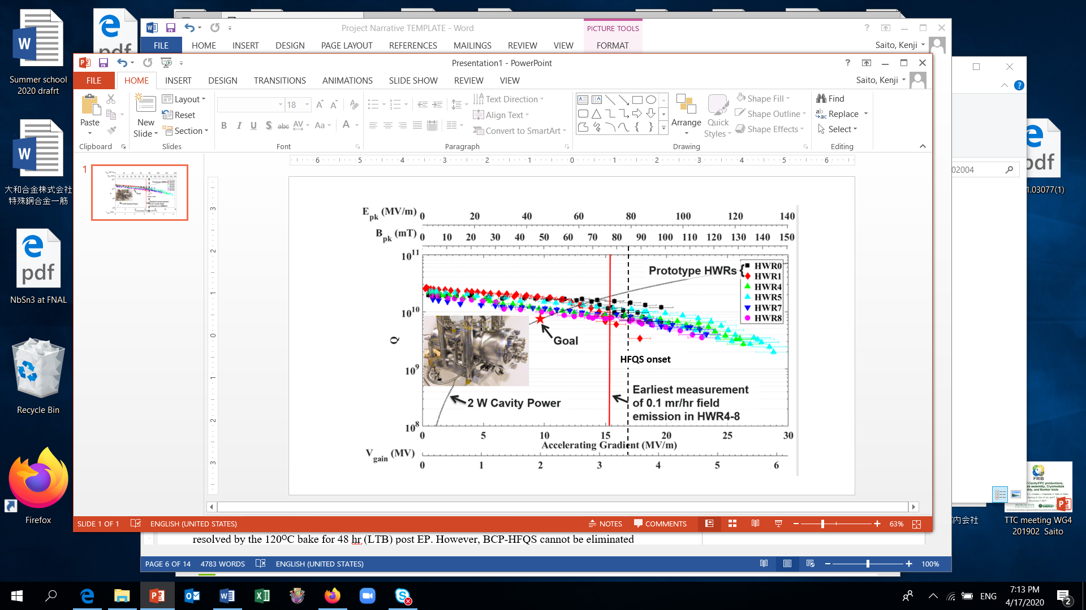
Object 1: Transformative Technology against FE or HFQS on FRIB Cavities: Electropolishing
Electropolishing (EP) produces a smooth surface.
  Typical surface roughness: EP ~ 1-2 μm, BCP ~ 5 μm.
This smooth surface makes easy to rinsing, and results in less FE.
Successful pilot study result of EP with 162.5MHZ beta = 0.11 HWR at ANL
EP+ LTB could eliminate the HFQS, and results in High Q?G performance.
The goal is promising and low risk in technical development.
EP only, no LTB
Z. A Conway et.al. SRF2015
https://accelconf.web.cern.ch/srf2015/papers/weba05.pdf
Figure 2: Electropolishing on 162.5 MHz β= 0.11 HWRs at ANL. LTB was not carried out, therefore EP-HFQS is observed slightly at B_{op} > 85 mT These cavies reached 17 - 28 MV/m with a rather flat Qo. Bp/Eacc = 5.02 mT/ [MV/m].
TTC meeting in Aomori, Japan, WG1, Oct. 11-14, 2022, Saito

Slide 5
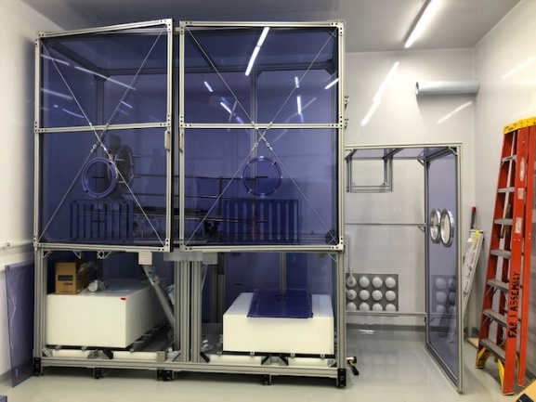
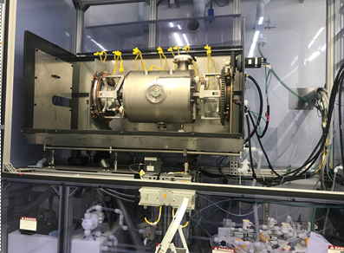
EP System at FRIB
EP system (horizontally rotating EP system) has been constructed at FRIB for future high gradient cavities, i.e. energy upgrade 644 MHz elliptical cavities.
Commissioning is under way, utilizing 0.53HWRs.
Fig.3: EP system at FRIB, which is located SRF Highbay.

Slide 6
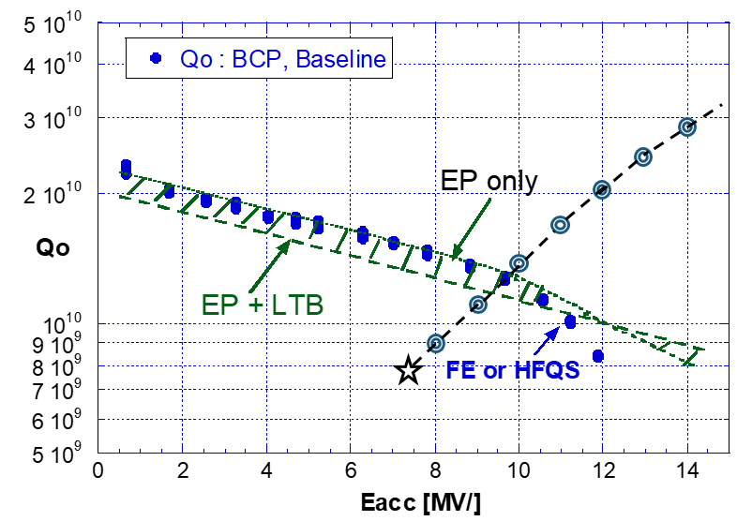
Object 1: EP or EP+LTB
Expected Cavity Performance in these processing
High Q/G performance is expected by EP or EP+LTB with low technical risk.
Required Qo performance
FRIB operation
Fig.4: Expected Cavity Performance in Object 1, EP or EP+LTB.

Slide 7
Object 2: Strengthen magnetic shielding
Backup Plan for High Qo Performance
EP or EP+LTB could be limited in high Q performance.
If reduced the remnant field in VT Dewar below 10-5 mG (current ~ 20 mG), Qo performance could be improved.
Put on magnetic local magnetic shield around the helium Jacket, which is developed for FRIB production cavities.
Fig.5: Expected Cavity Performance by EP or EP+LTB + an additional local magnetic shield.

Slide 8
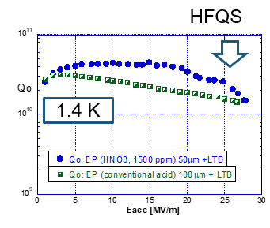
Object 3: Challenge to A Transformative BCP
HFQS-free BCP(combined LTB)
If similar high Q/G performance as EP is achieved by BCP, it could lead a big benefit to low/medium beta and reflecting mod cavities which have a complicate geometry.
However, so far, BCP based on the mixture: HF, HNO₃, and H₃PO₄ can not remove the HFQS even taken the post BCP LTB (120^{O}C, 48hr), with fine grain cavities (not heated 800-900 ^{O}C).
MSU PhD activity (Didi, 2015-2019) concluded that it is due to the reaction of nitric acid, If add nitric acid in the current EP acid, a HFQS not removed by LTB appears (reminded in KEK data).
The PhD activity successfully developed a new BCP acid without nitric acid, which can produce surface finishing ~ 3 μm with small samples (Didi Luo, PhD thesis, MSU, 2019 Aug.)
The object 3 tests this new BCP acid on the 0.53HWR and investigate the VT cavity performance.
Fig. 6: If added HNO₃ acid the current EP mixture, HFQS not removed by LTB appears (PhD thesis, Didi Luo, Aug. 2019). Reminded from KEK data by PhD activities, by T. Higuchi, 2001.

Slide 9
Object 4: Challenge to Much Higher Qo Performance
New doping technology
Expected the success of High Q/G cavity performance for 0.53HWR by EP, or combination of LTB and strengthening magnetic shielding.
However, needs more Qo performance for a much higher G operation, Eacc > 12 MV/m.
Object 4 explores new doping technologies.
  Current doping technology: N-doping or Oxygen doping, cavities are annealed at 800 - 900 ^{O}C high temperature in a vacuum furnace before the doping process.
  Such a high temperature annealing could have a big risk to the already dressed a He tank (titanium) FRIB 0.53 spare HWRs, i.e. frequency tuning point of view.
  Investigate whether the high temperature annealing is essential for doping.
  New doping method without high temperature annealing will be explored.

Slide 10
Summary
Recently, FRIB has been awarded a R&D project from DOE with a budget $704k and 2 years since 2022 September, in order to develop transformative processing technology for High Q/G performance, for FRIB 0.53 spare cryomodule.
In this project, EP or EP+LTB will applied to realize the high Q/G performance for FRIB 0.53HWRs, which is well developed on ILC cavities and low technical risk.
Local magnetic shield will be added around cavity jacket to reduce remnant magnetic field in VT Dewar, which has been developed in the FRIB production cavities, and well works.
After that, two challenges will be done with high risk:
  Development of HFQS-free BCP
  New doping method without high temperature annealing.
This presentation showed just a project plan, but the result will be reported in future TTC meeting step by step.

