Slide 1
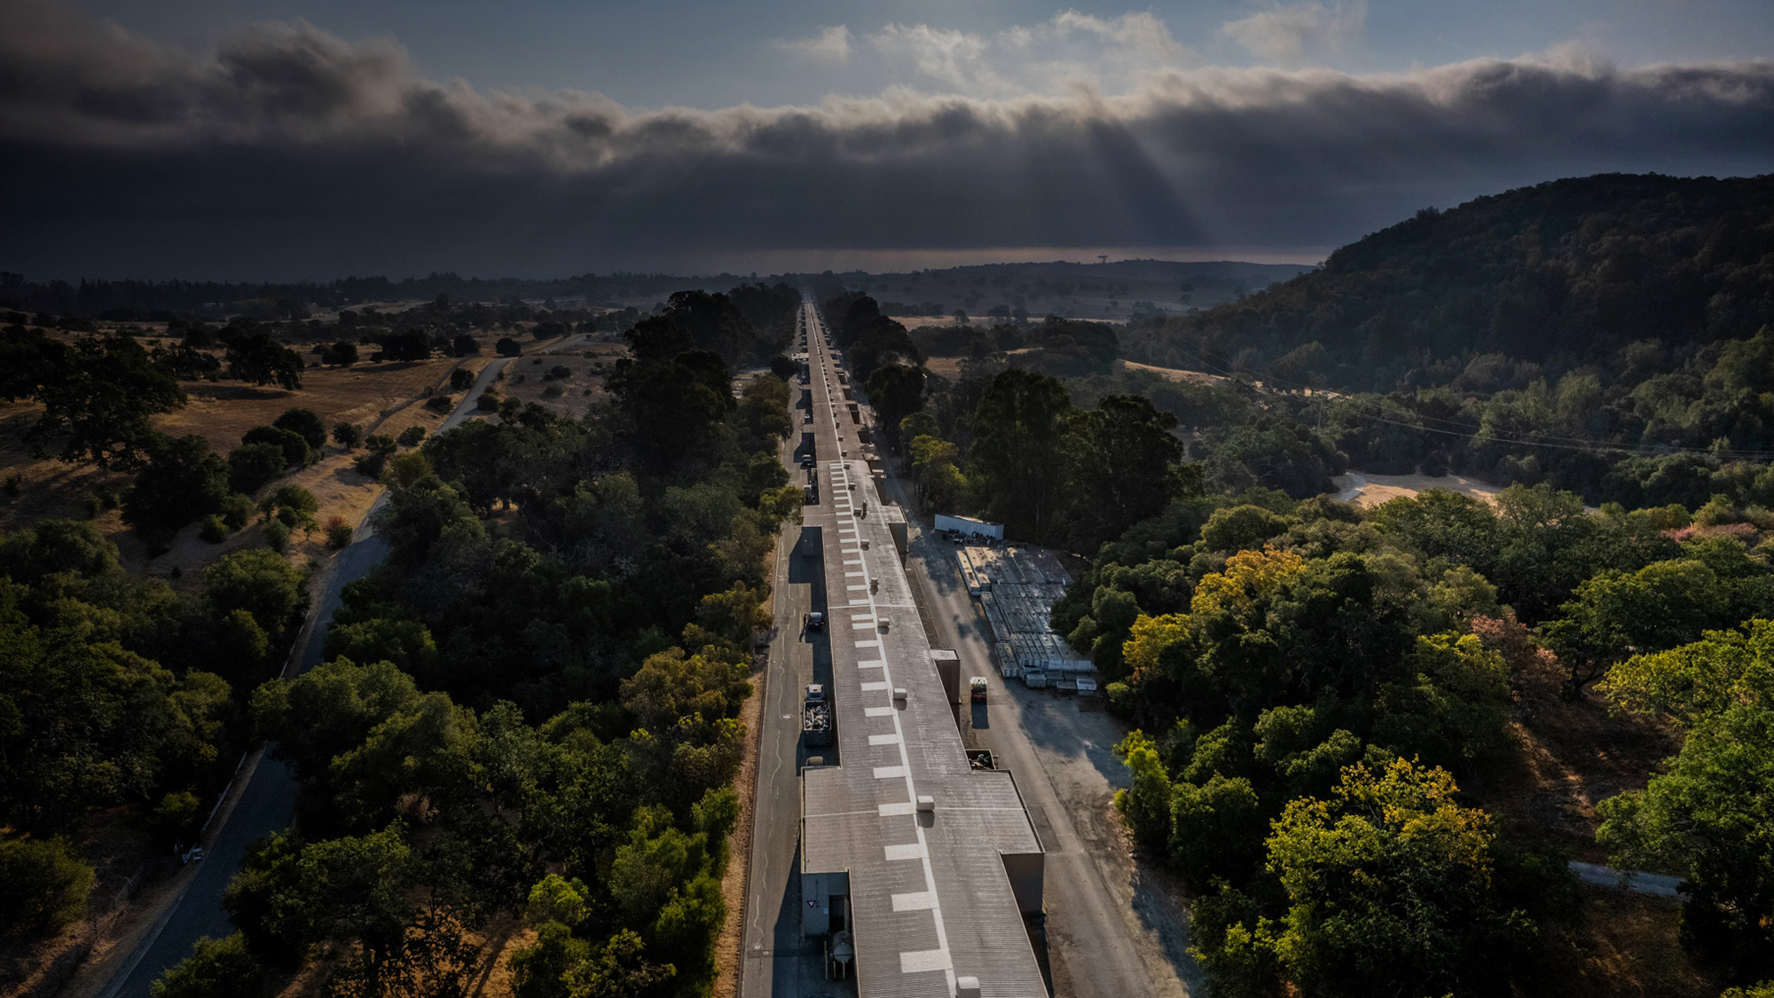
LCLS-II SRF Commissioning
Sebastian Aderhold
for the SRF commissioning team
11 October 2022, TTC2022 Aomori

Slide 2
Outline
LCLS-II Facility Overview, Scope, and Parameters
Installation
Cryogenic Systems & Cool Down
SRF and Cryomodule Commissioning
SC Beam Commissioning
Summary

Slide 3
LCLS-II Facility Overview, Scope, and Parameters
1

Slide 4
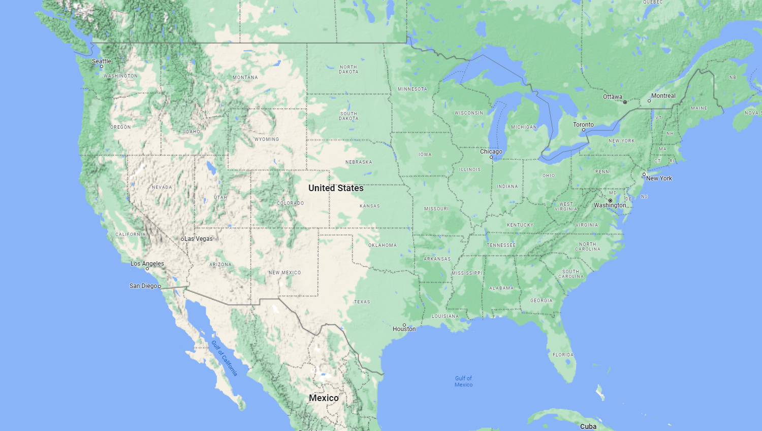
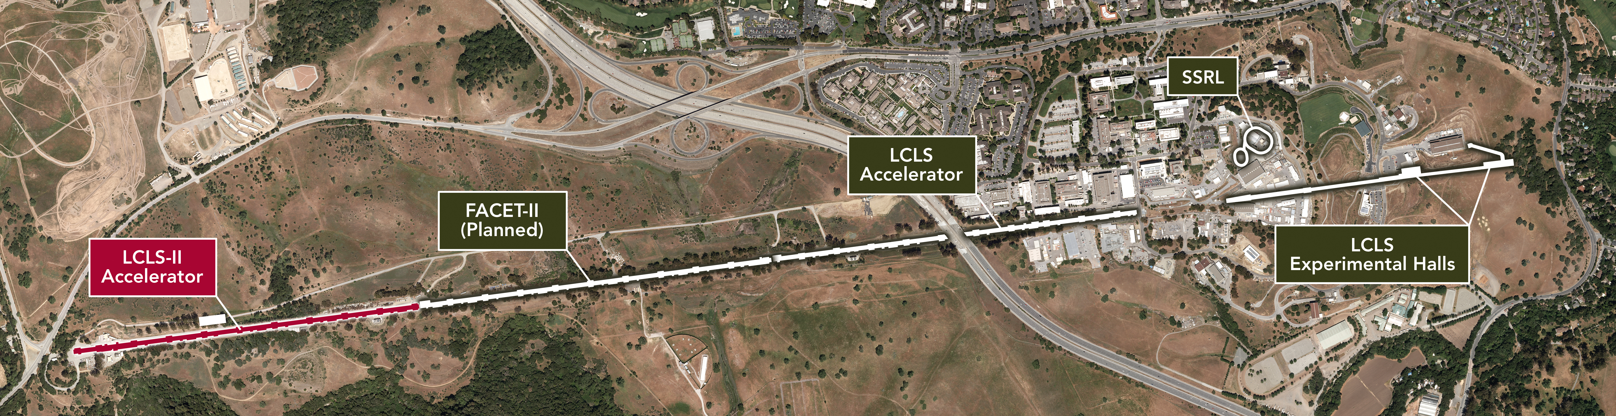
SLAC is developing an upgrade of its Linac Coherent Light Source (LCLS) that will be at the forefront of X-ray science.
LCLS-II will provide a major jump in capability:
  Increasing from 120 pulses per second to
  1 million pulses per second.
  Enabling researchers to perform experiments in a wide range of fields that are currently impossible.
  The unique capabilities of LCLS-II will yield a host of discoveries to advance technology, new energy solutions and our quality of life.
LCLS-II @ SLAC

Slide 5
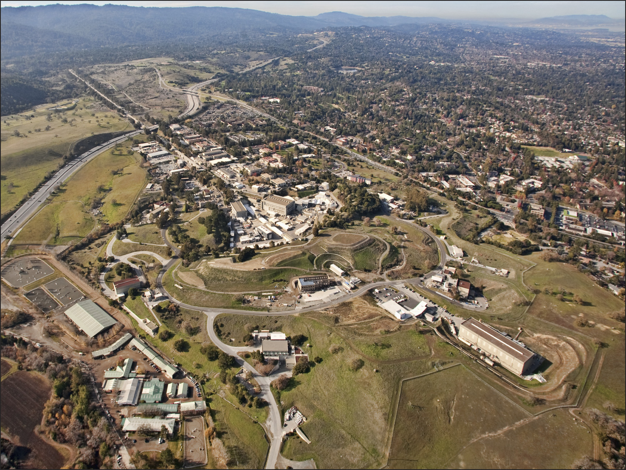

Remove SLAC
Linac from
Sectors 0-10
New Injector and
New Superconducting Linac
LCLS-II
New Cryoplant
Existing Bypass Line
New Transport Line
Reconfigure Near Experiment Hall
Two New Undulators
And X-Ray Transport

Slide 6
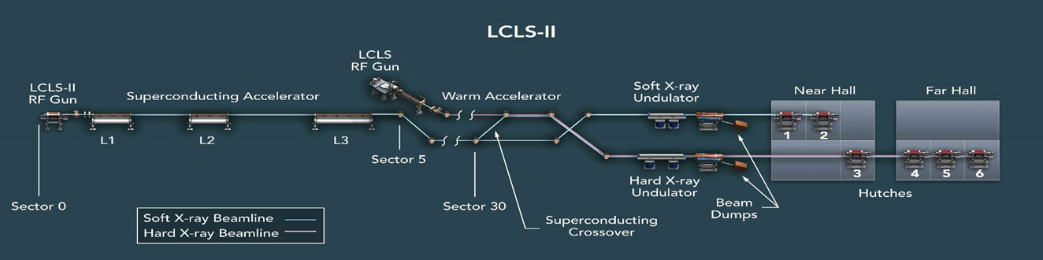
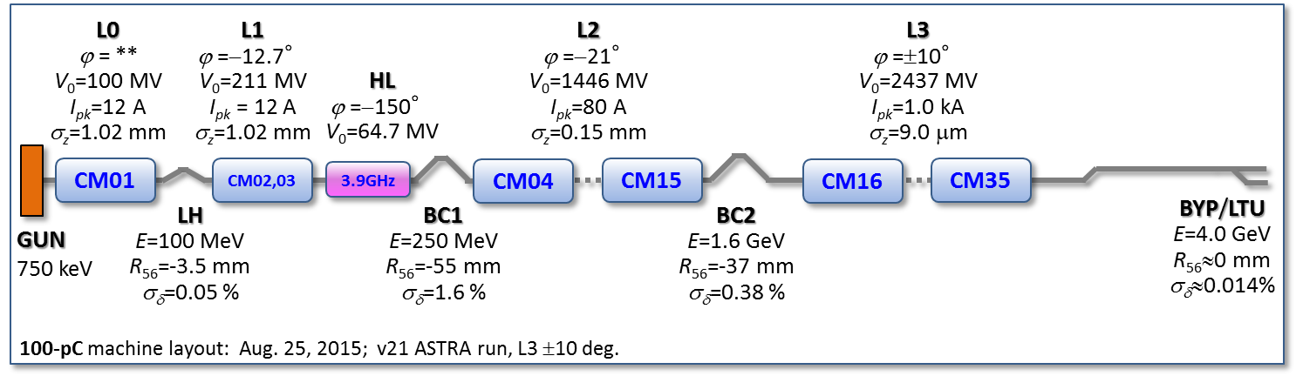
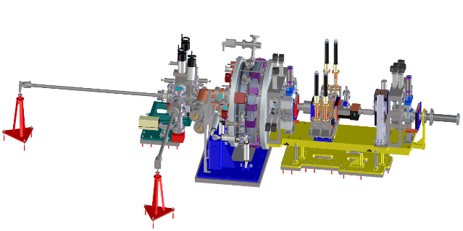
Linac & FEL Layout
RF Photocathode Gun
35 1.3 GHz Cryomodules
2 3.9 GHz Cryomodules
Photocathode Gun
750 keV electrons

Slide 7
LCLS-II Technical Parameters
Performance Measure | Threshold | Objective
Variable gap undulators | 2 (soft and hard x‑ray) | 2 (soft and hard x‑ray)
Superconducting linac-based FEL system
Superconducting linac electron beam energy | 3.5 GeV | ≥ 4 GeV
Electron bunch repetition rate | 93 kHz | 929 kHz
Superconducting linac charge per bunch | 0.02 nC | 0.1 nC
Photon beam energy range | 250–3,800 eV | 200–5,000 eV
High repetition rate capable end stations | ≥ 1 | ≥ 2
FEL photon quantity (10⁻³ BW) per bunch | 5x10⁸ (10x spontaneous) @2,500 eV | > 10¹¹ @ 3,800 eV
Normal conducting linac-based system
Normal conducting linac electron beam energy | 13.6 GeV | 15 GeV
Electron bunch repetition rate | 120 Hz | 120 Hz
Normal conducting linac charge per bunch | 0.1 nC | 0.25 nC
Photon beam energy range | 1–15 keV | 1–25k eV
Low repetition rate capable end stations | ≥ 2 | ≥ 3
FEL photon quantity (10⁻³ BWª) per bunch | 10¹⁰ (lasing @ 15 keV) | > 10¹² @ 15 keV
Achieved

Slide 8
LCLS-II Technical Parameters
Performance Measure | Threshold | Objective
Variable gap undulators | 2 (soft and hard x‑ray) | 2 (soft and hard x‑ray)
Superconducting linac-based FEL system
Superconducting linac electron beam energy | 3.5 GeV | ≥ 4 GeV
Electron bunch repetition rate | 93 kHz | 929 kHz
Superconducting linac charge per bunch | 0.02 nC | 0.1 nC
Photon beam energy range | 250–3,800 eV | 200–5,000 eV
High repetition rate capable end stations | ≥ 1 | ≥ 2
FEL photon quantity (10⁻³ BW) per bunch | 5x10⁸ (10x spontaneous) @2,500 eV | > 10¹¹ @ 3,800 eV
Normal conducting linac-based system
Normal conducting linac electron beam energy | 13.6 GeV | 15 GeV
Electron bunch repetition rate | 120 Hz | 120 Hz
Normal conducting linac charge per bunch | 0.1 nC | 0.25 nC
Photon beam energy range | 1–15 keV | 1–25k eV
Low repetition rate capable end stations | ≥ 2 | ≥ 3
FEL photon quantity (10⁻³ BWª) per bunch | 10¹⁰ (lasing @ 15 keV) | > 10¹² @ 15 keV
Parameter | LCLS-II
# 1.3 GHz CMs | 35
Operating Gradient | 16 MV/m
Required Q₀ at Operating Gradient | 2.7x10¹⁰
Achieved

Slide 9
Installation
2

Slide 10
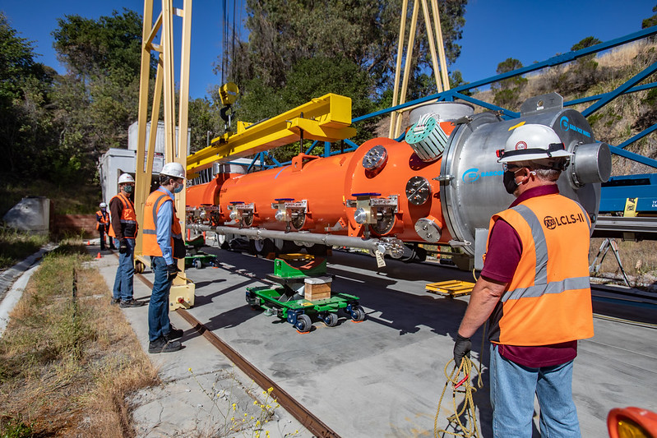
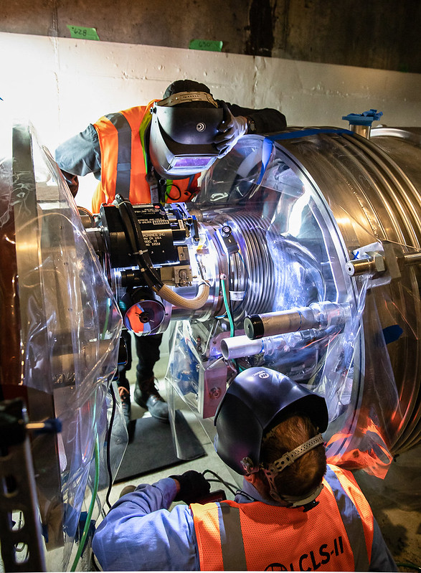
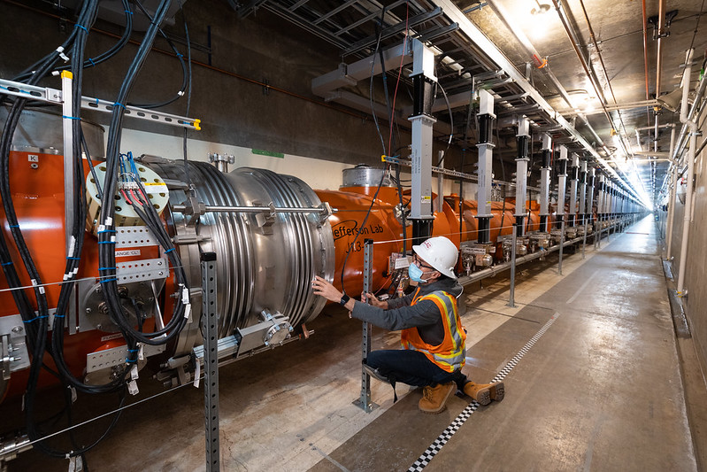
Cryomodule Installation
CM Installation Complete February 2021
Last CM (spare) Delivered in May 2021

Slide 11
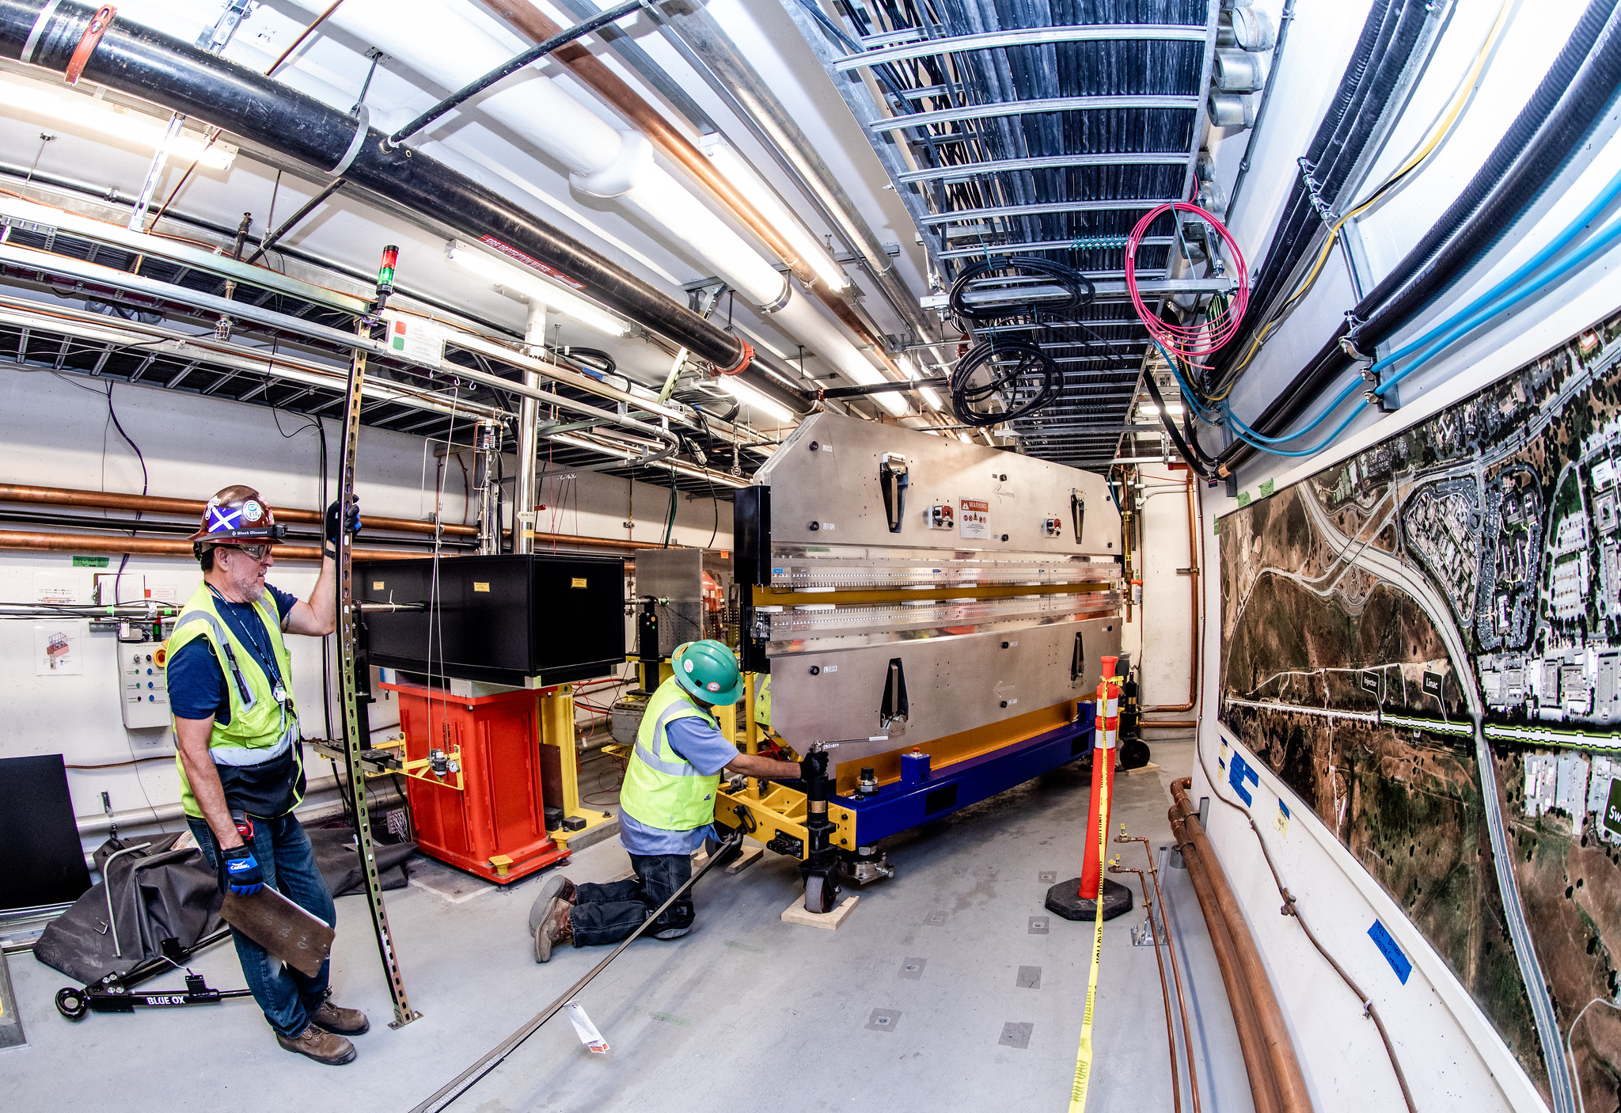
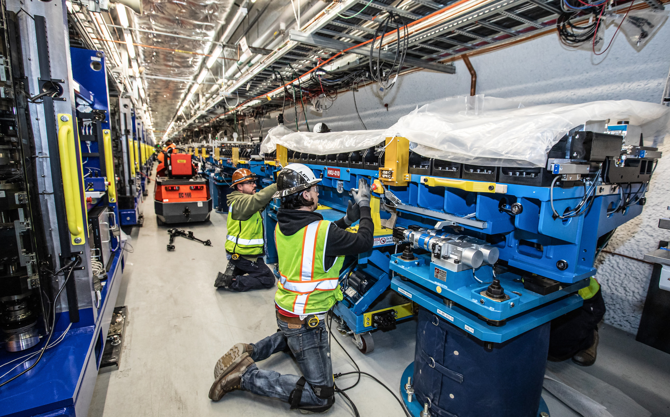
Undulator Installation
Vertical Variable Gap SXR Undulator
Horizontal Variable Gap HXR Undulator
Delivery of X-Rays to Instruments Began in 2020

Slide 12
Cryogenic Systems & Cool Down
3

Slide 13
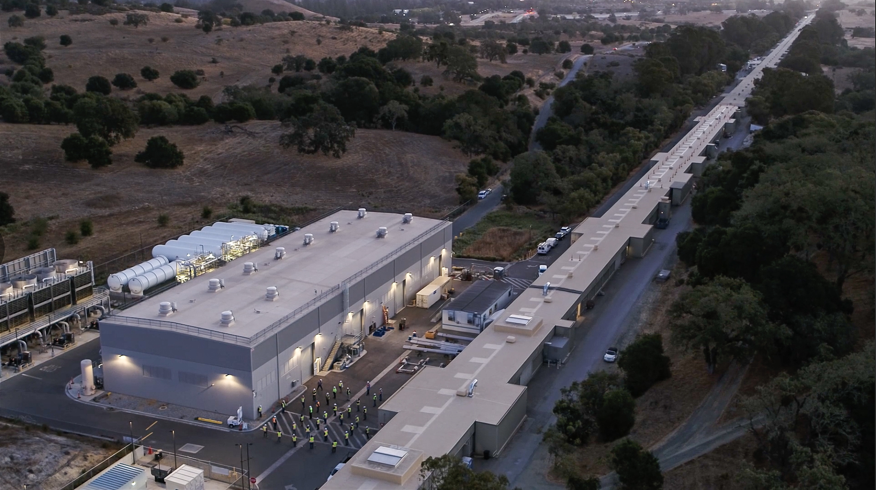
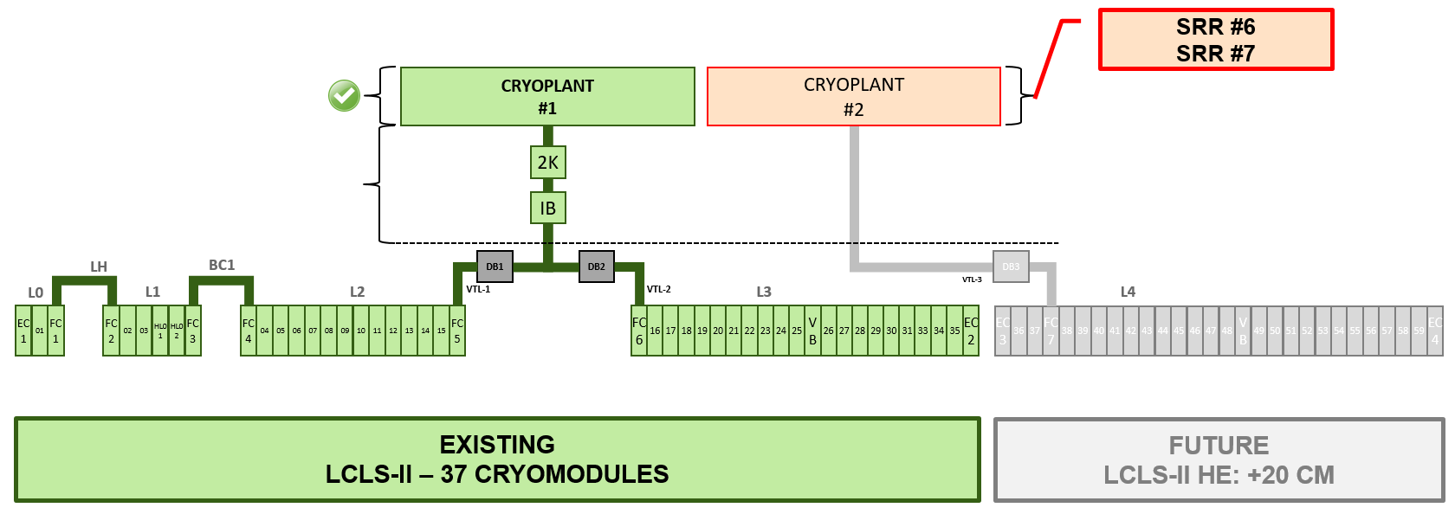
Plan to fully commission and operate LCLS-II with 1 of 2 installed cryoplants

Slide 14
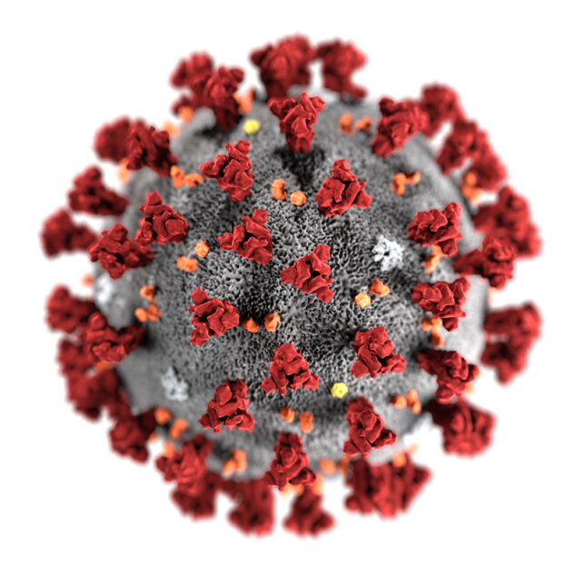
Cryoplant Commissioning Process
~ 30 Months
UTILITIES
Electricity
Control
Network
Water
Air
Nitrogen
Helium
AUXILIARIES
Recovery
compressor
Gas Analyzer
Purifier
COMPRESSORS
4K Cold Box
LINAC Ready
LINAC @ 4 K
Cool Down
LINAC @ 2 K
2 K Pump
Down
Aug. 15th 2019
Dec. 15th 2019
Mar. 15th 2020
Jan. 15th 2021
Oct. 15th 2021
Jan. 1st 2022
Mar. 30th 2022
May 15th 2022
4 mths
3 mths
10 mths
7 mths
2.5 mths
3 mths
1.5 mths

Slide 15
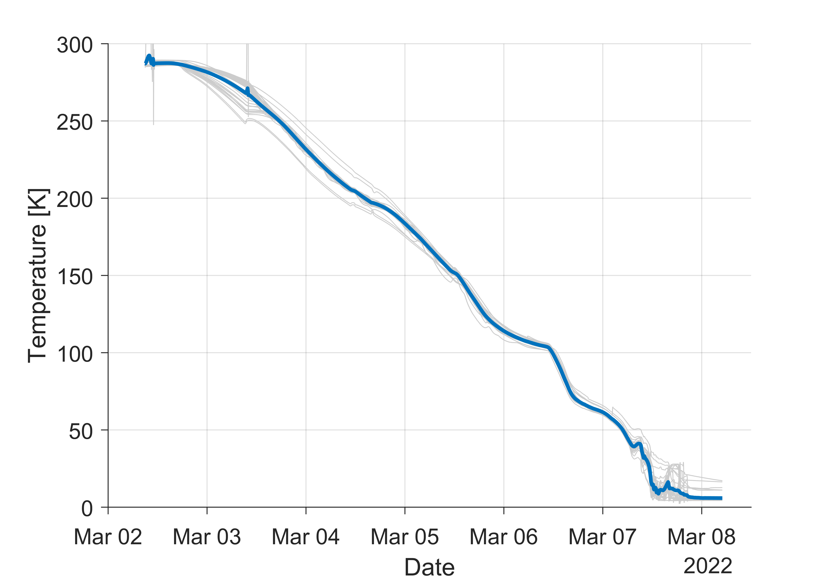
Cool Down & Pump Down to 2 K
Cavity Temperatures During Cool Down
Cool down of the entire linac was completed in ~5 days!
A rate of 2-3 K/hour was maintained over that duration
Cool down was near-fully automated by the cryogenic controls system
After multiple attempts, stable operation at 2 K was achieved only 11 days later
2-3 K/hr

Slide 16
SRF and Cryomodule Commissioning
4

Slide 17
SRF Commissioning Process
Goal of initial cryomodule RF checkout was demonstration of capability for 3.5 GeV total energy gain (sum of all cavities operated individually and without beam)
Verified function of all relevant CM components (tuners, piezos, magnets)
Watch temperature, vacuum and radiation sensors for excursions to catch any problems that develop
  Live plots of 2 power coupler temps, 2 HOM coupler temps, coupler manifold vacuum, insulating vacuum and beamline vacuum, readout of DecaRad radiation monitoring

Slide 18
SRF Commissioning Process
Per cavity:
Characterization of Solid State Amplifier (automated script mapping drive vs. output power
Tuning cavity to resonance (record initial frequency and steps to tuned for later reference), activate piezo tuner and verify functionality
Cavity signal calibration in pulsed mode: determine loaded Q_{ext} and scaling for cavity pickup probe signal

Slide 19
SRF Commissioning Process
Cavity ramp up in SELA
Initial ramp up of cavity is in SELA mode (Self Excited Loop, CW with Amplitude feedback)
Increase amplitude until reaching the lower value of either 18MV or the useable amplitude as determined during acceptance test at partner lab, or if radiation exceeds 50mR/hr
Watch radiation monitors, temperatures and vacuums for excursions
In case of early cavity fault, retest cavity to 0.5MV below trip value and record as new usable amplitude.
1 hour run in SELAP
Switch cavity to SELAP mode (Self Excited Loop, CW with Amplitude and Phase feedback)
Max amplitude is the lower value of either 16.6MV or the useable amplitude as determined earlier
Verify amplitude and phase stability

Slide 20
SRF Commissioning Process
12h full CM ‘unit test’
Upon completion of individual cavities set up of 12 hour run
  Monitoring of all relevant signals
  Turn on magnet package to design current
  Ramp all 8 cavities to operating amplitude
Maintain operation for up to 12 hours while moving on to individual cavity checkout on the next cryomodule
  Take cavity microphonics data while running.
Radiation physics group takes measurements outside shielding (at penetrations) during and at the cryomodule after the unit test

Slide 21
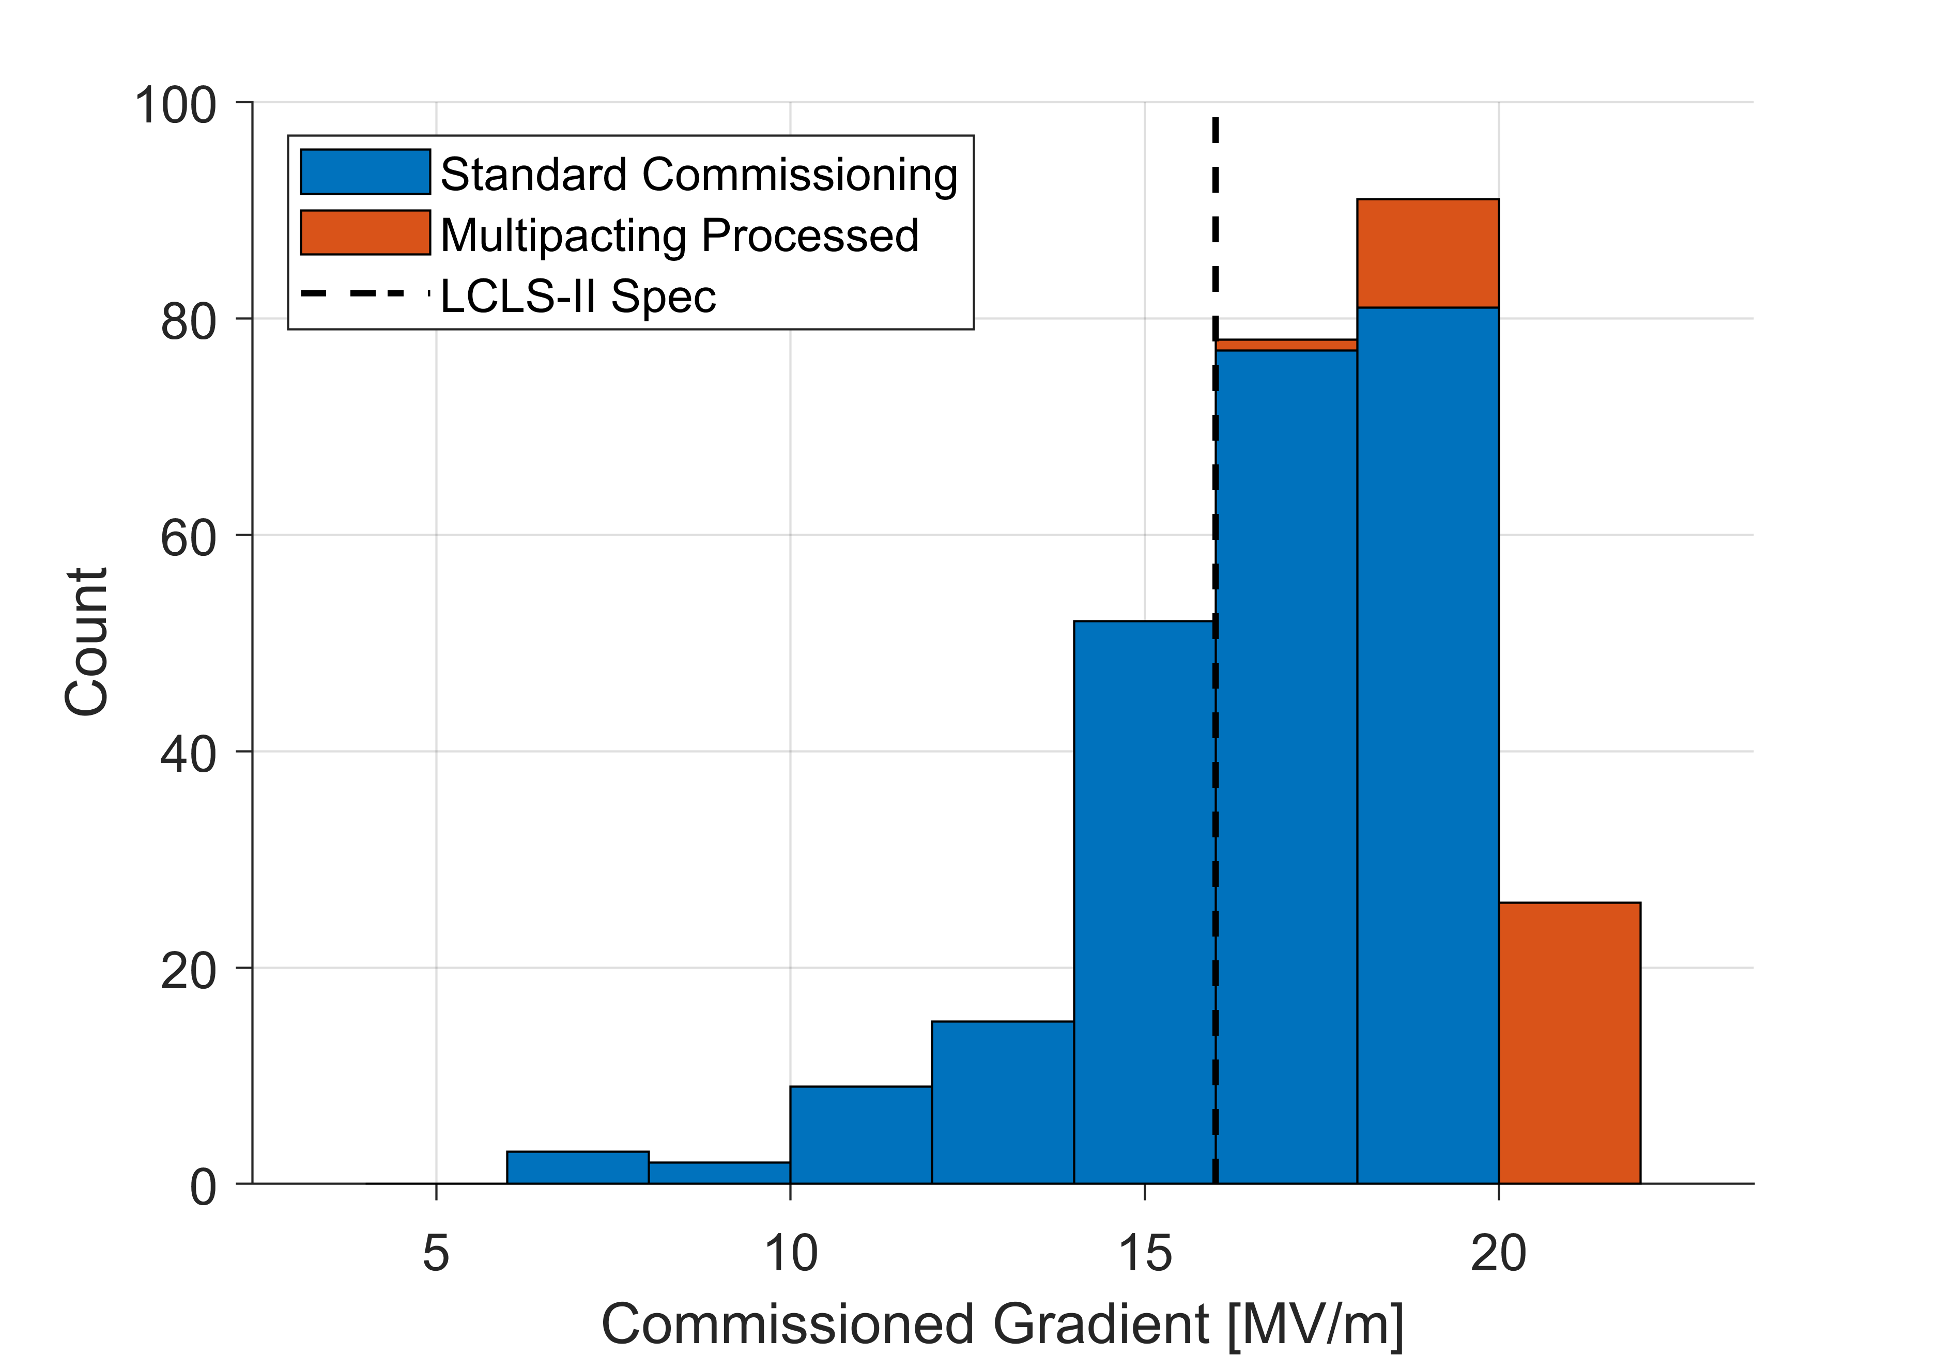
Overall SRF Commissioning Status
Gradient Performance
Cryomodule commissioning has been very successful
98% of installed cavities fully operational (planned 94%)
Majority of testing included an admin
limit of 18 MV/m
Total commissioned voltage
exceeds design by >20%
Total Commissioned Cavity Voltage: 4.8 GV

Slide 22
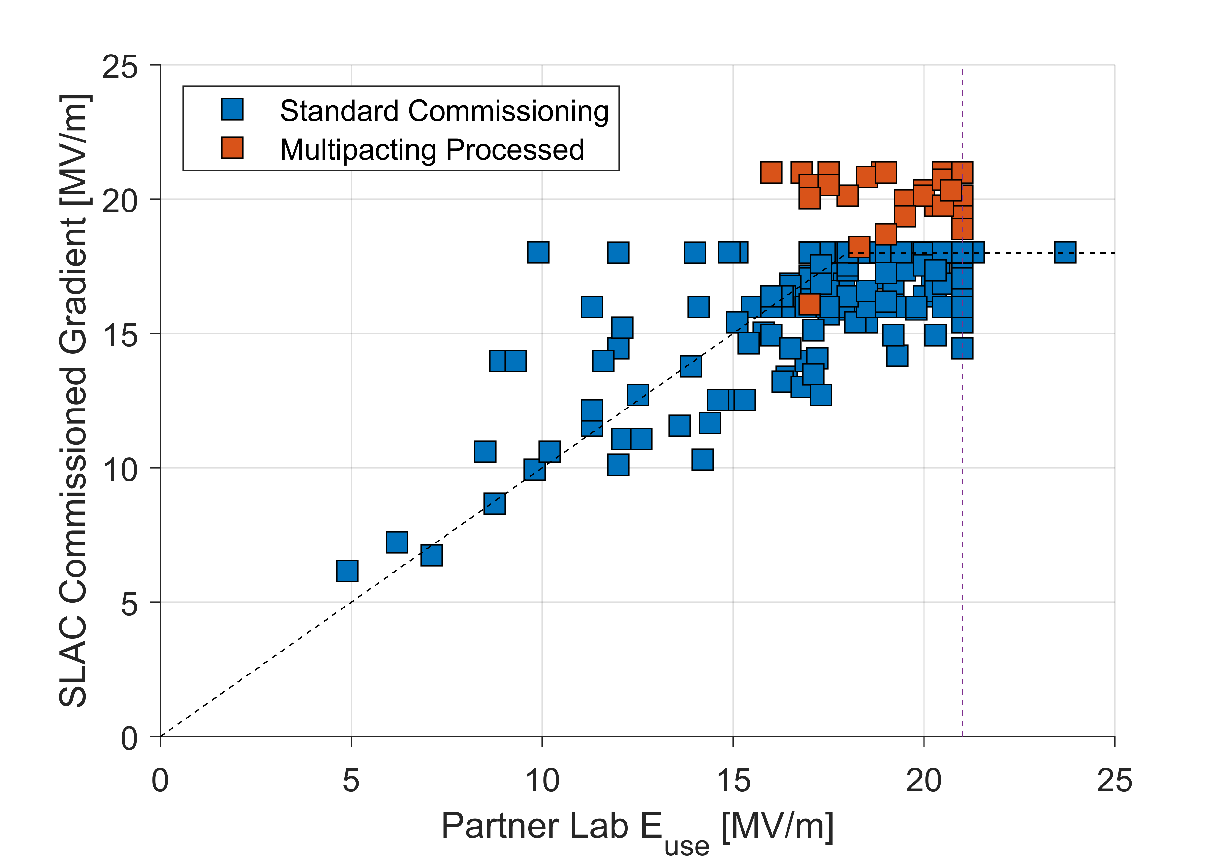
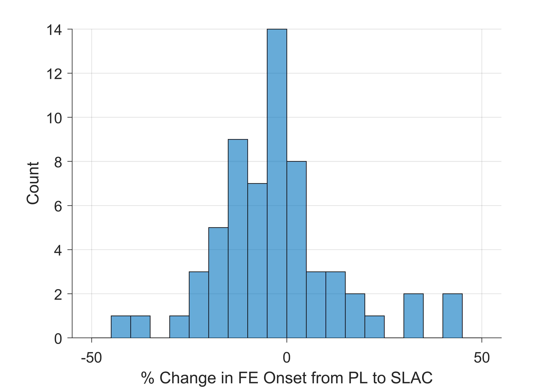

Gradient Performance
Comparison with Acceptance Test
Gradient performance is in line with CM acceptance test measurements at FNAL and Jlab
No observable change in field emission onsets or magnitude from installation
Multipacting processing resulted in ~3 MV/m gain in stable gradient
Change in FE Onset
$$\overline{Δ}=\left(−1±18\right)\%$$
Admin limits:
18 MV/m in commissioning
21 MV/m in acceptance test

Slide 23
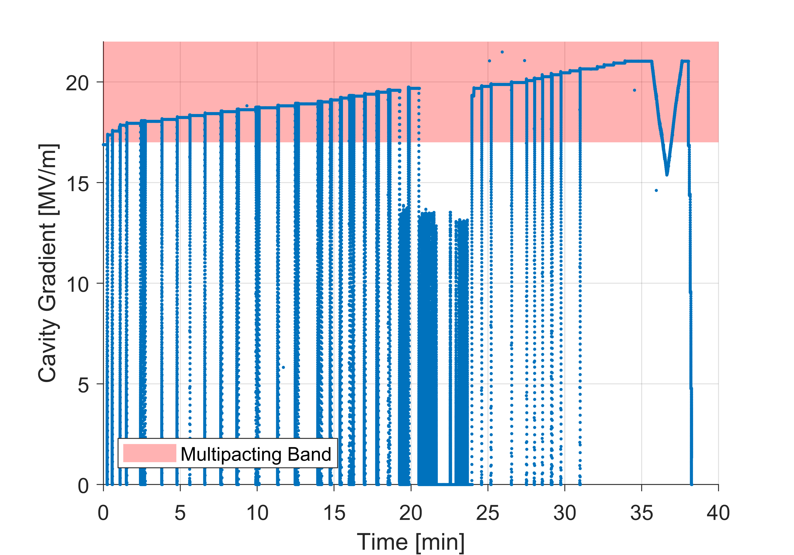
Multipacting Processing
Repeated quenches
Multipacting identified as a gradient limitation for LCLS-II cavities late in CM production
Observed as a short term stability at gradient in the band of 17-23 MV/m
Processing techniques developed and tested by LCLS-II-HE team and applied to a subset of cavities in the installed linac
  Consists of repeatedly quenching the cavity in CW mode with limited time (few seconds) for recovery
Stability achieved after ~35 minutes
Average gradient gain of ~3 MV/m observed in 37 cavities processed

Slide 24
SC Beam Commissioning
5

Slide 25
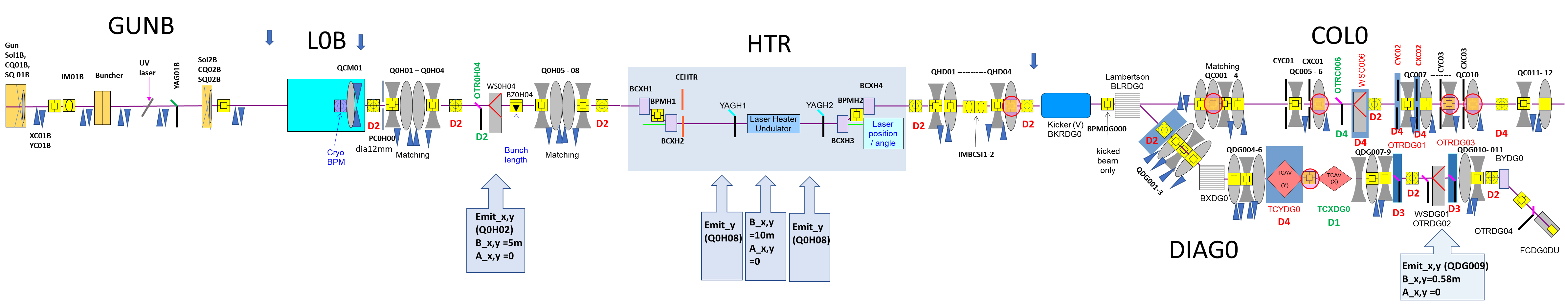
100 MeV Injector Commissioning Completed
Pulsed Magnet
SC linac →
1st Cryomodule providing beam energy to 100 MeV
Injector Diagnostics
Goals of Injector Commissioning:
Establish beam and optimize to design specifications (emittance, charge, transmission)
Conduct beam containment system (BCS) certification
  Calibration of Beam Safety System devices at high repetition rate and bunch charge
  Beam current and beam loss monitors

Slide 26
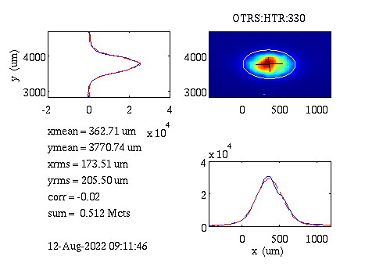
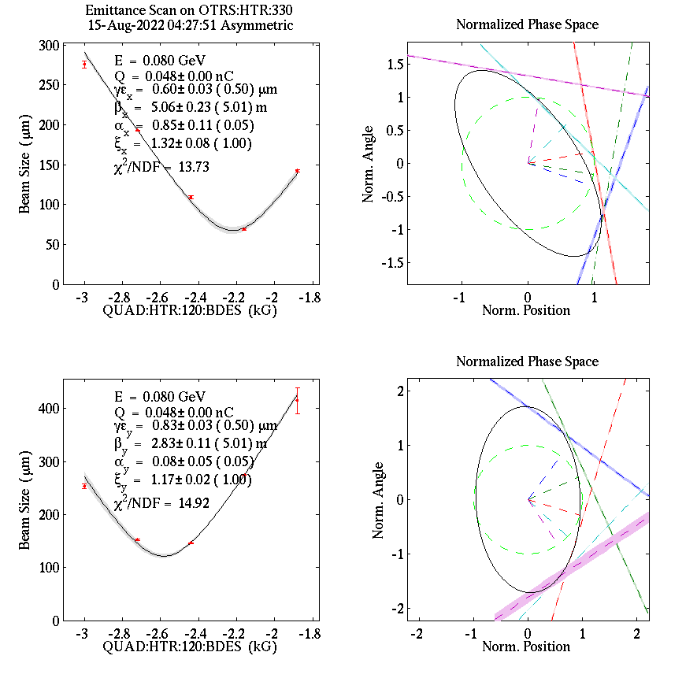
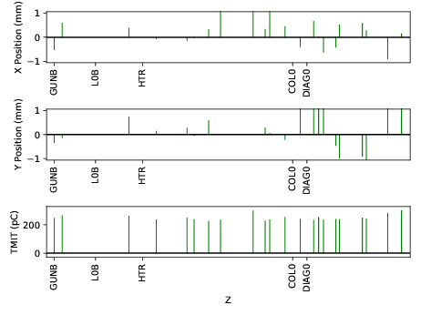
100 MeV Injector Performance
Excellent Injector emittance: 0.6x0.8 µm
100 MeV electron beam image
Injector electron beam orbit
250 pC, 100% transmission

Slide 27
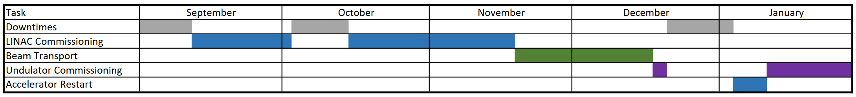
Schedule Outlook
1st Light Milestone is anticipated in January of 2023
Achievement of Threshold KPPs ←
Ready to begin routine delivery of x-rays to the instruments ←

Slide 28
Summary
LCLS-II commissioning is progressing well
Cool down of the superconducting linac went very smoothly and was complete in May 2022
Injector and 100 MeV commissioning has produced a beam of excellent quality
Cryomodule performance has been excellent, showing no degradation to cavity performance from installation at SLAC
The next few months will be very exciting!

Slide 29
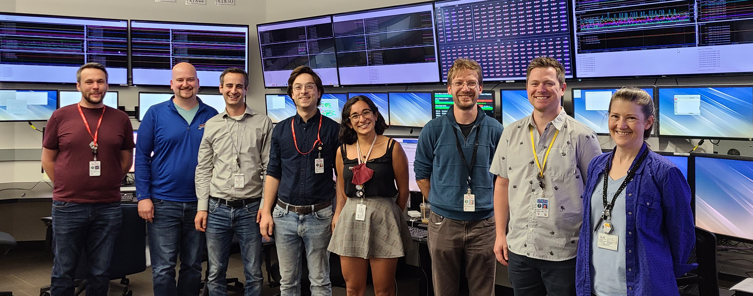
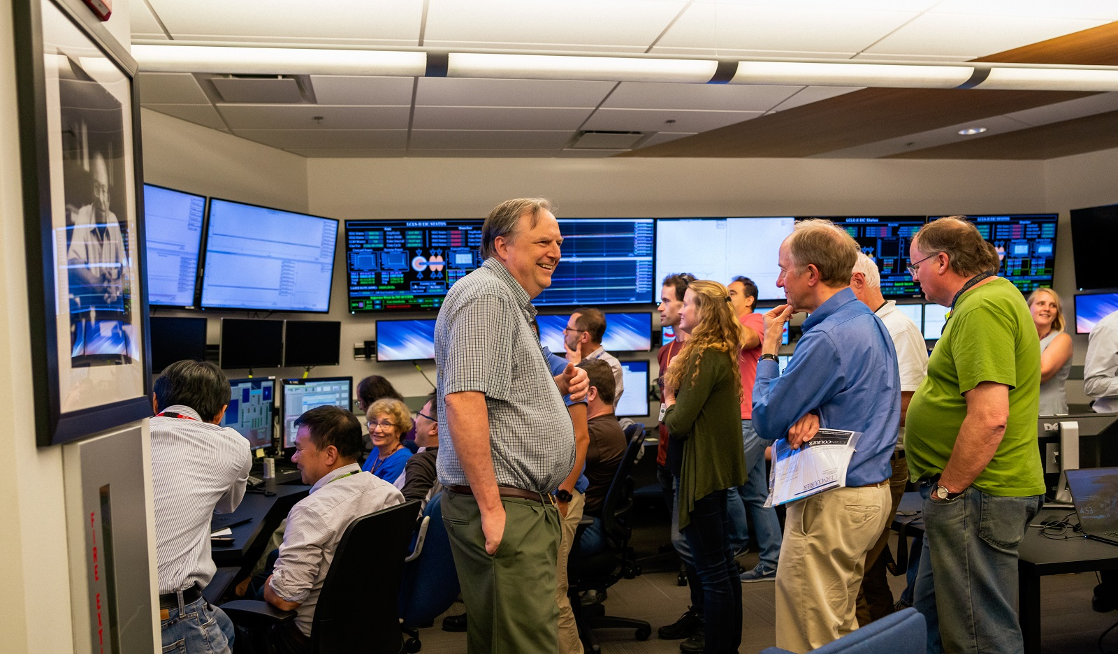


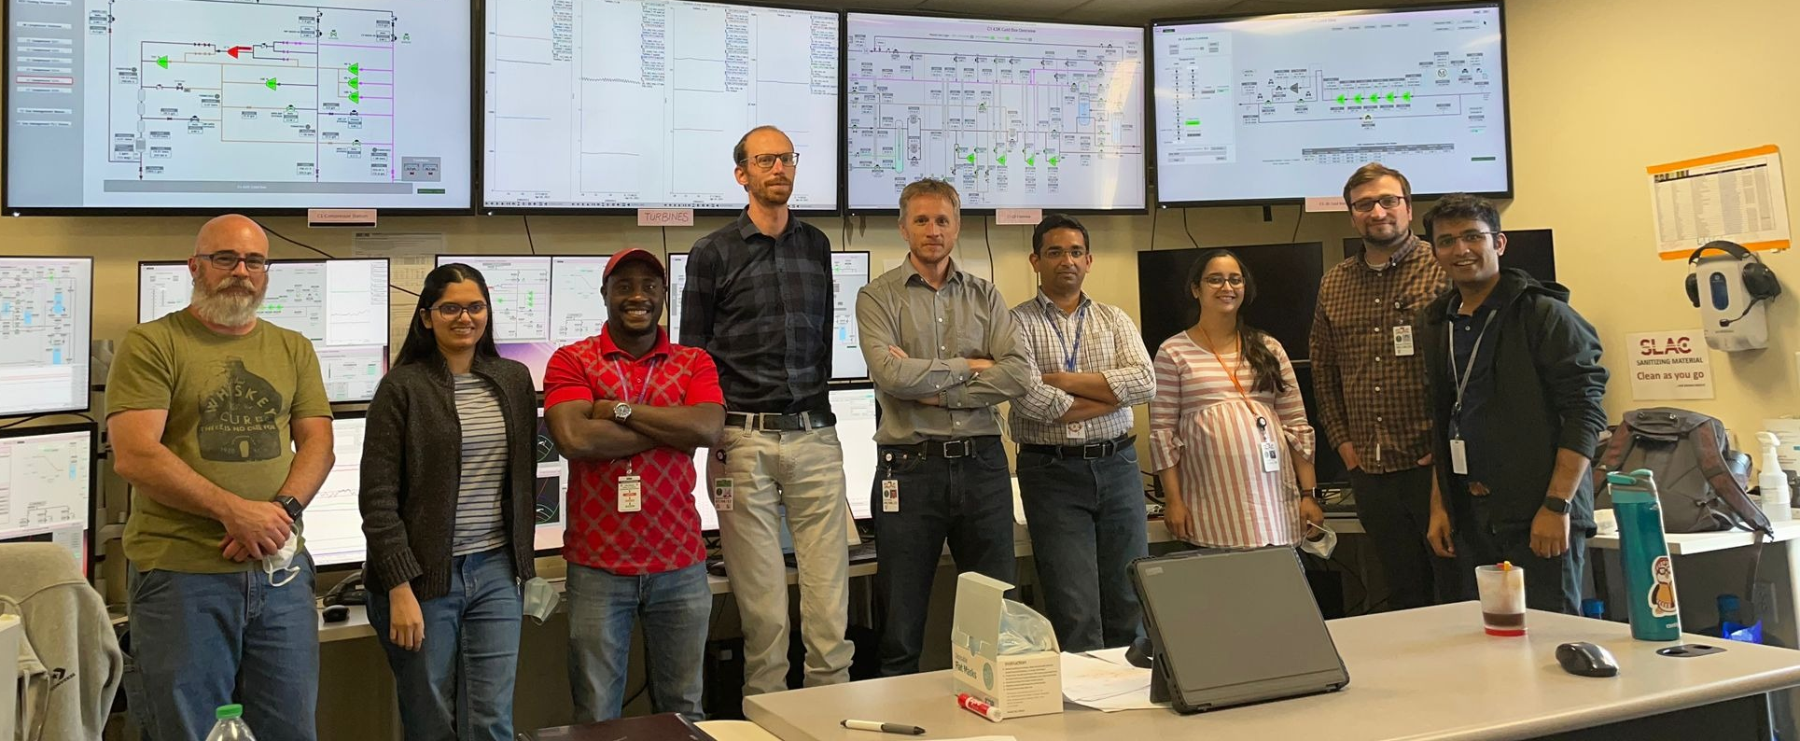



Special thanks to the entire LCLS-II collaboration for all their hard work to make this possible!
Thanks for your attention!

Slide 30
Backup

Slide 31
LCLS-II Technical Systems
Cryoplant #1 and Cryogenic Distribution
Injector Commissioning 100 MeV
SC linac and beam transport to Electron beam dump
Spreader system
SXR undulator beam line
HXR undulator beam line
X-Ray transport beamlines
X-Ray instruments

Slide 32
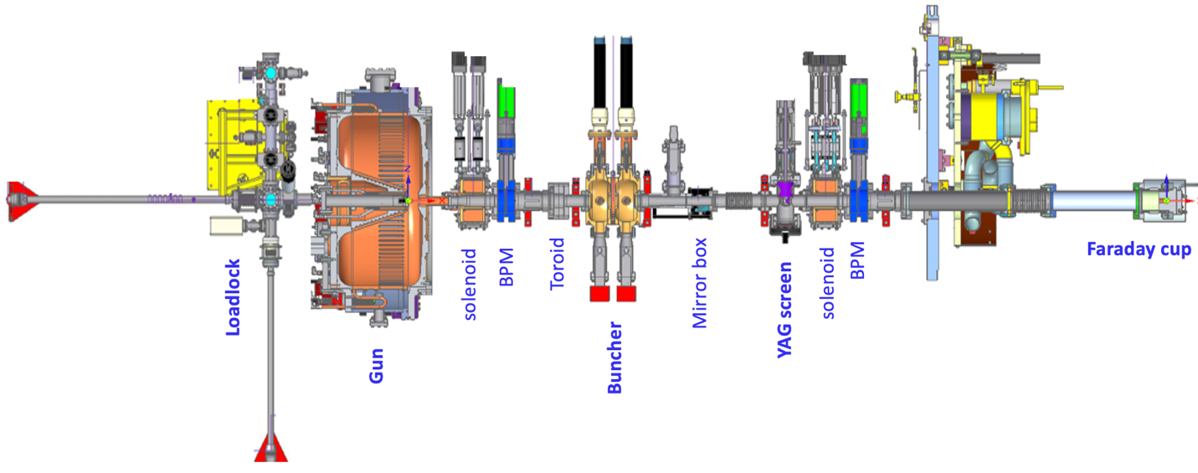
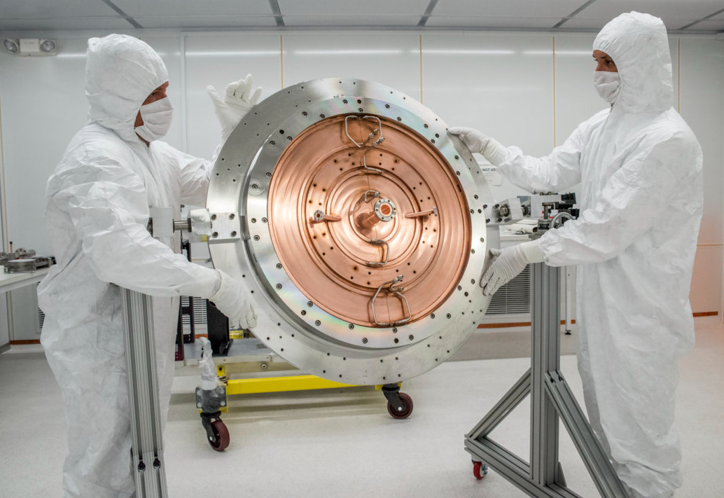
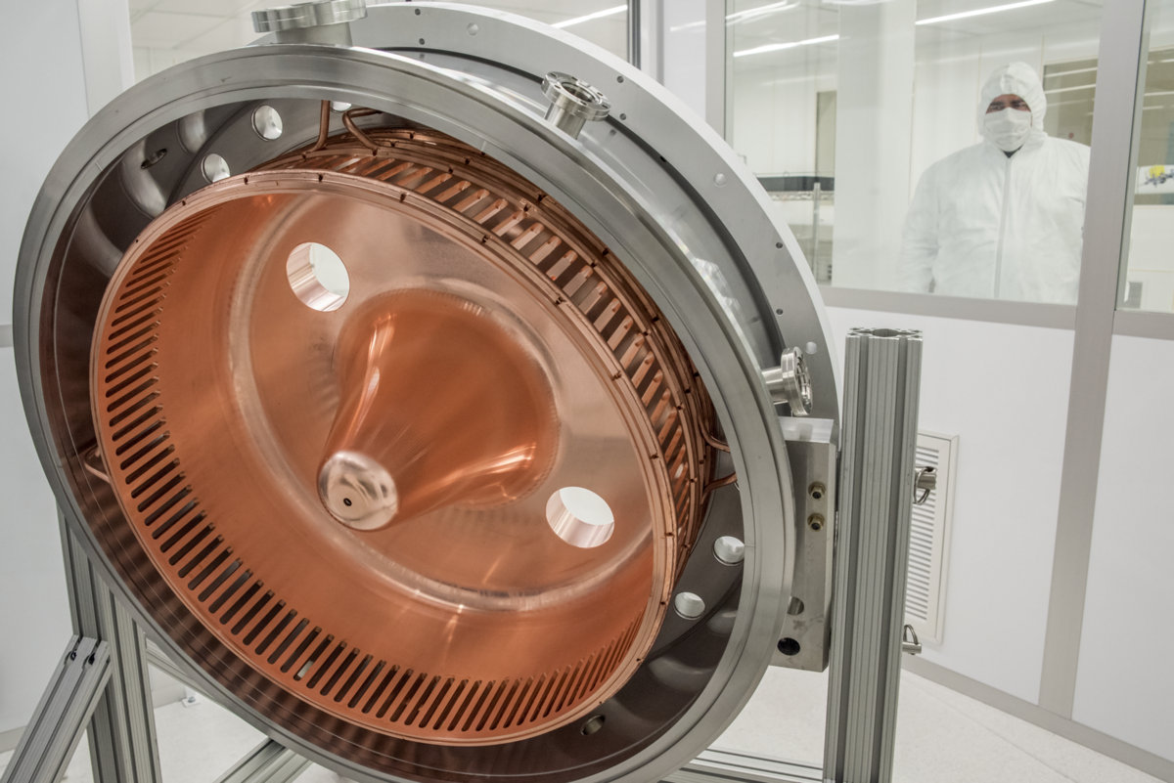
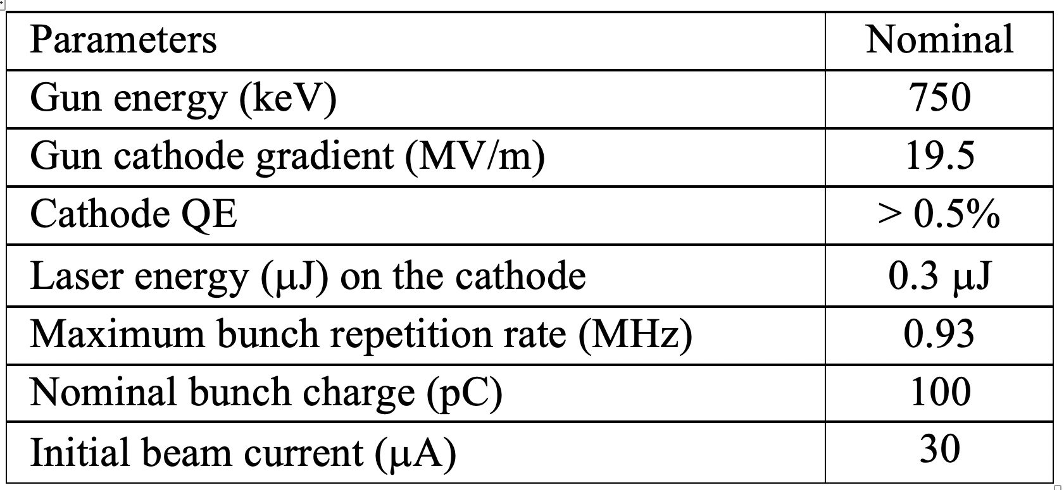
Electron Gun and NC Beam Line Installation
Electron Gun cavity
Completed in 2018, ready for source commissioning
Electron source beamline was built by LBNL (APEX Gun)
Laser system was manufactured by Amplitude:
    Oscillator operates at 46.43MHz
    Modulator selects pulse rate from 0 to 1MHz
    Conversion from IR to UV is 8-20%
Commissioned e-source (2018-2020), including several upgrades (e.g. tuners, additional collimators)

Slide 33
NC Linac Based Commissioning
3

Slide 34
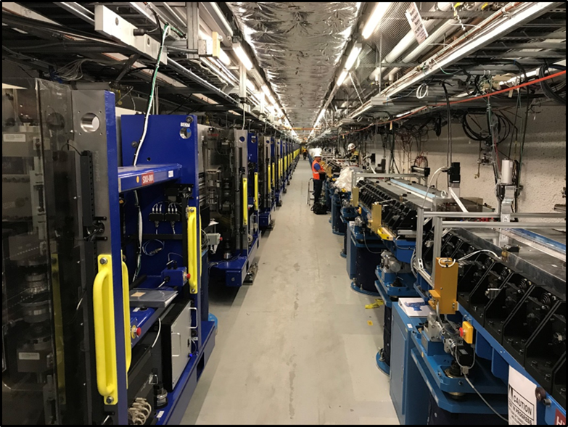
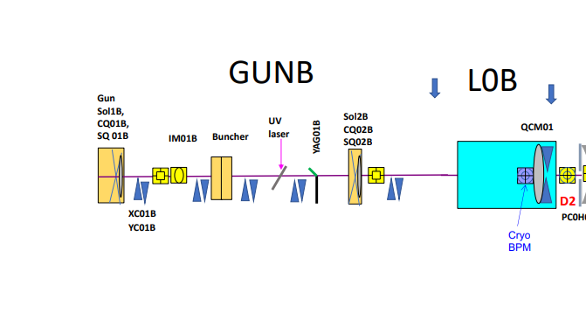
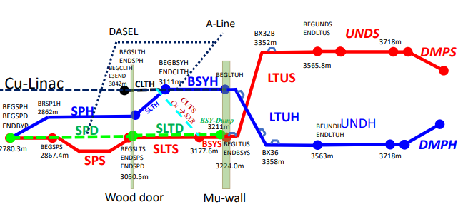
Completed Scope – NC Based Commissioning
750 keV Gun and laser system
fully commissioned
Low energy beamline (LEB)
Loadlock for photocathode
swaps
HXR Undulator
SXR Undulator
HXRSS-II
SXRSS-II (Ops)
Electron Gun
Beam Transport
Undulators
Linac to Undulators (LTUS, LTUH)
CLTS (Ops) beamline allowed early commissioning of SXR systems:
  Beam Transport
  Undulators and Instruments
✓
Cu-Linac operation allowed commissioning of warm beamline systems, undulators, and instruments
Notes:
CLTS: Copper Linac to Soft
LTUS Linc to Undulator(S-Soft, H- Hard)

Slide 35
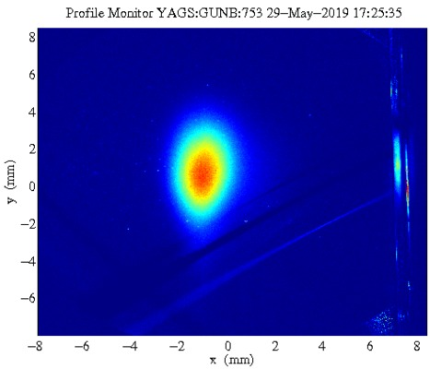
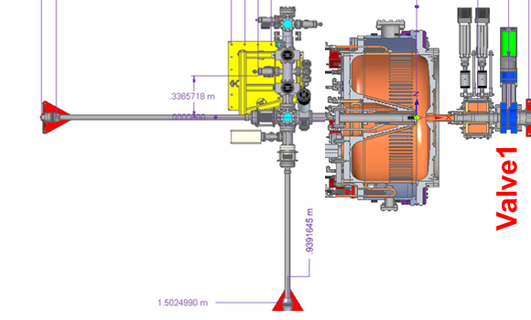
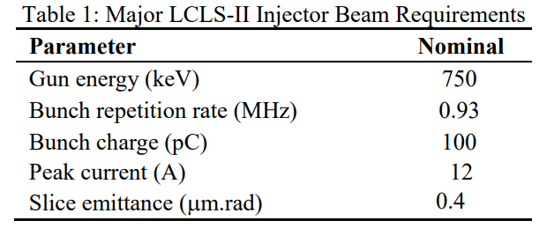
Early Injector Commissioning Completed in 2018
Top View
Cathode Suitcase
Suitcase Gate Valve
Airlock
Airlock Gate Valve
Cathode manipulator
(housing and arm)
BEAM
Trolley manipulator (housing and arm)
Cathode
Gun chamber
Loadlock-to-gun Gate Valve
Cathode Insertion Assembly
F. Zhou et al, “First Commissioning of the LCLS-II CW Injector Source,” presented at IPAC ‘19, Melbourne, Australia, May 2019, TUPTS106

