Slide 1
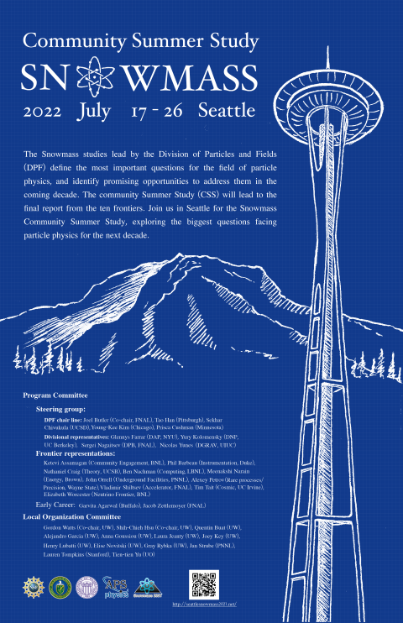
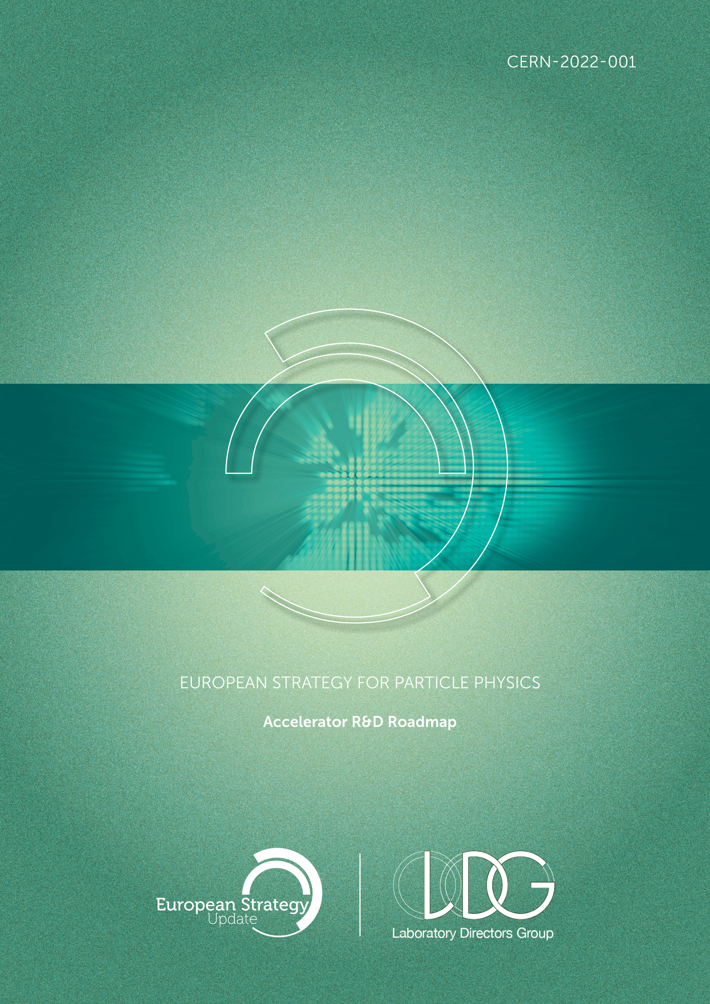


SRF activities discussed within Snowmass and European HEP strategy process
TESLA Technology Meeting, Aomori, Japan
Sergey Belomestnykh and Hans Weise
for the SNOWMASS and for the LDG Team
http://seattlesnowmass2021.net/
https://doi.org/10.23731/CYRM-2022-001.61
Aomori, Oct 11th, 2022

Slide 2
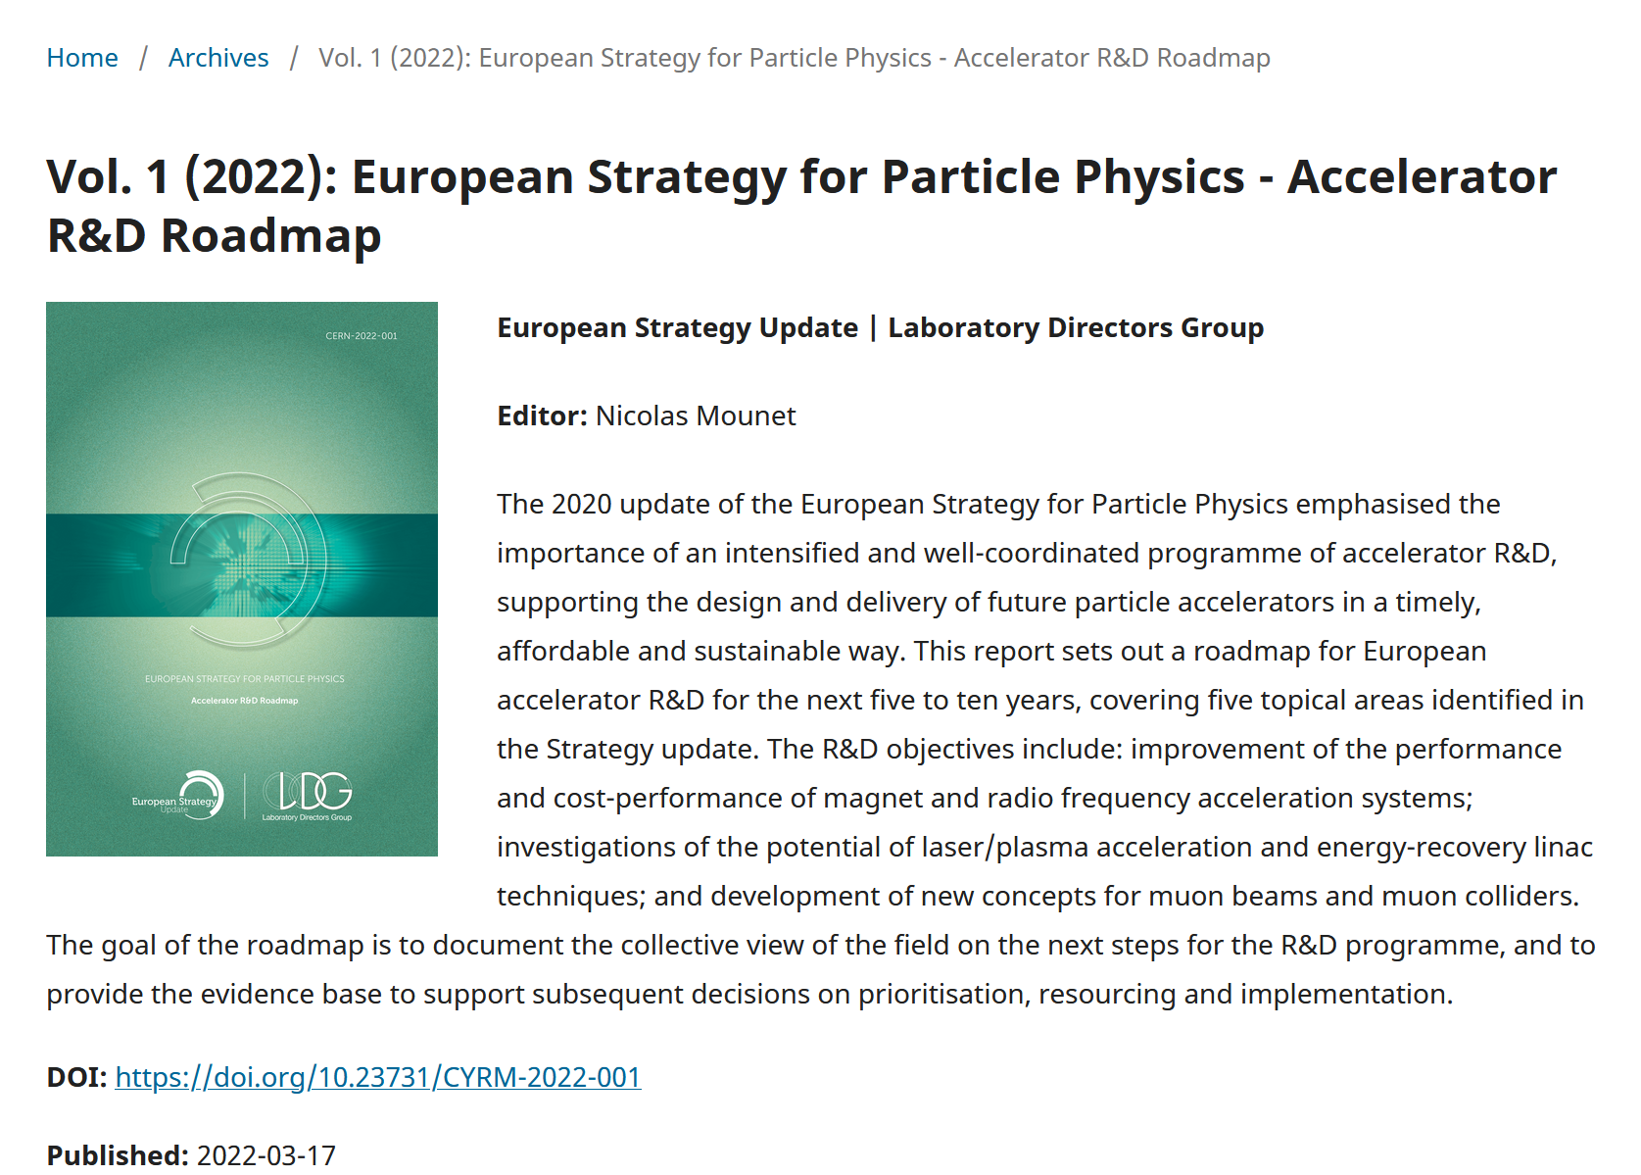
The Strategy Report was published bei CERN in 3/2022.
It is also known as LDG Report with LDG eq. Lab Directors Group.
The SRF related part can be found also via https://doi.org/10.23731/CYRM-2022-001.61
The assembly of Chapter 3: High-gradient RF structures and systems was chaired by S. Bousson and H. Weise.
The author team was S. Bousson, H. Weise, G. Burt, G. Devanz, A. Gallo, F. Gerigk, A. Grudiev, D. Longuevergne, T. Proslier, and R. Ruber

Slide 3
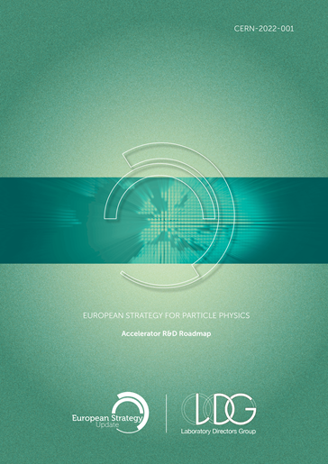
LDG RF Systems - Abstract
Abstract
Radio frequency (RF) systems are the workhorse of most particle accelerators and achieve high levels of performance and reliability. Despite five decades of improvement the community is still advancing RF performance with several novel developments. The next generation of particle accelerators will likely be still based on RF technology, but will require operational parameters in excess of state of the art, requiring an advanced R&D program. The R&D covers superconducting RF (SRF), normal conducting RF (NC RF) and ancillary systems such as RF sources, couplers, tuners and the systems that control them.
we are still advancing cavity RF performance
operational parameters in excess of state of the art
advanced R&D program
superconducting RF (SRF) and normal conducting RF (NC RF)
and ancillary systems such as RF sources, couplers, tuners and the systems that control them

Slide 4
LDG RF Systems – Excerpt from Executive Summary
In SRF the development is focused in two areas, bulk niobium and thin-film (including high-T_{c}) superconductors. In bulk SRF new treatments are allowing niobium cavities to exceed previous record Q factors and avoiding degradation with increasing gradients. This includes nitrogen infusion and doping, and two-step baking processes. There is also an emphasis on limiting field emission. For thin-films the community is investigating creating coated cavities that perform as good as or better than bulk niobium (but with reduced cost and better thermal stability), as well as developing cavities coated with materials that can operate at higher temperatures or sustain higher fields. One method of achieving this is to use multi-layer coatings. Innovative cooling schemes for coated cavities are also being developed. Coupled to the cavity development is improvement in the cost and complexity of power couplers for SRF cavities.
two areas, bulk niobium and thin-film (including high-T_{c})
  exceed previous record Q factors and avoiding degradation with increasing gradients
  includes nitrogen infusion and doping, and two-step baking processes
  create coated cavities that perform as good as or better than bulk niobium (but with reduced cost and better thermal stability
  materials that can operate at higher temperatures or sustain higher fields
  multi-layer coatings
innovative cooling schemes for coated cavities
RF power couplers

Slide 5
SRF challenges and R&D objectives
Bulk niobium and the path towards high quality factors at high gradients
Even though the hard fundamental limit of niobium has been close to being reached for the past 10 years, very specific and alternative surface and heat treatments have been investigated to tune the cavity performance to the very stringent specifications required by new projects and thus improve very specifically the driving parameters (Q₀, E_{max}, fabrication cost and reliability among others). Bulk niobium technology is still expected to be competitive for years to come, compared to the new alternative thin-film superconductors under investigation. Still many technical and technological challenges have to be tackled to allow their industrialization.
Material structure: Fine Grain -> Large Grain or Mid Grain?
Heat treatment at different temperatures, or in the presence of Nitrogen (or others?)
Surface polishing: established Electro-Polishing; new ideas: metallographic polishing (MP) and more recently electrolytic plasma polishing (EPP)
Field emission reduction is a must for all accelerators
  clean room preparation: Improvement in manipulation, pumping/venting procedures and automation, introduction of robots
  diagnostics to support analyzing X- and γ-ray patterns emerging from the cryomodule
  mitigation and recovery: plasma cleaning and dry-ice rinsing are very promising

Slide 6
SRF challenges and R&D objectives
Thin superconducting films for superconducting radiofrequency cavities
SRF cavities are one of the cornerstone infrastructures of particle accelerators… for the past 50 years great advances have been made with bulk niobium technology which is now reaching with a high level of reproducibility∼35 MV/m, Q∼2–5x10¹⁰ at 2 K. Nibbling on the last cavity performance improvements to reproducibly reach the intrinsic limits of niobium will become increasingly difficult and exponentially expensive. In order to overcome this roadblock, a technological leap is needed to produce next generation SRF cavities with cost-effective means and reliable production methods scalable to mass industrialization.
Reduced amount of superconducting materials: Recent remarkable results obtained at CERN with Nb/Cu
Increased operation temperature
  Higher T_{c} materials such as A15 compounds(Nb₃Sn, Nb₃Al, V₃Si) and MgB₂
  results obtained at Cornell and Fermilab with Nb3Sn synthesized on bulk niobium
  the major challenge is now to reproduce these results on Cu substrates and cavities
Increased maximum operation gradient (E_{max})
  new multilayer hetero-structures with higher critical fields than niobium have been proposed
  complementary deposition techniques and efforts must be pursued in Europe
    Vapor phase – CVD, atomic layer deposition (ALD) and physical vapor deposition (PVD), plasma-assisted deposition (HIP-IMS, custom DC/AC sputtering) and electro deposition are promising methods

Slide 7
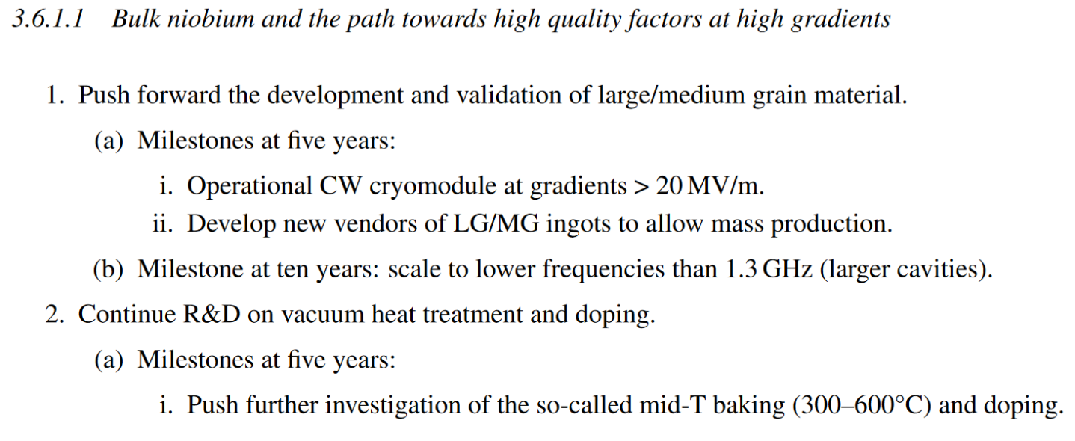
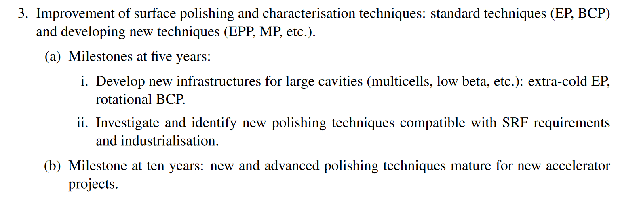
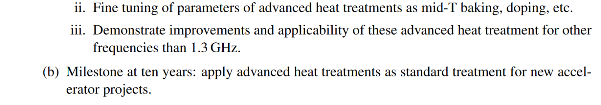
SRF R&D plan
A nominal plan, roughly based on the actual effort of European labs in generic R&D
The proposed plan is addressing a generic R&D program for RF acceleration. The corresponding estimated cost is the required budget to develop technologies and solutions that could be later adapted to targeted HEP projects which could benefit from the scientific and technological outcomes. The required budget for the specific adaptation or optimization for a given facility is not accounted for here, as we consider it as direct project funding. The generic R&D budget is to support development of new concepts, new ideas and to prove their feasibility…

Slide 8
SRF R&D plan
Further milestones are given for a large number of R&D goals
Develop robotization/cobotisation (human-robot collaboration) for surface processing/cleaning of SRF components
Pursue R&D effort on particle counting in clean room and X-rays diagnostics capabilities
Intensify R&D on field emission mitigation/in-situ recovery techniques (dry-ice, plasma)
Continue R&D niobium on copper – construction cost saving and securing supply
Intensify R&D of new superconductors on Cu – 4.2 K operational cost saving
Pursue multilayers – push for high gradient
Intensify Cu cavity production and surface preparation
Develop 3D printing and innovative cooling techniques.
Infrastructures and manpower – high-throughput testing
5 year cost estimate (see the several disclaimers given in the report!!!)
bulk Nb | 4M CHF | 75 FTEy
FE related R&D | 4M CHF | 40 FTEy
thin film | 15M CHF | 100 FTEy
Key technologies | 5M CHF | 15 FTEy
RF couplers | 4M CHF | 16 FTEy
For each topic five-year as well as ten-year milestones can be found in the LDG report chapter 3.6.1.

Slide 9

Snowmass
Introduction
The Particle Physics Community Planning Exercise (a.k.a. “Snowmass”) is organized by the Division of Particles and Fields (DPF) of the American Physical Society
Snowmass is a scientific study. It provides an opportunity for the entire particle physics community to come together to identify and document a scientific vision for the future of particle physics in the U.S. and its international partners
Snowmass goal is to define the most important questions for the field of particle physics and identify promising opportunities to address them
The P5, Particle Physics Project Prioritization Panel, will take the scientific input from Snowmass and develop a strategic plan for U.S. particle physics that can be executed over a 10-year timescale, in the context of a 20-year global vision for the field
The previous Snowmass was in 2013 and P5 in 2014
Snowmass 2021 (https://snowmass21.org/start) was delayed by one year by COVID-19 but retained its 2021 designation

Slide 10
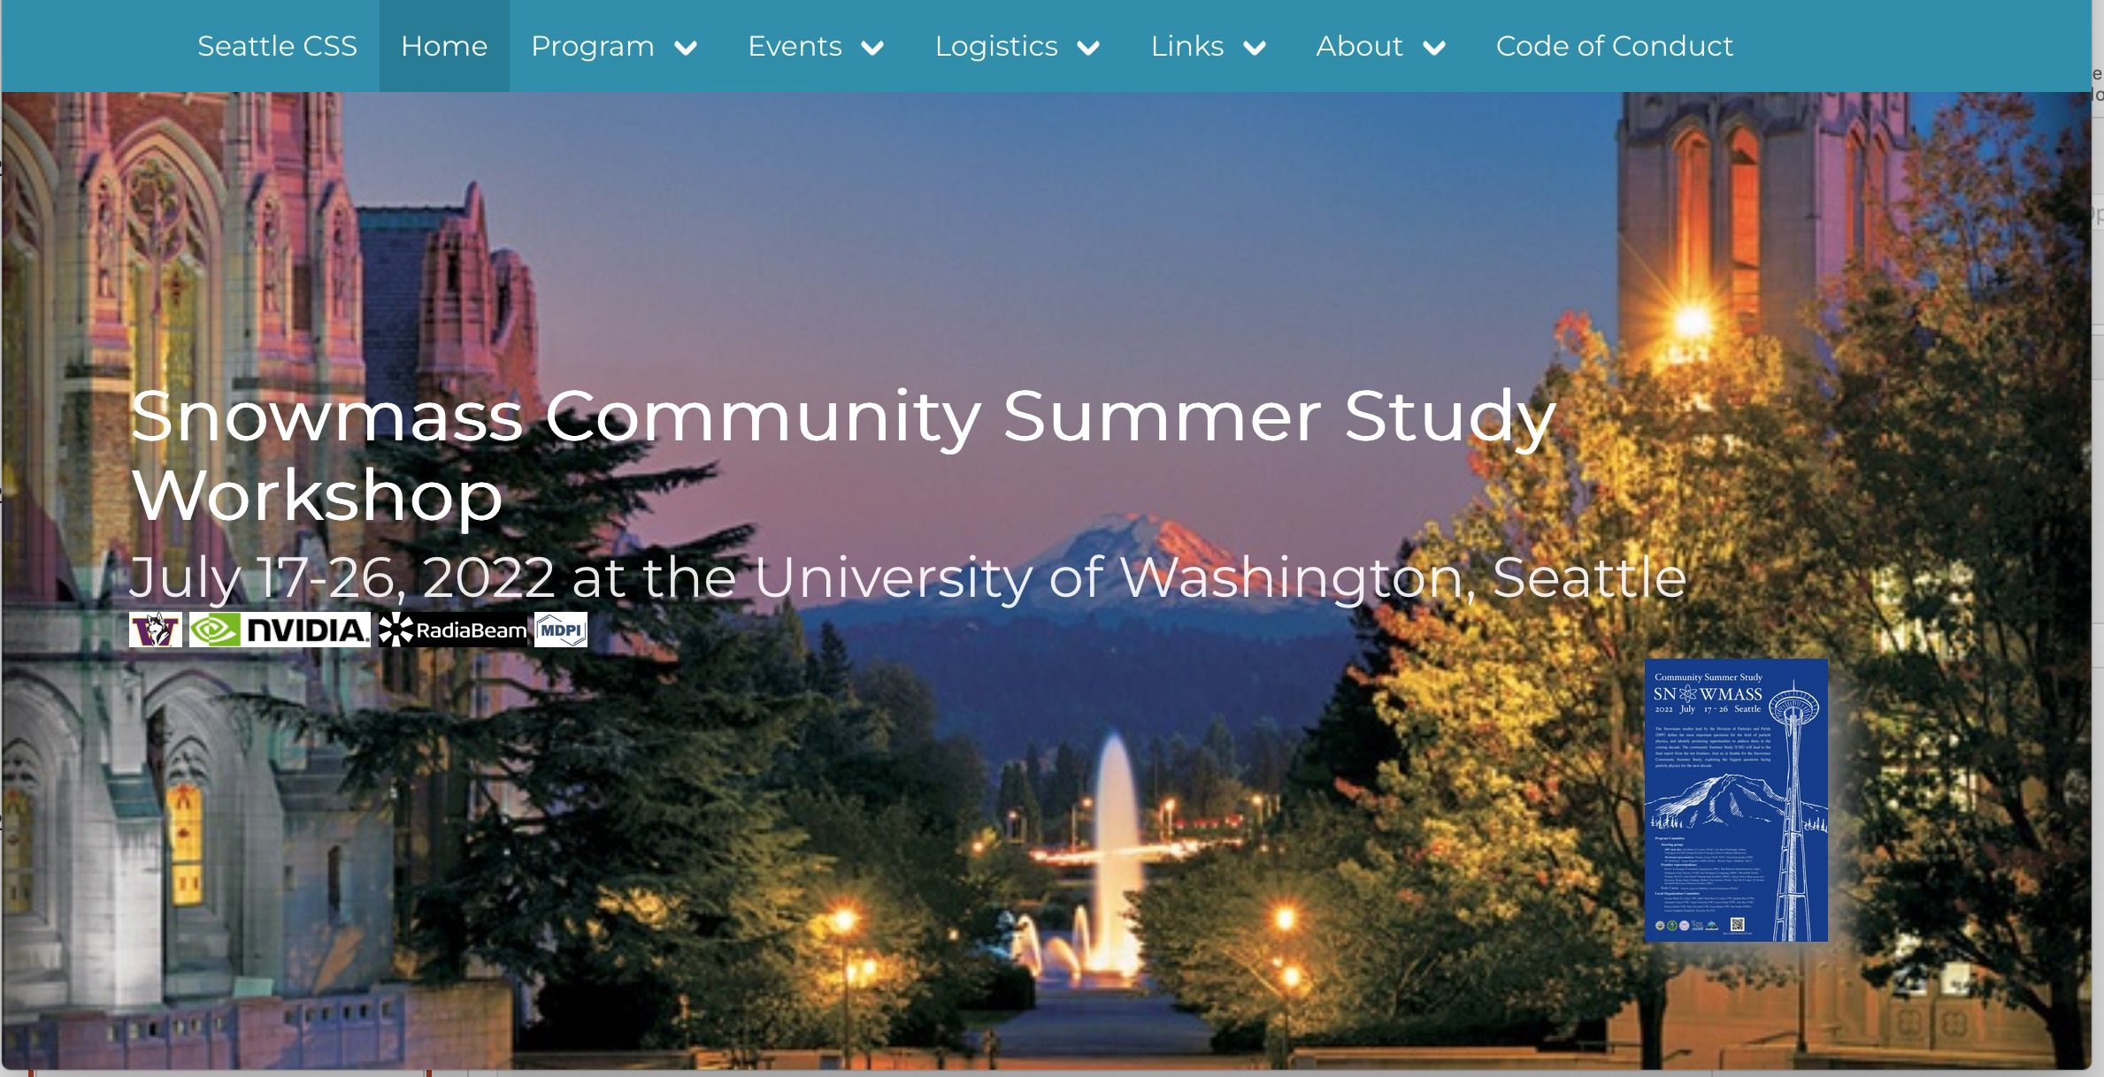
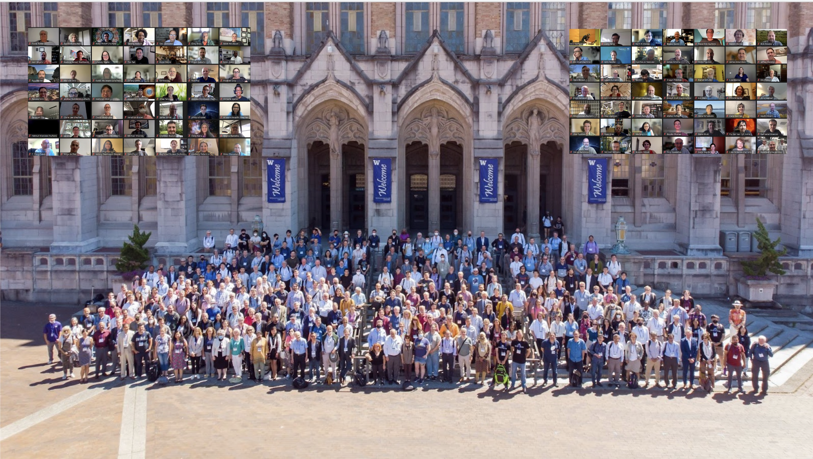
Snowmass 2021
Introduction
Snowmass 2021 was divided into 10 Frontiers, e.g., Energy Frontier, Neutrino Physics Frontier, Rare Processes, etc.
The community was encouraged to submit Letters Of Interest (LOIs) and then White Papers based on those LOIs
The Exercise culminated in the Community Summer Study (CSS) and Workshop in Seattle (July 17-26, 2022), https://seattlesnowmass2021.net/
Due to COVID, it was a hybrid meeting with 1397 total number of participants (743 in person)

Slide 11
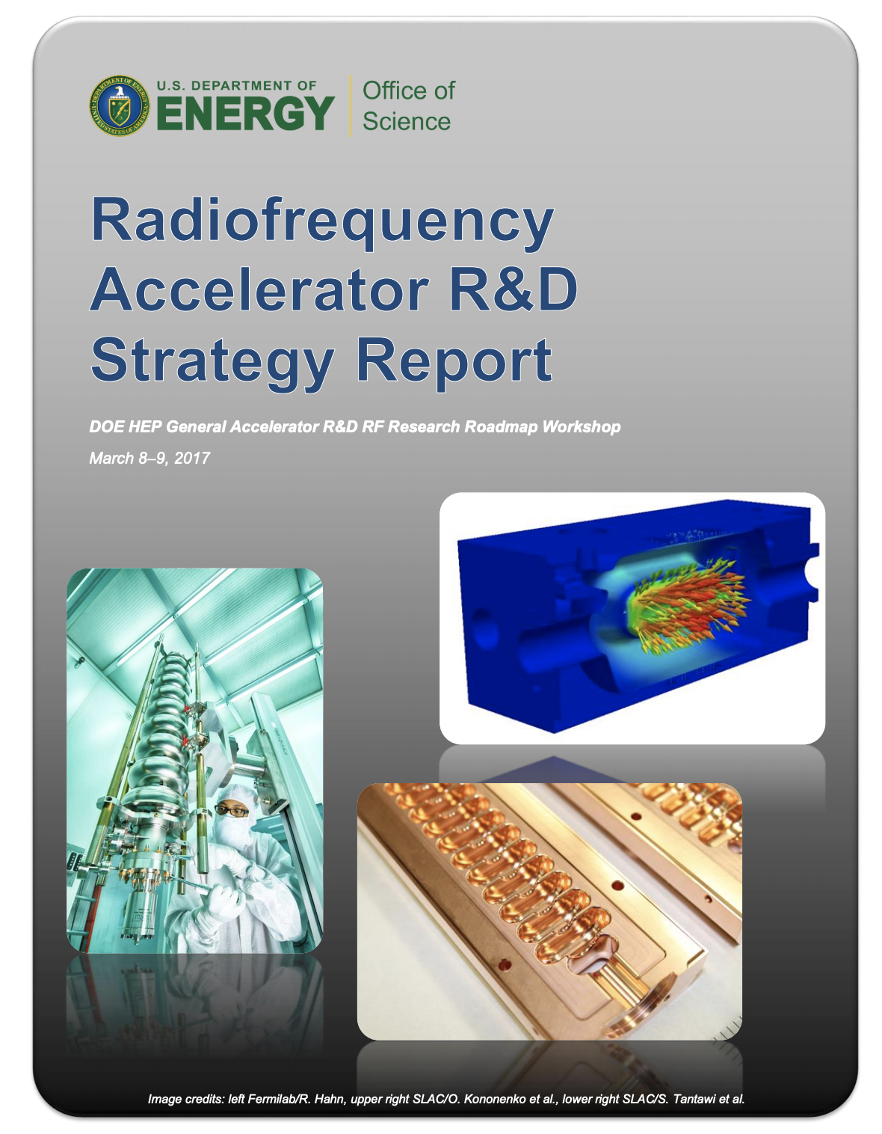
Snowmass AF7-rf
RF Technology Topical Group
The Snowmass Accelerator Frontier (AF) consisted of several topical groups including AF7-rf, which covered RF Systems and Sources, Innovative Design and Modeling, and Cavity Performance Frontier
The AF7-rf co-conveners were Emilio Nanni (SLAC), Hans Weise (DESY), and Sergey Belomestnykh (FNAL)
SRF technology was discussed under the Cavity Performance Frontier topic
To facilitate the process, AF7-rf held miniWorkshops and seminars
AF7-rf discussion were structured around DOE RF Accelerator Roadmap (developed in 2017)
In addition, we explored new or overlooked topics and concepts
All White Papers were submitted to arXiv as part of Snowmass Proceedings (to be finalized soon)

Slide 12
SRF-related White Papers
SRF Cavity Performance (Gradient and Q), Studies of New Superconductors, Other Topics
Overview papers
Key Directions for Research and Development of Superconducting Radiofrequency (SRF) Cavities http://arxiv.org/abs/2204.01178
Challenges and opportunities of SRF theory for next generation particle accelerators https://arxiv.org/abs/2203.08315
Next-Generation Superconducting RF Technology based on Advanced Thin Film Technologies and Innovative Materials for Accelerator Enhanced Performance & Energy Reach https://arxiv.org/abs/2204.02536
Specific topics
Medium-Grain Niobium SRF Cavity Production Technology for Science Frontiers and Accelerator Applications https://arxiv.org/abs/2203.07371
Nb₃Sn Superconducting Radiofrequency Cavities: a Maturing Technology for Particle Accelerators and Detectors https://arxiv.org/abs/2203.06752
An Impartial Perspective for Superconducting Nb₃Sn coated Copper RF Cavities for Future Linear Accelerators https://arxiv.org/abs/2203.09718
Plasma Processing for In-Situ Field Emission Mitigation of Superconducting Radiofrequency (SRF) Cryomodules https://arxiv.org/abs/2203.12442

Slide 13
SRF-related White Papers
White Papers for Proposed Facilities with Strong Need for High-gradient / High-Q SRF Technology
Colliders
The International Linear Collider: Report to Snowmass 2021 https://arxiv.org/abs/2203.07622
Higgs-Energy LEptoN (HELEN) Collider based on advanced superconducting radio frequency technology https://arxiv.org/abs/2203.08211
The ReLiC – Recycling Linear e+e- Collider https://arxiv.org/abs/2203.06476
The Future Circular Collider: a Summary for the US 2021 Snowmass Process https://arxiv.org/abs/2203.06520
Snowmass2021 White Paper AF3-CEPC https://arxiv.org/abs/2203.09451
CERC – Circular e+e- Collider using Energy-Recovery Linac https://arxiv.org/abs/2203.07358
A Muon Collider Facility for Physics Discovery https://arxiv.org/abs/2203.08033
Neutrino experiments
An 8 GeV Linac as the Booster Replacement in the Fermilab Power Upgrade: a Snowmass 2021 White Paper https://arxiv.org/abs/2203.05052
Dark matter searches
Searches for new particles, dark matter, and gravitational waves with SRF cavities https://arxiv.org/abs/2204.01178

Slide 14
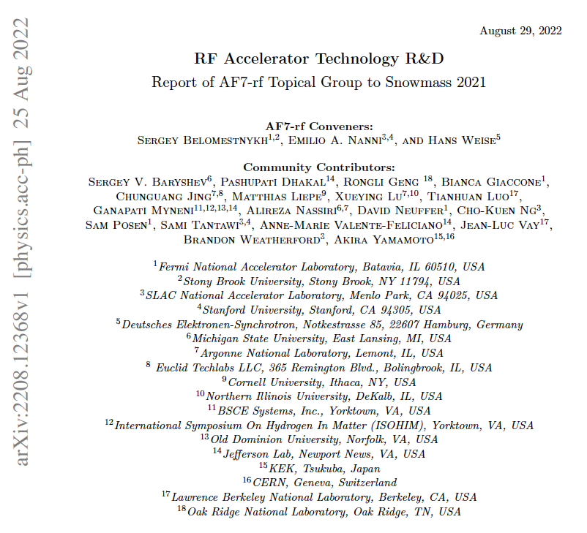
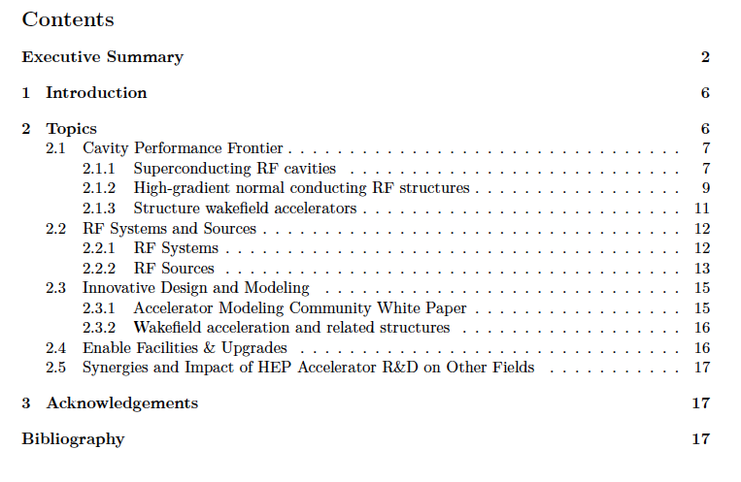
AF7-rf Topical Group Report
The AF7-rf discussions and submitted White Papers and LOIs are summarized in the topical group report, which was discussed at the Snowmass Community Summer Study Workshop in Seattle and then published in arXiv: https://arxiv.org/abs/2208.12368

Slide 15
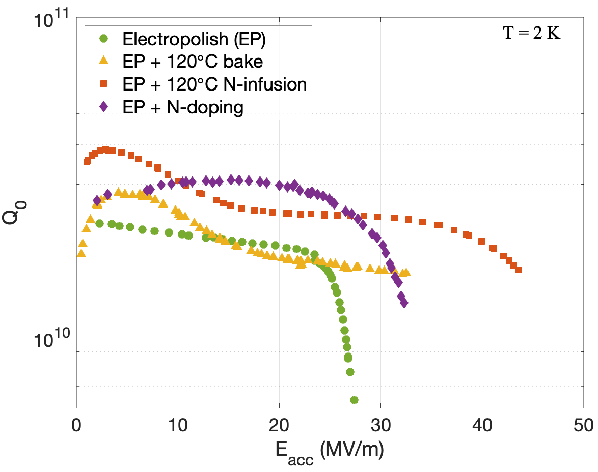
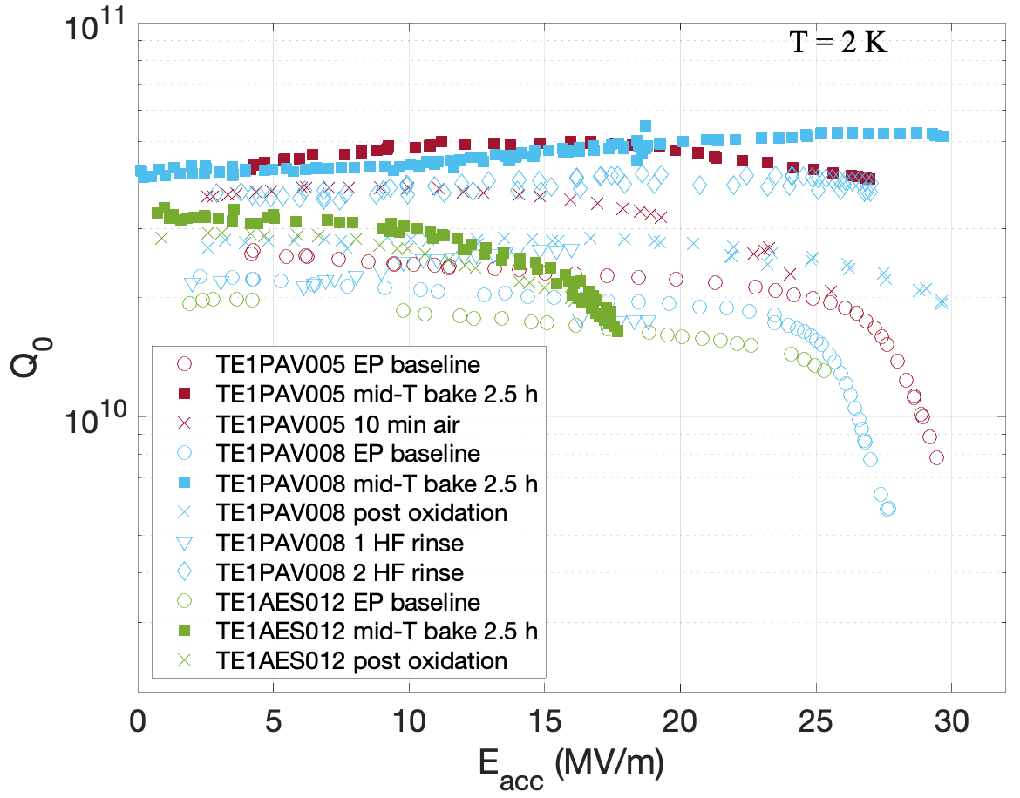
Key Directions for SRF R&D (1)
From AF7-rf Topical Group Report, White Papers, and Presenttaions
The key directions for SRF technology R&D are outlined in the AF7-rf Topical Group Report to be pursued during the next decade. In the next slides we list these directions and show some examples.
Studies to push performance of niobium and improve our understanding of SRF losses and ultimate quench fields via experimental and theoretical investigations
Developing methods for nano-engineering the niobium surface layer and tailoring SRF cavity performance to a specific application, e.g., a linear collider, a circular collider, or a high-intensity proton linac
Examples of new cavity treatment methods:
Nitrogen doping and infusion
Mid-T baking
2-step low-temperature baking

Slide 16
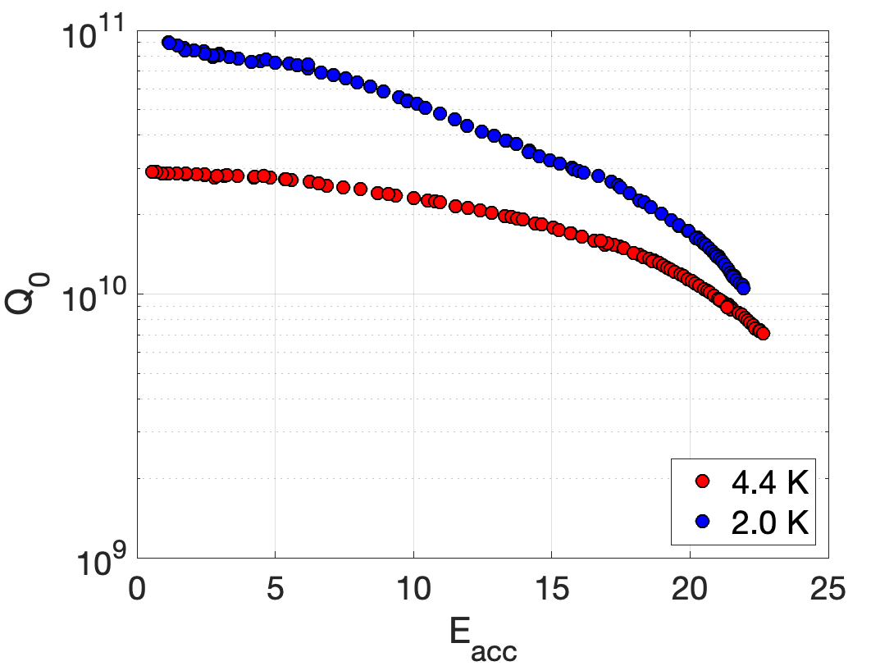
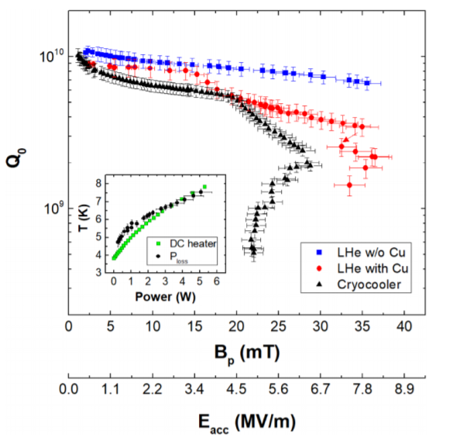


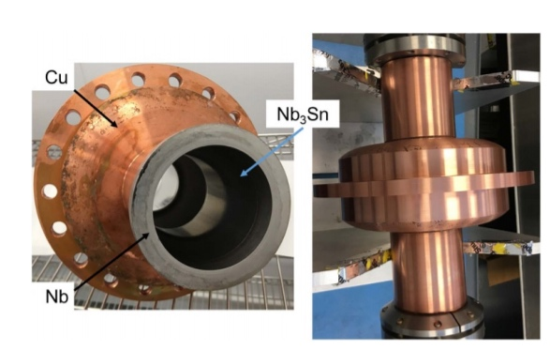
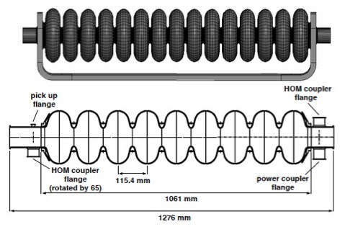
Key Directions for SRF R&D (2)
From AF7-rf Topical Group Report, White Papers, and Presentations
Investigations of new SRF materials beyond niobium via advanced deposition techniques and bringing these materials to practical applications
Developing advanced SRF cavity geometries to push accelerating gradients of bulk niobium cavities to ∼70 MV/m for either upgrade of the ILC or compact SRF linear collider
Examples:
Record performing Nb₃Sn cavity
Multi-metallic conduction cooled Nb₃Sn cavity
Advanced SRF cavity geometries
LL geometry
TESLA cell
Traveling wave cavity

Slide 17
Key Directions for SRF R&D (3)
From AF7-rf Topical Group Report, White Papers, and Presentations
Research on application of SRF technology to dark sector searches
Pursuing R&D on companion RF technologies to mitigate field emission, provide precise resonance control, enable robust low level RF systems for high gradient and high Q accelerators, develop high efficiency, low-cost RF sources, etc.
Example:
Plasma processing for in-situ field emission mitigation

Slide 18
Summary
The U.S. DOE Radiofrequency Accelerator R&D Roadmap and the European Accelerator R&D Roadmap cover similar SRF technology topics
The Snowmass discussions, White Papers, and reports confirmed that the DOE Roadmap remains valid, highlighted recent progress, and outlined the key directions for the SRF technology
There are many opportunities for collaboration between the European and U.S. institutions on many topics discussed during the European HEP Strategy Process and Snowmass
Some key direction are among WG topics of this TTC Meeting

