Slide 1
Summary of ERL2022 workshop on SRF activities
Hiroshi Sakai (KEK)
On behalf of WG4 convenors of ERL2022
Nilanjan Banerjee (University of Chicago)
Matthias Liepe (Cornell University)
Peter McIntosh (STFC)
See details
https://indico.classe.cornell.edu/event/2018/overview
or
https://www.classe.cornell.edu/NewsAndEvents/ERL2022/
25 min. + 5 min.
Acknowledgements : For all contributors of ERL2022 workshop
TTC meeting @ Aomori (2022.Oct.11-14)

Slide 2
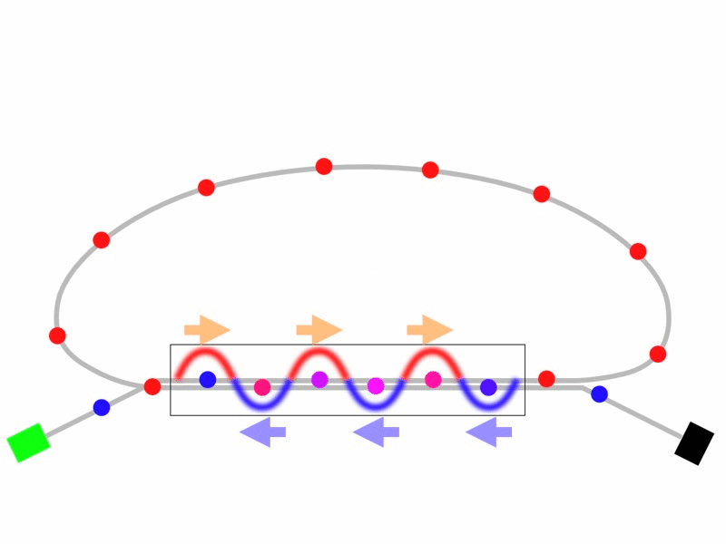
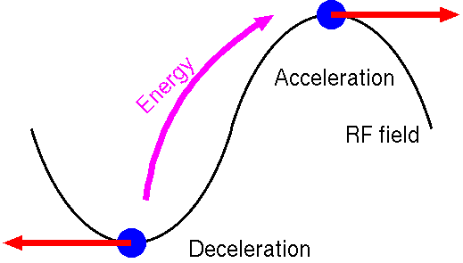
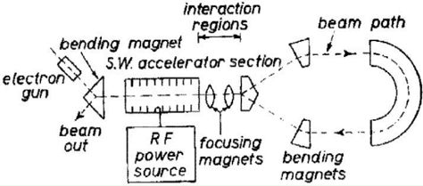
What is ERL (Energy Recovery Linac)
Colliding beam
High energy
High current beam
FEL
1965 M. Tigner
“A possible apparatus for electron clashing-beam experiments”
Electron Ion beam
Cooling (EIC)
λ/2
In cavity
Final low energy
Electron gun
Beam dump
Figure of Merit of ERL
Linac beam with high current beam
Low emittance beam (High quality beam)
Short bunch (< 100 fs) with high current beam (> 10 mA)
It is difficult to fulfill these conditions by using storage ring
→ high current FEL and future HEP and beam cooling .
Key technologies for ERL
High brightness electron gun
Superconducting RF (SRF) cavity
Beam handling of energy recovery beam with high current
Beam power was saved by energy recovery
→ ERL is a sustainable technology to reduce a operational power
To be discussed in ERL workshop

Slide 3
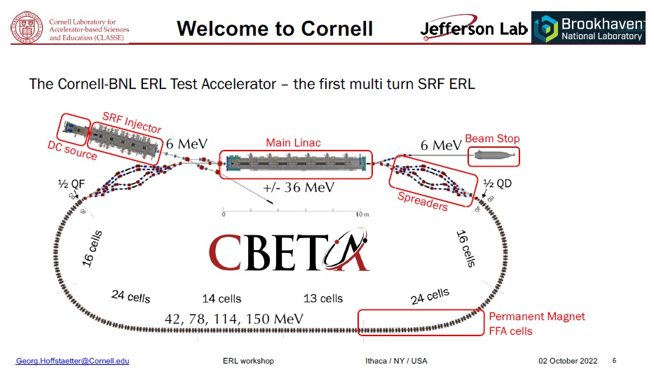
ERL workshop history & ERL2022
ERL’22 - Cornell University Ithaca, NY USA
ERL'19 - Helmholtz-Zentrum Berlin Germany
ERL'17 - CERN, Geneva, Switzerland
ERL'15 - Brookhaven National Lab, New York, USA
ERL' 13 - Novosibirsk, Russia
ERL'11 - KEK, High Energy Accelerator Research Organization, Tsukuba, Ibaraki, Japan
ERL'09 - Cornell University Ithaca, NY USA
ERL'07 - Daresbury, UK
ERL'05 - Jefferson Lab Newport News, VA, USA
For EIC
From :Georg Hoffstaetter, Dejan Trbojevic, Steve Benson

Slide 4
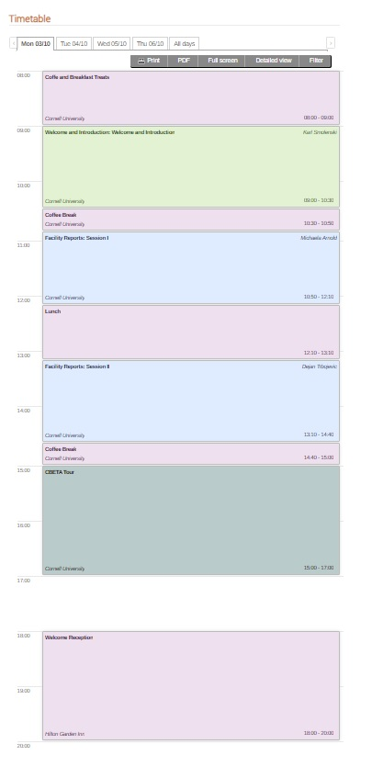
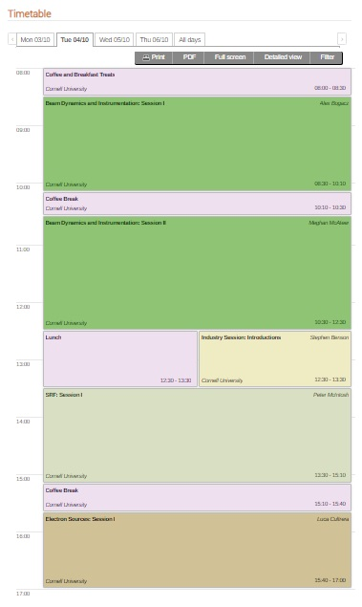
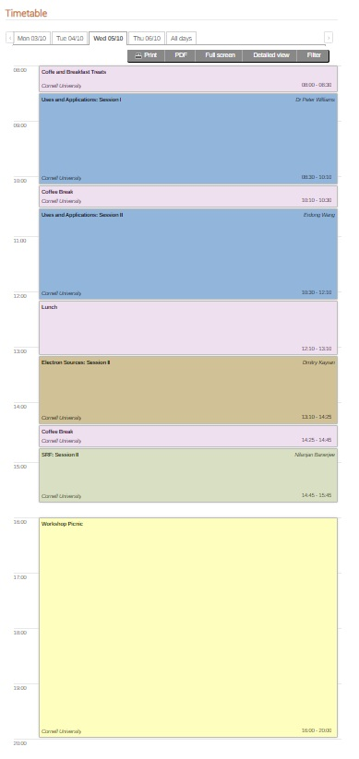
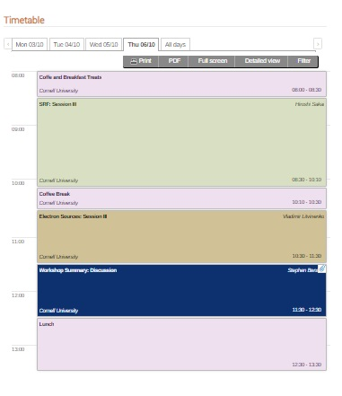
Agenda of ERL2022
10/3 (Mon.)
10/4 (Tue.)
10/5 (Wed.)
10/6 (Thu.)
8:00
Beam Dynamics & Instruments
(WG2)
SRF (WG4)
Welcome
Uses & Application (WG5)
The European ERL Roadmap
(Andrew Hutton)
Facility Report (WG1)
Beam Dynamics & Instruments
(WG2)
Uses & Application (WG5)
Electron sources (WG3)
WG summaries
Closing
Facility Report (WG1)
Electron sources (WG3)
SRF (WG4)
SRF (WG4)
5 Working Groups (WG)
WG1 : Facility Report
WG2 : Beam Dynamics & Instrumentation
WG3: Electron sources
WG4: SRF
WG5: Uses & Application
CBETA tour
Electron sources (WG3)
17:00
Picnic
Reception

Slide 5
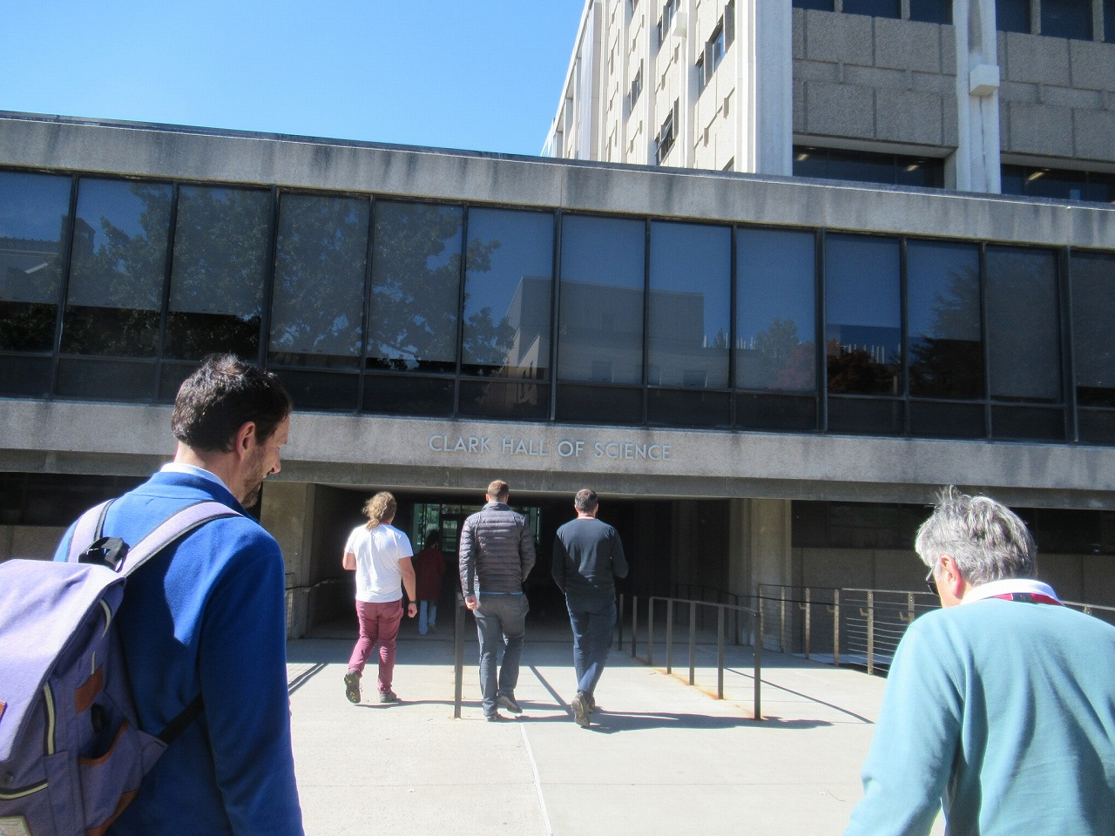
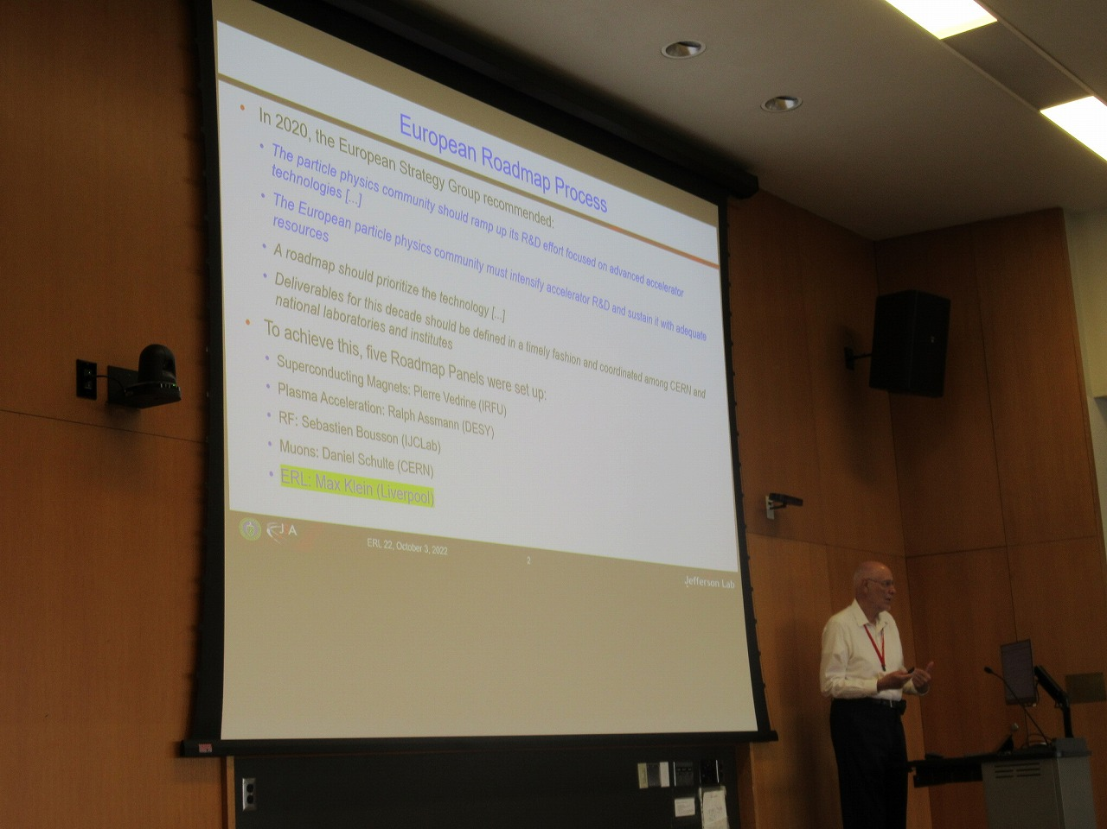
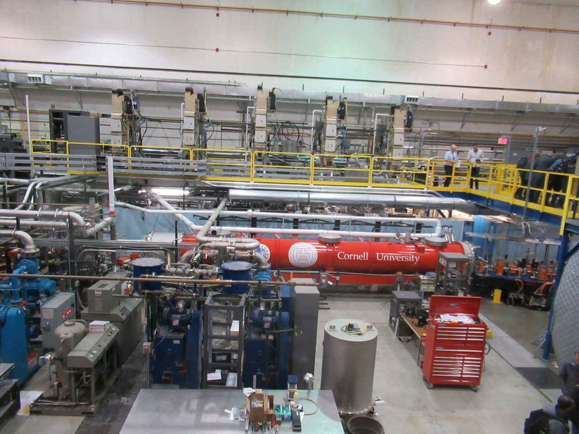
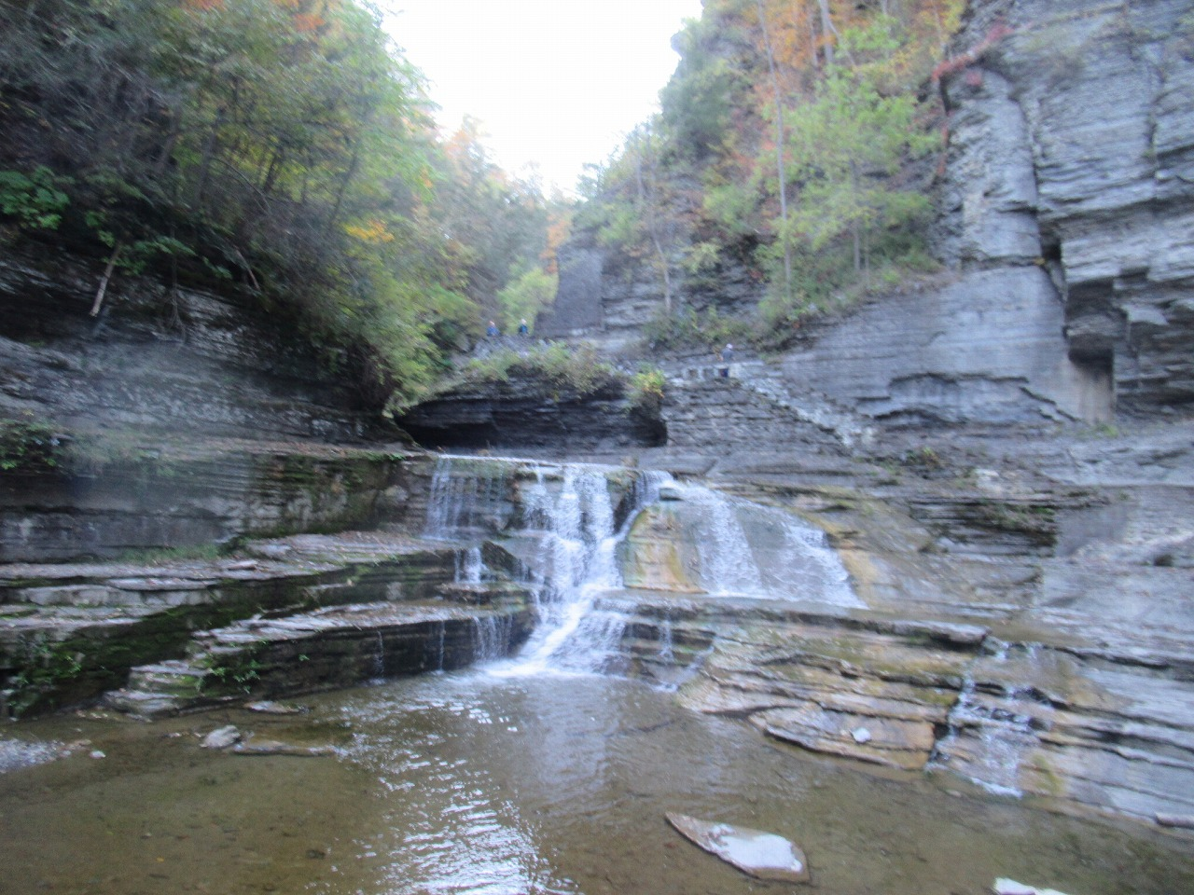
Pictures & statistics
52 Oral presentations
In person event:
47 presented live, 5 remotely
(three last minute changes due to illnesses)
Continuous poster session:
18 poster
10 facilities posters,
8 contributed posters
CEBTA tour was done.

Slide 6
ERL Roadmap (Andrew Hutton)
See also talk by Andrew Hutton (Mon, 9:50) in ERL2022
Achieved line by ERL
(1-pass)
ERL application were proposed for High Energy and Nuclear Physics
  High current low emittance beam for High energy physics use of ERL machine
  Cooling of Electron Ion collider by ERL
  Dark matter search and nuclear physics by high intensity ERL machine
The unique performance gives us several important (industrial) applications as follows.
  Laser Compton Scattering (LCS) ( high resolution x-ray to gamma-ray)
  Free electron laser (FEL) (IR-FEL to EUV-FEL (lithography) and X-FEL)
arXiv:2207.02095 [physics.acc-ph]
European ERL Roadmap
Via ERL symposium held on Jun.2021
https://indico.cern.ch/event/1040671/

Slide 7
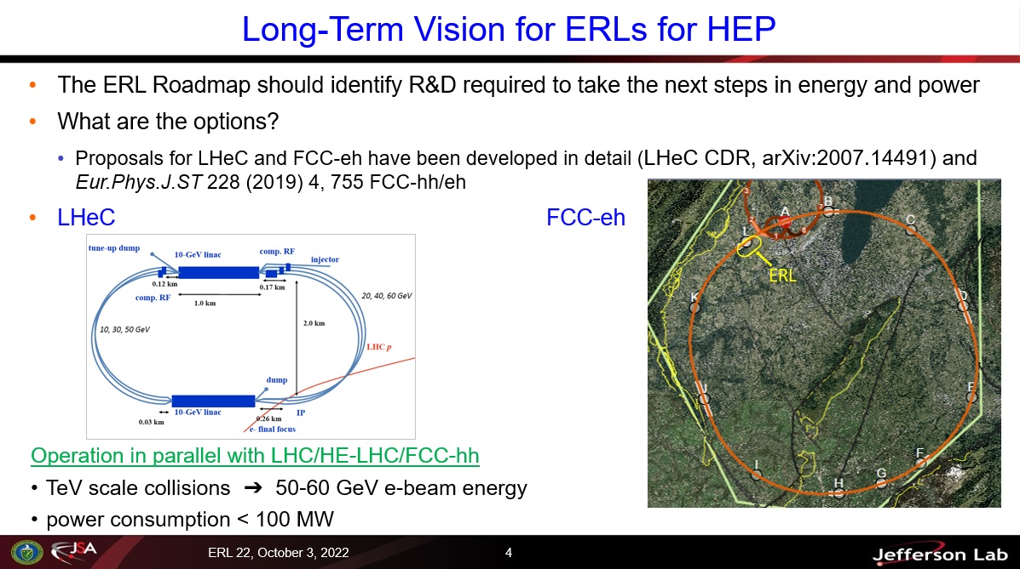
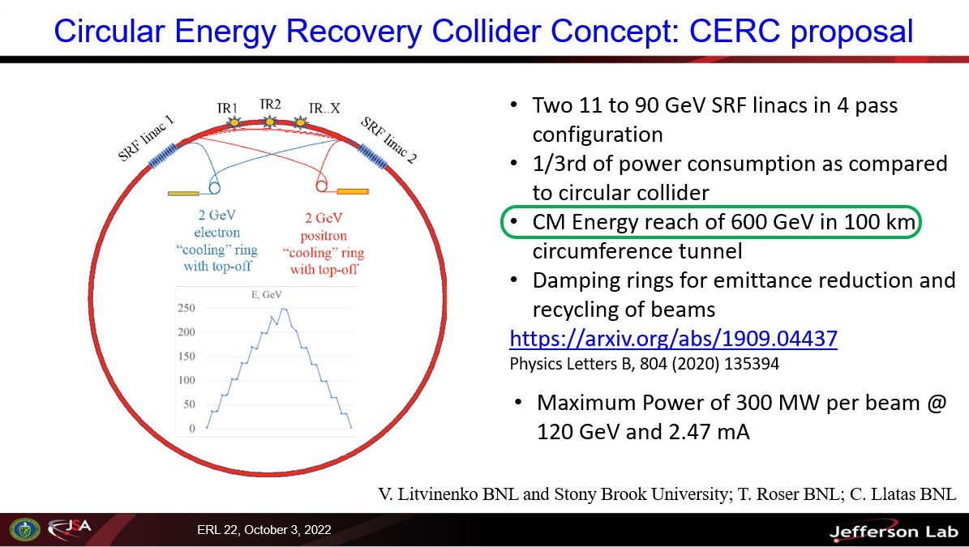
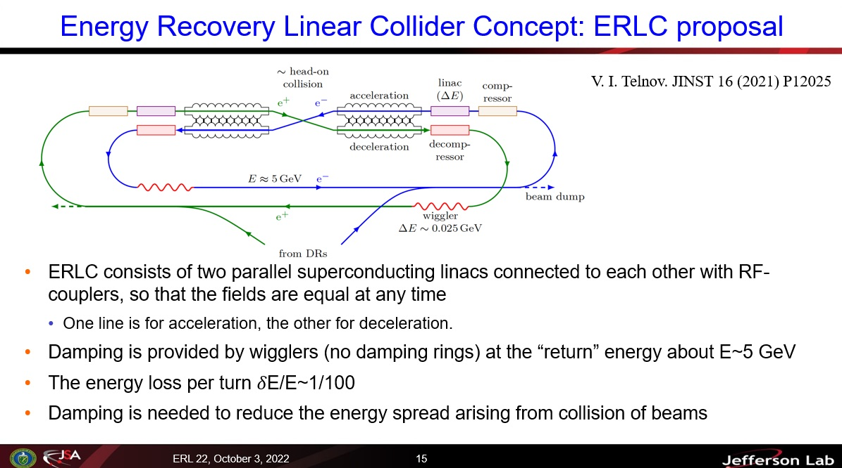
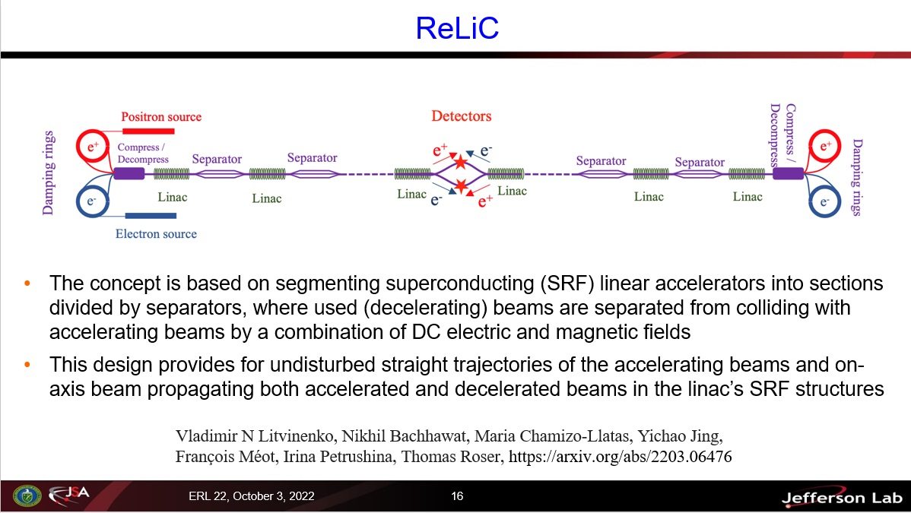
Proposal for future High energy colliders with ERL
See also talk by Andrew Hutton (Mon, 9:50) in ERL2022
Two concepts were published and explored as part of this roadmap process for reaching higher luminosity at high energies: for the FCC-ee, termed CERC**; and for the ILC, termed ERLC***

Slide 8
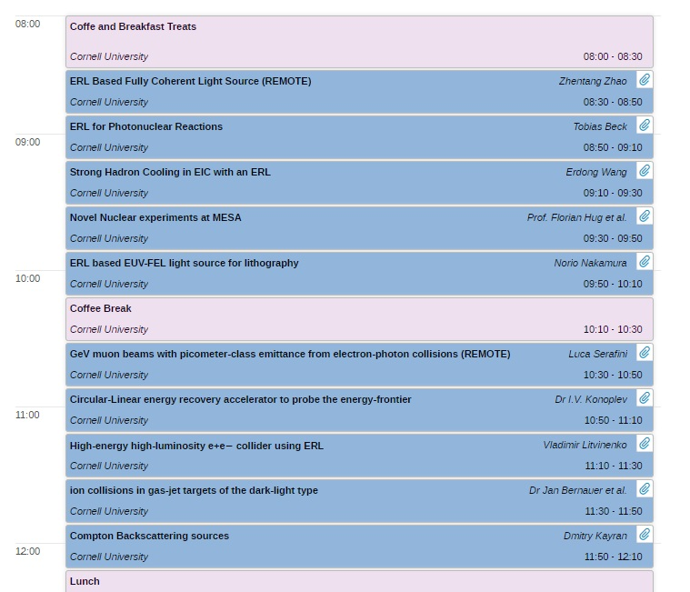
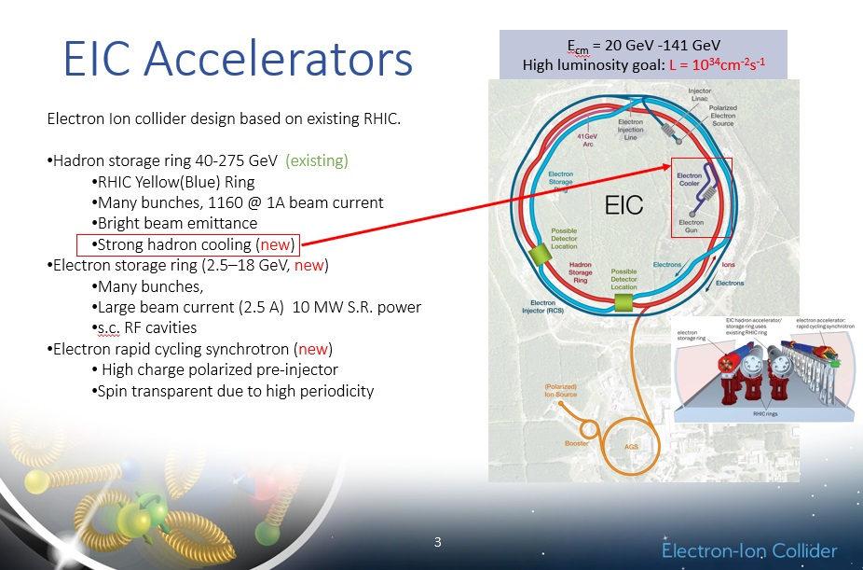
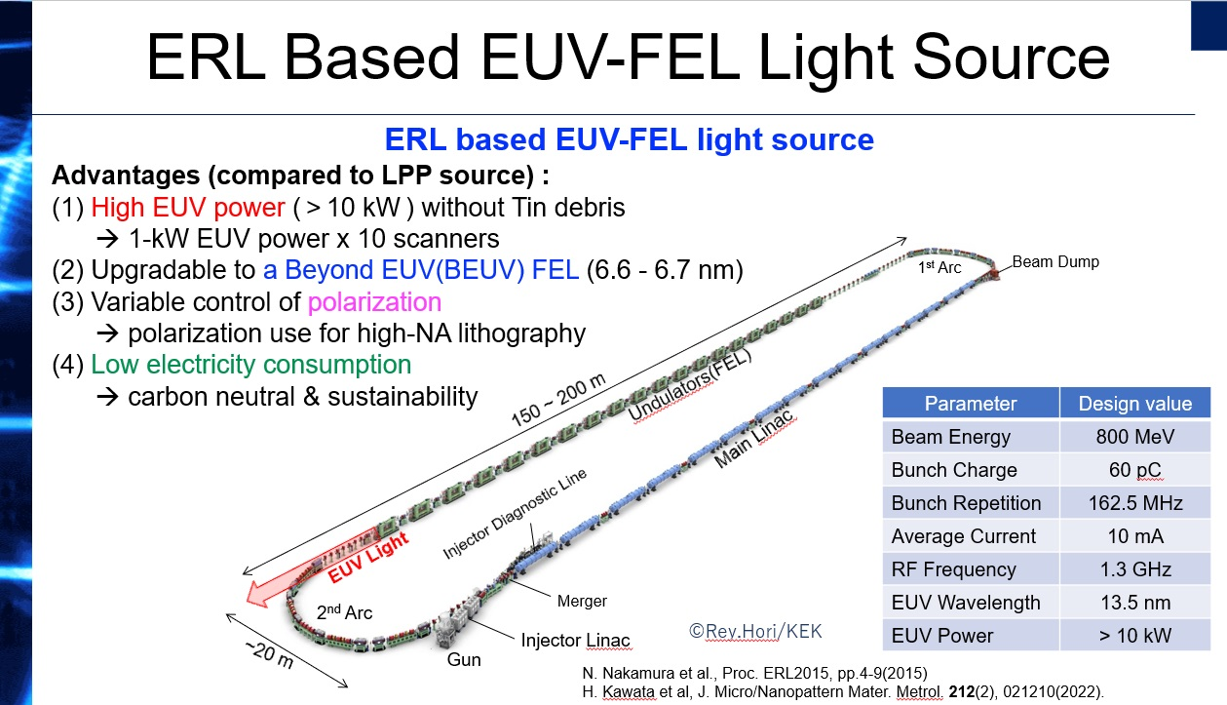
ERL application session
Erdong Wang (BNL)
Norio Nakamura (KEK)
Many proposals were presented for light source including EUV-FEL , EIC, laser-Compton, dark matter search, nuclear physics

Slide 9
ERL achievements
(see facility report)
Walid KAABI :PERLE Facility Report (ERL2022)
1987 Los Alamos
FEL-operation, nc,
coupled acc/dec cavities
1987 High Energy Physics Lab
Stanford University
SRF cavities, proof of principal experiment
1965 M. Tigner
“A possible apparatus for electron clashing-beam experiments”
2000
Jefferson Lab
“Front End Test”
SRF, first CW
recovery
2002 JEARI, Japan
FEL, SRF, 700kW beam power
2005 Daresbury Lab, GB
“Alice”, SRF, 26MeV, versatile
10-year user program
under construction:
MESA, Germany
particle physics application
PERLE, France
Technology test facility (LHeC/FCC-eh) + eRIB test facility
bERLinPro, Germany
SRF/ERL technology test facility
CeC, BNL, USA
Coherent electron cooling for EIC
2002
Jefferson Lab
“IR-Demo”
SRF, 5mA, 48MeV,
2.1kW beam power IR
2003
CEBAF, 1 GeV, single turn
2007 Upgrade:
9mA, 150MeV
1.1MW beam power with ~300kW total power
2004 BINP, Russia
FEL-operation
normal conducting RF,
30 mA
2007: 4-passes
2013 KEK, Japan
“cERL”, prototype
ERL light source
Industrial applications
2020, Cornell/BNL
cbeta, FFA-arc
4-pass ERL
(80mA injector, e = 0.3mm mrad)
Courtesy to Bettina Kuske
ERL technologies are gradually matured and ERL test facilities will grow up more future ERL machine

Slide 10
Summary ERL22,
WG4 Superconducting RF
Nilanjan Banerjee (University of Chicago)
Matthias Liepe (Cornell University)
Peter McIntosh (STFC)
Hiroshi Sakai (KEK)
Notes:
Hello everyone, I am Nilanjan Banerjee, presenting the summary report for WG4 on behalf of my colleagues, Matthias Liepe, Peter McIntosh and Hiroshi Sakai.

Slide 11
SRF WG4 Themes
SRF Systems and Operations
  SRF performance on the CERL at KEK – H Sakai (KEK)
  High gradient "turn key" SRF systems for small scale ERLs like MESA – F Hug (U Mainz)
  SRF systems for the EIC hadron cooling – R Rimmer (Jlab)
Injectors
  KEK SRF Gun development – T Konomi (KEK)
  SRF photo-injector and Booster modules at bERLinPro – A Neumann (HZB)
  Long term operational experience of running Cs2Te cathodes in HZDRs SRF gun – R. Xiang (HZDR) (WG3)
  Low frequency 113MHz SRF gun with room temperature photocathode for Coherent electron cooling experiment (CeC-X)
  - I. Petrushina (U. StonyBrook & BNL) (WG3)
Cavities, Couplers and Tuners
  Overview Nb3Sn cavity progress (for CW machine) – L Shpani (Cornell U)
  SRF R&D for EUV-FEL – T Konomi (KEK)
  Fast Reactive Tuner developments at CERN - N Shipman (CERN)
RF Control and HOM damping
  SRF operations, microphonic control etc at CBETA – N Banerjee (U Chicago)
  Achieving stable cw operation in vector sum – R Leewe (TRIUMF)
  Iterative Learning Control for Beam Loading Compensation – R Leewe (TRIUMF)
  HOM-Damping Studies in a Multi-Cell Elliptical Superconducting RF Cavity for the Multi-Turn Energy Recovery Linac PERLE – C Barbagallo (IJCLab)
12 x 15+5min talks, over 3 x WG4 sessions
(more SRF gun talks, 2 x WG3 sessions)
Notes:
We had 12 talks in WG4 spread over 3 sessions. Each had a duration of 15 mins, plus 5 mins of discussion time. For the summary, we grouped the talks into 4 themes: SRF systems and operations, injectors, cavities, couplers and tuners and finally, RF control and HOM damping.

Slide 12
SRF Systems and Operations
Notes:
Let’s start with SRF system and operations.

Slide 13


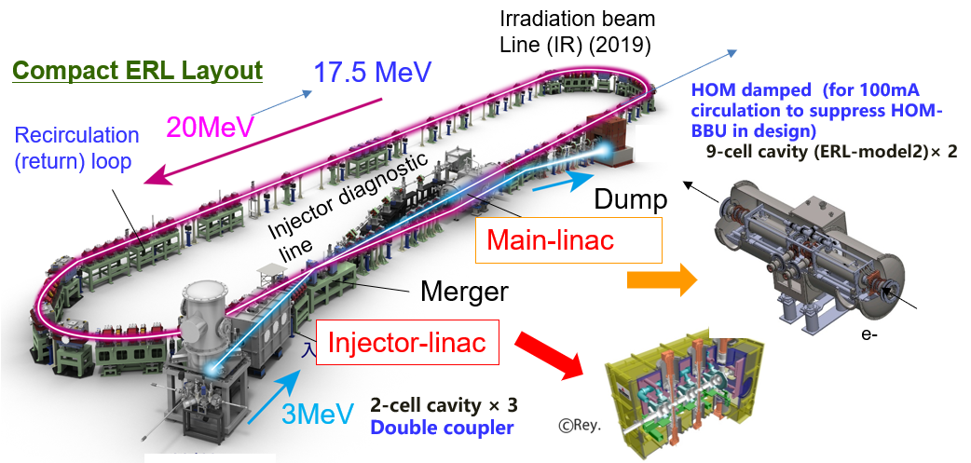
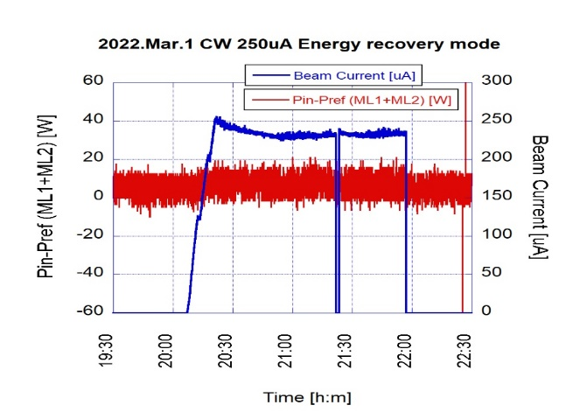
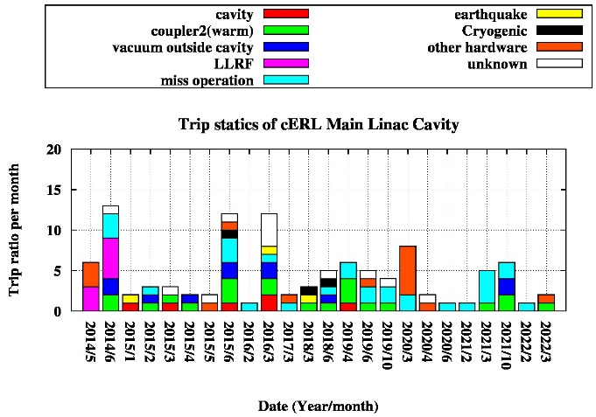
SRF performance on the cERL at KEK – Hiroshi Sakai (KEK)
KEK cERL cryomodule are operating from 2012 until now for almost 10 years.
Very stable
100.0% +- 0.3 % energy recovery
We could stable CW beam operation with 0.3mA energy recovery mode after installing undulator in 2022
Small trip ratio for 10 years
SRF performance of cERL cryomodules under cERL beam operation in the latest three years
  For injector, one we met the severe degradation in 2020. But we could recover the normal radiation onset level by the pulse processing.
  For Main iinac we met the cavity degradation under beam operation after the unknown burst event of ML1. But for the latest 3 years, we did not see more degradation. Main issues are field emission for ML2 and thermal breakdown for ML1.
  Finally, by applying the pulse processing for both cryomodule before the beam operation, we kept the stable beam operation under LLRF optimization.
  For higher energy operation, we applied pulsed operation to escape the HOM quench of injector. We could increase the energy from 17.5 MeV to 23.0 MeV for irradiation beam line.
SRF R&D for future EUV-FEL and so on from cERL operation in KEK
  More reliable operation, we design the F.E suppression and HOM suppression cavity for EUV-FEL and develop the F.E reduction approaches (clean assembly , HOM damper)
  SRF Gun is under developing for CW high current beam generation in KEK. (now FRIB)
  Higher-Q R&D and Nb3Sn cavity R&D also tried to reduce CW heat load.
Notes:
On Tuesday, we heard from Hiroshi Sakai about SRF performance on the compact ERL at KEK. Notably both the injector and main linac cryomodules witnessed cavity performance degradation reducing the total energy of the beam, some of which were stabilized using pulse processing. Currently, they can operate stable beam at 0.3 mA in ERL mode. We also heard about various R&D activities including upgrade of the HOM dampers, new SRF gun and Nb3Sn.

Slide 14
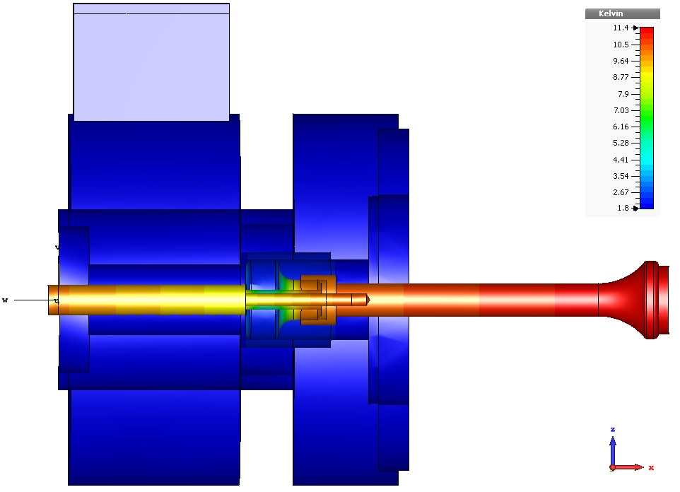


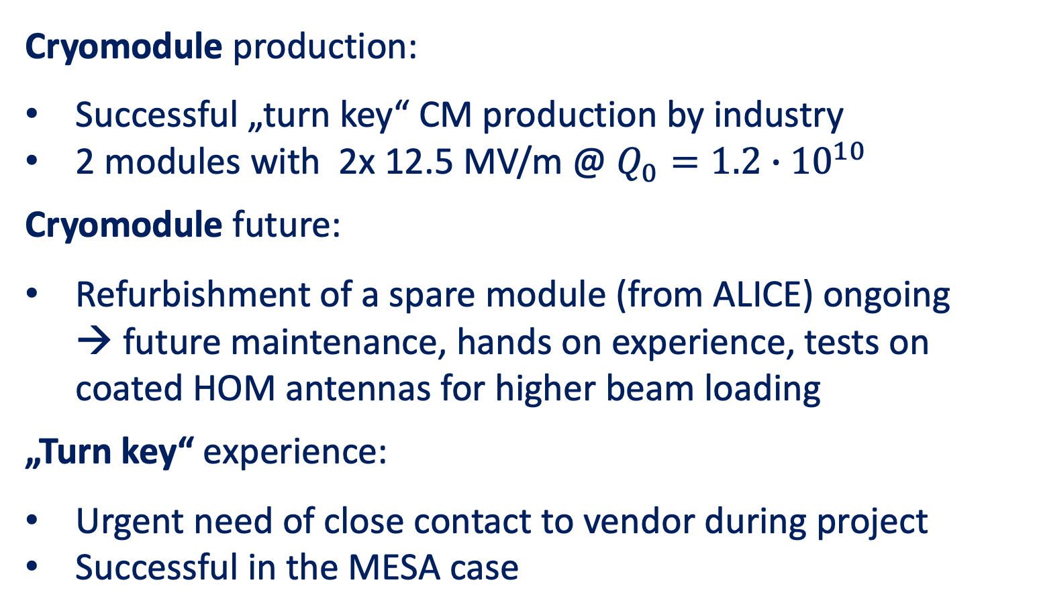
Summary MESA Modules – Florian Hug (U Mainz)
Cryomodule production:
Successful „turn key“ CM production by industry
2 modules with 2x 12.5 MV/m @ $Q_{0}=1.2∙{10}^{10}$
Cryomodule future:
Refurbishment of a spare module (from ALICE) ongoing
→ future maintenance, hands on experience, tests on coated HOM antennas for higher beam loading
„Turn key“ experience:
Urgent need of close contact to vendor during project
Successful in the MESA case
T / K
11.4
1.8
100 mW load
Notes:
Florian Hug discussed their experience with “turn-key” production of two ELBE-type cryomodules with 2 9-cell TESLA cavities for the MESA project. While the first cryomodule reached design parameters on delivery, the second cryomodule had severe FE issues which the vendor repaired after which it also also reached specifications. In addition, they have a spare module obtained from ALICE. They are also working on Nb3Sn coatings on the HOM antennas to avoid quenches.

Slide 15
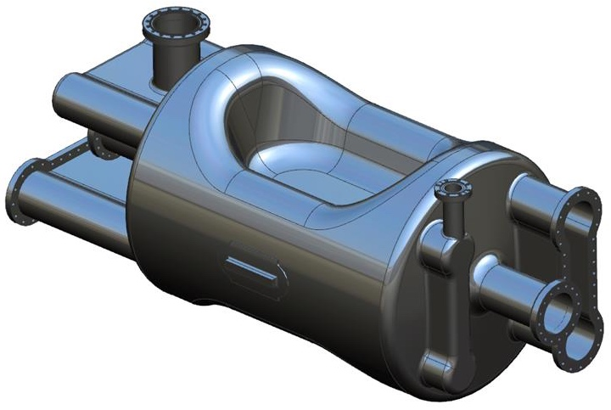
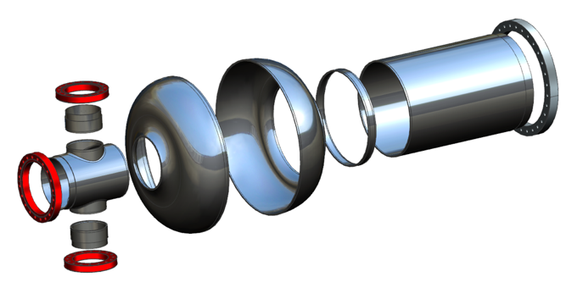
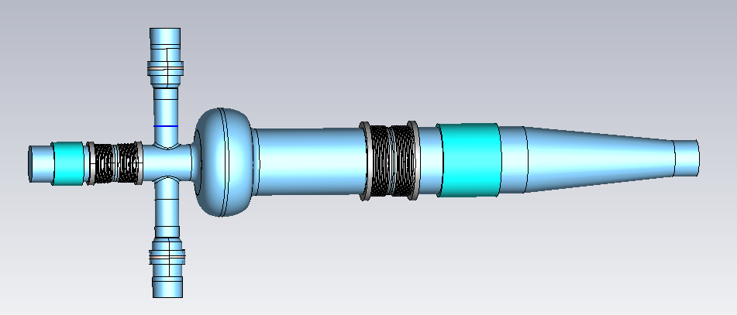
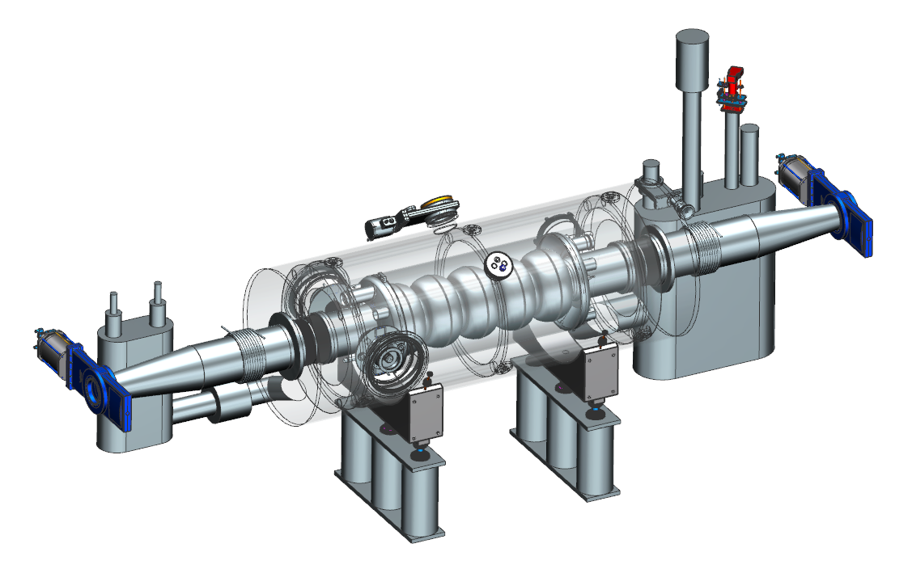
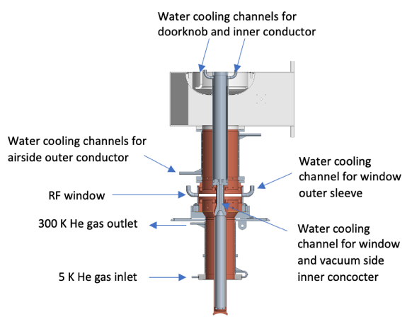
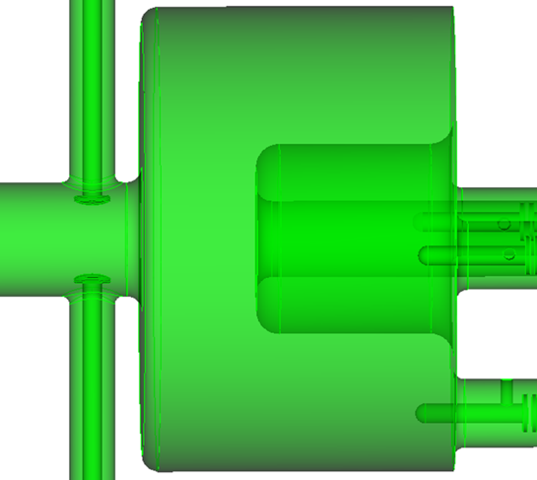
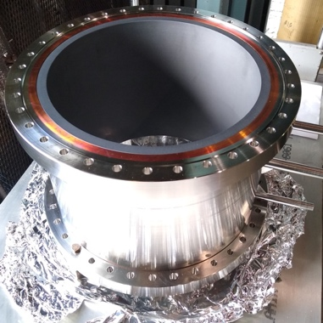

SRF Systems for the EIC Hadron Cooling – Rob Rimmer (JLab)
FPC
ESR and crab Prototypes coming soon!
ERL cavity may be developed from ESR
  Baseline HOM damping scheme using BLA’s
  Other options can be considered
Pick Up
VHOM
Dogbone
HHOM
Dogbone
HSR 197 MHz crab
FPC
HSR 591 MHz 5-cell
Also RCS and ERL
BLA
BLA
FPC
ESR 591 MHz 1-cell
591 MHz 5-cell (w/o HOMs)
FPC
HOM dampers
400 kW FPC
BLA
Pre-cooler 197 MHz QWR
Notes:
On a much larger scale, we heard about SRF systems for the EIC from Rob Rimmer at Jlab. In total, the project will require 7 distinct SRF cavity types, including a 591 MHz 5-cell elliptical cavity, which will be used in the hadron storage ring, rapid cycling synchrotron and the ERL. The cell shape is same as a single-cell electron storage ring cavity shown here which will be prototyped very soon. Other supporting components are also being designed.

Slide 16
Injectors
Notes:
Next, we had two talks on injectors.

Slide 17
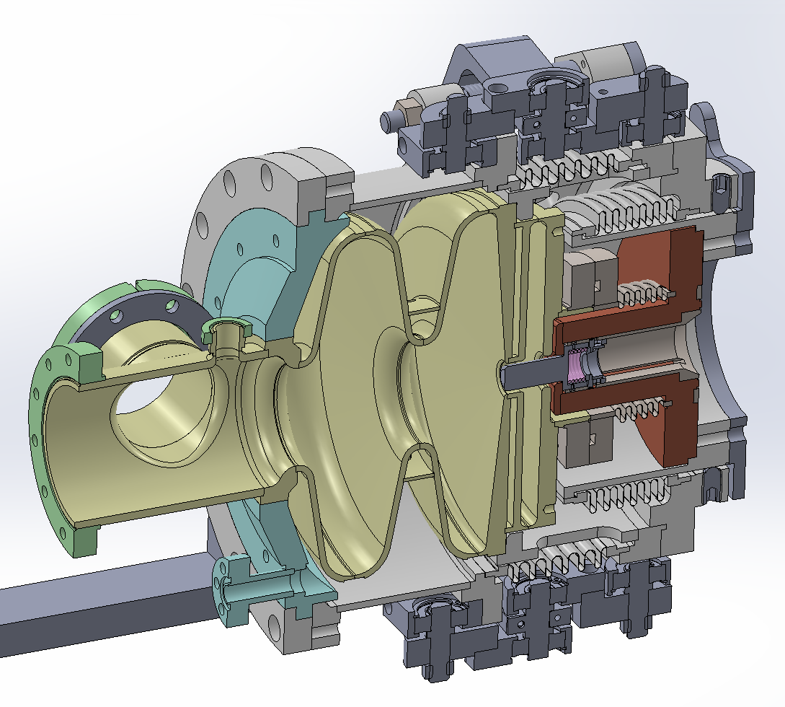
Horizontal test of SRF gun #2 at KEK – Taro Konomi (KEK/MSU)
Esp reach the target value by applying EP and HPR in VT because assembly procedure is well established.
  Esp= 76 MV/m w/o cathode, Esp=61.5 MV/m w/ cathode (target Esp=41.9 MV/m)
The gradient was significantly lower in HT. This was due to the complicated procedure.
  Esp=42 MV/m (6th HT)
Cathode holder
Cathode rod
1.5 cell cavity
Helium jacket
Choke Cell
Notes:
We heard from Taro Konomi on the horizontal test of SRF gun cavity for the ERL at KEK. This is a 1.3 GHz Niobium 1.5 cell cavity with a choke cell. After an initial EP and HPR, the cavity reached 76 MV/m without cathode rod and 61.5 MV/m with a lower Q0 with the cathode rod. The Q vs E data for tests without the cathode rod are shown in the plot. The best horizontal test result was 42 MV/m under much worse Q0 and heavy field emission.

Slide 18
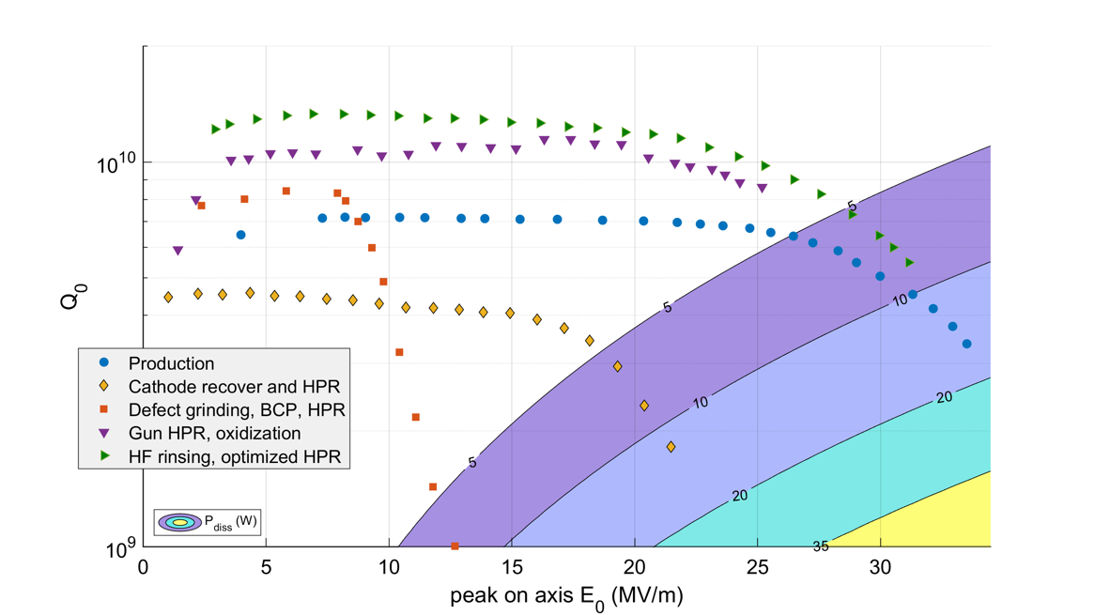
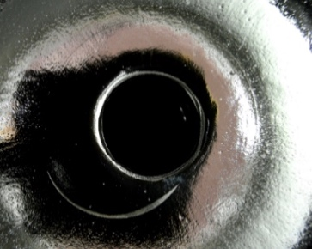
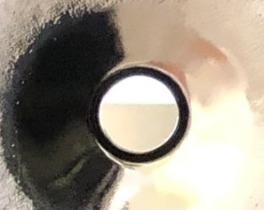
Status of SRF systems for bERLinPro – Axel Neumann (HZB)
Summary SRF hzb
Focus on finalizing cryo-modules for the injector line of SRF gun and booster
Currently, after a two years long refurbishment program to recover the SRF gun cavities from
damages during the production process, cavities are back on performance level.
During coldstring acceptance test, a field emitter was activated,
currently the gun string is back in the cleanroom for cavity and
couplers exchange
The booster will follow-up, once the gun is completely assembled
in the accelerator hall.
As preparatory work, the couplers were conditioned up to 60 kW
CW in traveling wave at 1.3 GHz
All cold string parts are in house and several booster cavity tests
demonstrated the cavities being twice in field above the specs
required for bERLinPro
In total, first beam from the gun will take place about in summer
2023
Comment: Built at least 3-4 SRF gun cavities for such a program
Notes:
Axel Neumann from HZB, presented the status of gun development for the bERLinPRO 1-turn ERL. They built 3-4 SRF gun cavities for the program, where they had various issues including field emitters, damage on rf surface as shown in the image and a cathode puck falling into the cavity. They are refurbishing the cavities with one already exceeding initial numbers after production. The gun cryomodule is now on track to generate beam in summer 2023.

Slide 19
SRF @ELBE

Slide 20
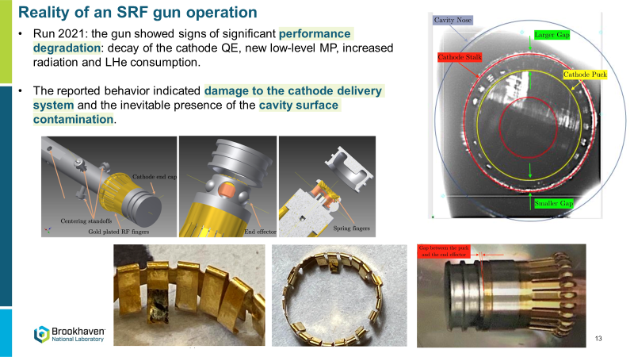
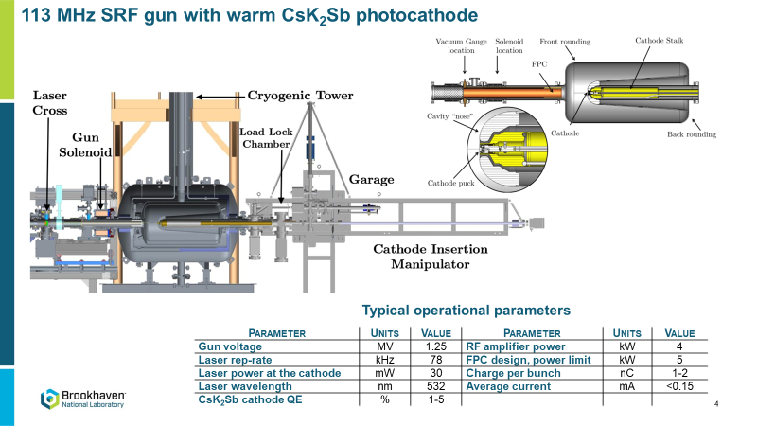
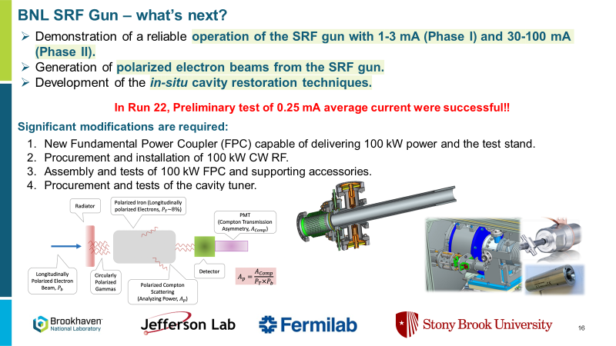
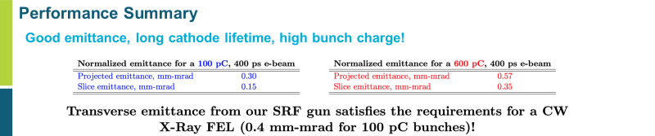
SRF gun @BNL

Slide 21
Cavities, Couplers and Tuners
Notes:
Now we move on to cavities, coupler and tuners.

Slide 22
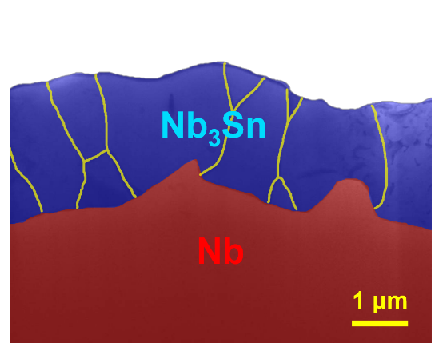
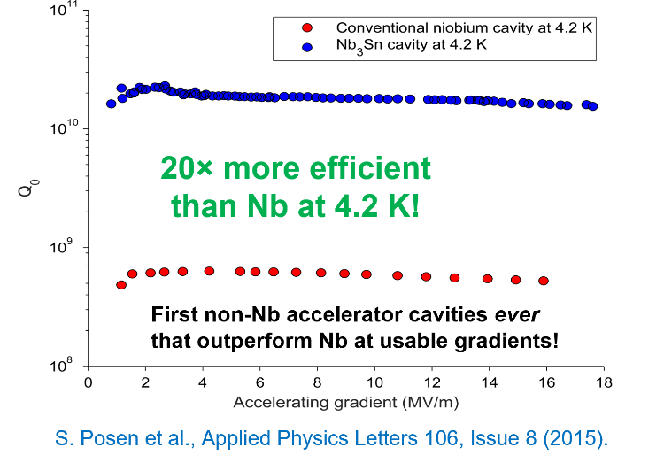
Overview of Nb₃Sn Cavity Progress (for CW machines)
Presented by Liana Shpani*, Cornell University
Nb₃Sn is a high-potential material for next-generation SRF cavities
  Higher energy gain
  Lower cooling cost and complexity
Nb₃Sn coating facilities are established around the World (Cornell, FNAL, JLab, KEK, etc.)
Ongoing R&D will improve Nb₃Sn performance of Nb₃Sn films
  Thinner films
  Reduced surface roughness
Applications are at early stages
  Multicell Nb₃Sn cavities
  Prototype cryomodule testing
  Turn-key compact cryomodules
Notes:
We heard an overview of the progress on developing Nb3Sn cavities for CW machines from Liana Shpani. Nb3Sn cavities could potentially operate with much larger gradients and lower dissipation than Niobium cavities. State-of-the-art coating facilities can fabricate cavities which reach 16-22 MV/m in a reproducible fashion while operating at 4.2 K at a quality factor comparable to Niobium at 2 K. Multi-cell cavities, conduction-cooled turn-key cryomodules, etc are being developed.

Slide 23
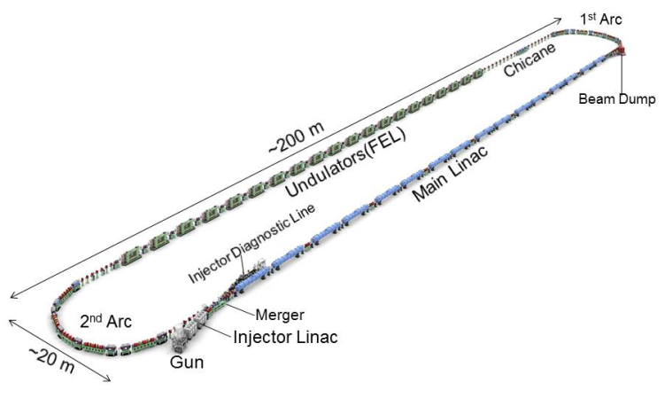
Design of the 9-cell superconducting cavity for EUV light source accelerator
Taro Konomu (KEK/MSU)
Cavity Parameters | KEK-EUV | TESLA
Frequency (MHz) | 1300 | 1300
Iris diameter (mm) | 70 | 70
R/Q (Ω) | 1009 | 1036
G (Ω) | 269 | 270
Ep/Eacc | 2.0 | 2.0
Hp/Eacc (mT/(MV/m)) | 4.23 | 4.26
BBU limit | >190 mA | ~80 mA ?
EUV cavity has been designing for EUV-ERL/FEL accelerator.
9 cell cavity was optimized by tuning End cell shape.
HOM damper was designed with AlN data taken by ourselves.
Monopole HOM
Dipole HOM
Parameters | Target value
Wavelength | 13.5 nm
EUV Power | 10 kW
Bunch charge | 60 pC
Beam energy | 800 MeV
Repetition frequency | 162.5 MHz
Average current | 9.75 mA
Accelerating gradient | 12.5 MV/m
Number of cavities | 64
Notes:
Taro Konomi presented the design of 9-cell SRF cavity for use in the planned EUV light source at KEK which will use 800 MeV electrons at an average current of 9.75 mA. They use the conventional TESLA parameters for the center cell but modify the end cell shape to minimize HOM excitation in order to have a BBU threshold of almost 200 mA. The bottom two plots show the distribution of simulated monopole and dipole HOM modes with and without damping demonstrating the effectiveness.

Slide 24




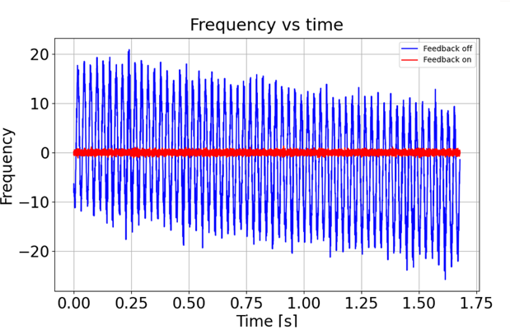
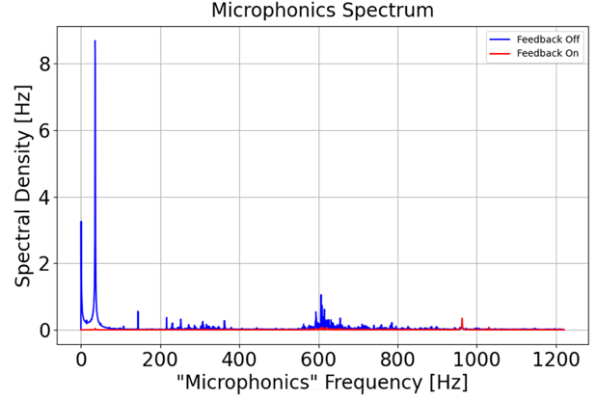
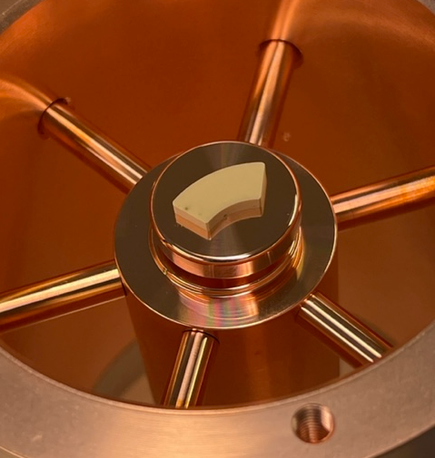
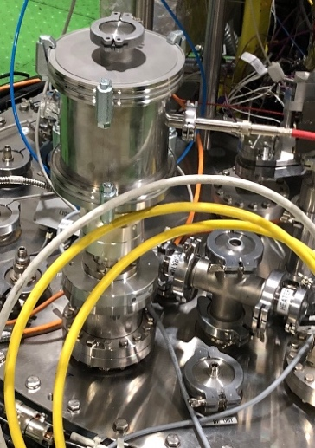
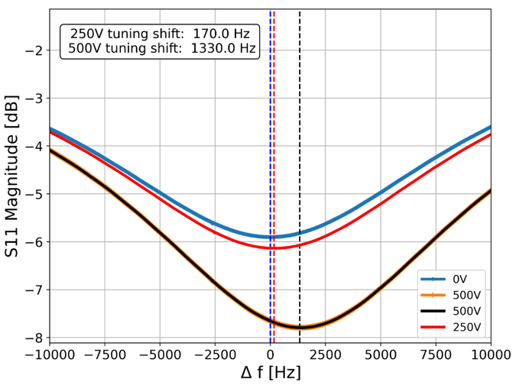
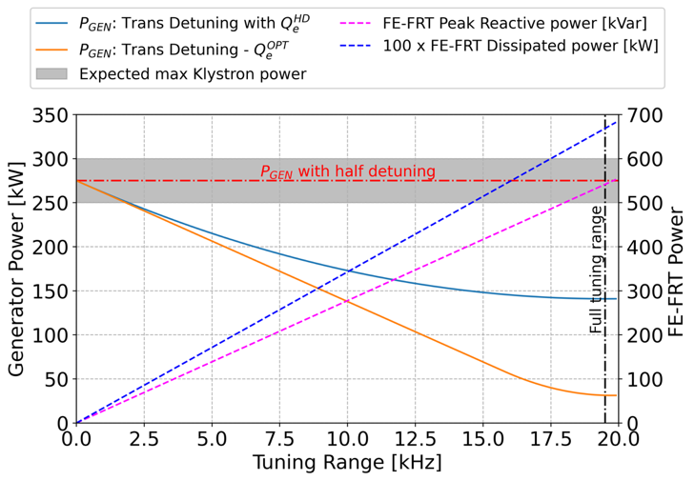
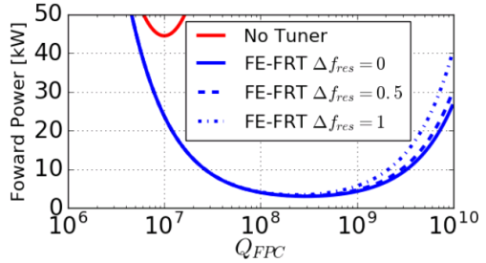
FRT Developments at CERN
N. Shipman et al.
Microphonics:
FRTs perfectly suited to compensating microphonics in low beam loading machines
Can reduce RF power demands by order of magnitude
Excellent microphonics compensation already demonstrated experimentally
Should be developed for real application, EIC, bERLinPro, PERLE, CEBAF, HIE-ISOLDE, other?
Transient detuning:
CERN FRT research now focussed on transient detuning
Could reduce RF power demand at injection by up to order of magnitude
Significantly more challenging due to higher reactive power
New prototype TDD0 designed, built and tested
Tuning of LHC cavity demonstrated
Targeting transient beam loading demonstration with “TDD1” in new year
Measurement of cavity frequency with and without FRT.
Measurement of µphonics spectrum with and without FRT compensation.
“TDD0” prototype FRT during assembly and installed on cryostat top plate.
Measured frequency shift of LHC cavity with FRT.
Estimated RF power reduction vs tuning range for HL-LHC with FRT (orange).
Estimated power reduction for PERLE with and without FRT.

Slide 25
RF Control and HOM Damping
Notes:
Finally, we have the theme of rf control and hom damping.

Slide 26
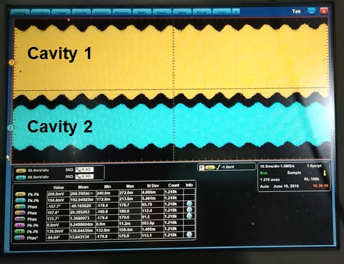




Achieving stable CW operation in vector sum at TRIUMF - Ramona Leewe, Ken Fong
Operating two cavities in vector sum and CW – starting conditions
Challenges and Issues and Solutions
  Microphonics
    Solution: system damping +piezo
  Lorentz force driven oscillations
    Solution: additional control loop
Stable operation
Ramona Leewe, Ken Fong
Notes:
We heard of a method of achieving stable CW operation in vector sum in TRIUMF by Ramona Leewe and Ken Fong. A cryomodule for the ARIEL linac containing two cavities operated in vector sum at TRIUMF developed a ponderomotive instability, with oscillating cavity fields shown in the image. They developed an additional tuning control loop which keeps both cavities on the correct side of the resonance curve to avoid these instabilities.

Slide 27




SRF Operations, microphonic control at CBETA – Nilanjan Banerjee (UChicago/Cornell)
Q (kV)
I (kV)
Vibrations
Chiefly from cryogenics and mechanical coupling which we mitigated. Further suppressed using a modified narrowband Active Noise Control (ANC) algorithm.
Field Stability
Mostly dominated by microphonics detuning on most cavities.
Measured an energy recovery efficiency of 99.4±0.1% for 1-turn operations at 70 μA.
Beam Loading
Reactive beam loading due to relativistic effects will be important for high-current operations.
Notes:
Next we heard about SRF operations at CBETA. Cryogenic valves and externally coupled vibrations were major sources of detuning for the main linac which were mitigated. In addition, a modified Active Noise Control algorithm was successfully used to suppress detuning. Noise in the field is dominated by microphonics detuning on 4 out of 6 cavities. At high current, reactive beam loading due to relativistic effects will become important.

Slide 28





Iterative learning controller for beam loading compensation at TRIUMF
Block diagram
Window function
Bode diagram
Rate of convergence
BPM measurement with and without ILC
Summary
  Frequency domain analysis allows different window function evaluation
  Stability depends mainly on the phase which depends on the look ahead in the window function
  BPM measurements show great results with a good choice of window function and look ahead
Ken Fong, Ramona Leewe
Notes:
What can we do to mitigate the field instabilities? From the controls perspective the first thing we usually do is to check if we can use a feedback system such as shown on the bottom left here. So we would look at the cavities output signal y and then change the input such that we get the desired field. The problem for this application is that a feedback system is too slow. By the time the system reacts the beam bunch is gone. So, we can’t apply a feedback system for beam loading. But we also know that beam loading is a repetitive error, every time a bunch comes into the cavity it generates the same kind of error. A solution for a repetitive system such as beam loading is a feed forward system. How that works is, we look at the error a beam bunch created and then feed a correction signal into the cavity right when the next bunch arrives at the cavity. We already know the error before it happens and can apply the correction before it happens. There are different approaches such as manual feedforward where you have a constant repetitive feedforward signal or ILC an iterative learning controller, which learns in every repetition. We have applied both approaches to the e-Linac and the results I will show you know.

Slide 29











International Workshop on Energy Recovery Linacs (ERL 22), October. 3-6 October 2022
HOM-Damping Studies in a Multi-Cell Elliptical Superconducting RF Cavity for the Multi-Turn Energy Recovery Linac PERLE
C. Barbagallo^{1,2}, P. Duchesne¹, W. Kaabi¹, G. Olry¹, F. Zomer^{1,2} (¹IJCLab - CNRS, ²Université Paris-Saclay)
R. A. Rimmer³, H. Wang³
Our study focuses on the HOM-damping studies in the 5-cell SRF cavity designed for the Multi-Turn Energy Recovery Linac PERLE
Potentially dangerous HOMs were identified and classified until 2.4 GHz. A trapped monopole mode was found at around 2.25 GHZ
Three possible HOM coupler designs were optimized to damp monopole and dipole HOMs of the PERLE cavity
The DQW coupler exhibits a better monopole coupling for TM010 mode than the probe design.
The hook coupler provides higher damping of the first two dipole passbands (TE111 and TM110)
  The damping scheme with four DQW couplers shows promising results in damping both monopole and dipole HOMs
  Computed impedance levels are below the analytically-computed beam-stability limits

Slide 30
Recent SRF progress of each lab since 2019 (Discussion & Summary)
Cavity & module design for ERL
  Design for high current or high energy machine
  Or compact, turn-key?
High Q R&D, Nb3Sn and more
  Nb3Sn is promising for open a new era for CW ERL machine
Supporting components
  High-power and HOM couplers, tuners and controls.
  Careful not to duplicate efforts.
SRF guns
  Cathode dissipation and mechanical manipulation
Incorporating advances in SRF technologies to further improve the wall-plugefficiency of ERLs: Nb3Sn, FRTs, RF control
Improved Collaboration?

Slide 31

Next ERL2024 workshop
ERL2022 was held in Cornell University in U.S
Next ERL2024 was held in KEK (Tsukuba) in Japan
Plan to held between June – Oct. in 2024.

Slide 32



See you in ERL2024 in Tsukuba KEK !
ERL2011
KEK Mt.Tsukuba
Compact ERL

