Slide 1
European XFEL
Experience with 5 Years of Operation
TESLA Technology Meeting, Aomori, Japan
Julien Branlard and Nick Walker and Hans Weise (as presenter…)
for the linac operations team
and all contributors to the XFEL construction
Aomori, 13.10.2022

Slide 2
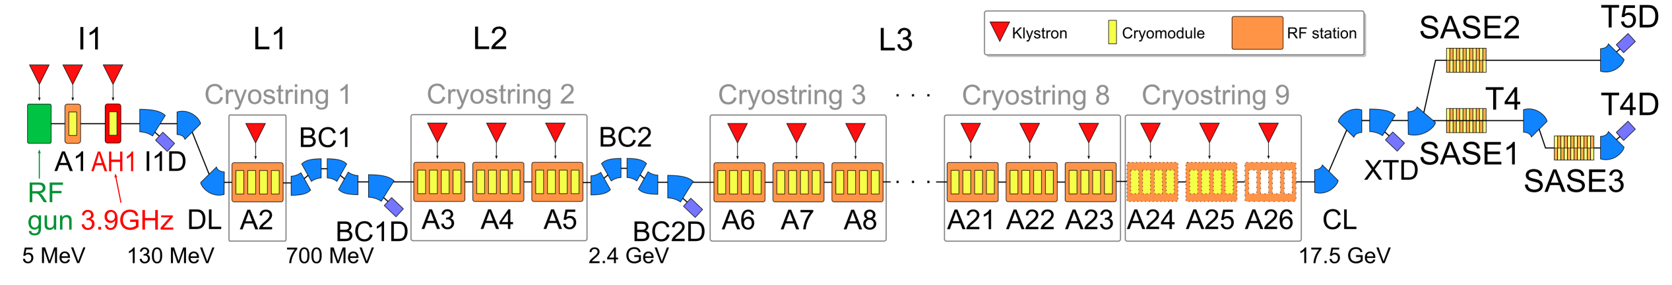
Introduction / Reminder
The European XFEL Accelerator
Injector
120 m
130 MeV
8× 1.3 GHz
8× 3.9 GHz
Bunch compression
Two stage
354 m
2.4 GeV
L1 1× 1.3-GHz RF station
L2 3× 1.3-GHz RF stations
Main Linac
1180 m
17.6 GeV (max)
20× 1.3-GHz RF stations
3 photon beam lines
6 experiments
demonstr. photon energies
SASE1: 6-30 keV
SASE2: 6-19 keV
SASE3: 0.5-3.2 keV

Slide 3
Introduction / Reminder
The European XFEL Accelerator : one RF station for 32 cavities
CM1 (8 cav.)
CM2 (8 cav.)
CM3 (8 cav.)
CM4 (8cav.)
KLYSTRON
10 MW klystron to power 32 cavities
one accelerating field RF control FB loop
remote frequency tuning (motor / piezo) / cavity
remote phase and external coupling tuning / cavity
average coupler peak power 102 kW (140 kW) for low (high) runs
average gradient 18.5 MV/m (22.5 MV/m) for low (high) runs
average detuning +/- 10 Hz
average Q_{ext} = 4.6e6 average Q₀ = 1e10

Slide 4
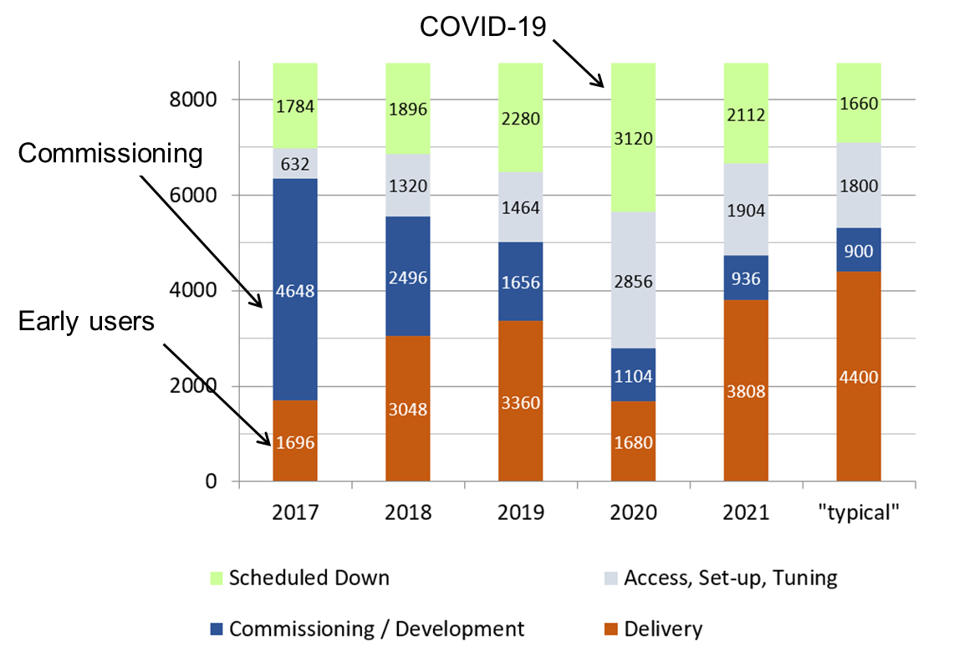
History
Cool down in 1/2017 - 1st Lasing May 2nd, 2017
Milestones (some)
Dec. 2016 Cool down
Apr. 2017 First beam
May 2017 First SASE
Sep. 2017 First users
Jul. 2018 Max energy: 17.5 GeV
Oct. 2018 3 SASE beamlines
Nov 2018 Max bunch (2700)
Jan. 2019 Parallel user run in all 3 beamlines
Feb. 2020 30 keV photon energy
May 2021 100% availability for 1 week
May 2022 5 years of successful operation
Machine time (in hours)

Slide 5
Linac Operations

Slide 6
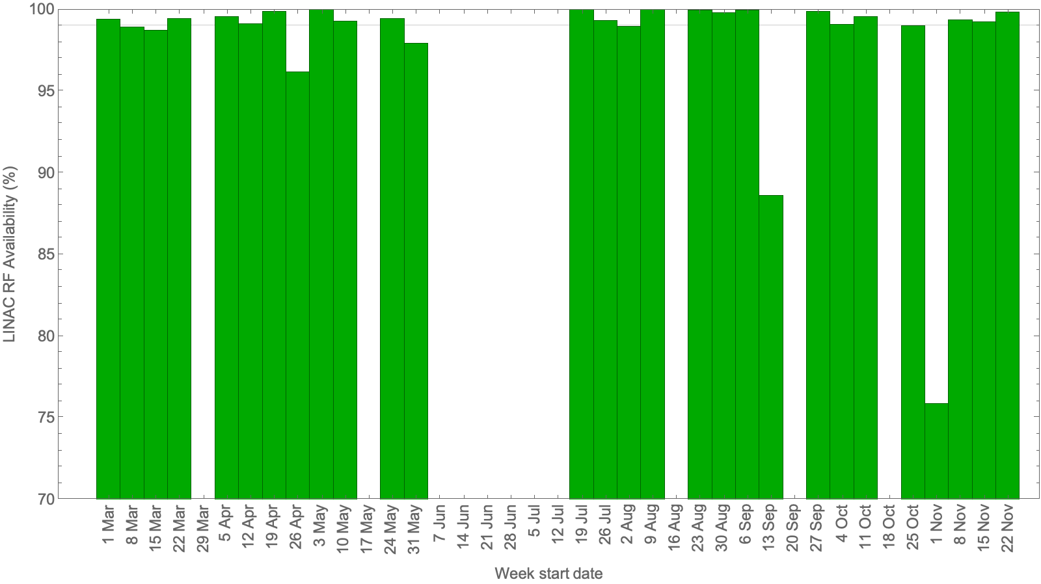
Operation Overview
Example: 2021 LINAC availability during user runs
SRF LINAC Availability
power outage
cryo
*)
SRF LINAC has very high availability
Availability remains a “routine” focus
  Careful review / follow-up of all events
  Documentation is a must (DB) etc.
  Weekly maintenance to reset all systems (~1 hour)
Maintained two operations configurations in L3 stations:
  MAX Voltage (>16 GeV)
  REDUCED Voltage (≤14.5 GeV)
    reduced trips
    reduced (dark current) radiation
Carefully monitor / document changes (time)
  Radiation (dark current)
  Cavity quench limits
blue week
blue week
blue week
blue week
blue week
shutdown
*) Even if cold since 1/2017…
We still suffer from
cold compressor bearings
Operation Config. | REDUCED V ≤14.5 GeV | MAX V >16 GeV
2021 | 79% | 21%
2022 | 68% | 32%

Slide 7
Operation Overview
SRF LINAC Availability
We are monitoring the maximum energy on the <1% level
  Established procedures
  Make use of off-beam stations to perform parasitic measurements (i.e. during user runs)
  Dedicated study time as part of overall schedule
  Re-establish maximum achievable gradient at start up twice a year
  Perform undulator beam-based alignment measurements every ~5 weeks (last march 2022 demonstrated ~17.6 GeV)
Detuned cavities due to increased field emission
  We have detuned 3 cavities in the last 2 years due to increased field emission (administrative limit = 500 µSv/h)
  Impact : lowered max energy by ~1.0% (~170 MeV) due to field emission
  16.3 GeV runs were delivered for 7 user weeks in 2021 (11 scheduled for 2022)
  For high availability, we like to have enough RF margin that any 1 station can fail at 16.3 GeV
  → this margin is slowly eroded
  We are paying close attention especially to stations with strong dark current
  We are currently investigating other possible reasons for the observed margin reduction. Is there a drift in the overall calibration?

Slide 8
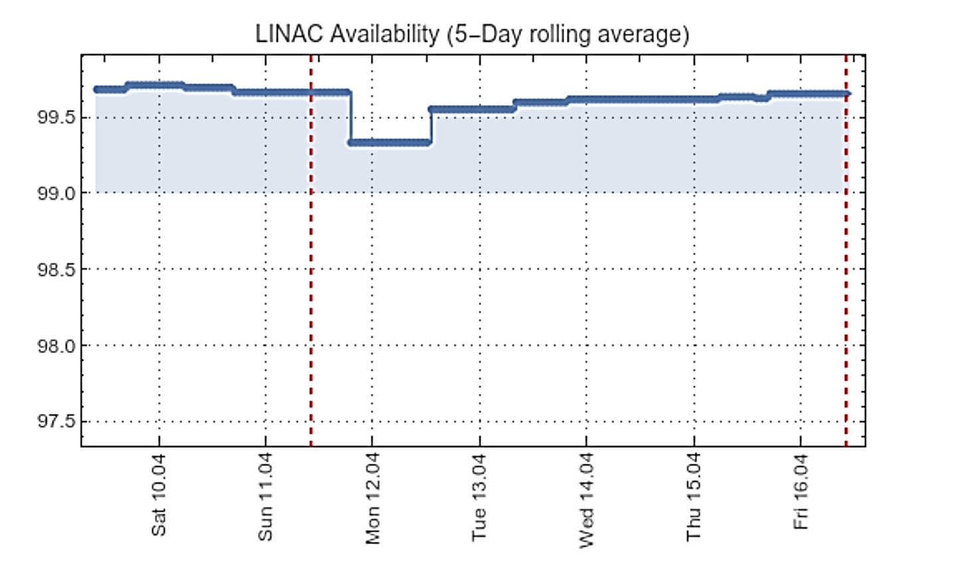
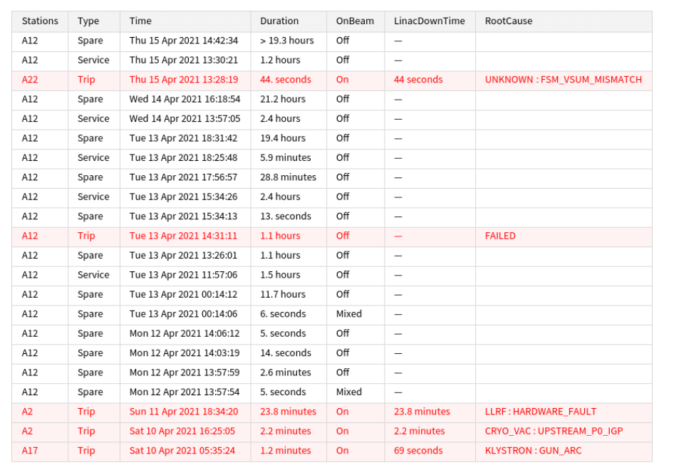
The Linac Operations Team
Cross-disciplinary team
  5 – 6 regular members
    Operations
    Low and high power RF
    Couplers and cavity
  Special topics:
    Controls, cryo, MPS
Weekly meetings
  Review / tag the trip of the week
    Availability
  A.O.B.
    Workflow, procedures
    Accelerator development
    Maintenance
    Etc…
Clarify root cause
and update DB

Slide 9
Covid-19

Slide 10


2020 – Our first COVID-19 year
User stats
5640 operating hours
  6888 hours planned
1856 user hours (as planned)
  with 95% availability
30 keV (world record) and
17.8 keV (routine) photon energy

Slide 11
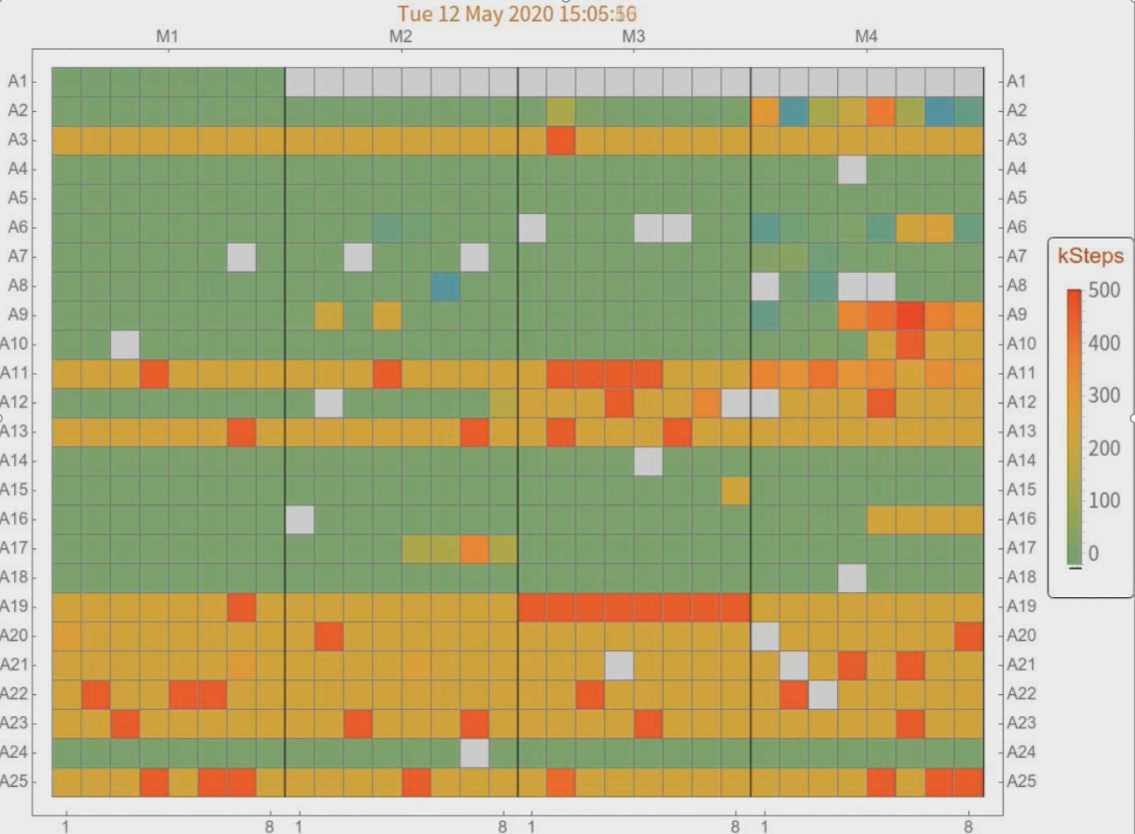


COVID (de)retune
March 2020
  Unclear if personnel on site could guarantee cold linac in case of cryo failure
  Preventive measure: detuning all 776 SRF cavities
  2 shifts, 8 people
April 2020: lockdown (“light” shutdown)
May 2020
  Remote facility operation possible
  Retune all cavities (2 shifts, 8 people)
Lessons learnt
  Went well BUT too long, too resource intensive
  1-button automatic detuning was developed (no RF, bare system)
Movie credit N. Walker

Slide 12
MAX Voltage Operations

Slide 13
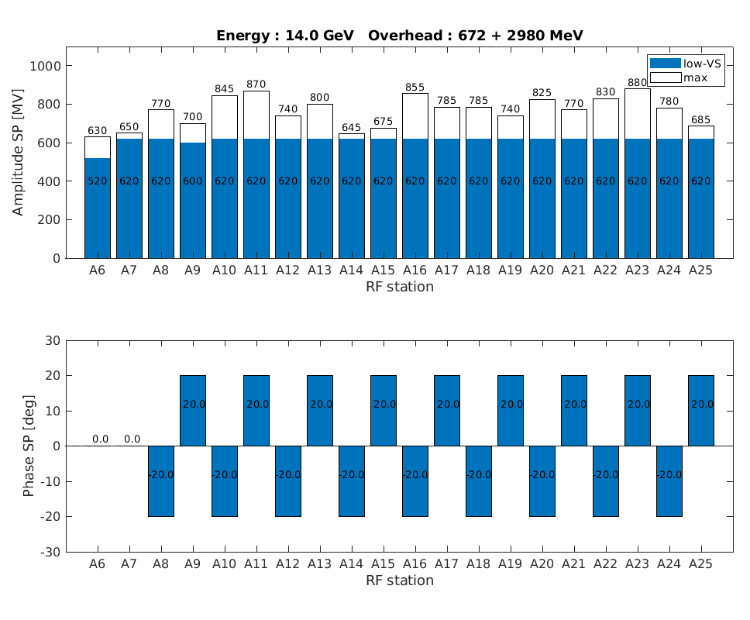
Linac Setup
Two modes of operation:
  low-VS : for beam energies 8.0 – 14.0 GeV
  high-VS : for beam energies 14.5 – 16.5 GeV
High-VS
  Cavities operating at max gradient
  ➔ more radiation coming from RF
  Cavities operating with almost no RF overhead
  ➔ almost at quench limit
  Couplers, klystrons running with more power
  ➔ more arcs, sparks, etc..
  Overall, operating on the edge
  ➔ more trips
Energy overhead by placing all stations on crest
Energy overhead by ramping all stations to max SP

Slide 14
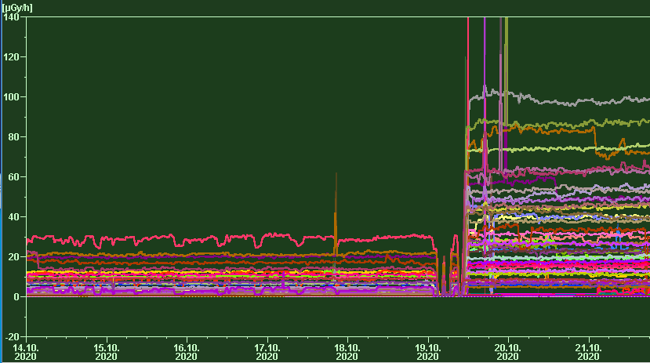
High-Voltage (high-VS) Experiment
6.3 SEU / week
56 SEU / week
31.08 – 18.10.2020 → 7 weeks at low-VS
19.10 – 22.11.2020 → 5 weeks at high-VS
Careful Monitoring of
  Single Event Upsets (LLRF systems)
  Cavity quenches
  Gradient limiters
  Radiation
x6
high-VS
low-VS
x2-3
x6

Slide 15
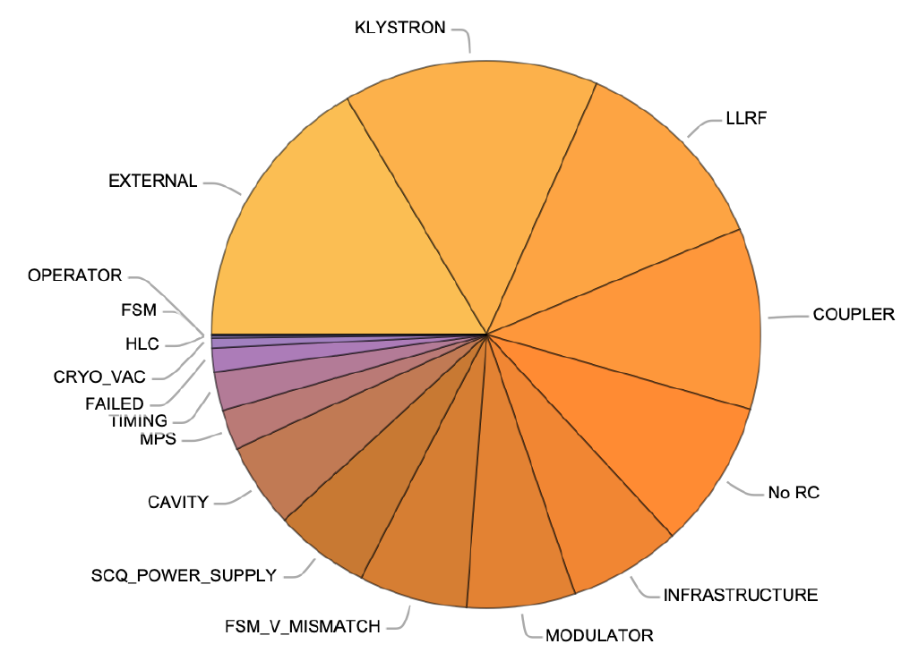
High-Voltage (high-VS) Experiment
Statistics
 |  | Total | Low-V | High-V
Availability | % | 97.9 | 98.7 | 95.6
Total operation time | days | 125.2 | 90.4 | 34.8
Number of events | hrs | 300 | 124 | 176
Total down time | hrs | 64.7 | 27.9 | 36.9
dominated by 1 event
system failures (radiation?)
mostly tunnel access
 |  | Total | Low-V | High-V
Trips | hrs | 40.1 | 13.5 | 26.6
Linac off (access) | hrs | 18.3 | 10.7 | 7.6
Ramp down | hrs | 3.5 | 1.8 | 1.7
Development | hrs | 1.9 | 0.8 | 0.8

Slide 16
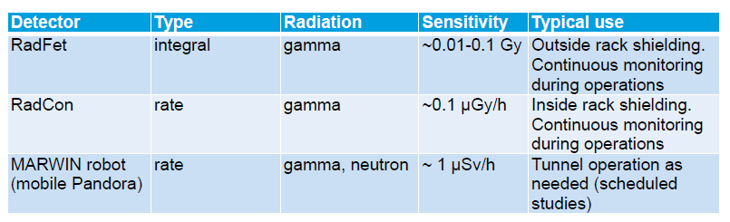
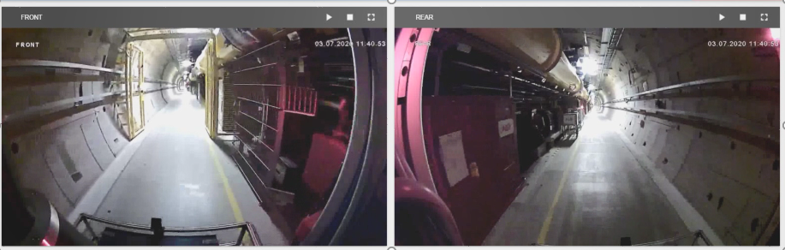

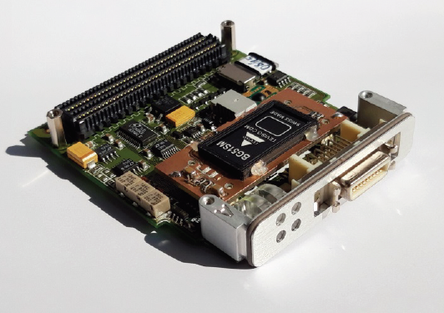
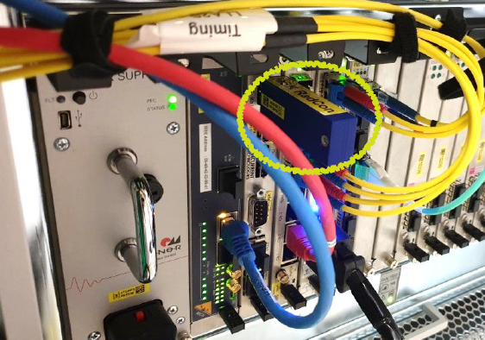
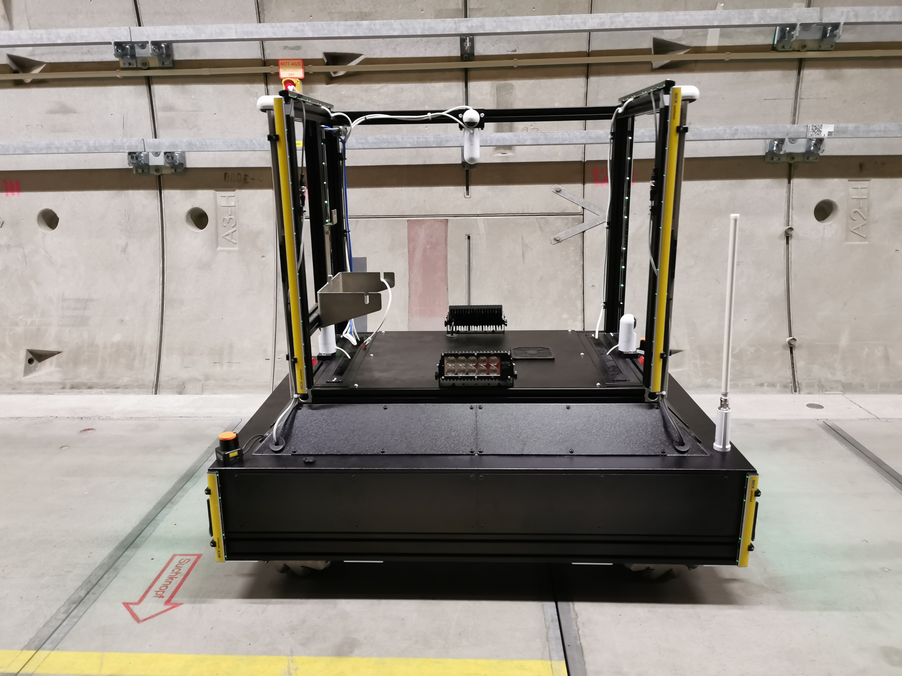
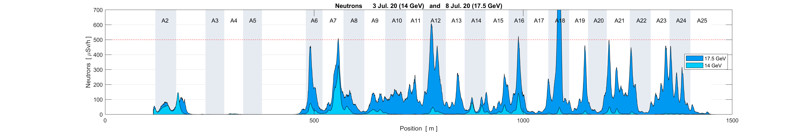
Dark Current Radiation in the Tunnel
Monitoring radiation
New field emitter detected
RadFet
RadCon
MARWIN3
Administrative limit 500 uSv/h
A12 operating above its operational gradient

Slide 17
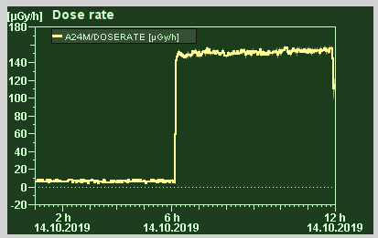
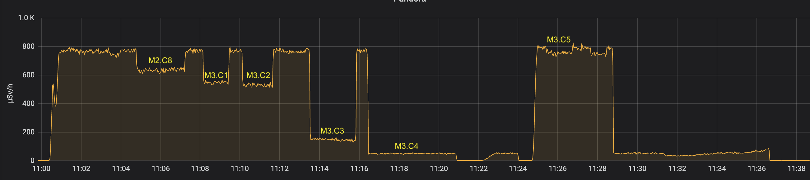
Field emitters
Example Module A18.M3.C4
Procedure
  Park MARWIN at peak neutron radiation (often located at quadrupole)
  Detune / retune cavities one at a time until field emitter is found
  Once found, detune field emitter (30-40 kHz)
sudden FE onset
observed by RadCon
administrative limit 500uSv/h

Slide 18
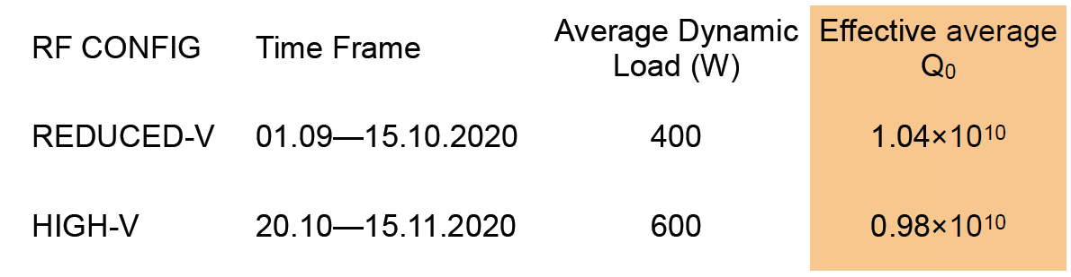
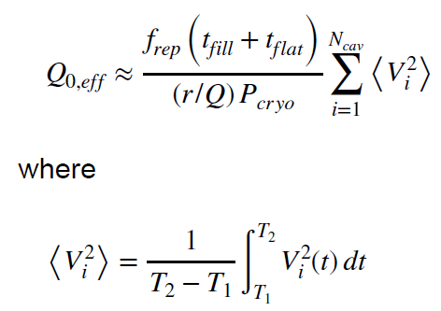
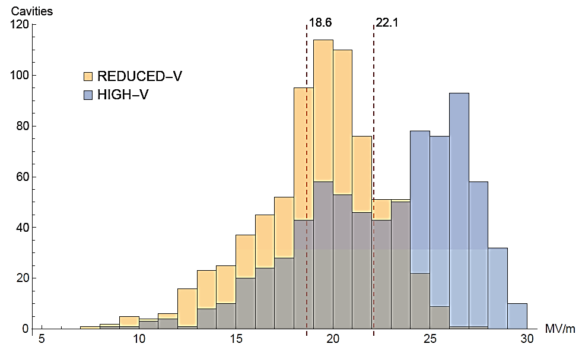
Heat Load Measurement
As part of the High-Voltage (high-VS) Experiment
Effective (average) cavity Q₀ from measured dynamic load
LOW-VS
HIGH-VS

Slide 19
Operations Summary

Slide 20
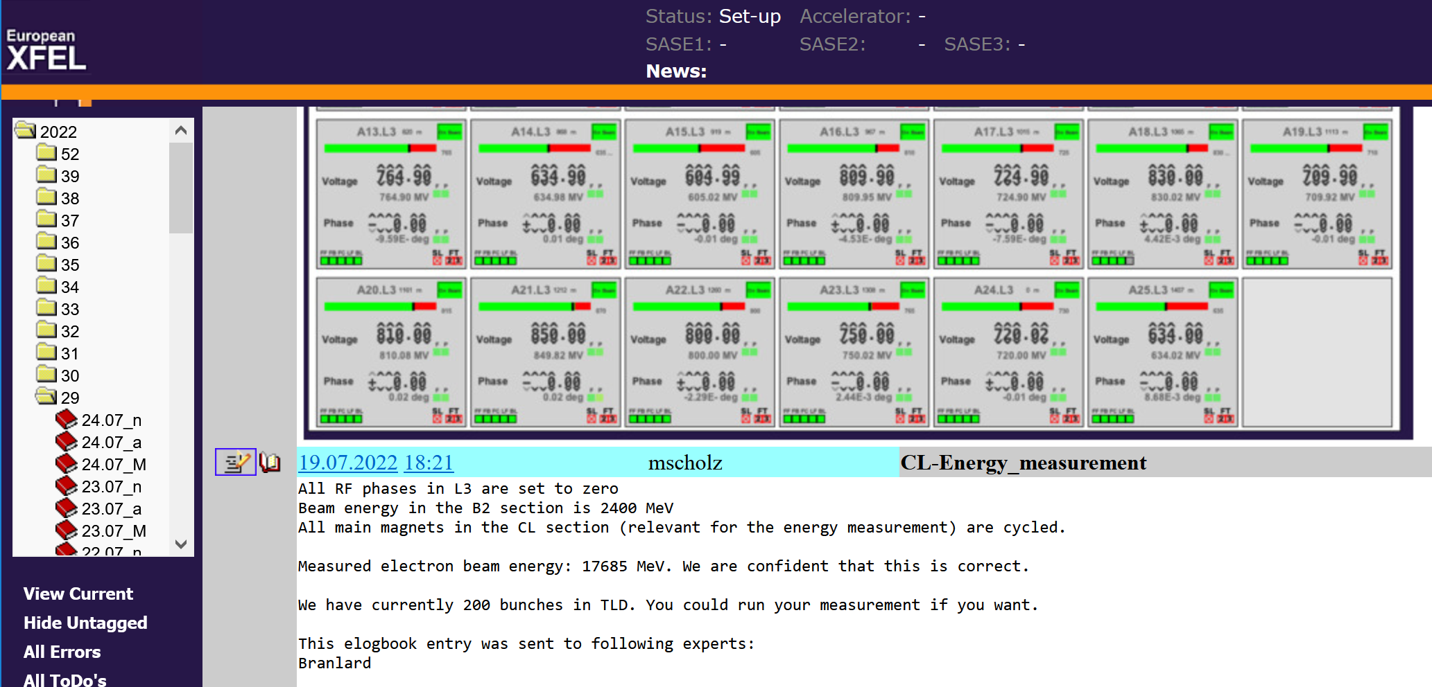
Summary
Last but not least…
We are cold since 1/2017
RF linac availability > 95% (100% achieved for some weeks)
Constant monitoring and survey of maximum energy
Some cavity degradation observed (on 1% level)
Keep a close eye to radiation and field emitters (online monitors, scans, studies)
Linac development includes exploring the energy / power parameter space
Well developed strategies for reliable high energy operation (see picture 17.685 GeV)
Better prepared for emergency detune
From the European XFEL Logbook…

Slide 21
On-going Development
Disclaimer:
Improving the facility means creating more flexibility in operating parameters but we also need to consider energy savings and to be getting greener…

Slide 22
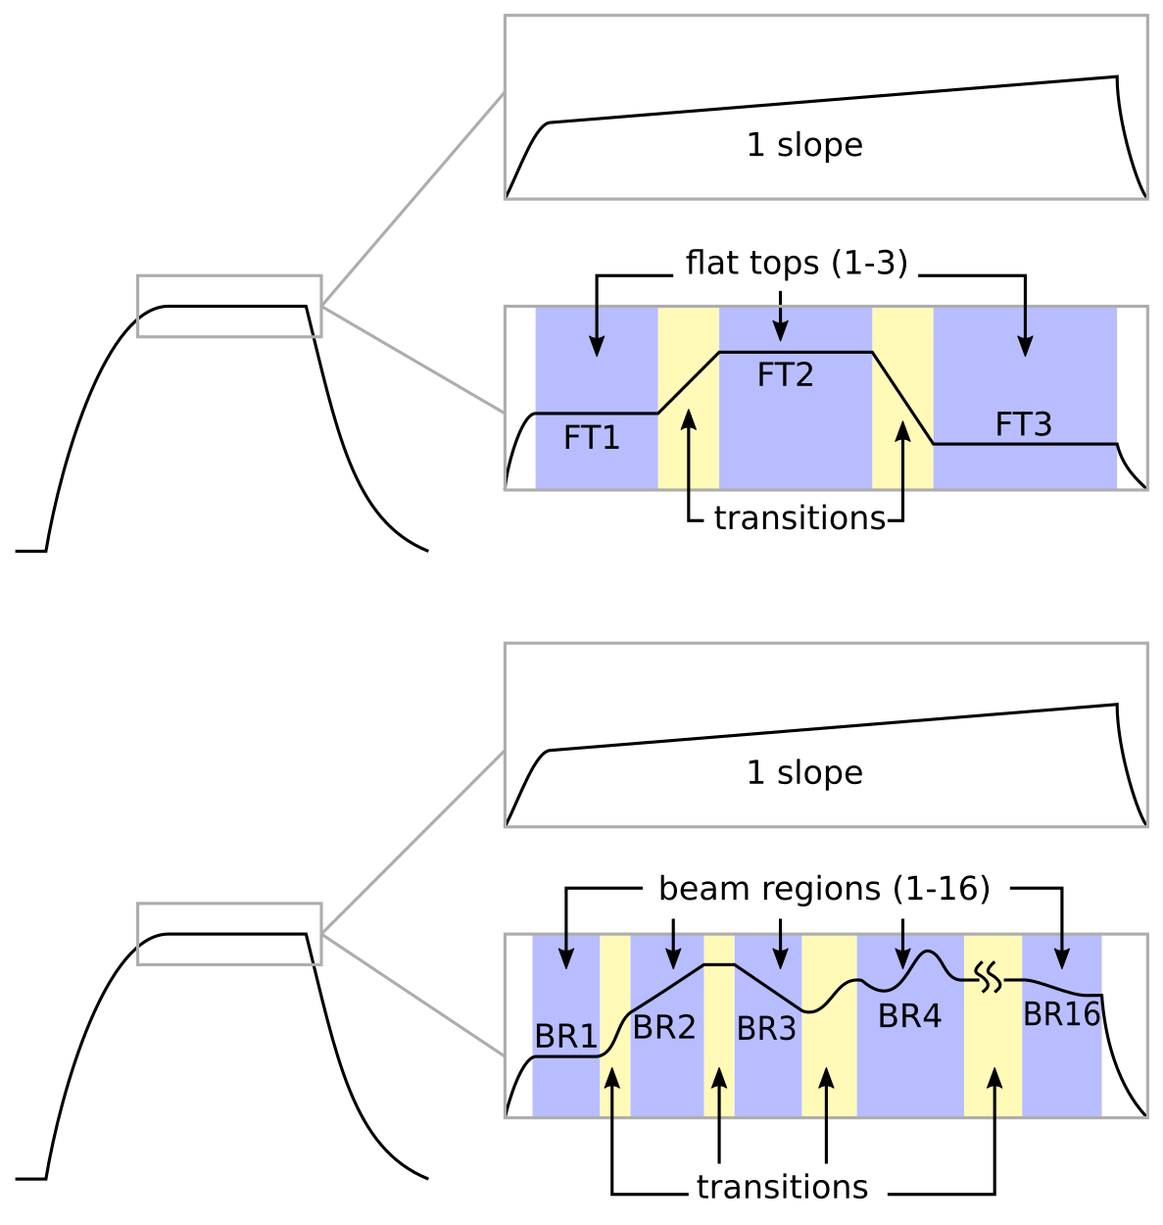
On-going Developments
Beam Regions
So far
  only option to set up to 3 different flat tops (ampl/phase)
  or a slope across the entire beam time
New
  define up to 16 beam regions (BR) based on beam parameters (chirp, energy)
  BR can have arbitrary waveforms (within limits)
  constant slope still supported
Challenge(s)
  More complexity (high-level controls)
  Fast transitions require high peak klystron power
Gains
  Our users like the flexibility
now
new

Slide 23
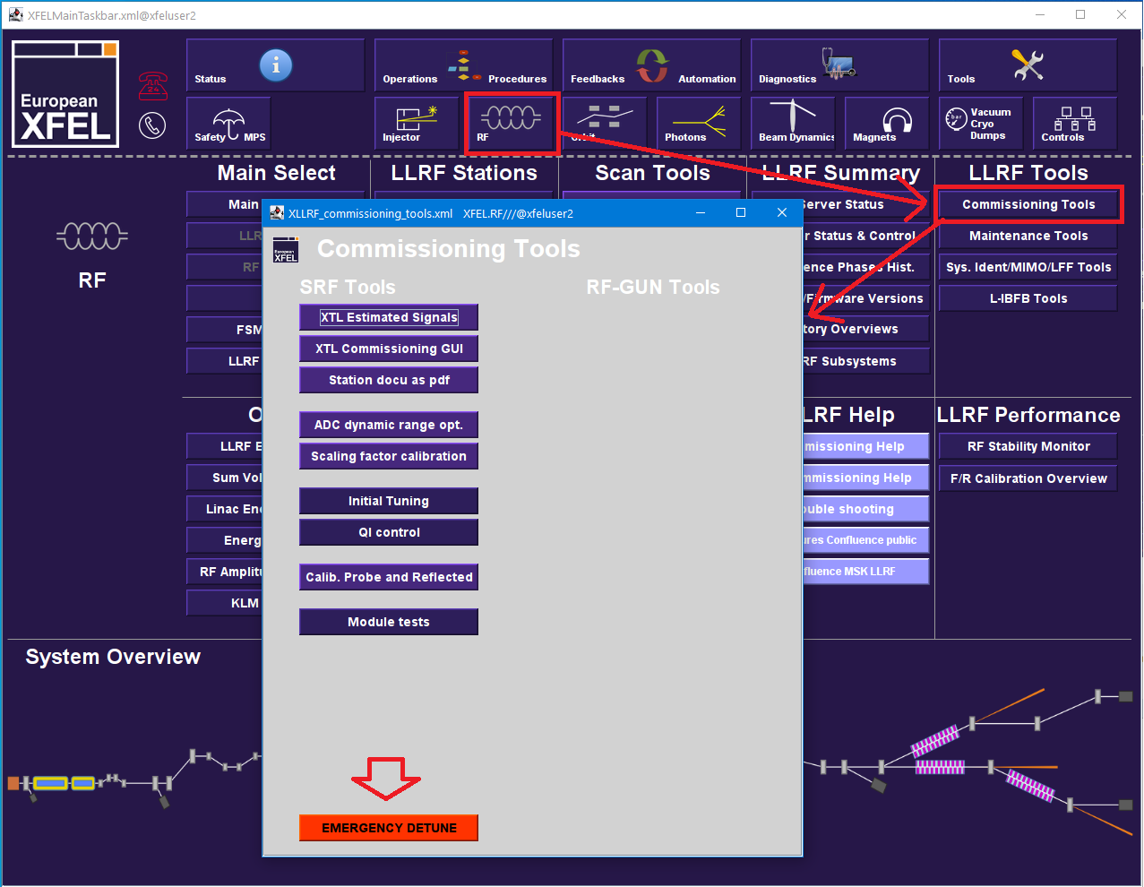
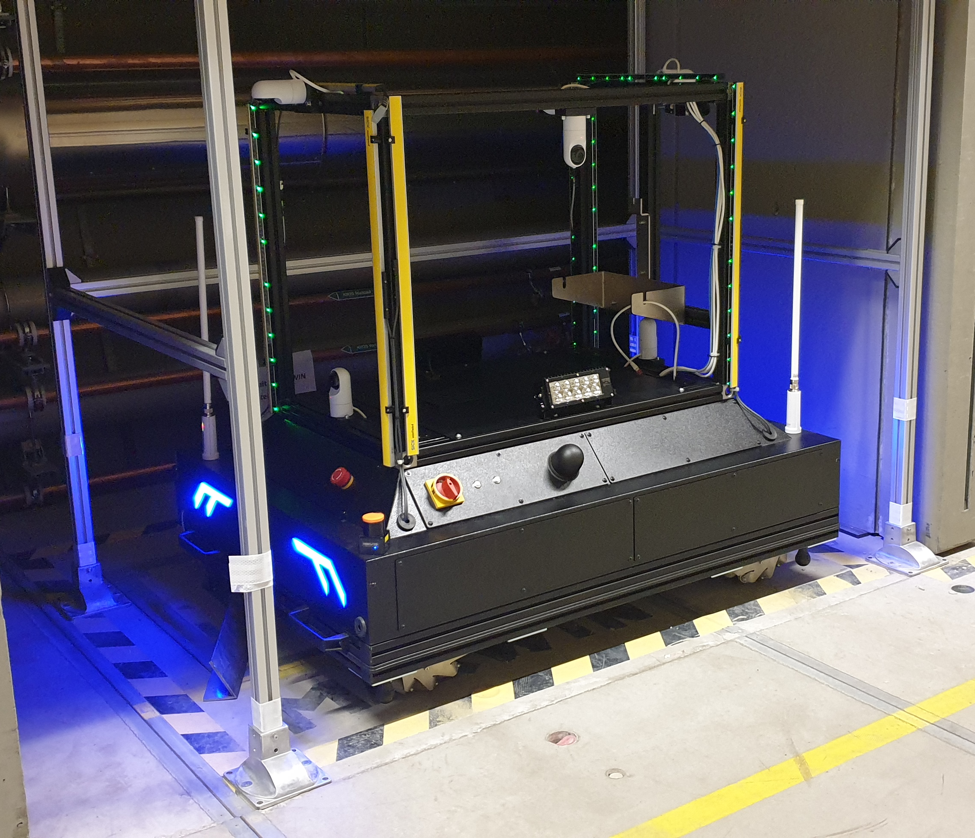
On-going Developments
Various machine development strategies
Improve energy efficiency
  By reducing modulator high-voltage to min. required
  Possible cost saving ~400k€/year, lower C0₂ emissions (~ 800 t/year)
  No low-hanging fruit, every effort counts
Emergency automatic cavity detune
  Developed, tested and successfully used tool
  All 776 SRF cavities detuned within < 40 mins
  Same time for retuning
Next generation radiation inspection robot
  MARWIN3 (faster tunnel scans ~ 1h)
  Routinely used for radiation maps and studies

Slide 24
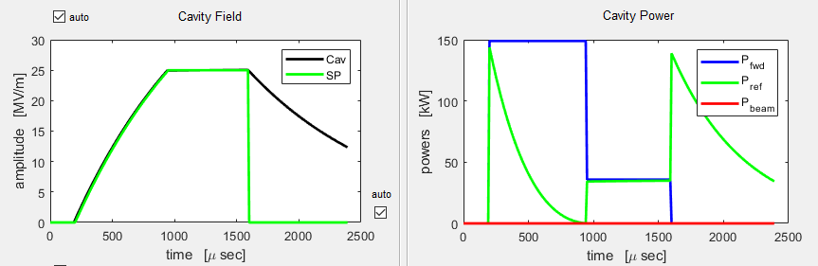
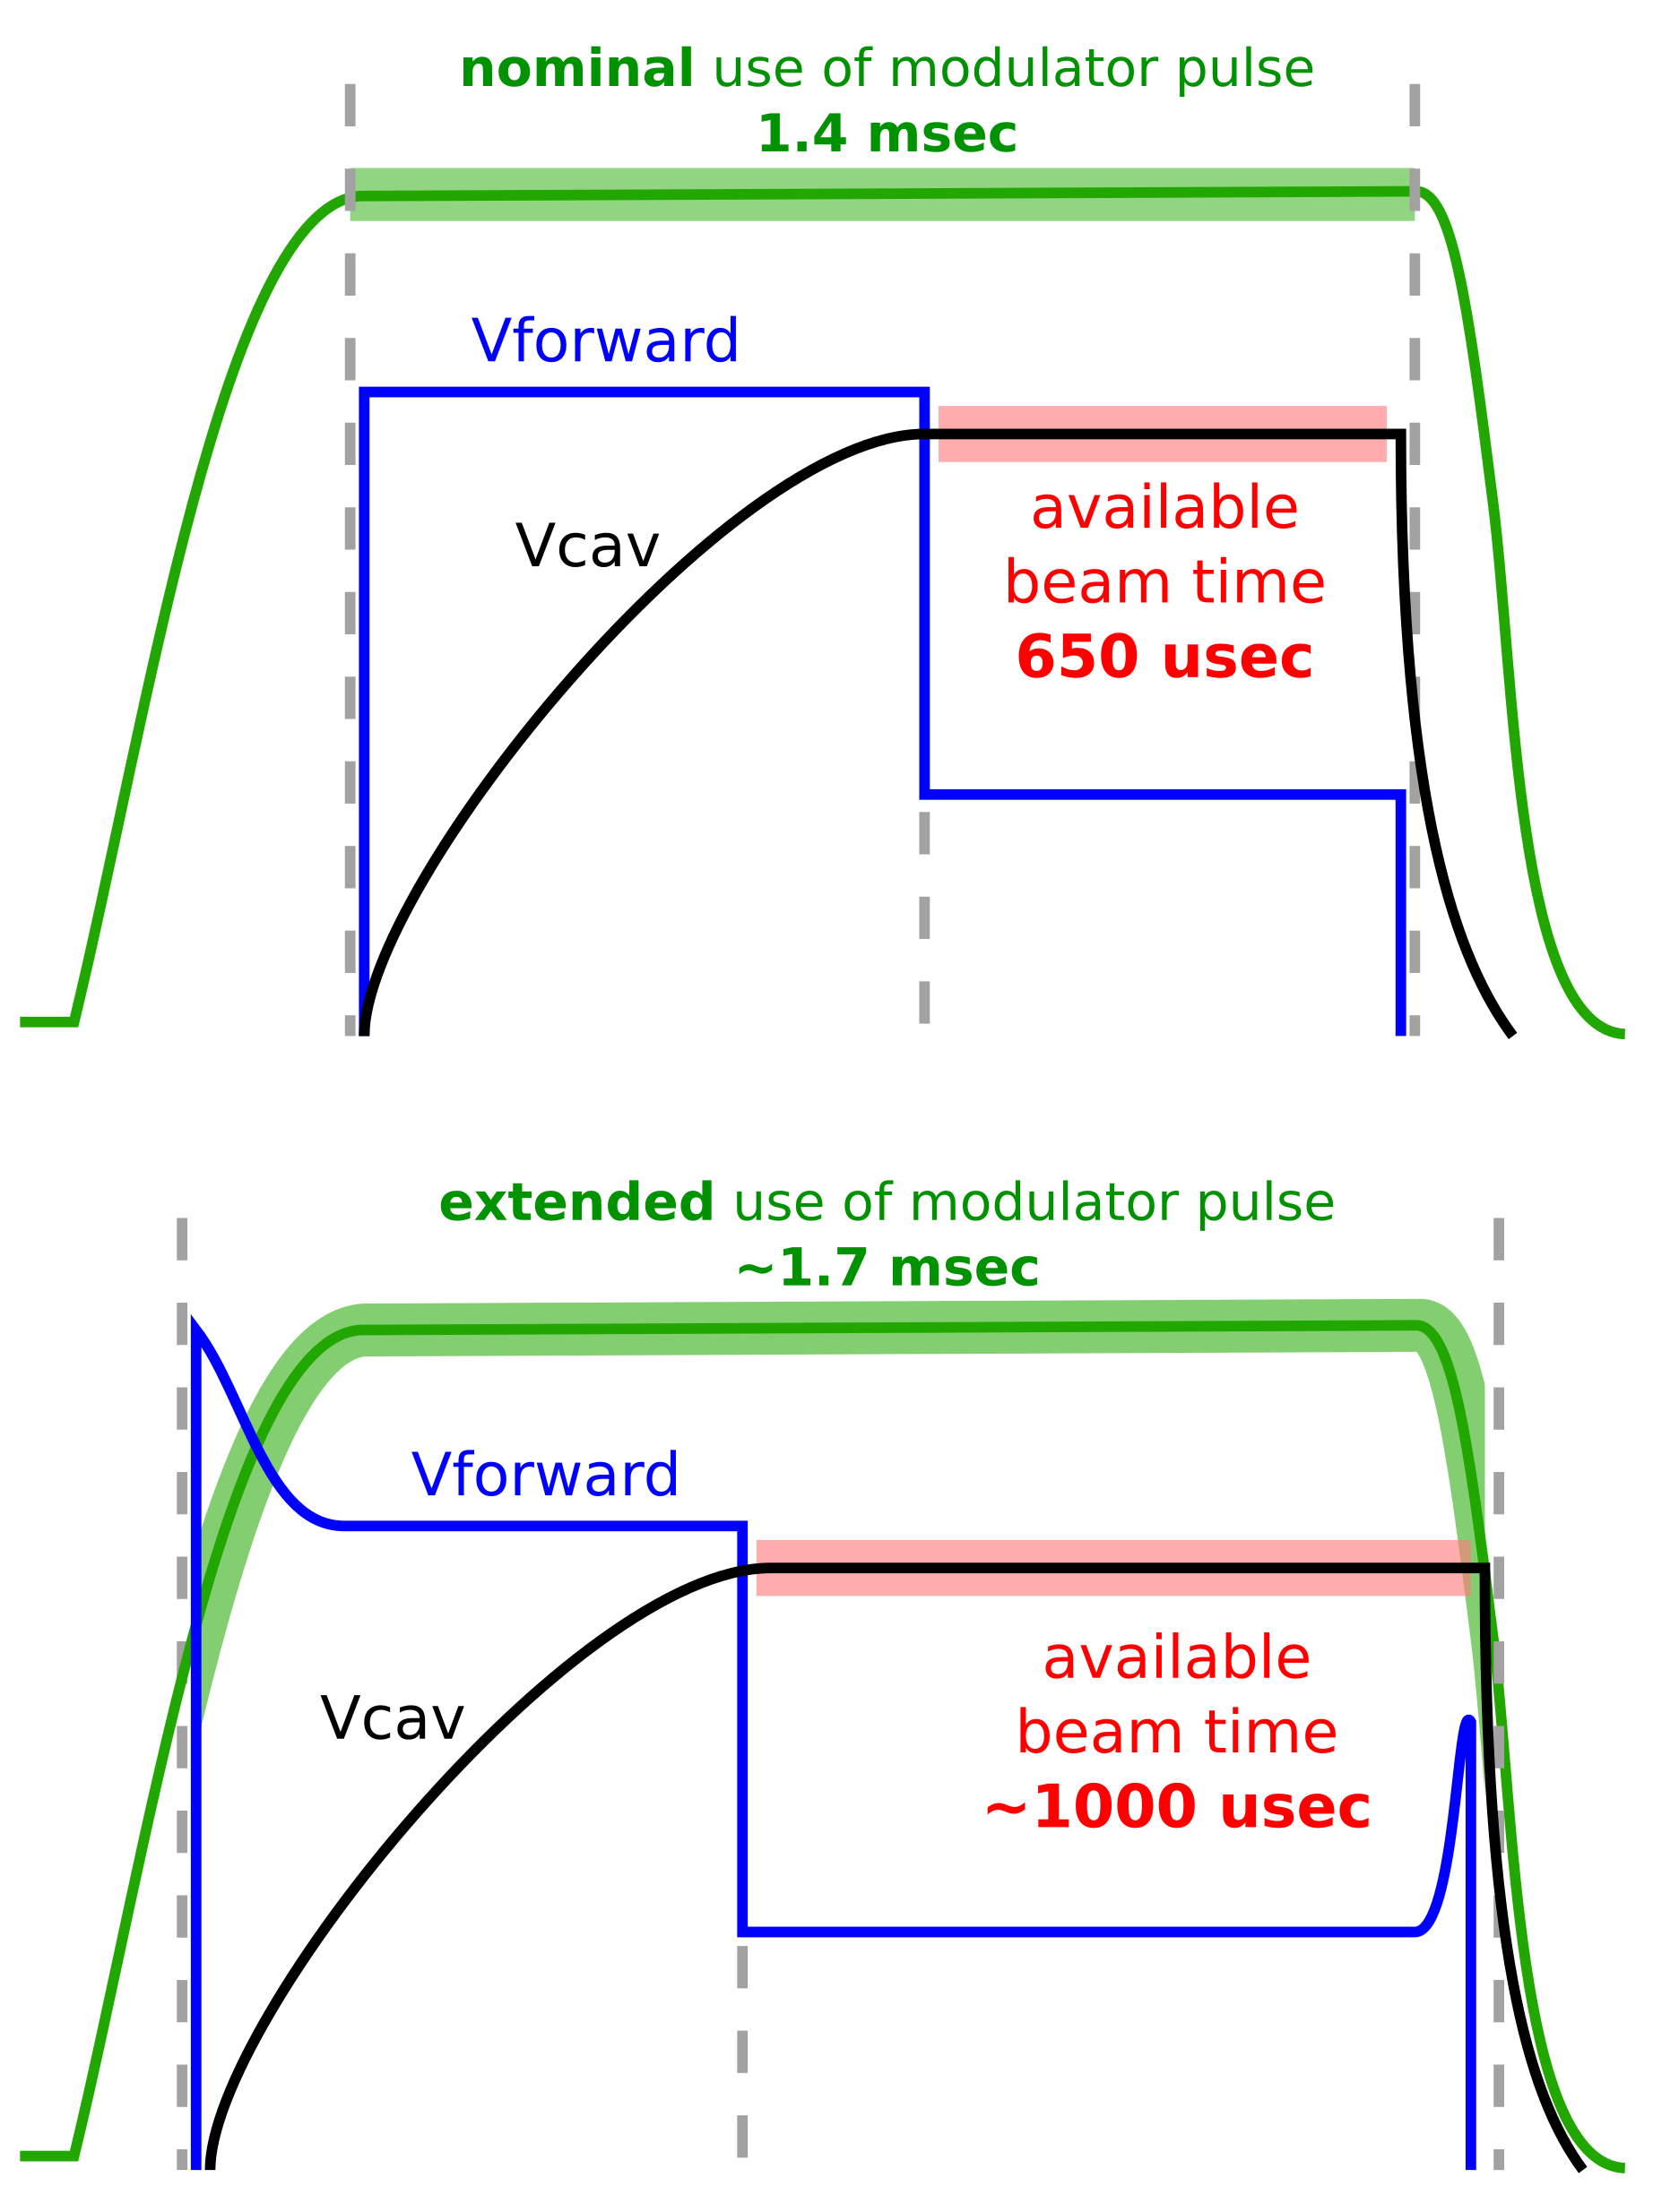
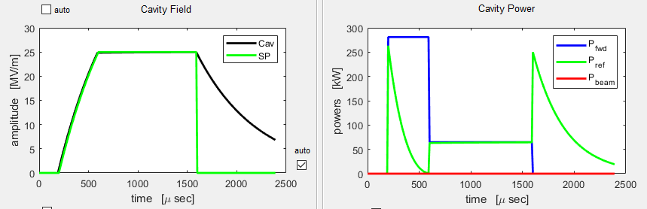
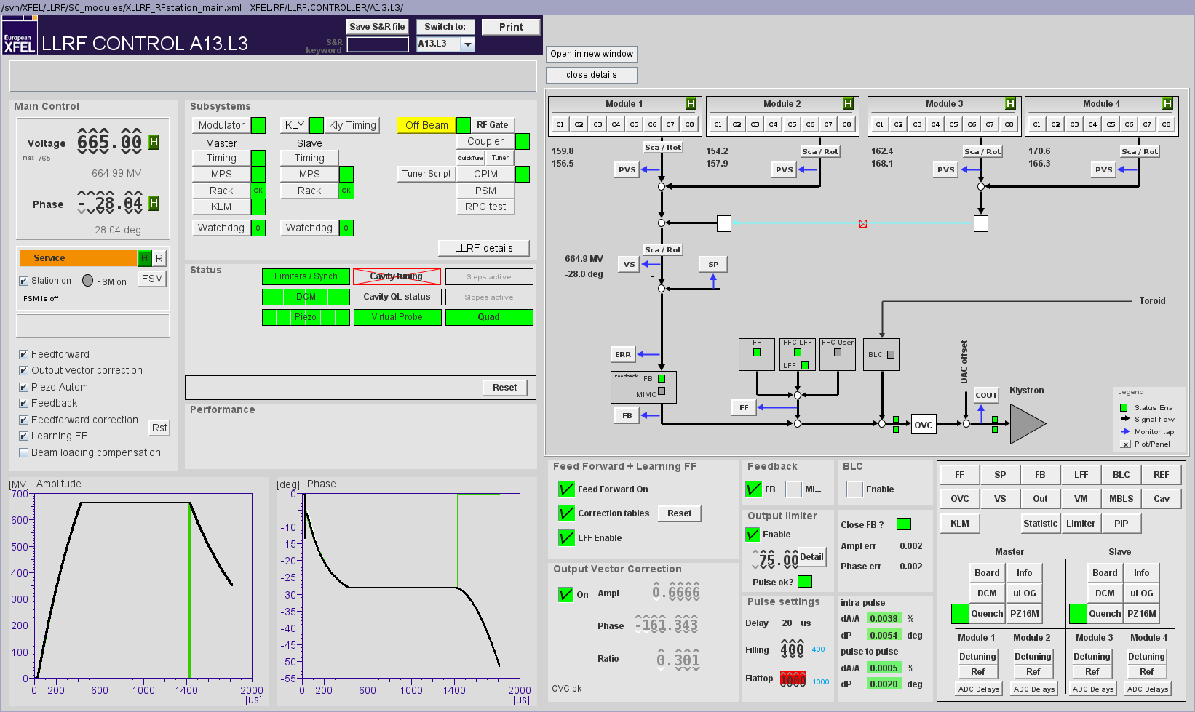
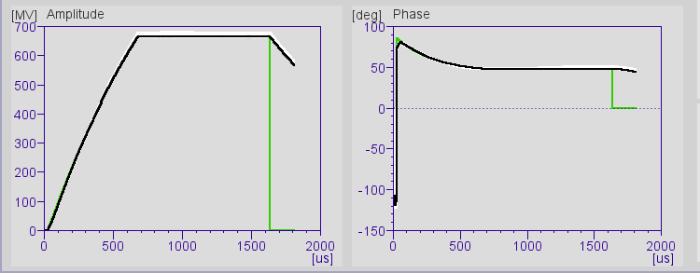
On-going Developments
Extending RF available for beam acceleration (for 14 GeV)
Sept 2021 : longer beam time by shortening fill time
and lowering Q_{L} (4.6e6 → 2.5e6)
March 2022 : longer beam time by using extended modulator pulse
Note: the same approach could be used to shorten the modulator pulse (possible energy savings)
A13 665 → 1000 µsec flat top
A10 665 → 970 µsec flat top

Slide 25
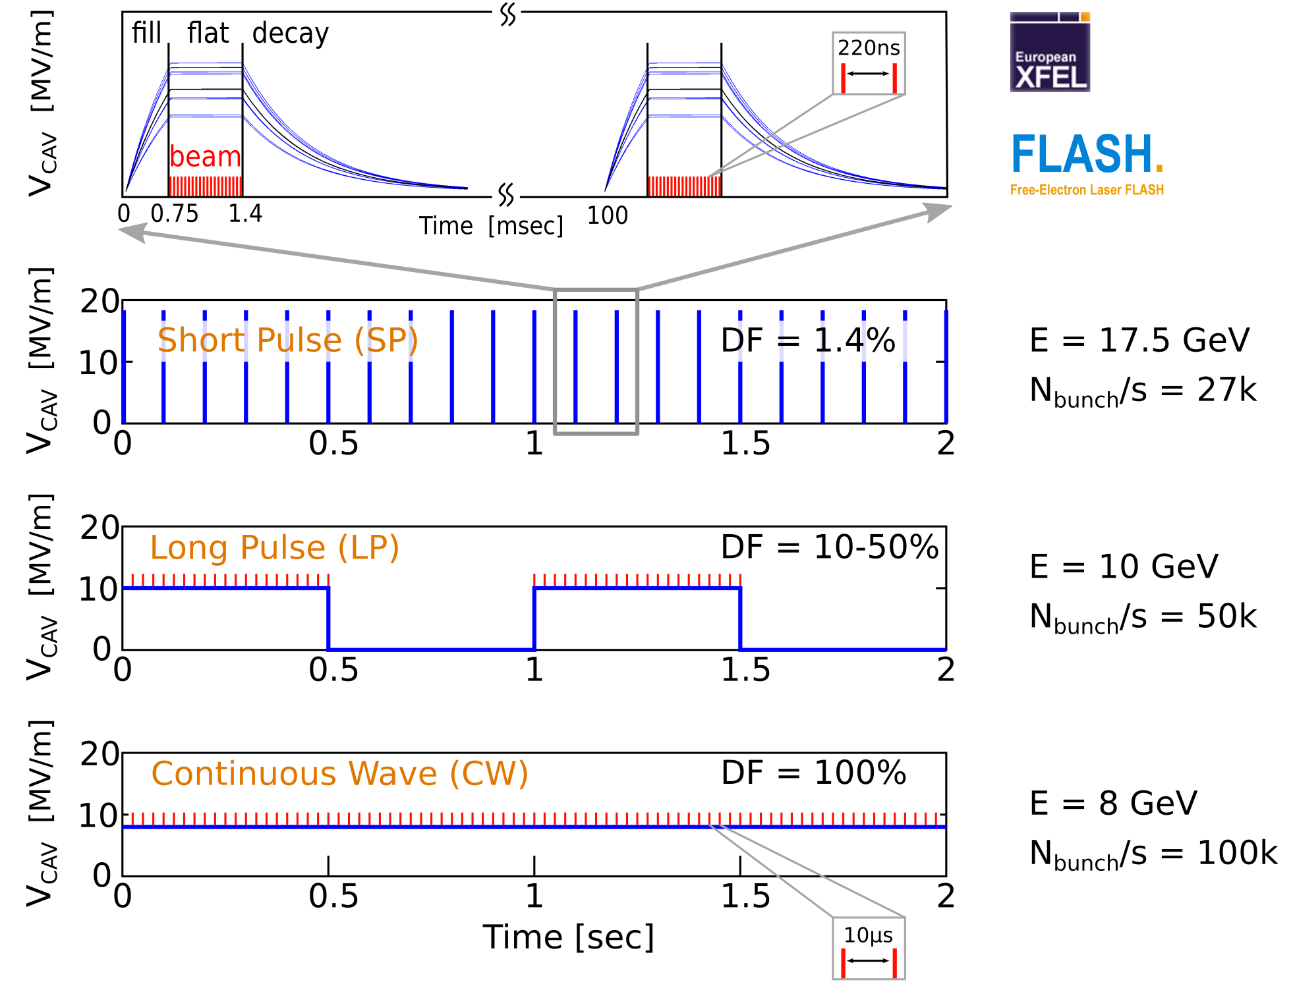
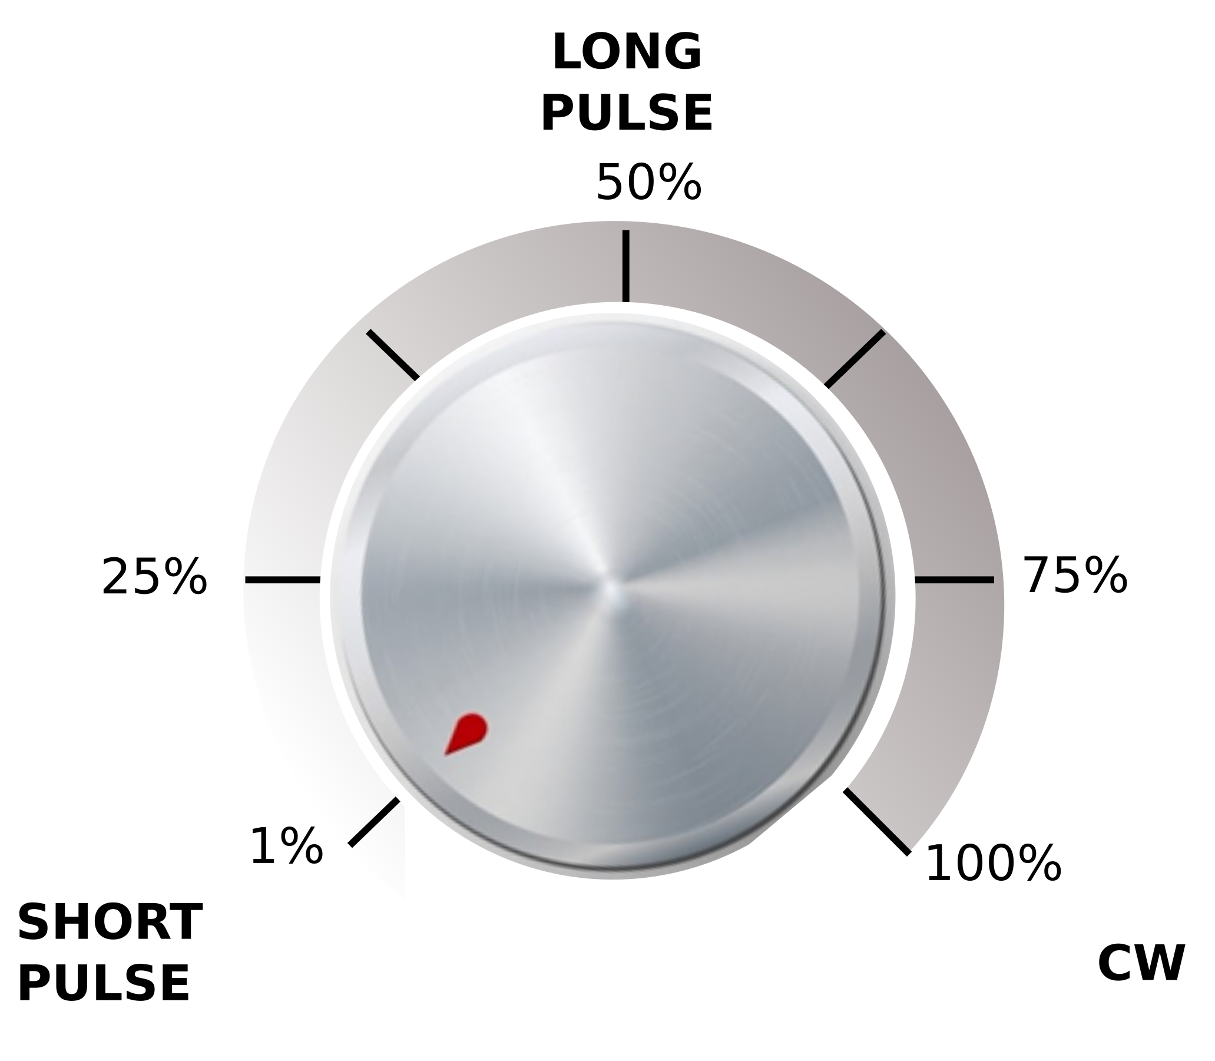
CW as a possible extension of EuXFEL operation
Short Pulse (SP), Long Pulse (LP) and Continuous Wave (CW) operation
CW would be in addition to SP
Not just CW but also LP
Explore the parameter space:
  beam energy vs. RF duty factor at constant dynamic heat load
E = 17.5 GeV
E* = 10 GeV
E* = 8 GeV
* design goal pending on-going R&D

Slide 26

CW as a possible extension of EuXFEL operation
Injector
1.3 GHz module
3.9 GHz 3rd harm.
L1
4 modules
(1 RF station)
L2
12 modules
(3 RF stations)
L3
80 modules
(20 RF stations)
SASE2
A2
A3
A4
A5
A2
A3
A4
A5
A6
A25
A6
A29
A1
AH1
A1
AH1
+4 stations
SASE1
SASE3
cw optimized modules
Linac section L3
lengthened by former A2 … A5
80 + 16 = 96 modules
24 RF stations
operated at moderate CW gradients
Many detailed and
quite interesting studies
are on-going…
1 – Replace the front-end cryomodules (17x)
  Larger cooling capability
  CW cavities
2 – Install CW capable RF sources
  1x (2x?) IOT(s) per RF station
3 – Double the cryo plant capacity (cost driver)
  2.5 → 5kW
4 – Install CW capable gun
  RF gun in second injector

Slide 27
Further recommended reading
LLRF2022 Julien Branlard Machine Learning assisted Cavity Quench Identification at the European XFEL
SRF2021 Julien Branlard (DESY), Four Years of Successful Operation of The European XFEL.
LINAC 2020 Nick Walker Performance and Operational Experience with the European X-FEL Linac
….
FEL2017 Winfried Decking, Hans Weise Commissioning and First Lasing of the European XFEL
Thank You

