Slide 1
Operation of the CeC 113 MHz SRF Gun
Igor Pinayev for CeC Team
Brookhaven National Laboratory

Slide 2
Introduction
The gun quarter-wave cavity was developed as part DoE SBIR program to be a prototype for the electron cooling
It was configured as SRF gun with room temperature photocathode for the Coherent Proof-of-Principle Experiment at RHIC
The aim of the experiment was to demonstrate cooling of single hadron bunch circulating in RHIC
S. Belomestnykh et al., Proc. of PAC’11, TUP051
V.N. Litvinenko et al., Proc. of IPAC’12, MOPPD016
D. Kayran et al., Proc. of IPAC’12, MOPPP028

Slide 3
Design Parameters
Parameter | Value
Frequency | 112 MHz
R/Q (linac definition) | 126 Ω
Geometry factor | 38.2 Ω
Quality factor Q₀ w/o cathode insert | > 3.5×10⁹
Operating temperature | 4.5 K
E_{pk}/V_{acc} | 19.1 m⁻¹
B_{pk}/V_{acc} | 36.4 mT/MV
Operating voltage | 2 MV
T. Xin et al., Rev. Sci. Instrum. 87, 093303 (2016)

Slide 4
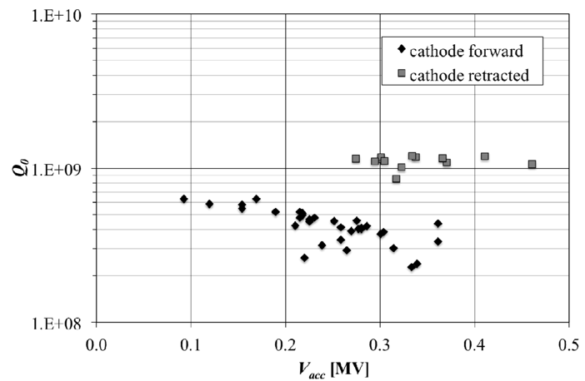
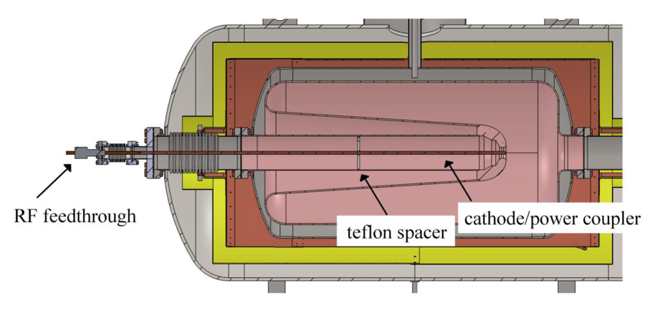
First Tests
Due to the size of this cavity, testing in the cryomodule was easier and more efficient than trying to carry out an intermediate test before cryomodule assembly
The cryomodule’s vacuum vessel was made from low carbon steel. The vessel was demagnetized and acted as a magnetic shield.
Fundamental mode frequency was 113 MHz
Cooling time was 3.5 hours
Heat load 7 W
Observed gap voltage was 0.5 MV limited by allowable radiation levels
Sensitivity to the helium bath pressure is 10 Hz/mbar
S. Belomestnykh et al., Proc. of SRF’11, MOPO054
S. Belomestnykh et al., Proc of PAC’11, TUP051

Slide 5
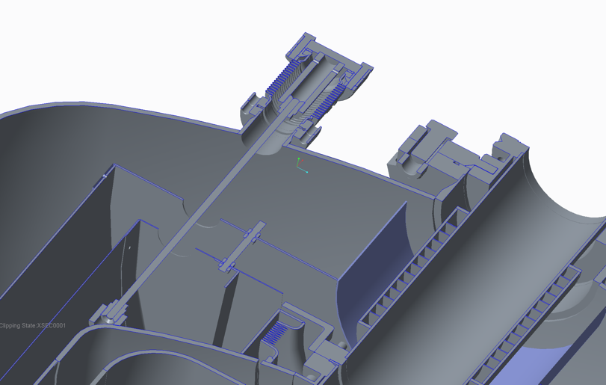
Modifications for CeC Experiment
The low-carbon-steel vacuum vessel was replaced with the stainless steel
The vacuum vessel has flanges on both ends to allow easy access to inside of the cryostat
Cryogenic stack was modified to interface with the BNL He refrigeration system
Two manual coarse tuners provided 80 kHz tuning range to match the harmonic of the RHIC revolution frequency
Fine tuning is achieved with movable FPC (tuning range >3 kHz)

Slide 6
Conditioning
The modified gun was cold tested again at Niowave in December of 2012 and February of 2013. During the test we have encountered multipacting zones
at very low fields, which were processed only after we modified the RF input coupler to increase its coupling.
Black squares show the processing which includes the activation of emitter and the consequent Q switch. Blue dots show the final Q₀ vs. V_{c} curve after the high power pulse process.
After processing the gap voltage reached 0.92 MV in CW mode, only limited by the radiation concern at Niowave test facility.
S. Belomestnykh et al., Proc. of SRF’13, MOP016
S. Belomestnykh, Proc. of SRF’13, MOIOB03

Slide 7
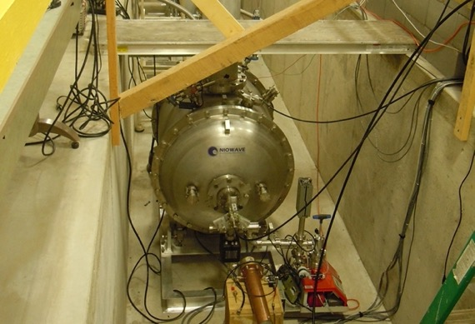
Tests after Modification
A ring down measurement of 3.2 dB in 4.7 seconds
Measured low-field Q exceeded 4×10⁹ (no coupler correction)
Frequency sensitivity to pressure is 8 kHz/mbar
T. Xin et al., Proc. of PAC’13, THPAC35

Slide 8
Cross Section of the Installed Gun

Slide 9
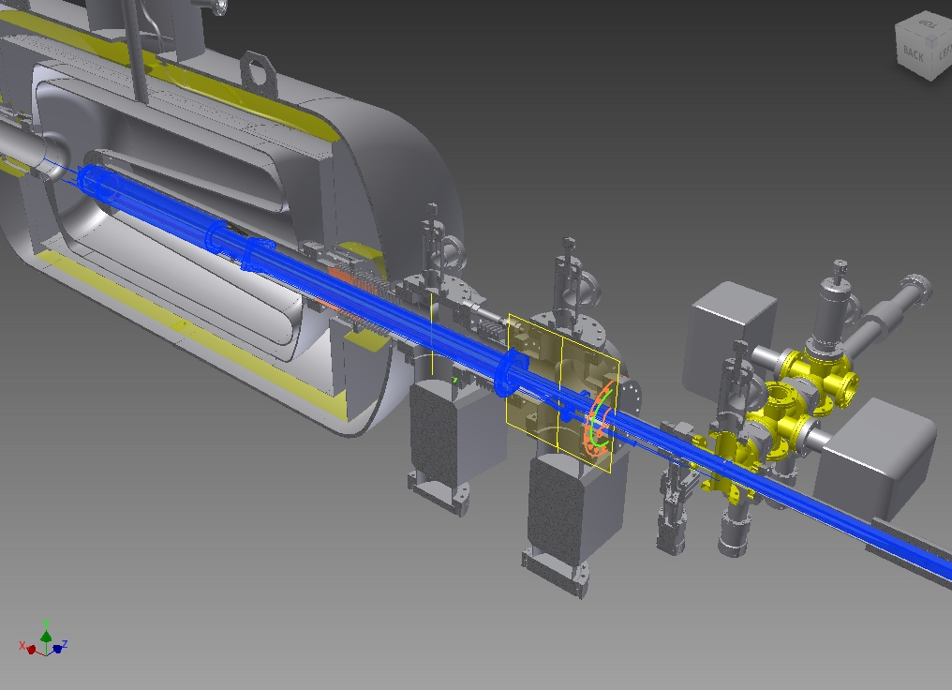
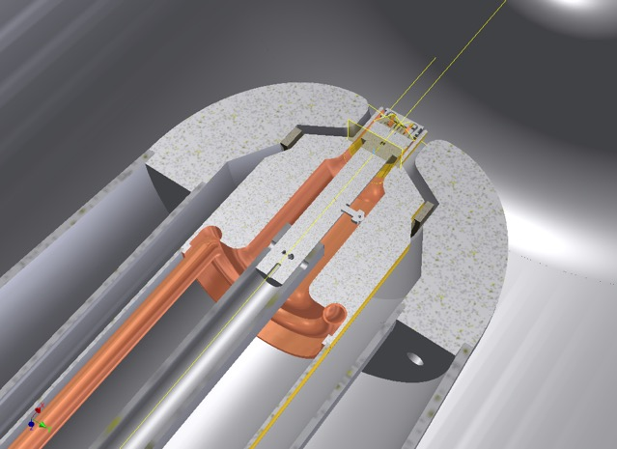
Cathode Injection System Components
Kinematic stalk stop
Cooling line interface
Stalk Assembly
Cathode and stalk position can be adjusted inside the cavity nose for beam dynamics
External stalk Ion pump
Internal stalk Ion Pump

Slide 10
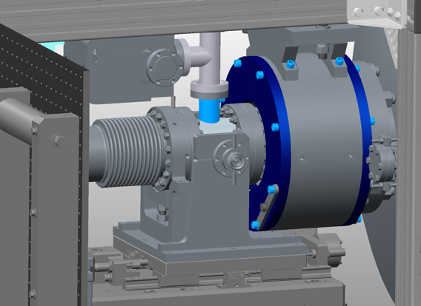
Fundamental Power Coupler
Movable fundamental power coupler serves two purposes:
Fine frequency tuning (full range 4.5 kHz)
Coupling adjustment
After initial tests and selecting operating frequency the manual tuner was adjusted that nominal FPC position corresponds to the optimal coupling
J.C. Brutus et al., Proc. of PAC’13, WEPAC07

Slide 12
Multipacting
Areas of the gun affected by multipacting (shown in white). Primary electrons are emitted from the surface of the FPC.
Trajectories of electrons at two multipacting sites (red lines). The left one is under 29 kV gap voltage and the right one appears at 40 kV gap voltage. The color scale indicates the relative strength of electric field.
T. Xin et al., Proc. of PAC’13, THPAC13
T. Xin et al., Proc. of IPAC’15, TUPMA048
I. Petrushina et al., PRAB 21, 082001

Slide 13
Initial Conditioning
Vacuum oscillation in the FPC during vacuum conditioning
Gun voltage pulse during conditioning
Voltage oscillations due to the thermo-acoustic instability
Cavity conditioning was performed with pulsed vacuum operation followed by condition with helium at 10⁻⁶ Torr pressure. It took about a month from start with pulse conditioning to generate first electrons.
S. Belomestnykh et al., Proc. of IPAC’15, WEPWI049
S. Belomestnykh et al., Proc. of SRF’15, THPB058
I. Petrushina et al., Phys. Rev. Accel. and Beams, 25, 092001 (2022)
Pressure during helium conditioning

Slide 14
One of the First Beams
After gun cavity conditioning we have inserted cathode and obtained the first electron beam.
We performed laser phase scan to synchronize laser and gun RF.
I. Pinayev et al., Proc. of FEL’15, TUD03
I. Pinayev et al., Proc. of NAPAC’16, WEPOB59

Slide 15
First Energy Measurement with Solenoid
April 21 2016
54 degree 1.2 MV
7 g/s helium consumption
We have tried to measure the beam energy using trims but found that measurements inconsistent. Therefore we developed new method based on rotation of the plane of motion by solenoid.
I. Pinayev et al., Rev. Sci. Instrum. 92, 013301 (2021)

Slide 16
Breaking through Multipacting Barriers
The outgassing during multipacting damages the QE of photocathode. Therefore, we have developed and later automated procedure to overcome the multipacting barriers:
Close valve to block light
Turn off solenoid current
Fully insert FPC (low external Q)
Drive the cavity at low power below the first multipacting barrier (around 2 kV) for tuning PLL
Apply short full power pulse. If the voltage exceeds the highest multipacting barrier then full power stays, otherwise it drop to zero.
Slowly withdraw FPC with gradual decrease of the drive power
Turn on IQ loop
Increase of PA power from 2 kW to 4 kW also helped
I. Petrushina et al., Proc. of IPAC’19, TUPTS079

Slide 17
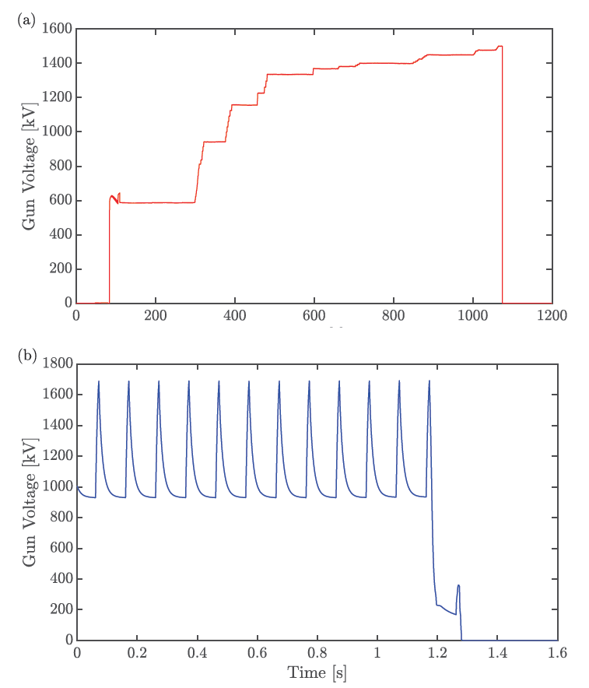
Achieved Performance
Parameter | Value
CW Voltage | 1.5 MV
Pulsed voltage | 1.7 MV
Bunch charge | 19.7 nC
Idle He consumption | 1.4 g/s
1.35 MV He consumption | 2.5 g/s
Microphonics ∆F | 5-10 Hz
I. Petrushina et al., Phys. Rev. Lett., vol. 124, no. 24, p. 244801
I. Petrushina et al., Proc. of IPAC’21, WEPAB138
E. Wang et al., Scientific Reports, vol. 11, no. 1, pp. 1–9, 2021.

Slide 18
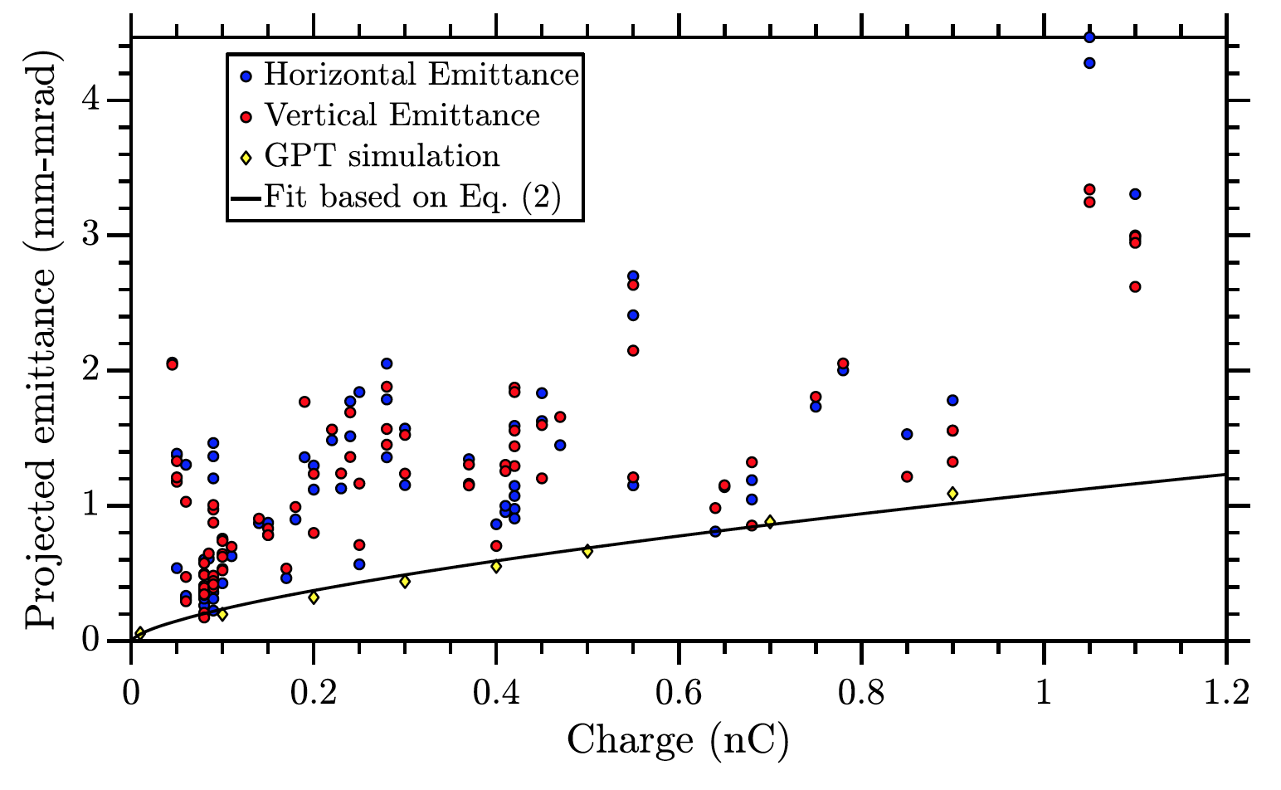
Emittance
$$ε_{n}∝\frac{\sqrt{E_{MTE}}}{E_{em}}{\left(\frac{q}{∆t}\right)}^{2/3}$$
I. Petrushina et al., Phys. Rev. Lett, 124, 244801

Slide 19
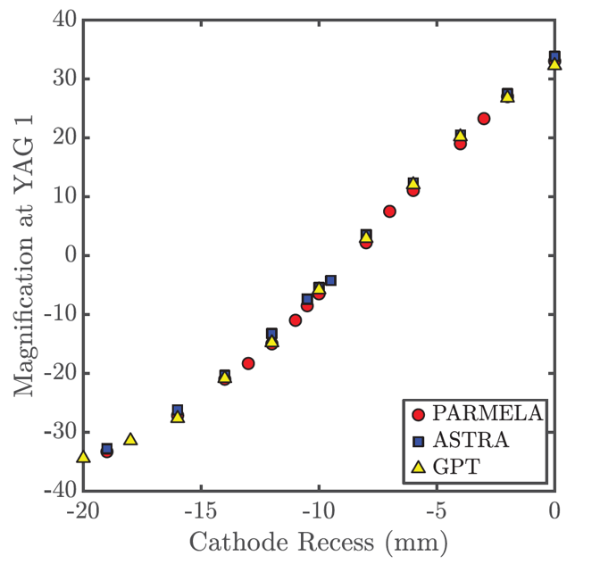
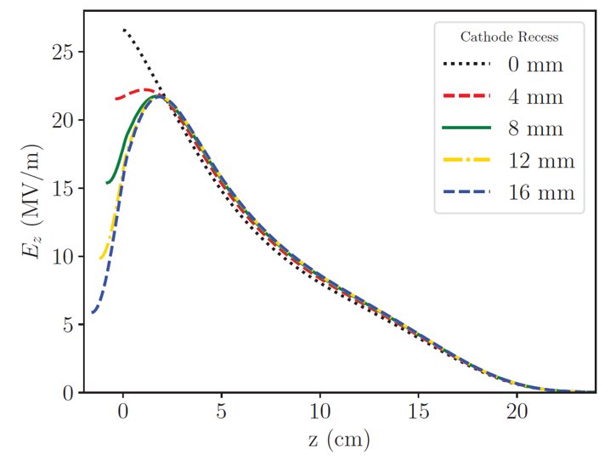
Measuring Cathode Recess
Distribution of the axial electrical field depends on the location of the cathode vs. cavity nose as well as transverse field and, hence, focusing in the gun.
We scan laser spot position on the cathode and measure electron beam position on the profile monitor to extract information on the cathode location.
I. Petrushina et al., Proc. of IPAC’19, WEPRB094

Slide 20
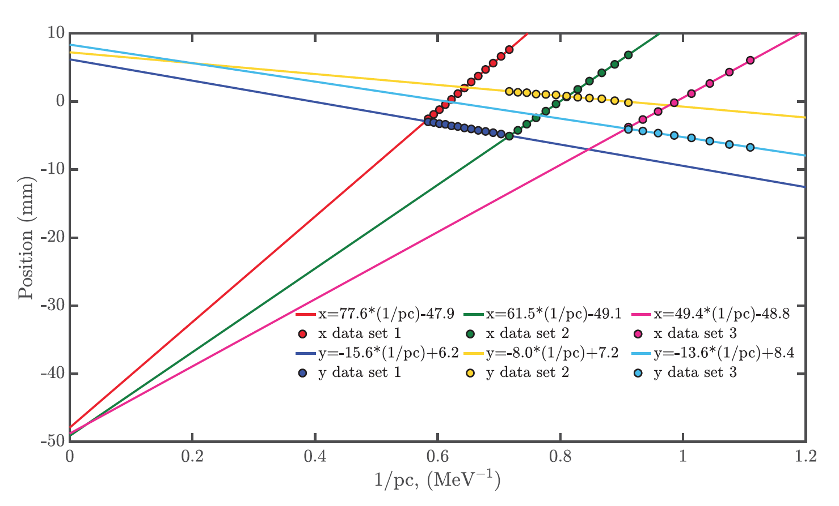
Measuring Gun Axis Tilt
We found that the electron beam leaves the gun at substantial angle.
The measurements were performed varying the gun voltage and measuring beam position on the profile monitor.
Extrapolating beam position for infinite beam energy provides information on the beam angle.
I. Petrushina et al., Proc. of IPAC’19, WEPRB094

Slide 21
Observations
Cooling of the FPC with effluent helium leads for extension of the cold region when gun is at high voltage. After voltage drop cooling rate decreases and the gases trapped on the surface are being released making sometimes hard to break through the multipacting barrier.
We also observed increase in QE after turning on electron beam (from the very beginning)
Contamination of the gun with cathode material can be eliminated by warming up the cavity (released gases neutralize the active components)

Slide 22
Future Plans
There is three-prong proposal for the future development of the SRF gun:
Development of the in situ gun conditioning
Demonstration of 1-10 mA CW current
Operate GaAs cathode for the polarized electron source
Hardware modifications:
Added high-power dump in the diagnostics beamline
Modified cathode insertion part to achieve high vacuum level required for the GaAs cathode
Added focusing solenoid for transport of the high-charge beam
Replaced laser allowing up to 5 MHz pulse rate
Development of the new 100 kW coupler to generate up to 100 mA
Development of Compton transmission polarimeter for polarized electron beam
I. Petrushina et al., Proc. of IPAC’21, WEPAB138

