Slide 1
Low-field Multipacting in FRIB Quarter-Wave Resonators and Its Mitigation
October 11, 2022
TTC2022 at Aomori, Japan
Sang-hoon Kim on behalf of FRIB SRF team

Slide 2
Outline
Low-field multipacting in FRIB β=0.085 80.5 MHz QWR
Theoretical calculations
Single-stub matching element to improve MP conditioning speed
Experimental results
Discussion
Summary

Slide 3
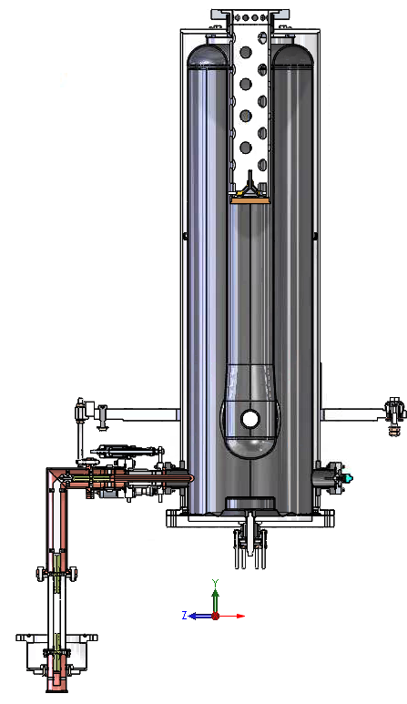
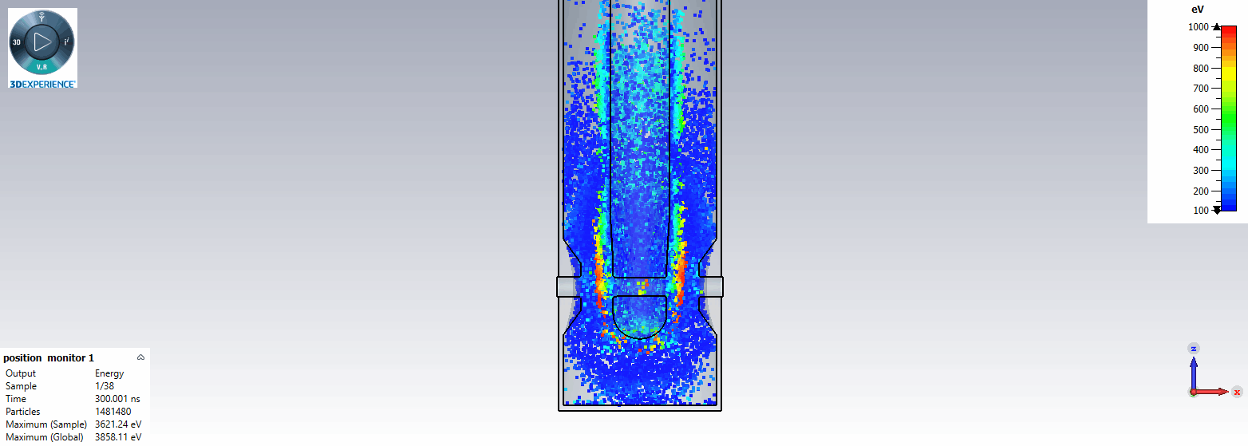
Low-field MP in FRIB QWR085
Coaxial MP between inner and outer conductors of QWR
MP band: ~6 kV/m to ~14 kV/m in E_{acc} (cf. E_{acc} spec: 5.6 MV/m)
FPC Q_{ext} is ‘fixed’ once cryomodule is cooled down: Q_{ext} = 2e6
MP electrons at E_{acc} of 12 kV/m

Slide 4
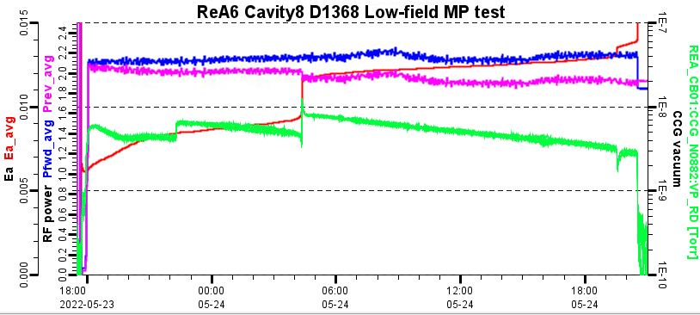
Limitation of CW MP Conditioning
Operational and conditioning experience
Techniques used in FRIB & ReA Linac: pass the MB band during the rising time before MP at “low-field” is built up
CW MP conditioning in the ReA6 cryomodule (the same as FRIB QWR085 cryomodules): 26 hours at P_{fwd} of 2 W, 16 hours at P_{fwd} of ~3 W
ReA6 cryomodule in FRIB ReAccelerator

Slide 5
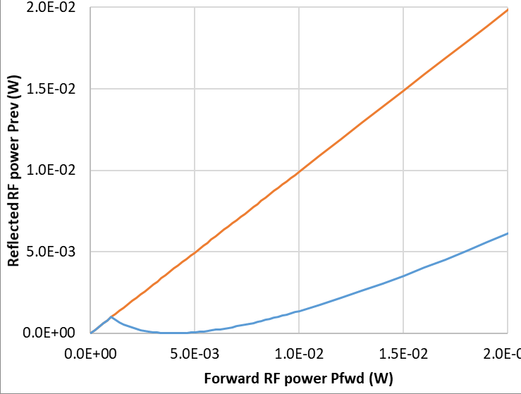
Theoretical Explanation
Time-dependent wave propagation model in a resonant cavity system [1]
Incident wave from the generator $V_{in}=V_{+}e^{j(ωt−kz)},$ Wave ‘reflected from the coupler’ $V_{ref}≅V_{+}e^{j\left(ωt+kz\right)},$ Wave radiated from the cavity $V_{rad}={−V}_{+}\frac{2β}{1+β}(1−e^{−\frac{t}{τ}})e^{j\left(ωt+kz+φ\right)},$ Backward wave $V_{−}=V_{ref}+V_{rad}$: Wave ‘reflected from the resonant cavity system’
$β$: coupling coefficient $β=Q_{0}/Q_{ext}$, $τ$: RF filling time, $φ$: cavity detuning phase
$$V_{in}$$
$$V_{−}=V_{ref}+V_{rad}$$
Power difference = dissipated at multipactor
[1] T. Wangler, “RF Linear Accelerator”, pp. 146 – 148.

Slide 6
Motivation of Stronger Coupling

Slide 7
Single-stub Matching Element: Simplified Model
stub position
transmission line
single
stub
stub length
Strongest coupling condition can be obtained when (stub position) + (stub length) ~= λ/4,
FPC is assumed to be lossless in these simulations

Slide 8
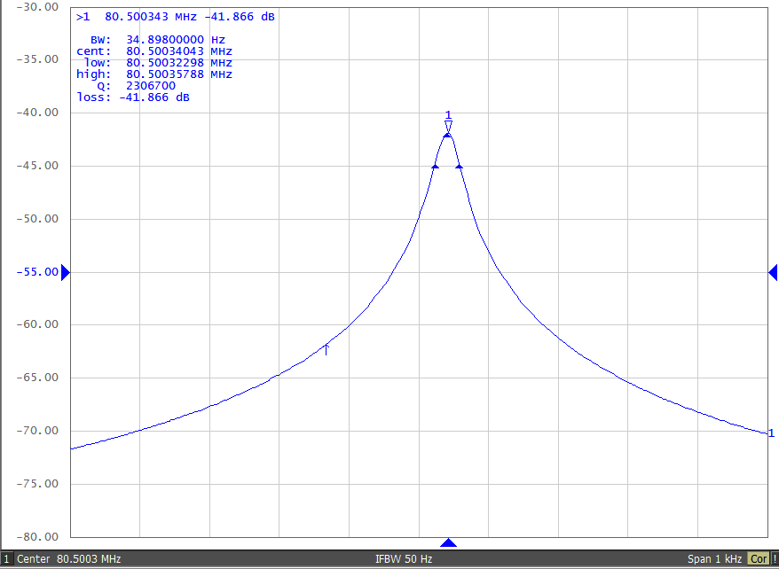
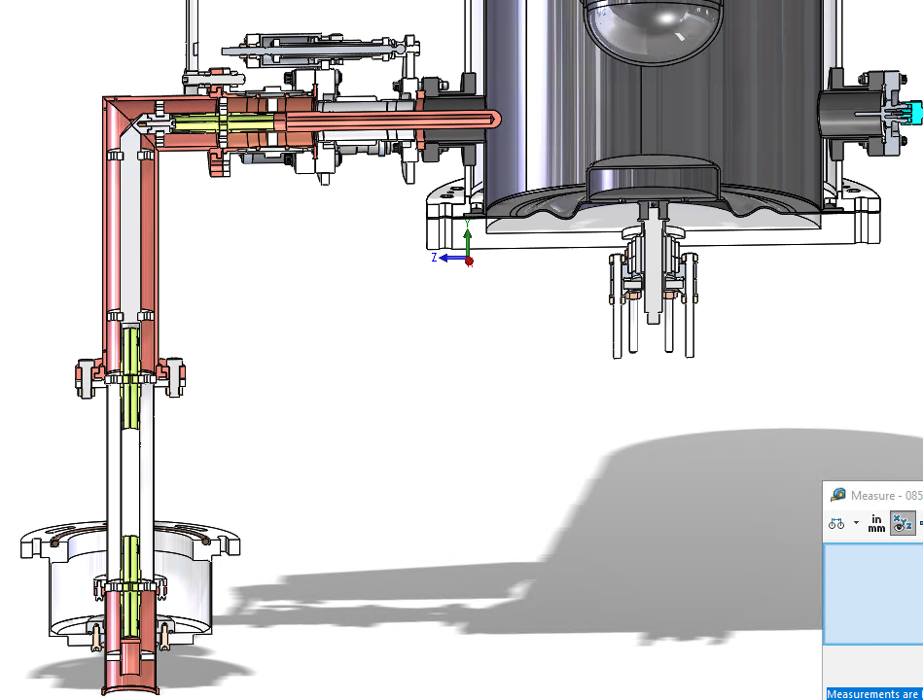
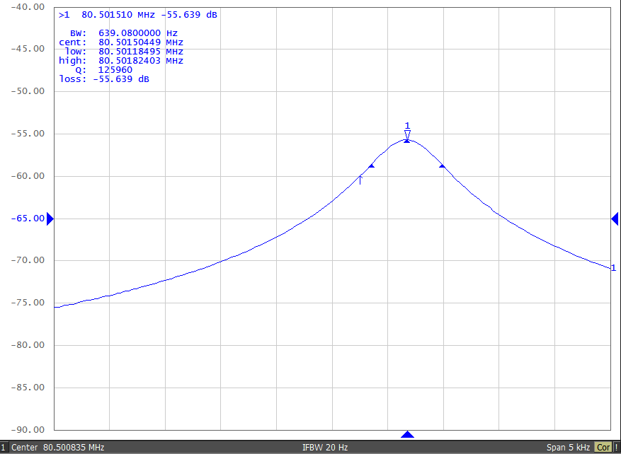
Single-stub Matching Element: Measurements
Regular FPC: Qext = 2.3e6
With single stub: Qext = 1.6e5
(Reduction of Q0 due to normal conducting structure was taken into account)

Slide 9
Improvement of Conditioning Time with the Single-Stub Matching Element

Slide 10
Discussion
Applications to linac cryomodules
Plan for FRIB linac cryomodules
CW conditioning at a few tens of Watts with the regular FPCs: already completed for ~30% of total 104 QWRs
For cavities with relatively strong MP: temporarily insert the single-stub matching element for conditioning

Slide 11
Conclusion
For the low-field MP in FRIB QWRs, theoretical calculations predicted efficient conditioning with higher RF power and/or stronger FPC coupling
Developed a single-stub matching element to externally improve coupling strength. Experimental results on MP conditioning time are consistent with theoretical predictions
More statistical results will be obtained as we perform conditioning of FRIB Driver Linac QWRs

