Slide 1
LCLS-II-HE: High Q₀ and High Gradient in Mass Production
James Maniscalco, LCLS-II-HE SRF Engineer
TTC 2022 Aomori
October 11, 2022

Slide 2
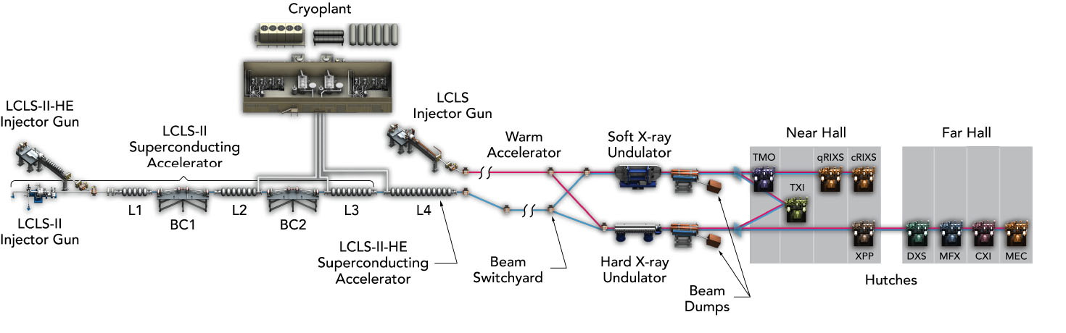
LCLS-II-HE project scope
Slide adapted from G. Hays
Install low-emittance injector and SRF gun for extended hard X-ray performance
Add 23 additional cryomodules (L4 linac) to increase the LCLS-II accelerator energy to 8 GeV.
Install new cryogenic distribution box and transfer line between the cryoplant and the new L4 linac.
New long period Soft X-ray Undulator
Upgrade the LCLS Hard X-ray endstations for MHz beam and data rates

Slide 3
LCLS-II-HE cryomodule performance requirements
HE modules have increased gradient requirement: 20.8 MV/m vs. 16 MV/m
  Same Q₀ required at new operating gradient, 2.7×10¹⁰ at 2.0 K
R&D program following LCLS-II project to improve nitrogen doping recipe and surface processing (2018-2020):
  Increase cavity gradient without degrading Q₀
  Improve uniformity of performance with tighter QA
  See D. Gonnella’s 2020 TTC talk for more info.

Slide 4
LCLS-II-HE recipe
LCLS-II | LCLS-II-HE
Bulk EP High Temperature Furnace Treatment & Doping (2N6) Fine EP | Bulk EP 1 High Temperature Furnace Treatment Bulk EP 2 (last portion cold) Doping (2N0) Fine EP (all cold)
Increased monitoring requirements:
  Continuous RGA spectrum during furnace runs
  Continuous temperature monitoring during electropolishing runs

Slide 5
LCLS-II-HE cavity scope
10 qualification + 168 production + 24 additional cavities ordered from an industrial vendor in Europe, following competitive bid processes
  Qualification cavities went into “verification cryomodule” (vCM).
Cavities prepared with recipe developed in R&D program
Heat treatment temperatures determined per Nb vendor heat lot using single cell flux expulsion technique
  See for example A. Palczewski’s talk from 2018 TTC/ARIES flux expulsion workshop.
  Lesson learned from LCLS-II, where many cavities needed heat treatment rework due to poor flux expulsion
Cavities delivered ~50/50 to JLab/FNAL
Current status: ~50% through final cavity delivery

Slide 6
LCLS-II-HE vertical test qualification requirements
  Gradient: E_{acc} ≥ 23 MV/m
  Quality factor: Q₀(21 MV/m) ≥ 2.5×10¹⁰
    VT stainless steel flange R = 0.8 nΩ
  HOM coupling: Q_{ext} > 2.7e11
  HOM power: P_{HOM}(21 MV/m) < 1.7 W
  Field emission: no detectable FE up to quench
  Frequency: f = 1.300 GHz
  Field probe coupling: 2.5×10¹¹ < Q_{ext} < 7.0×10¹¹
  Multipacting: fully processed before final Q vs. E
  7π/9 mode: avoid mode buildup → quick msmts.
new for HE

Slide 7
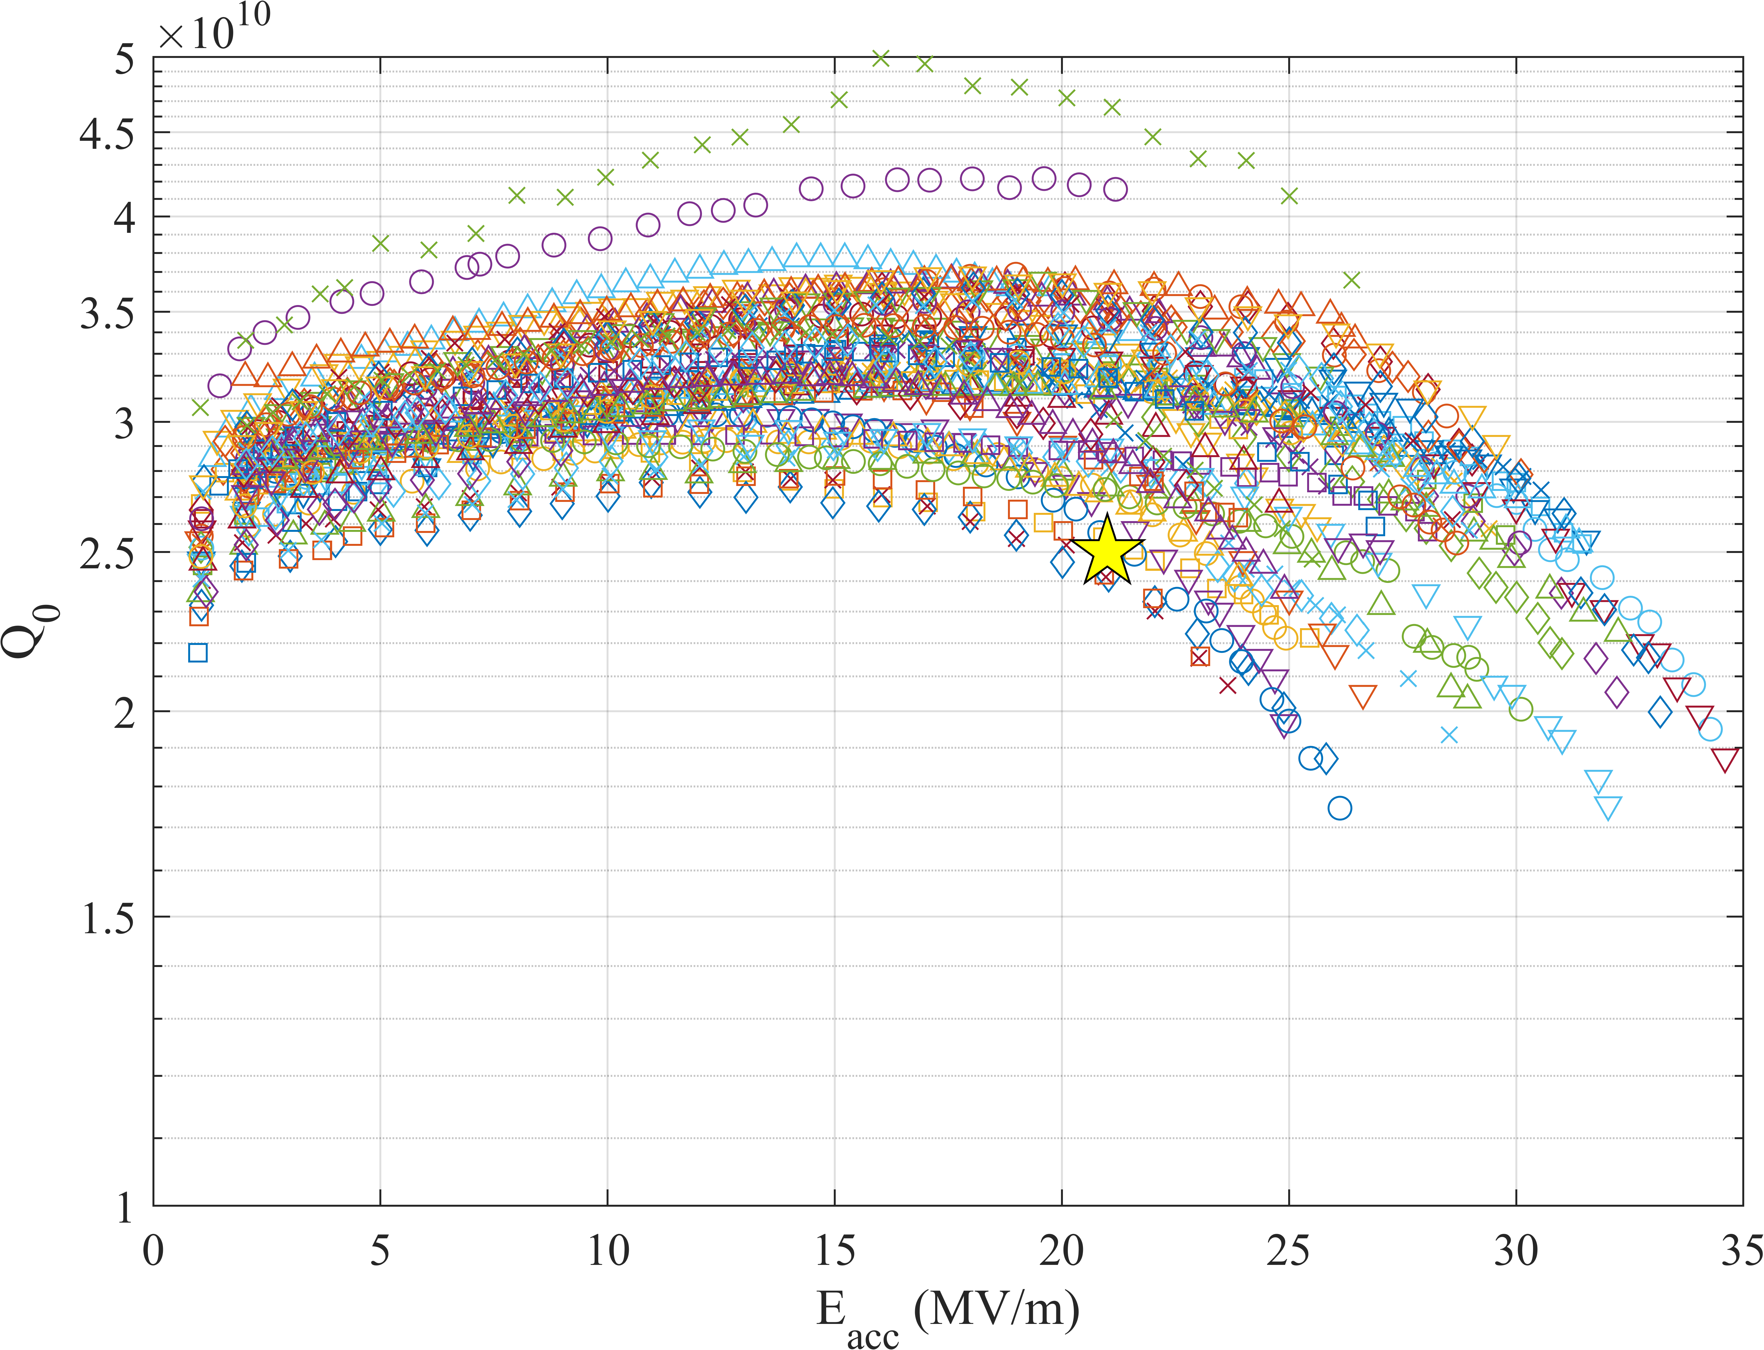
Results so far – as of Oct 6, 2022
80 cavities tested, of which:
  57 qualify
  4 disqualified
  3 placed on hold (marginal E_{acc})
  Remainder awaiting re-test
24 cavities required re-rinse after first test (30%)
  8 cavities removed FE via HPR
  15 cavities in rerinse cycle
  1 DQ’d for persistent FE
All cavities with no FE

Slide 8
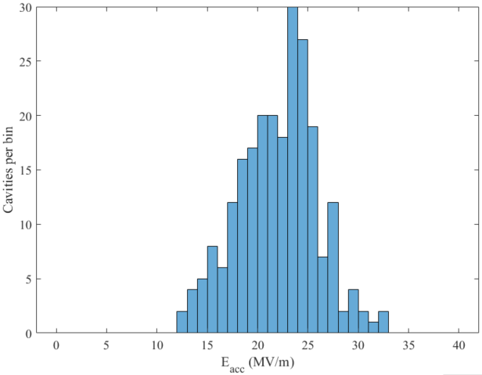
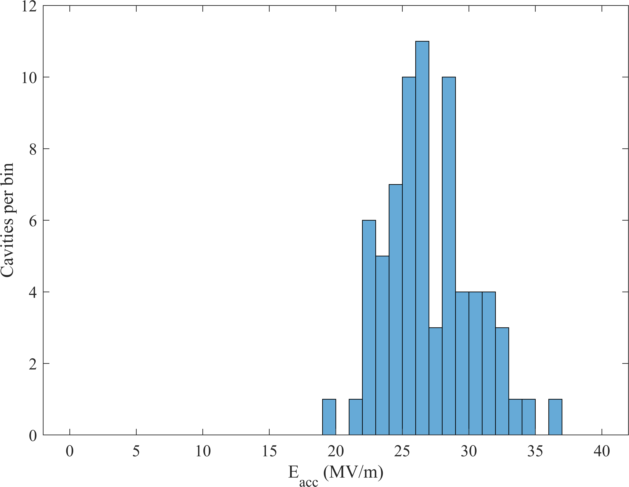
HE cavities vs. LCLS-II: accelerating gradient in VT
LCLS-II
HE vCM + production
Average quench gradient: 22.0±3.9 MV/m
Average quench gradient: 27.1±3.3 MV/m
LCLS-II spec: 19 MV/m
LCLS-II-HE spec: 23 MV/m
>5 MV/m improvement

Slide 9
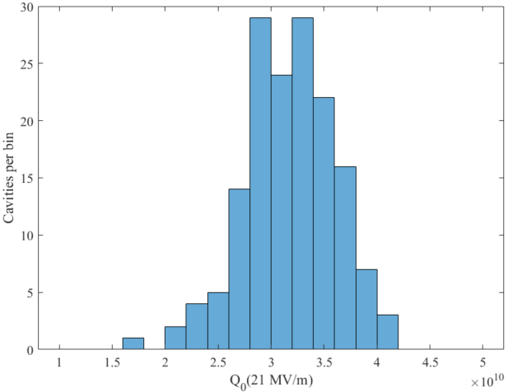
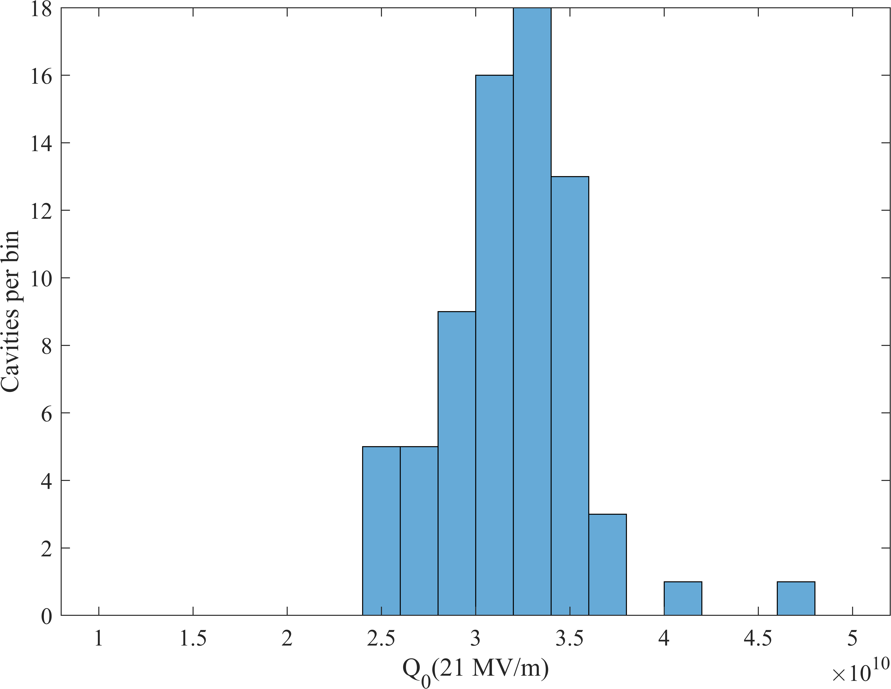
HE cavities vs. LCLS-II: quality factor in VT
LCLS-II
HE vCM + production
Average Q₀:
3.18±0.44×10¹⁰
Average Q₀:
3.18±0.38×10¹⁰
Only considering cavities that reached at least 21 MV/m
Very few cavities
below spec

Slide 10
What changes led to these improvements?
Higher accelerating gradients
Cold EP
  Decreased temperature and tighter temperature control keeps cavity squarely in the polishing regime
  Limits etching / pitting / uneven removal
  Hypothesis: quenches caused by morphological surface defects; smoother surface with fewer & smaller defects pushes quench field higher.
    See for example V. Chouhan 2022, arXiv:2208.04392 for reduced surface defects
    See for example C. Reece SRF2019 paper for discussion of EP parameters
    See for example H. Safa SRF97 paper for discussion of defect size vs. quench field

Slide 11
What changes led to these improvements?
Higher accelerating gradients
Limited annealing time
  New recipe has no annealing step following doping phase, vs. 6 minutes annealing in LCLS-II recipe
  Hypothesis: less time at temperature following introduction of nitrogen leads to less nitride growth → fewer & smaller morphological surface defects
    See for example C. Reese and E. Lechner IPAC2022 papers for discussion of nitride growth
Separating high temperature and doping steps
  Reduces impact of furnace contamination: second bulk EP removes impurity defects that may cause early quench
    See D. Gonnella SRF2019 paper – higher temp treated cavities with lower quench fields

Slide 12
What changes led to these improvements?
Maintaining High Q₀ at Higher Gradients
Sorting material by heat treatment temperature
  Single cell cavity produced from each heat lot from the niobium vendor; each underwent flux expulsion testing to determine required heat treatment temp.
  No retreatment has been required!
  Temperature ID method was unsuccessful for one heat lot – see next slide
  Early cavities produced from “pure” lots; later allowed mixing lots with same temperature
    Mixing heat lots appears to mitigate risk of mis-IDing temperature required for a given lot

Slide 13
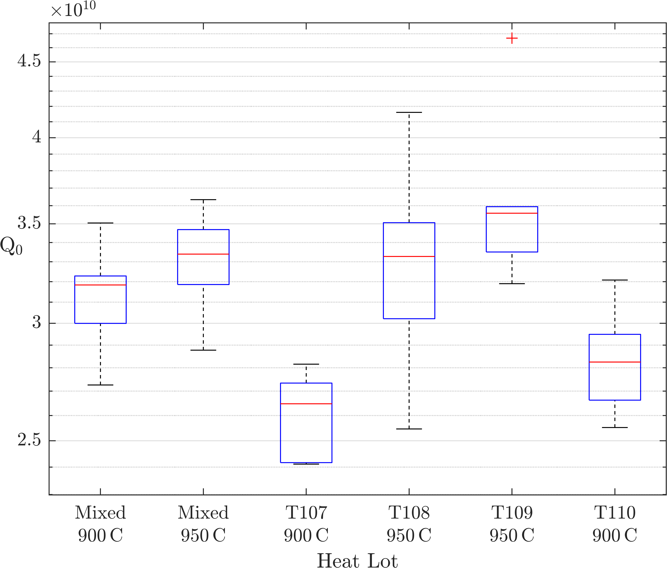
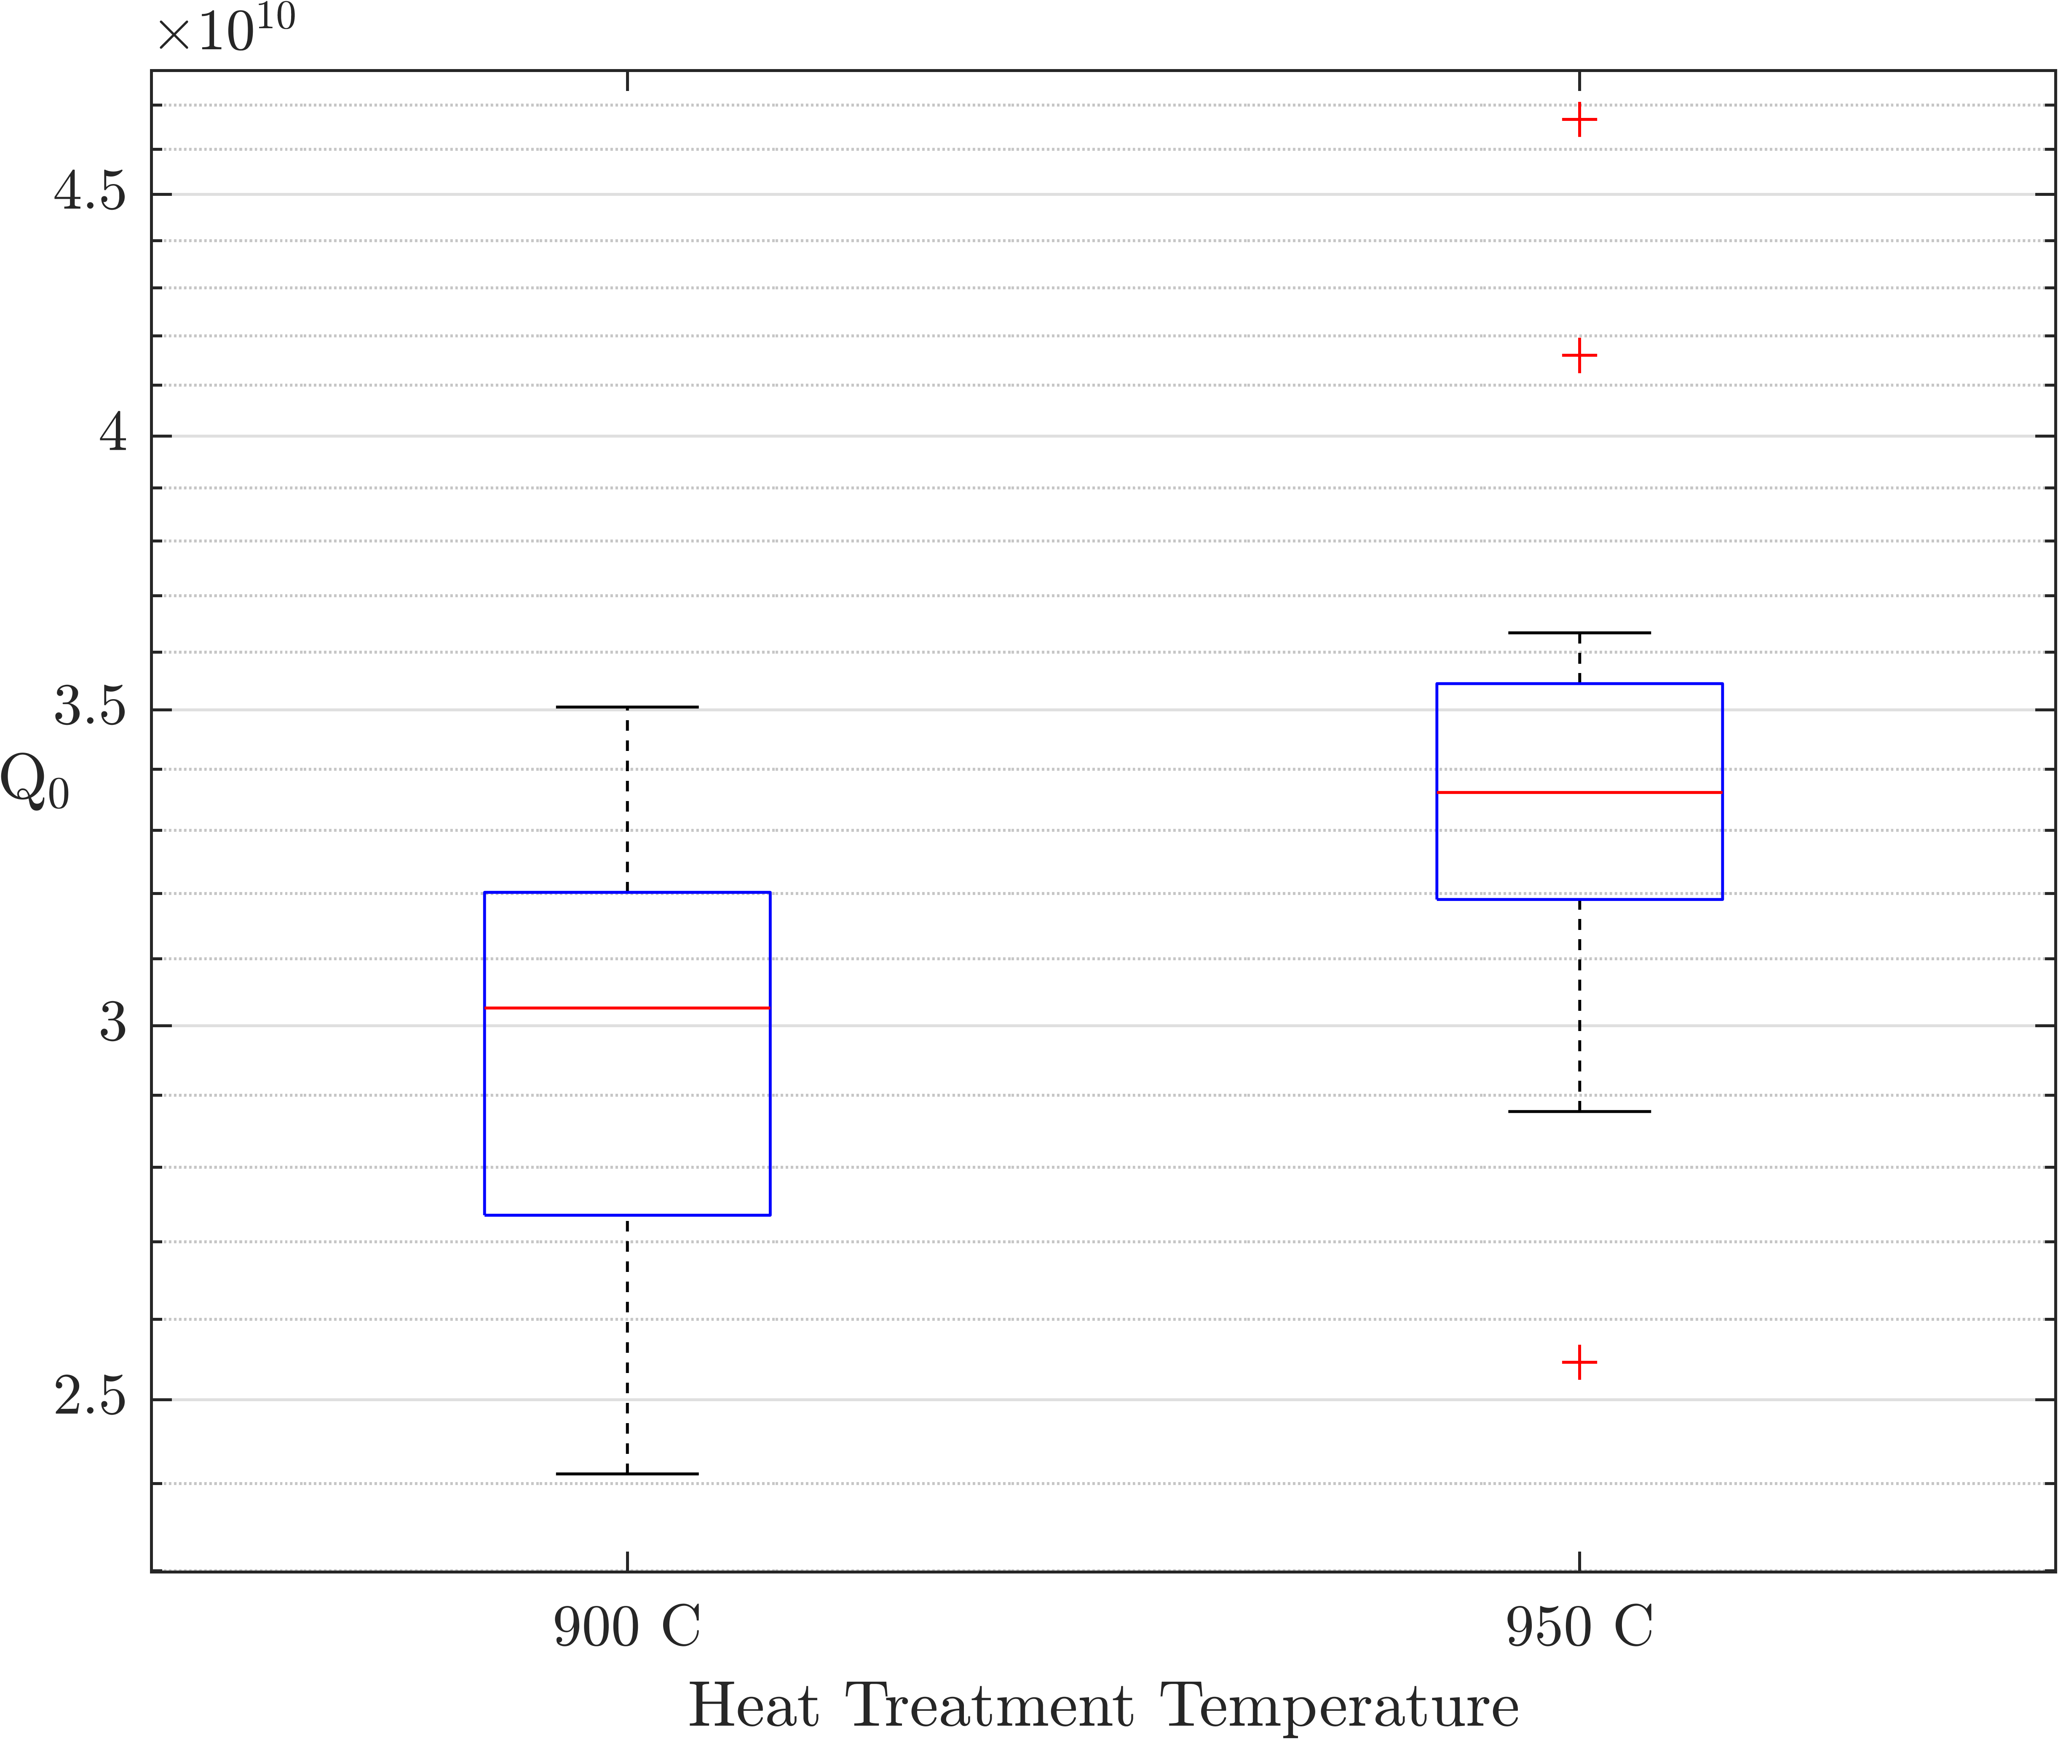
Quality factor by heat lot
Higher heat treatment lots generally show higher Q₀ (better flux expulsion)
One lot (T107) appears to have been assigned the wrong temperature. Still meets specification (except 1 cavity)
Mixed 900 °C cavities have higher Q₀ than pure cavities at same temp.

Slide 14
What changes led to these improvements?
Maintaining High Q₀ at Higher Gradients
Separating high temperature and doping steps
  Reduces impact of furnace contamination: second bulk EP provides clean, high quality surface for doping run
Improved process control/monitoring keeps a tight feedback loop on furnace
  Continuous RGA scans on all furnace runs
  Timely review of data

Slide 15
Further challenges in mass production
Field emission
Damage to helium vessel bellows
Shipping damage & mishandling
Delays to schedule

Slide 16
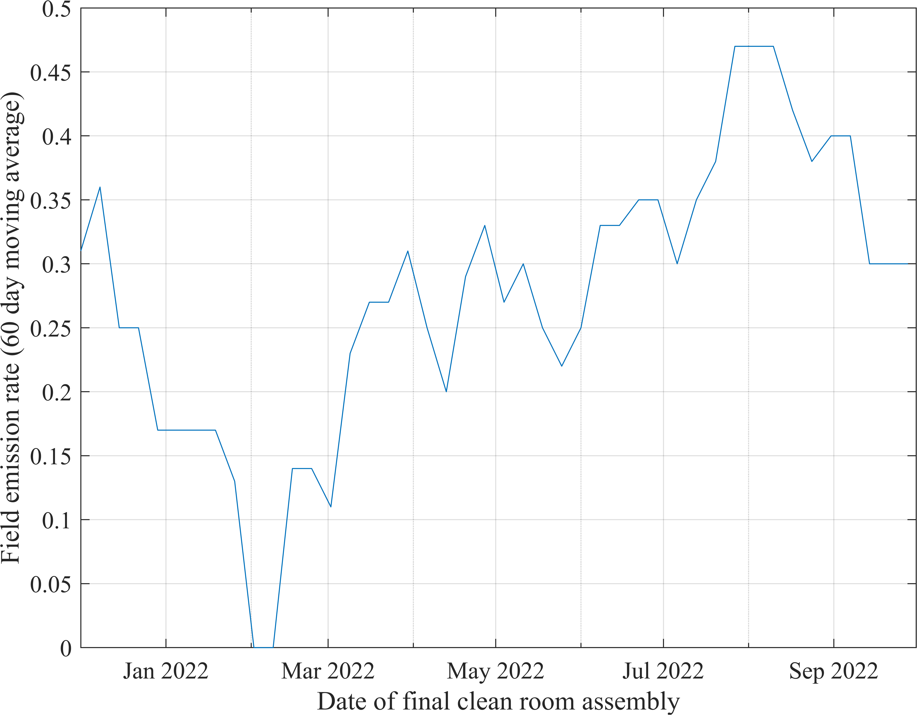
Field emission
Has been a recurring issue throughout production. Similar long term average rate to LCLS-II
HPR has removed FE in some cavities (8 of 13 so far)
Higher gradients might lead us to expect higher FE rates – are we doing better?
Have engaged in regular site visits to cavity vendor to inspect & observe activities
  Positive and negative outcomes: teamwork; nerves; recommendations
Limited deliveries skew statistics
Elevated FE in Summer 2022 under investigation
Site visit

Slide 17
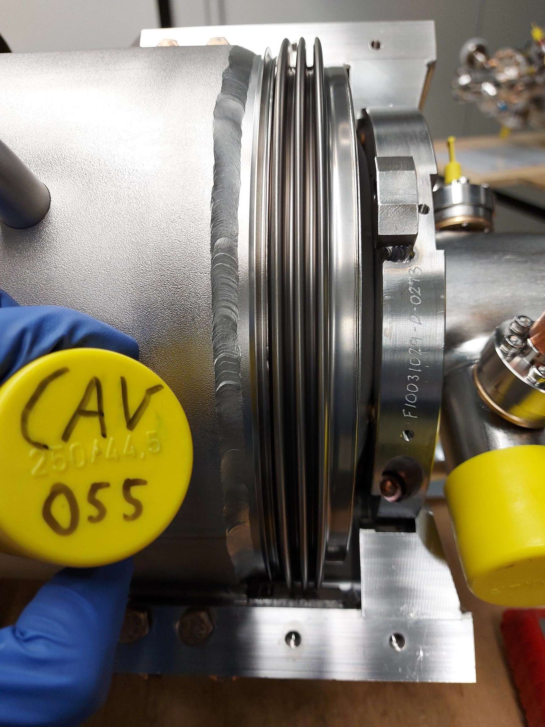
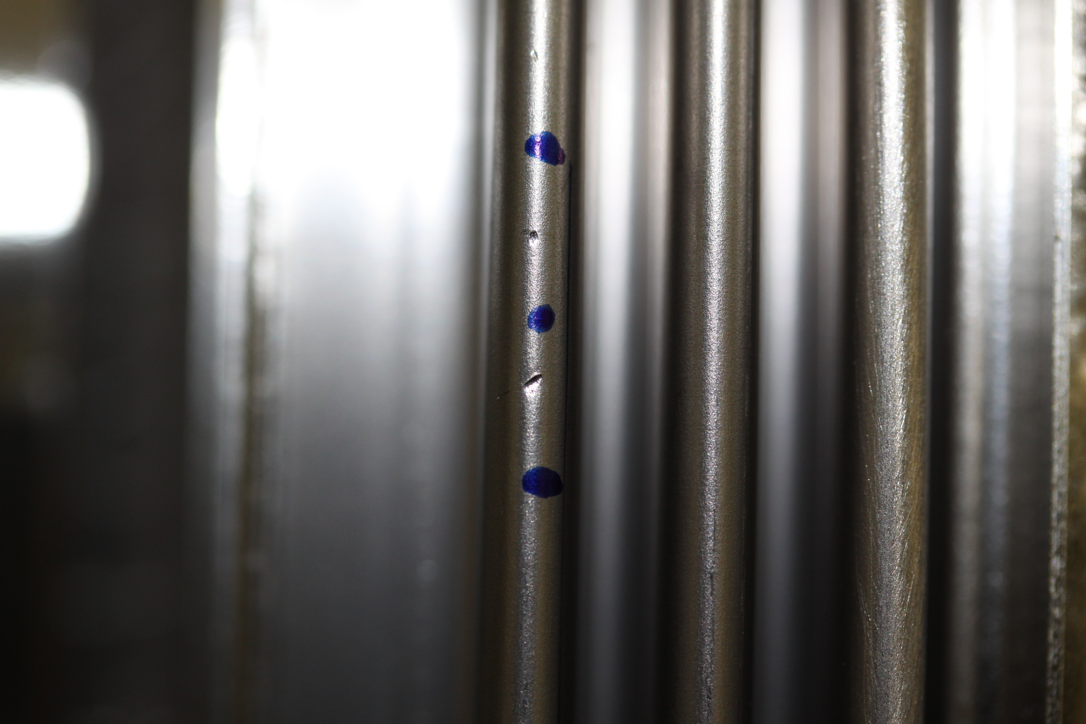
Bellows damage
LCLS-II cavity external bellows are prone to damage if handled improperly; this happened several times early on.
Some units also had pre-existing deformations that was not noted until after tank welding
Combination of loss of expertise/rusty skills & habits/improper oversight, exacerbated by unclear specifications, led to need for bellows replacement on ~10 cavities.
  Major schedule impact
Lesson learned: bellows would be prime target for redesign for next TESLA-style SRF linac.
Typical bellows unit – covers normally installed during handling and transport
Damage encountered early in production

Slide 18
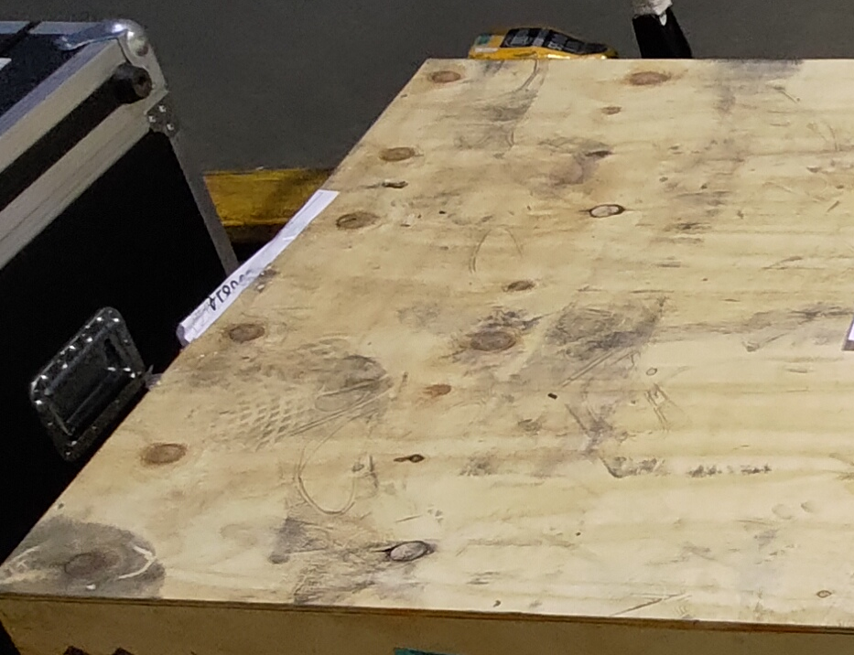
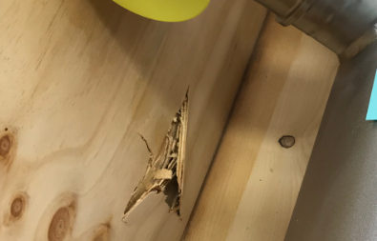
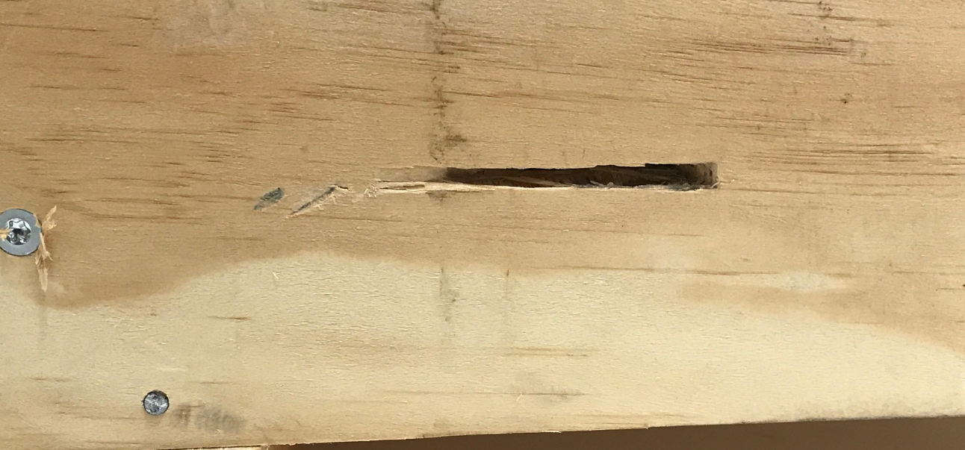
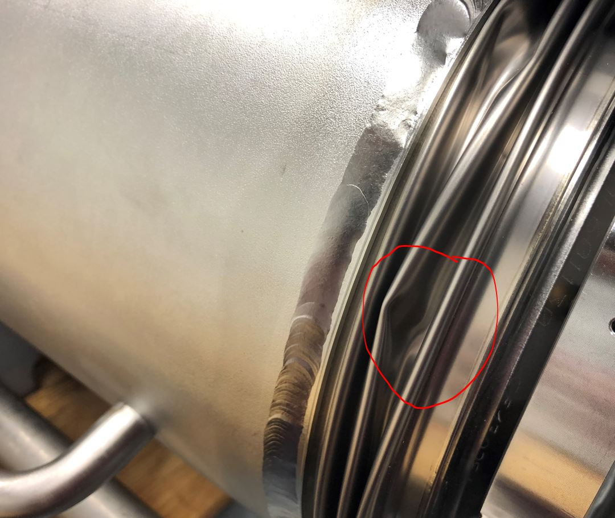
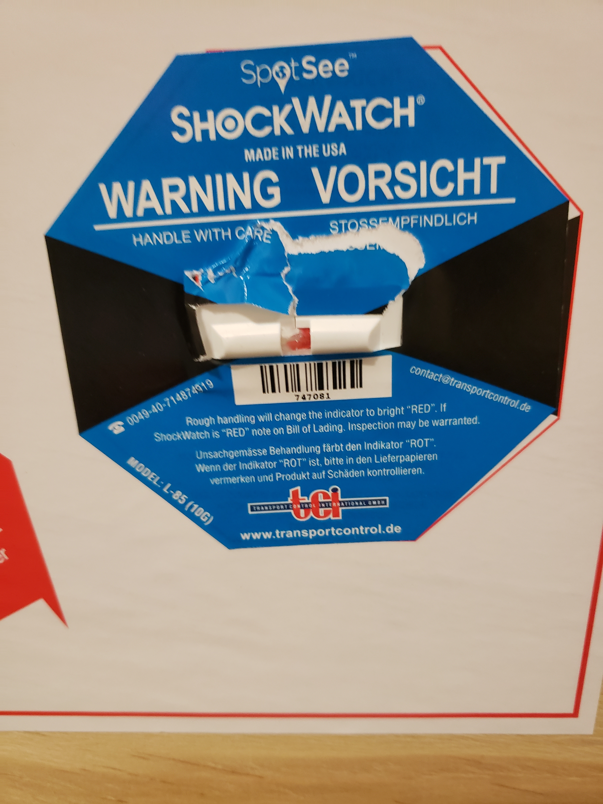
Shipping damage & mishandling
Much evidence of improper handling during shipment.
  International logistics is a hard problem!
  Cavities handled by many companies, individuals, government entities…
  No cavities conclusively damaged due to shipping mishandling
Conversations ongoing with shippers to correct issues
Footprints frequently found on crates
Crates pierced by forklift!
Bellows damage possibly caused during shipping
Shock indicators often destroyed

Slide 19
Delays to schedule
All of above issues have had negative impact on project schedule
Additional schedule impact from:
  Supply chain issues
  COVID-19
  Early errors in estimates of total processing time and resource load required
  Other projects at cavity supplier
After initial rocky period, have stabilized at a steady monthly rate
  Final deliveries will be 3-5 months behind original schedule

Slide 20
Outlook for future international SRF linacs
Working with international vendors comes with a lot of challenges
  Shipping – complex supply chain, tariffs, administrative overhead
  Oversight challenges – long distance travel, language barriers
  Slow feedback loop for diagnosing production issues
For LCLS-II-HE there were no qualified domestic cavity suppliers
  US cavity market does not look to be in a good place
  For the next US project on LCLS-II scale or larger, independent or international collaboration, efforts to spin up new vendors or qualify existing ones domestically will go a long way in mitigating the issues encountered.
Despite the challenges, the LCLS-II-HE cavity project has been very successful!

Slide 21
Summary
Midway through delivery, cavities continue to perform well. Modifications to cavity recipe achieved desired results.
Q₀ and E_{acc} meet HE specifications:
  Average quench gradient (including vCM): 27.1±3.3 MV/m
    +5 MV/m improvement over LCLS-II
  Average Q₀(21 MV/m) (including vCM): 3.18±0.38×10¹⁰
Field emission has been an issue, but HPR has been successful method to remove FE
Cavity delivery expected to continue through March 2023

Slide 22
Backup

Slide 23
Vertical test qualification – test procedures
  Cavities shipped by vendor ready for VT
    High-Q coupler: Q_{ext} ≈ 1.5×10¹⁰
  VT’d at partner labs after receipt:
    Installed on vertical test stand (up to 3 cavities at same time)
      Active pumping at JLab; not at FNAL
    Instrumentation installed
      Radiation monitors
      Four thermometers (minimum) – height of beam tubes, cells 4 & 6
      Two fluxgate magnetometers (minimum) – height of cells 1 & 9
    Fast cool to 4.25 K, with B_{amb}(T_{c}) ≤ 5 mG
    Cool to testing T = 2.00±0.02 K
Largely the same
as for LCLS-II

Slide 24
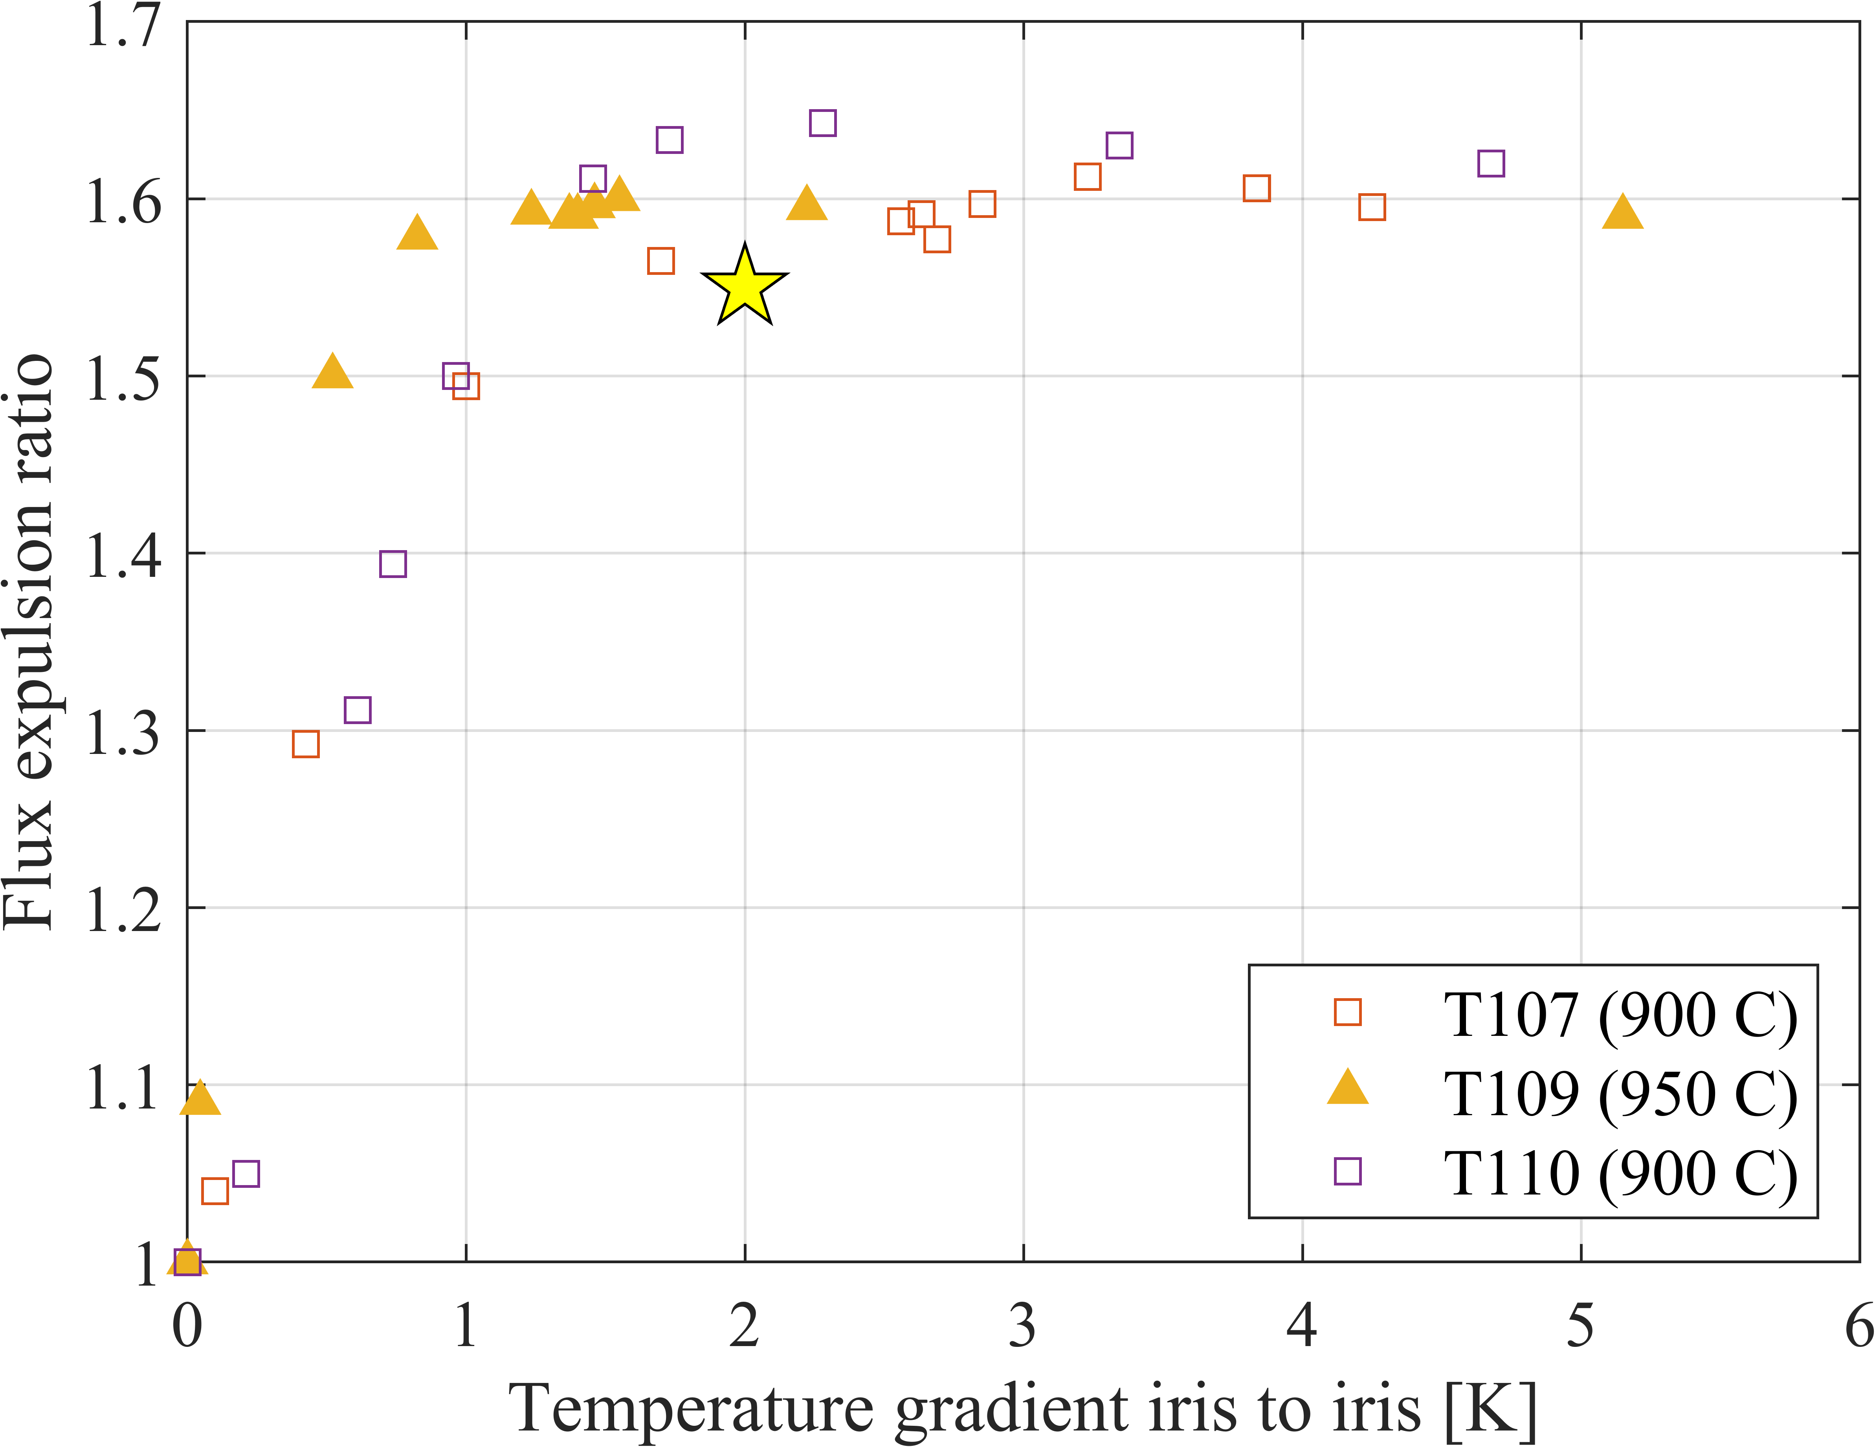
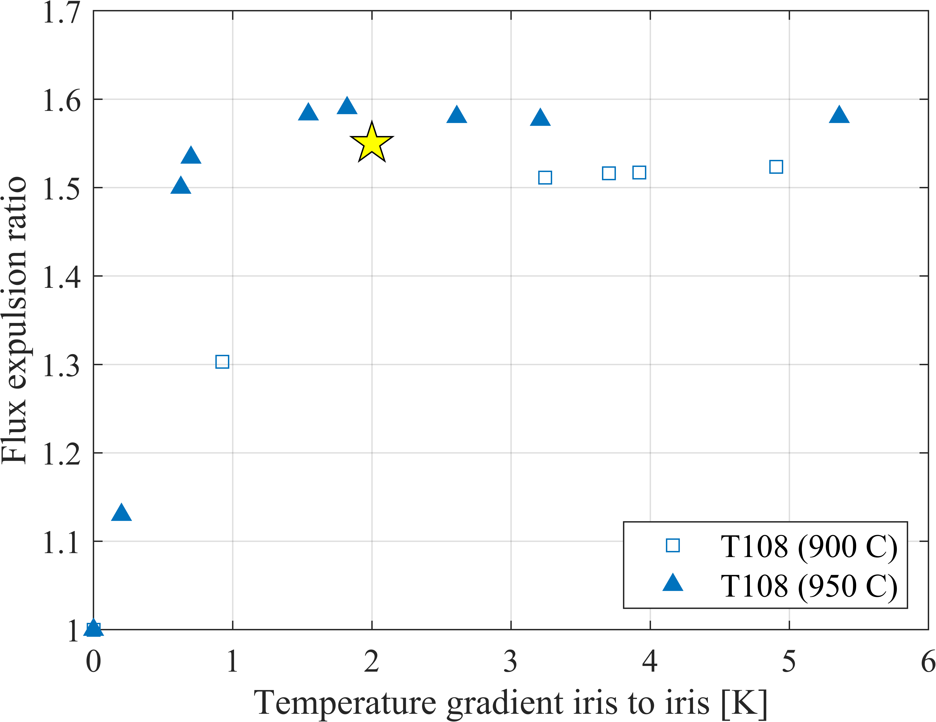
Example flux expulsion test results
T107 and T110 showed good flux expulsion after only 900 °C treatment
Compare to more typical T108 results before and after 950 °C treatment

Slide 25
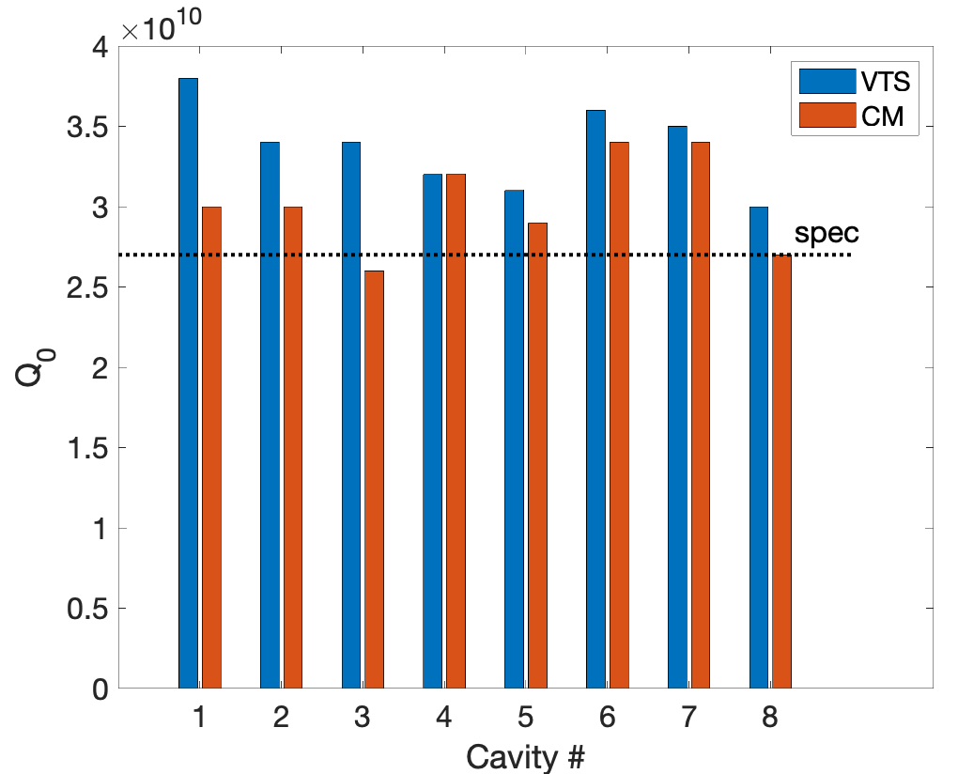
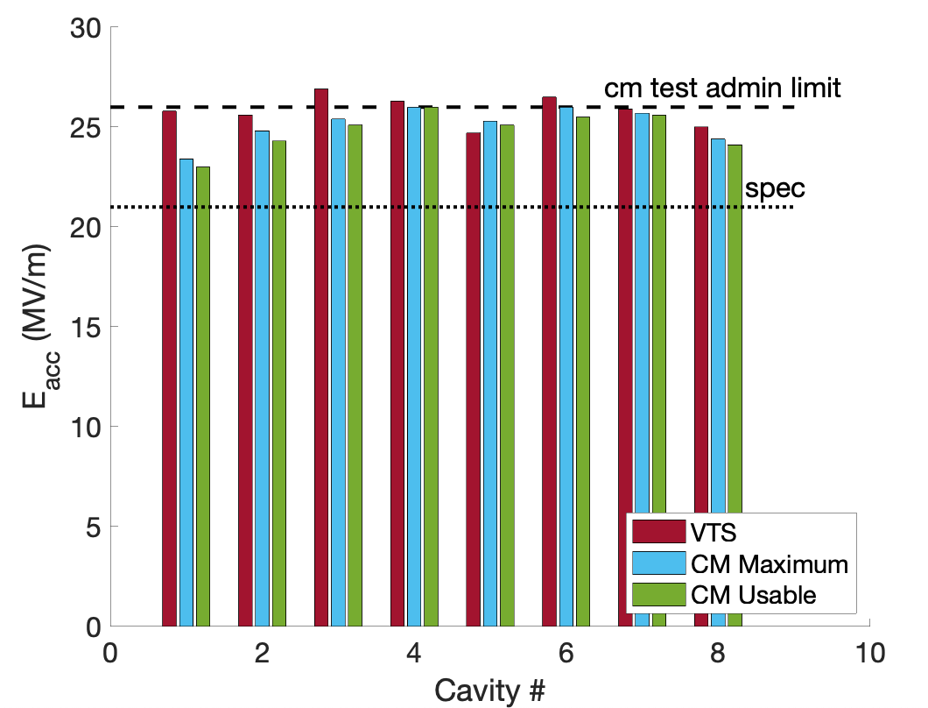
Verification cryomodule performance
Plots from Sam Posen
vCM assembled and tested at Fermilab
Used 8 out of 10 qualification cavities.
Q(21 MV/m) = 3.1×10¹⁰
200.0 MV in SELAP(GDR) mode – average of 24.1 MV/m
Success gated cavity supplier to proceed with doping recipe

