Slide 1

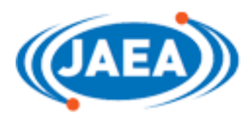
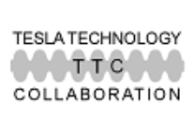
Test results of electro-polishing
for quarter-wave resonators
○K.Nii, Y.Ida, H.Ueda, T.Yamaguchi （Marui Galvanizing Co., Ltd.）
H.Kabumoto, J.Kamiya, Y.Kondo, J.Tamura, H.Harada, Y.Matsui, M.Matsuda
（Japan Atomic Energy Agency （JAEA））
TTC 2022 meeting
WG2
11-14 October 2022
TTCM2022 WG2, K.Nii – 1/16

Slide 2
Contents
1 Introduction
1-1 Tokai Tandem Accelerator and superconducting booster
1-2 Quarter-wave resonators (QWRs)
1-3 What about electro-polishing (EP) ?
1-4 EP setup of QWRs
2 EP experiment
(Phase 1)
2-1 EP parameters and logged data
2-2 Results of EP (surface inspection and roughness)
2-3 Cavity performance measurement
3 EP experiment
(Phase 2)
3-1 Cathode surface area increase
3-2 Applied voltage increase
3-3 Electrolyte flow rate and agitation increase
3-4 Removal thickness, surface inspection and roughness
4 Summary and next step
TTCM2022 WG2, K.Nii – 2/16

Slide 3
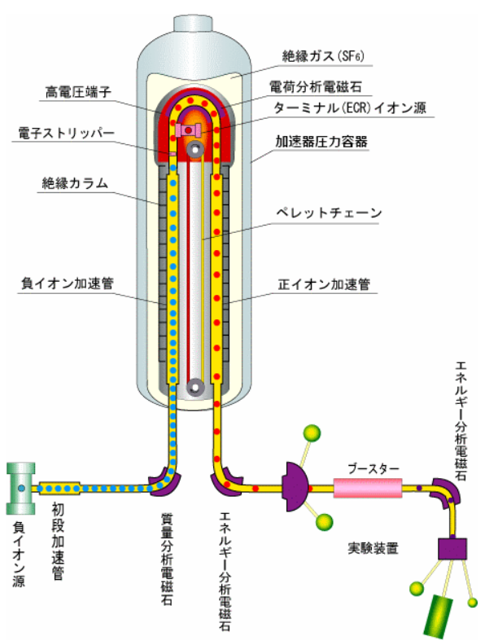
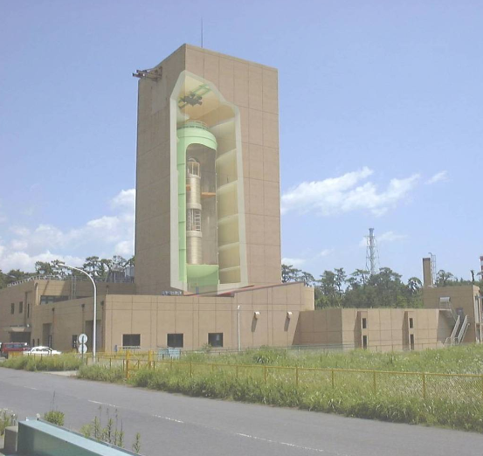
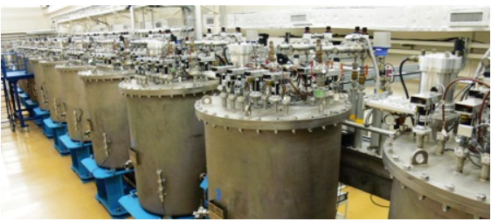
Introduction
1-1 Tokai Tandem Accelerator and superconducting booster
TTCM2022 WG2,
K.Nii – 3/16
Tokai Tandem Accelerator of JAEA
Tokai Tandem Accelerator
ttps://ttandem.jaea.go.jp/index.html
Superconducting booster
At the Tokai Tandem Accelerator of JAEA, research on nuclear physics, nuclear chemistry,
material irradiation, etc. using heavy ion beams is being conducted. A superconducting booster has been
installed in the latter part of the tandem to increase the beam energy by 2 to 3 times, but it has
been out of service for a long time. The specifications of this superconducting booster are
model = coaxial 1/4 wavelength resonator (QWR), frequency is 130MHz, optimum beam velocity = 10%
of the light velocity, and acceleration electric field = 5.0MV / m @ 4W.

Slide 4
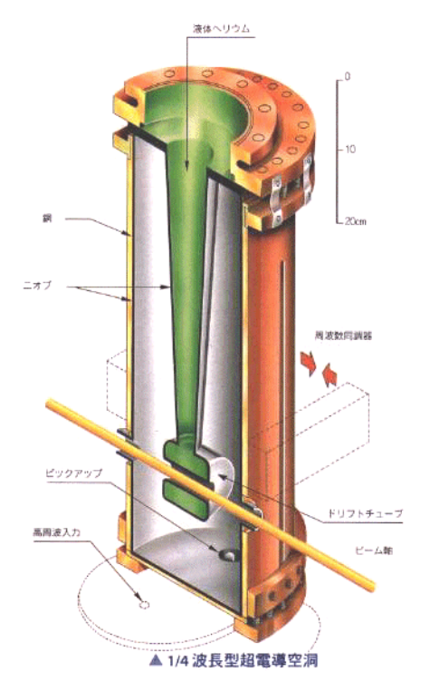
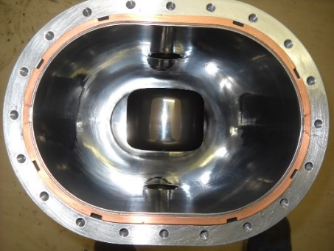
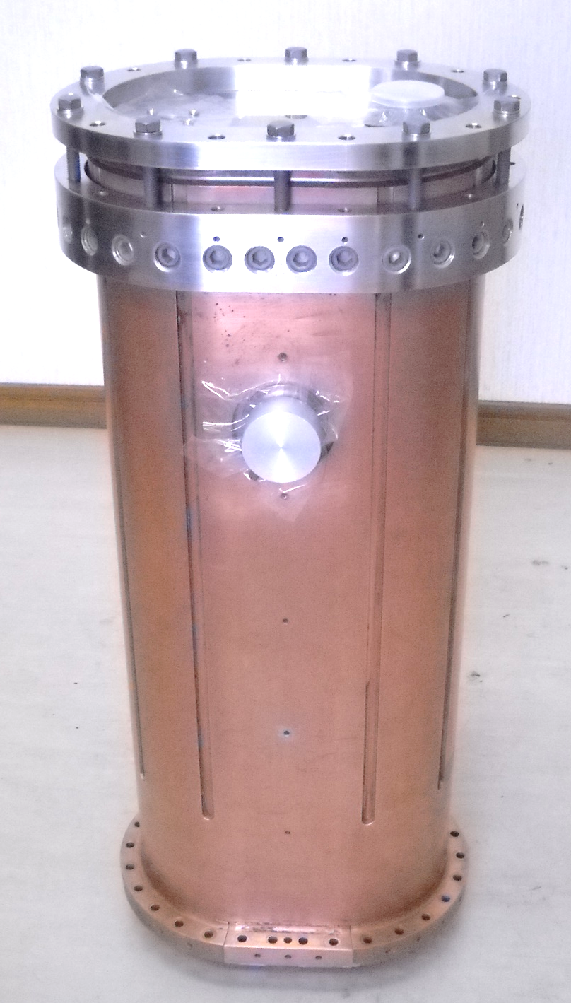
Introduction
1-2 Quarter-wave resonators (QWR)
Currently, we are working on restarting,
and we are considering electro-polishing
of the preliminary superconducting cavity
in preparation for conducting various tests.
This cavity is made of a niobium-copper
clad plate and has a large opening at the
bottom, which allows it to be
electro-polished again.
Marui Galvanizing Co., Ltd. and Japan
Atomic Energy Agency jointly examined
the equipment and conditions for 1/4
wavelength type superconducting cavity
inner surface electro-polishing, conducted
electro-polishing, and evaluated the surface
and cavity performance after polishing.
Quarter wave
resonators
（Outside：copper
Inside：Niobium）
A spare cavity used
for experiments (L42)
TTCM2022 WG2, K.Nii – 4/16

Slide 5
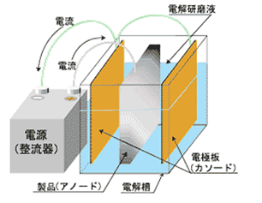
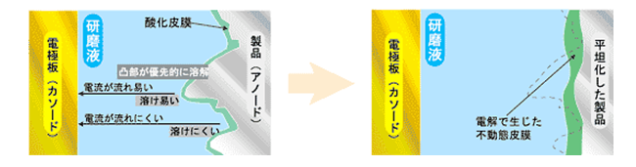
Introduction
1-3 What about electro-polishing (EP) ?
General method of EP（schematics）
（Electro-polishing, EP for short）
General reaction of EP
A technology that dissolves and polishes
the metal surface by electrolyzing the
object (metal to be polished) as the anode
in an electrolytic solution with a counter
electrode (cathode).
Improves surface flatness, corrosion
resistance, and cleanliness.
Anode：M→M^{n+}+ne⁻
H₂O→1/2O₂+2H+2e⁻
Cathode：2H⁺+2e⁻→H₂
M^{n+}+ne⁻→M
（M:polished metal, n:atomic value）
How EP progresses（schematics）
Niobium cavity EP
Since the protruding part of the product is close to
the cathode, electricity flows easily and it melts easily.
Since the amount of melting is proportional to the
amount of electricity, the convex portion melts preferentially.
As a result, the unevenness gradually disappears and
the surface becomes flat.
In 1.3GHz niobium superconducting cavities,
electro-polishing is applied to the inner surface
to improve cavity performance.
TTCM2022 WG2, K.Nii – 5/16

Slide 6
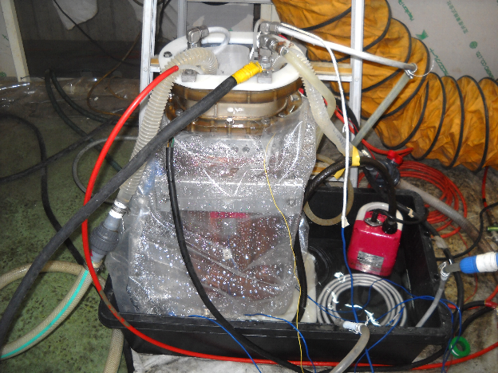
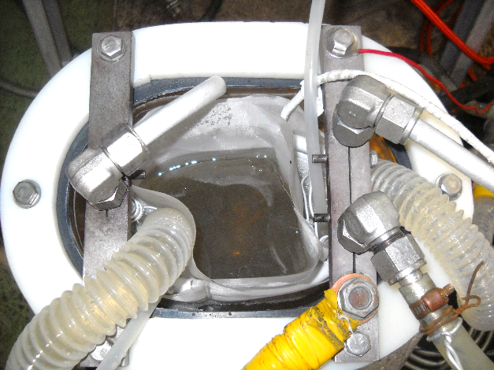
Introduction
1-4 EP setup of QWRs
A schematic of EP setup
EP setup
Cavity
・Place the cavity with the opening facing up. Electrodes and electrolyte hoses were
inserted through the openings.
・The electrolyte was circulated by a pump.
(Injected into the bottom of the cavity, recovered from the top)
・Cavity cooling by cooling water shower using vat and submersible pump
・There were no serious problems with the EP implementation.
TTCM2022 WG2, K.Nii – 6/16

Slide 7
EP experiment (Phase 1)
2-1 EP parameters and logged data
TTCM2022 WG2, K.Nii – 7/16
 | 1st EP | 2nd EP | 3rd EP | 4th EP
Electrolyte | H₂SO₄(98%):HF(55%)=9:1(USED) | H₂SO₄(98%):HF(55%)=9:1(NEW) | H₂SO₄(98%):HF(55%)=9:1(USED) | H₂SO₄(98%):HF(55%)=9:1(NEW)
Voltage | ～18V | ～20V | ～20V | ～20V
Voltage apply | Continuous | 3min-ON/3min-OFF | Continuous | 3min-ON/3min-OFF
Cavity cooling | None | Done | Done | Done
N₂ bubbling | None | Done | Done | Done
Target removal | 30μm | 20μm | 25μm | 25μm
4th EP current, voltage
4th EP IV curve
4th EP electrolyte temp.
・ 4 times EP (total removal 100μm) were performed using one
cavity (L42).
・The logged data of 4th EP is shown.
In IV curve, plateau region was shown around >5V.
Cavity temperature was around 10-14℃ using water cooling.
Electrolyte temperature in the cavity was under 10 ℃ .
EP current was around 80 A.
EP current, voltage, temperature were almost on target.
4th EP cavity temp.

Slide 8
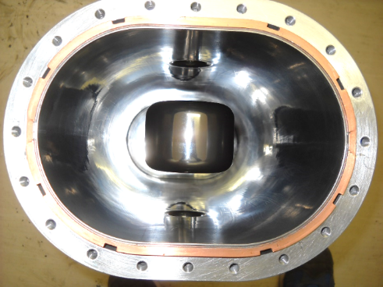
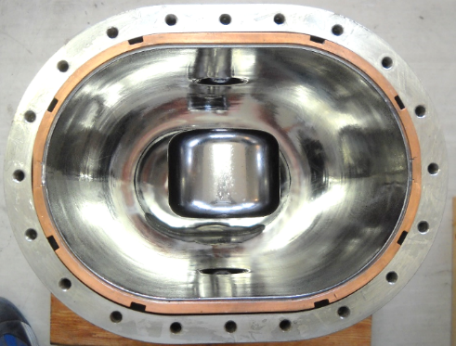
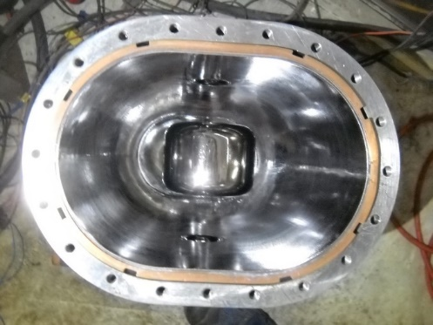
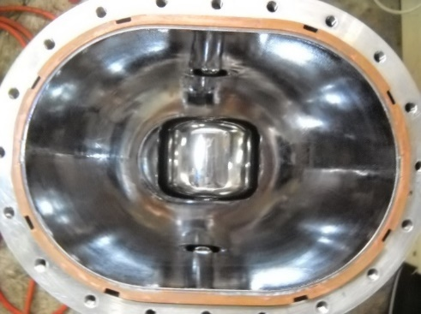
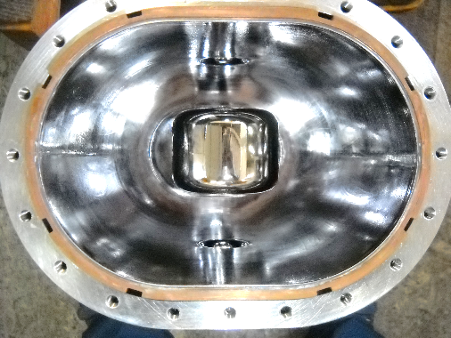
EP experiment (Phase 1)
TTCM2022 WG2, K.Nii – 8/16
2-2 Results of EP (surface inspection and roughness)
Before EP (Mechanical polish) | After 1st EP | After 2nd EP
After 3rd EP | After 4th EP | A legend
Ra＝0.11μm
Rz＝1.21μm
Ra＝0.67μm
Rz＝3.40μm
Ra＝0.48μm
Rz＝2.53μm
Digital camera photo
Microscope
photo
（×200）
Ra＝0.47μm
Rz＝2.24μm
Ra＝0.45μm
Rz＝2.06μm
Surface roughness
（Average of 4 points）
・After 1st EP, the surface roughness became worse （It seems that the conditions were not optimized）.
・After 2nd – 4th EP, the surface roughness tended to improve (The conditions seem to have improved).
・After 4th EP, the surface became more glossy but roughness was larger than before EP.

Slide 9
EP experiment (Phase 1)
2-3 Cavity performance measurement
TTCM2022 WG2, K.Nii – 9/16
After Phase 1 EP, the cavity
performance was measured
at 4.2K.
Low electric field Q₀ value was
2.7E8 and the cavity
performance was 4.2MV/m
＠4W
It did not reach the standard
value （5.0MV/m＠4W）
Measurement of the cavity performance
The main reason
seems to be rough
surface and high
surface resistance.
Eacc vs Q0
It is necessary to
review the EP
conditions, electrodes,
methods, etc.
Phase 2 EP
experiments

Slide 10
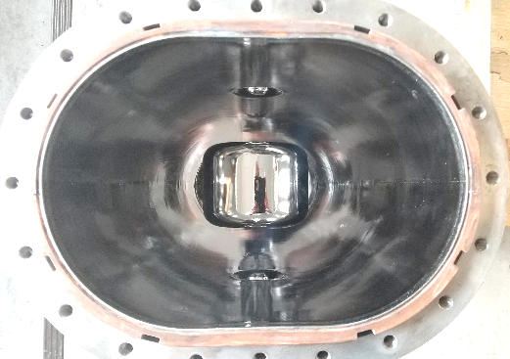
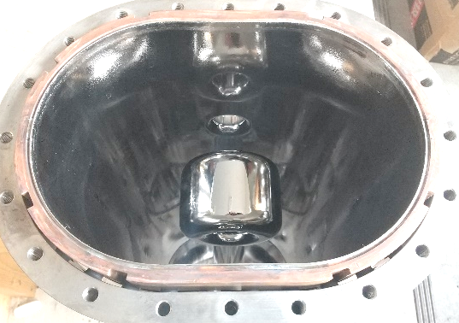
EP experiment (Phase 2)
3-1 Cathode surface area increase
TTCM2022 WG2, K.Nii – 10/16
A schematic of electrode, auxiliary electrode
Inner surface after
this EP
Current：50～70A Voltage：～20V
Cavity temp. ～10℃
Electrolyte flow rate 12～14L/min
Average current comparison
・An auxiliary electrode was added to the
conventional electrode in order to increase
the current density and improve the polished
surface by increasing the cathode area.
（Approx. 30% increase in electrode area,
red line in the above schematic）
・ No clear improvement was seen (details later).
→There is no problem with the conventional
electrode.

Slide 11
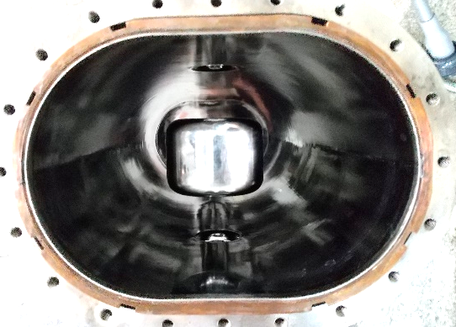
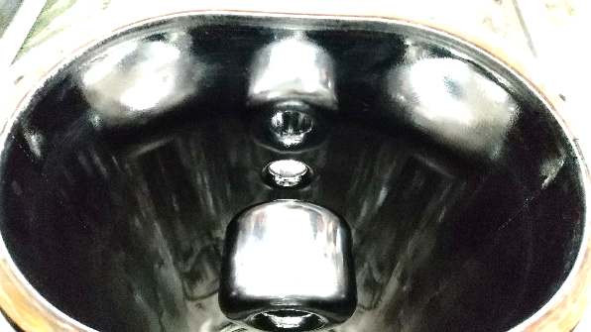
EP experiment (Phase 2)
3-2 Applied voltage increase
TTCM2022 WG2, K.Nii – 11/16
IV curve
Plateau region 5～25V
Current：40～100A
Voltage：～25V
1min-ON/1min-OFF
Inner surface after this EP
Cavity temp. ～10℃
・To confirm the range of the plateau region, the IV
characteristics were confirmed from 0 to 30V.
・An increase in current was observed from 25V
in the IV curve.
→5～25 V is set as the plateau region from the
shape of the curve and EP was performed at 25V
that is the upper limit of the plateau.
・No clear improvement was seen (details later).
→There is no problem with the conventional 20V.
Electrolyte flow rate ～10L/min

Slide 12
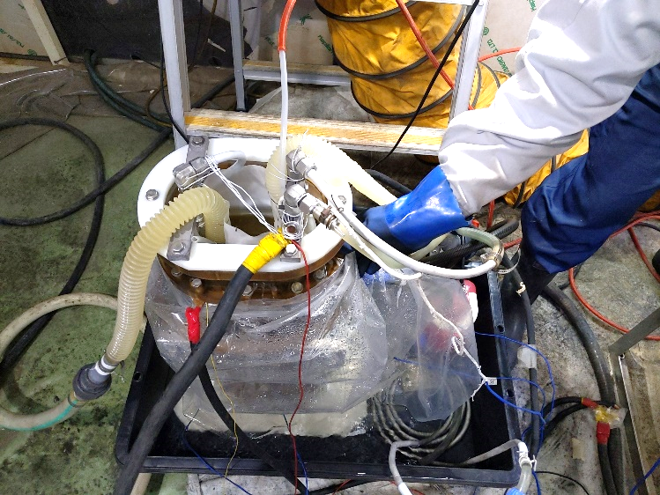
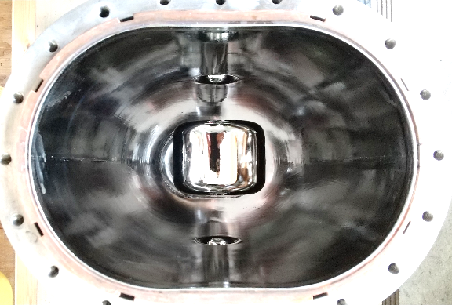
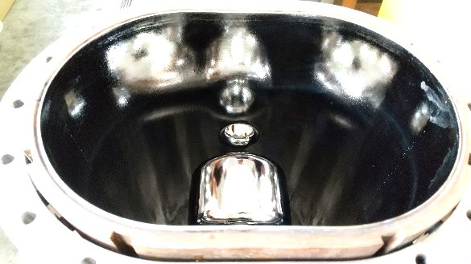
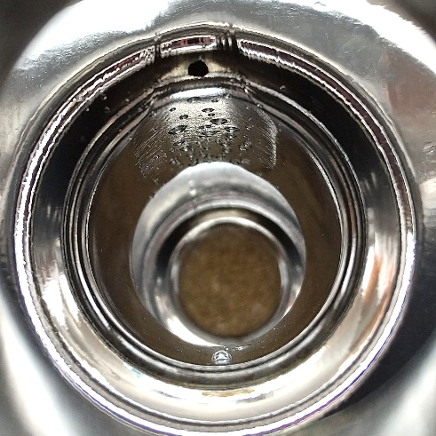
EP experiment (Phase 2)
3-3 EP acid flow rate and agitation increase
TTCM2022 WG2, K.Nii – 12/16
Current：40～80A
Voltage：～20V
3min-ON/3min-OFF
Shake the cavity by hand during EP
Inner surface after this EP
Electrolyte flow rate 20～25L/min
Cavity temp. 10～12℃
・ Electrolyte flow rate was increased to ～20L/min and it was shaken
by shaking the cavity by hand to improve agitating effect during EP.
・EP was stopped due to temperature and odor abnormalities during EP.
The cause was that the center conductor had a hole and the electrolyte
was leaking into the cavity cooling water.
A hole in the center conductor

Slide 13
EP experiment (Phase 2)
3-4 Removal thickness, surface inspection and roughness
Endoscope inspection （After all EP）
Removal thickness
Center
conductor
Surrounding
body
Roughness Ra
Measurement points
Results of removal and roughness evaluation
・The removal thickness of center conductor is 2-3 times larger
than that of body part.
・The surface roughness has no proper tendency and has not
changed significantly in case of phase 2 EP.
Roughness Rz
Results of endoscope inspection
・Upward surfaces at EP (blue lines) were relatively flat and glossy.
・Downward surfaces at EP (red lines) were relatively rough and
had bubble traces.
TTCM2022 WG2, K.Nii – 13/16

Slide 14
4 Summary and next step
・The inner surface of the QWR (spare cavity) used for the superconducting booster of the Tokai tandem
accelerator was re-polished by electro-polishing.
・Electro-polishing (EP) set-up and operation could be carried out without serious problems.
A total of about 100 μm polishing was performed in Phase 1 experiments in four stages.
・Compared to before electro-polishing (surface after mechanical polishing), the surface gloss seemed
to be improved, but the surface roughness value became worse.
・ As a result of the cavity performance measurement in liquid helium (4.2K), the performance was
4.2MV/m@4W with a Q0 value of 2.7E8 at a low electric field.
This did not reach the standard value (5.0MV/m@4W).
・ Phase 2 experiments were conducted to improve the EP parameters.
Electrode area, voltage, and agitation were examined, but no significant improvement was observed.
・The removal thickness of the center conductor was much larger than other parts,
and a hole was opened during the Phase 2 experiment.
No significant improvement in surface roughness was observed.
・The upward surface at EP was glossy, but the downward surface was rough with bubble traces.
TTCM2022 WG2, K.Nii – 14/16

Slide 15
4 Summary and next step
Next step
It is necessary to…
・Suppress bubble diffusion and internal accumulation to improve inner surface.
・ Investigate the cause of uneven removal and state of electrolysis.
for that purpose…
・Confirmation of cavity oscillation, electrolyte stirring and agitation effect
・Review of electrode shape and improvement of bubble cover
・ Improvement of electrolyte flow method
・Optimization of voltage ON/OFF application conditions
TTCM2022 WG2, K.Nii – 15/16

Slide 16
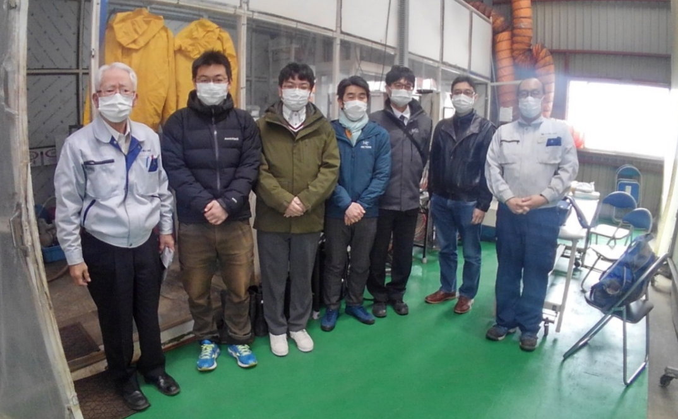
Thank you for your attention.
TTCM2022 WG2, K.Nii – 16/16

