Slide 1
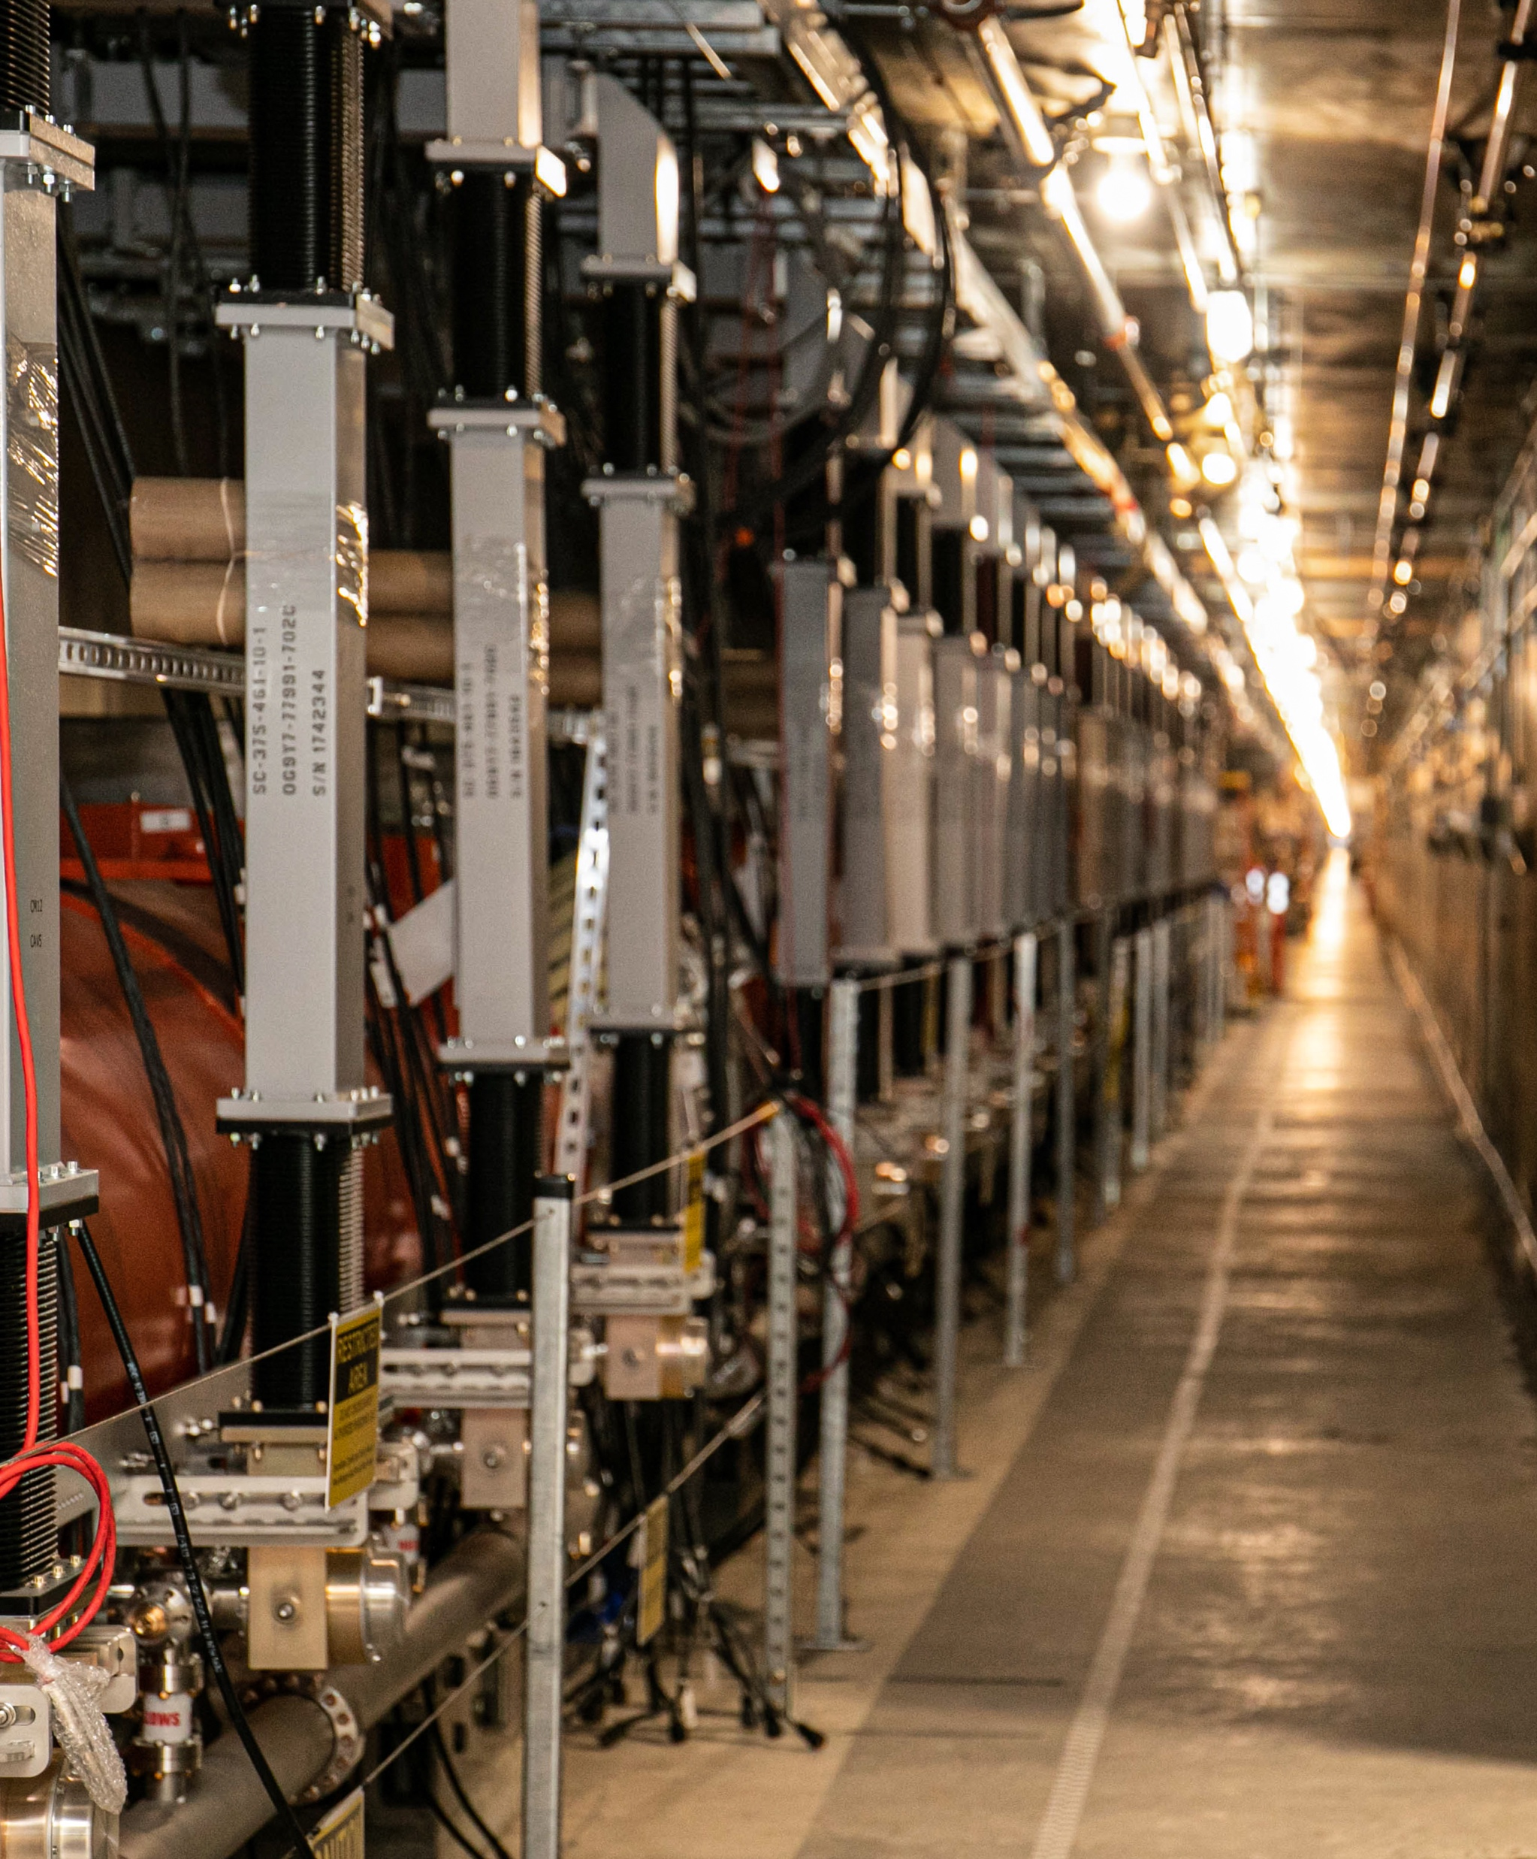
Machine availability and reliability in LCLS-II at SLAC
TTC2022 Aomori, WG-4
Sebastian Aderhold
October 12, 2022

Slide 2
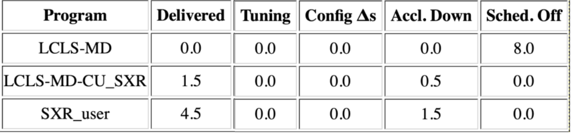
How is availability defined?
Time accounting (in 0.1h increments) happens per each 8h operations shift and is part of the shift summary with the following categories:
  Delivered
    Beam meeting the requirements available for user program
  Tuning
    Adjusting the machine because beam does not meet requirement
  Configuration changes (∆s)
    Time setting up accelerator when switching users or change of beam requirements
  Accelerator down
    Beam not available due to hardware/software/utility error, procedural error, …
  Scheduled Off
    Planned maintenance days, scheduled safety system checks, …

Slide 3
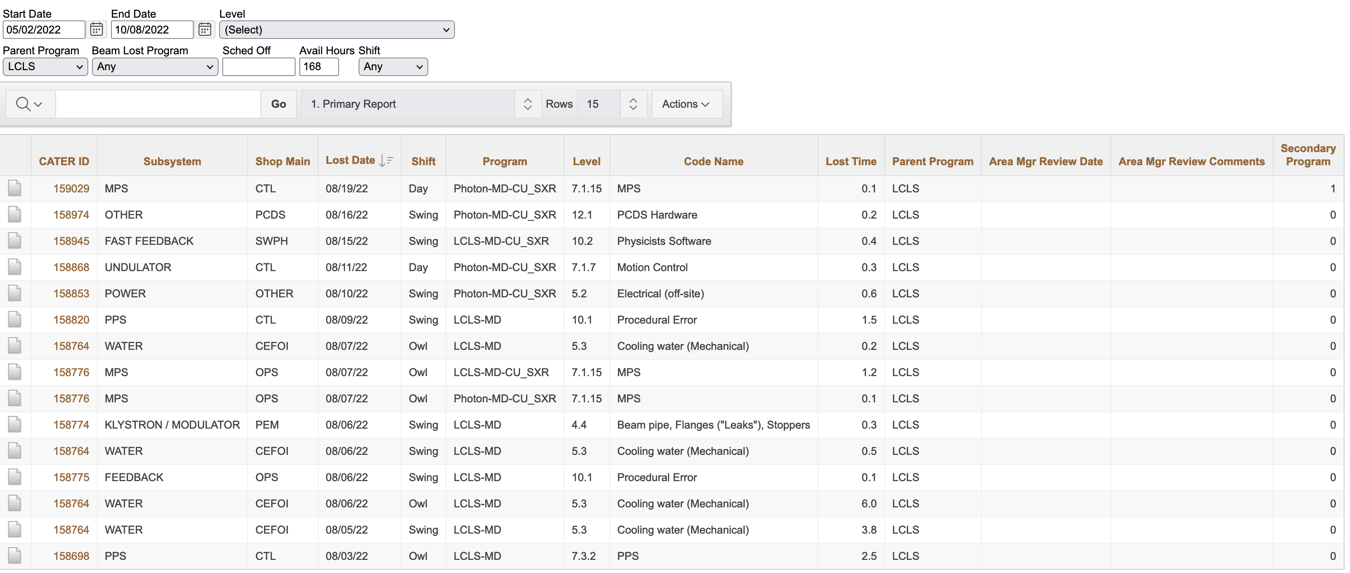
Documentation of hardware/software problems

Slide 4
What are the top 3 SRF failure modes?
Hard to say for an accelerator that has not delivered beam (yet)
Most likely not quench.
  Based on RF commissioning plenty of gradient overhead and won’t have to operate near individual cavity limits
During (limited) long term operation of full CMs during commissioning saw a few sub-systems drop cavities out of accelerating mode sporadically [e.g. local instability of phase reference line, waveguide pressure monitoring (NIRP),…].
??? (Time will tell)
  Excited to learn how the machine performs under operating conditions and how to improve it

