Slide 1
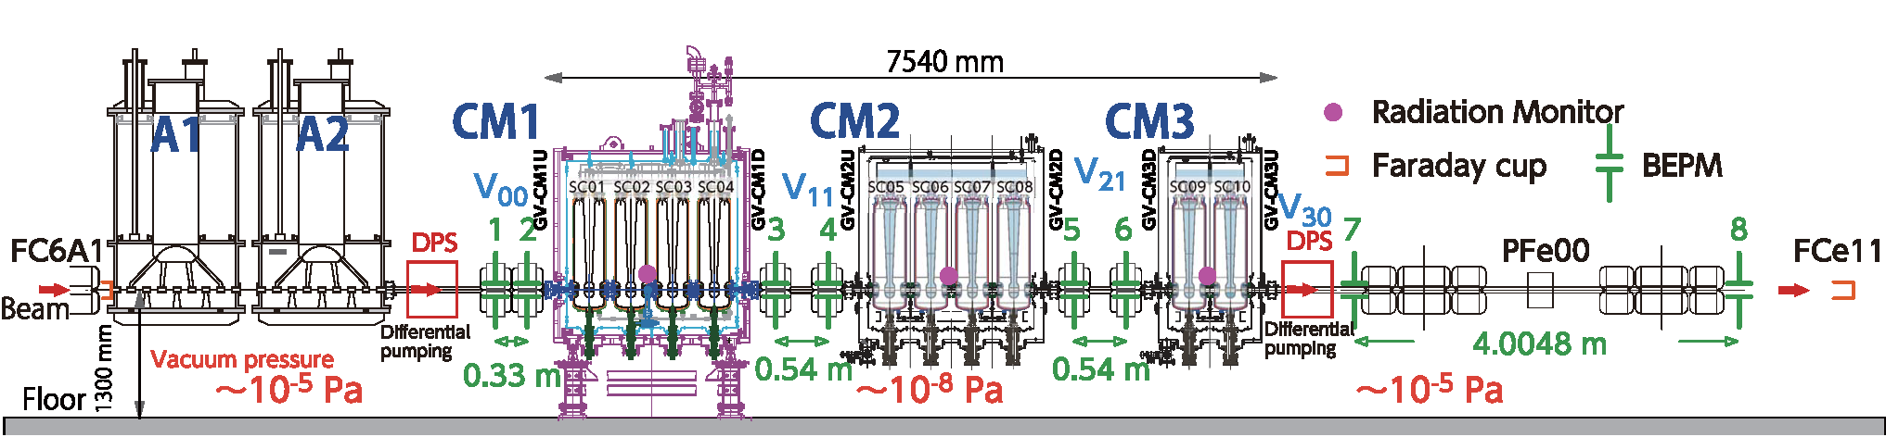
Operational status of SRILAC at RIKEN
Kazunari Yamada, RIKEN Nishina Center
1981~
Superconducting linac section (2019~)
>6.5MeV/u
2001~
Entire layout of the superconducting heavy-ion linear accelerator at RIKEN
・10 superconducting QWRs arranged into three cryomodules
・Located downstream of the old room temperature linac section
・Room temperature quadrupoles for focusing elements
WG4, TTC2022, October 12, 2022
Notes:
Today, I’d like to talk about the operational status of heavy-ion superconducting linac, called SRILAC at RIKEN in short time.
This is the entire layout of the SRILAC.
The SRILAC consists of 10 superconducting QWRs arranged into three cryomodules like this.
Room temperature quadrupole magnets are used for focusing elements between cryomodules.
This superconducting linac section is located downstream of the old room temperature linac section,

Slide 2
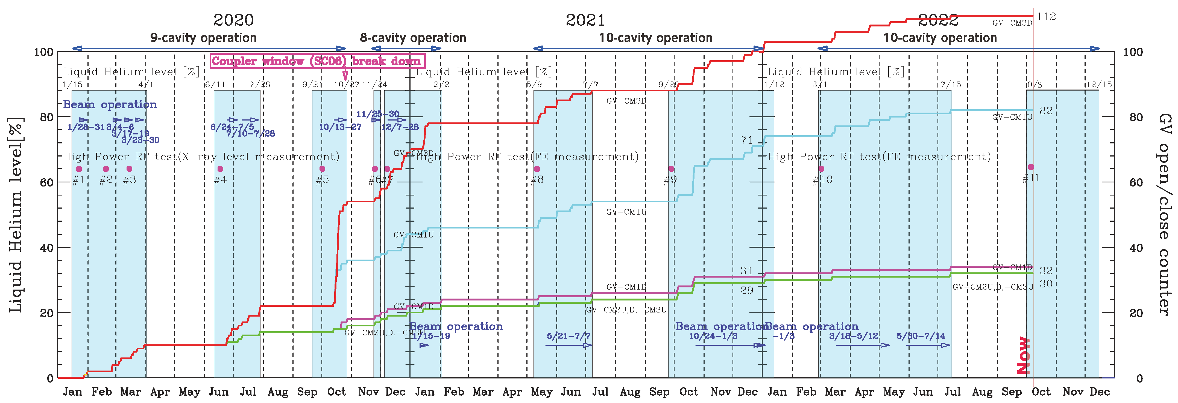
Operation history of SRILAC
After the beam acceleration test for the first time in January 2020, user beam service was initiated.
We have experienced vacuum problem with coupler windows twice (SC05, SC06).
So far cryomodules were cooled for eight times and beam services were made keeping the beam loss as low as possible.
Overall availability of the SRILAC including RT section was more than 90% (SRF 1%).
Degradation of cavity performance is significant.
Notes:
At the first, I show you the operation history of the SRILAC.
After the beam acceleration test for the first time in January 2020, user beam service was initiated.
The blue areas indicate the cooling down cycles for the SRILAC after starting the beam delivery.
We have experienced vacuum problem with couple windows twice, as reported by Ozeki-san yesterday.
The beam services were made keeping the beam loss as low as possible.
During these operation, overall availability of the SRILAC including room-temperature section was more than 90%, RF error of the SRILAC was 1%.
However, the degradation of cavity performance is significant.

Slide 3
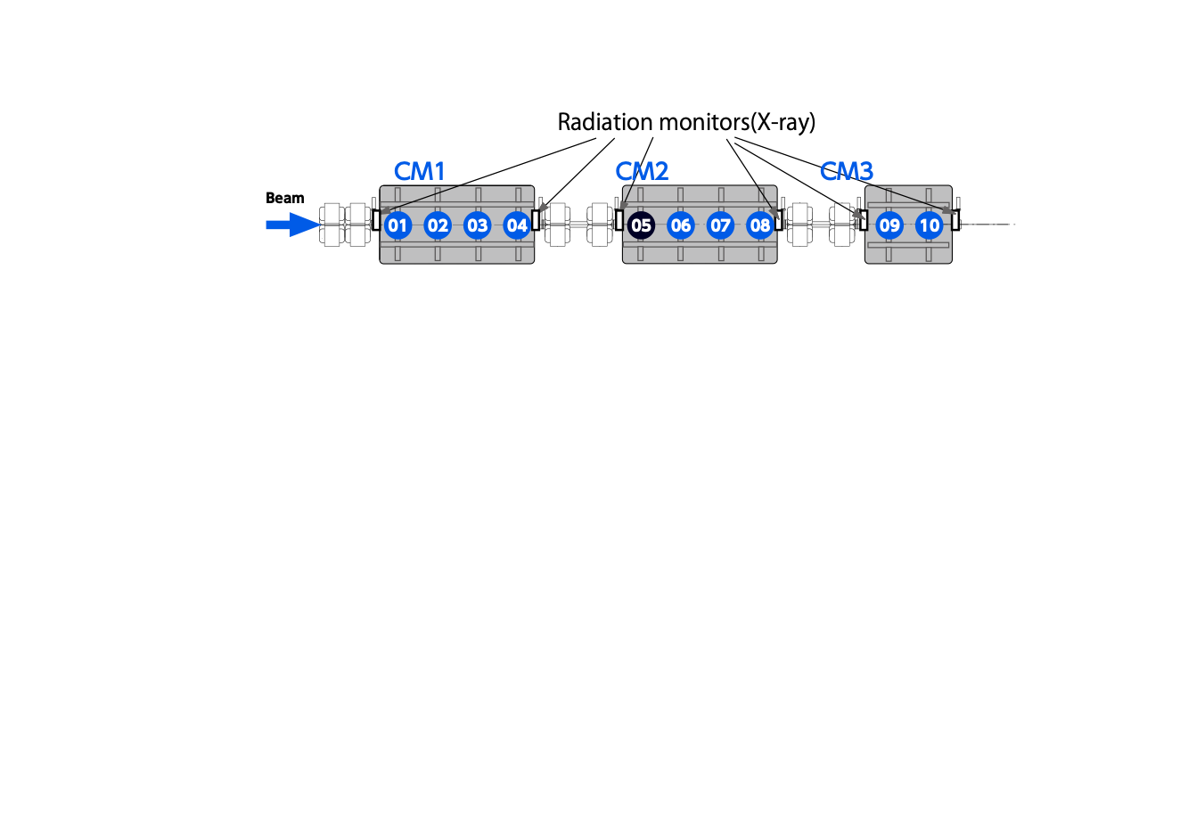
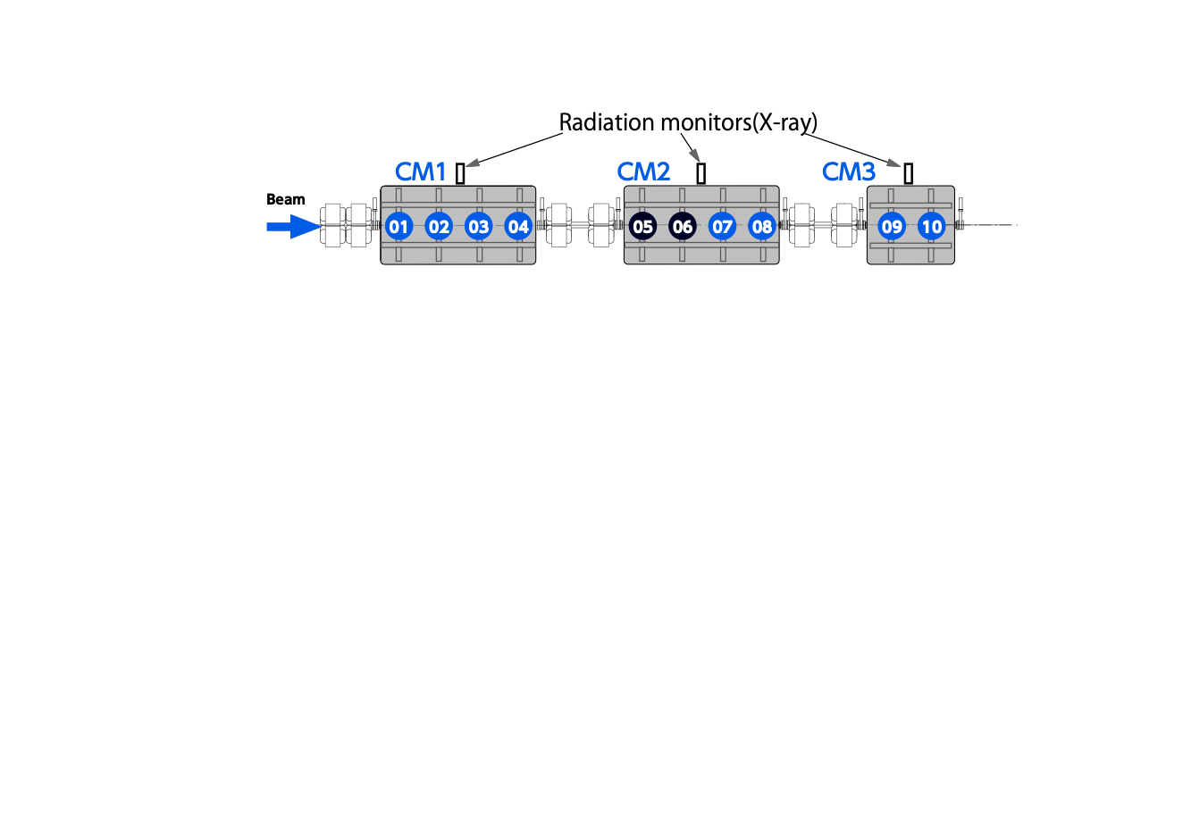
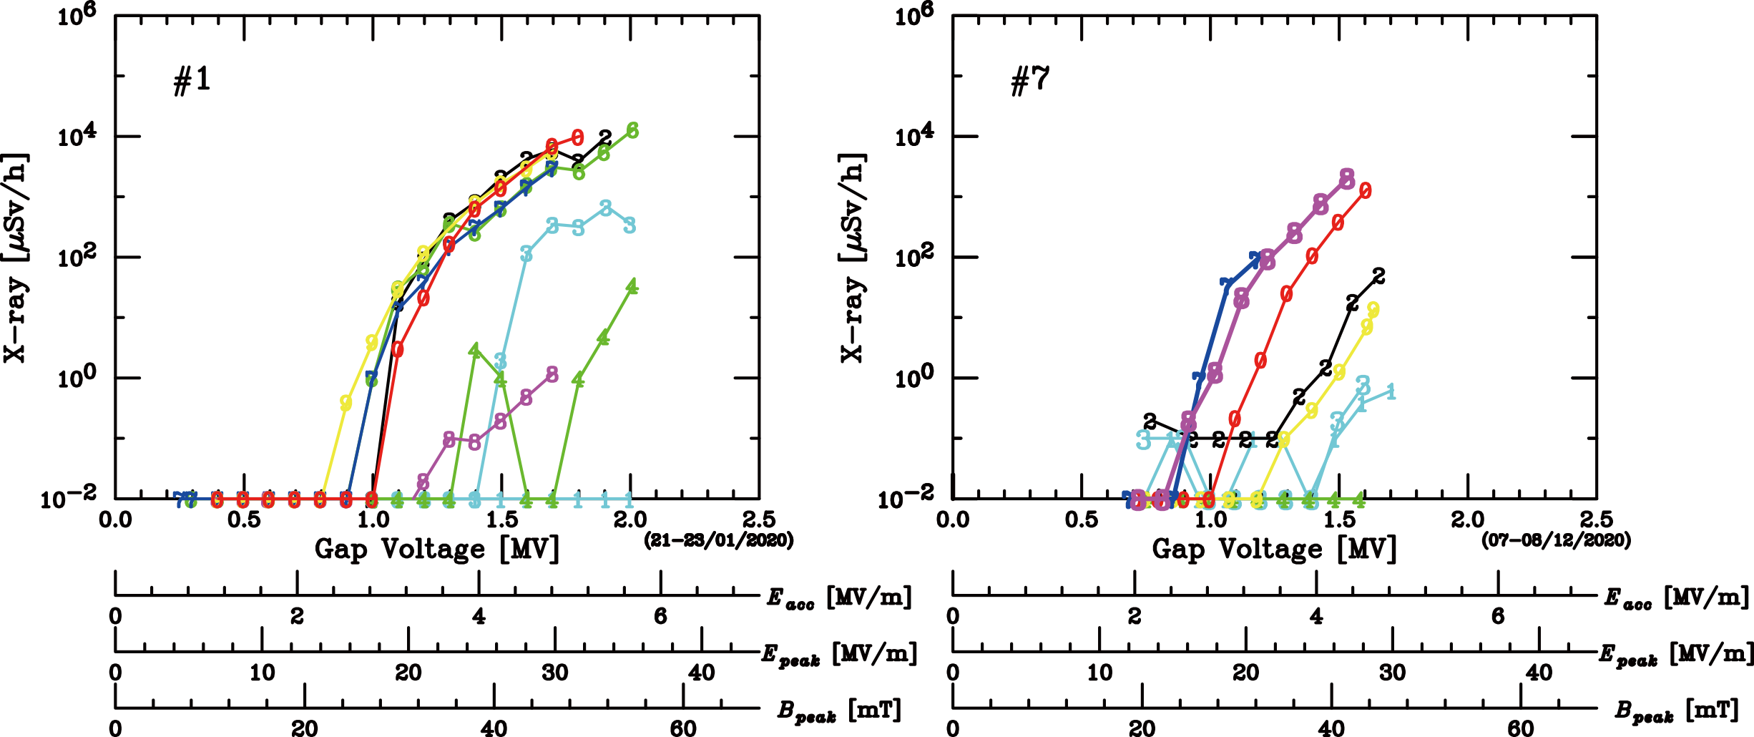
Comparison of Field Emission Levels
After an impact of SC06 coupler-window-break emission levels of SC07, SC08 became higher than those of the measurement #1.
Situation of degradation of SC05, 06, 07, 08 (CM2) is significant.
before opening the GVs
after one year operation
SC07
Voltage
Drop
SC08
Quench
Notes:
Now I compare the field emission levels before opening the gate valves and after one year operation.
After an impact of coupler no.6 window break, emission levels of cavity no.7 and 8 became significantly higher.
This window break occurred during beam supply.
Some contaminants moved to the cavity 7 and 8.
Thus the performance degradation of SC05, 6, 7, 8 is significant.
The performance of the other cavities are almost kept.

Slide 4
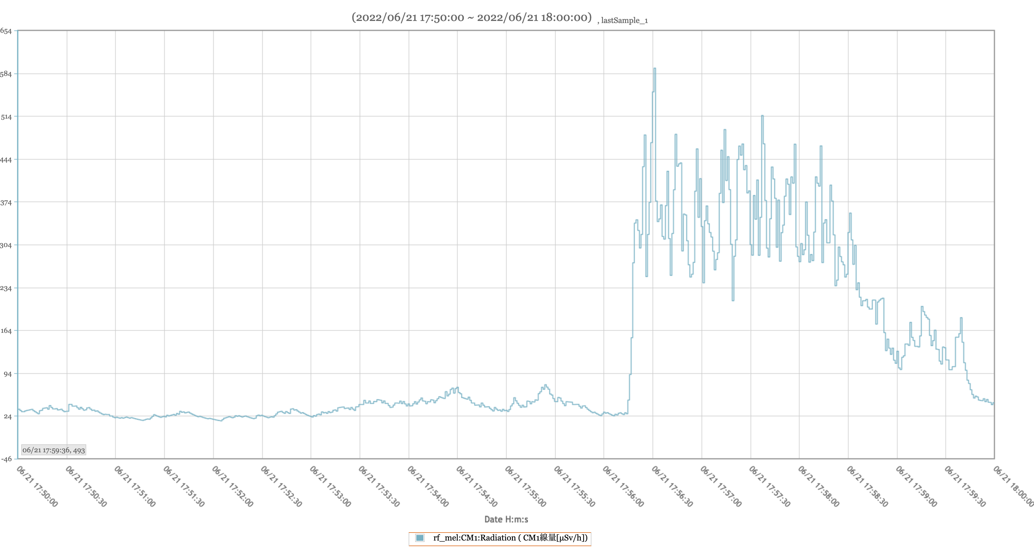
X-ray emission from cavities
Sudden increase of emission level was observed for CM1 during beam services.
No events such as increased beam loss or gate valve opening/closing at this time.
Emission of SC01 was increased.
CM1
Notes:
Other performance degradation have also been observed.
Sudden increase of emission level was observed for CM1 during beam services.
There were no events such as increased beam loss or gate valve opening or closing at this time.
Since the emission of cavity no.1 was increased, some contaminants must have come from upstream.

Slide 5
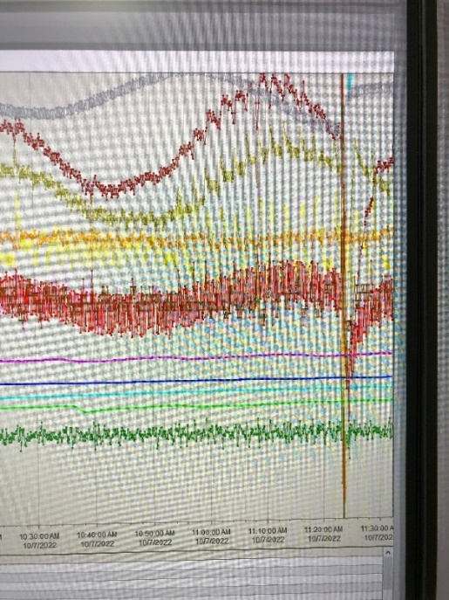
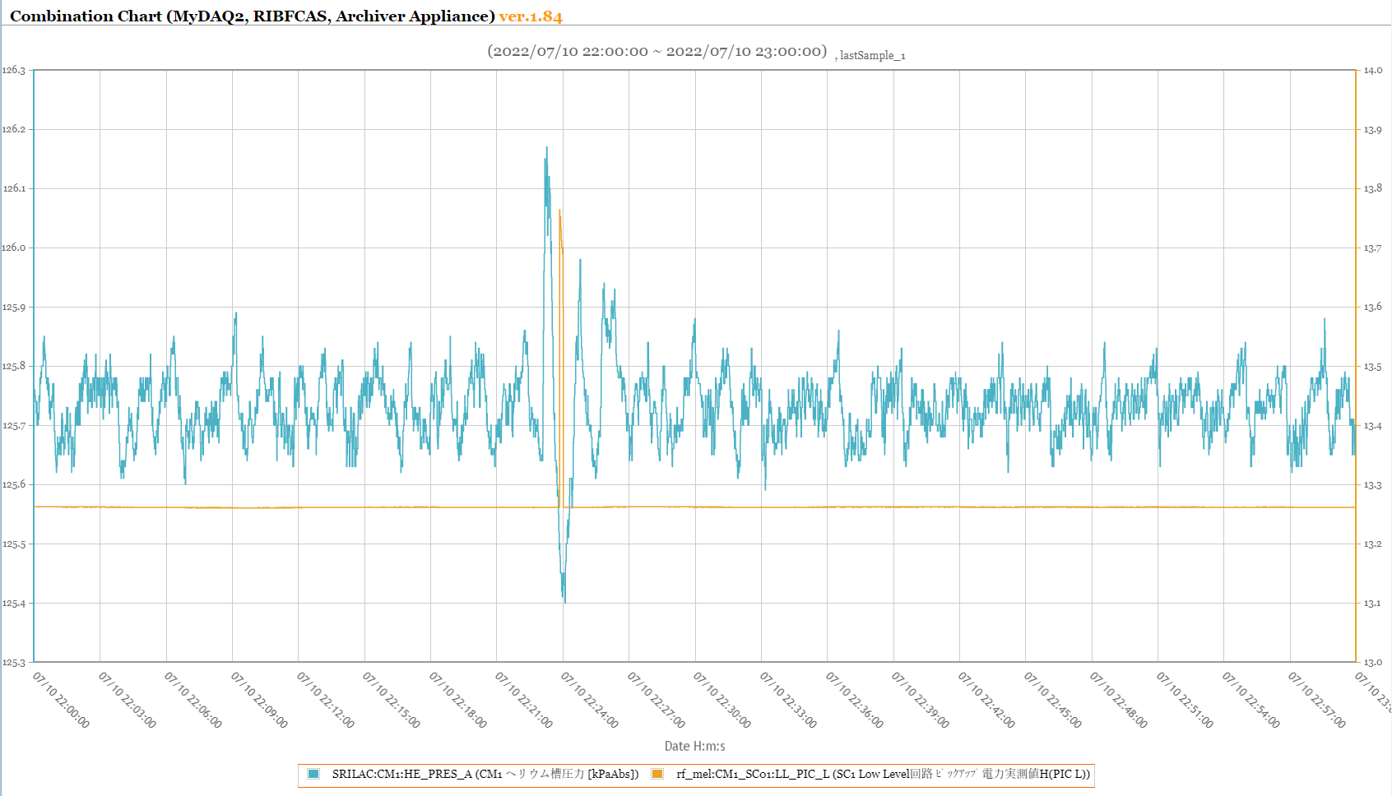
Out of voltage regulation due to He pressure fluctuations
He pressure inside the cold box of refrigerator (near the JT valve)
sometimes drops suddenly and a valve opens to compensate,
causing pressure to rise and large pressure fluctuation.
~ Once a day
He pressure at Cryomodule
10 mbar(1 kPa)
Pickup power
Notes:
Another issue is the occasional voltage out-of-regulation.
He pressure inside the cold box of refrigerator (near the JT valve) sometimes drops suddenly and a valve opens to compensate,
causing pressure to rise and large pressure fluctuation.
The slow tuner cannot keep up with this sudden fluctuation and is unable to stabilize the voltage.
Most of the case the RF does not go down, however we have to wait a few minutes for everything to stabilize.

Slide 6
Backups

Slide 7
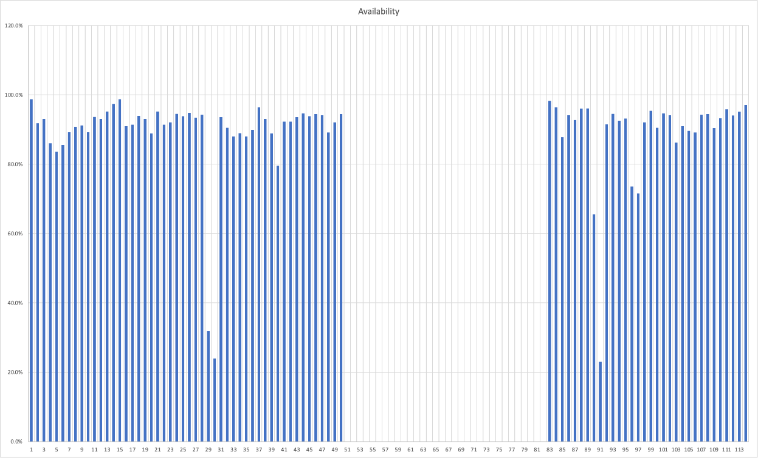
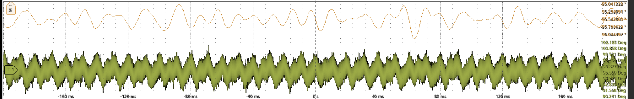
Availability
Overall availability of the RILAC and SRILAC was more than 90%.
Recovery of the cavity voltage sometimes took 20 min. because leaked rf field adjacent cavity affected to re-energize the cavity.
- Cavities talk each other? -
LLRF looked to work well. (Phase error is less than ± 1°)
series 7
90%
Daily inspection of HPGR
RILAC RF error 0.9%
SRILAC RF error 1.0%
IS restart, tuning 2.7%
1°

Slide 8
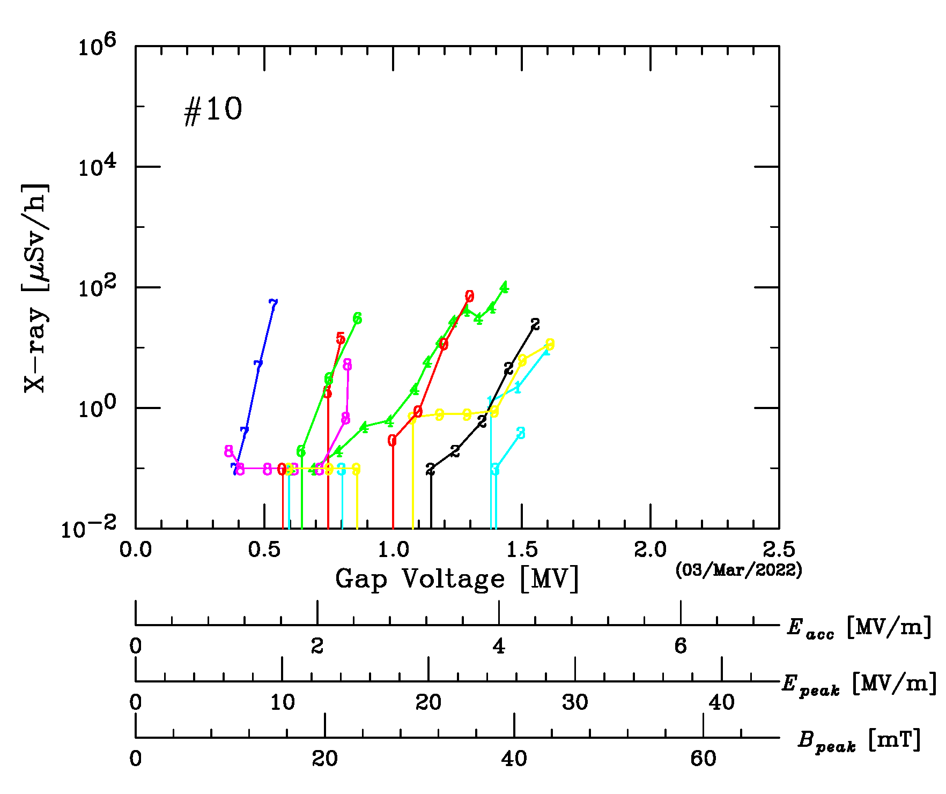
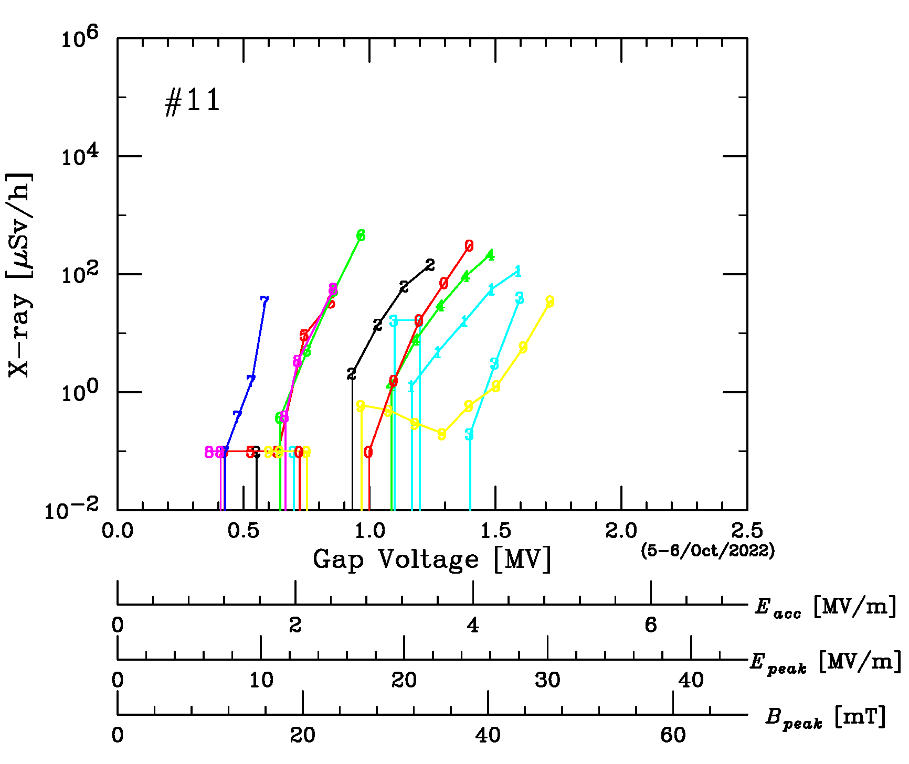
X-ray emission from cavities
Sudden increase of emission level was observed for CM1 during beam services.
After that the performance of SC01 was degraded.
2022.03
2022.10.07

