Slide 1


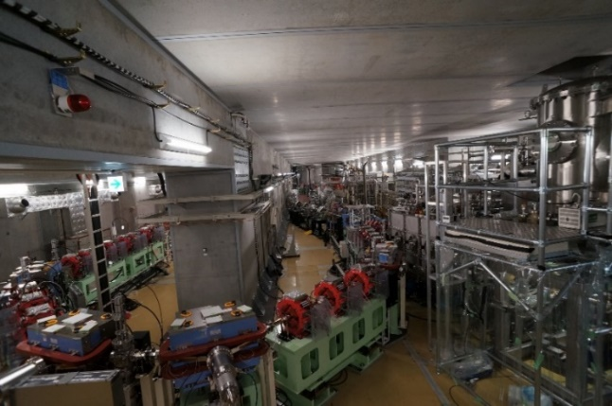
Machine availability and reliability in cERL at KEK
Hiroshi Sakai (on behalf of SRF development team)
Innovation Center for Applied Superconducting Accelerators (iCASA), Accelerator Division
High Energy Accelerator Research Organization (KEK)
Compact ERL (cERL)
8 pages, but some can skip and only give the material for discussion
if you need short time
?? pages
Introduction of cERL cryomodules
SRF performance of cERL cryomodules under cERL beam operation in the latest three years
This talk is based on ERL2022
5 min.
TTC meeting @ Aomori (2022.Oct.11-14)

Slide 2
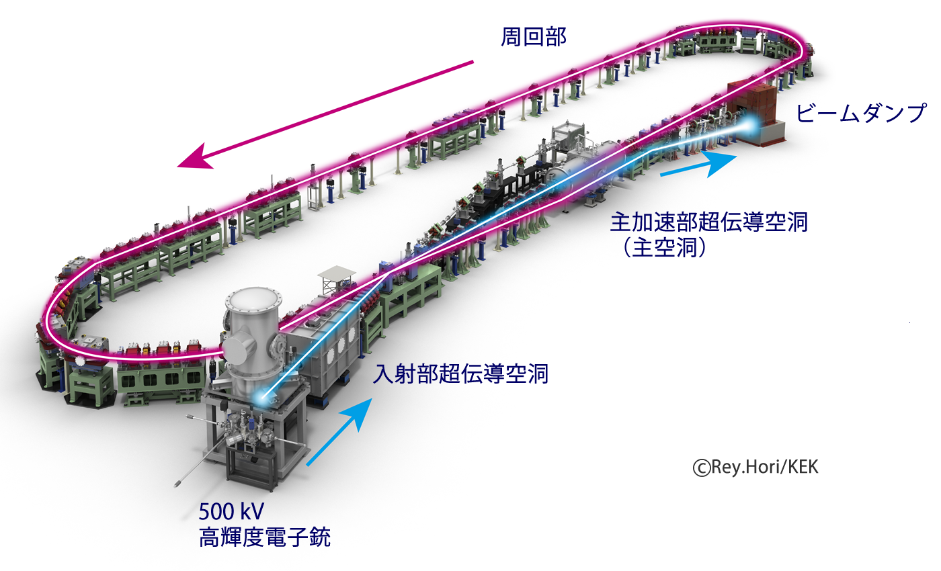
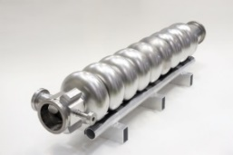
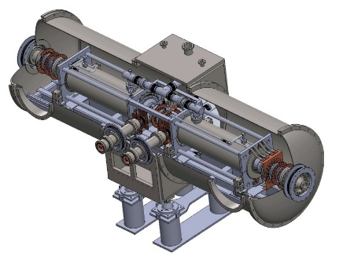
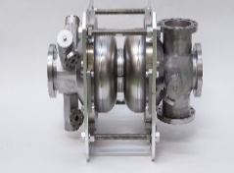
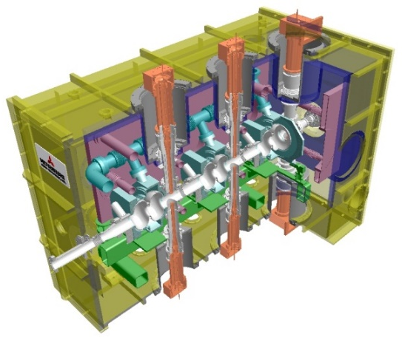
Comact ERL (cERL) in KEK & cERL cryomodules
Irradiation beam
Line (IR) (2019)
Main linac module
Compact ERL Layout
17.5 MeV
HOM damped (for 100mA circulation to suppress HOM-BBU in design)
9-cell cavity (ERL-model2)× 2
Recirculation (return) loop
20MeV
RF frequency: 1.3 GHz
Input power : 20kW CW (SW)
E_{acc}: 15 MV/m（design）
Unloaded-Q: Q₀ > 1×10¹⁰
H.Sakai et al. “Field emission studies in vertical test and during cryomodule operation using precise x-ray mapping system”. Phys. Rev. Accel. Beams 22, 022002 (2019)
Injector diagnostic line
Dump
Main-linac
Cryostat
Two 9-cell SC cavities
HOM absorber
Merger
Injector-linac
Tuner
Photocathode DC gun
(Not SRF Gun)
Target Energy : 35MeV
→ Change 20MeV due to field emission
3MeV
Tuner
Input couplers
e-
Injector module
K. Watanabe, et al. “Development of the superconducting rf 2-cell cavity for cERL injector at KEK” Nucl. Instru. Meth. A Vol. 714, p67-82 (2013)
Requirement was satisfied at V.T. Issue: Heavy F.E was met @9-10MV/m after string assembly. & met quench shown later In detail
2-cell Cavity
Tuner
2-cell cavity × 3
Double coupler
Cryostat
Design parameters of the cERL
RF frequency: 1.3 GHz
Input power :
10kW/coupler (10mA, 5MeV)
180kW/coupler (100mA, 10MeV)
E_{acc}: 7.6MV/m（5MeV）
15MV/m (10MeV)
Unloaded-Q: Q₀ > 1×10¹⁰
Nominal beam energy | 35 MeV → 20MeV →17.5MeV
Nominal Injector energy | 5 MeV →2.9MeV
Beam current | 10 mA (initial goal) 100mA (final)
Normalized emittance | 0.1 ‒ 1 mm⋅mrad
Bunch length (bunch compressed) | 1-3ps (usual) 100fs (short bunch)
Input Coupler
e-
HOM Coupler &
RF Feedthrough
Issue: We met the HOM coupler heating if field inceased more than 7MV/m. It is the reason for heating not perfectly to be filiterd in HOM coupler iand results in lower Q0 than 1x10¹⁰.

Slide 3
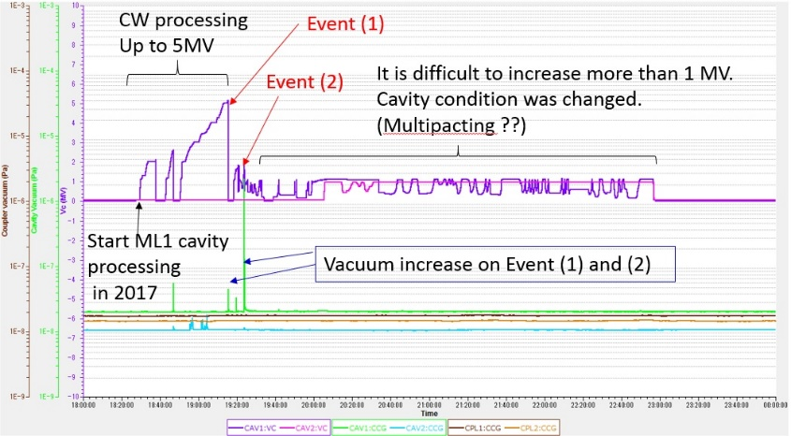
Operational history of cERL cryomodule (almost 10 years)
Construction, Maintenance
Operation
Start beam operation
Pick up the processing example at latest operation
Beam operation
2012 | 2013 | 2014 | 2015 | 2016 | 2017 | 2018 | 2019 | 2020 | 2021 | 2022
Commissioning of injector& main linac
Commissioning of cERL (with loop)
Commissioning of LCS system
Increasing the beam current
High bunch charge
& THz study
1mA again
RI beam test & production
IR-FEL operation
CW 0.3mA ERL
with undulator
Construction of
Injector and main linac cryomodule
1mA ERL achieved
Construction of IR-FEL
Construction of recirculation loop
Construction of LCS system
Construction of RI beamline
Cryogenic &Gun maintenance work
(Injector performance history) field emitted electrons hitting Faraday cup leading to vacuum discharge and F.E much increased in injector cryomodule in 2015
(Main linac performance history) Unknown burst event was occurred at ML1 in 2017. Finally processed but quenched 6.9 MV.
We cooled 2K before beam operation and warmed up after beam operation
cERL beam operation from Oct. 2019 to Feb. 2022
Period(beam operation time) | Energy[MeV] (Comment) | Current
2019.Oct. (3 weeks) | 17.5 (loop) | 60 pC/ bunch
 | 19.0 (IR) | ~1 uA (CW)
2020.Jun. (4 weeks) | 17.5 (loop) | 60 pC/ bunch
2020.Jun. (3 weeks) | 17.5 (loop) | 60 pC/ bunch
2021.Feb-Mar. (6 weeks) | 17.5 (loop) | 60 pC/ bunch
 | 23.0 (IR) | 1pC/bunch (pulse)
2021.Oct. (3 weeks) | 17.5 (loop) | 40 pC/ bunch
 | 10.0 (IR) | ~1uA (CW)
2022.Feb-Mar. (3 weeks) | 17.5 (loop) | 300uA (CW)
 | 10.0 (IR) | ~1uA (CW)
High-power pulse processing found to reduce radiation. It works to recover nominal operation field of 7MV/m.
But from 2017 ML1 did not reach more than 7MV after unknown burst event. (before reach >10MV)
E. Kako “Degradation and Recovery of CavityPerformance in compact-ERL Injector Cryomodule” talk in ERL2019
H.Sakai et al. “LONG-TERM OPERATION WITH BEAM AND CAVITY PERFORMANCE
DEGRADATION IN COMPACT-ERL MAIN LINAC IN KEK” Proc. of LIINAC2018
What happened in long term beam operation ? And how do we keep cavity performance in latest three years?
3

Slide 4
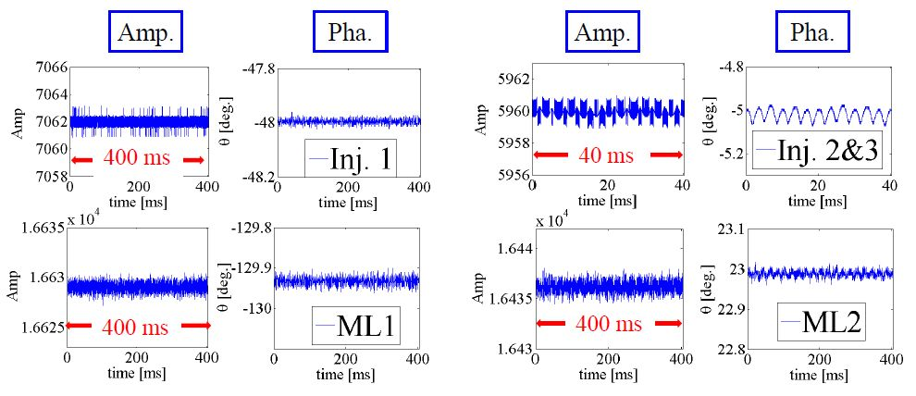
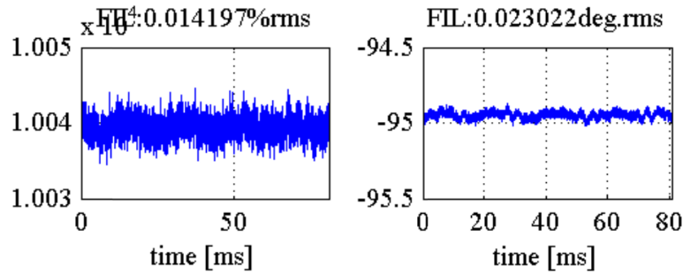
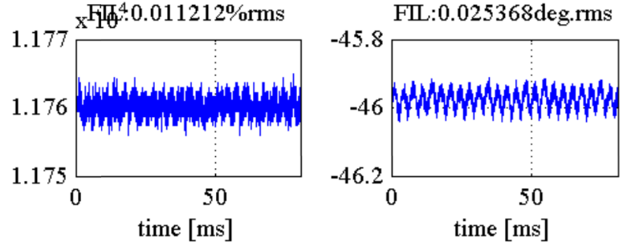
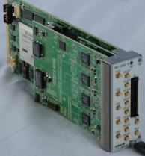
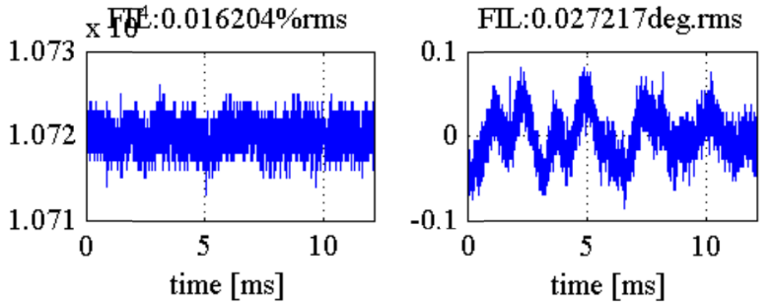
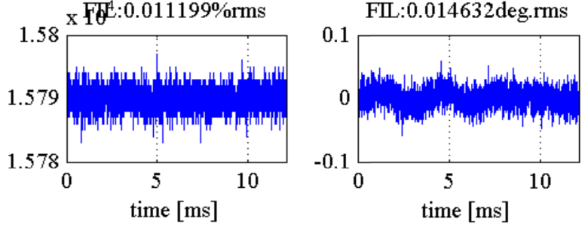
Power & LLRF stability in cERL beam operation
Data taken in 2021.Feb.5. Basically suppress michrophonics and almost close our requirements of ΔA/A ~ 0.01% , Δθ ~ 0.01 deg.
FPGA
Virtex5-FX
T. Miura, IPAC2014 @Dresden
Microphonics suppression in ML
Inj1
Inj2,3
Beam stability was also achieved about 0.01% by measuring momentum jitter at screen monitor on arc section thanks to LLRF optimization
ML1
ML2
dBc/Hz
Present (2022) | Inj1(2cell) | Inj2(2cell) | Inj3(2cell) | ML1(9cell) | ML2(9cell)
Acc. Field | 3.4 MV/m | 3.6 MV/m | 3.2 MV/m | 5.2 MV/m | 8.2 MV/m
power | 0.6 kW | 1.4 kW | 1.1 kW | 0.7 kW | 2kW
Power source | 25 kW klystron | 300kW klystron (Vector sum) |  | 16 kW solid state Amp | 8kW solid state Amp
QL | 1.2e6 | 5.8e5 | 4.8e5 | 1.3e7 | 1.0e7
ΔA/A(% rms) | 0.014% | 0.011% |  | 0.016% | 0.011%
Δθ(deg rms) | 0.023deg | 0.025deg |  | 0.027deg | 0.015deg
Hz
Phase noise by Microphonics was suppressed well by RF FB.
Phase noise of Vc with FB was almost the same as that of Master Oscillator.
(Up to now, we keep the RF stability after ML1 field reduced 8.3 MV/m → 5.2 MV/m in 2017 )
Total beam energy 17.5 MeV
Injector gain : 3.0 MV
Main linac gain : 14.0 MV

Slide 5
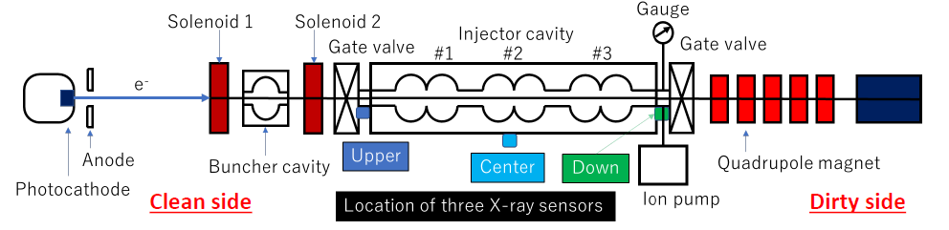
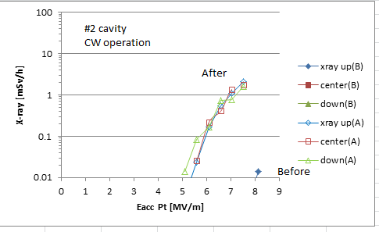
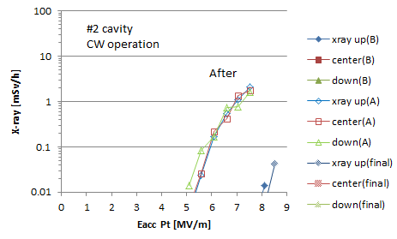
Injector performance from Oct. 2019 to Feb. 2022
We once met the sudden severe X-ray increase during beam operation in Jun. 2020.
F.E onset reduced from 8 MV/m to 5 MV/m in Inj #2 cavity. We do not know the reason.
After pulse processing, F.E onset recovered at normal level. → kept 7 MV/m operation
(Before pulse processing)
CW = 8MV/m (onset 5MV/m)
Pulse duty (0.5ms 10Hz)
18 MV/m (~2 hours)
final
Pulse duty (5ms 10Hz)
12 MV/m (~1 hours)
(After Pulse processing)
CW = 8MV/m (onset 8MV/m)
2020.Jun.18
2020.Jun.19
Suddenly x-ray onset reduced
X-ray onset before and after pulse processing、
From now, we apply same pulse processing after 2 K cooldown before beam operation.

Slide 6
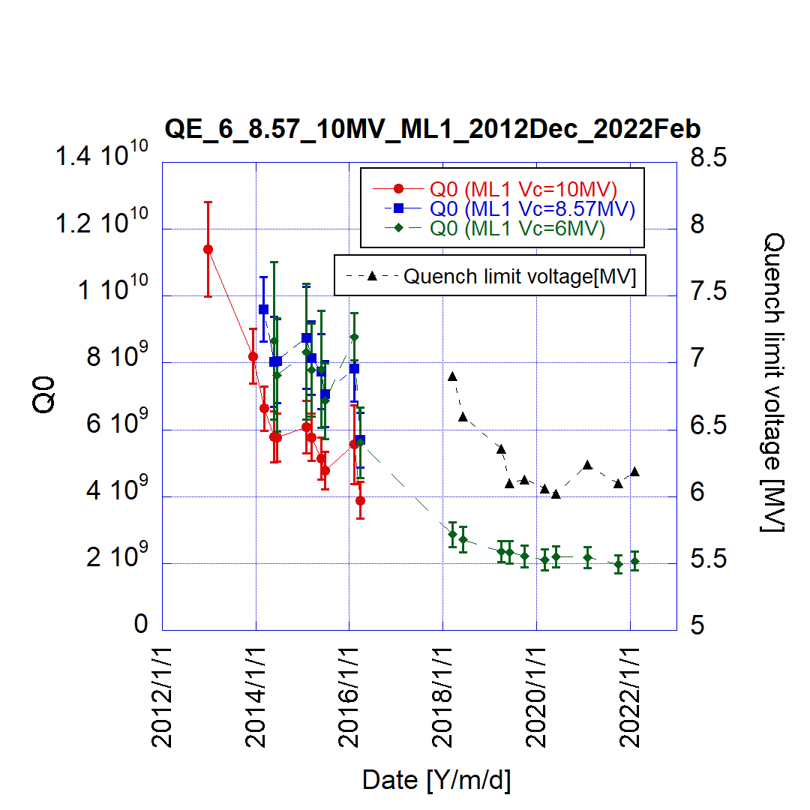
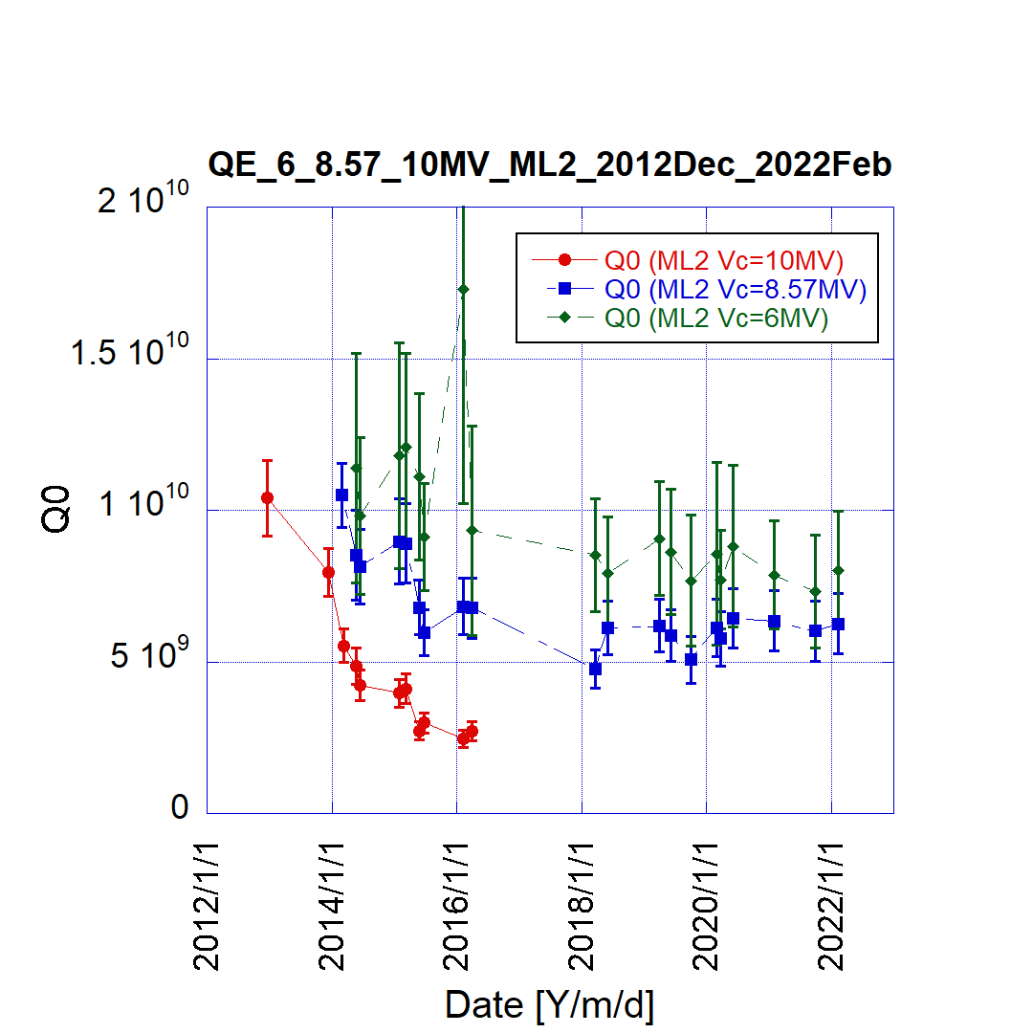
Main linac performance (long-time Q-value history (2012.Dec – 2022.Feb))
ML Pulse processing (peak 11.7MV)
Vc = 8.8MV(CW) + 2.9MV(pulse 10Hz 4ms) (3 hours apply)
ML1
ML2
Before
Beam operation
Before
Beam operation
Kept same level of
Q-values on 3years
Kept same level of
Q-values on 3years
After pulse processing, 0.5 MV onset of x-ray was increased. X-ray monitor was set at the downstream of cryomodule.
Before the beam operation, we could keep 1x10¹⁰ at 10MV on both cavities in 2012.
Main degradation of ML1 is thermal breakdown from 2017. we doubt the some ceramic and/or HOM absorber crack and/or something from outside of the cryomodule (NEG?) might come into the ML1 cavity ??
After that quench limit and Q-values gradually reduced. But in latest three years both kept same level.
In first five years (2012-2016), we see the degradation by the field emission. In the latest three years, we kept the same Q-values in both cavities by applying the pulse processing on every cERL operational phase.
Up to now, we apply same pulse processing for both ML cavities after 2 K cooldown before beam operation.

Slide 7
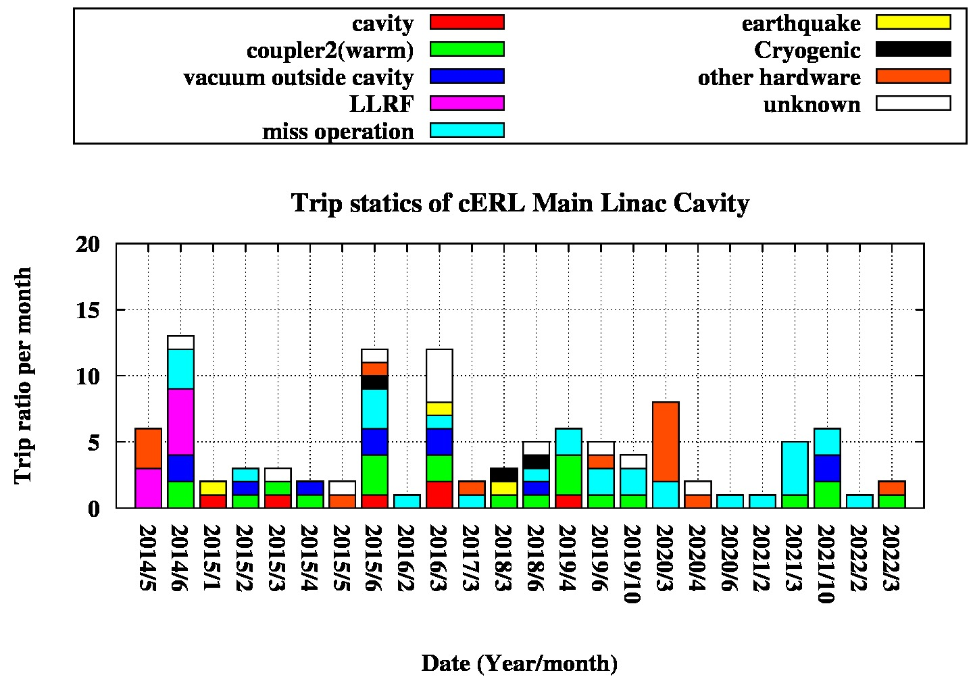
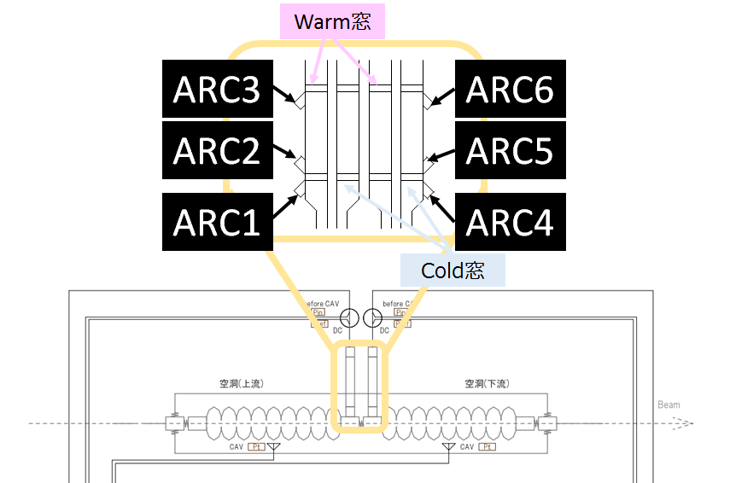
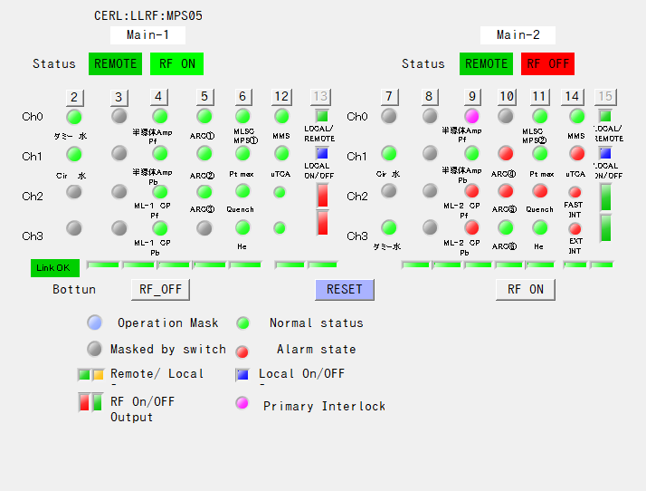
ML Trip ratio (longterm) (2014.Apr. ~ 2022.Mar.) (almost 9 years) & Inj
After optimization of LLRF gain in 2014, we kept small trip ratio in 2015. If cavity field increased higher in 2015. trip ratio increased. Main reasons of trip come from the warm coupler (ML2) discharge event (light green). We did not know why these discharged events would occur. However, we could safely turn off RF within 10us by using ITL of arc sensor of input coupler.
We note that cERL injector did not meet the trip caused by Inj cryomodule itself in 3 years
Stably operated without severe hardware problem on both Inj and ML cryomodule until now.

Slide 8
Summary
KEK cERL cryomodule are operating from 2012 until now for almost 10 years.
For injector, one we met the severe degradation in 2020. But we could recover the normal radiation onset level by the pulse processing.
For Main iinac we met the cavity degradation under beam operation after the unknown burst event of ML1. But for the latest 3 years, we did not see more degradation. Main issues is field emission for ML2 and thermal breakdown for ML1.
Finally, by applying the pulse processing for both cryomodule before the beam operation, we kept the stable beam operation under LLRF optimization.
For WG4 discussion
We mainly define the availability as the trip ratio. Our case is mainly come from mis-operation and sometimes coupler trip after LLRF optimization to suppress the microphonics in early years. It is available for our experiment. But is it available for other facilities ??
Did you meet the severe hardware trouble about SRF cryomodule for other facilities ?

Slide 9
backup

Slide 10
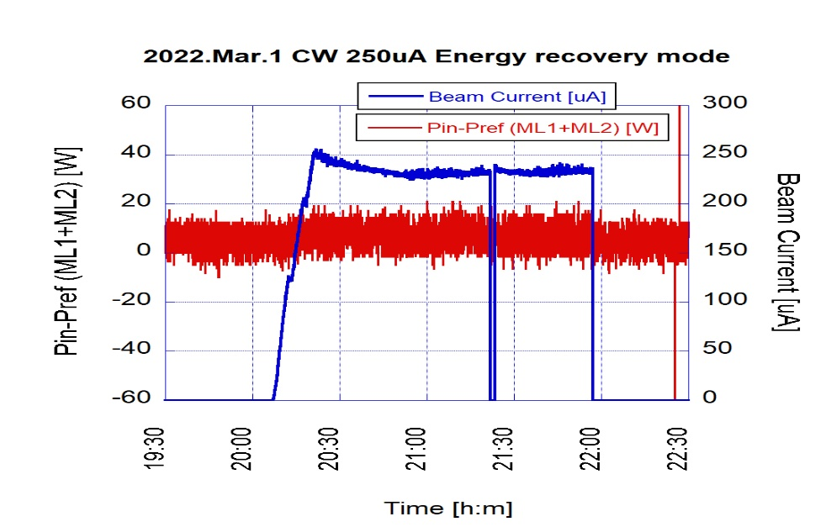
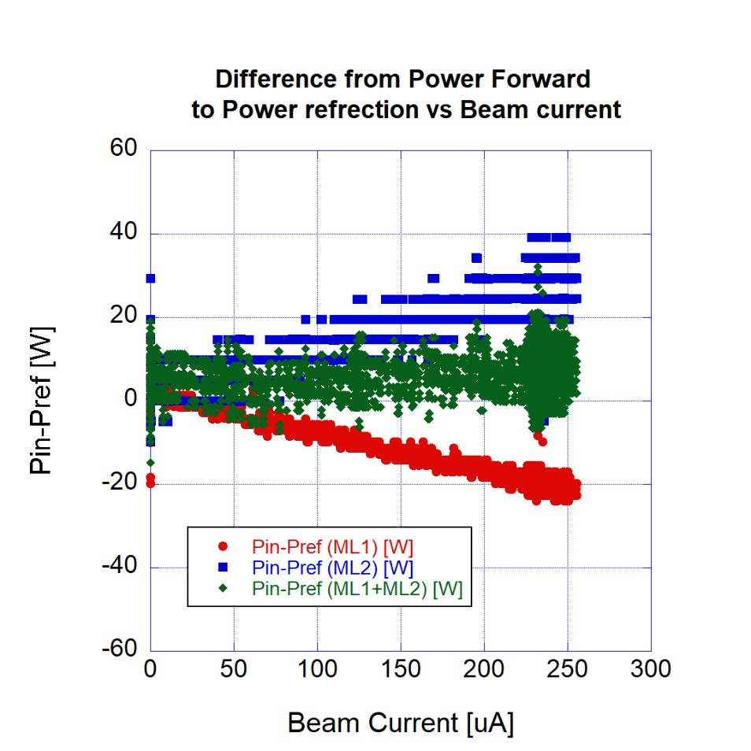
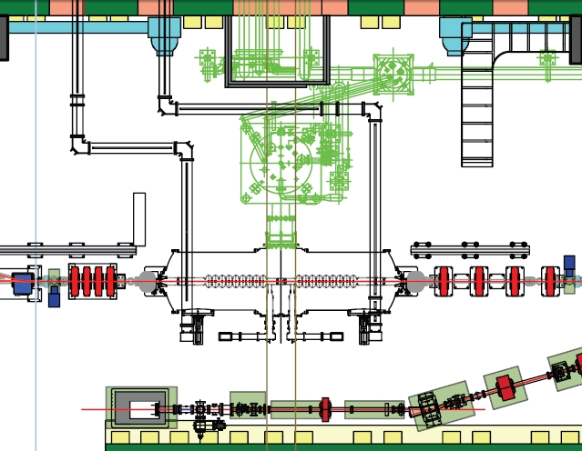
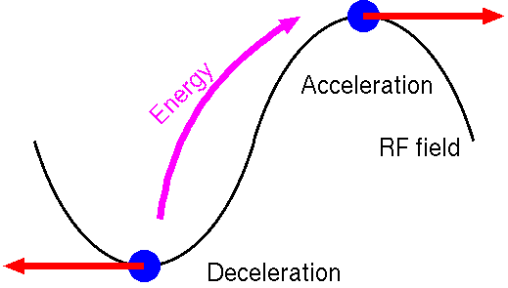
Successful ~ 0.3mA CW beam operation with energy recovery with Undulator in 2022
Change CW mode and increase the beam current :Reach 0.3 mA on Feb/2022 with undulator.
0.25 mA
Trend of beam current under energy recovery
Beam current [μA]
Required power without recovery is :
14.0 MV x 250 uA = 3.5 kW
2 hours
Energy recovery was successfully done with 100%
Feed power : less than 10W !! (r.m.s 4 W)
ML2: Δ(Pin2-Pref2)
Main linac
（lower）ML2
5.5 MV
（upper） ML1
8.5 MV
Δ(Pin-Pref) [W]
e-
Pref
Pin
Total (ML1+ML2): Δ(Pin-Pref)
ML1: Δ(Pin1-Pref1)
Beam current [μA]
Next, we try to increase beam current more
Stable energy recovery of about 0.3 mA was successfully done without beam loss.

