Slide 1
Machine Availability and Reliability in SNS SRF at ORNL
Presented at
TESLA Technology Collaboration Meeting
October 11-14, 2022
Rongli Geng, Sang-ho Kim, Amith Narayan, Shane Passmore
Spallation Neutron Source
Oak Ridge National Laboratory

Slide 2
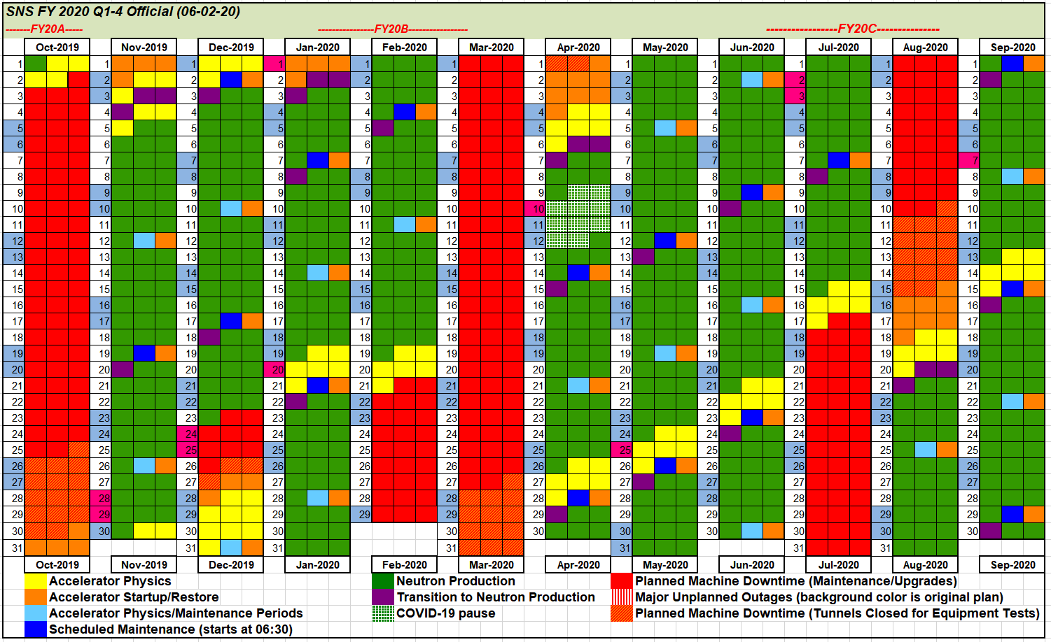
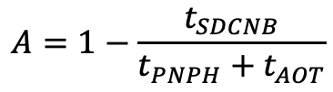
SNS Operation and Availability
SNS operation schedule
Availability Defined
$$A=1−\frac{t_{SDCNB}}{t_{PNPH}+t_{AOT}}$$
SDNB=System Down Causing No Beam
PNPH=Published Neutron Production Hours
AOT=Additional Option Time
Downtime for each sub-system is tracked
Major sub-systems: Target, electrical including HVCM, Magnet PS, Chopper etc., RF, Ion Source, Beam Instrumentation, Controls, Vacuum, Cooling, Cryogenics, SRF, Machine Protection Sys etc.
Availability goal for SRF System: 99%
Availability commitment for SNS: 90%
Planned neutron production hours in recent years: 4,700~4,900 (green)
  Input from ‘target management plan’ and major maintenance activities
  Goal in near future: 5,000 planned hours at > 90% availability

Slide 3
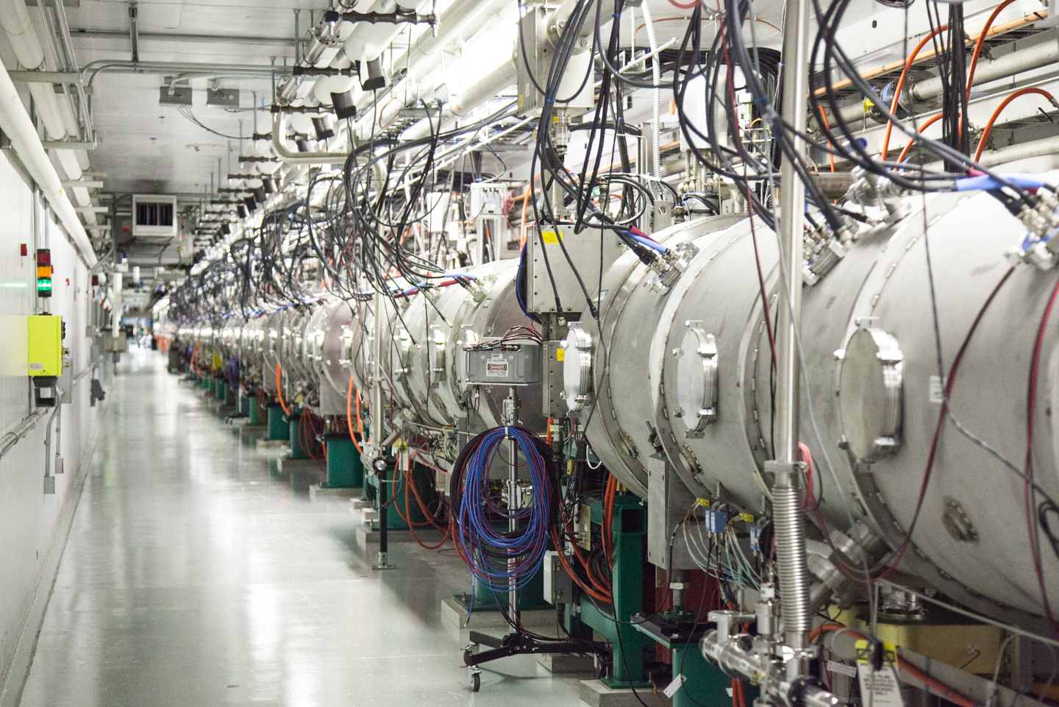
SRF and SCL Availability
Key Facts
High Availability Performance
First adoption of SRF technology for large scale pulsed proton machine
Designed for H- beam acceleration from 186 MeV to 1000 MeV
Two types of cavity geometries to cover broad range of particle velocities
  33 medium beta (β_{g}=0.61) SRF cavities
  48 high beta (β_{g}=0.81) SRF cavities
157-m long, 81 independently powered 805-MHz SRF cavities in 23 cryomodules
71-m long space is reserved for energy upgrade
Avg over
past 12 years
SRF: 99.55%
SCL: 97.95%
SCL supporting systems Including CHL, RF, High Voltage Modulator,
control, vacuum etc
SNS SCL demonstrated high availability operation of SRF cavities leading the field of SRF operation and encourage SRF adoption for future machines

Slide 4
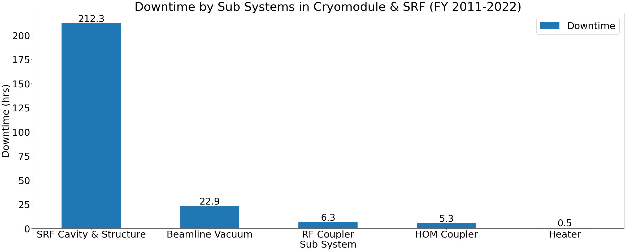
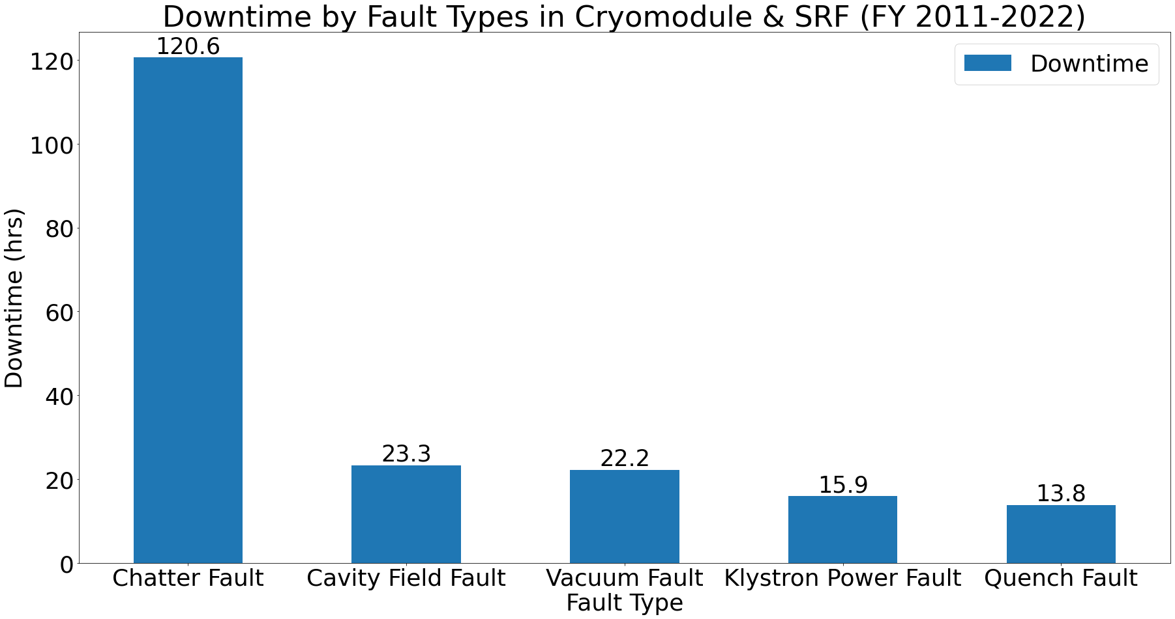
SRF Reliability: Leading Downtime Sources & Fault Types
Top 5 SRF downtime sources by sub-sys
Top 5 SRF Fault Types
Sustaining availability
  In-situ and/or offline repairs
  spare cryomodules
  In-situ plasma processing
  Diagnostics & predictability
    Average trip or downtime: <1 trip/day corresponding to <5 min./day

Slide 5
Backup Slides

Slide 6
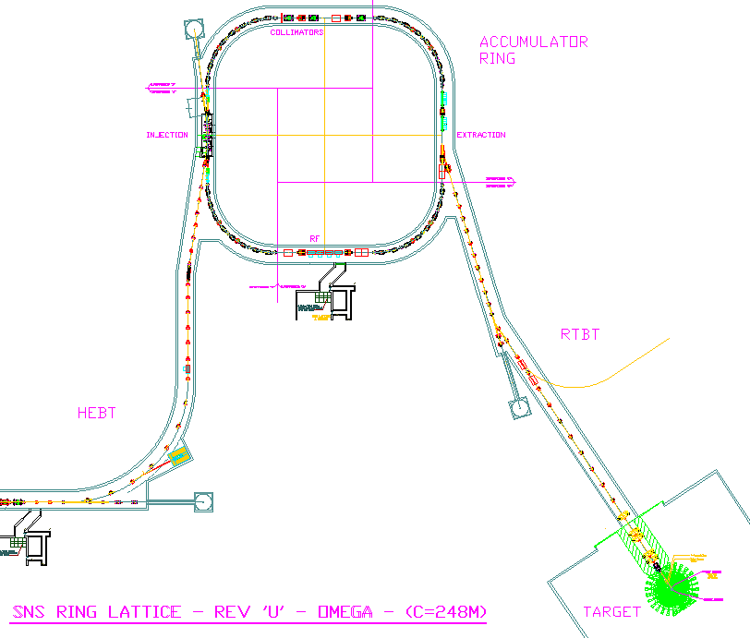


SNS machine layout
Ring: Accumulate
1-ms long pulse
to 700 ns
Front-End: Produce
a 1-ms long, chopped, H-beam at 60 Hz
H- stripped to p
Linac; 1 GeV acceleration
402.5 MHz
805 MHz
DTL
CCL
SRF, β=0.61
SRF, β=0.81
upgrade
Liquid Hg Target
2.5
86.8
186
387
1000 MeV
259 m
157 m
71 m
Chopper system makes gaps
945 ns
mini-pulse
Current
Current
1 ms
1 ms macro-pulse
Average macro-pulse beam current: 26 mA

Slide 7
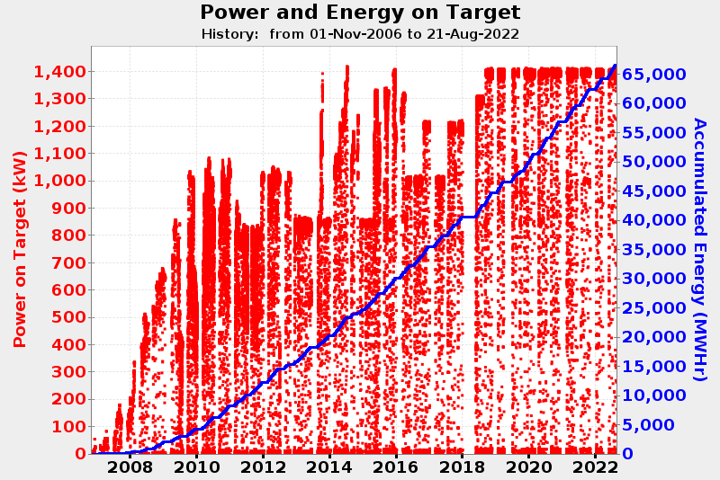
Beam power on target since FY07
Various issues has been encountered and addressed
SNS has achieved a stable operation at 1.4 MW

Slide 8
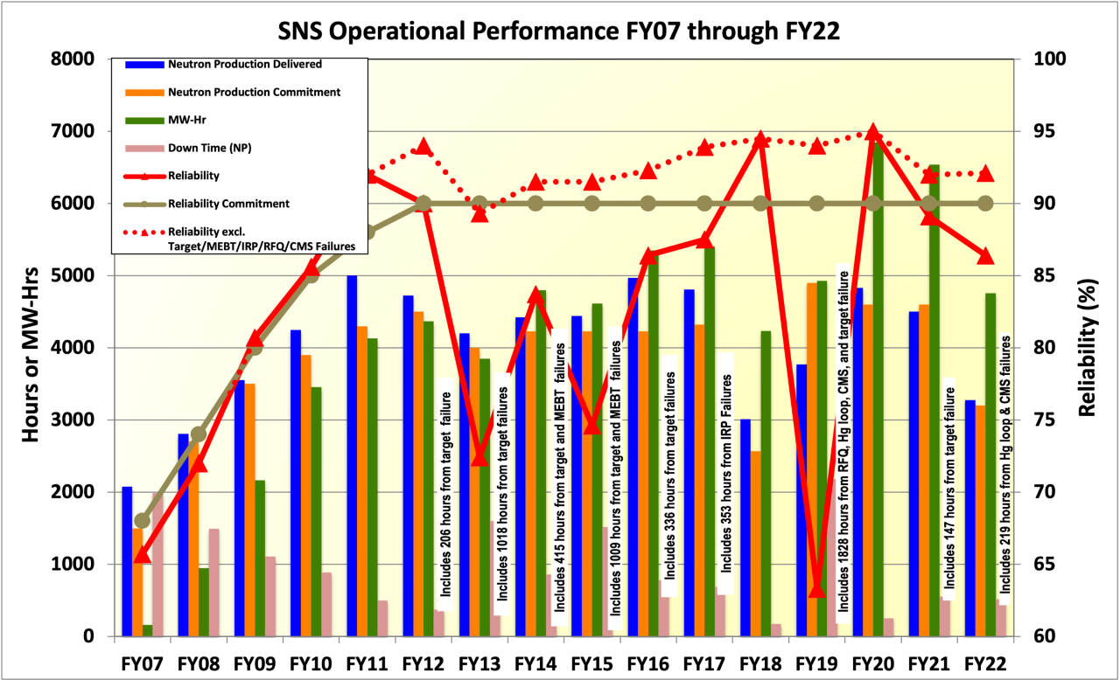
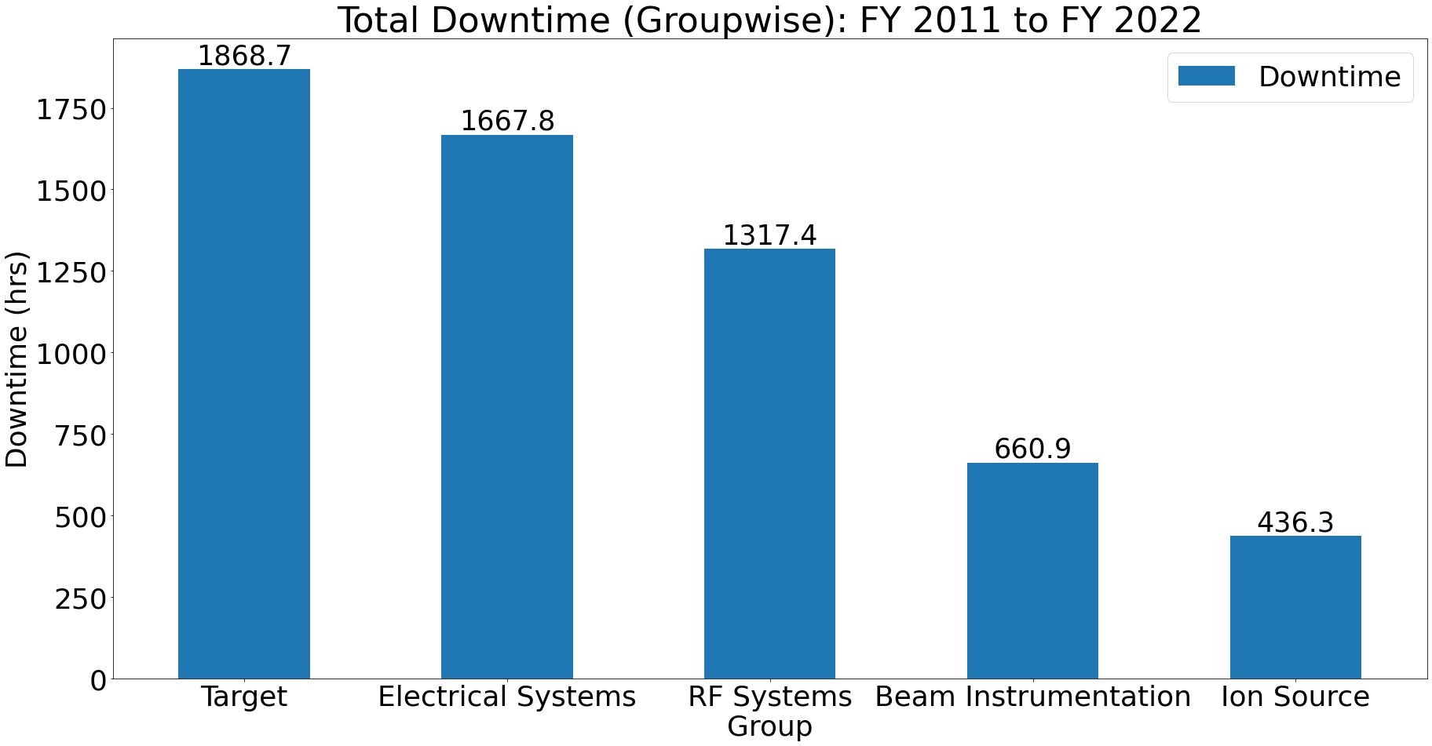
Overall SNS Facility Performance FY07-FY22
Operational reliability remains excellent
  Machine availability for neutron production in FY20 95%
Main downtime sources in SNS are understood and actively managed to sustain the machine availability

