Slide 1
Plasma processing at FNAL
Sergey Belomestnykh on behalf of the plasma processing team at Fermilab*
TTC2022 Aomori
*The slides are prepared by B. Giaccone and P. Berrutti

Slide 2
Outline
Plasma processing applied to LCLS-II-HE vCM
Plasma processing studies for ILC cavities
Plasma processing for SRF gun

Slide 3
Outline
Plasma processing applied to LCLS-II-HE vCM
Plasma processing studies for ILC cavities
Plasma processing for SRF gun

Slide 4
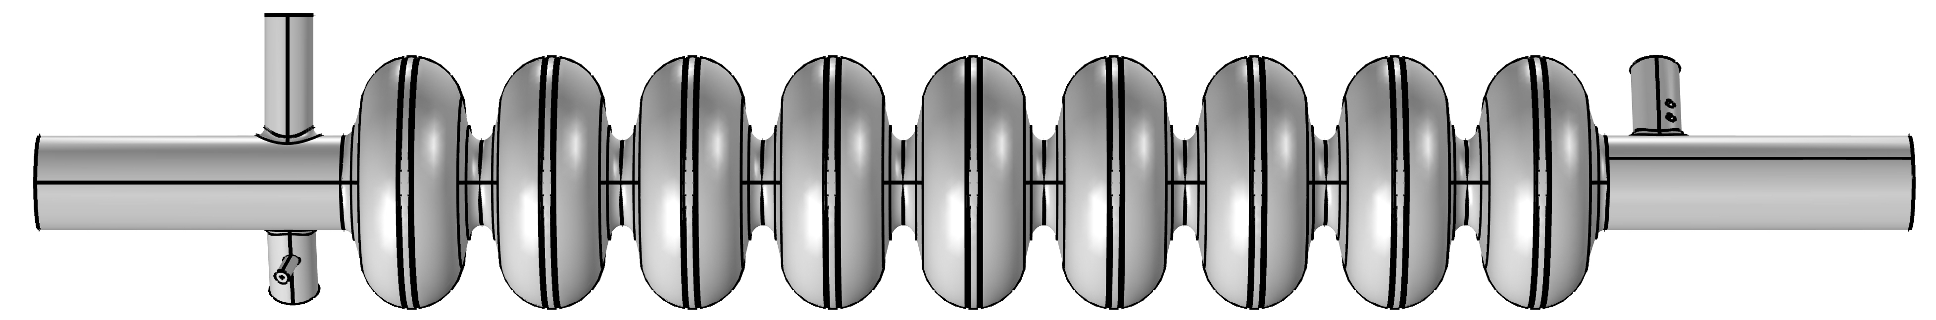
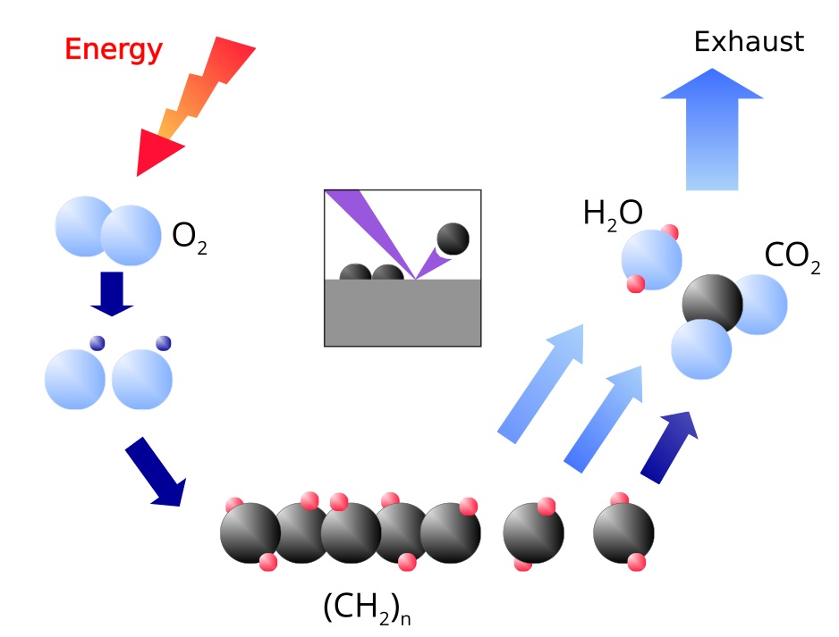
Plasma processing for field emission mitigation
Gas IN
Gas OUT
RF excitation
Gas flow of Ne-O mixture (mostly Ne with a few % of O₂) at p ~ 75-150 mTorr
Once plasma is ignited, oxygen reacts with hydrocarbons
Reaction products (mostly CO, CO₂, H₂O) are pumped out
Work function increases, reducing FE
M. Doleans, et al., Nucl. Instrum. Methods Phys. Res. A 812, 50-59 (2016)

Slide 5
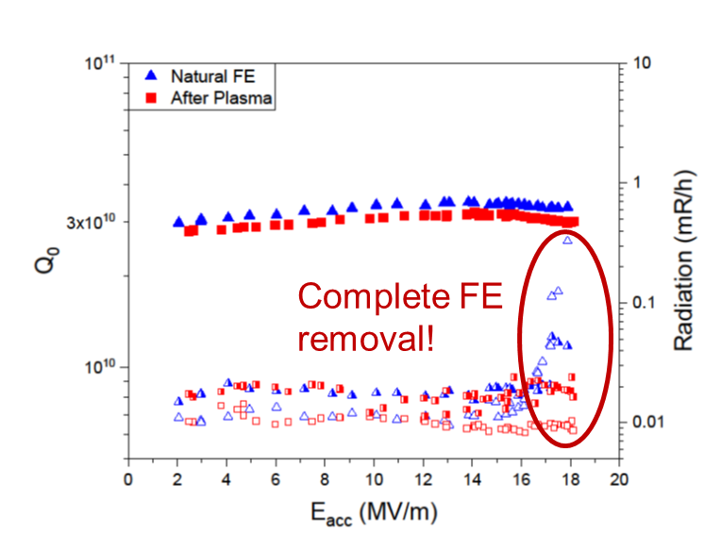
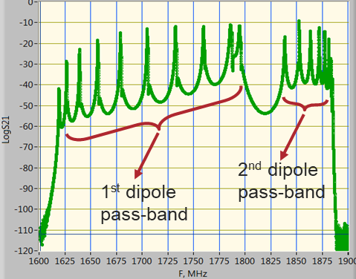
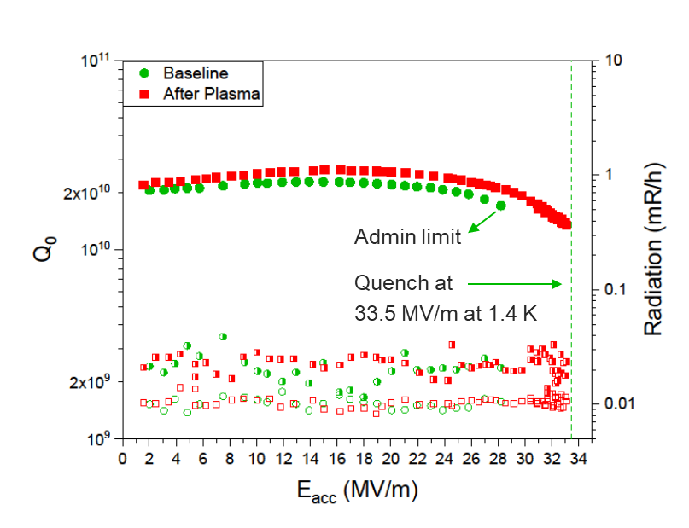
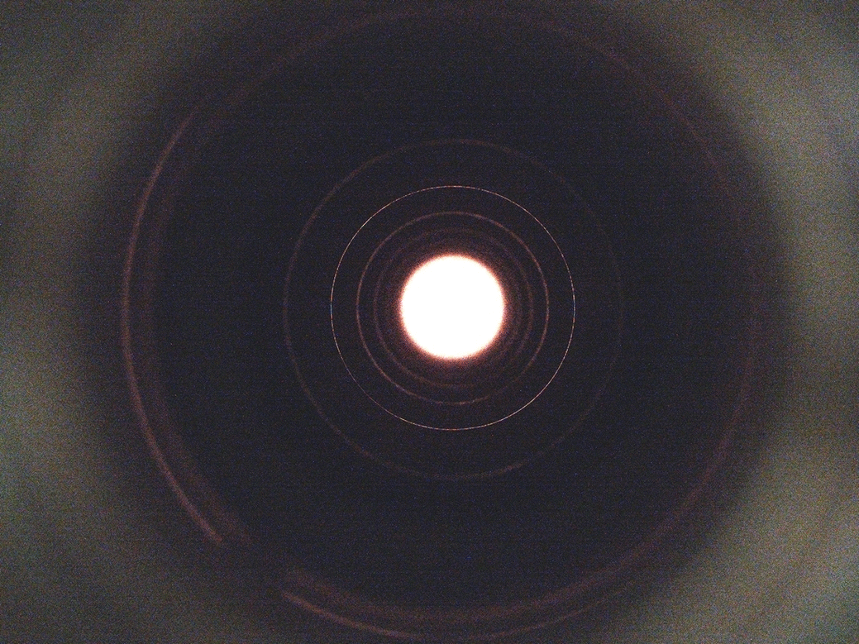
Plasma processing for LCLS-II and LCLS-II-HE
Plasma ignition sequentially cell-by-cell using HOM modes and antennas
Plasma is ignited in the central cell and moved to adjacent cells using a superposition of HOMs
We demonstrated removal of hydrocarbon induced FE
And no negative effect of plasma processing on N-doping: high Q₀ and quench field are preserved
P. Berrutti, et al., J. Appl. Phys. 126, 023302 (2019)
B. Giaccone et al., Phys. Rev. Accel. Beams 24, 022002 (2021)

Slide 6
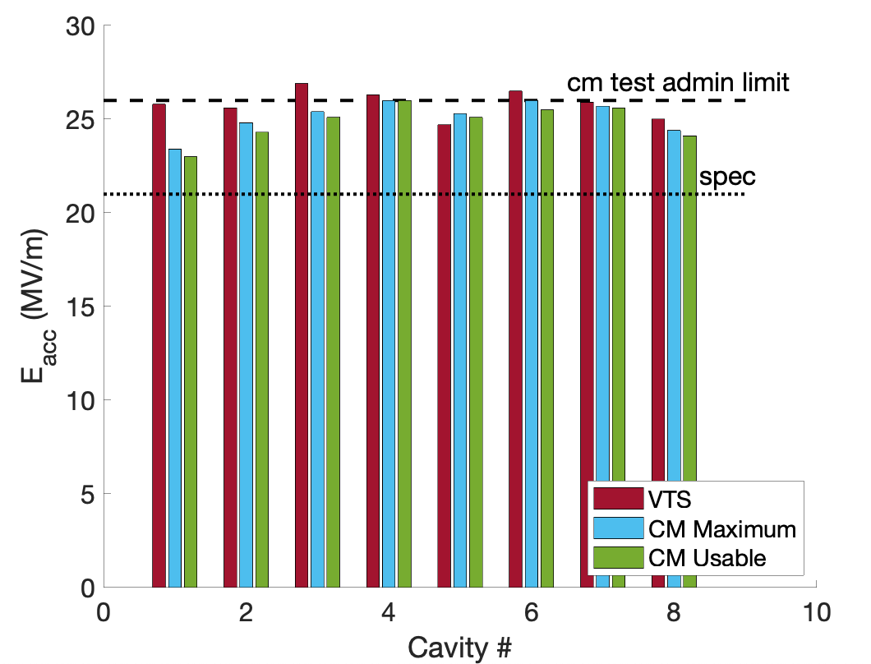
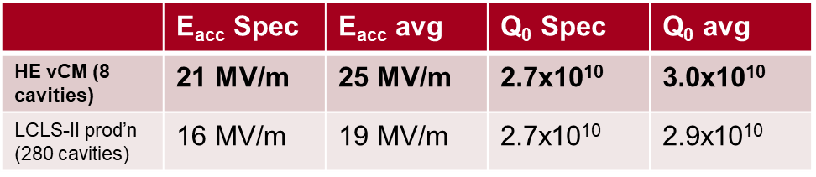
LCLS-II-HE verification Cryomodule
Verification CM for LCLS-II-HE: assembled and tested at Fermilab
Gradient and Q₀ in all 8 cavities exceeds the ambitious LCLS-II-HE specification
No field emission observed at any gradient in any cavities after processing
World record cryomodule!
S. Posen et al., Phys. Rev. Accel. Beams 25, 042001 (2022)

Slide 7
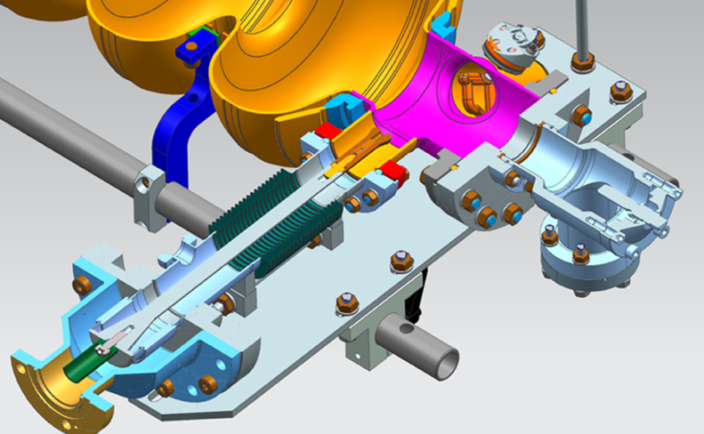
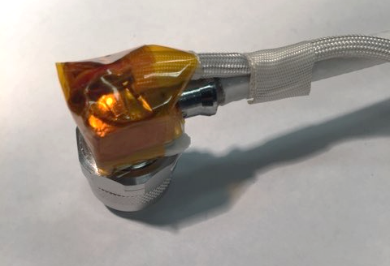
Risk & mitigation analysis for vCM
Major risks for applying the plasma processing in the vCM:
Unstable pressure in the cryomodule: new vacuum cart was assembled and tested on single cavity.
FPC ignition: ‘dummy’ variable FPC was installed on 9-cell cavity and subjected to plasma processing. It was verified that there was no ignition in the FPC during processing. Optical inspection of cavity and FPC after plasma processing showed no discoloration.
Heating of HOM cables: cables and cavity temperature were monitored during plasma processing on vCM (ΔT < 3 K). Previously verified that applying 100 W for 30 min does not degrade cables/connectors and do not cause excessive heating.
Heating of cavities: the vCM insulating vacuum was spoiled.
B. Giaccone et al., Phys. Rev. Accel. Beams 25, 102001 (2022)

Slide 8
Timeline & Procedure
No cavity with FE in vCM → processed 4 instrumented cavities (CAV1, CAV4, CAV5, CAV8)
Processing order: started from CAV1 (closest to vCM end, gas injection side) and proceeded to CAV4, CAV5, CAV8 following the direction of gas flow.
Processing time: 1.5-2 hours/cell → 13.5-18 hours/cavity
Plasma ignition procedure:
  Plasma is ignited in cell # 5 (requires ≈ 60-70 W)
  Plasma is transferred to cell # 9 (going through cell # 6, 7, 8)
  Plasma density is maximized in cell # 9 and cell processed for 45 min
  Plasma is detuned (plasma density is decreased) and plasma is transferred to cell #8
  Procedure is repeated for each cell

Slide 9
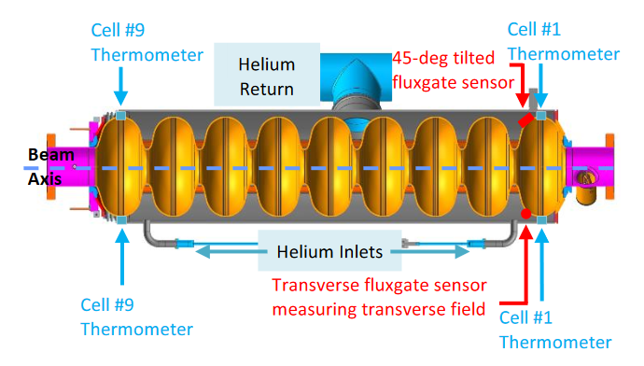
Plasma Processing Plan for vCM
Parameters monitored during plasma processing
Partial pressure of Ne, O₂, C, CO, CO₂, H₂O
Pressure at the two ends of the cryomodule
RF signals (forward & reflected power from HOM1, transmitted power from HOM2)
Temperature of HOM1 cable connector, can and clamp
Cavity temperature

Slide 10
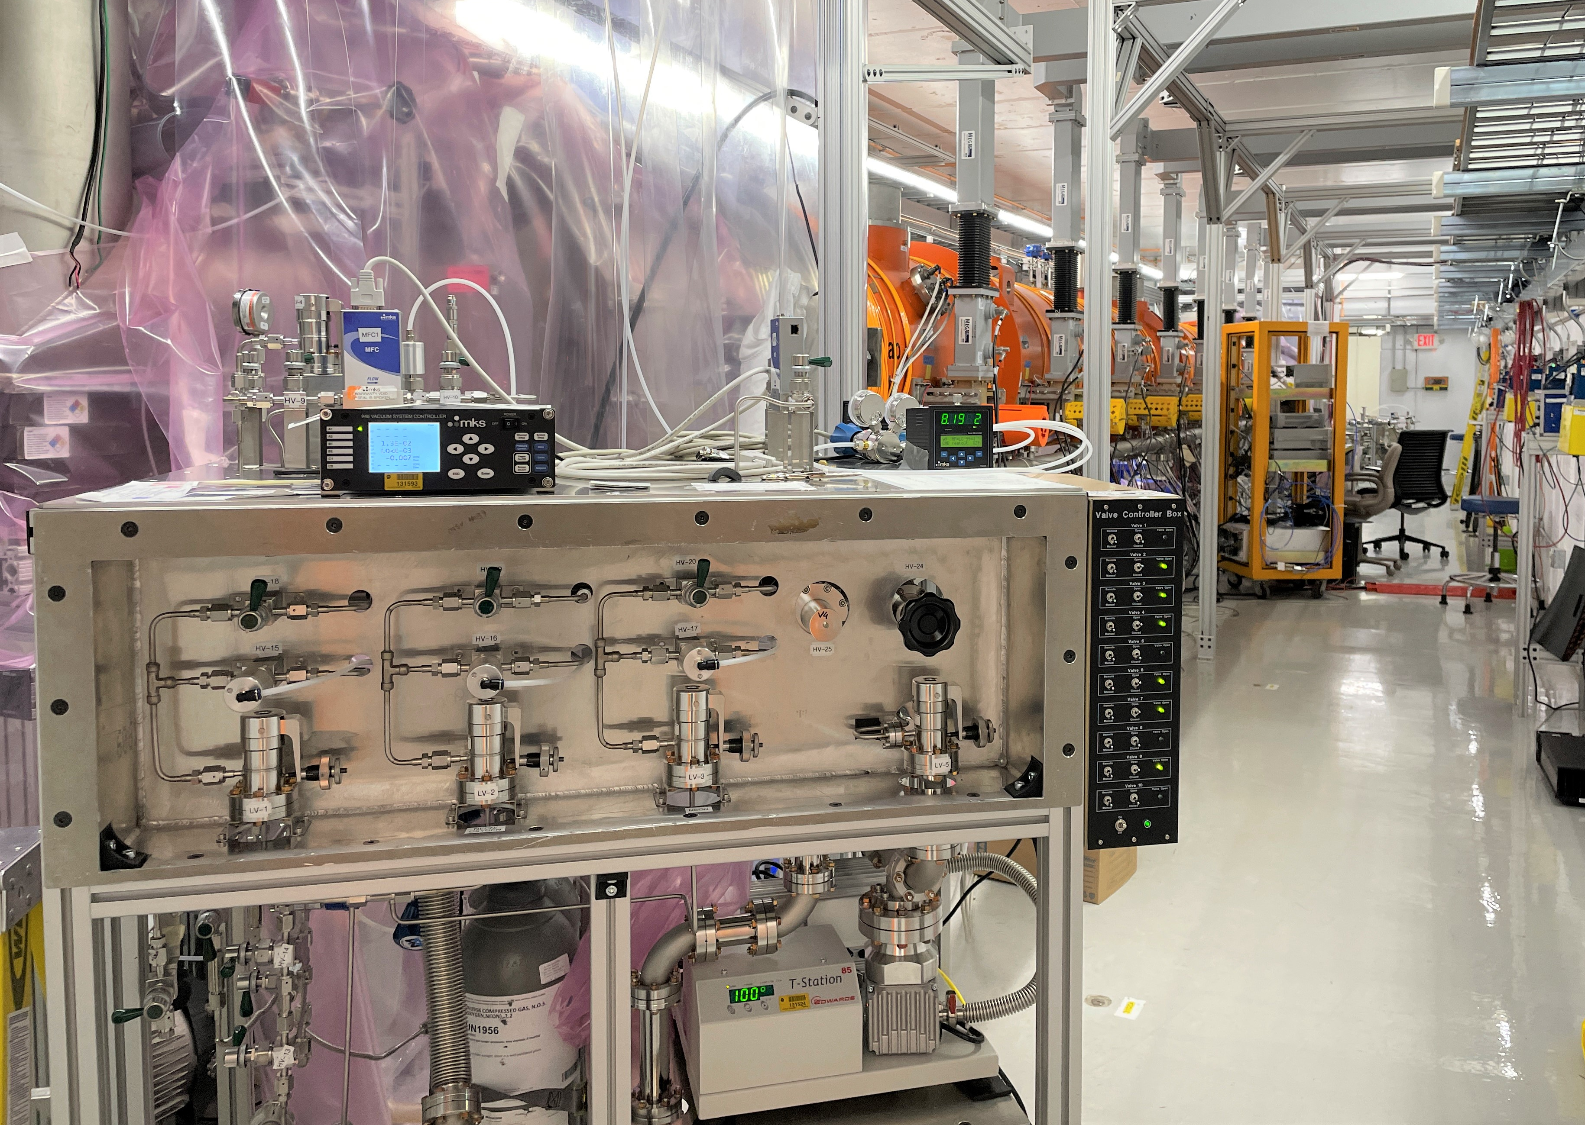
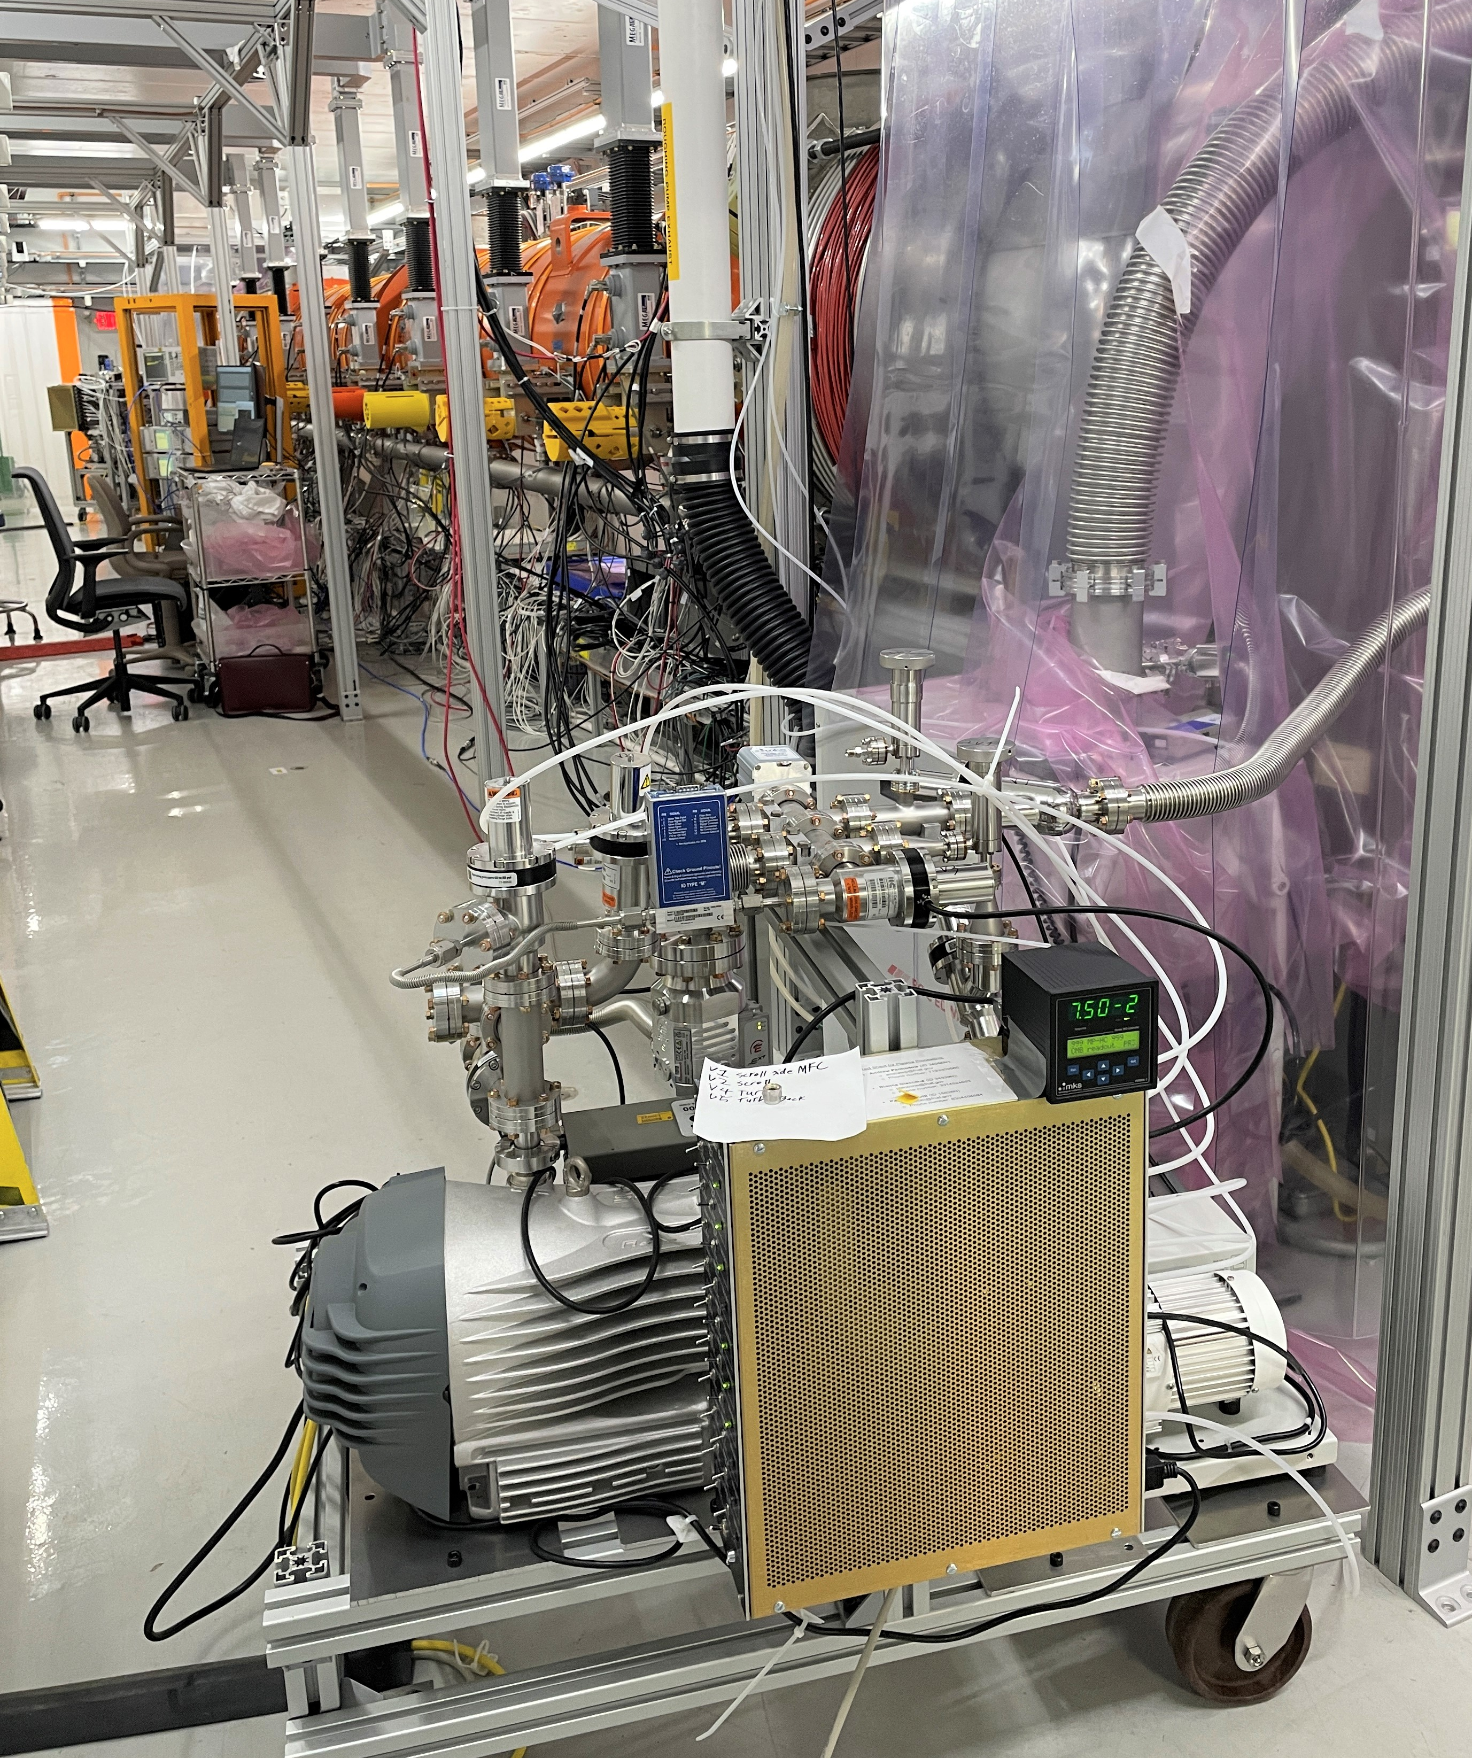
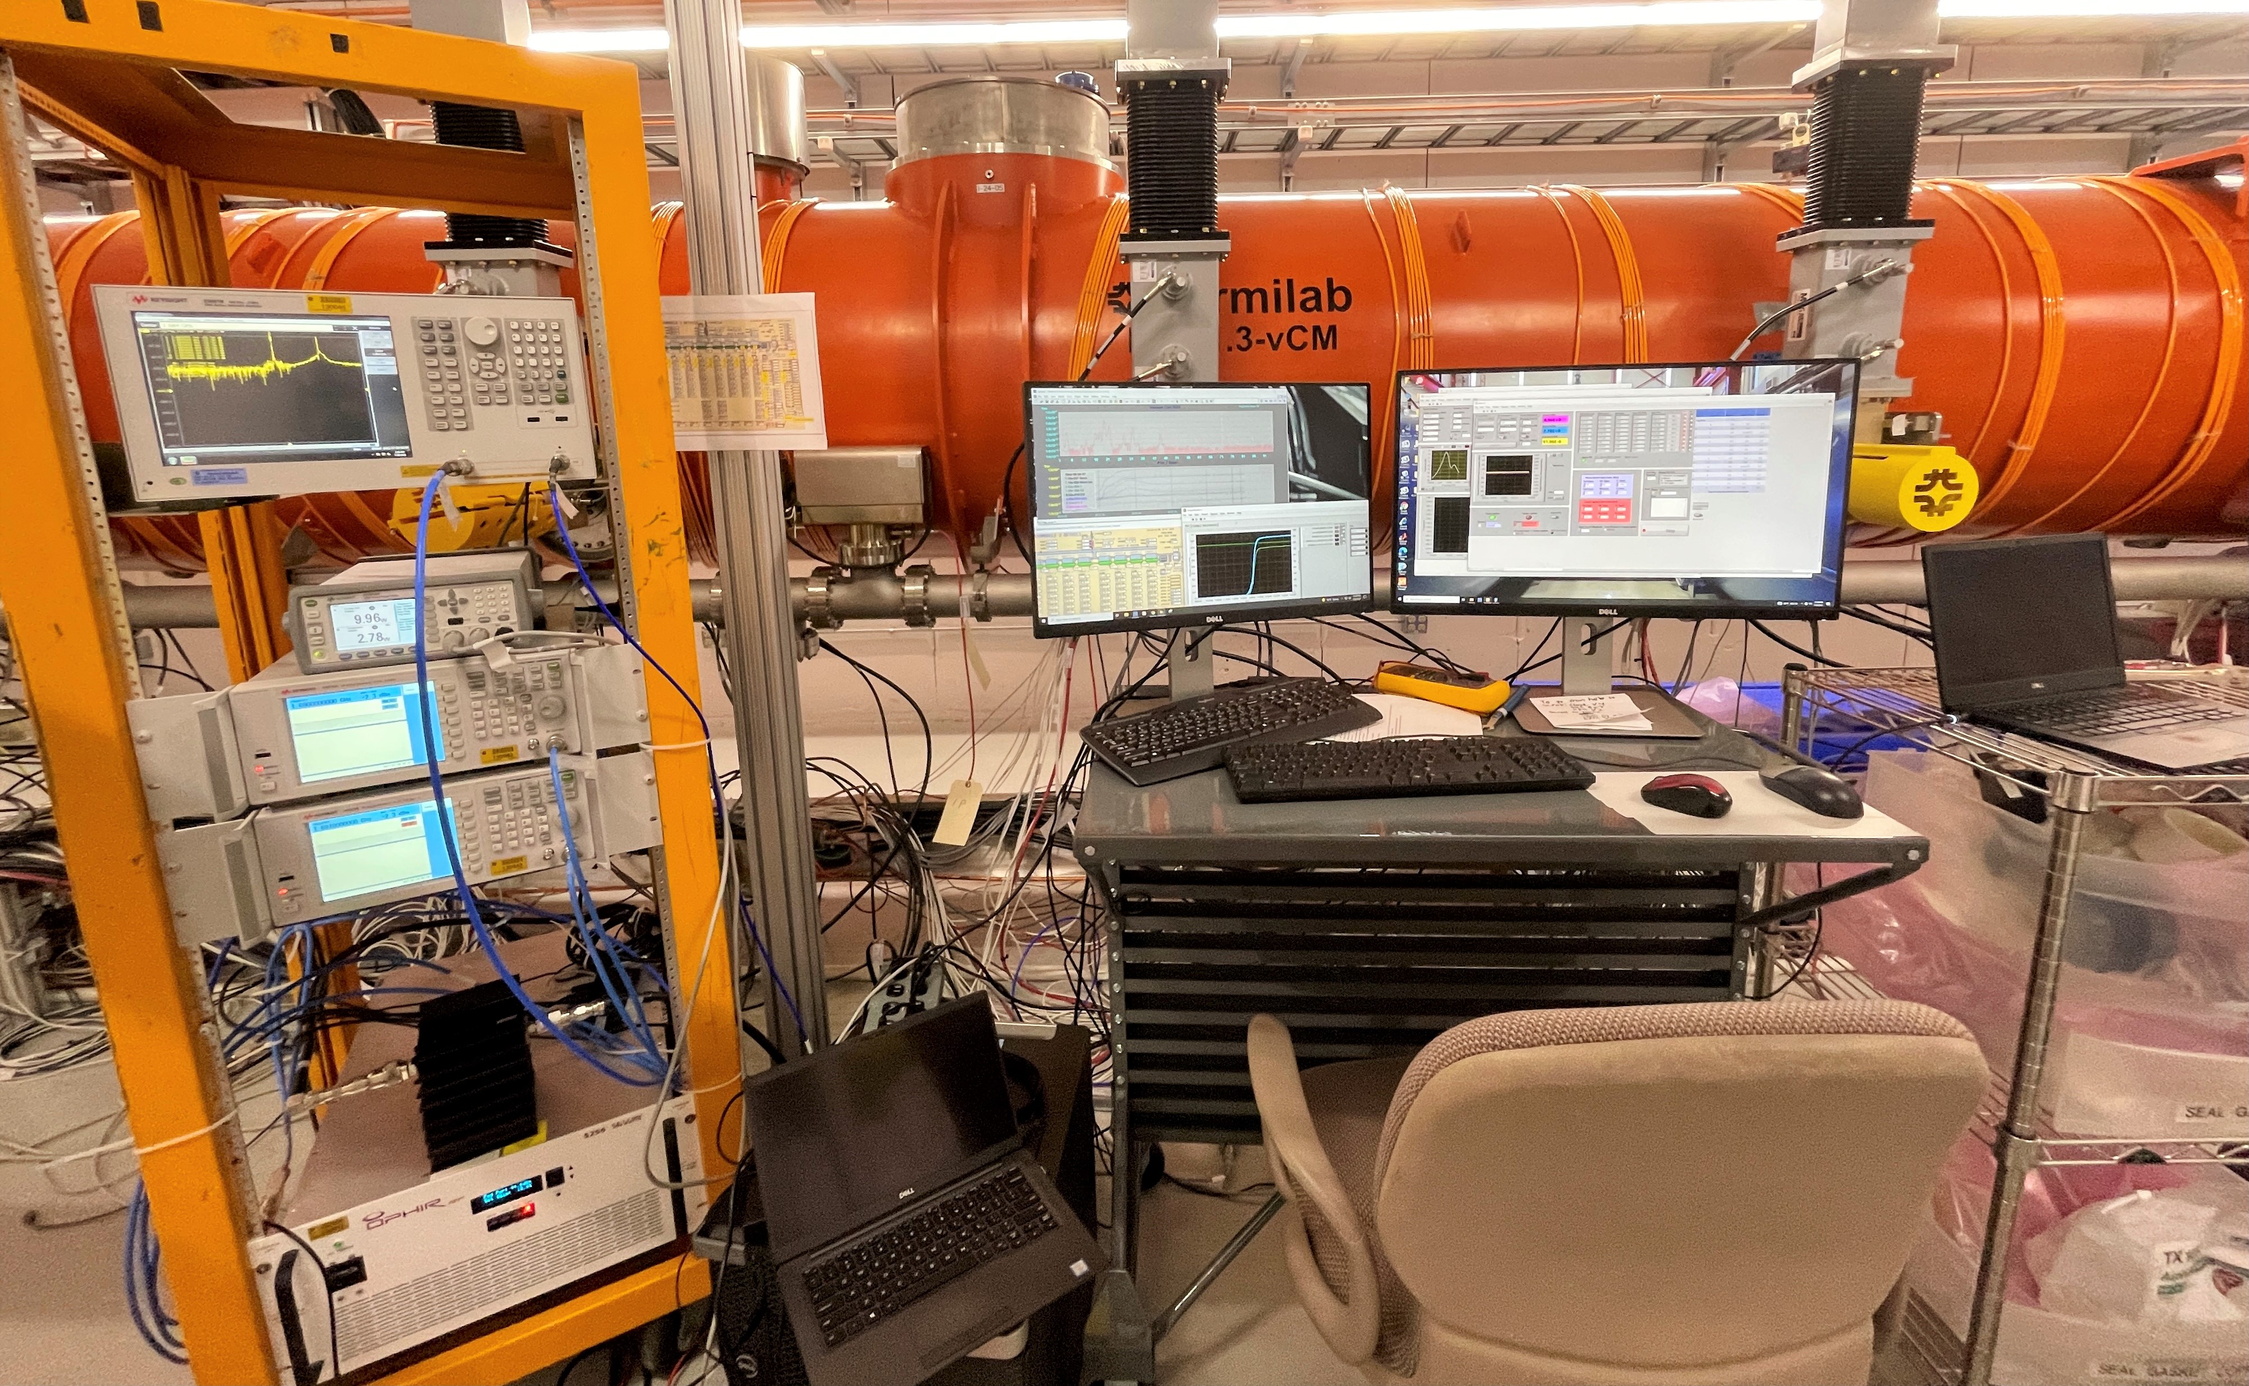
Experimental systems: gas injection, vacuum & RF
Vacuum cart connected to the Endcap side
RF system, computers
Gas cart connected to the Feedcap side

Slide 11
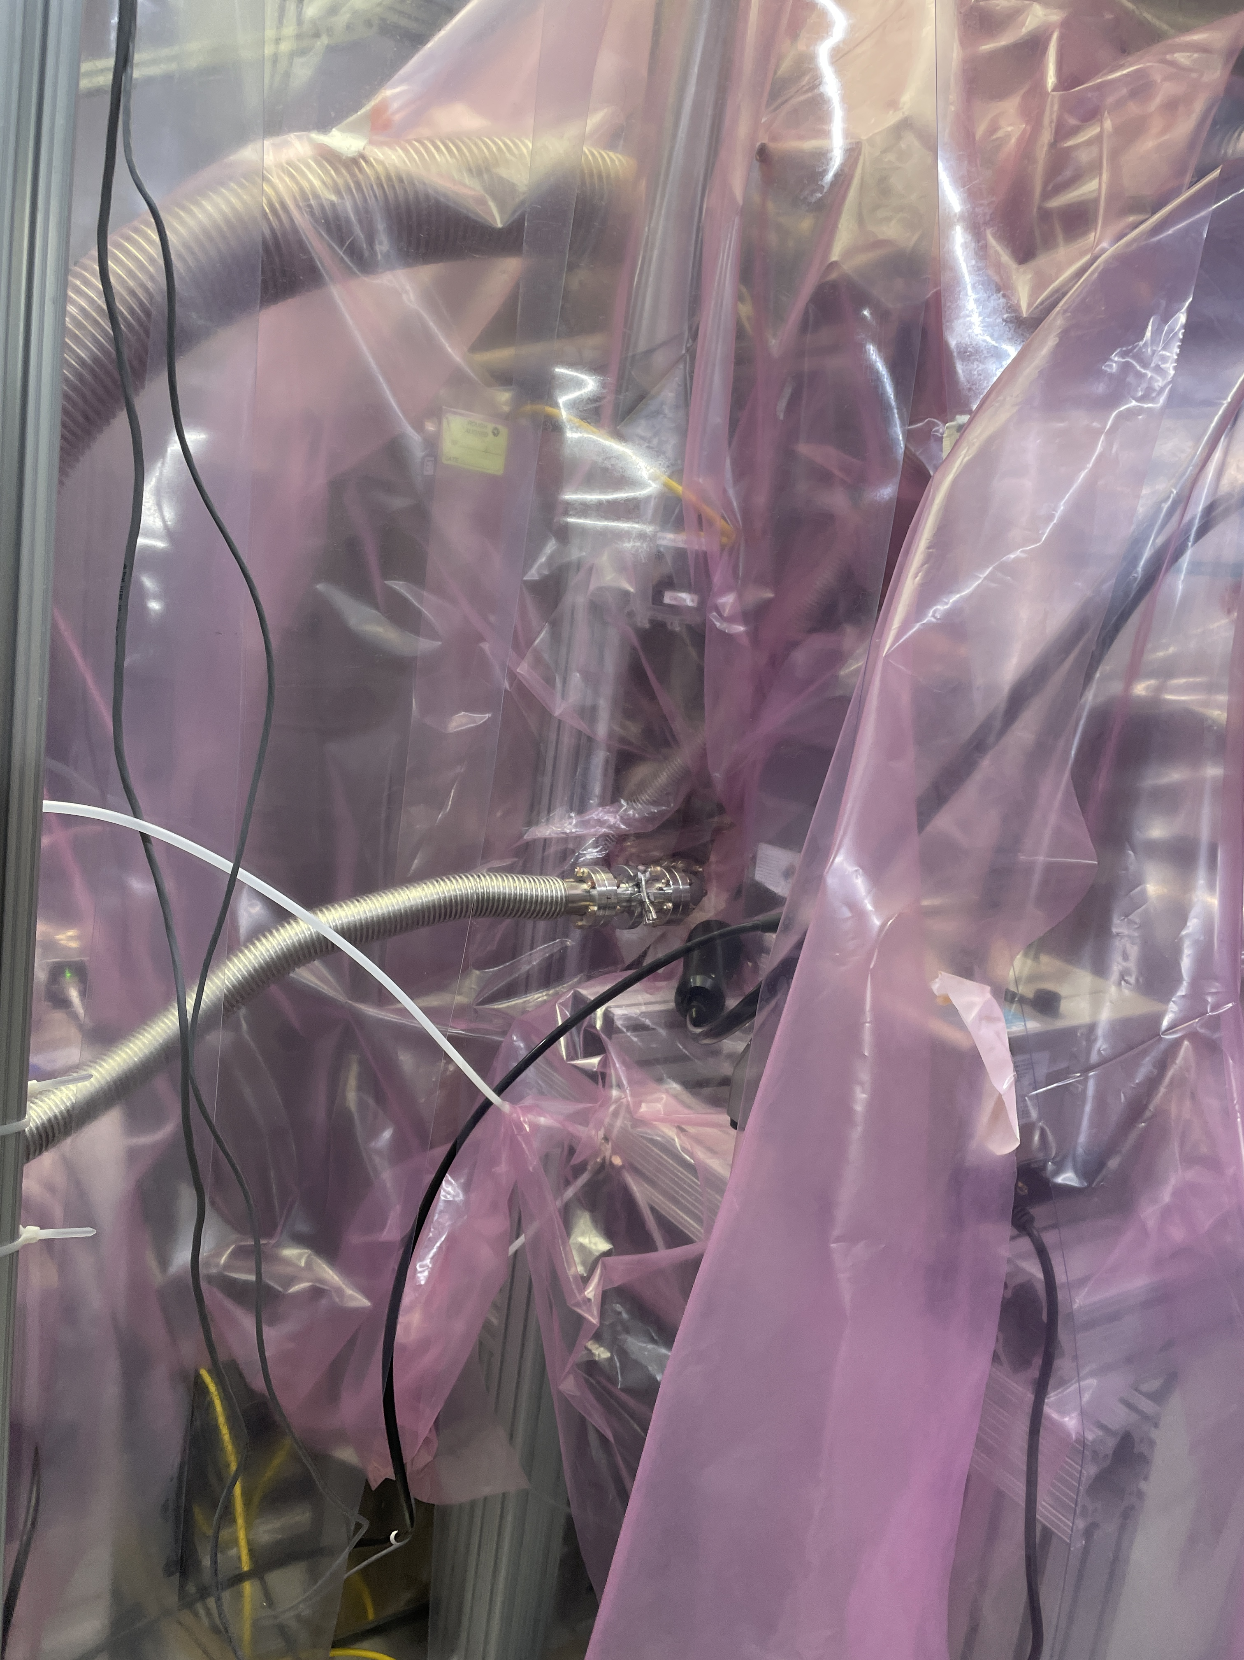
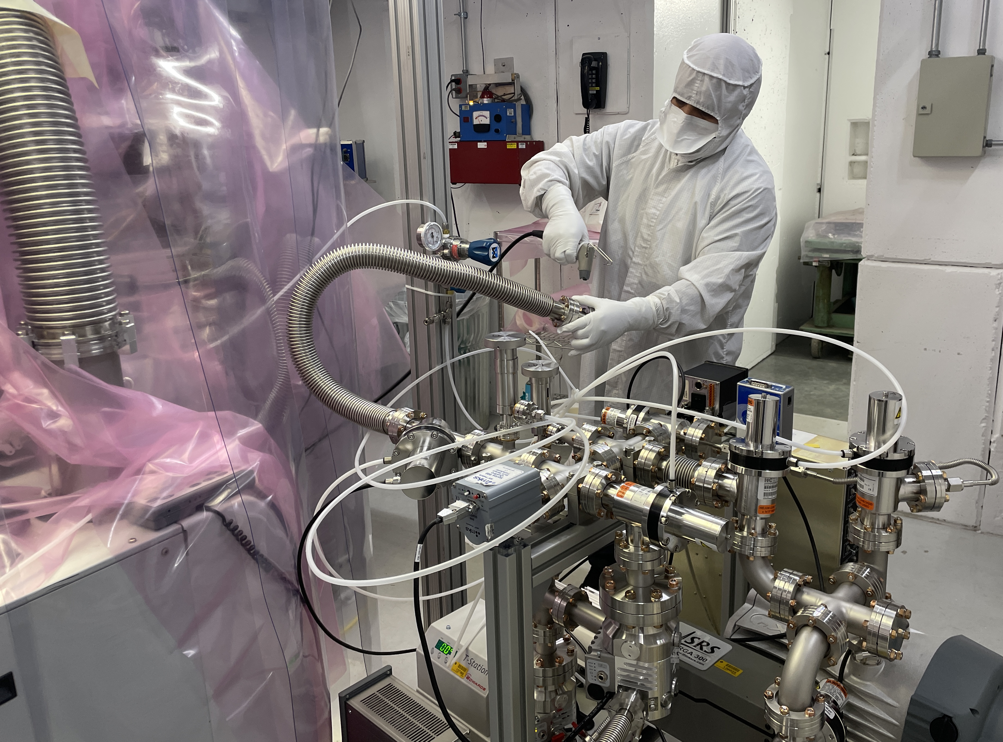
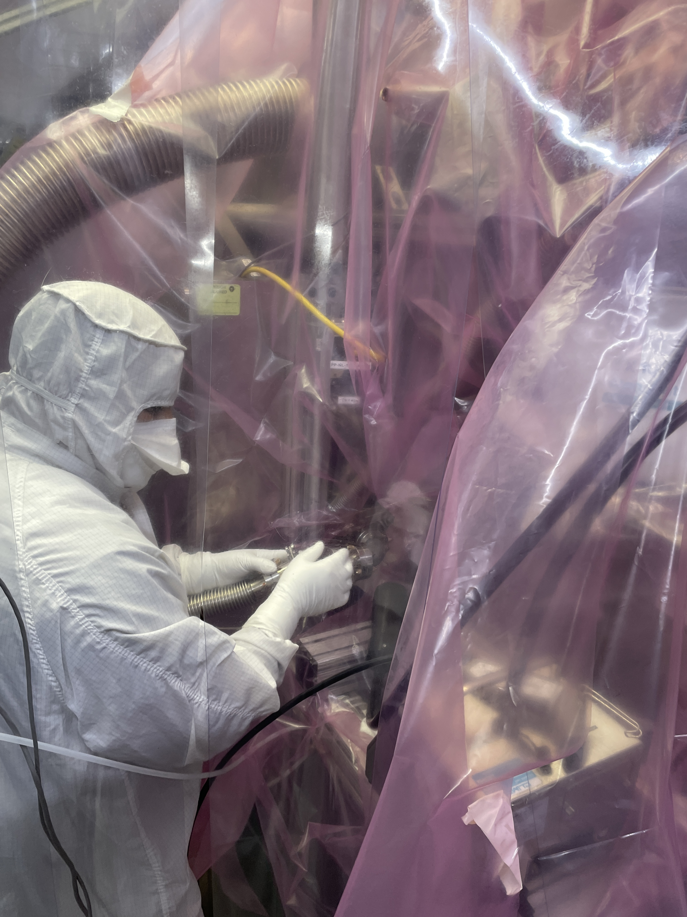
Connections between gas/vacuum systems and CM
Connections between gas/vacuum systems and vCM were conducted in cleanroom to minimize risk of particle contamination

Slide 12
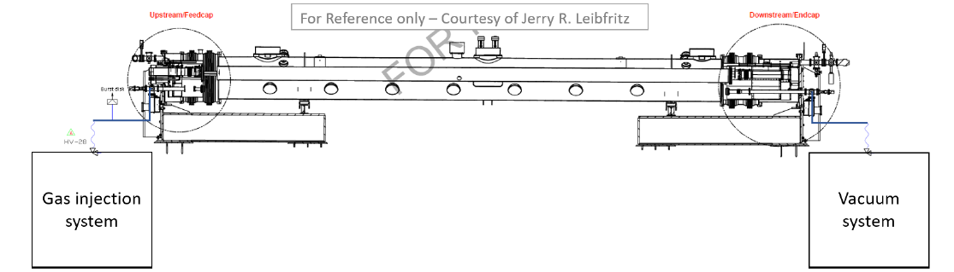
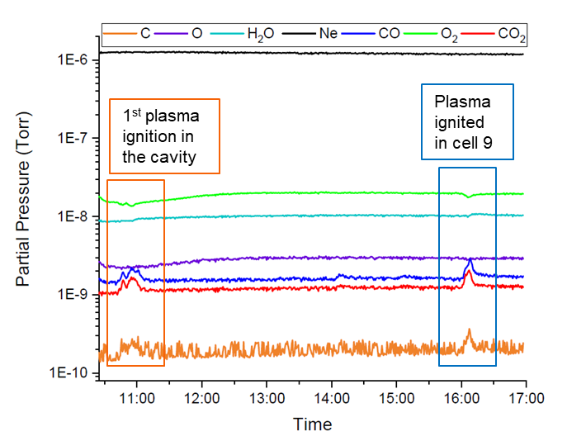
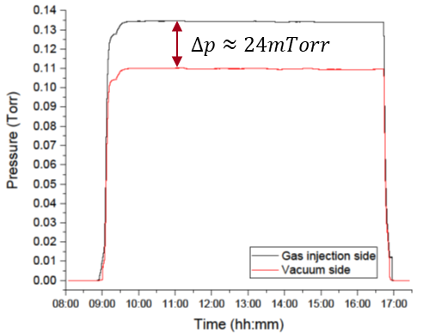
Plasma processing applied to vCM (1)
CAV1: 1st day of plasma processing
PI
Each morning the gas flow was established through the vCM
Increase in CO,CO₂, C signals is observed along with decrease in O₂ signal
Almost no by-products measured by RGA during 2nd day of plasma processing.

Slide 13
Plasma processing applied to vCM (2)
Example of experimental data collected during plasma processing of CAV4. This includes a rare case of plasma ignition at the HOM coupler
Plasma transfer from cell 5 to desired cell
Plasma tuning/detuning
HOM coupler ignition
45 min of processing per cell
Plasma ignition in the cavity

Slide 14
Plasma processing applied to vCM (3)
Example of experimental data collected during plasma processing of CAV4. This includes a rare case of plasma ignition at the HOM coupler
Temperature increase on:
  HOM1 cable < 2 K
  HOM2 cable < 0.5 K
During coupler ignition: 1.4 K increase on HOM1 cable
Temperature increase on:
  Cell # 1 < 1.2 K
  Cell # 9 < 1.6 K
  During coupler ignition: 0.3 K

Slide 15
Questions to address after plasma processing
RF test after processing to monitor changes in performance:
  Maximum gradient and usable gradient
  X-ray & Dark current
  Q-factor at 20.8 MV/m
  Check that cavities can sustain stable operation at 20.8 MV/m
  Time necessary to process multipacting
Did plasma processing deteriorate cavity performance in any way?
Did plasma processing have an impact on multipacting?

Slide 16
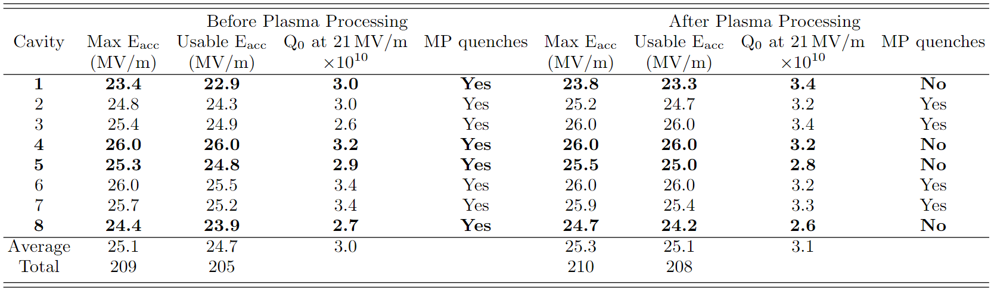
vCM performance before and after plasma processing
Plasma processing procedure is fully validated!
RF test after plasma processing demonstrated that:
vCM performance is preserved
Plasma processing did not introduce any contamination: vCM is still FE-free
B. Giaccone et al., Phys. Rev. Accel. Beams 25, 102001 (2022)

Slide 17
vCM performance before and after plasma processing
RF test after plasma processing demonstrated that:
vCM performance is preserved
Plasma processing did not introduce any contamination: vCM is still FE-free

Slide 18
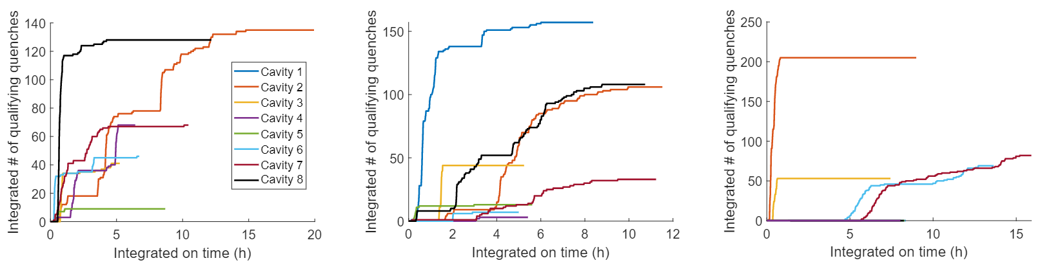
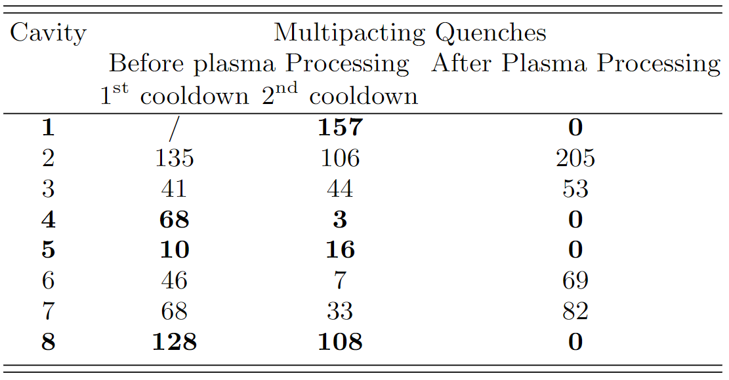
vCM performance before and after plasma processing
Before Plasma processing 1st cool down
Before Plasma processing 2nd cool down
After Plasma processing
Plasma processing can eliminate multipacting:
the 4 plasma processed cavities do no exhibit any MP quench, contrary to the other 4 cavities
We could address both FE and MP in situ at the same time
B. Giaccone et al., Phys. Rev. Accel. Beams 25, 102001 (2022)

Slide 19
Conclusions for Plasma processing applied to LCLS-II-HE vCM
Plasma processing was already validated in test bench setup on N-doped LCLS-II 9-cell cavities, no Q-factor degradation observed
Through this test the procedure was fully validated on a CM: plasma processing has the potential of not only reducing field emission but also fully eliminating multipacting in cryomodules.
Multipacting mitigation through plasma processing could:
  significantly reduce cryomodule testing time
  decrease the accelerator commissioning time and cost (for example: cavities can require up to 1 day of processing in case of severe multipacting, with an average of 2 hours per cavity)
  increase reliability during operations

Slide 20
Outline
Plasma processing applied to LCLS-II-HE vCM
Plasma processing studies for ILC cavities
Plasma processing for SRF gun

Slide 21
Motivation for applying plasma processing to ILC cavities
Demonstrated efficacy of in situ plasma processing for FE and MP mitigation and gradient recovery
For ILC style machine: gradient requirement is ambitious. Plasma processing can ensure 5-10% increase of E_{acc} → crucial for high gradient operation projects
ILC cavity design is similar, so the technique should require little effort to be adapted to ILC HOM couplers but could bring high reward

Slide 22
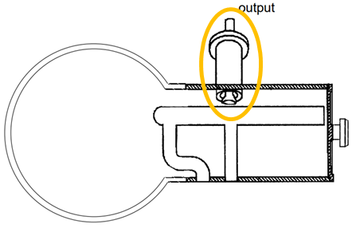
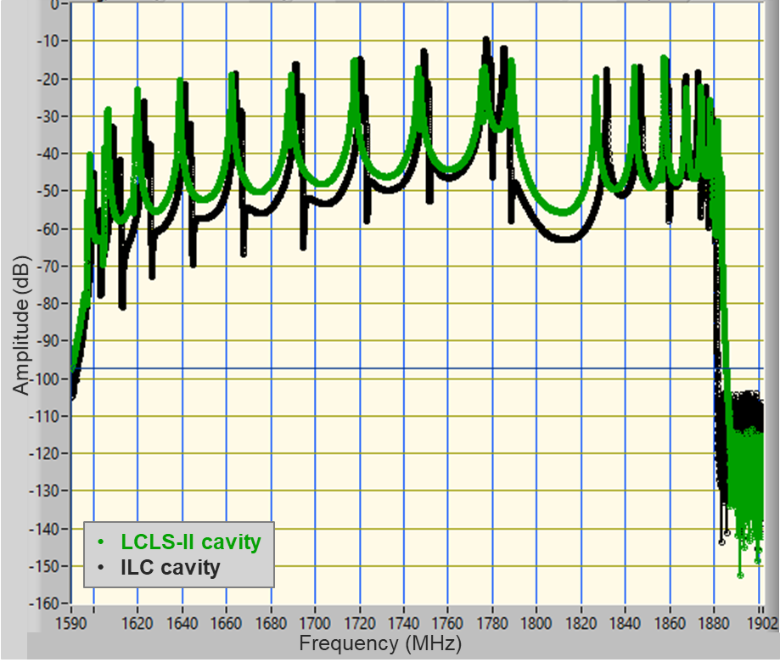
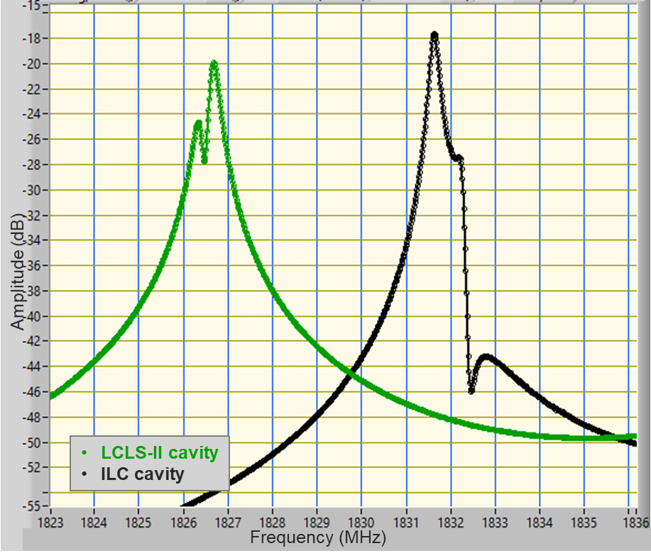
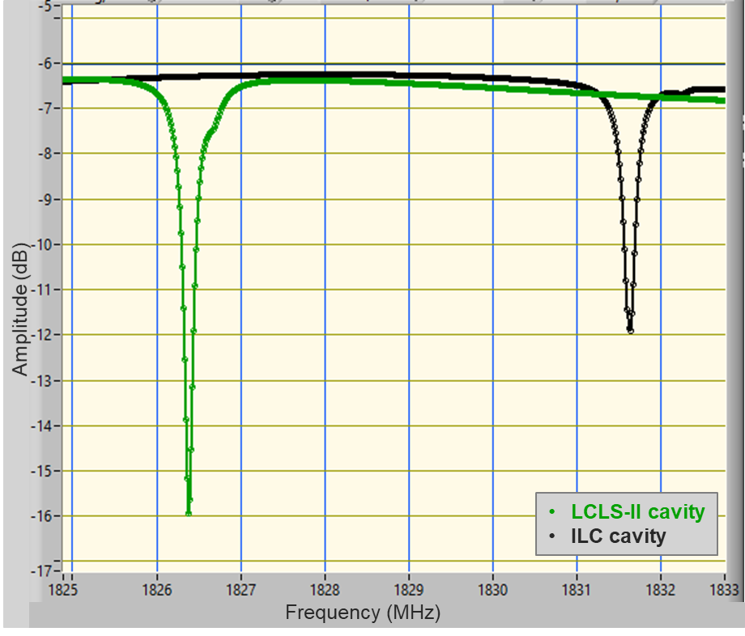
Plasma processing for ILC 1.3 GHz cavities
Plasma ignition method developed at FNAL for LCLS-II(-HE): uses HOM1 and HOM2 couplers to ensure good coupling at RT
Antenna tip for LCLS-II and ILC HOM couplers is different → different coupling to 1D and 2D modes → can we still use same ignition method?
Comparison of RT S21, S11, S22 measurements on ILC style and LCLS-II cavities: no dramatic difference in coupling to dipole modes
Possible issue: CM HOM cables: for LCLS-II rated for 10 W, for ILC rated for 1 W!
S21 – 1D and 2D passbands
S21 – zoom on 2D-1
S11 – zoom on 2D-1

Slide 23

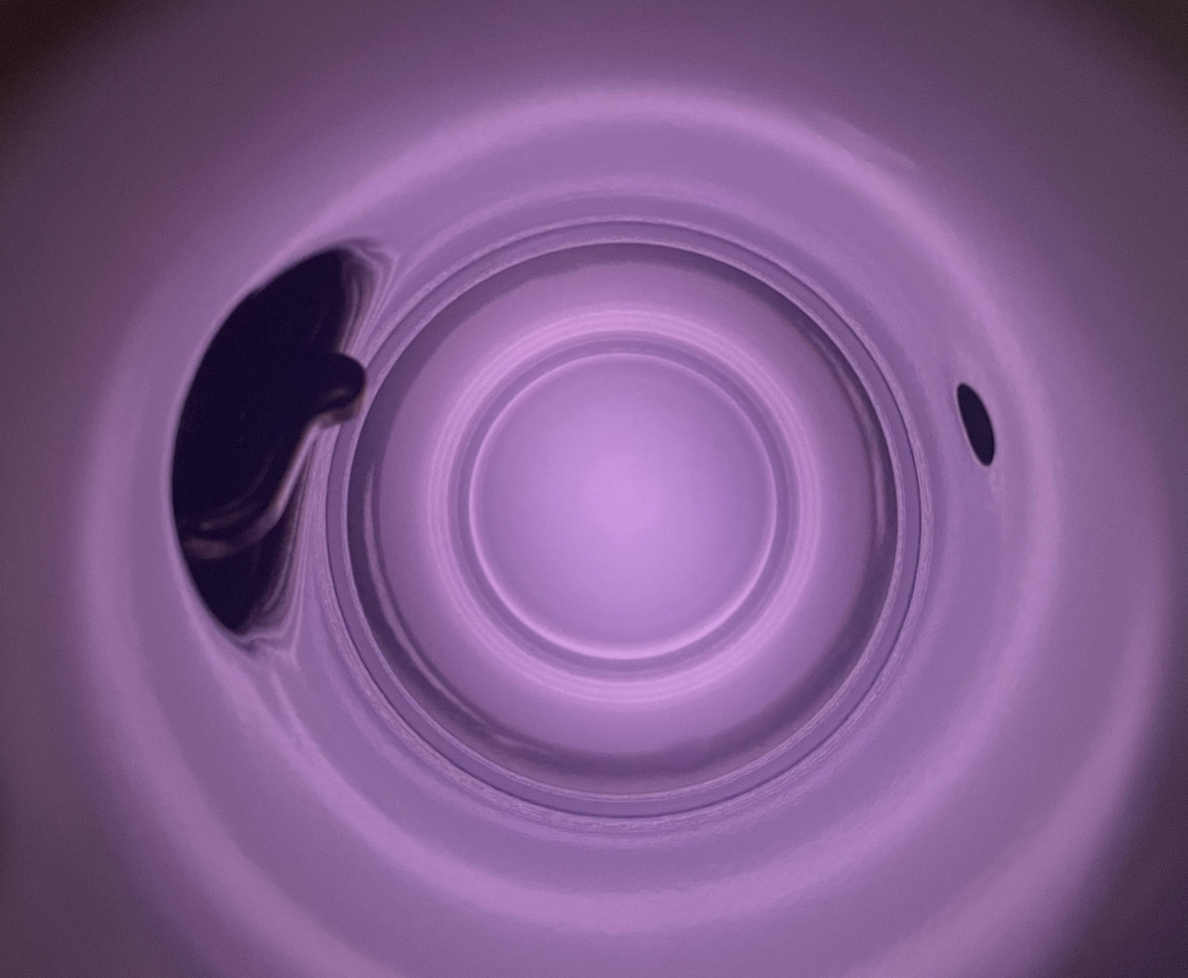
Plasma processing for ILC 1.3 GHz cavities (2)
Starting point: LCLS-II recipe → ignition method works, BUT excessive power required at ignition for ILC HOM cables (1W rated)
Conducted ignition and transfer tests with Neon and Argon at various pressures
Argon: lower 1st ionization energy → lower ignition power. Tested multiple pressure levels, monitoring ignition power, cable temperature, plasma transfer and tunability

Slide 24
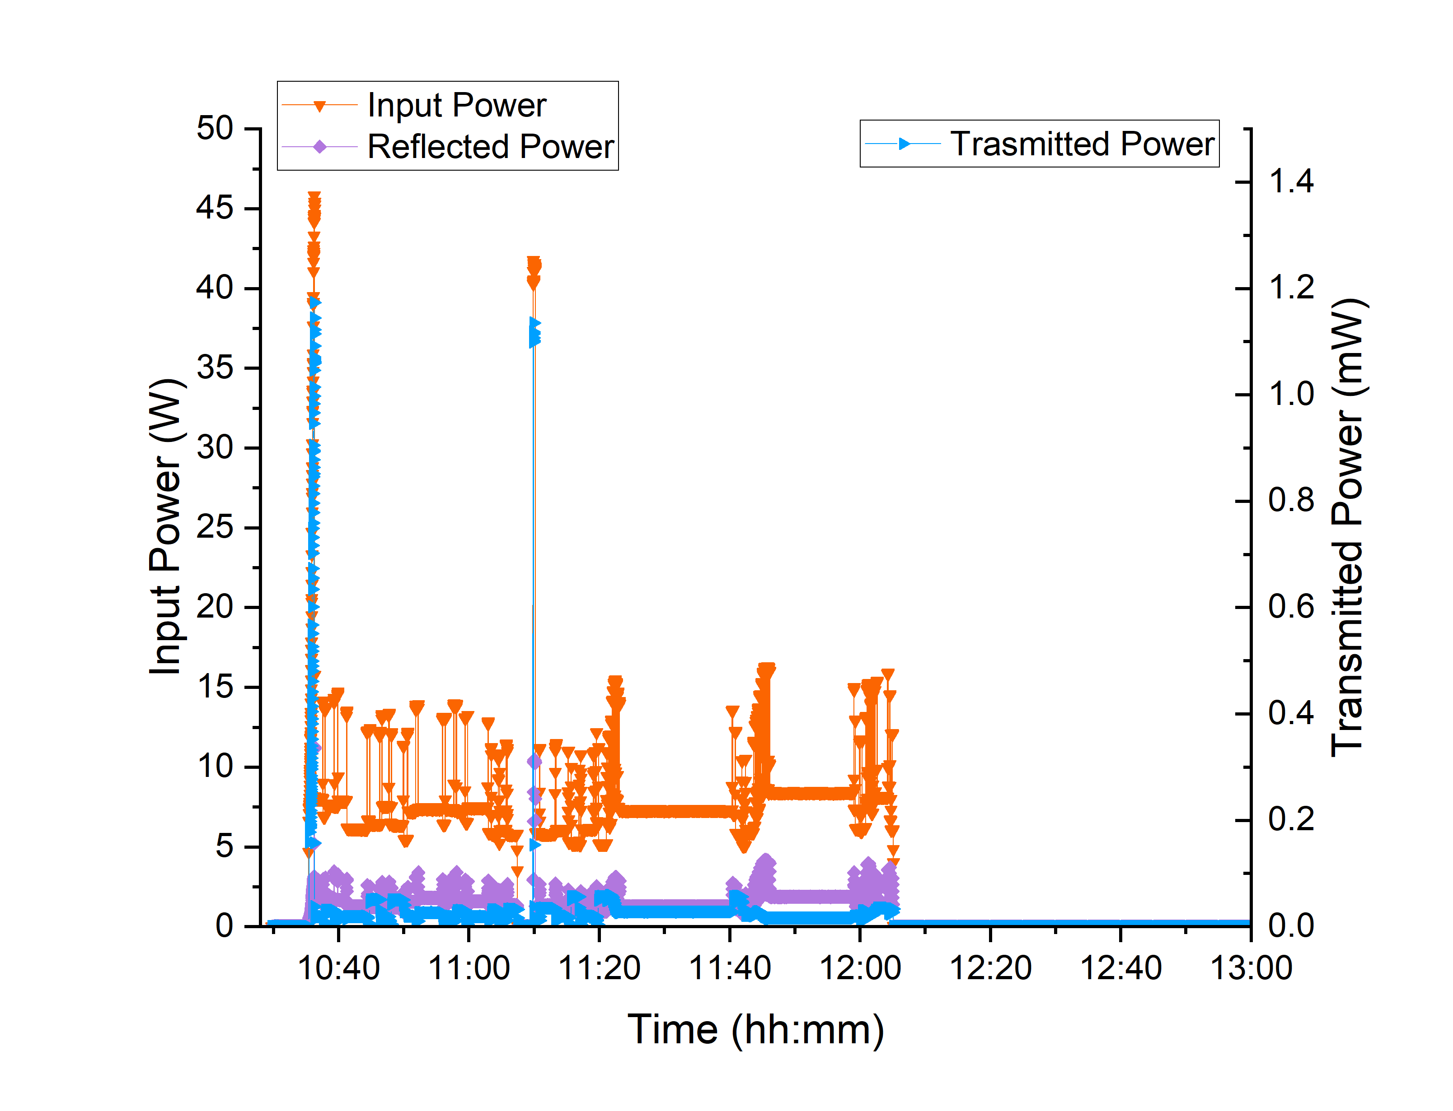
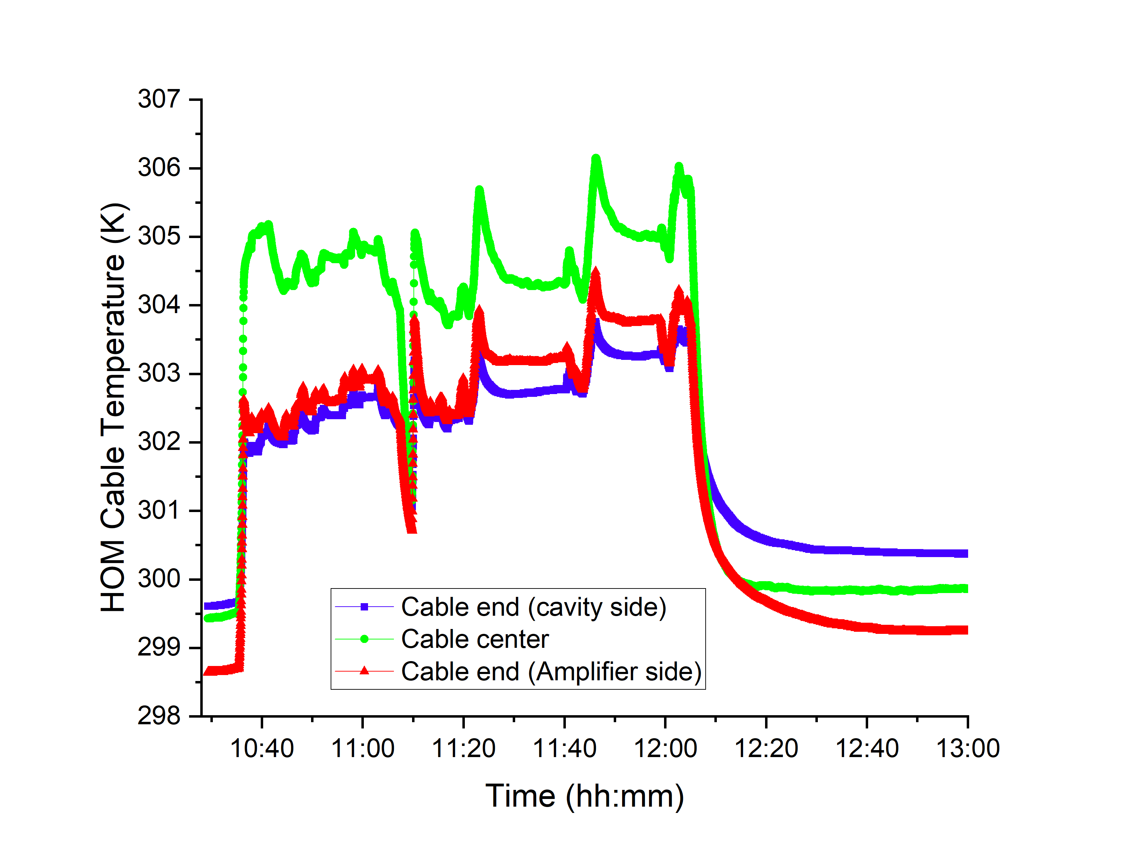

Potential recipe for ILC cavities
  Argon at $p≈50 mTorr$, $P_{IN}^{ignition}=45−55 W$, max observed $∆T=7 K$ on ILC HOM CM-style input cable
Power levels and corresponding cable heating recorded during plasma ignition, transfer to each cell and tuning tests for modes 1D-5, 1D-6, 1D-7

Slide 25
Outline
Plasma processing applied to LCLS-II-HE vCM
Plasma processing studies for ILC cavities
Plasma processing for SRF gun

Slide 26
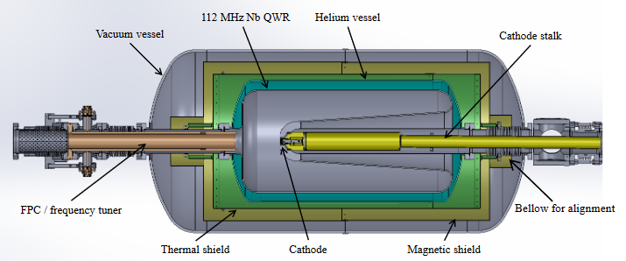
Plasma processing on 112 MHz SRF gun:
Gas injection and vacuum design
RF excitation
Gas OUT
Gas IN
To create a gas flow in the SRF gun system: gas can be injected from cathode side and pumped out from the FPC side
Can use same design of the gas injection and vacuum system cart currently employed at FNAL for LCLS-II and HE cavities

Slide 27
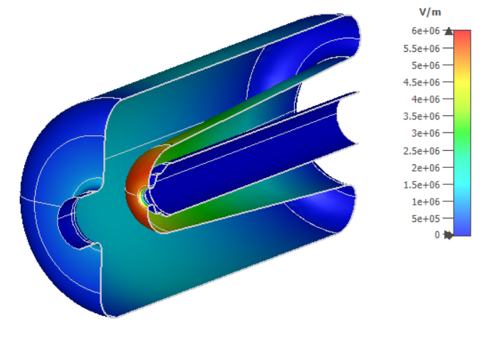
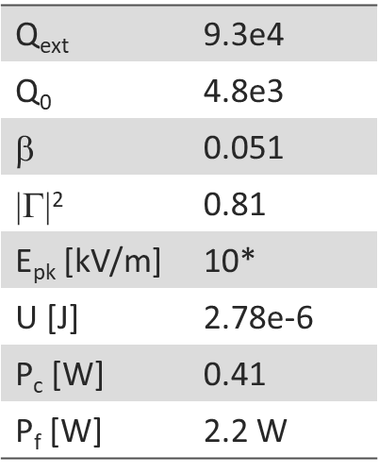
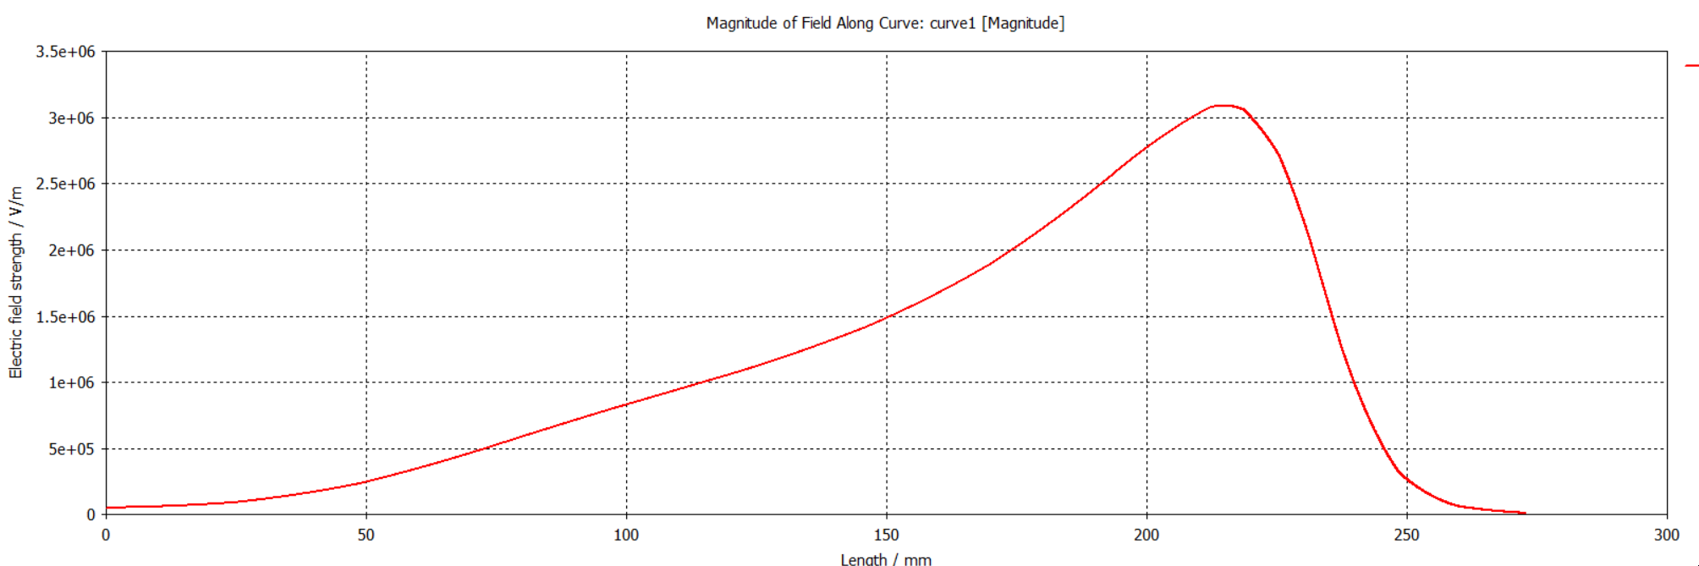
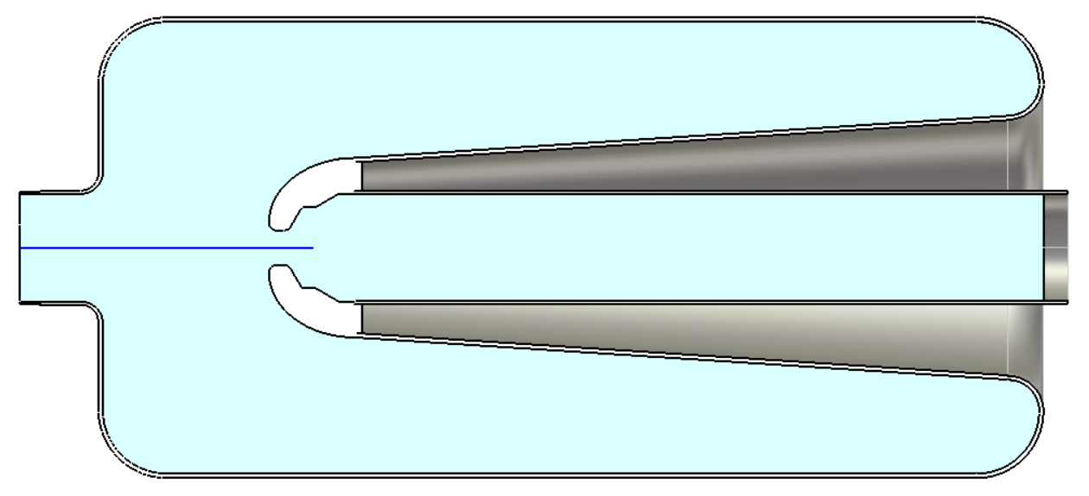
Analysis of plasma ignition in the SRF gun
E field
E_{max} is close to cavity inner conductor → plasma ignition area
At room temperature plasma can be ignited by exciting the cavity fundamental mode with just a few watts
U = 1 J
Courtesy of S. Kazakov, FNAL
E field along axis
* For elliptical cavities E_{pk} ~ 10 kV/m is needed to ignite plasma. It is necessary to verify experimentally that the same applies to this geometry.

Slide 28
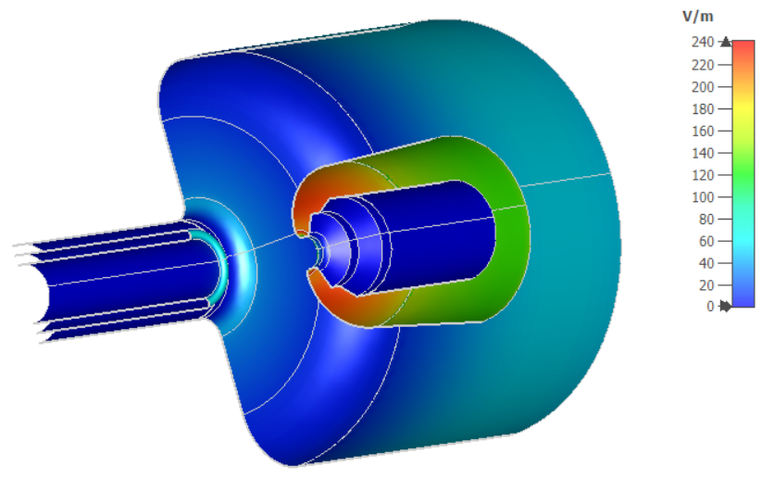
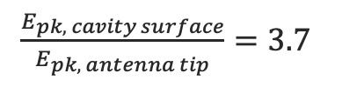
Analysis of plasma ignition in the SRF gun
E field is maximized on the cavity surface (inner conductor), not at the FPC antenna tip:
$\frac{E_{pk, cavity surface}}{E_{pk, antenna tip}}=3.7$
No risk of plasma ignition at the FPC!
Courtesy of S. Kazakov, FNAL

Slide 29
Conclusions for plasma processing feasibility for the SRF gun
Preliminary analysis suggests that plasma processing looks easily applicable to the 112 MHz SRF gun
From simulations: plasma ignition can be achieved using fundamental mode at a few watts → needs to be experimentally verified, E_{pk} needed for ignition may be higher than in case of elliptical cavities
No risk of igniting plasma at the antenna tip since field is maximized at the cavity surface
FNAL gas injection and vacuum cart design can be applied to the SRF gun system, only minor modifications are expected

Slide 30
Summary
Plasma processing is an in situ technique with demonstrated efficacy to mitigate FE and MP in elliptical cavities
It can be adapted to other cavity geometries (e.g., SRF gun). There is a lot of potential!
Thank you for your attention!

