Slide 1
ESS medium beta cavity recovery
L. Monaco
INFN Milano – LASA
for the SRF group

Slide 2
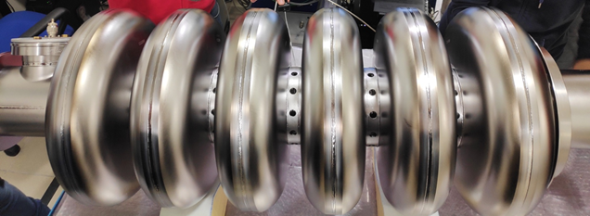

INFN-LASA Medium Beta Section Contribution
LASA responsible for this Italian in-kind contribution to ESS
36 (+2) 704.42 MHz MB cavities (β = 0.67), fully treated and
prepared for VT at vendor, ready for installation in cryomodule
  “built to print” strategy
  R&D on prototypes necessary for setup treatment at vendor and QA/QC control
  PED art. 4.3 included from beginning
Five entities (INFN, DESY, CEA, ESS, ZRI) involved in the process
Well defined interfaces are key points for success of collaboration
QA/QC is mandatory to supervise the whole process

Slide 3
INFN-LASA MB Production Cycle

Slide 4
INFN-LASA MB Production Cycle & QA/QC

Slide 5
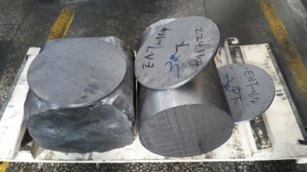
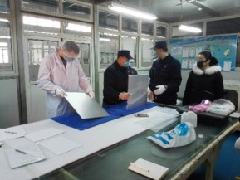
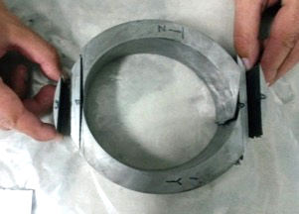
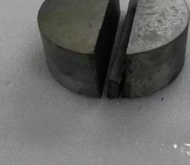
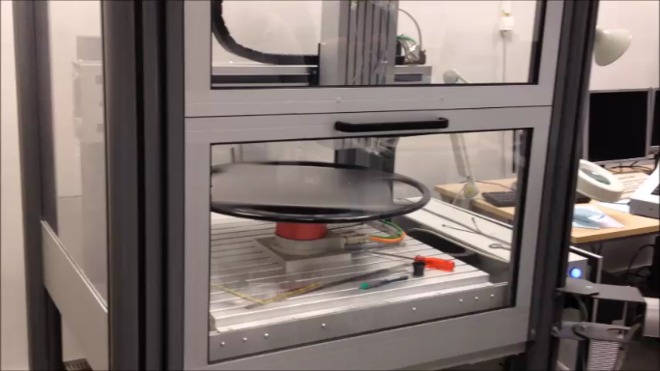
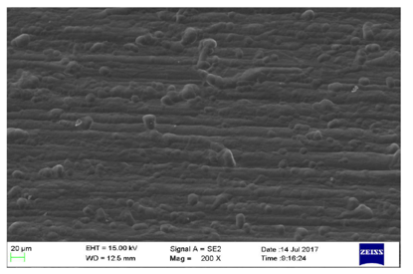
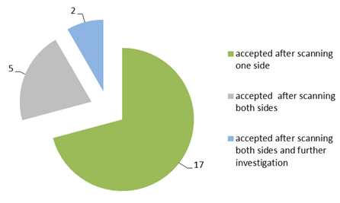
Nb Procurement and ECS QC
About 4 tons of Nb sheets delivered in 3 batches
and inspected at the company before delivery
Eddy Current Scanning of all 456 sheets at DESY
(no foreign materials found)
Niobium ingot and forged piece at Ningxia OTIC
Sheet inspection at Ningxia OTIC
Nb grain size, RRR and mechanical properties measurement
EDDY scanning results
EDDY scanning 24 spare sheets
Eddy current scanning at DESY
SEM after final polishing

Slide 6
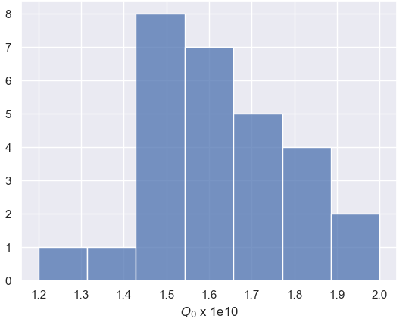
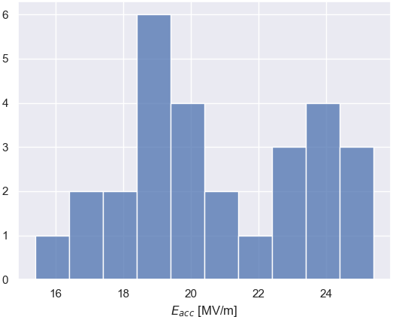
Actual delivery status
28 cavities delivered within specifications
  all the cavities overcome specifications in term of Q₀ by at least a factor 2.
  all cavities have
  negligible field emission
3 x ESS Goal
ESS Goal
1.5 x ESS Goal

Slide 7
HPR for FE suppression: M006 qualification
  HPR cure FE (only 2 cavities affected on the overall 36)
  M006 VT:
    1st VT: naked (after local grinding)
    -> strong MP not conditioned
    and high FE
    2nd VT: series VT (with tank)
    -> strong MP not conditioned
    and high FE
    3rd VT: series VT after optimized
    HPR -> no MP and no FE
HPR retreatment

Slide 8
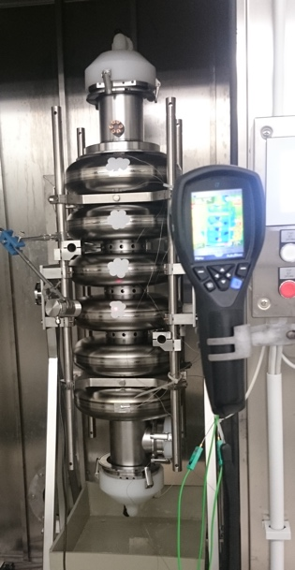
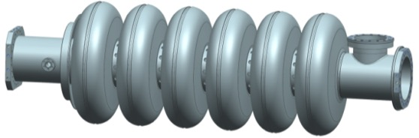
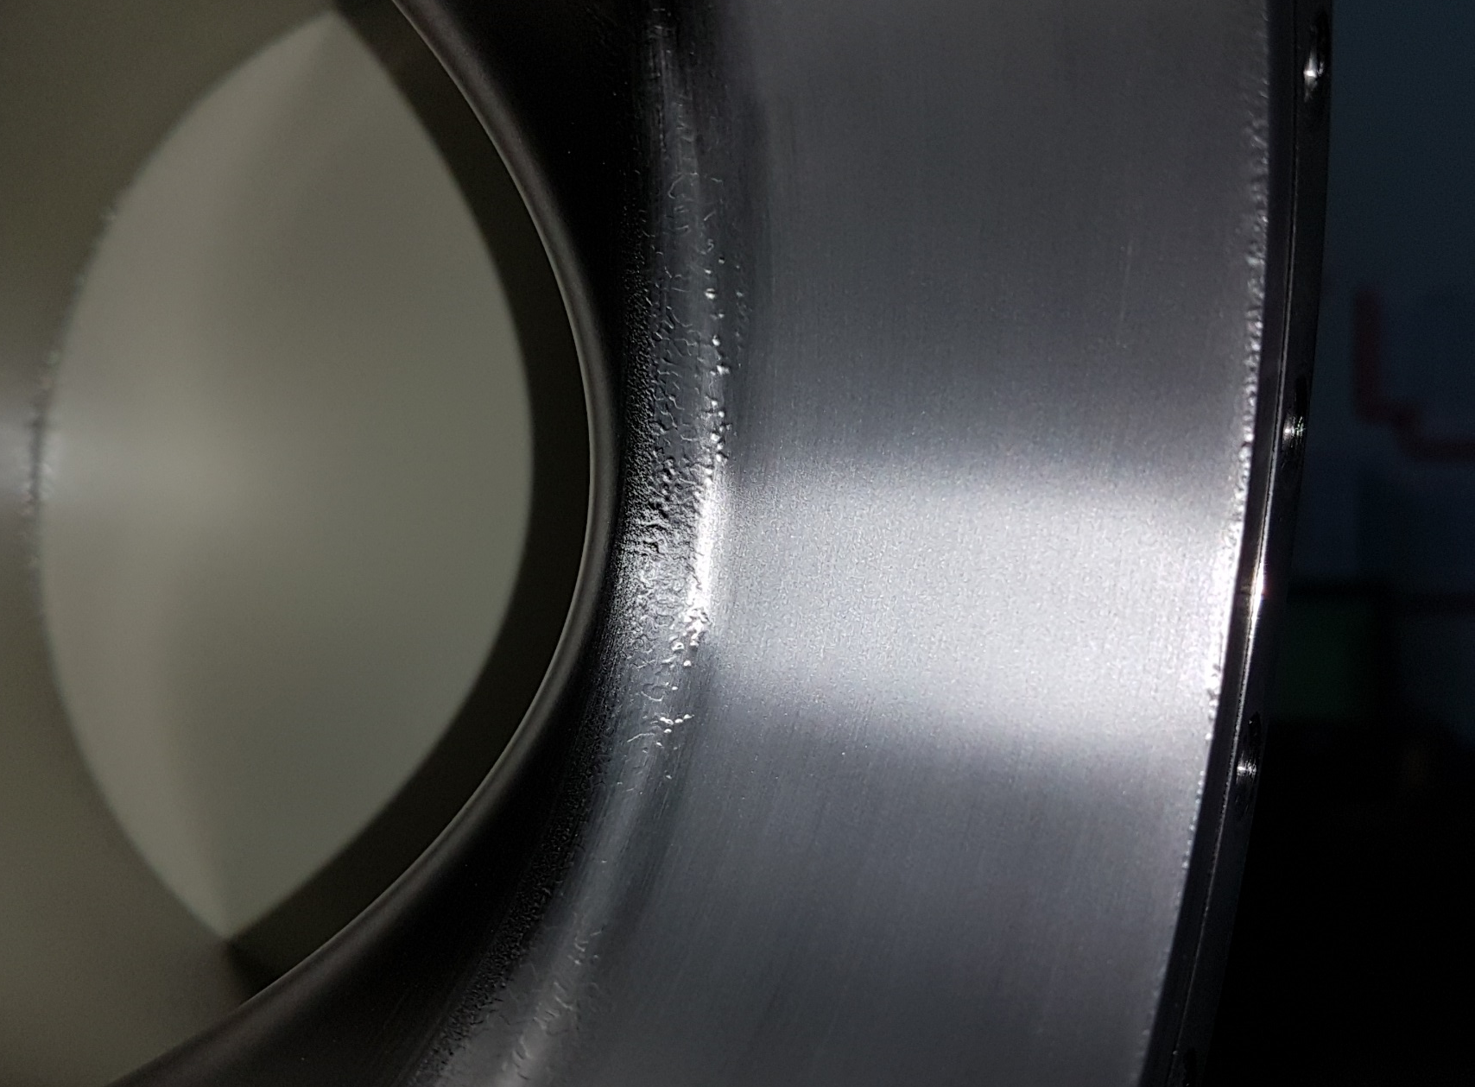
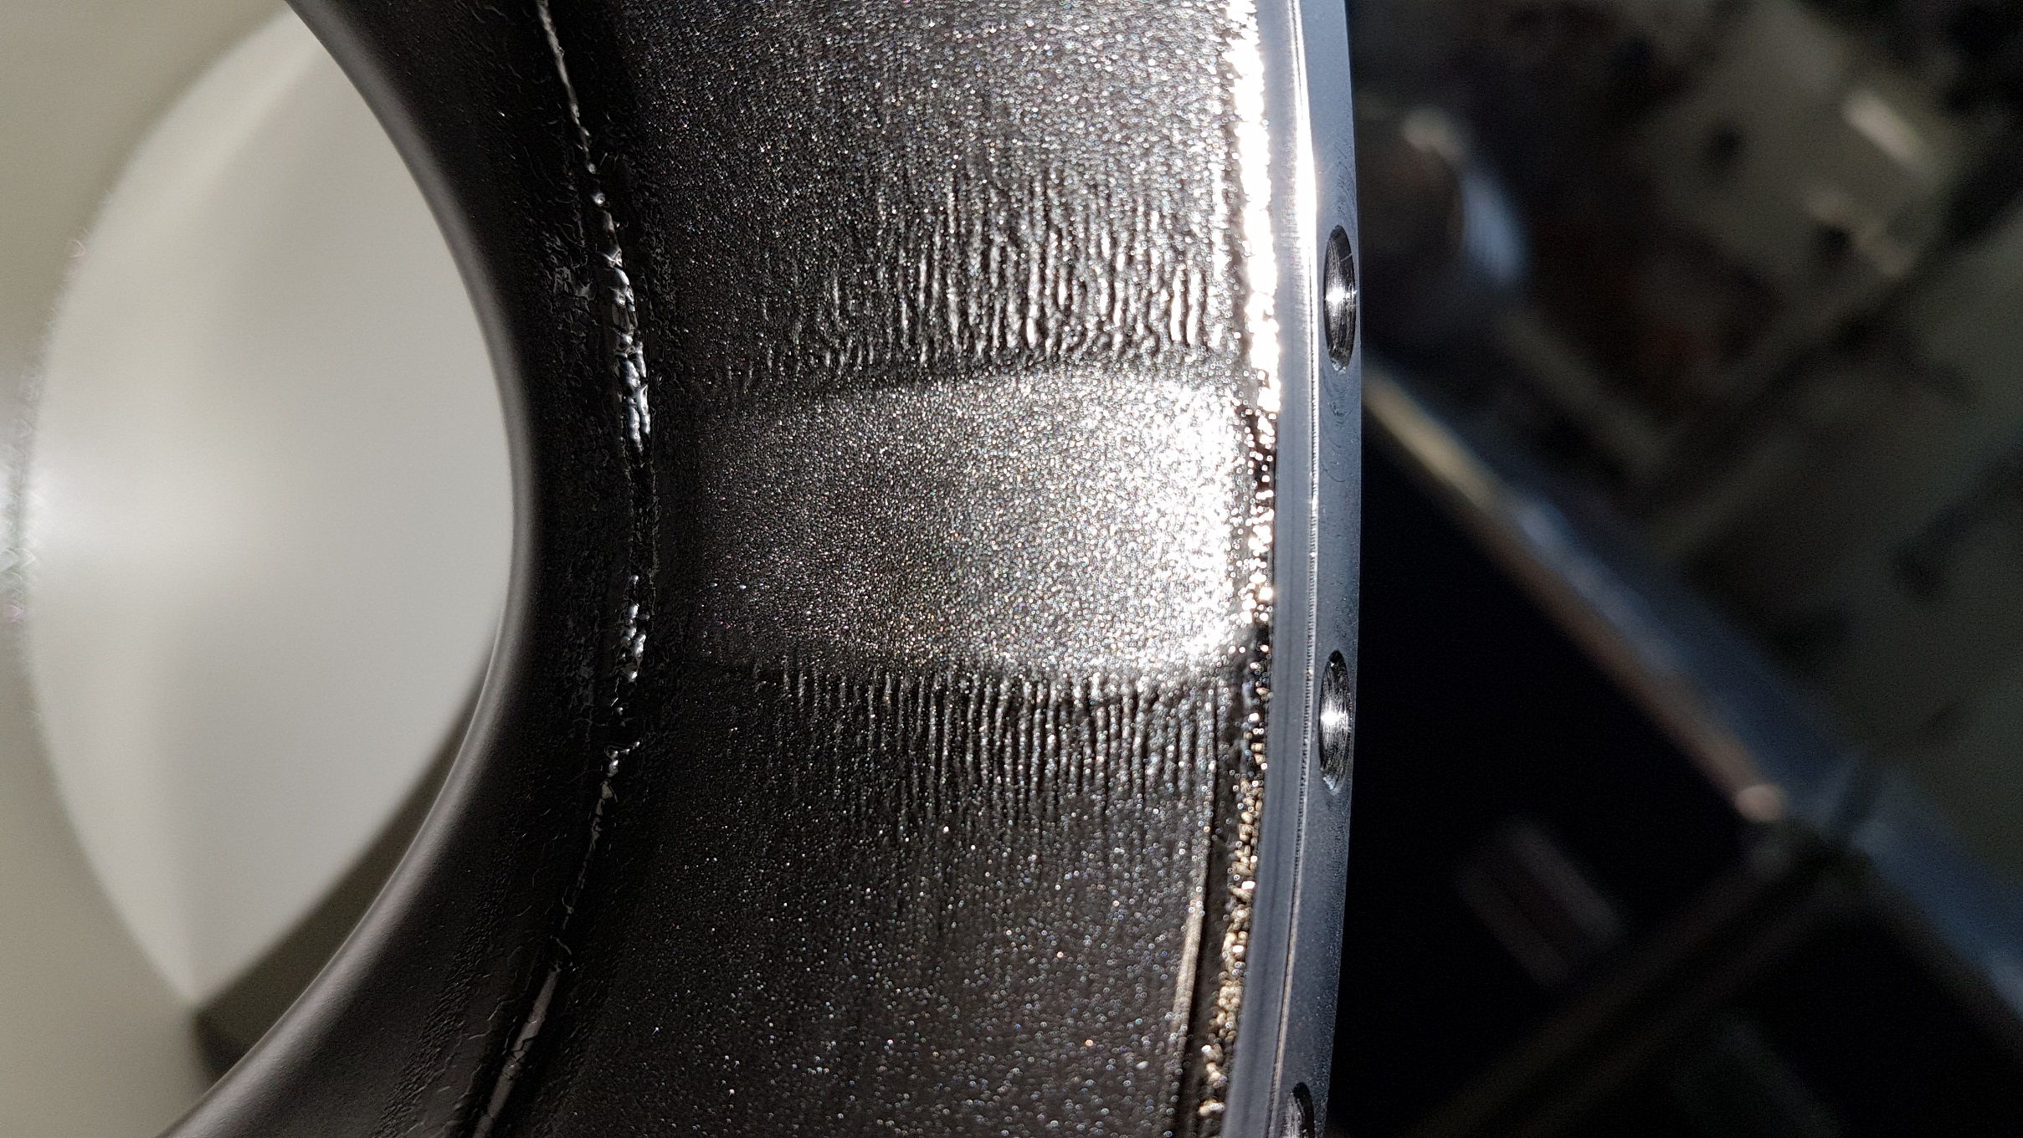
Bulk BCP new cycle: BCP grooves on MC tube
  Grooves on the MC tubes after Bulk BCP (done in two steps)
  Reason: BCP acid stagnant and possible air bubble when
  the cavity is in vertical position with the MC on the top
  How we recovered:
    Cavities already treated with Bulk BCP:
      Local grinding at the MC tube and 50μm BCP
    Cavities still to be treated with Bulk BCP:
      Reversing of the two main steps (starting with MC up)
      if grooves visible -> grinding and then 2nd BCP step
MC
Before and after grinding
MC
1st (110μm)
2nd (90μm)

Slide 9
Actual delivery status
28 cavities delivered within specifications
8 (+2) cavities are under qualification process
Cavity vendor (Ettore Zanon) financial crisis results in its failure and the acquisition of the company by SIMIC that created the Zanon Research and Innovation keeping the know-how
This, together with COVID’19, influenced the quality of the cavities resulting in 10 cavities not yet qualified

Slide 10
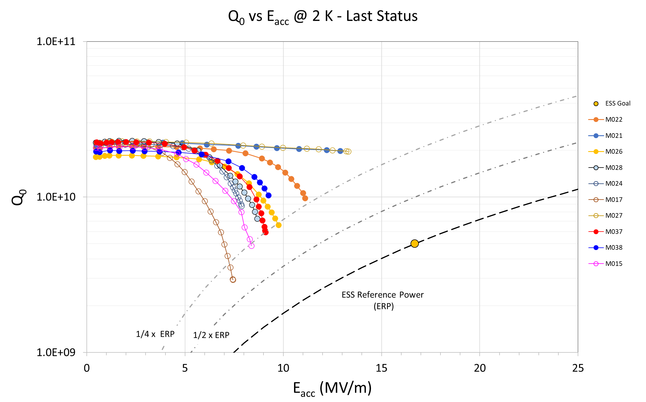
Batch of available cavities for qualification
7 cavities jacketed
  M015
  M021
  M022
  M024
  M026
  M027
  M028
3 naked cavities
  M017
  M024
  M037
No FE detected!

Slide 11
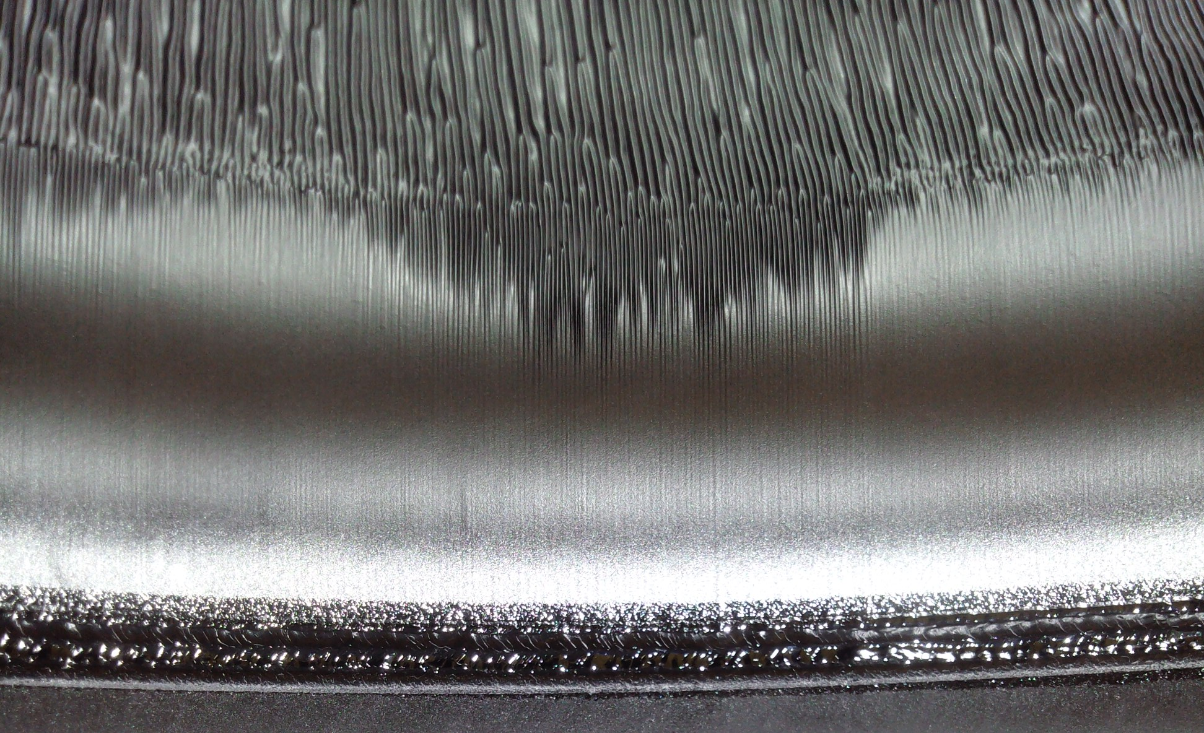
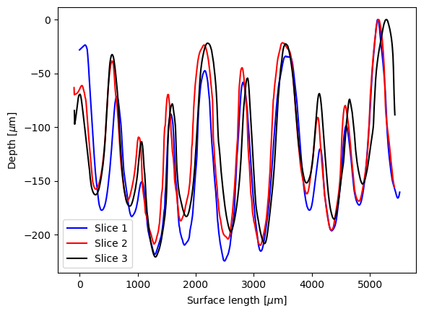
Production «review»
  Buffered Chemical Polishing (BCP) on
  MB Cavities is critical due to the large
  cell radius and steep wall angle
  We have observed grooves, deep and with
  high spatial frequency, on the cavity walls
  in some of the cavities not yet qualified.
  These might be the cause of not proper
  final cleaning or a source of dissipation
  No field emission has been observed
  on these cavities
  The new treatment approaches aims
  to improve final surface finishing to
  improve smoothness and/or cleaness.
Grooves pattern (from replica)

Slide 12
Boundary on additional cavity treatment
Jacketed cavities
  Limited frequency span
    Tank constrains cavity -> material removal limited to lower frequency boundary
  Field Flatness conservation
    Material removal not perfectly uniform -> possible FF change w/o tuning possibility
Naked cavities
  Final cavity length
    Further Nb material removal -> longer cavity
  Cavity sensitivities (LFD, pressure, etc.)
    Further Nb material removal -> thinner cavity wall

Slide 13
Naked cavities

Slide 14
New treatment approach
  In collaboration with Zanon Research & Innovation, we have agreed to treat an ESS MB cavity with Electro Polishing process, alternative to BCP used for series production.
  ZRI has long experience on EP starting from European XFEL, LCLS-II and, recently, with a cavity of the LB type for the PIP-II project.
  The EP process works differently w.r.t. BCP for material removal, acting more efficiently on edges than on flat surfaces. For this reason, we applied this treatment aiming to smooth the grooves present in our cavity. As a consequence of the increase smoothness, also the cleanness of the cavity should improve.

Slide 15
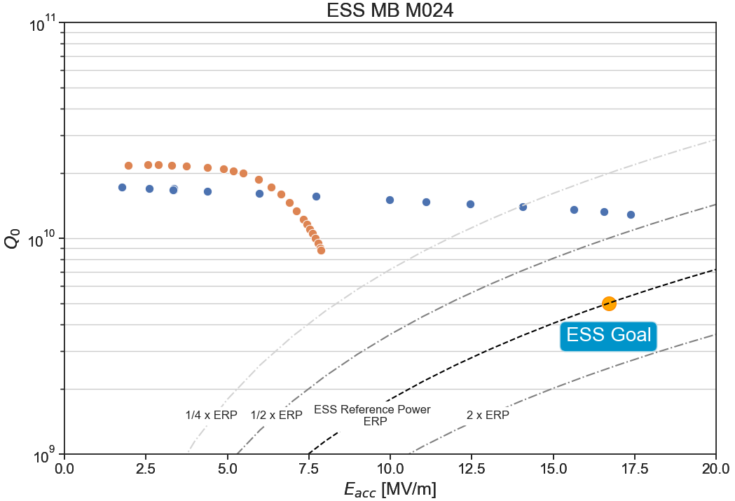
M024
  M024 has been selected as “test” cavity for EP treatment.
  “Series” BCP treatment
    Bulk: 228.7 μm
    Grinding MC tube: 50 μm
    Final BCP: 20 μm
    XRF: no result
  New EP treatment
    Bulk EP: 104.3 μm
    Heat treatment: 600 °C/10h
    Final EP: 10.3 μm
BCP
EP
…. but ….

Slide 16
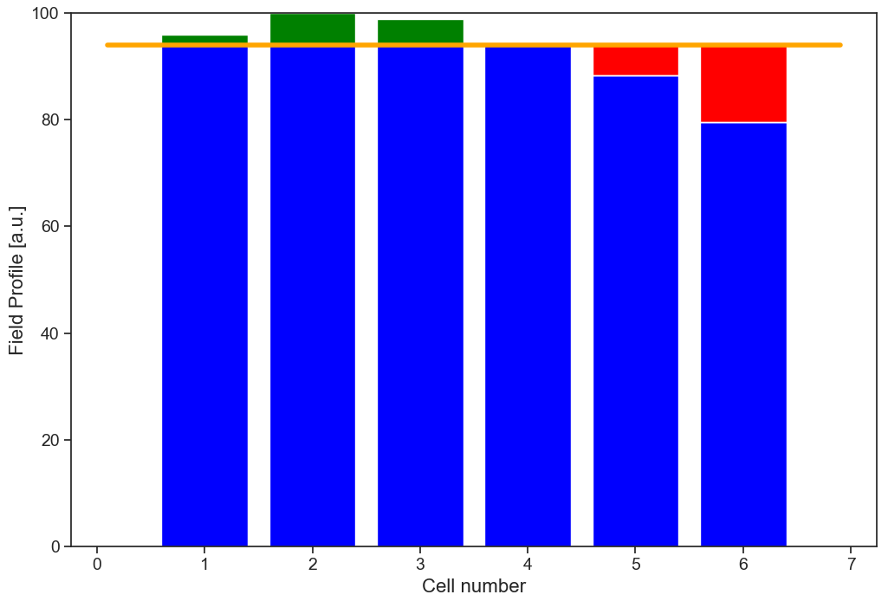
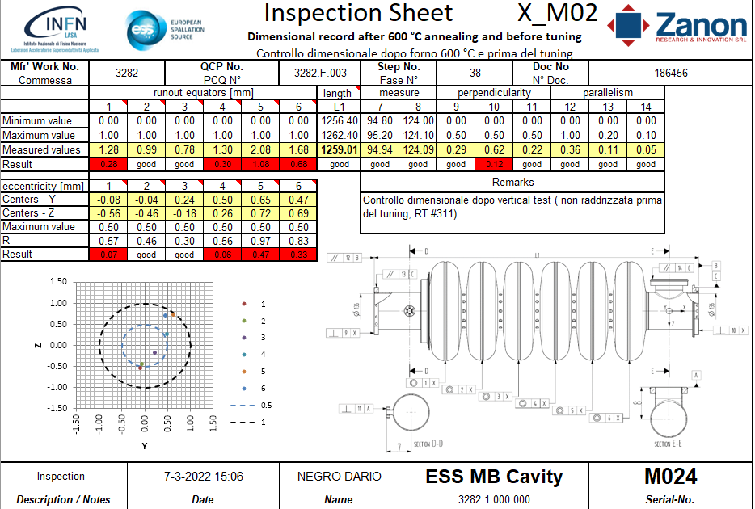
M024
ESS Field Flatness specification
-14 %
Measurement after VT test
  FF: 80 %
  Mechanics: out of tollerance
    Δl = -0.89 mm length
Cavity was set back into tollerance
and proceeded to integration,
informing INFN only at integration
already started.
  Detuned cell was the limiting one.

Slide 17
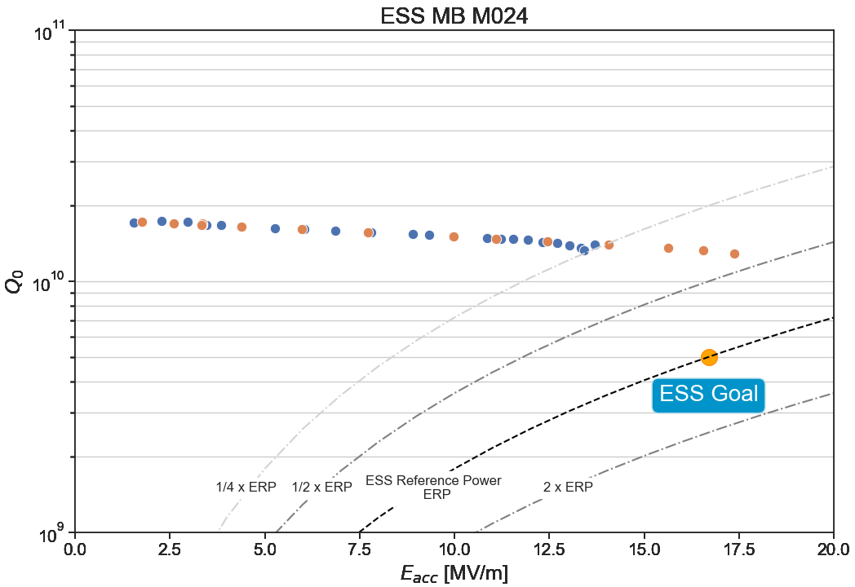
M024
Before
After
Final «BCP» treatment
  BCP: 10 μm
E_{acc} = 13.7 MV/m
Q₀ = 1.4e10
≈ - 15%

Slide 18
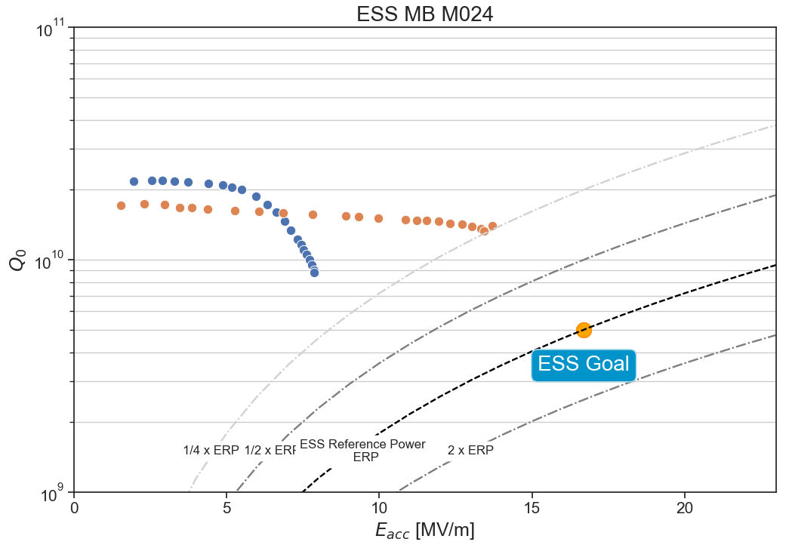
M024
Lessons learnt
  EP process successful in improving significantly cavity performance
    Maximum accelerating field improved by 80 %
  New process flow for EP introduces
  unexpected deformation to the cavity
    Activity is on-going to identify
    possible sources
    Additional control and approval actions
    introduced in the cavity life-cycle
    to handle and prevent them
  Unstable etching rate between
  treatments
EP effect for cavity recovery (1st vs 3rd VT)

Slide 19
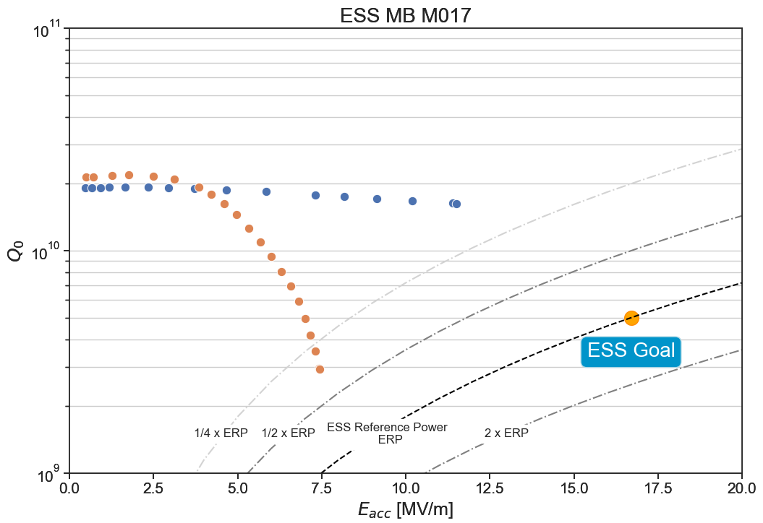
M017
Given the initial successful results of M024, the same treatment was applied to cavity M017 and M037
  “Series” BCP treatment
    Bulk: 210.0 μm
    Grinding MC tube: 50 μm
    Grinding defect: 50 μm
    Final BCP: 20 μm
  New EP treatment
    Bulk EP: 109.7 μm
    Heat treatment: 600 °C/10h
    Final EP: 10.9 μm
BCP
EP

Slide 20
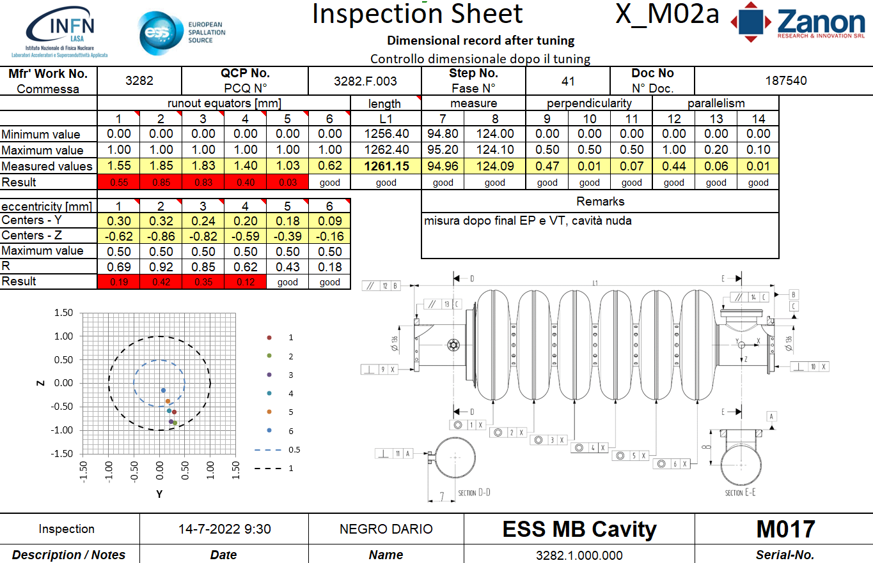
M017
Measurement after VT test
  FF: 92.2 %
  Mechanics: out of tollerance
    Δl = -0.61 mm length
Cavity is on hold!
E_{acc} = 11.5 MV/m
Q₀ = 1.6e10

Slide 21
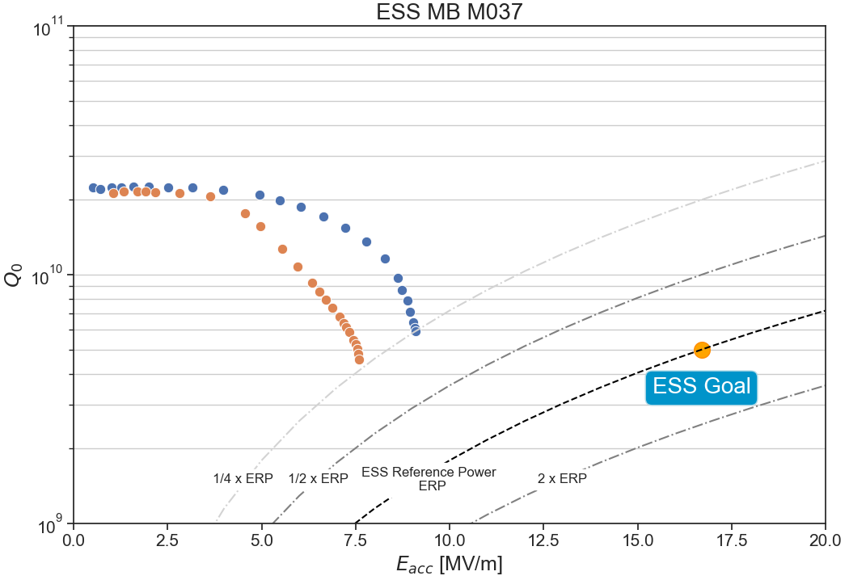
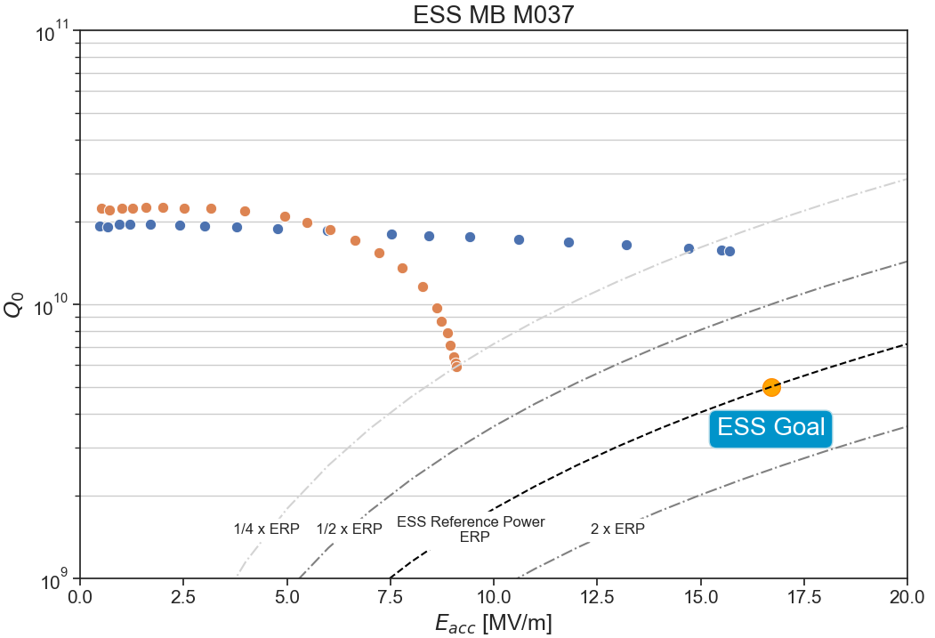
M037
BCP
BCP High Flow
  “Series” BCP treatment
    Bulk: 206.2 μm
    Grinding defects: 50 μm
    Final BCP: 20 μm
  Modified BCP (High Flow)
    Bulk BCP: 62.4 μm
    Final BCP: 20 μm
  New EP treatment
    Bulk EP: 109.7 μm
    Heat treatment: 600 °C/10h
    Final EP: 10.0 μm
BCP High Flow
EP

Slide 22
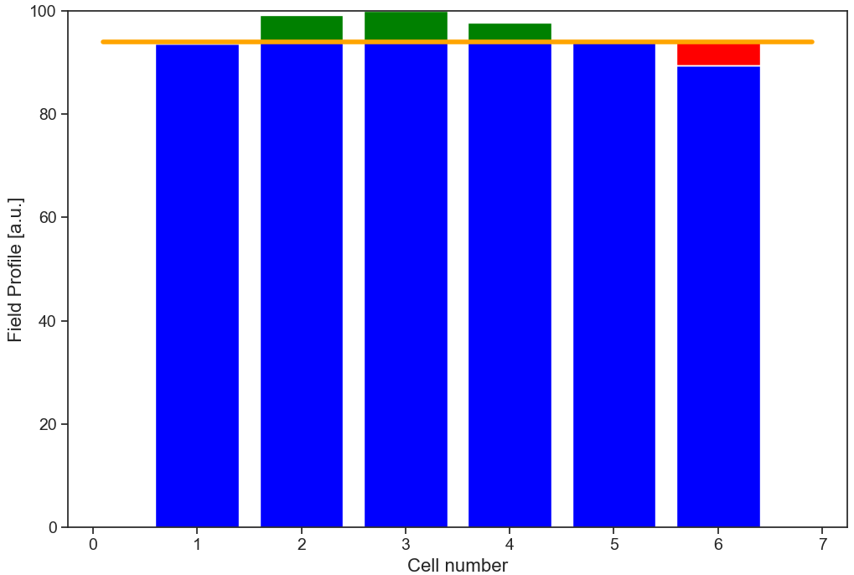
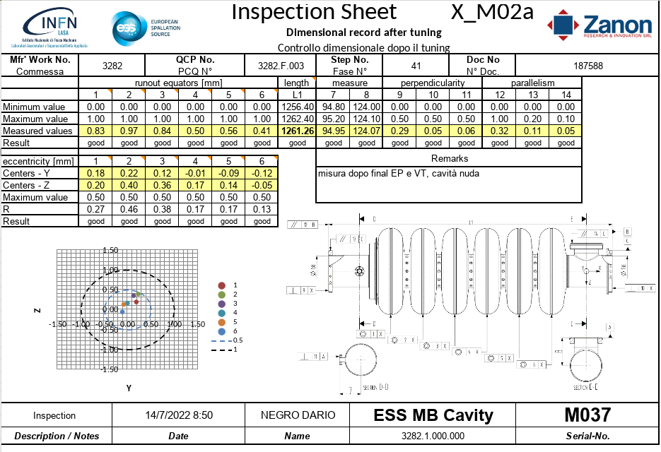
M037
ESS Field Flatness specification
-5 %
Measurement after VT test
  FF: 89.4 %
  Mechanics: OK
    Δl = -0.6 mm length
Cavity is on hold!
E_{acc} = 15.7 MV/m
Q₀ = 1.5e10

Slide 23
Jacketed cavities

Slide 24
New treatment approach
  In collaboration with Argonne National Laboratory, we have agreed to treat an ESS MB cavity with Rotational BCP process, alternative to BCP used for series production.
  Jacketed cavities are already integrated in the He-Tank and this limits the possibility for frequency variations before a removal of the He-Tank is necessary.
  We have chosen horizontal rotational BCP as a possible treatment for recovery similar cavities being alternative to our original one and given the good results obtained on similar cavities.

Slide 25
M028
Cavity was treated at ANL removing 25 μm.
ZRI prepared the cavity for Vertical Test
  Based on ANL experience, Viton sealings were used on the cavity to protect the inner surface during transportation instead of Hex Aluminum.
  Flanges were carefully cleaned at Zanon before preparation for VT
  Only HPR, no final “BCP” not to change surface finishing
Cavity was tested at CEA
  Test interrupted for huge field emission
Cavity is now at ZRI for new cleaning process (US + soap, HPR) before new VT

Slide 26
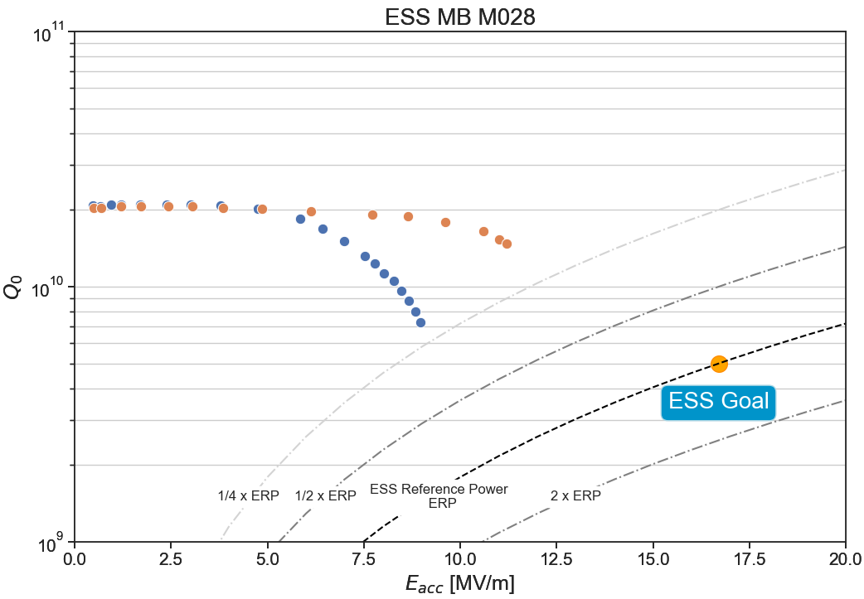
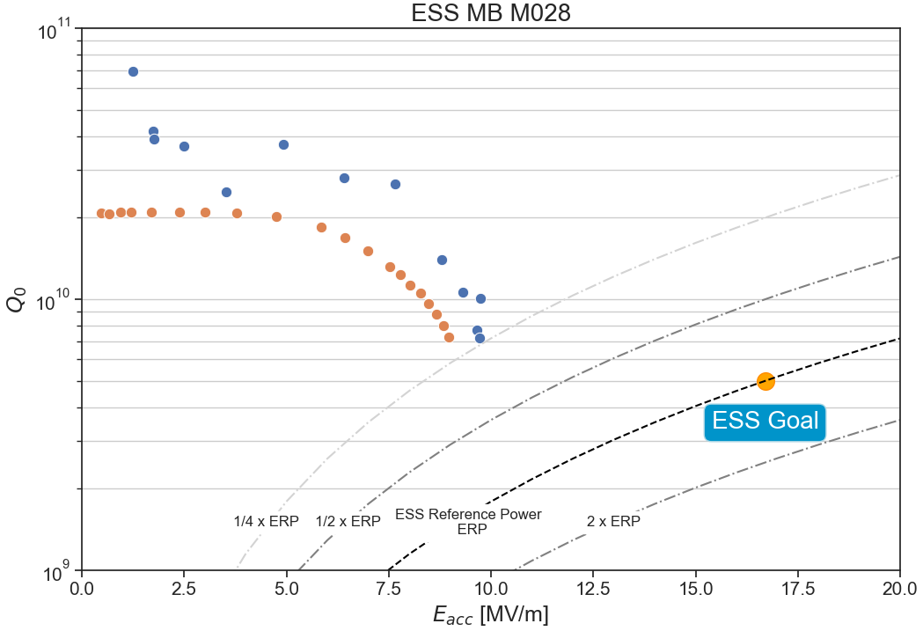
M028
BCP
20 μm BCP
“Series” BCP treatment
  Bulk: 206.2 μm
  Grinding defects: 50 μm
  Final BCP: 20 μm
Additional BCP (FE in previous VT test)
  Final BCP: 20 μm
  Reduced maximum gradient
New HPR
  No changes
Rotational BCP
  25 μm
  HPR
  Test at CEA
    Huge FE
20 μm BCP
Rotational BCP

Slide 27
New cavities production

Slide 28
New treatment process - ElectroPolishing
Four new cavities are being produced at ZRI with the new EP process flow.
All cavities have been mechanical fabricated and treated with bulk EP process.
We originally plan to have two of them tested naked to qualify the new EP treatment

Slide 29
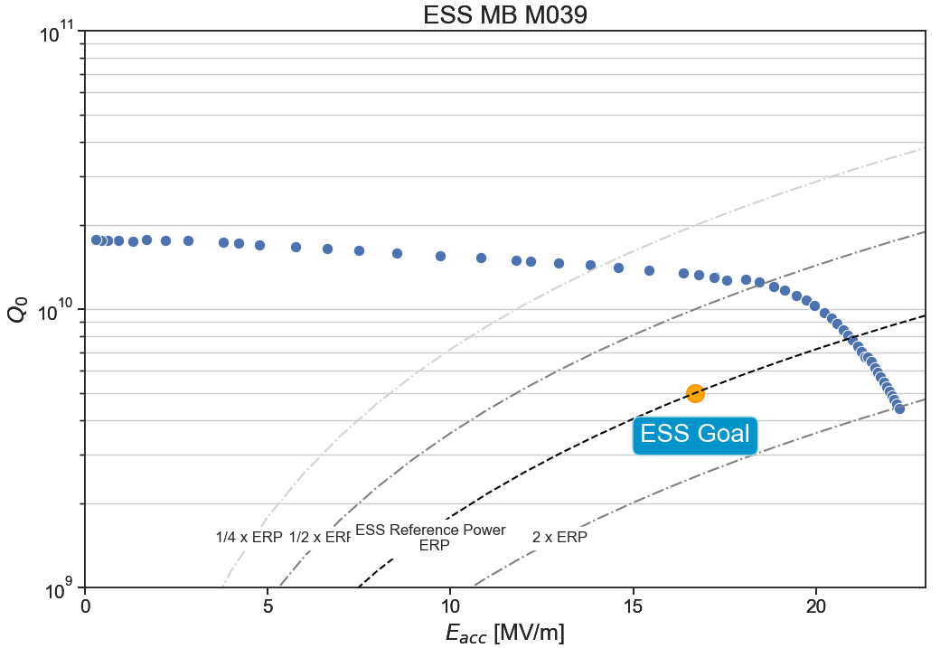
M039
EP treatment
  Grinding at EQ after EBW
  Bulk: 160 μm
  Final EP: 10 μm
Test naked
  E_{acc}^{Max} = 22.2 MV/m
  Q₀^{Max} = 4.4e9
  Q₀ ^{E}acc^{Goal} = 1.3e10
Cavity on hold before Integration
  Waiting FF and mechanical measurements

Slide 30
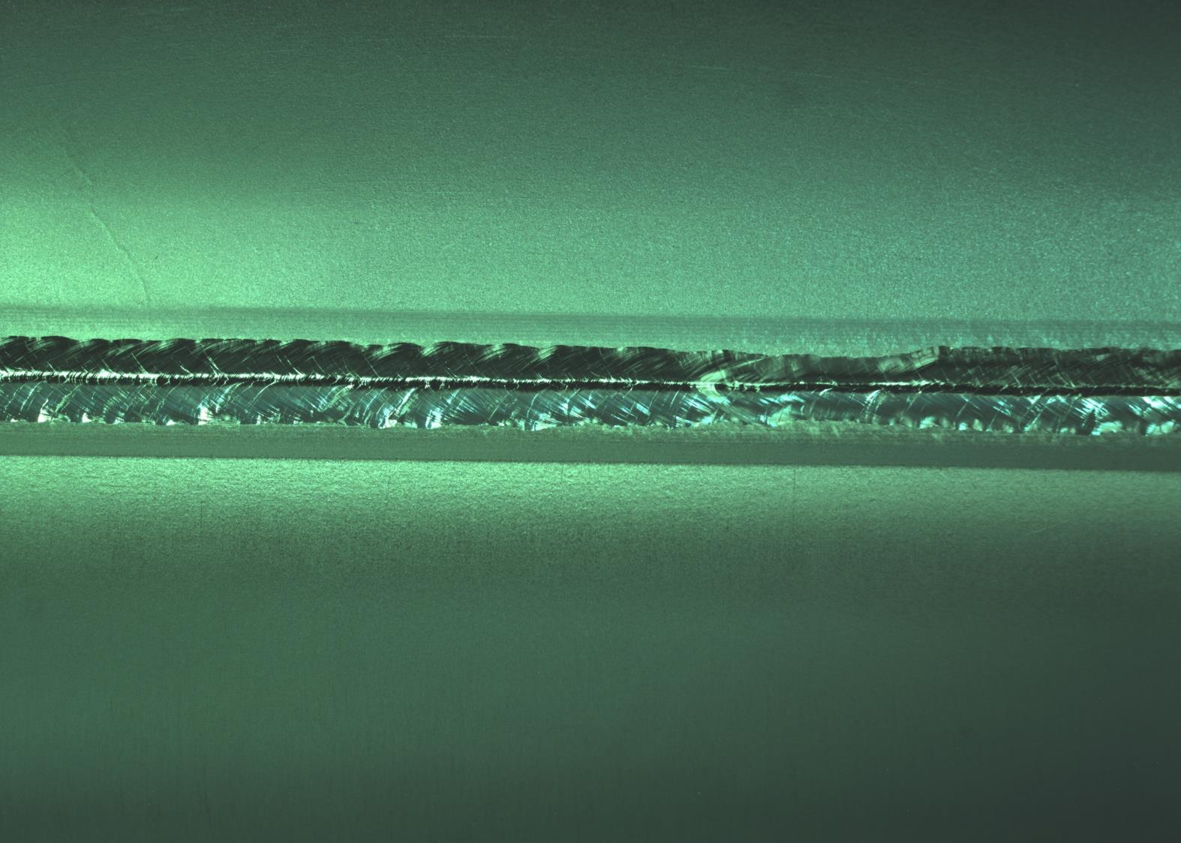
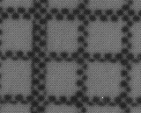
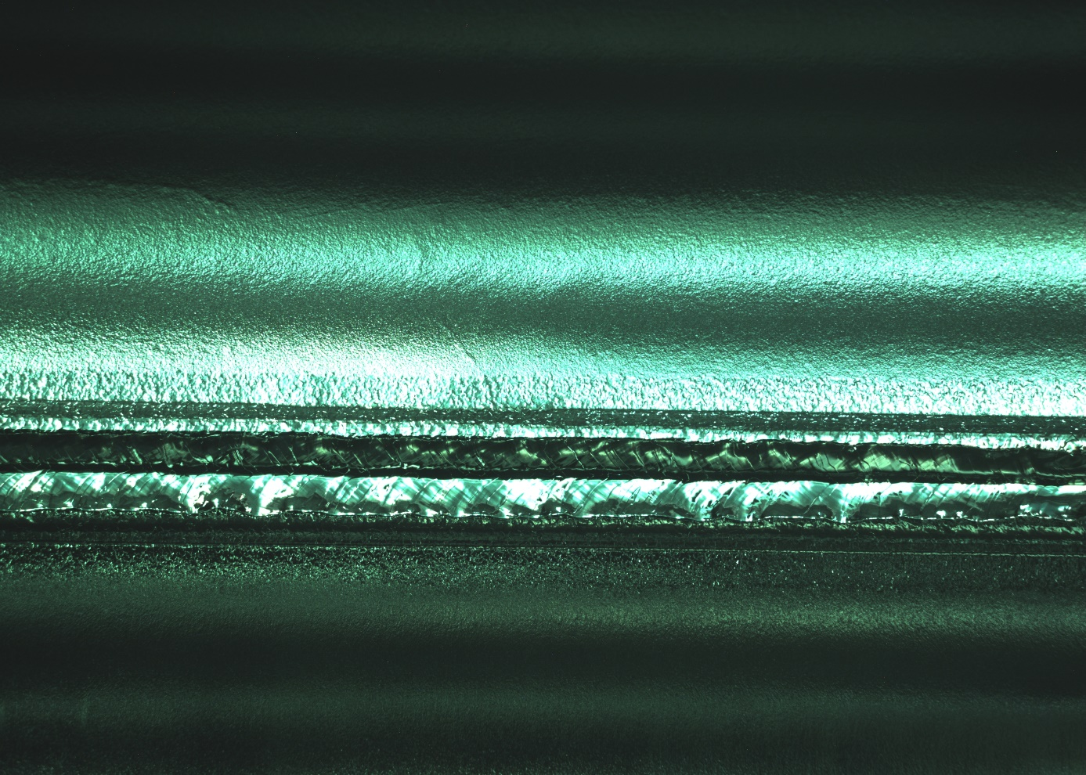
M040
After EBW
EP treatment
  Bulk: 160 μm
No significant defects
Few “lines” in the
equatorial region
Replicas do not help in
understanding
We plan for a VT test naked
middle of October (wk. 42)
After EP

Slide 31
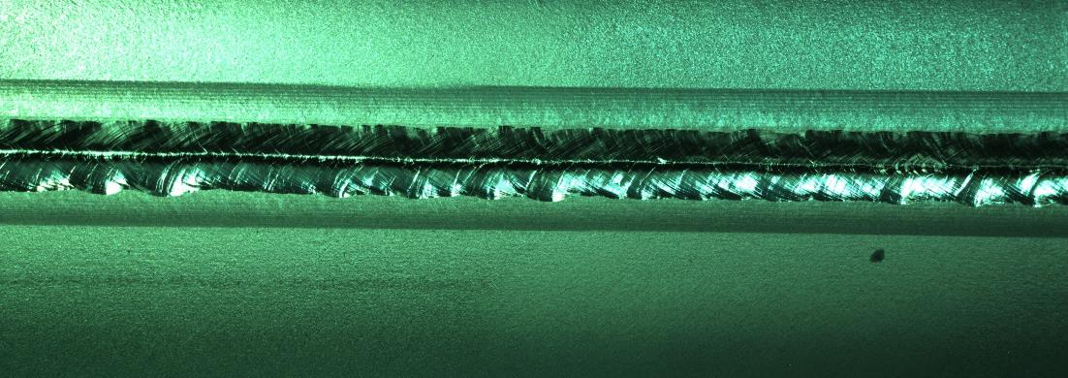
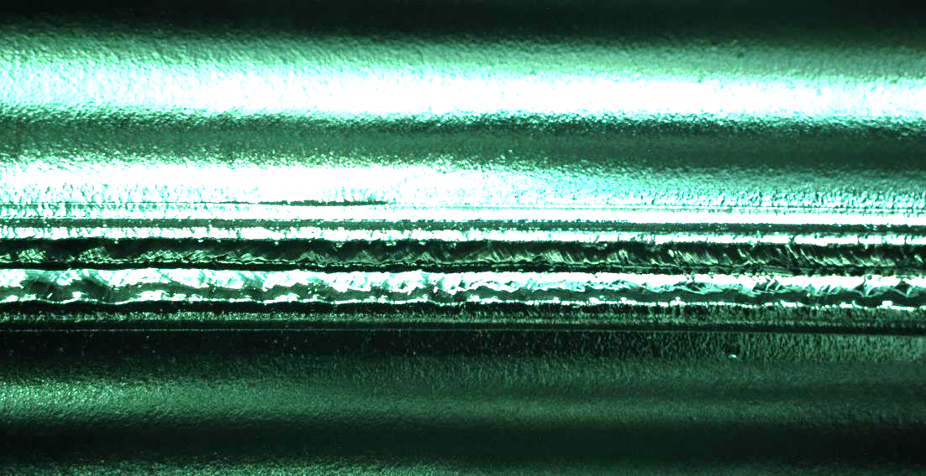
M042
After EBW
EP treatment
  Bulk: 159.9 μm
Defect after EBW grinded and
not visible
Defect re-appears after “bulk” EP
After EBW + grinding
After EP

Slide 32
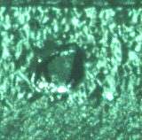
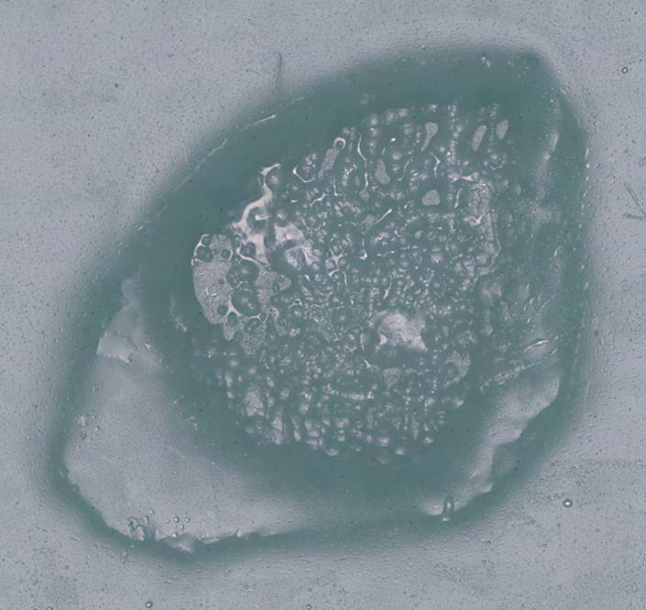
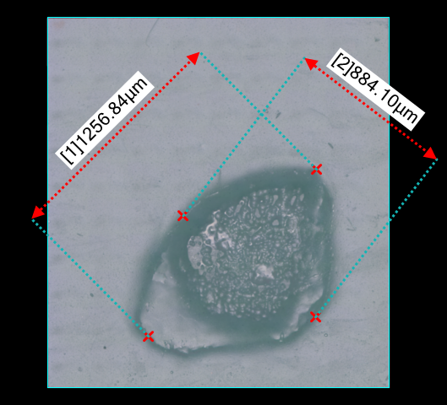
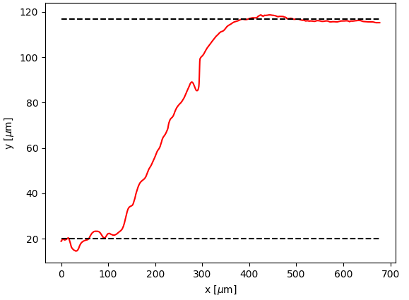
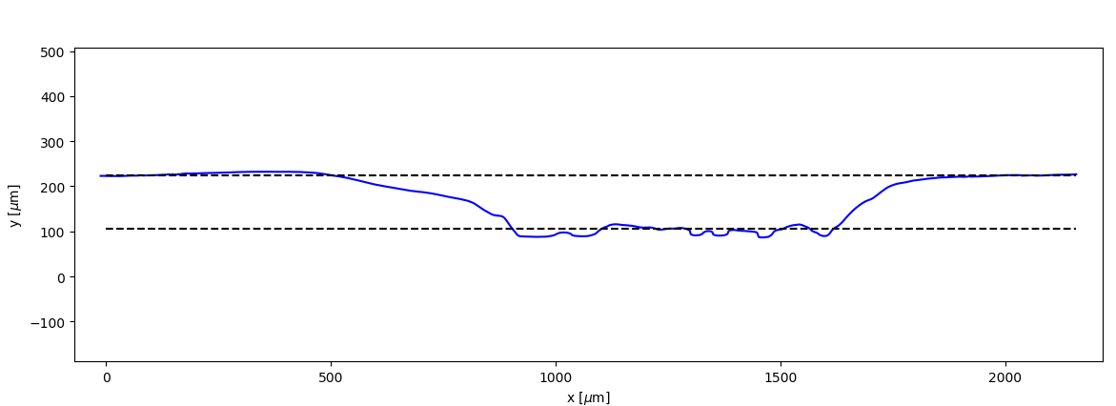
M042
3-D Microscopy
  Defects Dimensions
  Morphology investigation
    Note different finishing of the
    front surface
Border section profile
Transverse section profile
100-120 μm

Slide 33
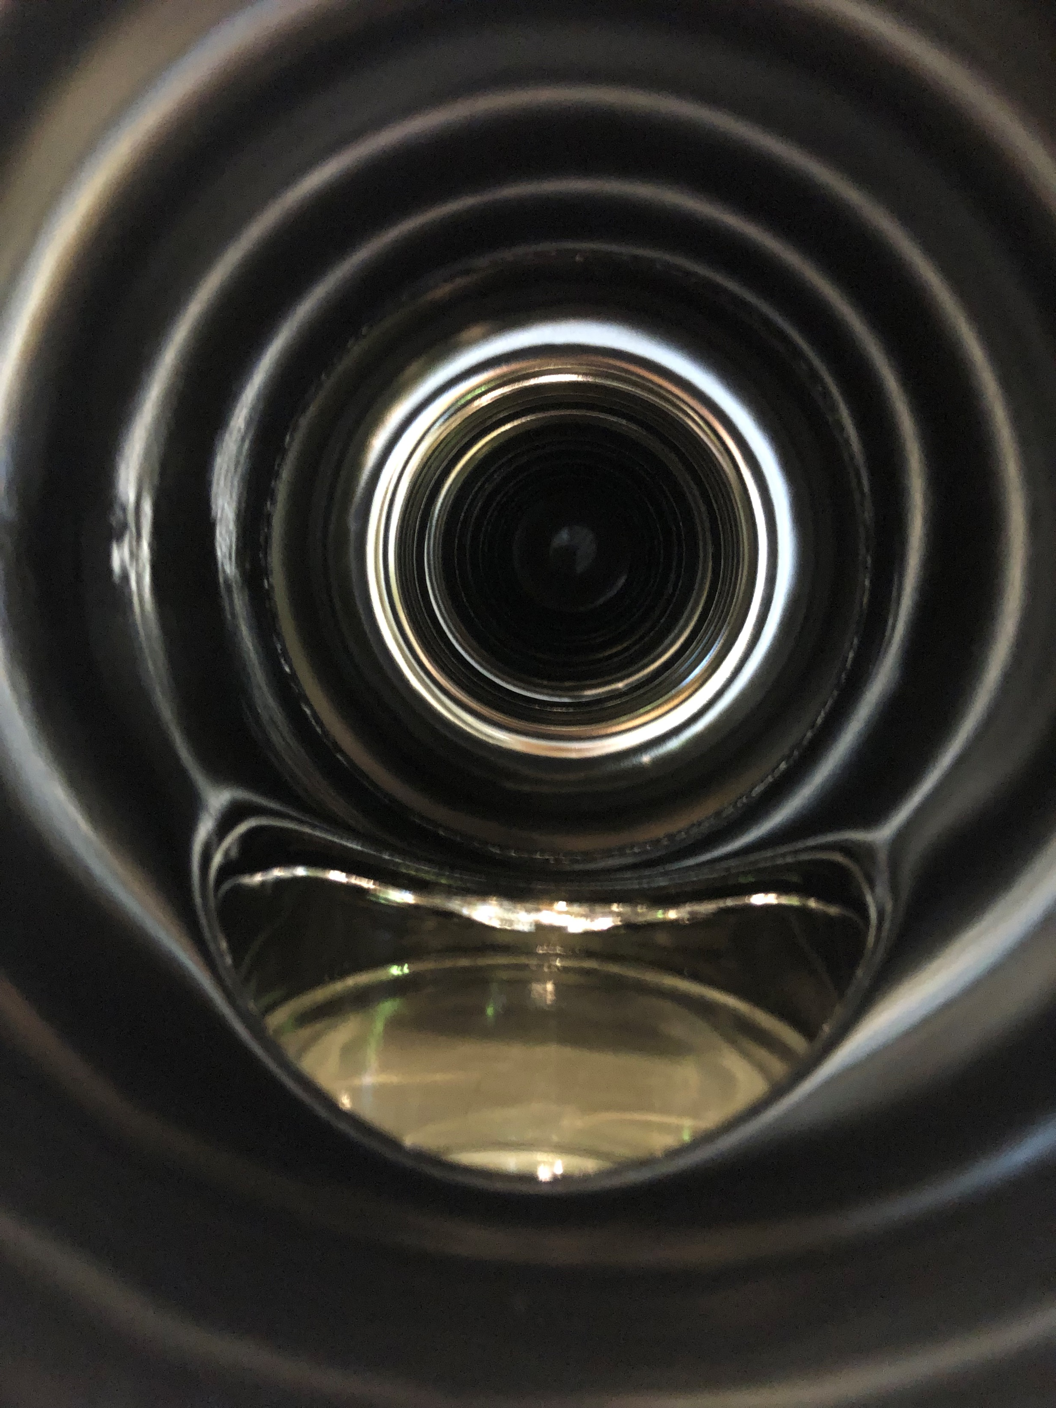
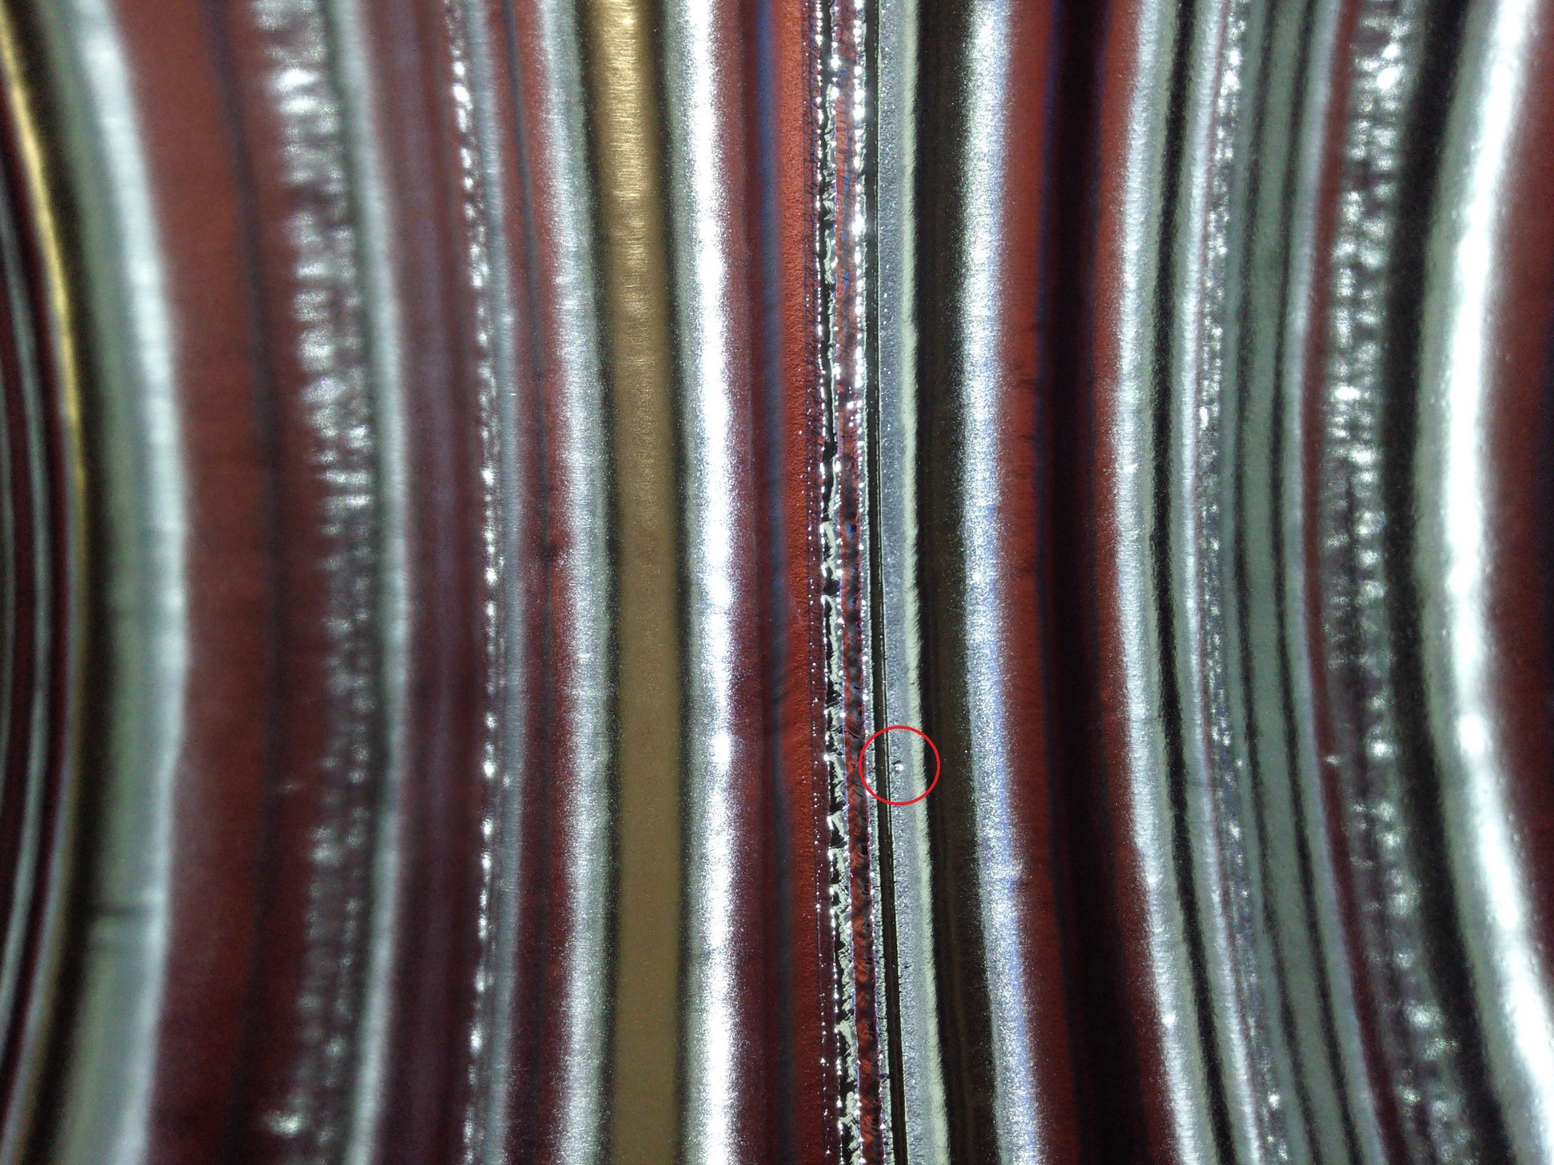
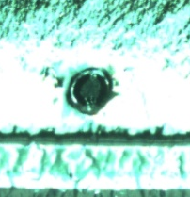
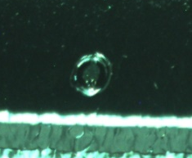
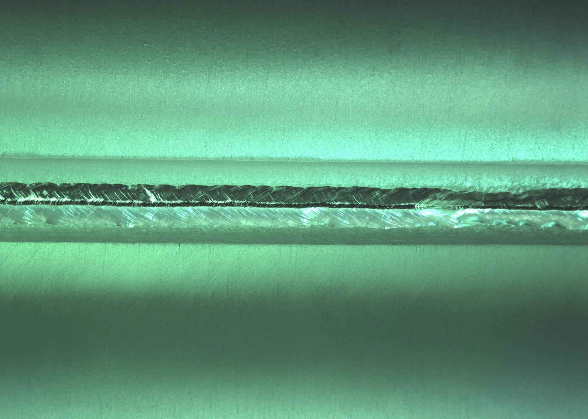
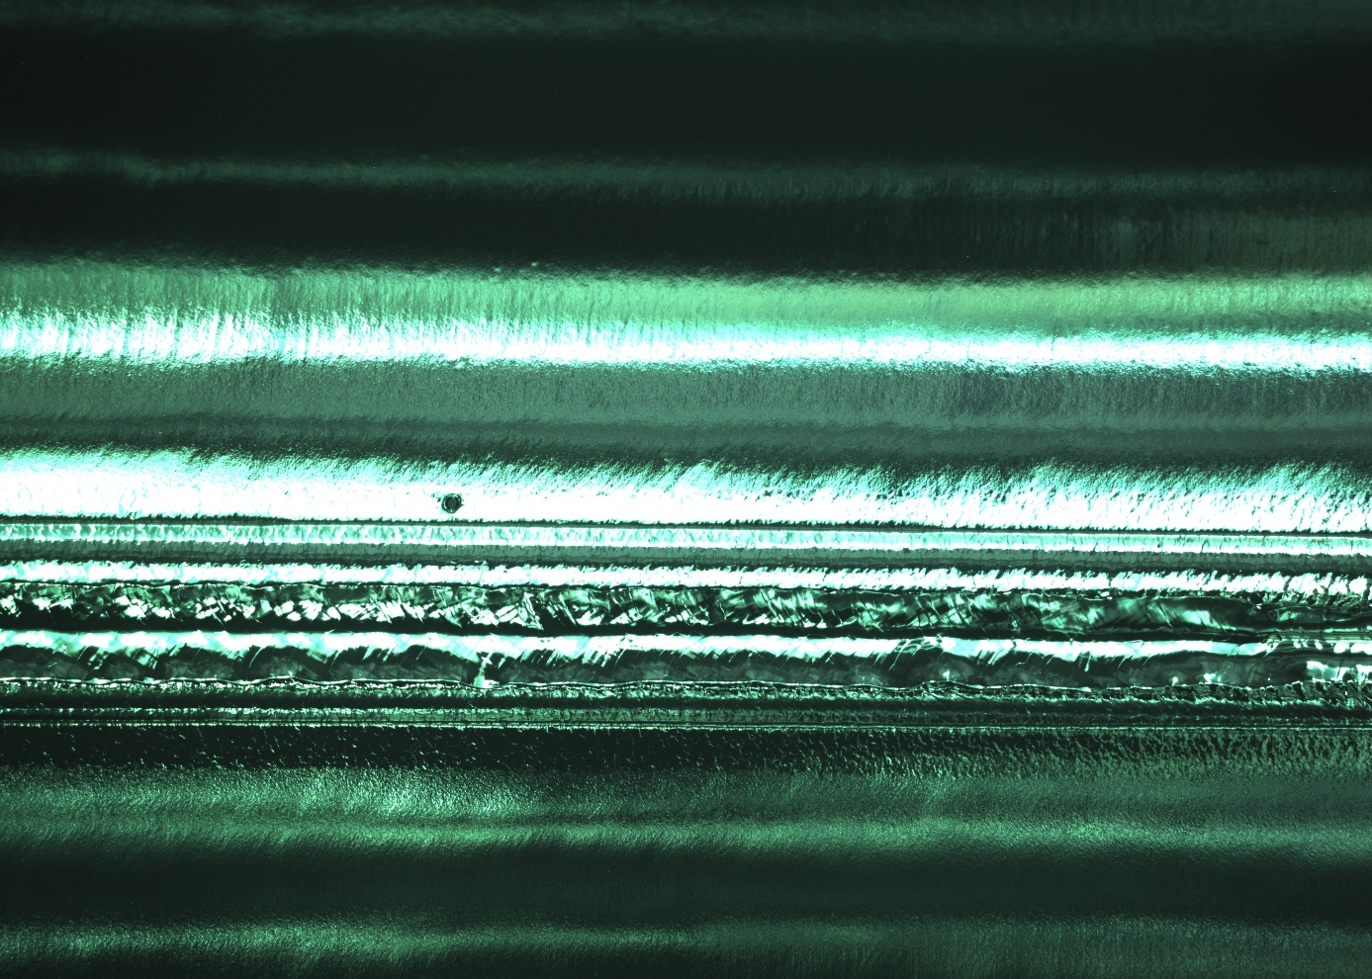
M041
EP treatment
  Bulk: 160 μm
Defect appears after EP on
Eq1 w.r.t. coupler
at 240° clockwise in beam direction
Defect is not visible after EBW
After EBW
After EP

Slide 34
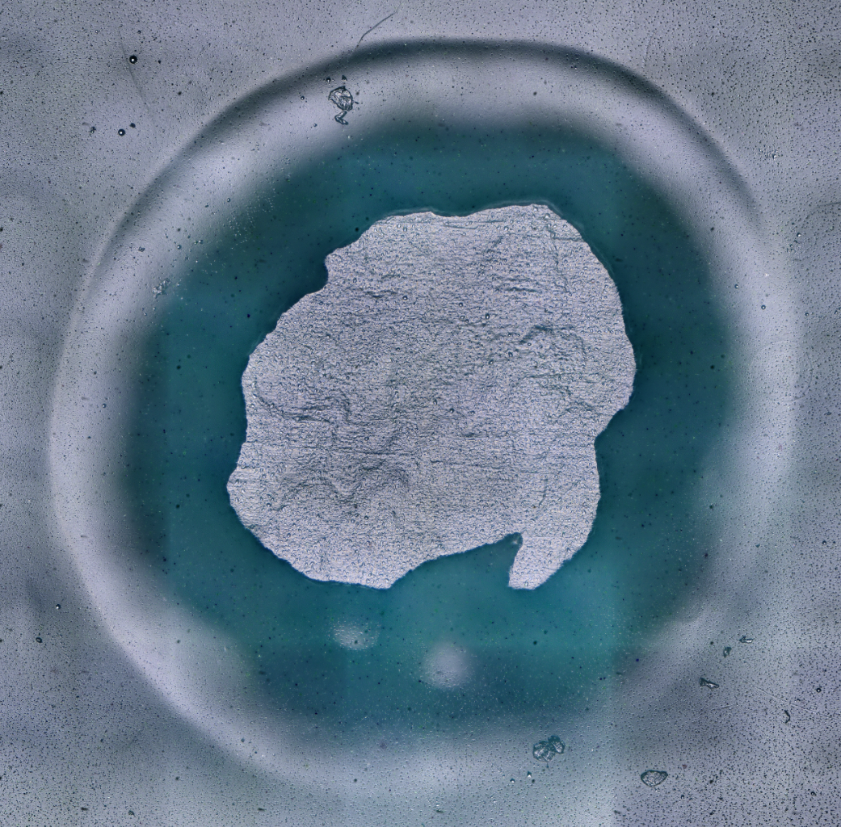
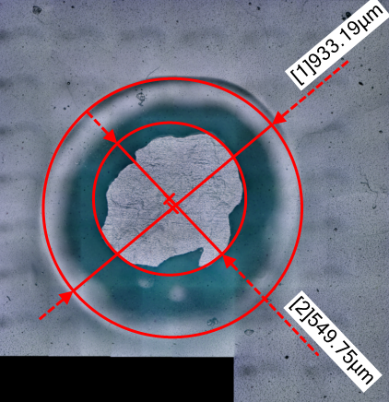
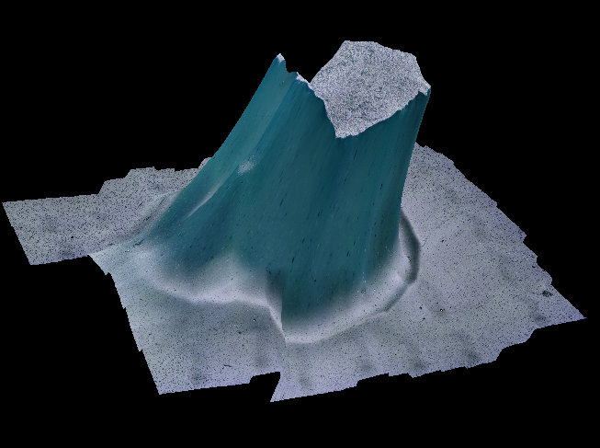


M041
3D-Microscopy investigation
  Defects Dimensions
  Morphology investigation
Next step:
  XRF (as for M042)
  X-Ray?
x1000
Transverse section profile
Height x 400
Border section profile
150-170 μm

Slide 35


M042 - XRF Spectrum
Ar
Kα1 = 2957.7 eV
Kα2 = 2955.63 eV
Kβ = 3190.5 eV
Nb
Kα1 = 16615.1 eV
Kα2 = 16521.0 eV
Kβ = 18622.5 eV
X-Ray Source Parameters
X-Ray Energy [keV] | 22.3
Current [mA] | 1
Collimator diameter [mm] | 3
Nb
Lβ1 = 2257.4 eV
Lβ2 = 2367.0 eV
XRF
  Technique sensitive to high Z materials (Z > 14)
  No clear indication of foreign materials
  Diffraction effects visible in the defect region
    Light element contribution?
    Niobium composite?
    Other?
X-Ray (next step)
  Investigation presence of light element
  by “Intensity” test
IR Thermography (now on-going)
  Investigation of the thermal response during heating/cooldown of the defect

Slide 36

M042 - XRF Spectrum
Ar
Kα1 = 2957.7 eV
Kα2 = 2955.63 eV
Kβ = 3190.5 eV
Nb
Kα1 = 16615.1 eV
Kα2 = 16521.0 eV
Kβ = 18622.5 eV
X-Ray Source Parameters
X-Ray Energy [keV] | 22.3
Current [mA] | 1
Collimator diameter [mm] | 3
Nb
Lβ1 = 2257.4 eV
Lβ2 = 2367.0 eV
XRF
  Technique sensitive to high Z materials (Z > 14)
  No clear indication of foreign materials
  Diffraction effects visible in the defect region
    Light element contribution?
    Niobium composite?
    Other?
X-Ray (next step)
  Investigation presence of light element
  by “Intensity” test
IR Thermography (now on-going)
  Investigation of the thermal response during heating/cooldown of the defect

Slide 37
M042 - XRF Spectrum
Ar
Kα1 = 2957.7 eV
Kα2 = 2955.63 eV
Kβ = 3190.5 eV
Nb
Kα1 = 16615.1 eV
Kα2 = 16521.0 eV
Kβ = 18622.5 eV
X-Ray Source Parameters
X-Ray Energy [keV] | 22.3
Current [mA] | 1
Collimator diameter [mm] | 3
Nb
Lβ1 = 2257.4 eV
Lβ2 = 2367.0 eV
XRF
  Technique sensitive to high Z materials (Z > 14)
  No clear indication of foreign materials
  Diffraction effects visible in the defect region
    Light element contribution?
    Niobium composite?
    Other?
X-Ray (next step)
  Investigation presence of light element
  by “Intensity” test
IR Thermography (now on-going)
  Investigation of the thermal response during heating/cooldown of the defect

Slide 38
Summary
The EP results on naked cavities are very encouraging
  M037 is near to specifications from 9.1 MV/m to 15.7 MV/m (> 70 %)
  M017 improved from 7.4 MV/m to 11.5 MV/m ( > 50 %)
    We are considering a further 50 μm EP
In our experience, EP etching rate is less reproducible w.r.t. BCP and we also observed cavity deformation and FF variation
Re-test of M028 will be done as soon as possible to understand the feasibility of rotating BCP for recovering jacketed cavities
The first new cavity treated with EP cycle largely overcome the ESS goal (but we are waiting for the mechanical and FF checks!). The second will be tested next week.
The new cavities with surface defects are under investigations with different not invasive techniques.
If no clear evidence of foreign material will be detected, both will be grinded, treated with 20μm BCP + 30μm EP and then move towards VT test naked

Slide 39
Thank you!

