Slide 1
Horizontal HPR in SuperKEKB at KEK
KEK –SuperKEKB
TTC 2022@Aomori in Japan
T. Okada
M. Morita
M. Nishiwaki
T. Furuya
S. Mitsunobu

Slide 2
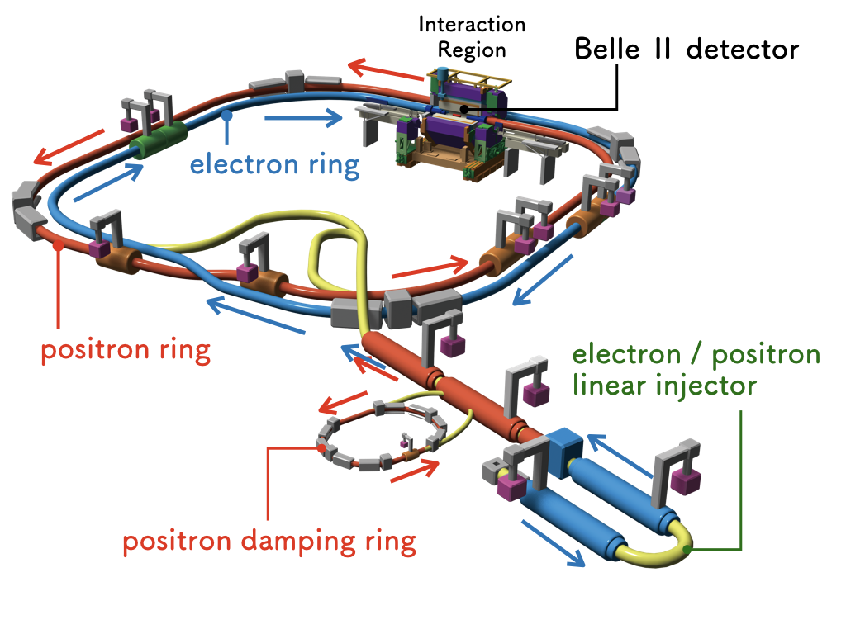
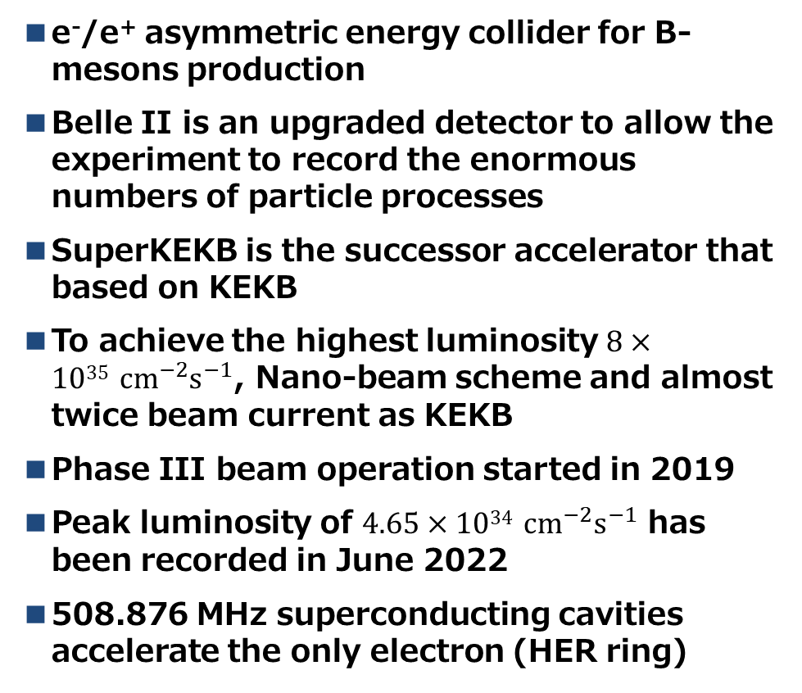
What is SuperKEKB?
e⁻/e⁺ asymmetric energy collider for B-mesons production
Belle II is an upgraded detector to allow the experiment to record the enormous numbers of particle processes
SuperKEKB is the successor accelerator that based on KEKB
To achieve the highest luminosity $8×1035 {cm}^{−2}s^{−1}$, Nano-beam scheme and almost twice beam current as KEKB
Phase III beam operation started in 2019
Peak luminosity of $4.65×1034 {cm}^{−2}s^{−1}$ has been recorded in June 2022
508.876 MHz superconducting cavities accelerate the only electron (HER ring)
 | LER (positron ring) | HER (electron ring)
Energy | 4 GeV | 7 GeV
Beam current | 3.6 A (design) 1.32 A (2022 June) | 2.6 A (design) 1.1 A (2022 June)
Bunch current | 1.44 mA (design) 0.59 mA (2022 June) | 1.04 mA (design) 0.49 mA (2022 June)
Circumference | 3016 m | 3016 m
Luminosity | 4.65×1034 cm⁻² s⁻¹
Int. Luminosity | 0.41 ab⁻¹
Y. Funakoshi, presented at IPAC’22, Jun. 2022, MOPLXGD1

Slide 3
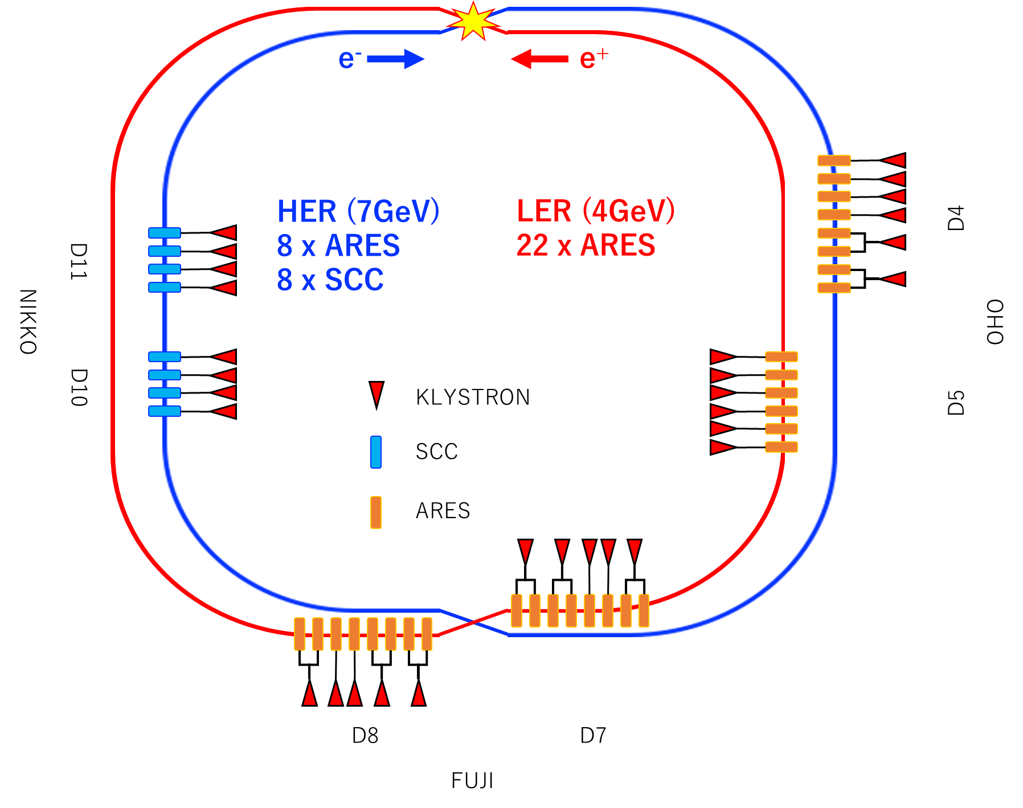
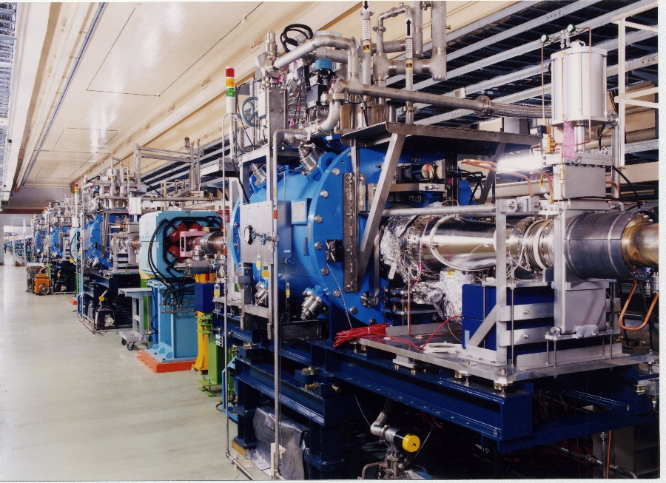
RF System of SuperKEKB
2 type cavities installed SuperKEKB (Frequency is 508.876 MHz)
ARES cavity (normal conducting)
  The three cavity system consist of energy storage cavity, accelerating cavity, and resonant coupling cavity
HOM damped superconducting cavity
  This cavity was developed for KEKB. And It reused until now
  508.876 MHz single cell cavity, made of Nb
  Total number of cavity is 8 (+1 spare). All cavities installed on the Nikko straight section of the tunnel
SRF system re-used for SuperKEKB
However, the beam current will be over twice.
HOM power will be increase greatly
M. Nishiwaki, presented at eeFACT2022

Slide 4
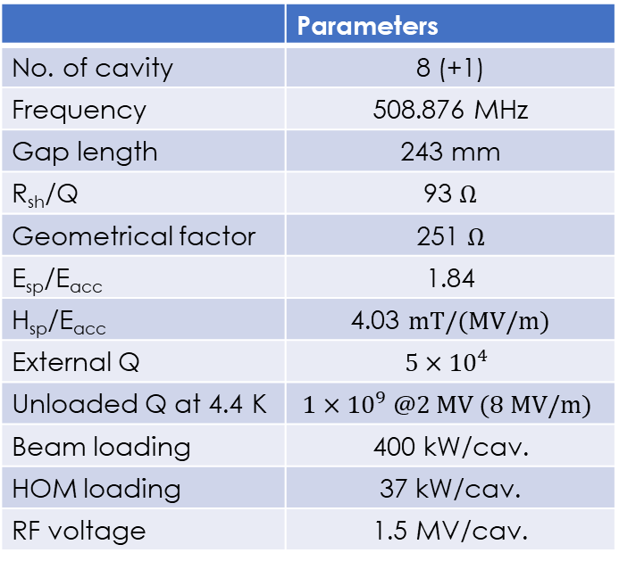
Superconducting cavity
The superconducting cavity installed in SuperKEKB was developed in the 1990 s for the previous ring of KEKB.
The cavity has been optimized to achieve a CW acceleration of 1.5 MV at a large beam power of 400 kW.
The temperature is 4.4 K by immersion cooling with liquid helium.
The single cell has been chosen to reduce the number of HOMs
 | Parameters
No. of cavity | 8 (+1)
Frequency | 508.876 MHz
Gap length | 243 mm
R_{sh}/Q | 93 $Ω$
Geometrical factor | 251 $Ω$
E_{sp}/E_{acc} | 1.84
H_{sp}/E_{acc} | 4.03 $mT/(MV/m)$
External Q | $$5×{10}^{4}$$
Unloaded Q at 4.4 K | $$1×10^{9} @2 MV (8 MV/m)$$
Beam loading | 400 kW/cav.
HOM loading | 37 kW/cav.
RF voltage | 1.5 MV/cav.

Slide 5
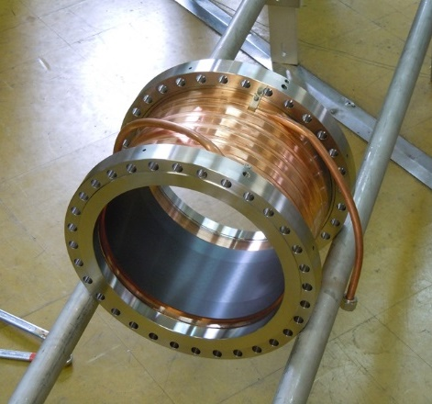
Superconducting cavity
Ferrite HOM Damper
Copper Pipe for Cooling
Stainless Steel Flange
HOM due to high beam current is absorbed by the HOM dampers installed at both side of the cavity.
The HOM damper is located outside the cryostat and the temperature is room temperature.
HOM of kW is absorbed and damper cooled by water cooling.
HIPped Ferrite (thickness: 4mm)
M. Nishiwaki, presented at eeFACT2022
 | SBP | LBP
Absorber material | Ferrite (IB004)
Jacket material | Copper
Diameter (mm) | 220 | 300
Length (mm) | 120 | 150
Thickness | 4-3 | 4-3

Slide 6
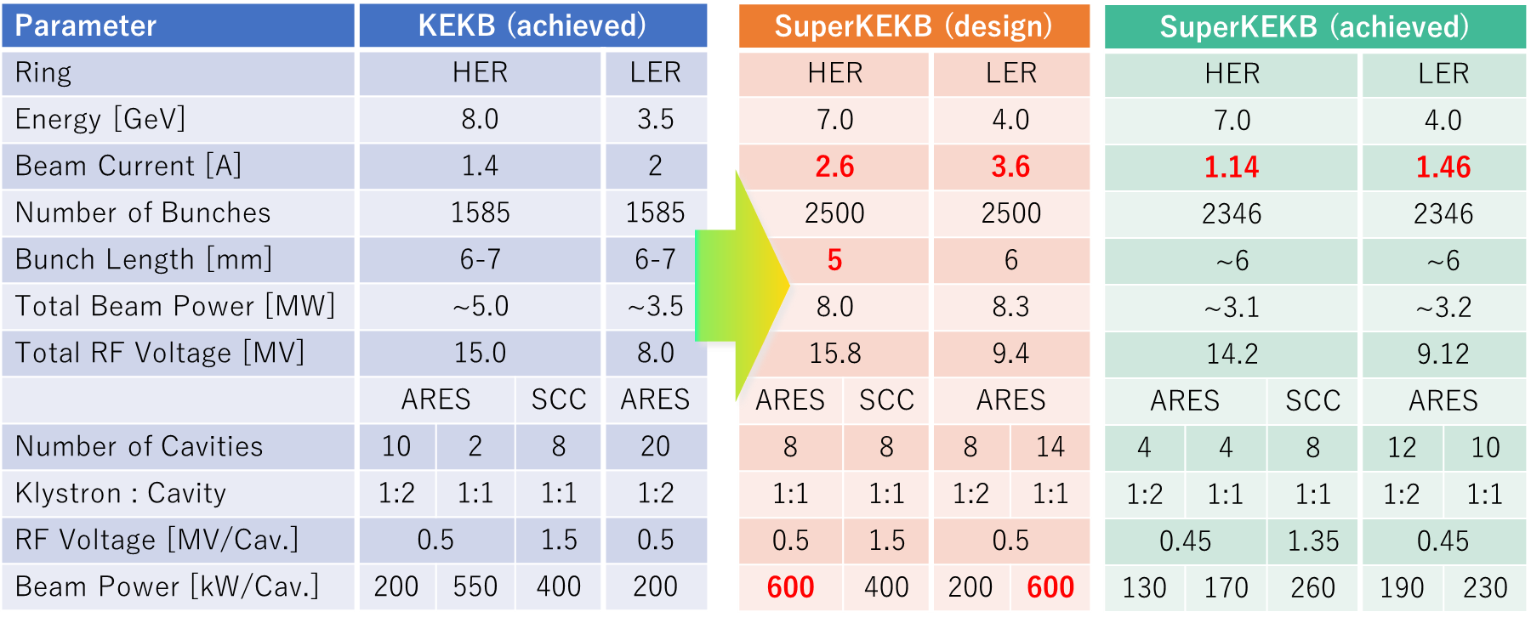
Status of operating
The superconducting cavities are operating very stably and low trip rate.
We applied RF aging as maintenance every two weeks.
SuperKEKB will increase e⁻ current to over 2 A.
These cavities have no experience as high beam current
Resent operation status (2022ab, 4months)
# of Beam Aborts caused by RF system : 72
: 0.6 aborts/day
(Total # of beam aborts : >1300)
Detailed in M. Nishiwaki, presented at This TTC2022

Slide 7
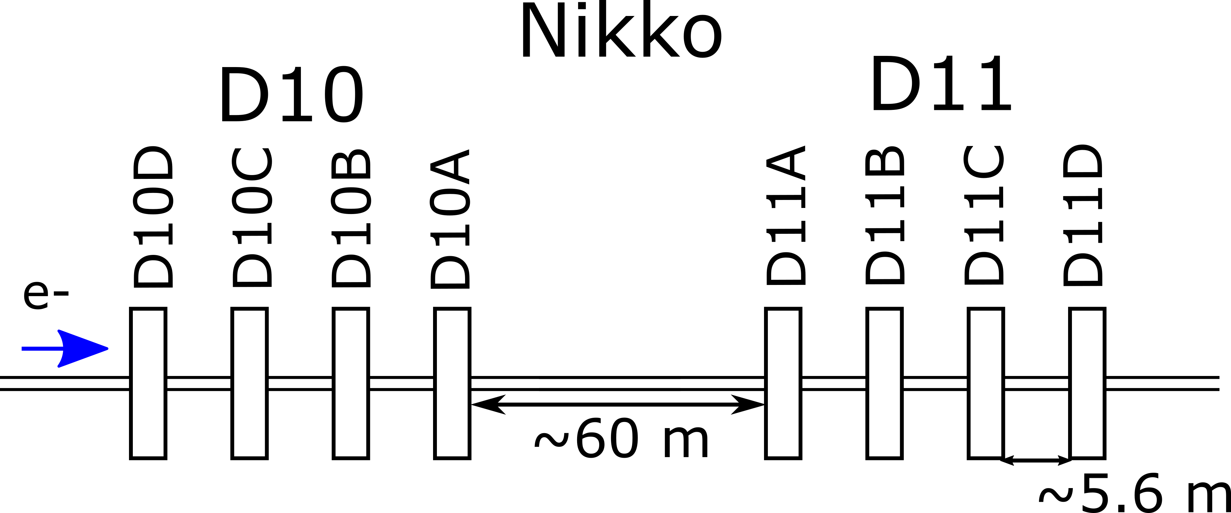

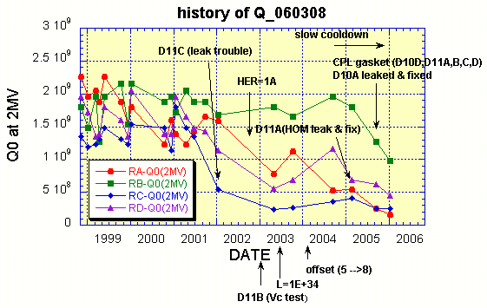
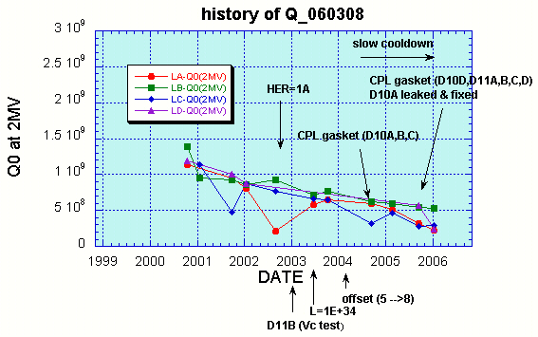
Degradating of $Q_{0}$ from KEKB era
Left side
Right side
T. Furuya
T. Furuya
From the KEKB operation, the performance gradually degraded with time.
There was a leak trouble, and a gasket was changed to change the coupling of the coupler, However, the performance was not greatly affected.
The cause of Q degradation seems to have occurred due to contamination of particles.

Slide 8
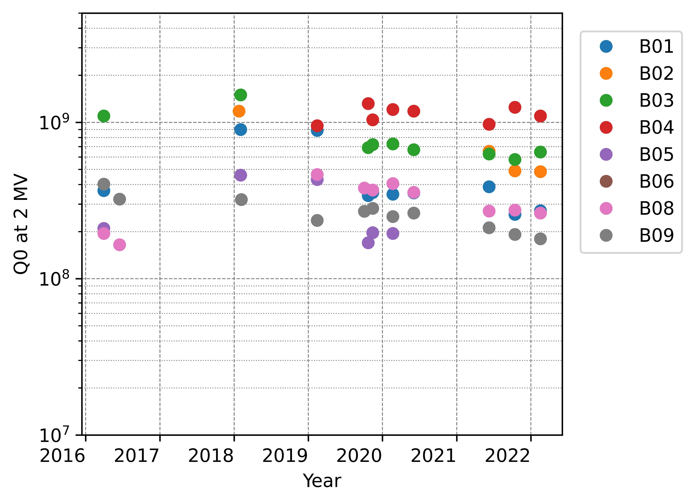

Degradating of $Q_{0}$ during SuperKEKB era
Although there is a tendency of performance deterioration even in this SuperKEKB era,
It is not a very serious.
However, x-ray level increase over time.

Slide 9
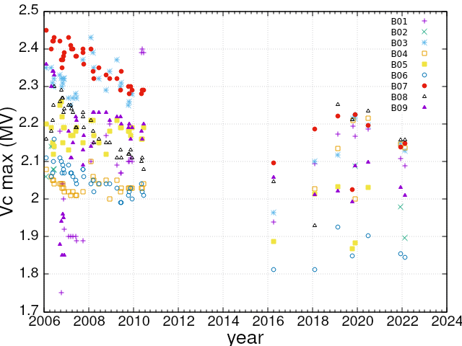
Degradating of Vc during SuperKEKB
KEKB era
SuperKEKB era
Maximum accelerating gradient also degraded with field emission over time.
2 MV (8.23 MV/m) is design require cavity voltage for SuperKEKB. Operating gradient is from 1.35 to 1.5 MV.
This degradation did not affect to operation.
RF aging (~a few hours) every two weeks maintenance is effective to keep performance.

Slide 10
Cavity leak and HHPR method
The degradation did not stop operating the accelerator—however, some cavities leaked in 24 years of operation.
Disassembly and assembly of the cavity are performed using a portable clean booth. However, performance degradation sometimes occurs with such strong field emissions. It can not be unrecoverable by RF aging.
We are dealing with the degradation by replacing the cavity with a spare cavity to resume operating the accelerator.
The most effective solution is to disassemble all components and start over with the surface treatment and clean assembly. However, it is very hard work in term of time and money.
The Horizontal High Pressure System developed at SuperKEKB is capable of HPR with the cavity installed in the cryostat without disassembling of cavity.
HHPR method allows reduced dead time and quick resume operation.
Spare
cavity
Replace
HHPR
Take out

Slide 11
Horizontal High Pressure Rinsing (HHPR)
If the cavity needs to be HPRed as usual, all components, including the cryostat, must be removed.
Horizontal high pressure rinsing can be applied by simply removing the beam pipe and the coupler port.
The reliably effective treatment of high pressure rinsing can be applied without reassembly of the module.

Slide 12
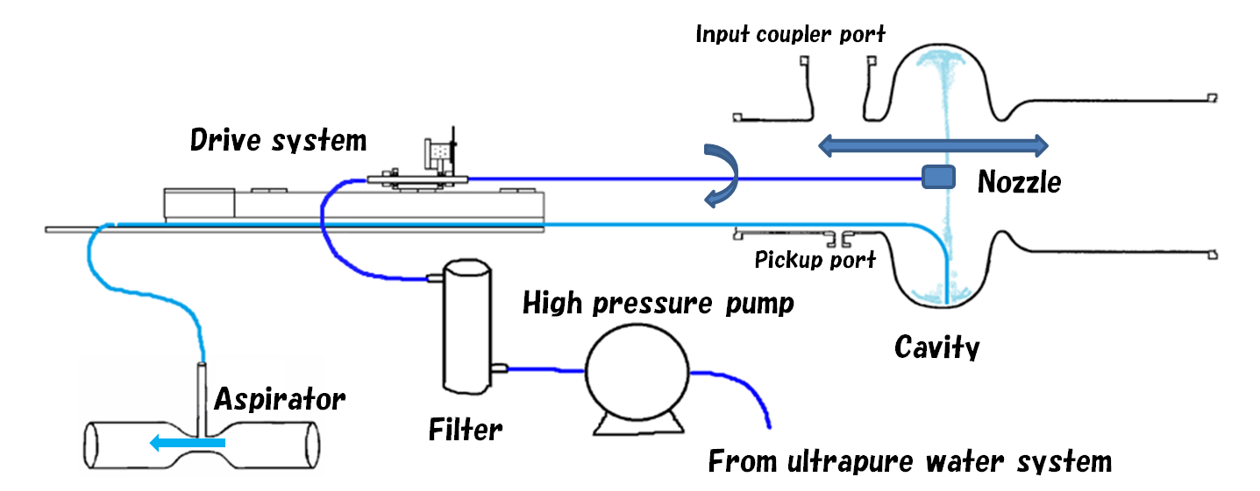
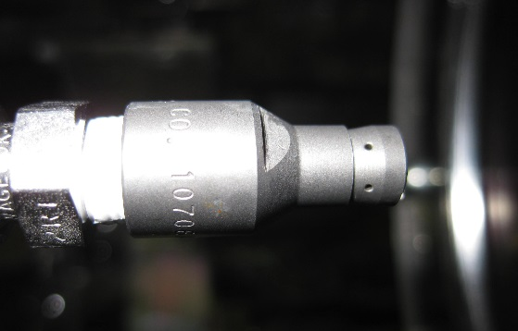
Horizontal High Pressure Rinsing (HHPR)
In the HHPR system of SuperKEKB, an HPR nozzle is inserted from the beam pipe, and cleaning is carried out using ultrapure water with 7 MPa.
The nozzle has six holes (angle is 60°) and shoots water laterally at little.
Nozzle can move from equator to both iris (movable range is +/- 200 mm)
The dirty water in the cell is pumped using aspirator.
The cleaning time was 15 min, and the drainage volume was ~120 L.
A clean booth (<0.3 um particle) used for assembly.
HHPR has been performed for three cavities used for operation
HHPR can focus on iris of the cavity
HHPR Parameters
Water Pressure | 7 MPa
Nozzle | φ0.54mm x 6
Driving speed | 1 mm/sec.
Rotation speed | 6 deg./sec.
Rinsing time | 15 min.
Stainless Steel Nozzle

Slide 13
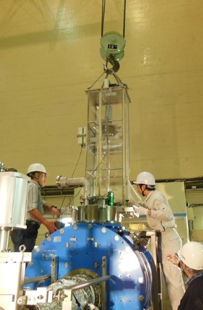
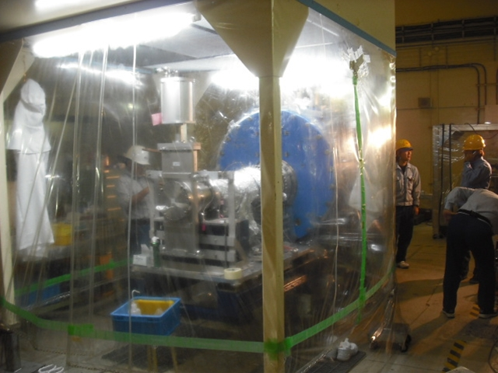
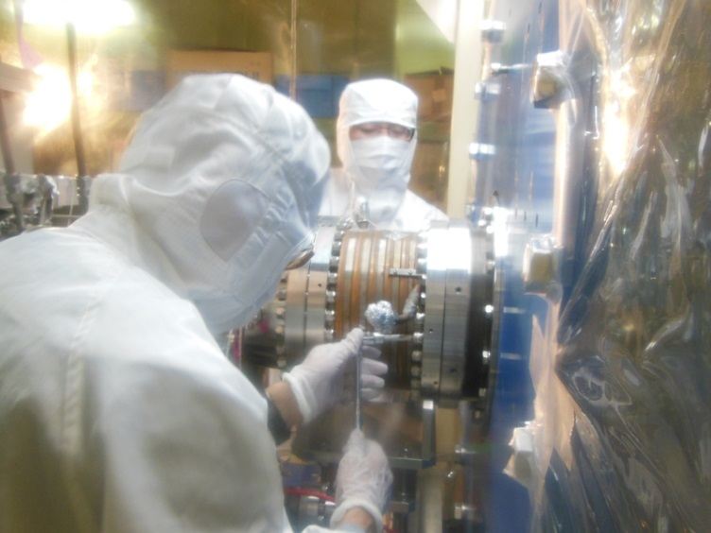
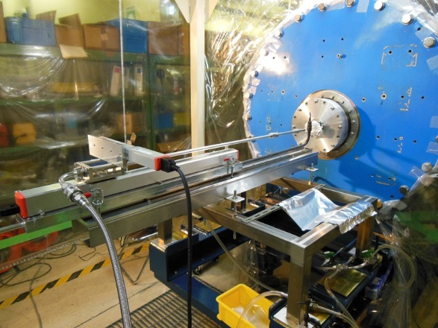
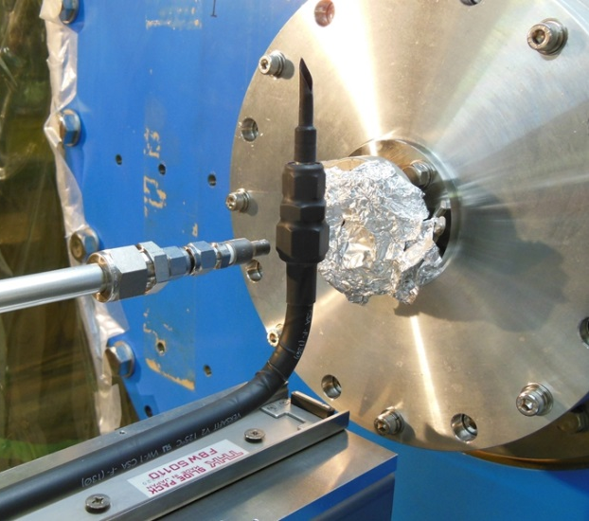
Horizontal High Pressure Rinsing (HHPR)
Removing Coupler
Removing HOM dampers and vacuum system
Before HHPR, input coupler and HOM dampers were dismounted in a clean booth.
Setting HHPR Apparatus
Nozzle and Aspirator Head

Slide 14
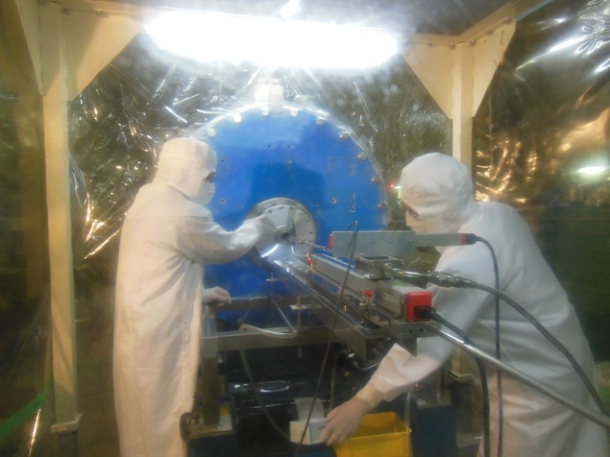
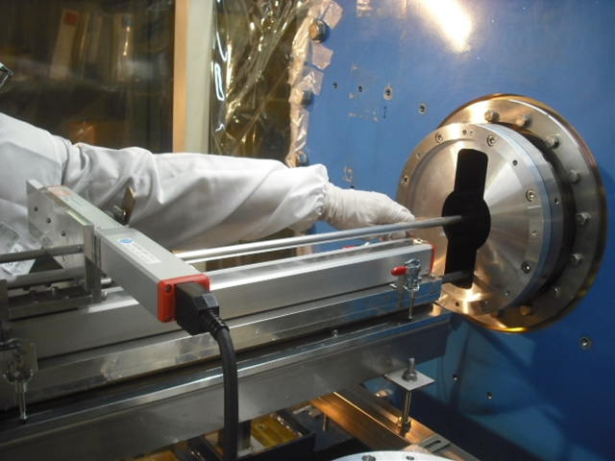
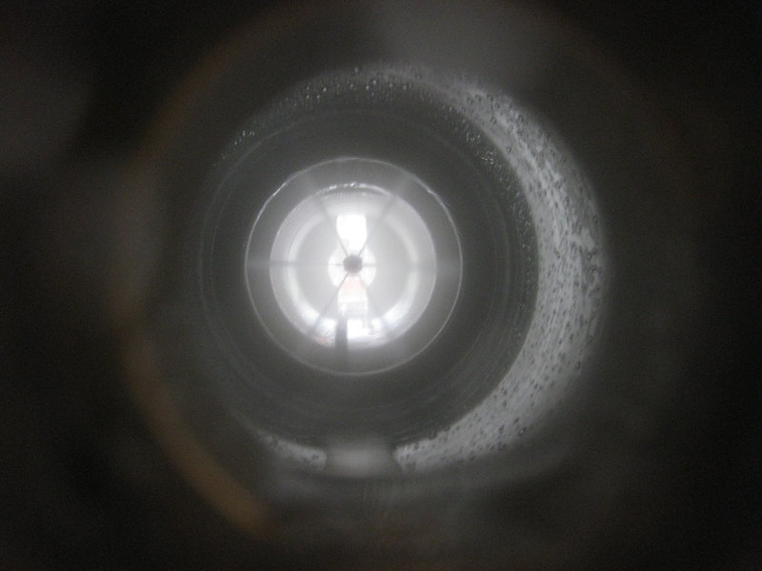
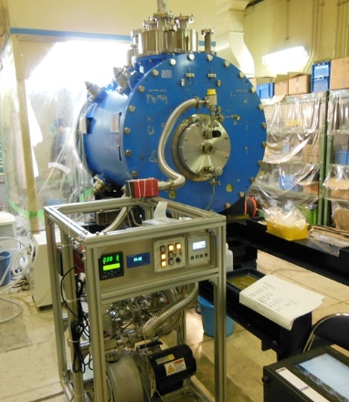
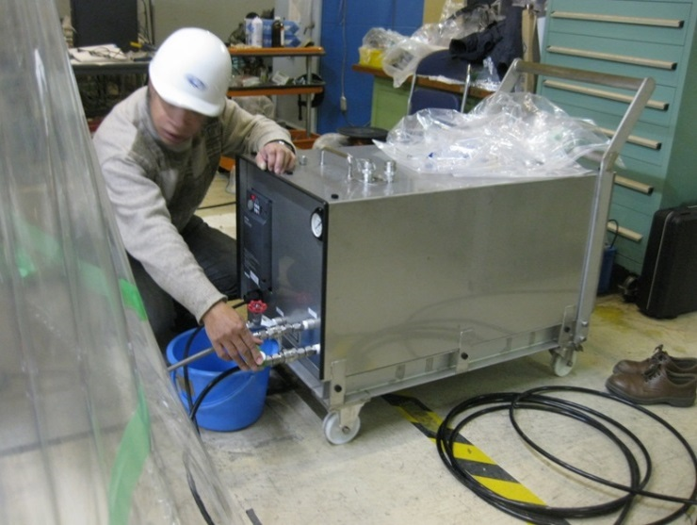
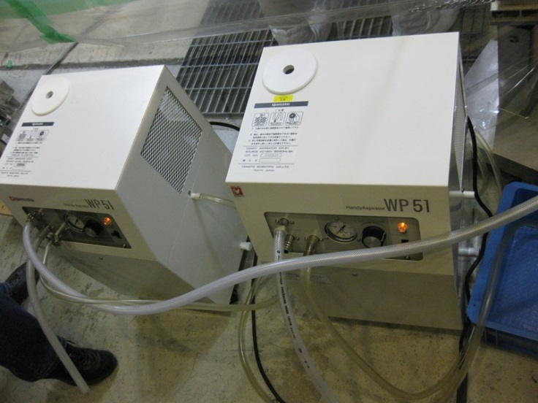
Horizontal High Pressure Rinsing (HHPR)
Opening Dummy Flange
Insert Automatic Drive Nozzle
Rotating Water Jets
Cavity was dried up by evacuation before setting the coupler and HOM dampers.
High Pressure Water Pump
Aspirator Pumps
Evacuation after HHPR

Slide 15
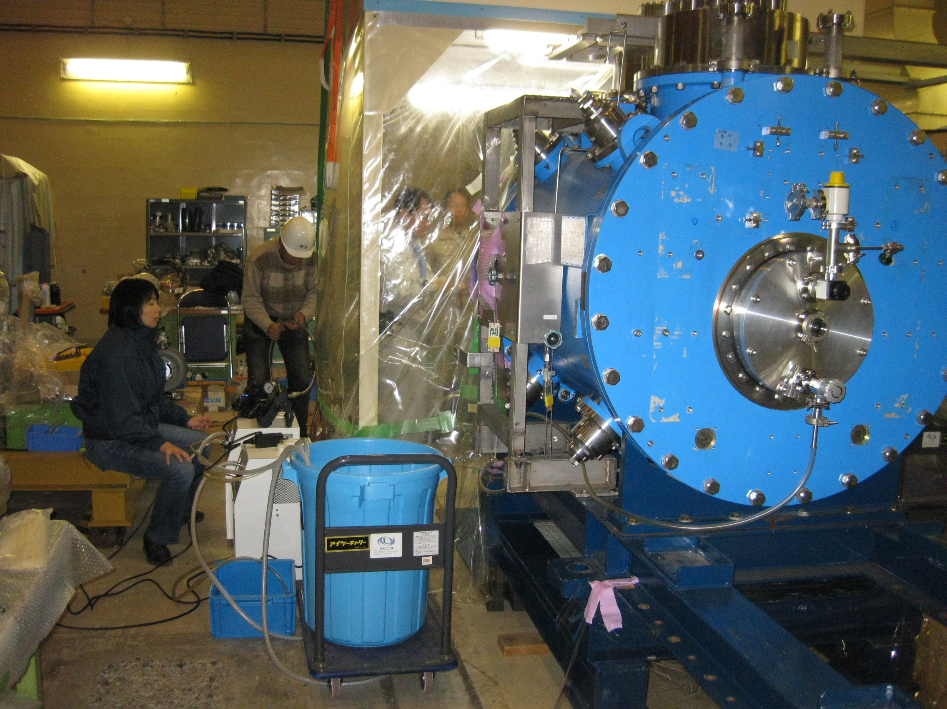
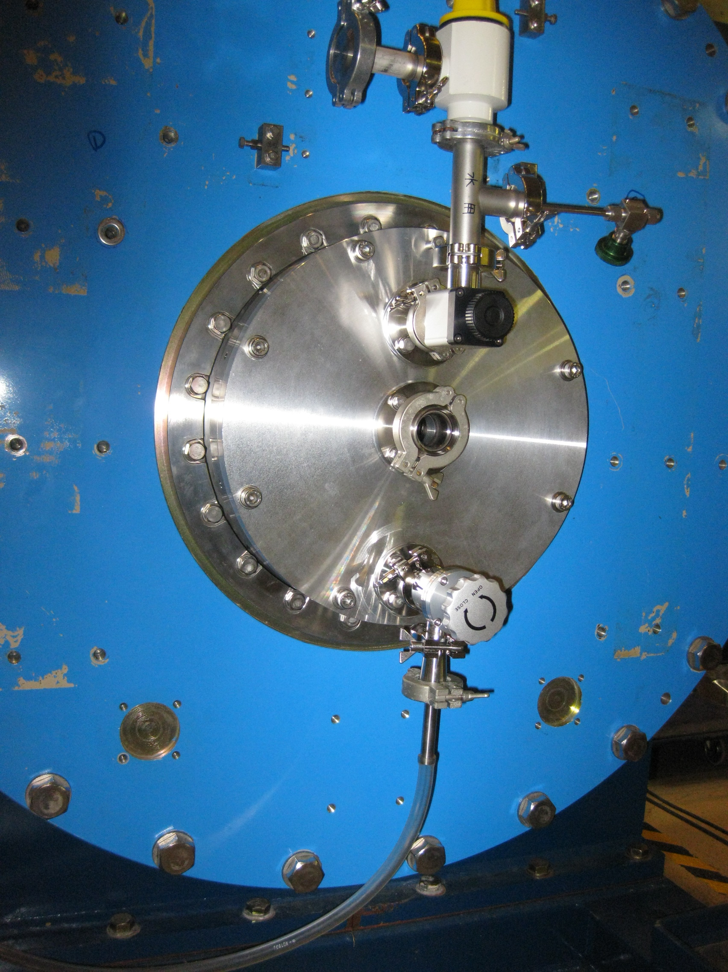
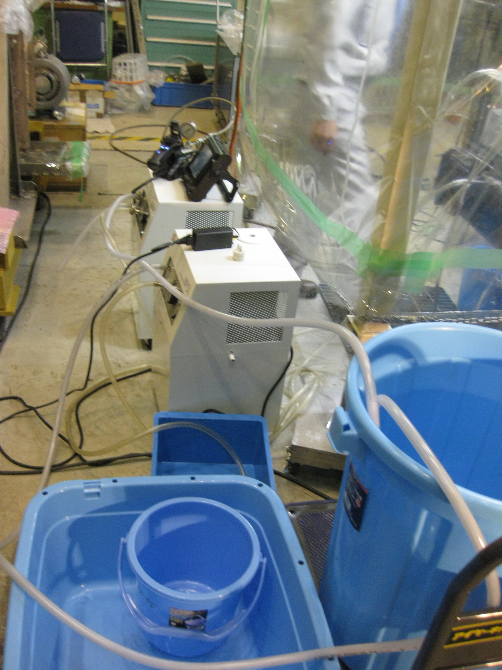
Horizontal High Pressure Rinsing (HHPR)
Water draining from LBP side

Slide 16
HHPR Cavity History
we have done this HHPR process for three cavities
B03
  He leak -> Repairing (Particle contamination) -> Horizontal test (HT) -> HHPR
  -> HT -> Tunnel
B04
  Accidental air induction -> HHPR -> HT -> Tunnel
B02
  Accidental air induction (little) -> HHPR -> HT -> Tunnel
The cause of the degradation of …
These cavities have been found to be contaminating particles during repair or due to atmospheric intrusion.
High pressure rinsing is the most effective and direct solution of field emission due to particle.
These cavities are recovered and install to the tunnel and operation.

Slide 17
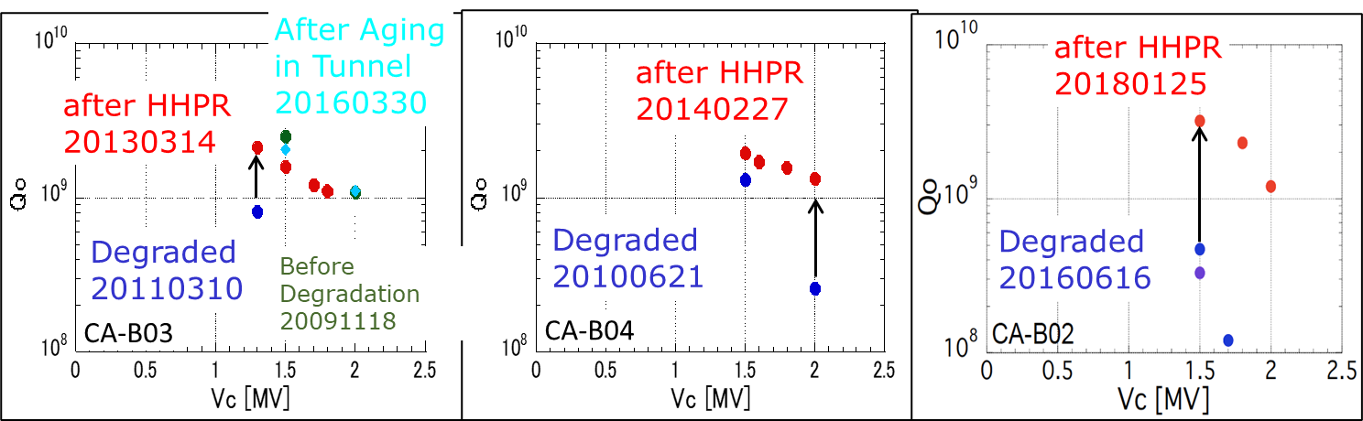
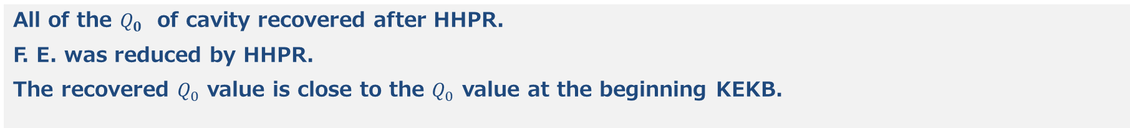
Cavity Performance Recovery
All of the $Q_{0}$ of cavity recovered after HHPR.
F. E. was reduced by HHPR.
The recovered $Q_{0}$ value is close to the $Q_{0}$ value at the beginning KEKB.

Slide 18
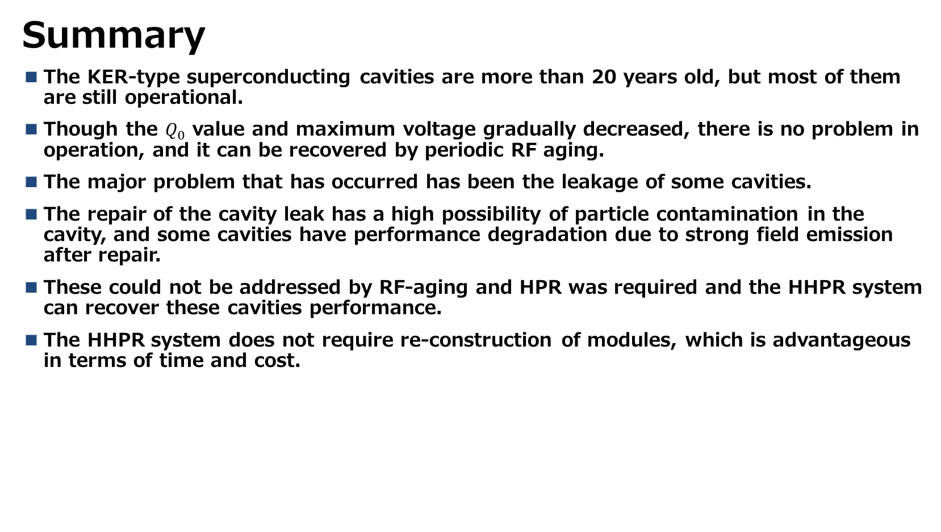
Summary and Future Plan
Summary
The KER-type superconducting cavities are more than 20 years old, but most of them are still operational.
Though the $Q_{0}$ value and maximum voltage gradually decreased, there is no problem in operation, and it can be recovered by periodic RF aging.
The major problem that has occurred has been the leakage of some cavities.
The repair of the cavity leak has a high possibility of particle contamination in the cavity, and some cavities have performance degradation due to strong field emission after repair.
These could not be addressed by RF-aging and HPR was required and the HHPR system can recover these cavities performance.
The HHPR system does not require re-construction of modules, which is advantageous in terms of time and cost.

Slide 19
Summary and Future Plan
Future Plan
HHPR applying to backup cavity.
HHPR without coupler removal
  There is a danger of particle contamination when the coupler is removed, and the coupling may be changed.
  We already tested “wet” coupler aging test.
  １）Coupler and ceramic RF windows set to test-stand in wet condition
  ２）Vacuum drying, no baking
  ３）Coupler pass the 800 kW P_{tr} RF aging. (pre-aging with bias voltage of ±2kV up to 150kW in total reflection
Compact HPR system capable of HPR in tunnels
  A more simplified HHPR system would benefit from reduced risk of failure and savings in time, so it is planned to be upgraded.

Slide 20
Appendix

Slide 21

Can HHPR recover the $Q_{0}$ degradation over time?
If the cause was contamination of particles, it can be recoverable by HHPR.
KEKB-type cavity have not experienced HHPR since beginning of KEKB.
To know what the cause is, we need to study the material and size of the particles.
D11D (end of right side of cavities) recently especially performance degradation is large
  Without leak, accident
We plan to apply the HHPR to D11D in the tunnel.

