Slide 1

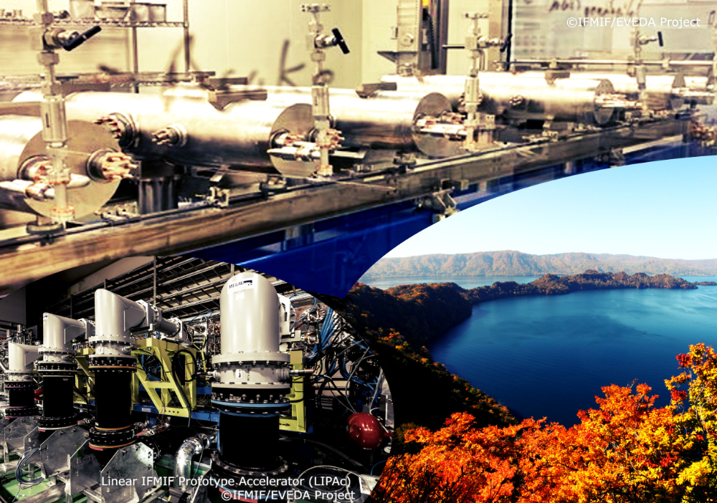

Introduction talk in
TTC-2022 Aomori meeting
Eiji Kako (KEK, Japan)
TTC Chair
October 11th , 2022

Slide 2
Mission of TESLA Technology Collaboration
Mission of the TESLA Technology Collaboration
The mission of the TESLA Technology Collaboration is
to advance SCRF technology R&D and related accelerator studies across the broad diversity of scientific applications.
to keep open and provide a bridge for communication and sharing of ideas, developments, and testing across associated projects.
To this end,
The TTC will support and encourage free and open exchange of scientific and technical knowledge, expertise, engineering designs, and equipment.
The TTC organizes regular collaboration meetings where new developments are reported, recent findings are discussed, and technical issues concluded.

Slide 3
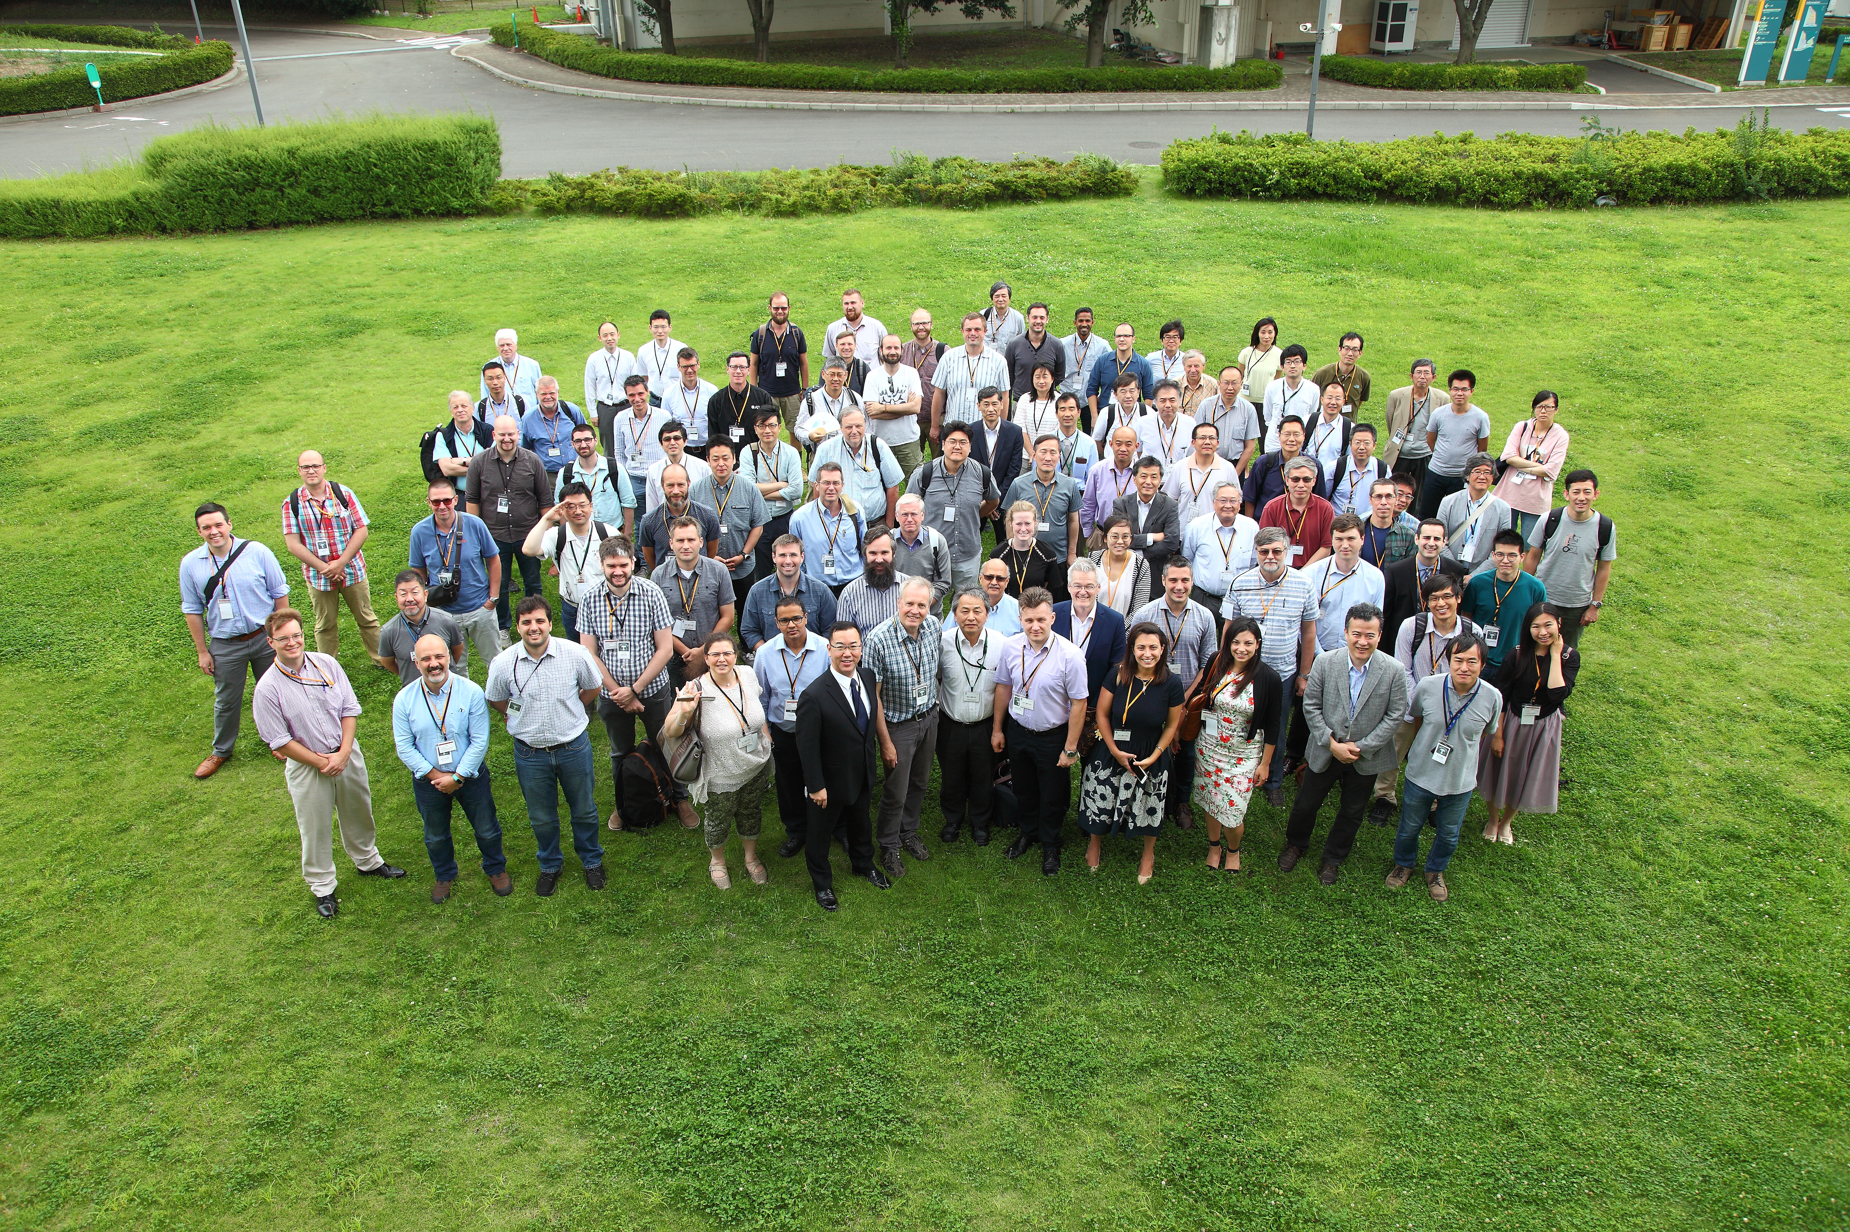
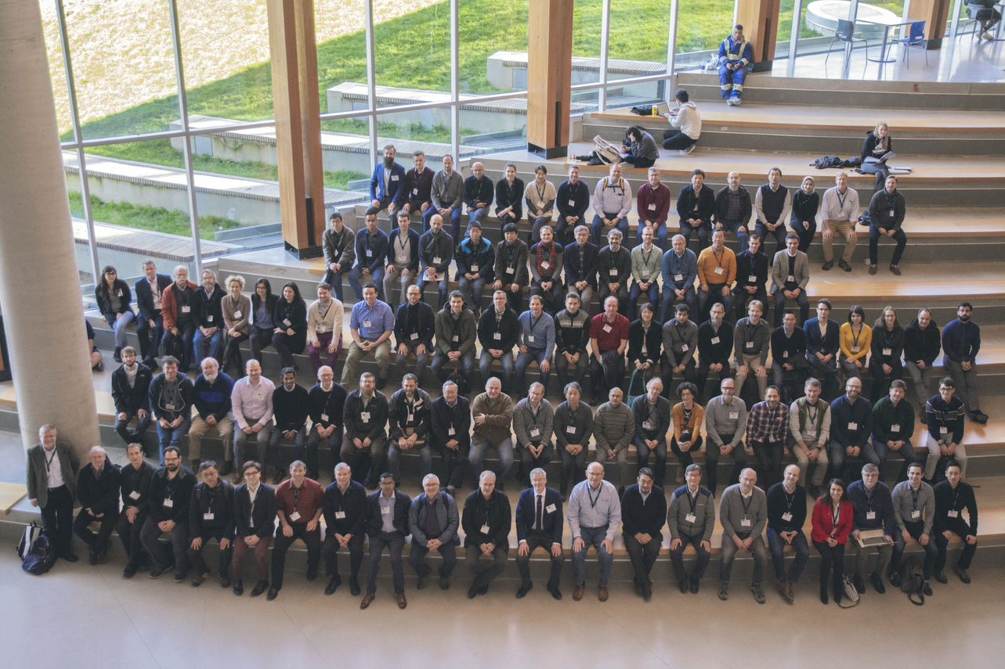
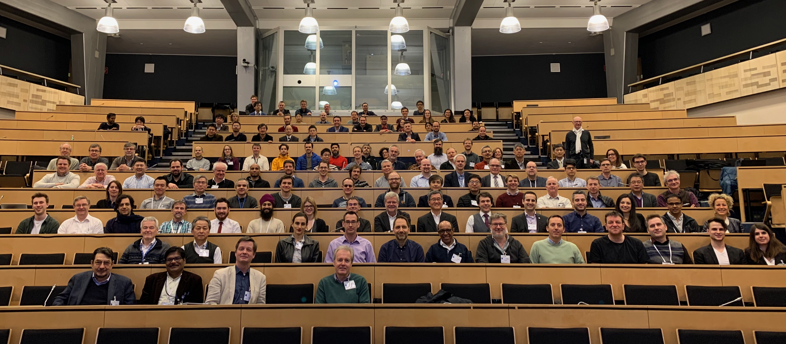
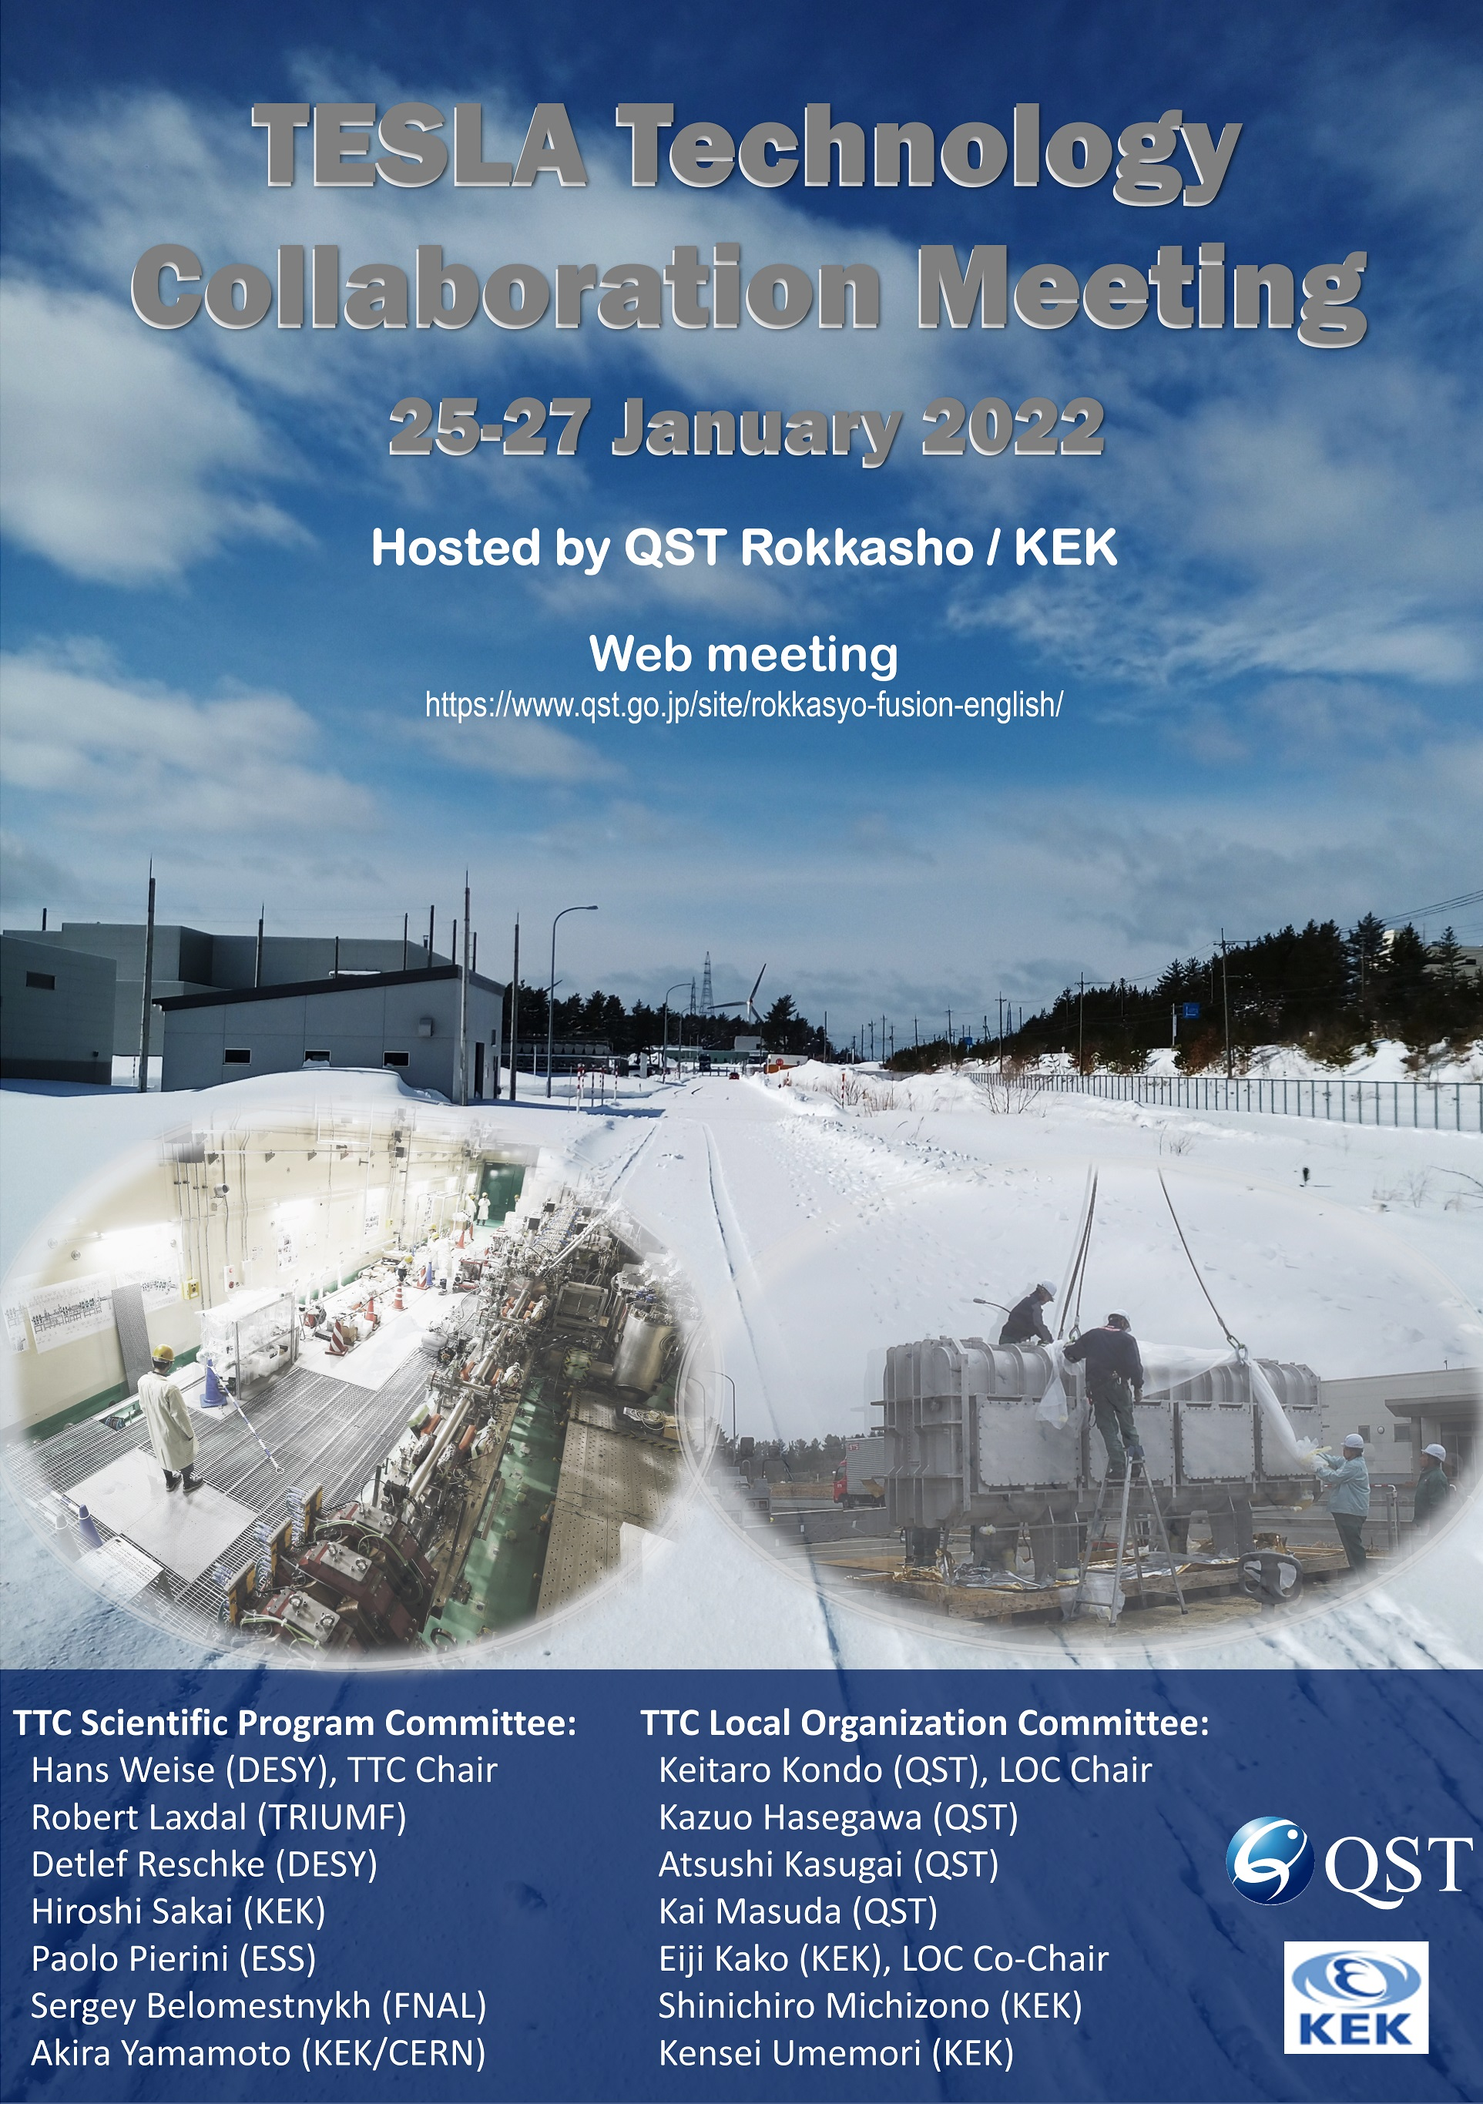
Revival of in-person meeting
TTC-2018 at RIKEN
TTC-2019 at TRIUMF
TTC-2020 at CERN
Now, TTC-2022 at Aomori
is an in-person meeting
with face-to-face discussions,
(in a small meeting room
without microphone.)

Slide 4
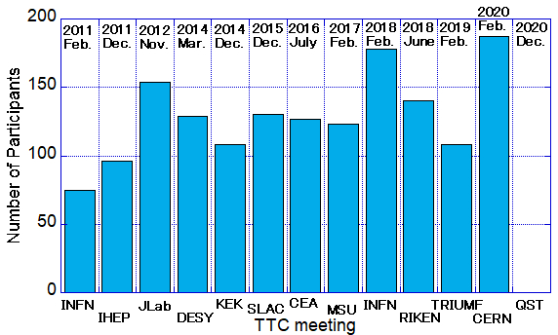
Number of participants in TTC
2021
Jan.
2022
Jan.
250
2022
Oct.
125
In-person
Number of participants
Virtual
DESY
QST
KEK
QST
CERN

Slide 5
Participants in TTC-2022 Aomori
Japan
50
Participants : 114
Countries : 10
United States
26
Germany
14
KEK
Industry (21)
South Korea
9
Italy
5
QST
France
4
non TTC lab (11)
RIKEN
Canada
3
JAEA
Sweden
1
Others
(1 person/lab)
DESY
Switzerland
1
BNL
JLab
China
1
TRIUMF
FNAL
SLAC
INFN
IBS

Slide 6
Invited talks in plenary sessions
SRF accelerators over the world
Construction
Operation
Euro-XFEL
Special Seminars:
Nb production
ADS in Japan
PIP-II
Hot topic discussion:
Global He resource
Workshop summary report on SRF:
Snowmass/European HEP
Thin film WG/WS at JLab
ERL2022 WS at Cornell

Slide 7
TTC-CB remote meeting on May 25th
21 Participants:
Eiji Kako (Chairman, KEK),
Bob Laxdal (meeting notes, TRIUMF),
Jie Gao (IHEP), Christian Pira (INFN-LNL),
Narahiko Sakamoto (RIKEN),
Jens Knobloch (HZB),
Catherine Madec (CEA),
Keitaro Kondo (QST),
Guillaume Olry (IJCL),
Felix Schlander (ESS),
Roger Ruber (Uppsala U),
Hitoshi Sakai (KEK), Camille Ginsburg (Jlab), Sang-Ho Kim (SNS), Hans Weise (DESY), Carlo Pagani (INFN-LASA),
Shin Michizono (KEK), Tianhuan Luo (LBL), Sergey Belomestnykh (FNAL),
Mike Kelly (ANL),
Georg Hoffstaetter (Cornell)

Slide 8
TTC statement and action
TTC statement and action against the Russian government's invasion of Ukraine
Dear TTC collaborators,
Further to our statement of March 8th we append the action shown below.
We condemn the military aggression by the Russian government against Ukraine and express our deep dismay at this unacceptable cruel behavior and our grave concerns about its impact. Such tragic events should never happen in the world. Our thoughts go to all the people suffering from the invasion of Ukraine, and to them we extend our deepest sympathy and support in this difficult time. As a peaceful, non-political scientific collaboration we stress the need for this war to end and ask all our TTC colleagues to support the peaceful resolution of the crisis.
While we continue to support the global scientific exchange between SRF technology experts and teams, due to the severity of the situation we are suspending participation of Russian institutes in TTC sponsored events and collaborations, until further notice.
March 11th, 2022
Eiji Kako, Bob Laxdal, Hans Weise, Paolo Pierini, Sergey Belomestnykh, and Akira Yamamoto
(TTC Chairs and Executive Committee members).
This TTC statement was sent to around 200 TTC collaborators.

Slide 9
New TTC Executive Committee
TTC chair | Eiji Kako (KEK)
TTC deputy | Bob Laxdal (TRIUMF)
Regional representative (Europe) | Hans Weise (DESY) Catherine Madec (CEA) *
Regional representative (North America) | Sergey Belomestnykh (FNAL) Camille Ginsburg (Jlab) *
Regional representative (Asia) | Akira Yamamoto (KEK) Gao Jie (IHEP) *
* new EC member
To strengthen the support of regional SRF activities and broaden reporting on overall SRF progress.
The EC members will attend the CB and TB meetings, as observers.

Slide 10
Updated TTC Technical Board
RF and tuning
F. Gerigk (CERN)
A. Wheelhouse (STFC)
C. Hovater (JLab)
Cryomodule and cryogenics
T. Arkan (FNAL)
K. Jensch (DESY)
J. Mammosser (ORNL)
S. Aderhold (SLAC) *
S. Barbanotti (DESY) *
A. Neumann (HZB) *
Integration and operation
M. Liepe (Cornell)
E. Harms (FNAL)
J. Branlard (DESY)
Honoris causa (observers)
C. Pagani (INFN)
M. Ross (SLAC)
O. Napoly (CEA)
H. Padamsee (Cornell)
W.-D. Moeller (DESY)
P. Pierini (ESS)
Co-chairs
D. Reschke (DESY)
H. Sakai (KEK)
Cavity and couplers
S. Calatroni (CERN)
R.L. Geng (ORNL)
J. Hao (PKU)
Romanenko (FNAL)
K. Umemori (KEK)
J.Y. Zhai (IHEP)
D. Longuevergne (IJCLab)
Z. Conway (BNL)
N. Sakamoto (RIKEN)
L. Monaco (INFN Milano) *
L. Popielarski (FRIB) *
M. Martinello (SLAC) *
P. Dhakal (Jlab) *
Improvements:
Gender balance
Laboratory balance
Age balance
Total (w/o observer) = 27
(EU=10, NA=12, Asia=5)
Gender balance = 4/27
* new TB member

Slide 11
Activities of TTC Working Groups
New chairs of TTC High-Q/High-G Working Group:
Martina Martinello (SLAC)
Kensei Umemori (KEK)
Akira Miyazaki (Uppsala U)
→→→ Summary talk in WG-1
TTC High-Q/High-G WG remote meeting was held on May 5th and Sept. 8th, 2022.
Chairs of TTC Thin Film Working Group:
Marc Wenskat (U. Hamburg)
Sebastian Keckert (HZB)
→→→ Summary talk in plenary session
TTC Thin Film WG remote meeting was held on Aug. 24th, 2022.

Slide 12
at TTC meeting:
Please enjoy insight discussions in WGs on cutting-edge SRF technologies.
Thank you for your attention!

