Slide 1
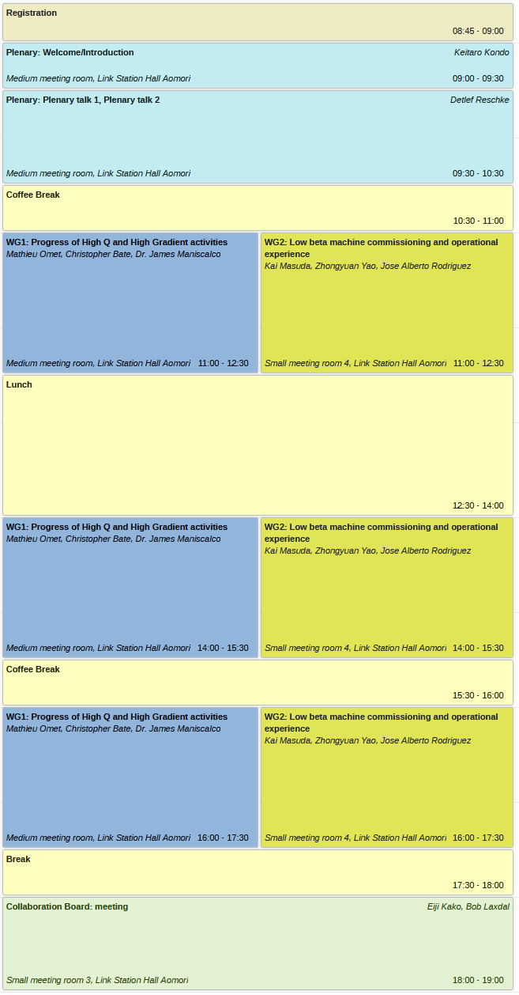
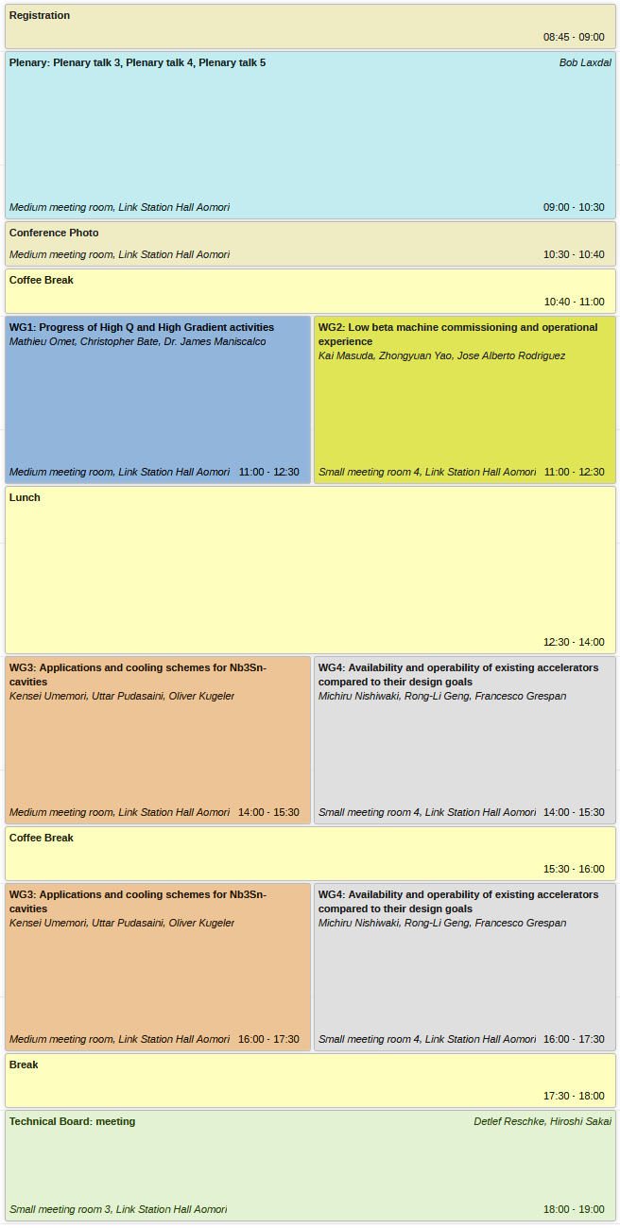
WG1 Summary
Conveners:
Mathieu Omet (KEK),
Christopher Bate (DESY),
James Maniscalco (SLAC),
SPC: Detlef Reschke (DESY)

Slide 2
WG1: Progress of High Q and High Gradient activities
WG description:
The scope of this working group is to discuss the most recent results related to pushing Niobium towards higher Q and higher gradient. A summary report of the latest two TTC High-Q/High-G WG meetings held in May and August should be presented as an opening talk. Advances in understanding material evolution under established but also newly developed heat treatments, such as N-Infusion, N-Doping, Low-T Bake and Mid-T Bake, the differences and advantages of low-temperature EP compared with conventional EP, and current results on flux-expulsion studies should be discussed. The working group should also discuss methods/results towards higher gradient performance for future pulsed-mode accelerators. Topics should include the achievable maximum gradient, the yield rate of high gradient, reliable cavity fabrication methods, cost reduction of niobium sheets and new ideas for achieving higher gradients. The presentations and discussion should include results from both elliptical and TEM mode cavities. The interplay between theoretical approaches and experiments should be emphasized. Results from sample and cavity studies (different cavity types and frequencies) which could help to establish a core understanding should be included.
4 Sessions and 16 talks
4 from Asia, 7 from America, 5 from Europe

Slide 3
TTC high Q/high G WG report 2022/10/
WG convenor: Kensei Umemori, Martina Martinello, Akira Miyazaki
In addition to results of May 5 and Sep 8 new results from IHEP (Peng Sha) on two 650MHz cavities after cold EP + low T-bake (1-step + 2-step with one cavity each) is presented; moreover both cavities have been mid-T baked in addition
Discussion:
Akira Yamamoto: Q1 about +5MV/m for LCLS2-HE => James: lower T for EP; 2-step furnace treatment => more in James talk
Kenji: Q1 about FE onset at CEA 650MHz: dark current is measured?; Enrico: No
Q2 about hydrogen in vertical EP: Enrico will show in his talk

Slide 4
INFN-LASA Activities on SRF cavities
Michele Bertucci on behalf of SRF team at INFN-LASA
Look back to EuXFEL and ESS
Main future activity is low beta cavities for PIP-II => More challenging than ESS specs.: Higher Q required!
Several 650MHz single-cell and five-cell cavities fabricated and first baseline tests done; close collaboration with Fermilab
Comparison of different surface treatments with EP+120C as baseline
First results look good and promising => values on slides!!!!

Slide 5
Recent results on single cell
704MHz cavity
E. Cenni [CEA PARIS-SACLAY IRFU/DACM/LISAH]
Last years dedicated to ESS activities
Now back to "old" project: vertical EP; cavity cooled with water from outside
Tests on HB 704 MHz single-cell
Collaboration with KEK; EP is cold (<15C); Ninja-cathode is used; low 0.5% HF content!!!;
For VT improved magnetic shielding applied
VT in different surface treatment conditions done and compared;
At 2K all low-field Q >3e10^10; gradients >34 MV/m; partially stopped due adminsitrative reasons not to spoil FE => re-rinse with HF; Final gradient >40MV/m
Next:
a) reset on single-cell; apply 2-step bake + effect of cooling speed
b) apply vertical EP to 5-cell cavity

Slide 6
LCLS-II-HE: High Q0 and High Gradient in Mass Production
James Maniscalco, LCLS-II-HE SRF Engineer (SLAC)
For HE upgrade 21 MV/m at 2.7e10^10 required in module; 23 new cryomodules; test qualification requirements see slide 6; VT gradient required is >23MV/m
Improve Doping recipe for gradient and more narrow distribution of cavity performance
=> bulk EP1, HT treatment, bulk EP2 (final cold), Doping 2/0, Fine EP (cold)
No FE is required up to quench
Q(E) plot summary on slide 7; 30% require re-rinse due to FE;
Gradient improved by 5 MV/m compared to LCLS2; few cavities below requirement
Improvements caused by :
cold EP
limited annealing time during doping (Folie 11) => less nitride defects
separating heat treatment steps for flux expulsion (up to 950C) and doping
sorting material by flux expulsion and respective heat treatment (slide 13)
better control of furnace process (RGA)
Field emission (slide 16): recurring issue; HPR often successful; regular site visits necessary and helpful
Discussion:
FE, NCR's, re-rinse procedures, ..
flux expulsion and related heat treatments (backup slide 24)
7/9pi mode excitation: goal is to avoid excitation; observed in ~50% of cavities; fast measurement necessary; builds up in few seconds; may cause early quench

Slide 7
Large Grain Cavity R&D
Mathieu Omet (KEK)
3-cell LG R&D for ILC cost reduction program
Strong degradtion quench due trapped flux but cureable by T-cycling
Similar perf. as FG!
Exceeded ILC specs.!
Discussion:
Question to community: Experience with negative pressure inside cavity?; Large degr. why so much FE?
General obs. for FG and LG and mg, will they work for future projects? => Yes looks very promising, will see if manage to repeat these performances
Can the degradation be repeated after thermal cycling? => Yes for 3-cells it has been shown
What baking Temperature for 9-cell? => 900°C
Differences between FG, MG, LG GB's? More storage of seeding? Therefore flux pen. is most important property of gb's?
Has anyone done tunnel spec to see diff. of flux trap on LG? -> AMR sensor meas.. done (going to be shown in Session4 on behalf of Felix Kramer)
welding issues for these cavities? Shape accuracy of half cells? => basically good symmetry, no affections on cavity performance
About the neg. pressure => Detlef(press control)
At DESY we don't see degr. of field, we see at least 1nOhm of Rres which is not the case here for KEK, interesting why that is?

Slide 8
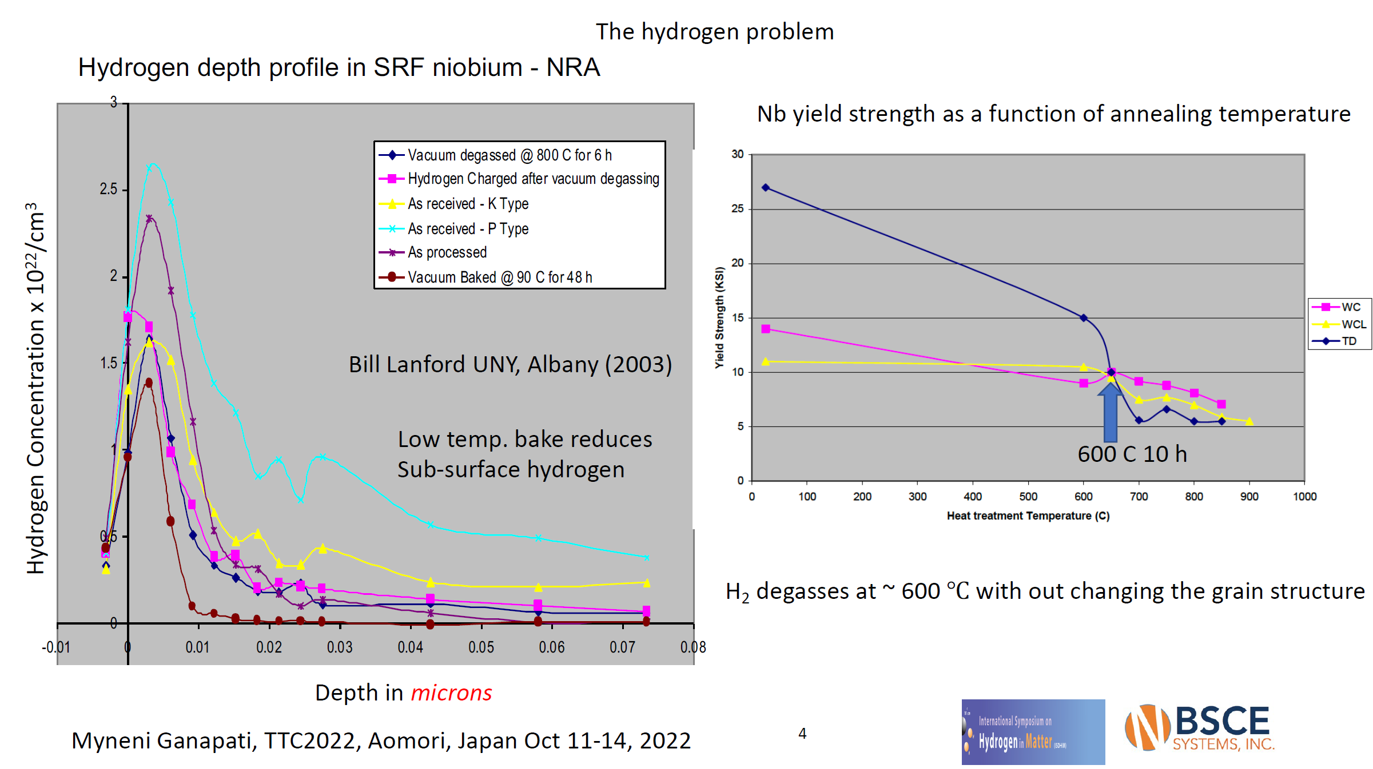
MG Nb technology for achieving high Q₀ and E_{acc} sustainably
Ganapati Myneni (JLab)
Summary of pro's and con's of FG, MG and LG material
Latest advances in medium-grain Nb SRF cavity production => main quench reason for RRR~100 cavities from Jlab were weld defects
Lower H by treatments is the reason for higher q's (shown by NRA meas. on samples)
650°C proposed as solution -> BUT we need clean furnaces! It lacks in our community!

Slide 9
2-step baking & mid-T furnace baking of 9-cell SRF cavities
Ryo Katayama (KEK)
Non-uniform heating by heating bands during 75°C suspected for no perf. Enhancement => reducing to 70°C "solved" the problem

Slide 10
medium temperature treatments of SRF cavities at DESY
Detlef Reschke for the SRF team of DESY and Uni Hamburg
Discussion:
James: Caps were the gas flow through caps characterized? => They were mainly applied to Zanon treatments, was certain factor smaller then the flange so 8mm hole
Benefits of baking in argon? => in old paper was just 120C and not the experiences from the EuXFEL baking, so it was just a try if one can make it simpler without vacuum chamber
Ganapati: What if one purges with argon instead so vacuum to argon? => With this chamber not possible, just overpressure
Material of the caps? High RRR? => Have to check, made of Nb sheets
Space between caps and flange? => No since just one on top, also no sticking problem at 300°C but at 800°C a little bit
What recommendation for future projects can be made?
=> question for technical board
Kensei:
=> technique to eliminate magn. field is now optimized, high Q is possible as LCLS ii shows; high gradients good solutions are still missing, mainly FNAL was most successful so far
=> more experiments on parameter space of time and temperatures for doping processes

Slide 11
Analysis of Low RRR SRF Cavities
Katrina Howard (UChicago), Daniel Bafia, Young-Kee Kim, Anna Grassellino
Discussion:
Q: What applications for lw RRR?
A: This is more R&D - understanding what impurities are present in low RRR material and searching for potential new dopants to study.
Q: Tantalum has not much impact on RRR? Did you do gas analysis?
A: I don't think we have done gas analysis.
Q: RRR comes from material sheet?
A: Yes, we did not measure it
Q: Would be interesting to see how RRR changes.
A: We will measure how MFP changes and do SIMS on samples.
Q: Material sheet from TD - normally gas component is beyond measurable range. What is dominant gas component?
A: It is tantalum. All others below threshold.
Q: Showed difference between R0 for low RRR and high RRR. Did you look at trapped flux sensitivity?
A: We have not taken that measurement yet, but experiments indicate that all difference in R is from R0 (slide 17)
Q: You should try intentionally trapping flux and measuring sensitivity.
A: So far the N-doped tests have been done in compensated field, but clearly some flux is still present.
Q/A: Would be interesting to see if sensitivity is different for diff RRR.
Q: All these 900 C high temperature annealing?
A: All 800 C, followed by bulk EP.
Q: Prior work by KEK measuring RRR100 cavities. RRR is very low on coated cavities. What is motivation for choosing RRR 61?
A: This was the cavity that was available!
Q: Slide 4 - these were done sequentially?
A: There was a big EP between LTB and N-dope.

Slide 12
Modeling O Diffusion During Nb Oxide Dissolution
Eric Lechner (JLab)
Discussion:
Q: Nb oxide model - how do you know that three layer model is correct?
A: We have done XPS studies - in some cases these are correct, in some cases no.
Q: Experimental confirmation of amount of pentoxide dissolved? How confident in your measurement precision?
A: You can't quantify always the same qty of oxygen when you probe different crystal orientations -> 20% uncertainty factor. Monocrystal would help this but is maybe not representative of a cavity.
Q: You may have overlooked experimental work done by Parvati
A: Yes, we are open to other models.
Q: Would like to ask about 2-step gradient. Is there an explanation for why 75 C needs to come before 120 C?
A: I wish I knew! Good question.
Q: What are the steps to explore the role of tailored diffusion profiles of impurities within the penetration depth?
A: Shorter times, maybe high Temp. & shorter time. Want to make surface as dirty as possible in a very thin layer.
Q: How accurate is model within this regime?
A: Needs to be tested with cavity results.
Q: Shorter times becomes more and more complicated. Furnaces are not good at acting on short time scales.
A: I agree, we need to find things that we can actually apply to cavities.

Slide 13
Development of Oxygen Doping Treatment for High Q₀
Hannah Hu (UChicago), Daniel Bafia, Young-Kee Kim
Discussion:
Q: You showed typical N doping and compared to O diffusion. There are many N doping recipes... many potential sources of behavior.
A: N doping is complicated because you can't remove the O. We are exploring these parameters because it is simpler and we have more control when there is just O.
Q: You discussed differences in the dips for N and O. To what extend do dips depend on the concentrations of N and O, and on grain sizes?
A: Can't speak to effect of grain sizes. Magnitude of dip is correlated with degree of anti Q slope, connected maybe to disordered superconducting layer. We would be interested in more directly comparing dip to concentrations.
Q: Bring 0.54 O doped closer to 1.31 -
A: Yes, we would be interested in doing this.
Q: Connection between dip and mean free path - correlated to concentration.
Q: In the double dip effect - influence of suboxide layer. Why not same after HF rinse, since HF resets the oxide?
A: Layer thicknesses are different after HF rinses.
Q: For how long do you do HF rinse?
A: Not sure.
Q: How much time between HF rinses?
A: We tested the cavity between the rinses, so maybe a month.
Q: N doping result - is Rres usually so flat as in Slide 7?
A: Different recipe from that in Katrina's talk.
Q: Partially refreshed oxide?
A: We think we did not do HF rinse for long enough.

Slide 14
Effect of cavity treatments on niobium oxide layers
Rezvan Ghanbari (UHamburg), on behalf of SRF R&D Team
Discussion:
Q: Does it mean that if I take a well performing mid T bake cavity, then do too much HPR, will I have negative impact on cavity?
A: Can't say exactly, but there is likely an optimal HPR amount.
Q: Could take a good mid T bake single cell, then do many HPR cycles and tests and more HPR cycles and tests after and see how performance changes.
Comment: I recall some study showing that oxide layer saturates at some point.
Comment: Sounds like a good exploratory experiment.
Comment: on the level of 6 or 12 HPR, does not change Q performance. Probably tricky to measure considering remanence.
A: Main point is not the oxide saturation - instead maybe thicker layer allows control over oxygen concentration in bulk.
Comment: I think Charlie Reece did a study of how much HPR is too much. Certainly leaving the jet in one spot ruins cavity performance.
Q: Want to do SIMS measurements after retreatments. What about XPS?
A: We think SIMS is more important.

Slide 15
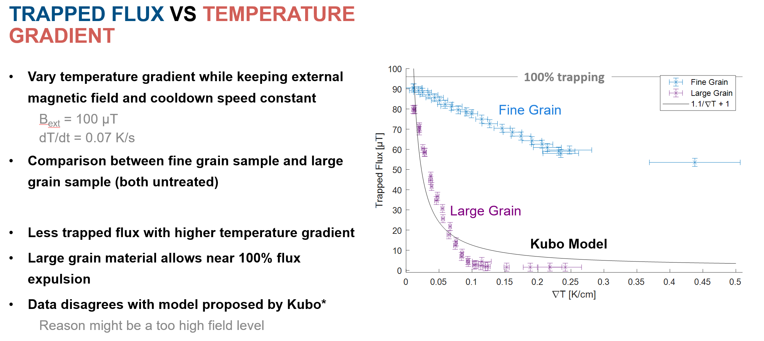
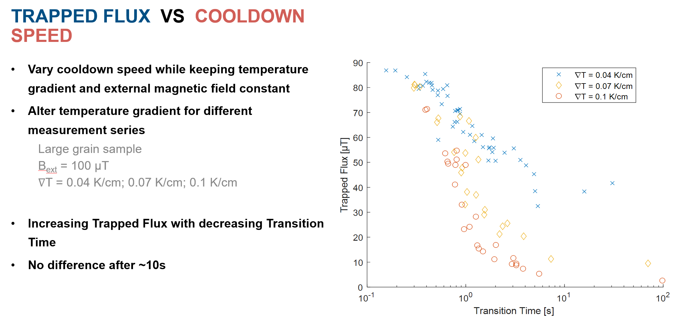
Dynamic flux trapping measurements in Nb samples
F. Kramer (HZB), S. Keckert, O. Kugeler, J. Knobloch
This presentation was given for a PhD student, who could not make it to the workshop.
Discussion:
Q1: Slide 8. Was the FG material heat treated?
A1: Yes, it was treated at 800 degC.
Q2: Different samples for FG (at different temperatures). Regarding KEK, LG is not perfect, but better as FG. But if FG sample is treated correctly, it is as good as LG.
C3: What is the definition of LG of the samples?
A3: The sample consists of only one grain. They tried also a sample with one grain boundary. It shows the same behavior.
Q4: Some parts are already magnetized. Are you checking degaussing in CM?
A4: We can try it out.
Q5: The sample is flat. The cavity is curved. Is it possible to compare the data (sample/cavity)?
A5: They checked the comparability. As long one can derive some linearity, then one can deduct some result.

Slide 16
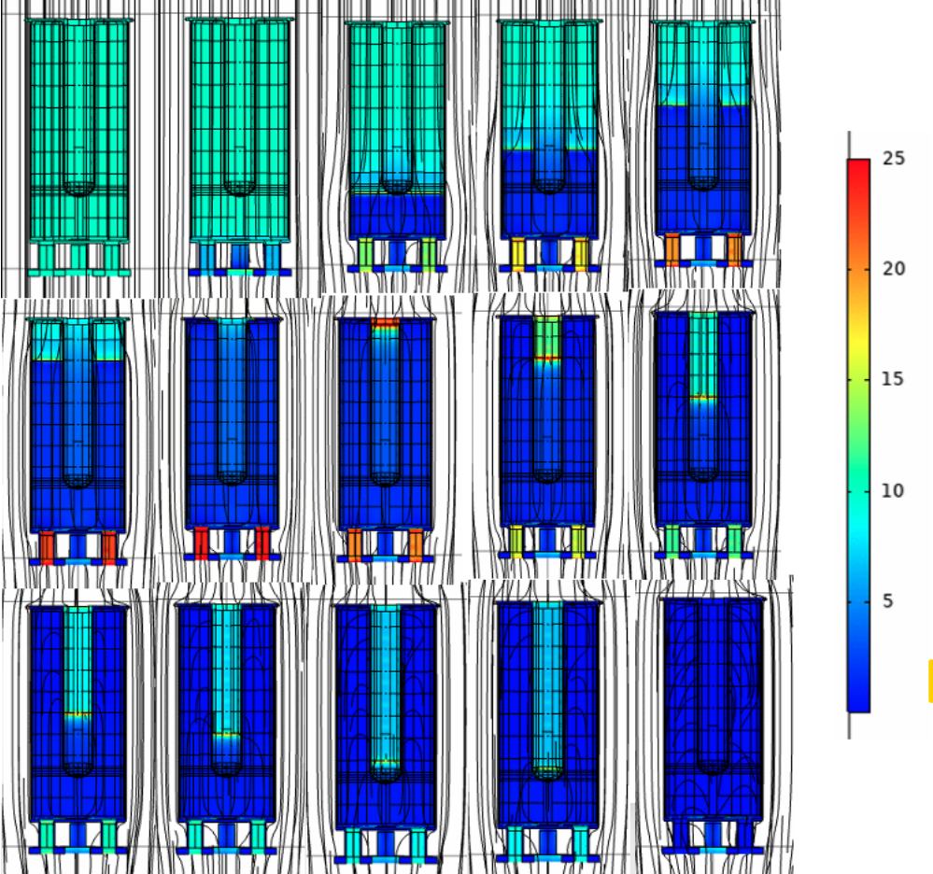
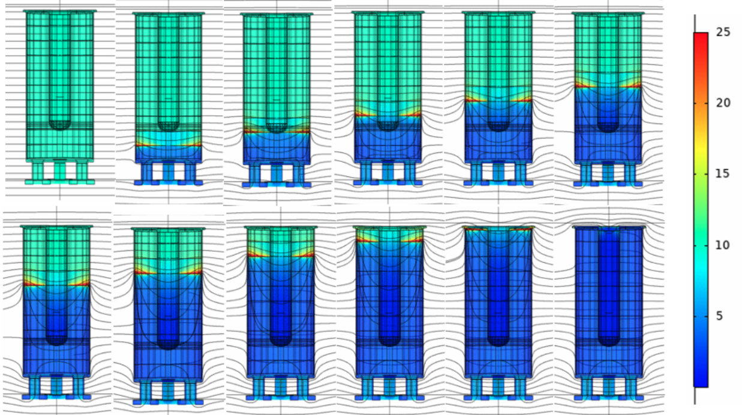
Mid-T Bakes on Multi-mode Coaxial Cavities
Philipp Kolb (TRIUMF), RuthAnn Gregory, Mattias McMullin, Zhongyuan Yao, Tobias Junginger, Robert Laxdal
Discussion:
Q1: Page 10. The right figure is only for 1166 MHz. How about other resonators?
A1: Numbers are similar with QWR.
Q2: Will you measure sensitivity of mid-T baking?
A2: The data has not been analyzed yet. Also, it is not possible to fit a linear function through data shown on page 11, due to the plateau.
Q3: How is field compensation done?
A3: Field compensation is done in all 3 directions.
Q4: Did simulation allow for flux trapping?
A4: It considers a perfect expulsion. It does not account for localized trapping.
Cooldown flux dynamics –
Vertical:
Horizontal:

Slide 17
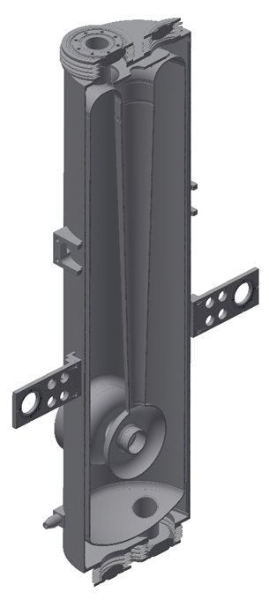
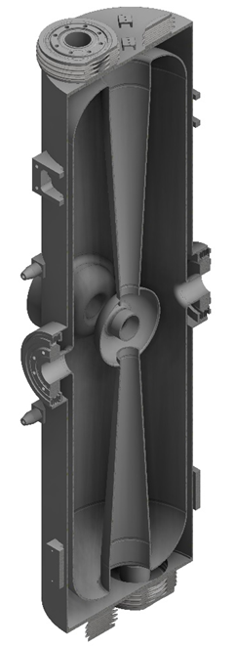
Latest results of treating and testing the RAON HWR SRF cavities
Heetae Kim (RISP)
Tryed to apply same treat. from elliptical cavities to TEM => not easy to extrapolate same effects to lower freq. cavities
Discussion:
Q1: In the test results some cavities were reaching, and some were missing the goal.
Q2: Yes, the failed ones were improved later.
Q2: If we look at the Q/E curve, what was the reason for the bad performing ones?
A2: The reason was mostly FE in the first VT. In further VTs the cavities passed.
Q3: How is the conditioning of the QWR and HWR going?
A3: QWR conditioning takes about one day. In the case of the HWRs
it takes about an hour.

Slide 18
High Q/G Beta 0.53 HWR Cavity R&D Program for High Gradient Cryomodule to Enhance Operational Gradient Margin
Kenji Saito (MSU/FRIB)
Could establish QWR and HWR cavity production and treatment
Discussion:
Q1: Show old KEK result on page 8.
A1: Anti-Q slope behavior, due to use of nitric acid. For the linear collider I want to remove annealing, due to the risk of contaminating the furnace.
Q2: On page 8, what does low temperature baking mean?
A2: 120 degC 48h.
Q3: (unclear)
A3: For DOE one has to show quick results. Thus, my strategy is to use already existing technology. EP is complicated. BCP shows Q slope. Thus, my goal is to develop BCP without Q slope.
Q4: How can a rotating-type EP for low beta cavities be realized?
A4: In this case several cathodes can be inserted from the different ports. Then always at least one cathode is submerged in the acid. There were results, showing using multiple cathodes works.
Q5: How is the etch rate for BCP without nitric acid?
A5: It shows a similar material removal rate compared to the traditional BCP. The surface roughness is around 3 um.

Slide 19
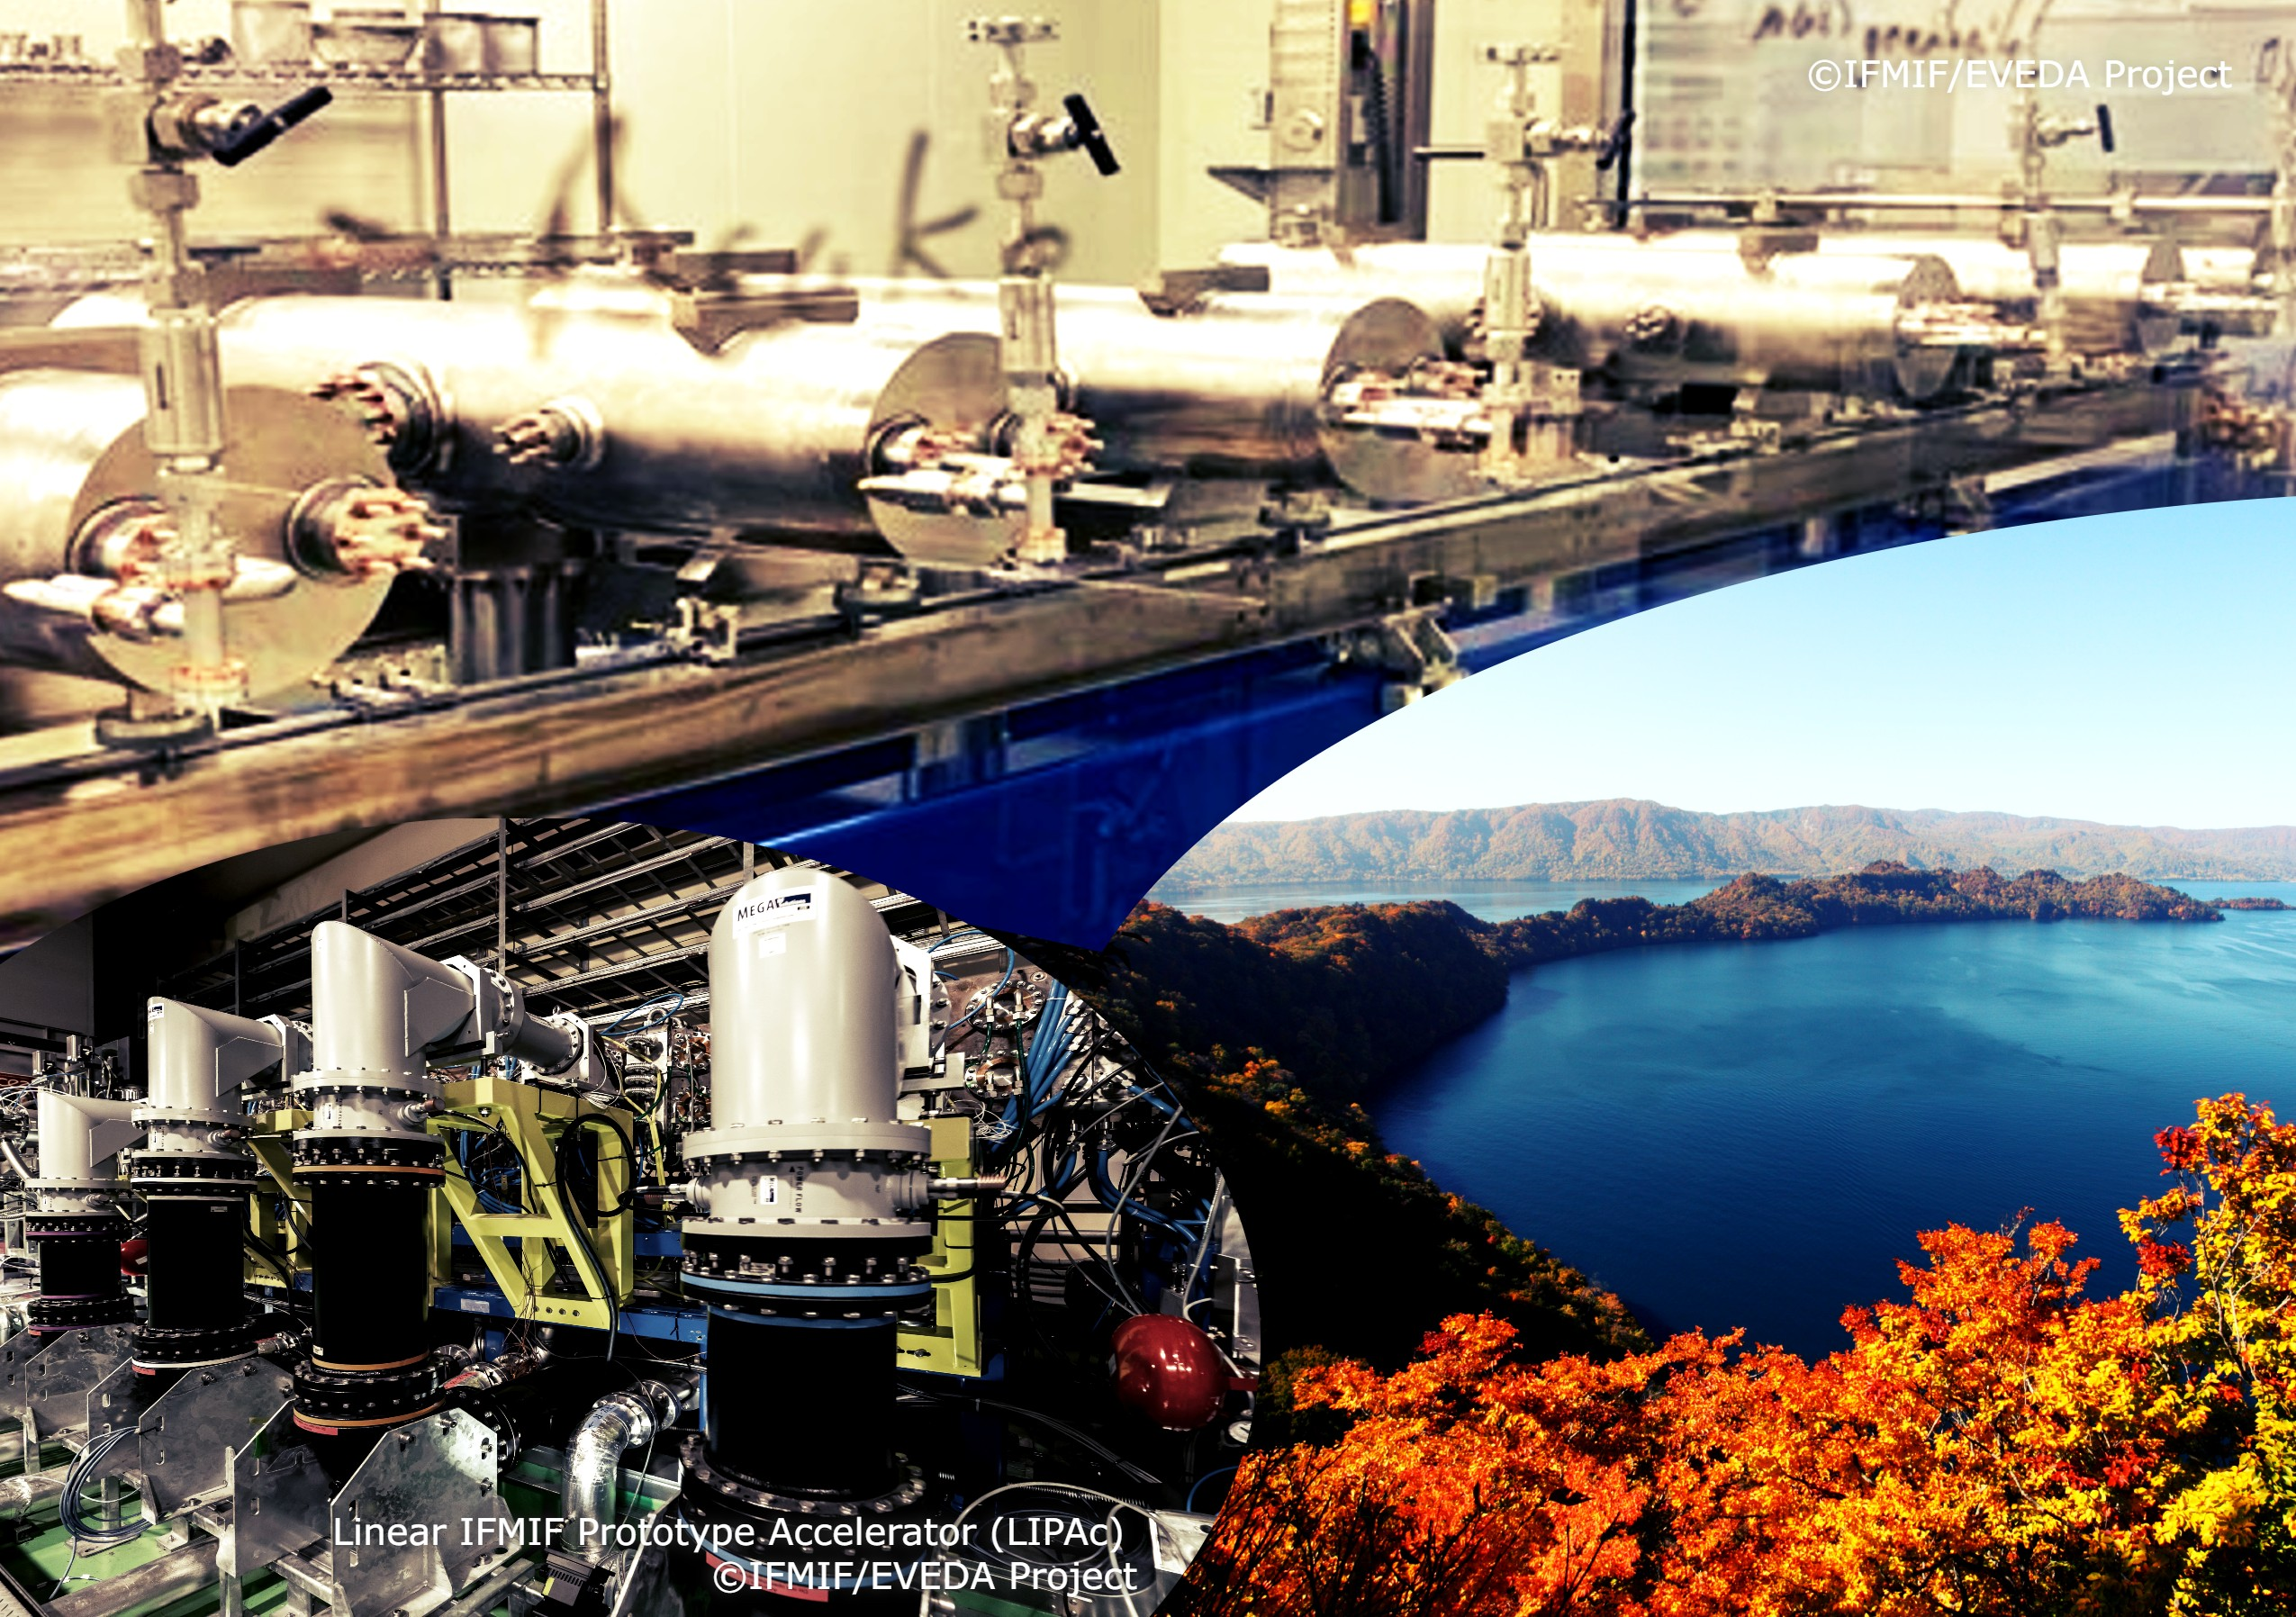
Thank you!!!
ありがとうございました
The WG1 conveeners would like to thank all speakers for their talks and everyone for the fruitful discussions!!!

