Slide 1
WG-2 Summary Report:
Low-Beta Machine Commissioning and Operational Experience
SPC Co-convener:
  Bob Laxdal (TRIUMF)
Conveners:
  Kai Masuda (QST)
  Zhongyuan Yao (TRIUMF)
  Alberto Rodriguez (CERN)

Slide 2
WG2 - Low-Beta Machine Commissioning and Operational Experience
Session 1: Lessons learnt during the beam commissioning and initial operations
Session 2: SRF performance - lessons learned - (Vertical tests, cryomodule performance,
on-line...)
Session 3: SRF ancillary equipment. Issues and operational experience
Session4: Other issues - solenoids, commissioning tools, ....
TTC2022 - WG2 Summary - Low-Beta Machine Commissioning and Operational Experience - B. Laxdal, K. Masuda, Z. Yao, J. A. Rodriguez

Slide 3
WG2 - Low-Beta Machine Commissioning and Operational Experience
Session 1: Lessons learnt during the beam commissioning and initial operations:
  Superconducting 56 MHz QW cryomodule for sPHENIX
  by Zachary Conway
  Operation of the CeC 113 MHz SRF Gun
  by Igor Pinayev
  Beam commissioning and early operations of the HIE-ISOLDE linac
  by J. Alberto Rodriguez
  Testing of PIP-II HWR and SSR1 Cryomodules at PIP2IT
  by Donato Passarelli
TTC2022 - WG2 Summary - Low-Beta Machine Commissioning and Operational Experience - B. Laxdal, K. Masuda, Z. Yao, J. A. Rodriguez

Slide 4
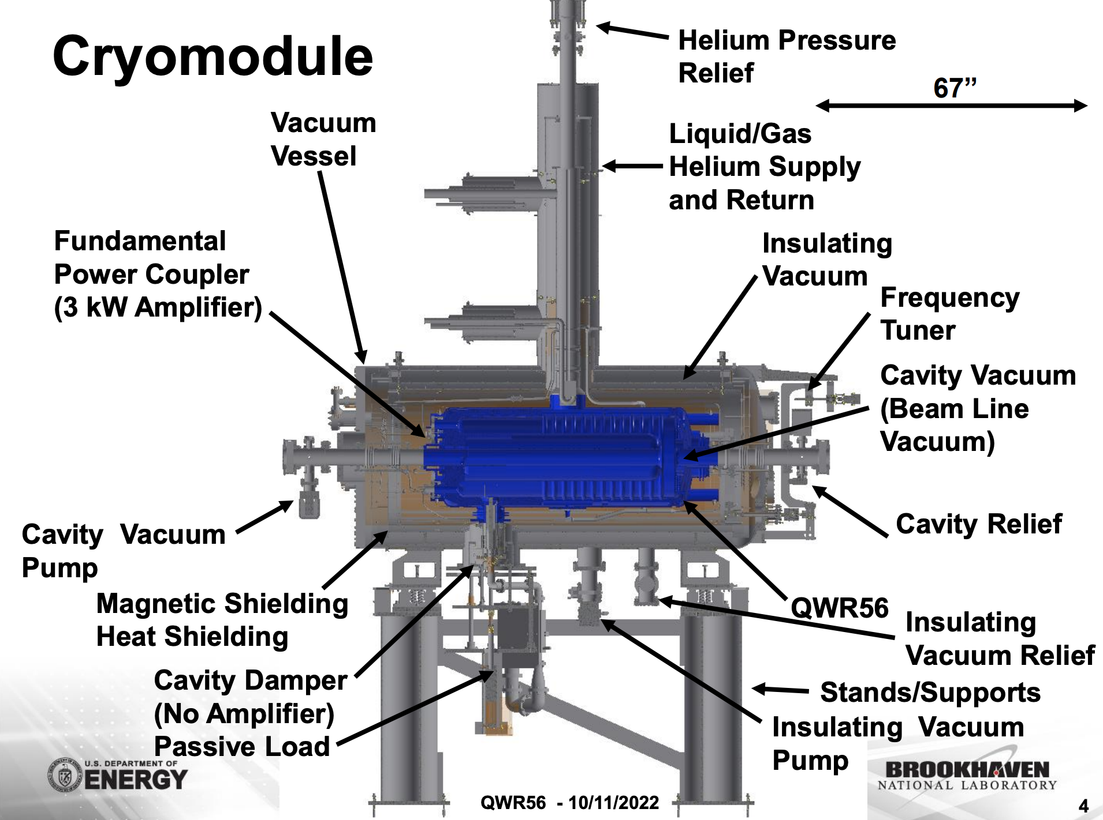
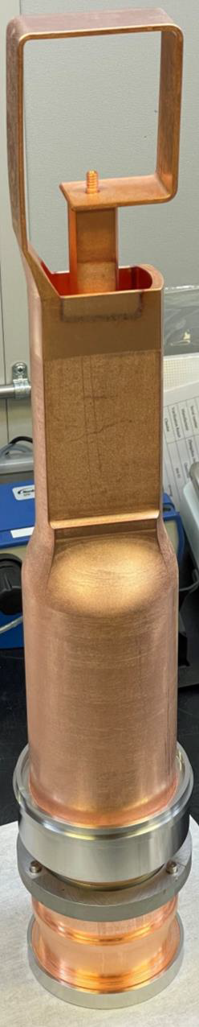
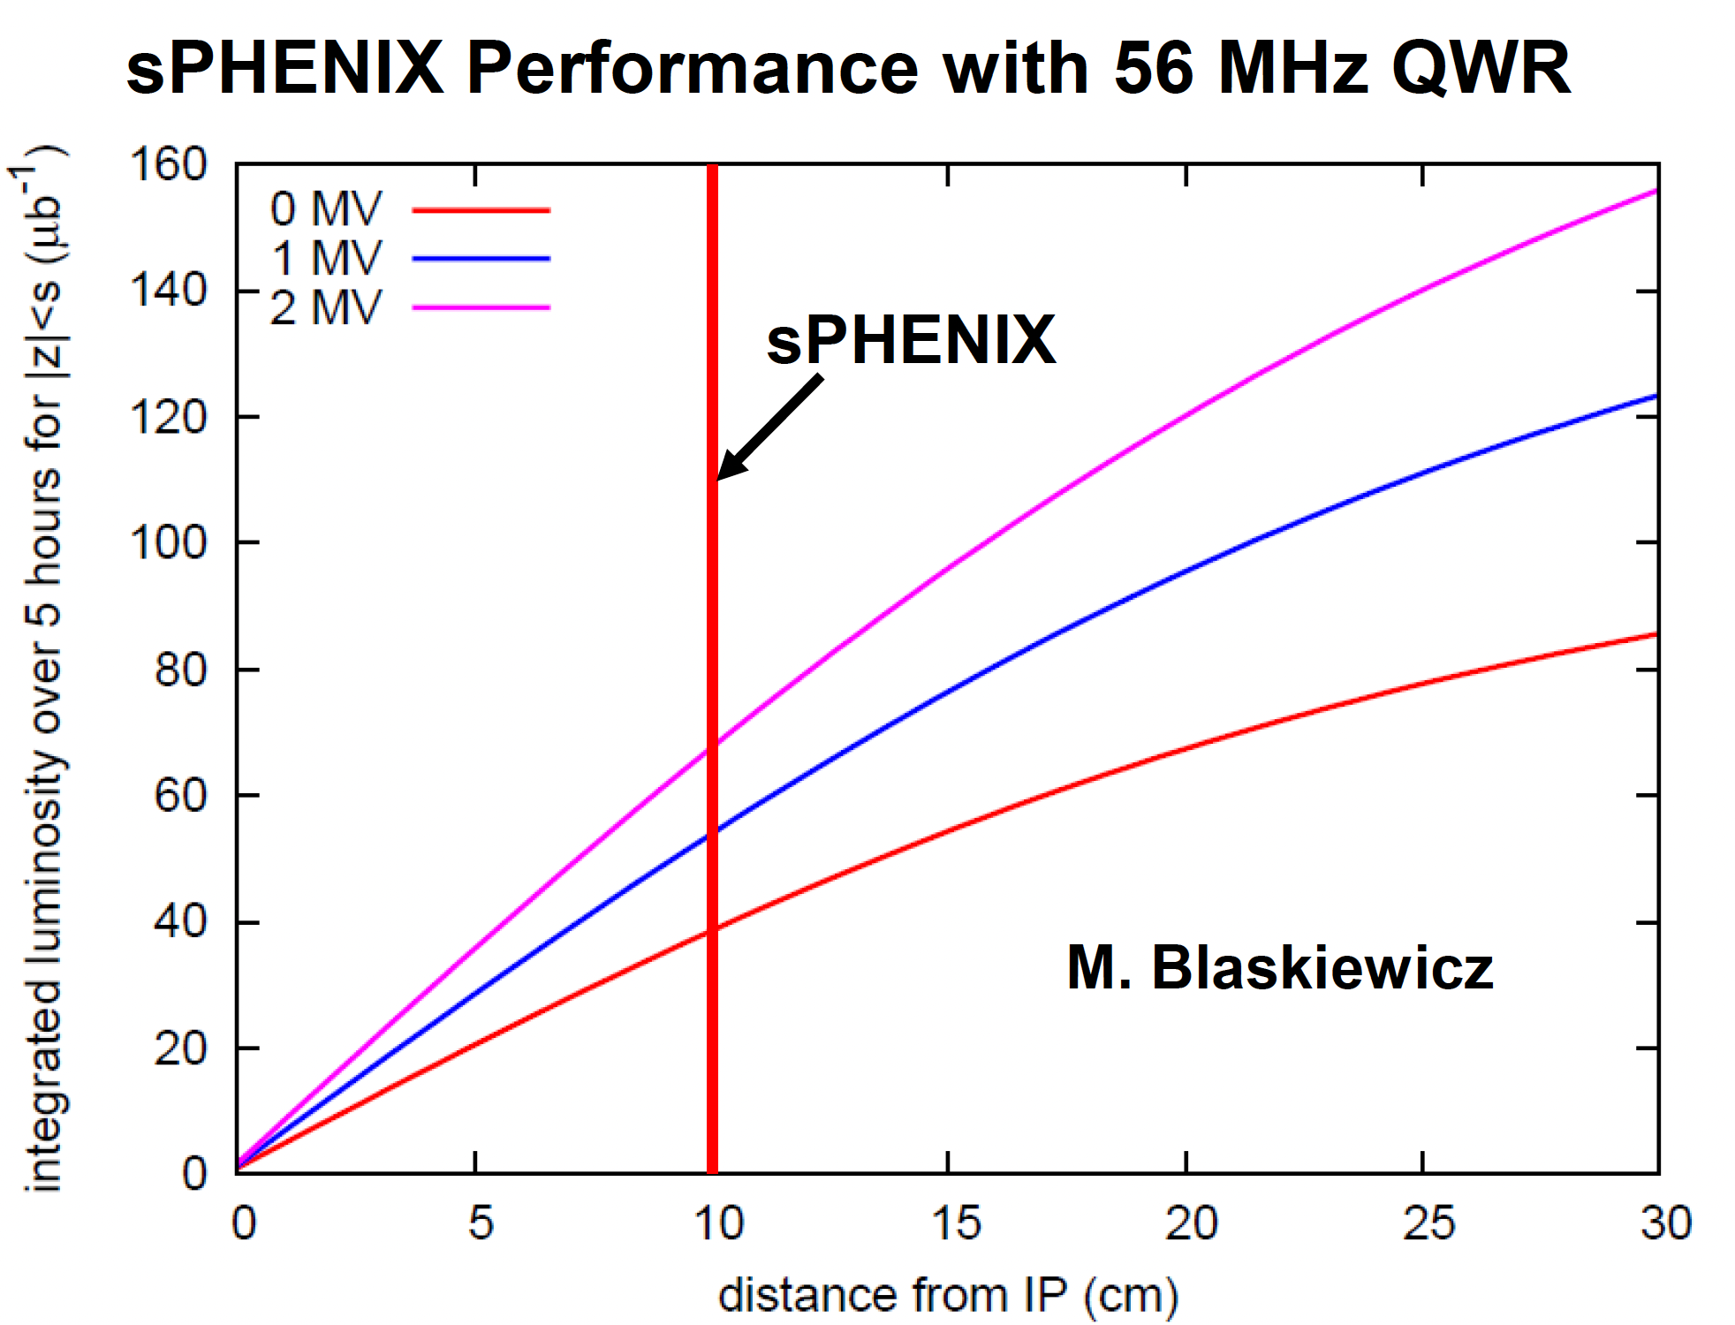
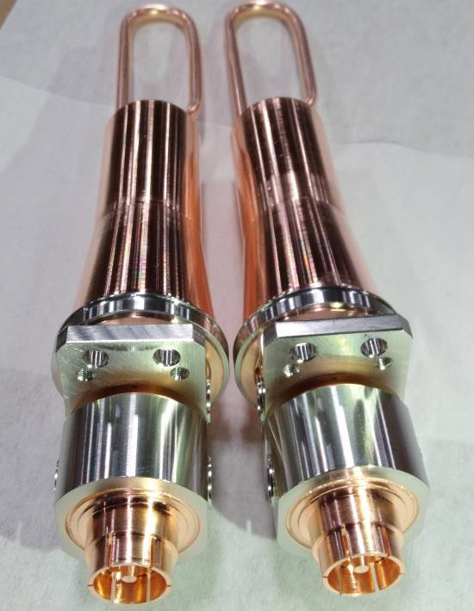
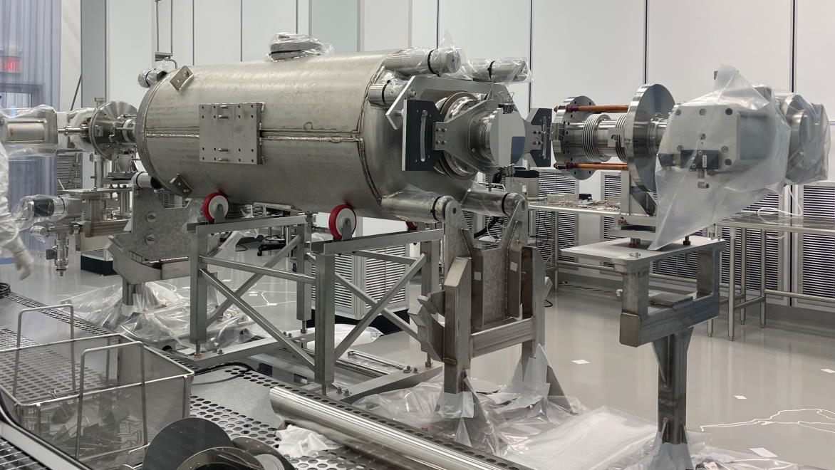
Superconducting 56 MHz cryomodule for sPHENIX by Zachary Conway
56 MHz SC QWR cryomodule to reduce particle losses during transfer of the accelerated 28 MHz bunches to the 197 MHz storage system (beta=1)
Upgrading the existing RHIC 56 MHz SRF system for sPHENIX
  sPHENIX requires 2MV
  Redesign fundamental mode damper for 126kW
  Two 3kW fundamental power couplers instead of one 6kW FPC
  Improved SRF processing and assembly
  Improved subsystem control
TTC2022 - WG2 Summary - Low-Beta Machine Commissioning and Operational Experience - B. Laxdal, K. Masuda, Z. Yao, J. A. Rodriguez

Slide 5
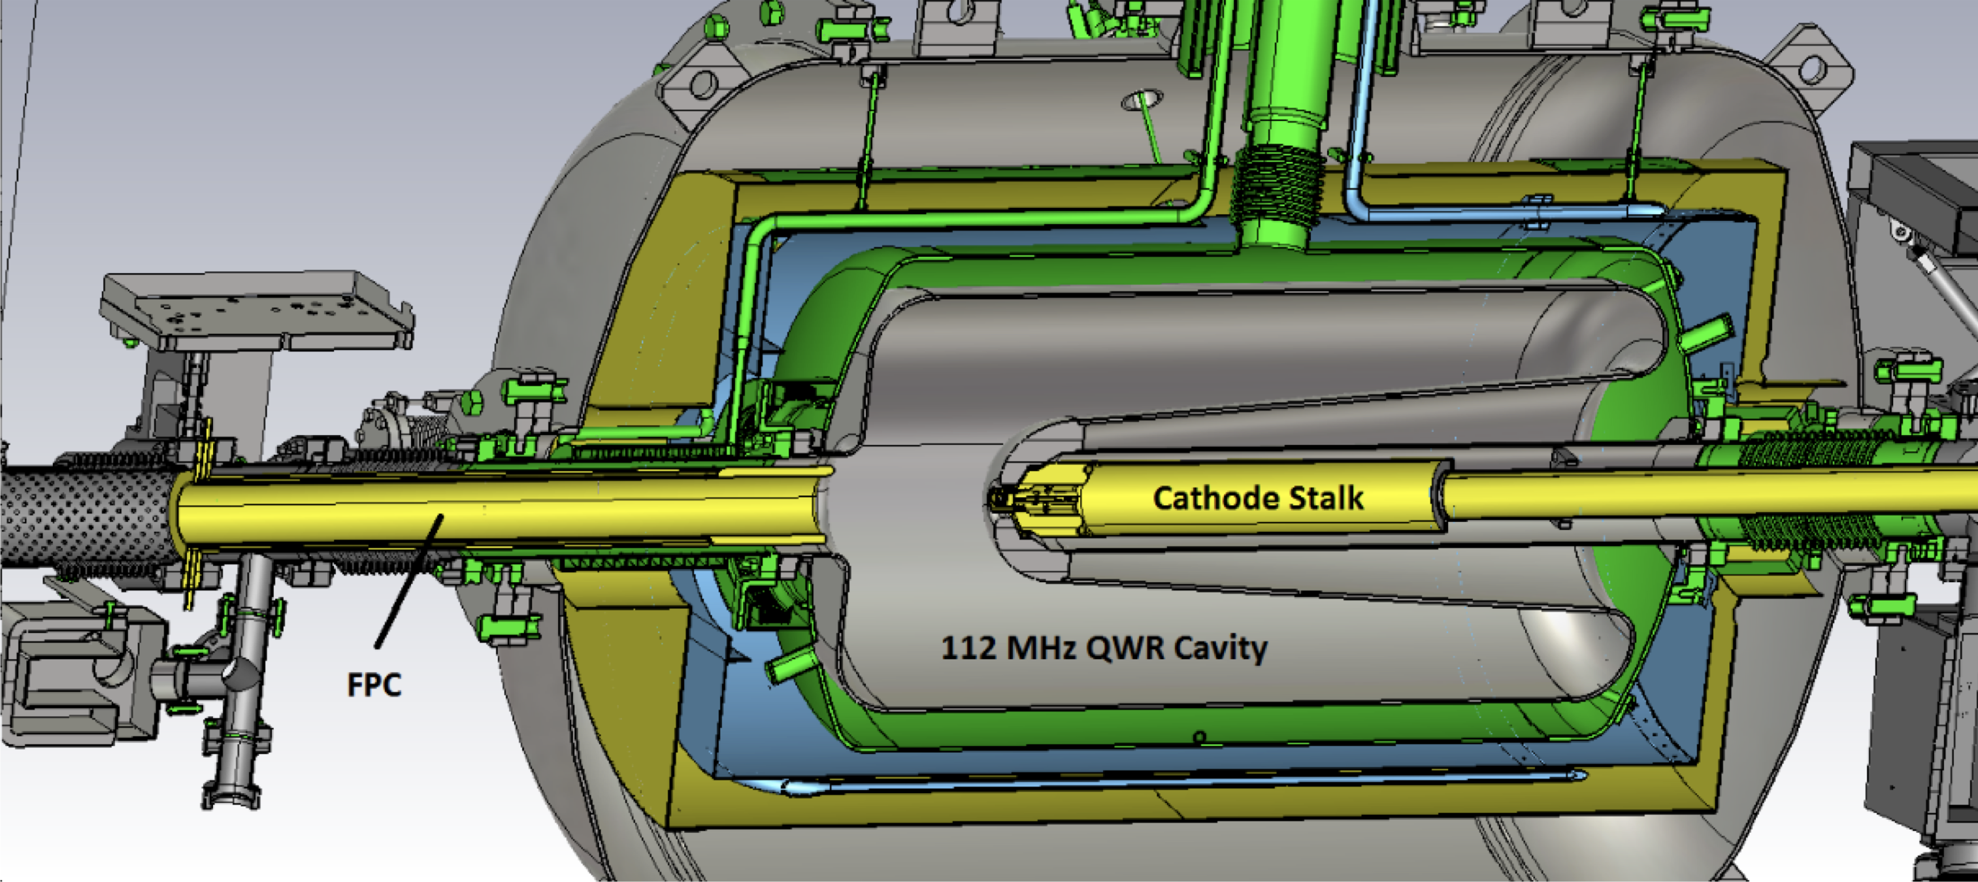
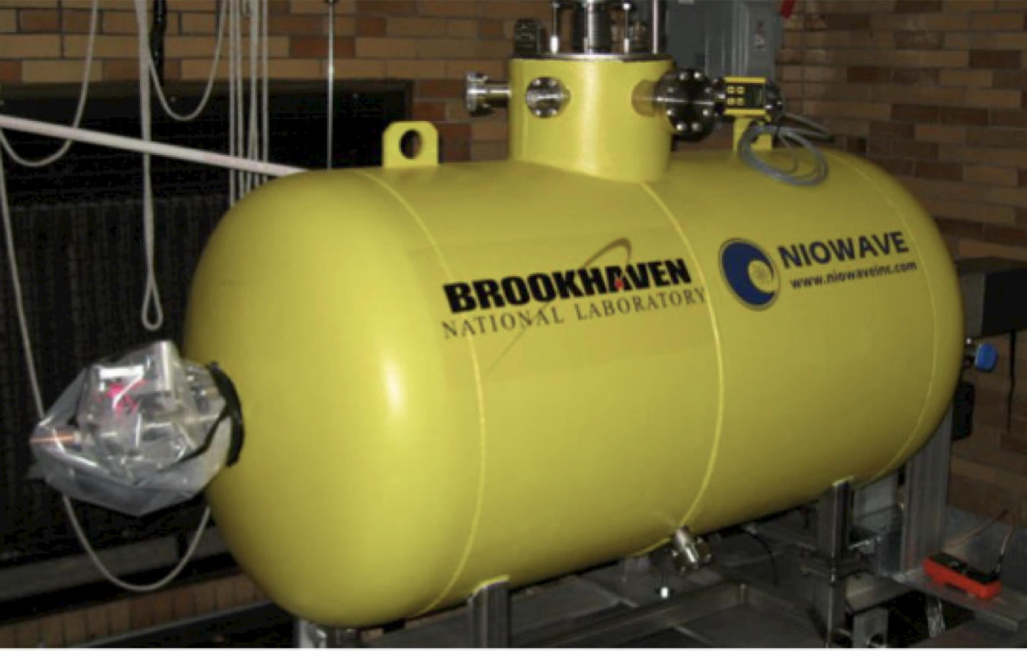
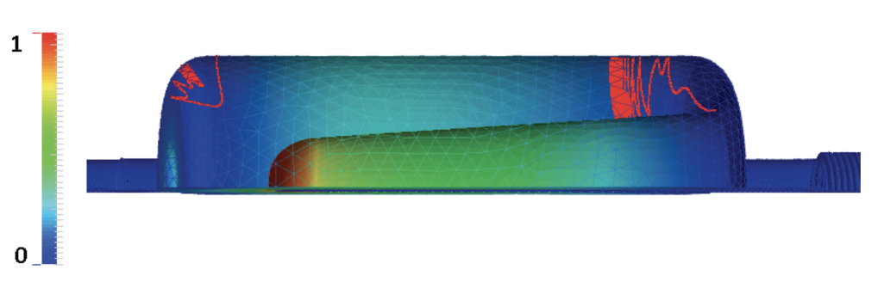
Operation of the CeC 113 MHz SRF Gun at BNL by Igor Pinayev
113MHz QWR photocathode electron gun
Frequency fine tune is achieved with moveable FPC (4.5kHz)
Developed automatic multipacting conditioning procedure
Cavity conditioned with helium at 10⁻⁶ torr pressure
Achieved 1.5 MV in CW and 1.7 MV in pulse, bunch charge 19.7 nC
Contamination of the gun with cathode material can be eliminated by warming up the cavity
TTC2022 - WG2 Summary - Low-Beta Machine Commissioning and Operational Experience - B. Laxdal, K. Masuda, Z. Yao, J. A. Rodriguez

Slide 6
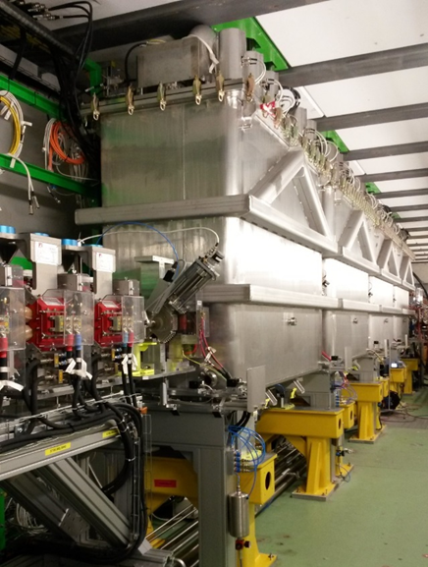
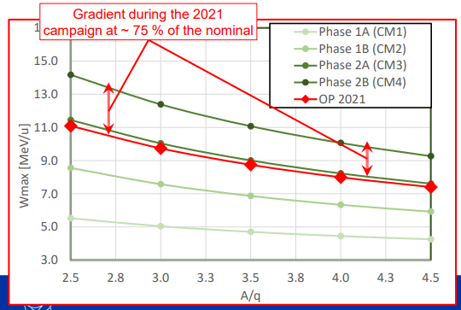
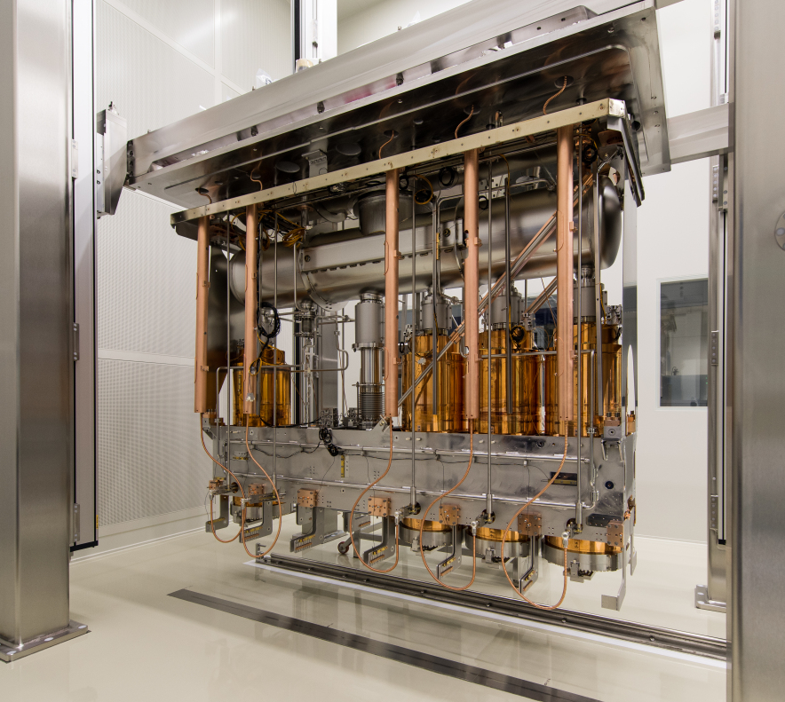
Beam commissioning and early operations of the HIE-ISOLDE linac by J. Alberto Rodriguez
Introduction to the ISOLDE facility and the REX/HIE-ISOLDE post-accelerator
  Radioactive Ion beam (RIB) facility located at CERN
  REX room temperature linac (5 keV/u to 2.8 MeV/u)
  HIE-ISOLDE superconducting linac (4 CM, 5 QWR + 1 SC solenoid in each, nominal energy up to 9.2 MeV/u A/q = 4.5)
Cavity phasing and beam energy measurement techniques
Beams since the commissioning of CM1 in 2015
Typical maintenance, hardware and beam commissioning, operations timeline
Issues / worries:
  Average gradient: ~ 75 % of nominal
  Cavity degradation observed
  Accidental thermal cycling
  Instabilities of the SRF cavities
  Physics only 4 months / yr
TTC2022 - WG2 Summary - Low-Beta Machine Commissioning and Operational Experience - B. Laxdal, K. Masuda, Z. Yao, J. A. Rodriguez

Slide 7
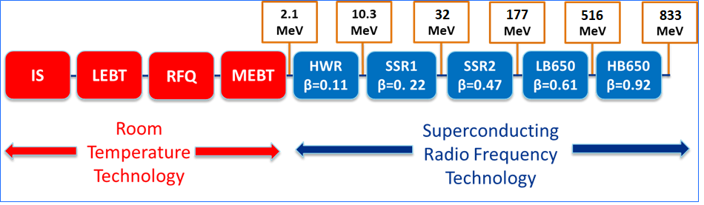
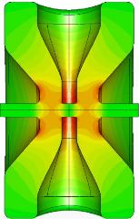
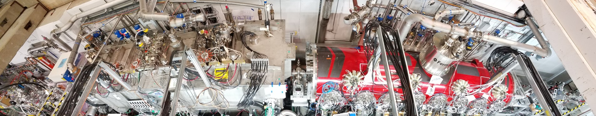
Testing of PIP-II HWR and SSR1 Cryomodules at PIP2IT by Donato Passarelli
Description and objectives of the test facility:
  Validate performance of the SRF cryomodules and other critical components
  Demonstrate H⁻ acceleration with PIP-II parameters
Test plan and results for both HWR and SSR1 cryomodule
Both cryomodules were successfully cooled down to 2K, tested, and operated in PIP2IT with beam
HWR cryomodule:
  Cavities, couplers, tuners passed all tests and met RF requirements at 2K, except cavities 1&2 and coupler 3 for which repair activities are planned
  The HWR qualifies to be operable in the PIP-II linac with a projected total 2K heat loads of 40W
SSR1 cryomodule:
  Cavities, couplers, tuners passed
  all test stand met RF
  requirements at 2K
  The SSR1 CM qualifies to be
  operable as SSR1-CM1 in the
  PIP-II linac
PIP2IT
10
TTC2022 - WG2 Summary - Low-Beta Machine Commissioning and Operational Experience - B. Laxdal, K. Masuda, Z. Yao, J. A. Rodriguez

Slide 8
WG2 - Low-Beta Machine Commissioning and Operational Experience
Session 2: SRF performance (Vertical tests, cryomodule performance, on-line...)
  Low-field MP in FRIB QWRs and its mitigation
  by Sang-hoon Kim
  Commissioning results of ISAC-II style separated vacuum QWR cryomodule
  by Zhongyuan Yao
  Experience from the series double-spoke cavity cryomodules for ESS
  by Akira Miyazaki
  Thin film QWRs performance for ALPI-SPES upgrade at INFN LNL: first results
  by Giorgio Keppel
TTC2022 - WG2 Summary - Low-Beta Machine Commissioning and Operational Experience - B. Laxdal, K. Masuda, Z. Yao, J. A. Rodriguez

Slide 9
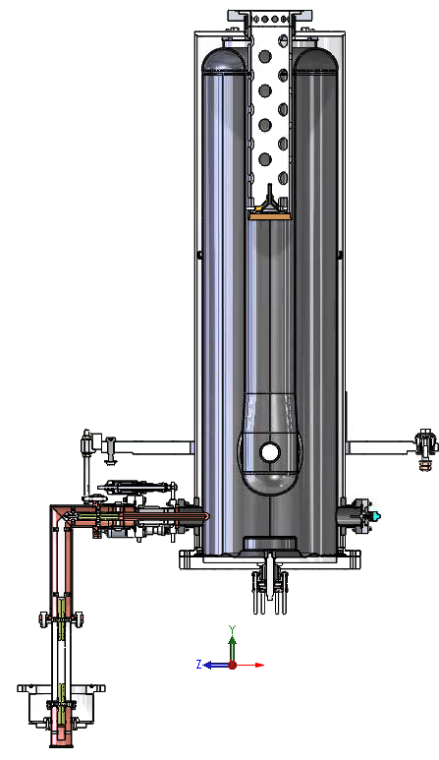
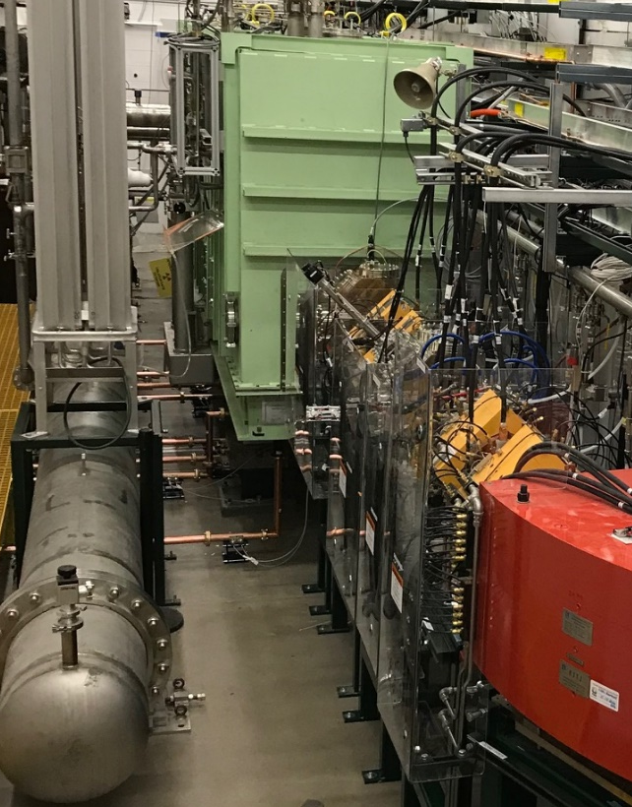
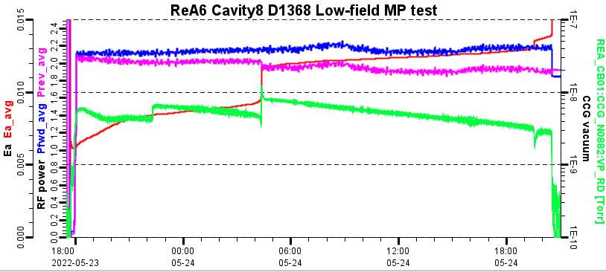
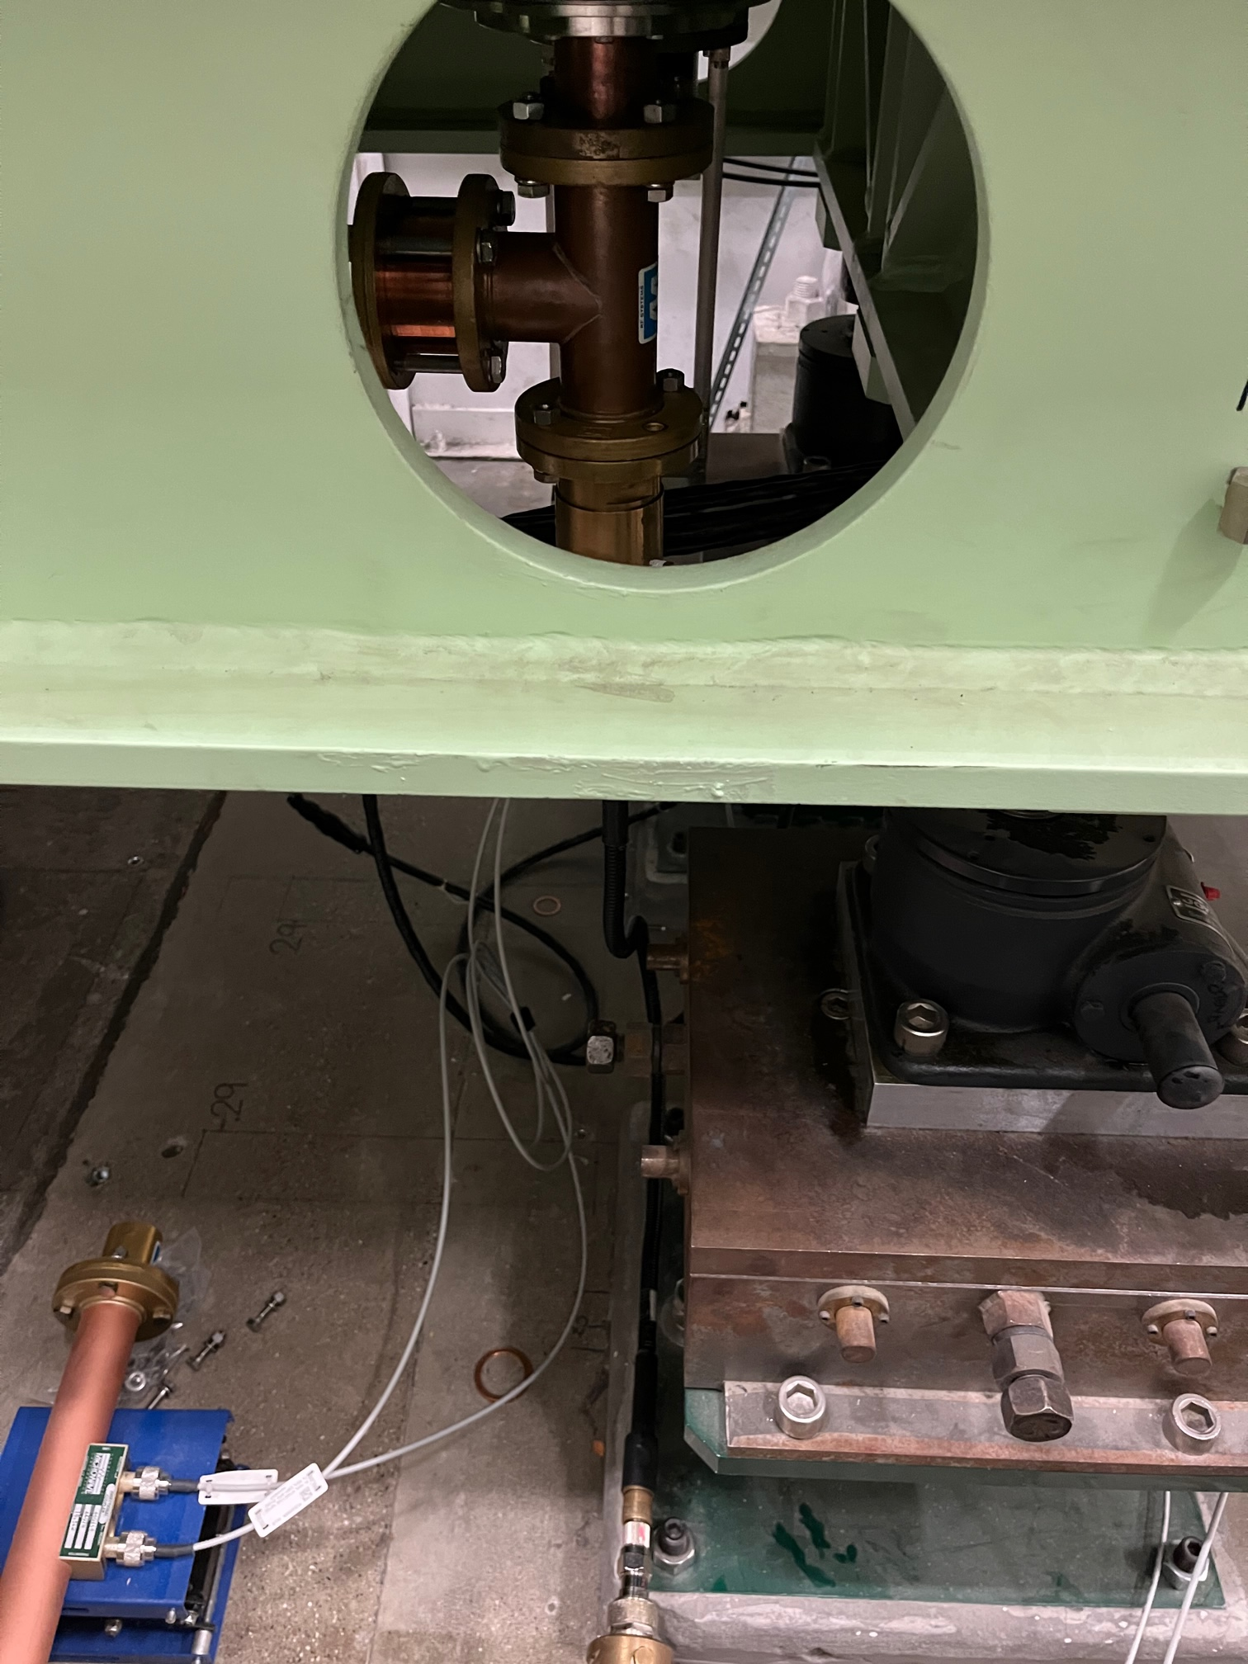
Low-field MP in FRIB QWRs and its mitigation by Sang-hoon Kim
FRIB and ReA6 QWR: 80.5 MHz, beta: 0.085
Multipacting barriers: ~ 6 - 14 kV/m
Conditioning: 26 hrs. with Pf = 2 W, 16 hrs. with Pf = 3 W
Theoretical explanation
Mitigation strategy: temporarily insert the single-stub matching element for conditioning
TTC2022 - WG2 Summary - Low-Beta Machine Commissioning and Operational Experience - B. Laxdal, K. Masuda, Z. Yao, J. A. Rodriguez

Slide 10
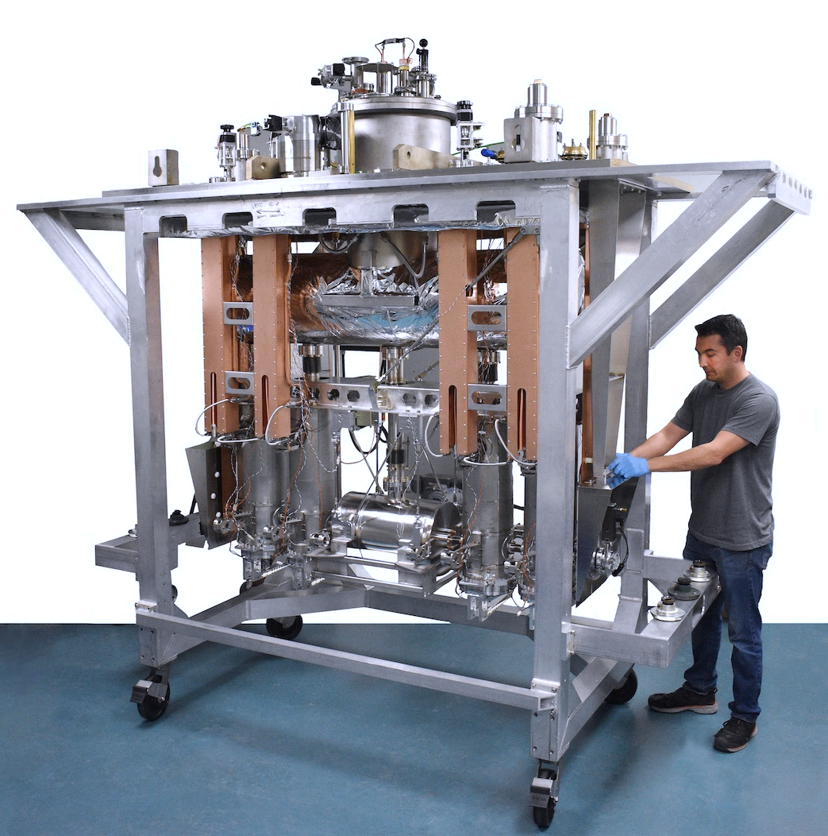
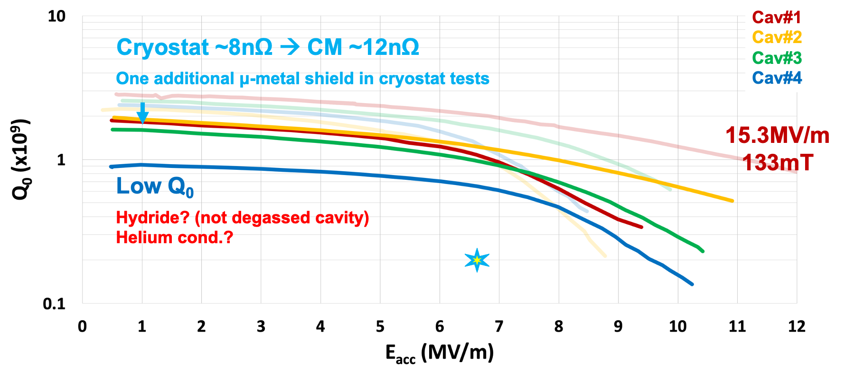
Commissioning of ISAC-II style separated vacuum QWR cryomodule by Zhongyuan Yao
TRIUMF developed and commissioned an ISAC-II style separated vacuum QWR cryomodule
Found issue with venting procedure
Helium conditioning was applied FE cavity
  More effective to remove field emitter than high power pulse conditioning
  Added new field emitter to neighbor cavity
  Reduced Q on one cavity
Cryostat test have higher Q
  Better magnetic shield
One low Q cavity in CM test
  Hydride and helium cond.
TTC2022 - WG2 Summary - Low-Beta Machine Commissioning and Operational Experience - B. Laxdal, K. Masuda, Z. Yao, J. A. Rodriguez

Slide 11
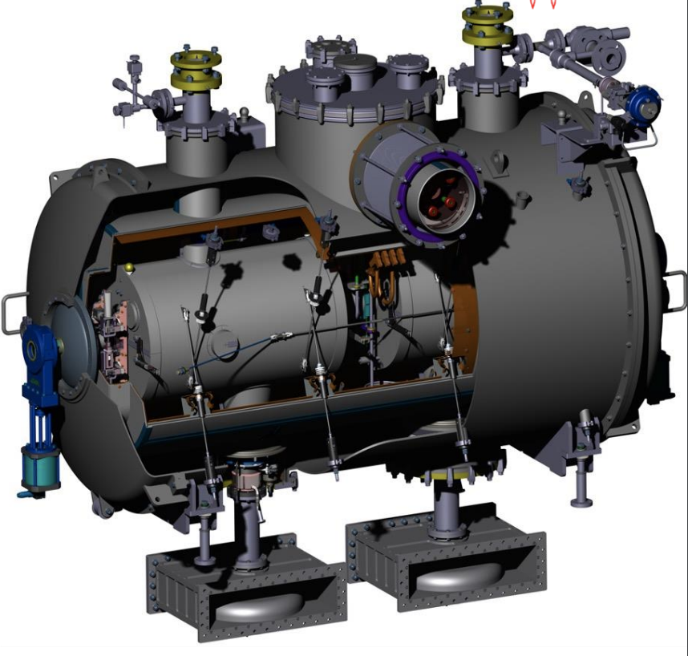
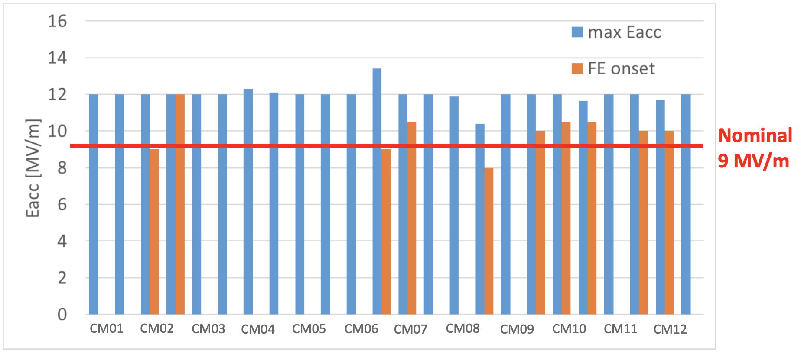
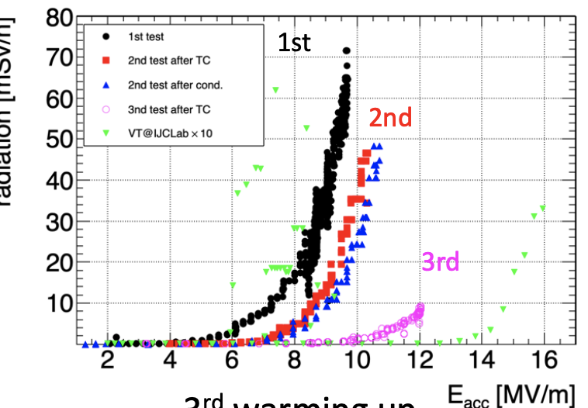
Experience from the series double-spoke cavity cryomodules for ESS by Akira Miyazaki
Double-spoke cavities at ESS
  Betag: 0.50, 352 MHz, 2 K, 90 to 216 MeV, 13+1 cryomodules…
Qualification of cryomodules
  Passed: 6 (first test) + 3 (second test)
  Waiting to be tested: 5 (by Mach 2023)
Warm RF coupler conditioning
Performance: all cavities reached the 9 MV/m nominal gradient
Heat loads: 16.5 W (average static), 17.4 W (average total at 9 MV/m, 4.5% duty cycle)
Improvement in field emission after thermal cycles
TTC2022 - WG2 Summary - Low-Beta Machine Commissioning and Operational Experience - B. Laxdal, K. Masuda, Z. Yao, J. A. Rodriguez

Slide 12
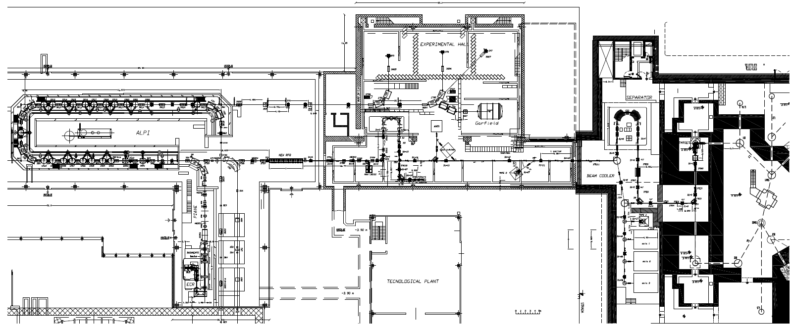
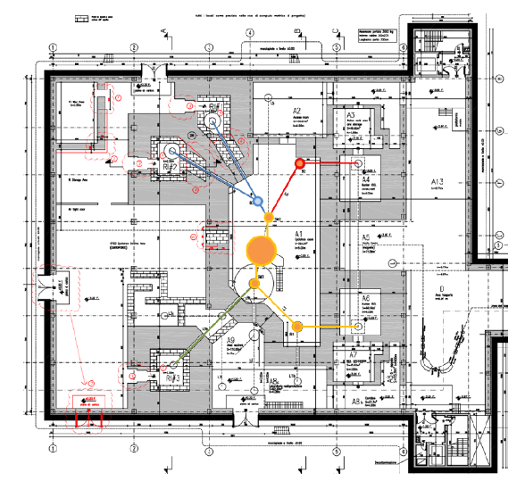
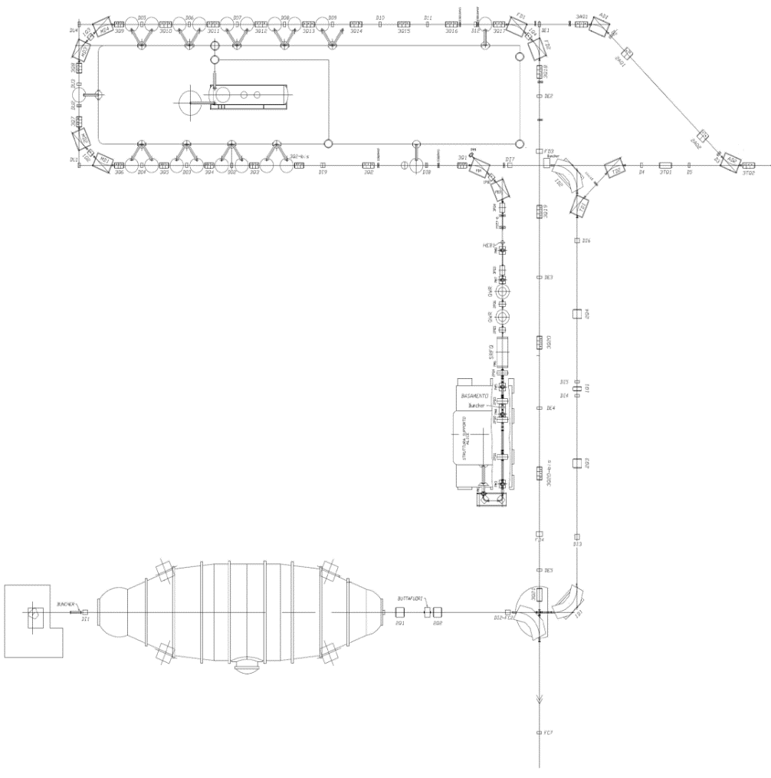


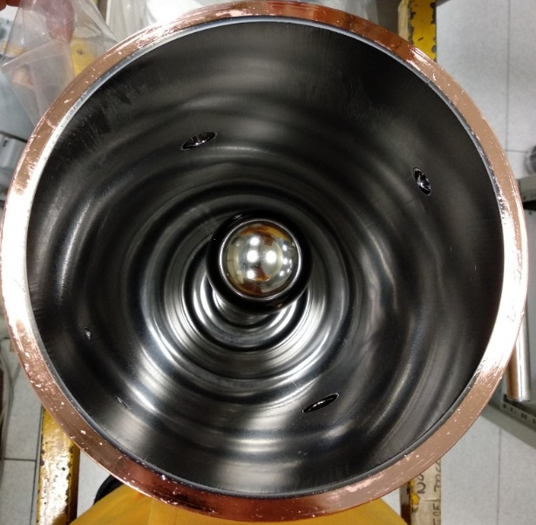
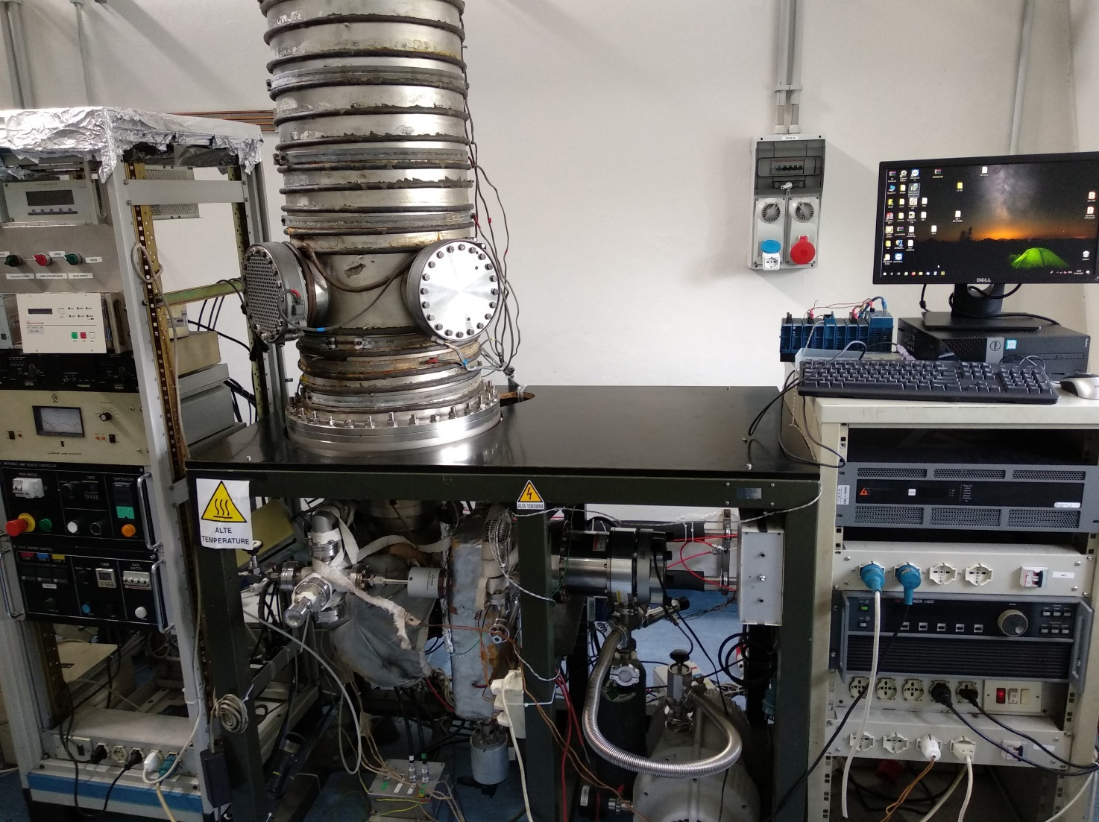
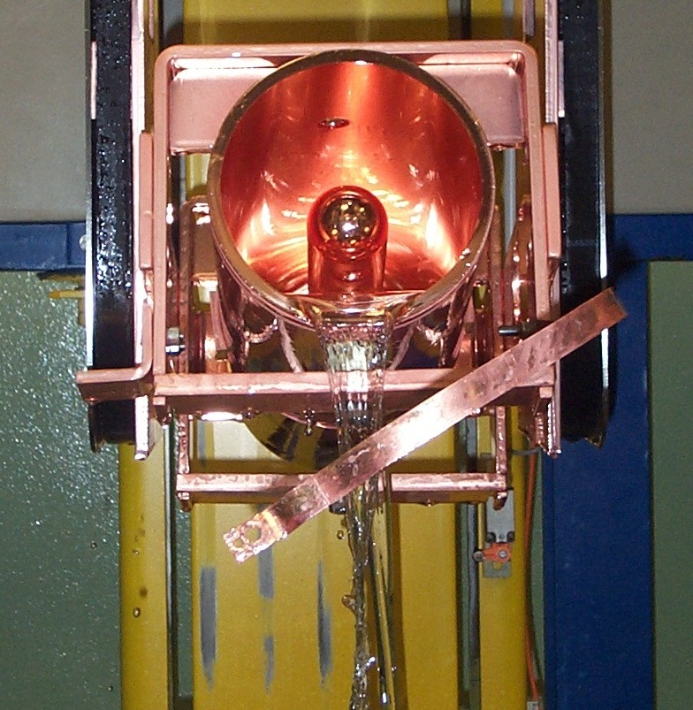
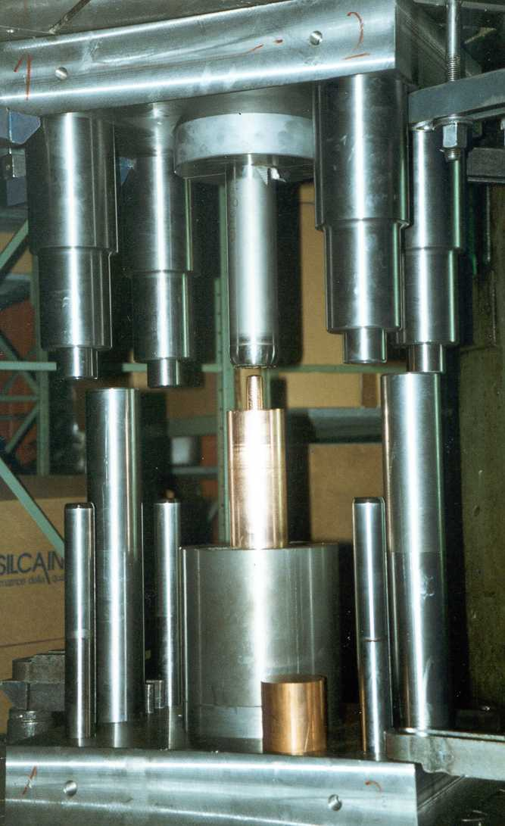
Thin film QWRs performance for ALPI-SPES upgrade at INFN LNL: first results by Giorgio Keppel
Description of the ALPI-SPES upgrade
  New high power compact cyclotron (70 MeV, 750 uA)
  Upgrade of the ALPI superconducting linac
QWR diode sputtering system upgrade
  Vacuum pumps, Ar mass flow controller, power supplies, control system…
Chemistry plant upgrade
  New stripping facility, control system…
Status of the new QWR
  Four cavities machined from bulk Cu, two by extrusion
  Cavity coating and performance
  Three (out of eight) cavities ready for installation in cryostat
Neutron production area (NEPIR)
STABLE BEAM FACILITY
RIB transfer and selection
HRMS
ISOL1
Low Energy area
ISOL2
TTC2022 - WG2 Summary - Low-Beta Machine Commissioning and Operational Experience - B. Laxdal, K. Masuda, Z. Yao, J. A. Rodriguez

Slide 13
WG2 - Low-Beta Machine Commissioning and Operational Experience
Session 3: SRF ancillary equipment. Issues and operational experience
  SRF Test Results and Current Status of the Low Energy SC Linac for RAON
  by Hyunik Kim
  Present status of RIKEN power coupler
  by Kazutaka Ozeki
  Experience with resonance control with slow tuners in low-beta CW linac
  by Sang-hoon Kim
TTC2022 - WG2 Summary - Low-Beta Machine Commissioning and Operational Experience - B. Laxdal, K. Masuda, Z. Yao, J. A. Rodriguez

Slide 14
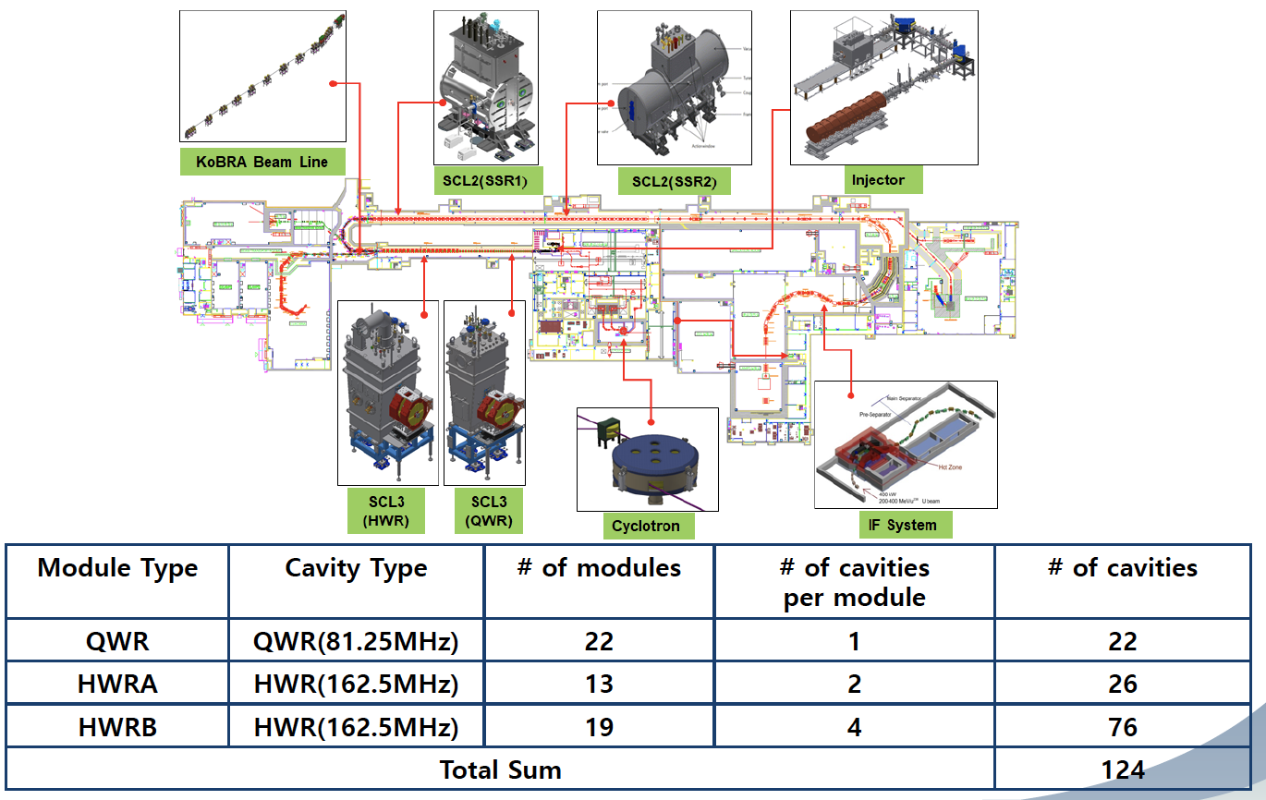
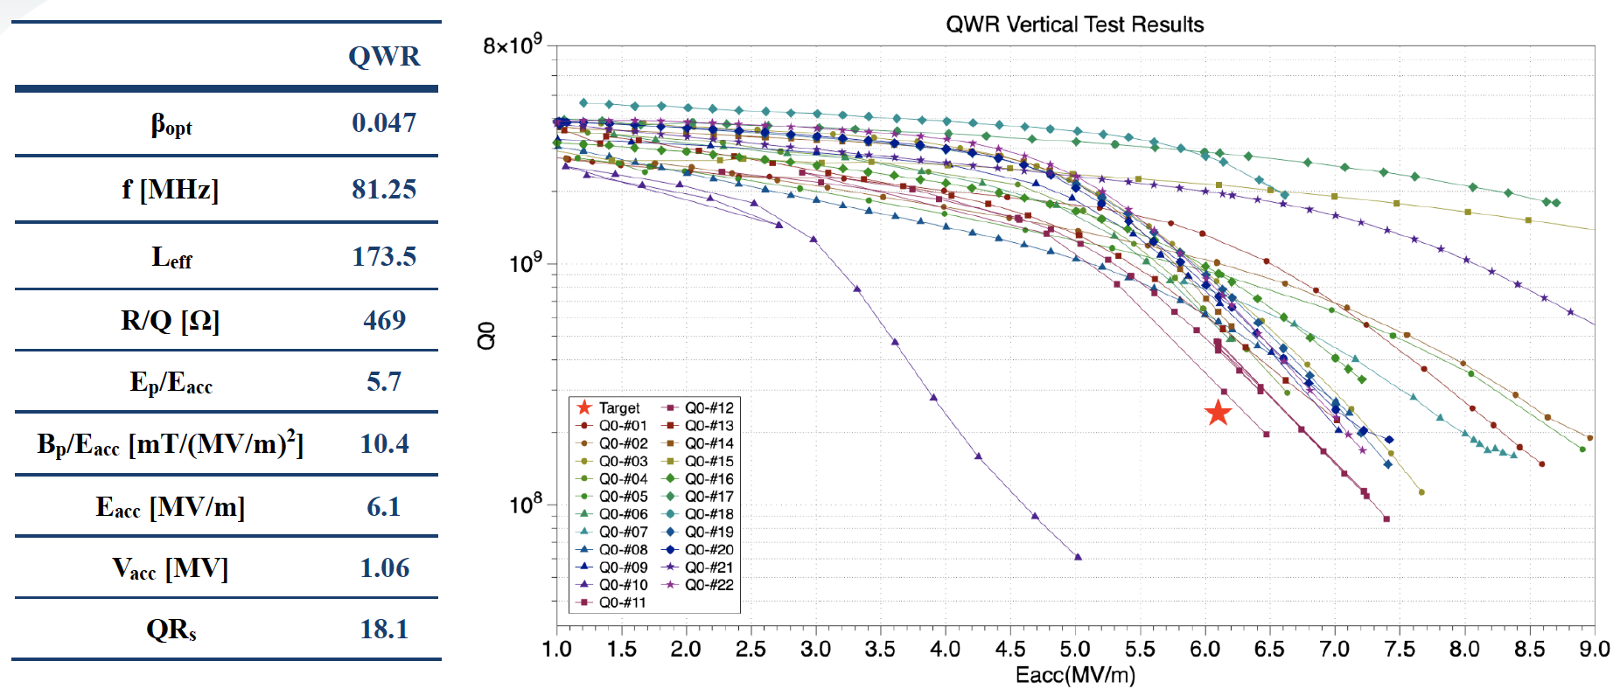
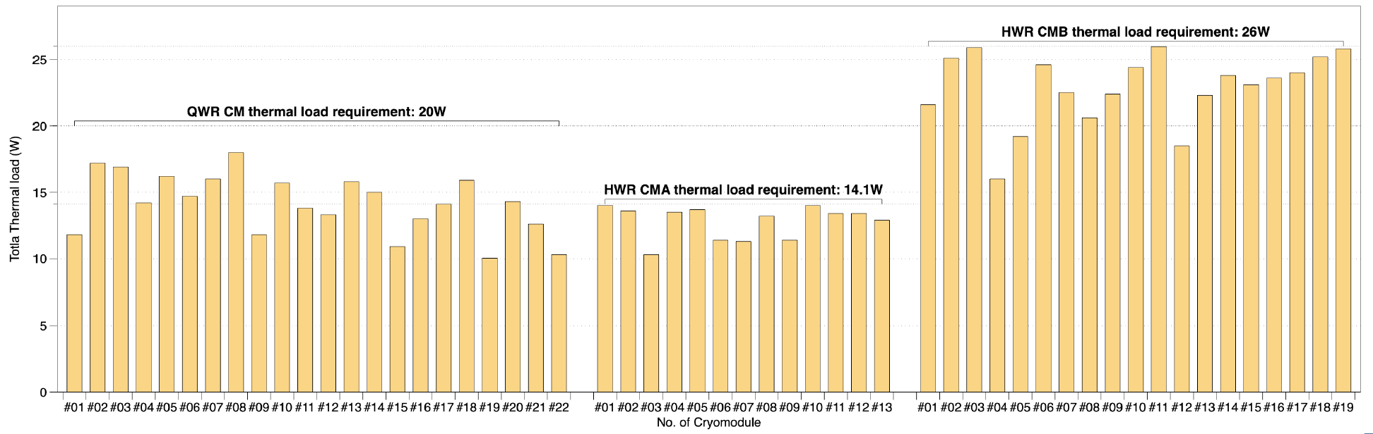
SRF Test Results and Current Status of the Low Energy SC Linac for RAON by Hyunik Kim
Status: Installation completed 2021, cool-down started Sept. 2022, RF conditioning in progress for 6 QWR
Results of the vertical tests
Horizontal test procedure and results
  Thermal load (specifications vs. measured)
  Frequency shift vs. LHe pressure
  Microphonics measurements and mitigation (e.g. reduction in
  flow rate from cryoplant, closing of bypass line…)
TTC2022 - WG2 Summary - Low-Beta Machine Commissioning and Operational Experience - B. Laxdal, K. Masuda, Z. Yao, J. A. Rodriguez

Slide 15
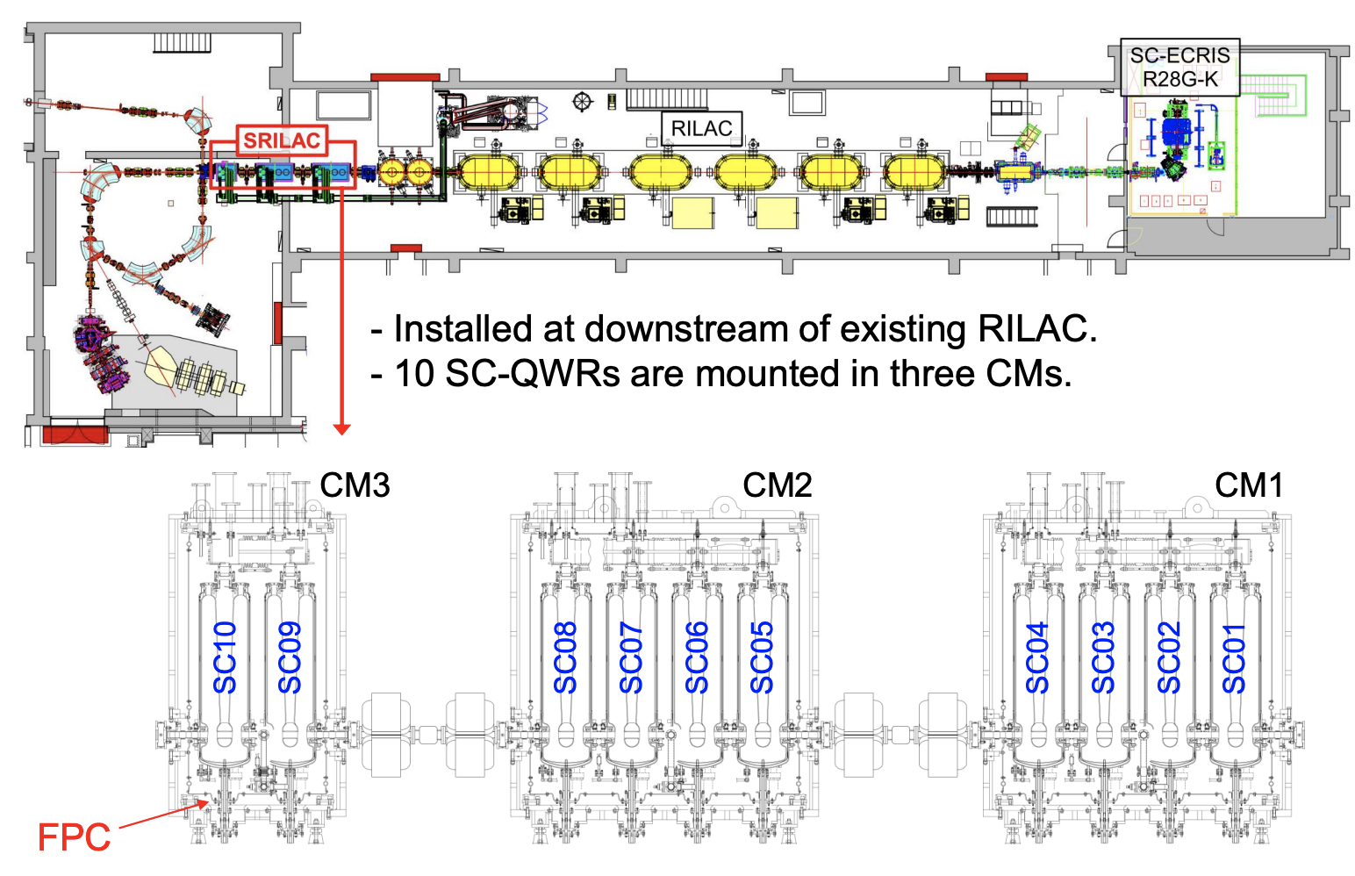
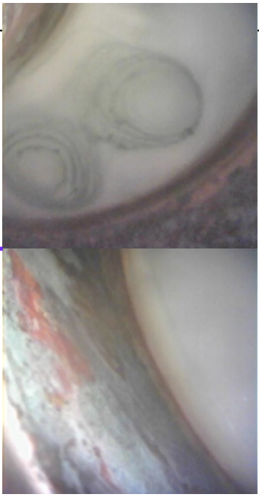
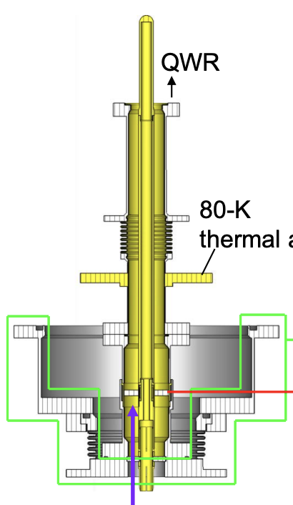
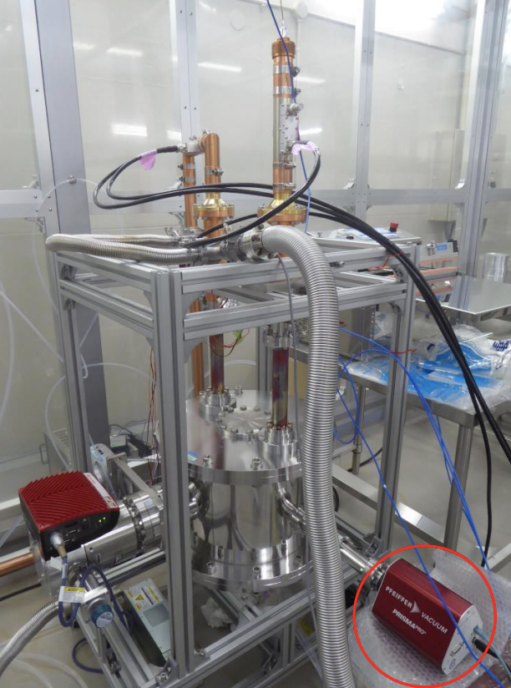
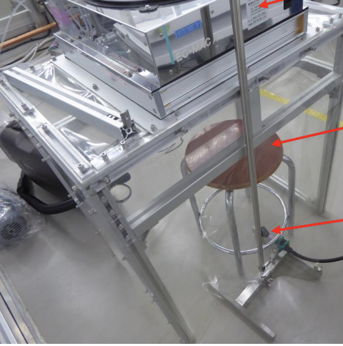
Present status of RIKEN power coupler by Kazutaka Ozeki
Overview of the RIKEN Superconducting Heavy Linear Accelerator (SRILAC)
Vacuum leaks in two of the FPC windows in 2019-20
  Condensation on the vacuum window
  Corrosion of metallization of the alumina
  Degradation of the brazing
Four newly designed FPCs delivered and being processed
Preparation for replacement of FPCs are now under progress.
  Difficult to move cryomodules
  On-site replacement
  Clean environment under CM being prepared
TTC2022 - WG2 Summary - Low-Beta Machine Commissioning and Operational Experience - B. Laxdal, K. Masuda, Z. Yao, J. A. Rodriguez

Slide 16
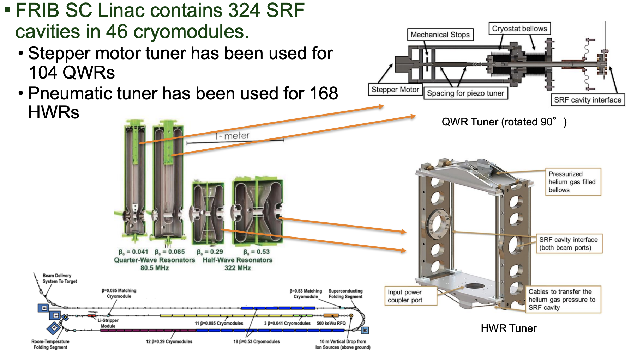
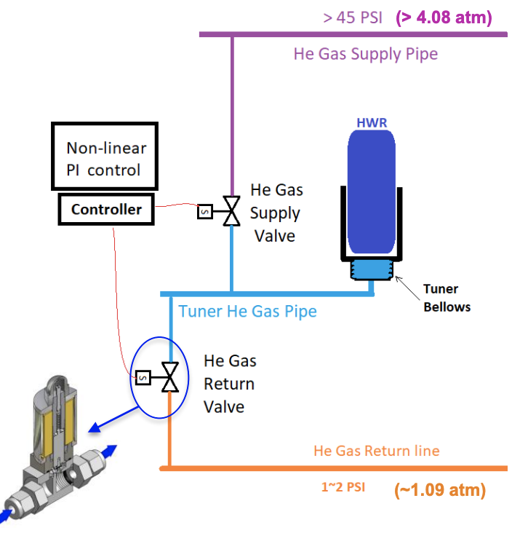
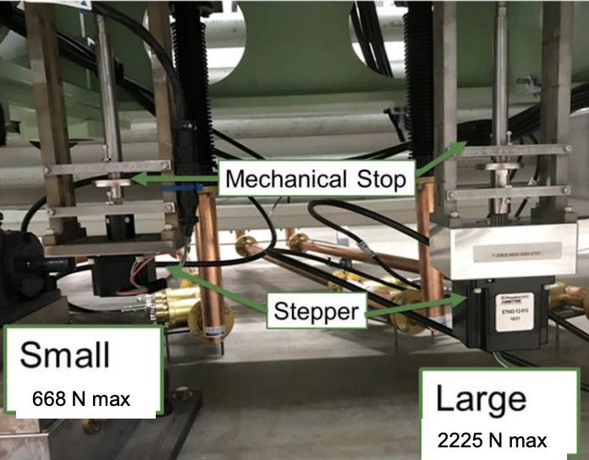
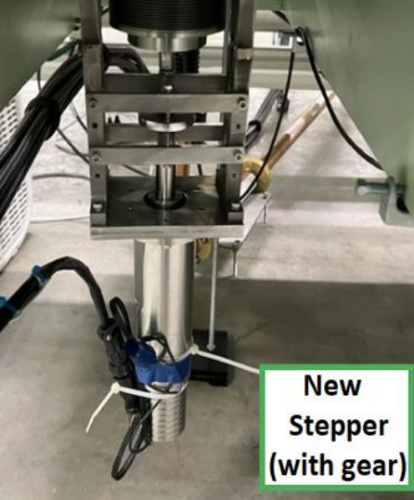
Experience with resonance control with slow tuners in low-beta CW linac by Sang-hoon Kim
Overview of the Linac SRF cavity and tuners
For the QWRs:
Cavity detuning sudden jump due to an issue with the stepper motor of the tuner
  Higher torque motor temporarily solves the problem
  But, the motor needs replacement after one or two years
New type of stepper motor with gearbox that doesn’t require holding current installed in July 2022
  No large jump since installation
For the HWRs:
Pneumatic tuner is being used
Performed well and reached its
design goals
TTC2022 - WG2 Summary - Low-Beta Machine Commissioning and Operational Experience - B. Laxdal, K. Masuda, Z. Yao, J. A. Rodriguez

Slide 17
WG2 - Low-Beta Machine Commissioning and Operational Experience
Session 4: Other issues – solenoids…
  Test results of electro-polishing for quarter-wave resonators (at the Tokai Tandem Accelerator)
  by Keisuke Nii
  Fabrication Status of the Prototype Spoke Cavity for the JAEA‐ADS Linac
  by Jun Tamura
  LIPAc cryomodule assembly progress and lessons learnt
  by Janic Chambrillon
  Lessons learned during the HPR of the superconducting solenoids of the LIPAc linac
  by Takashi Ebisawa
TTC2022 - WG2 Summary - Low-Beta Machine Commissioning and Operational Experience - B. Laxdal, K. Masuda, Z. Yao, J. A. Rodriguez

Slide 18
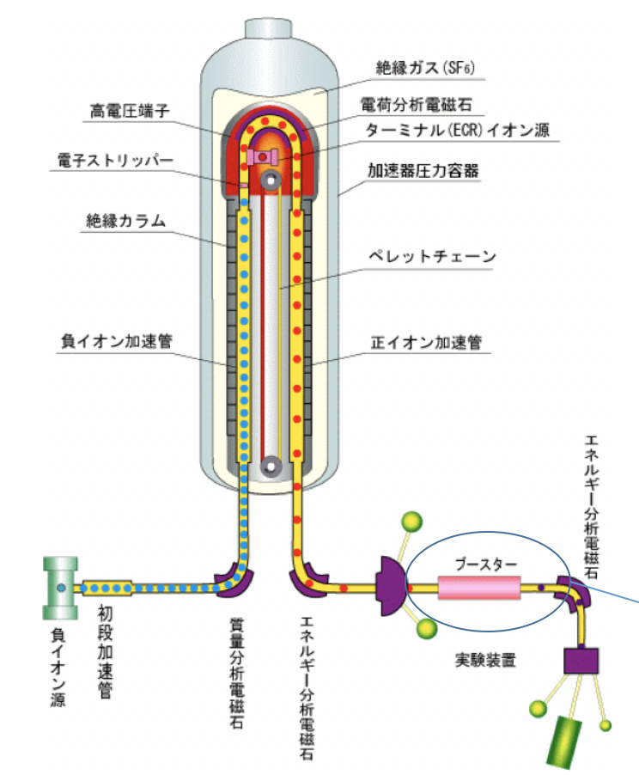
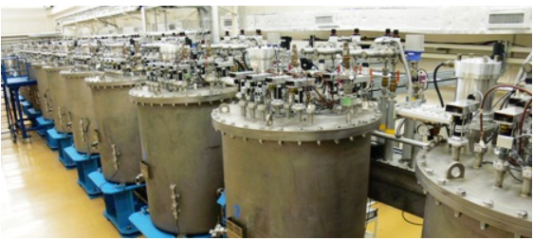
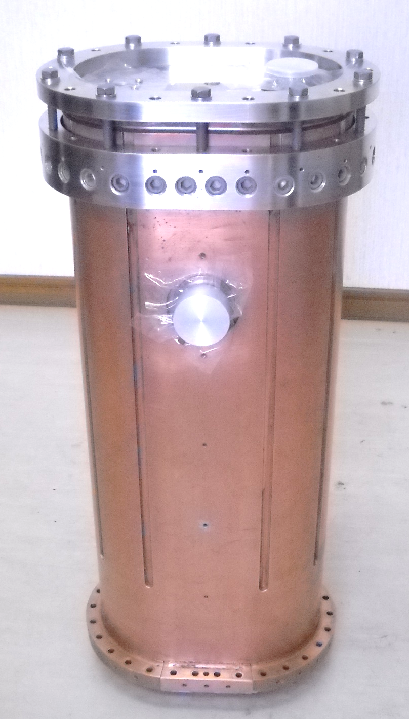
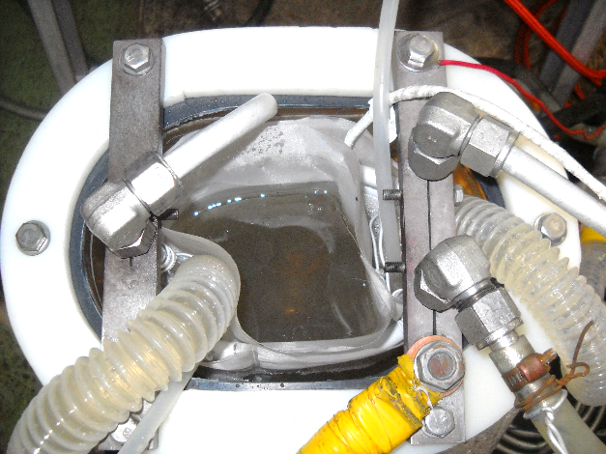
Test results of electro-polishing for quarter-wave resonators by Keisuke Nii
Introduction to the Tokai Tandem Accelerator and superconducting booster and its current situation
  Out of service for some time, trying to get it back in operations
Description of the EP procedure and setup
Four rounds of EP applied to the spare cavity
Unfortunately, the cavity didn’t reach the expected
5 MV/m at 4 W (only 4.2 MV/m)
Lessons learnt: uneven thickness removal, no significant improvement on surface roughness, traces of bubbles…
Next steps: review electrode shape, improve flow method…
TTC2022 - WG2 Summary - Low-Beta Machine Commissioning and Operational Experience - B. Laxdal, K. Masuda, Z. Yao, J. A. Rodriguez

Slide 19
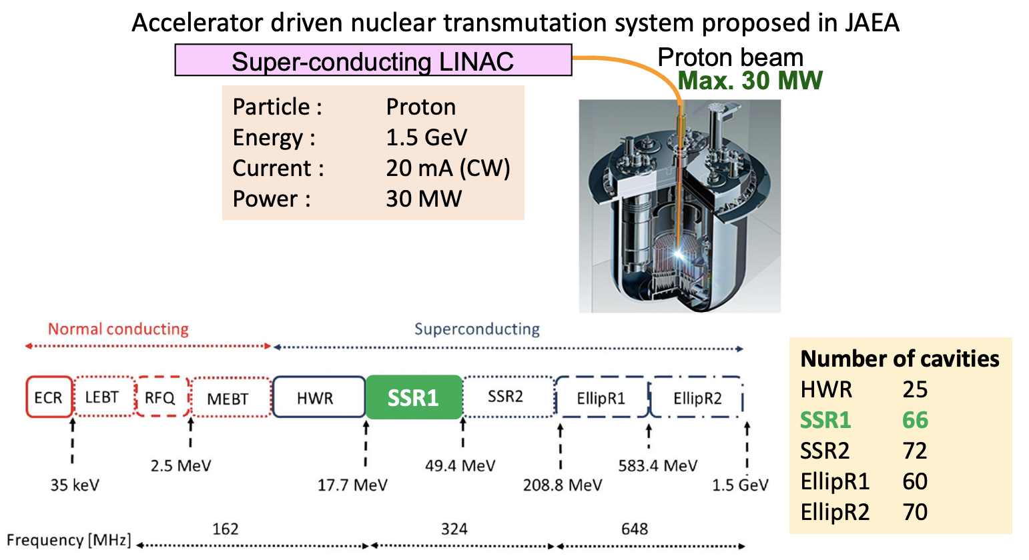
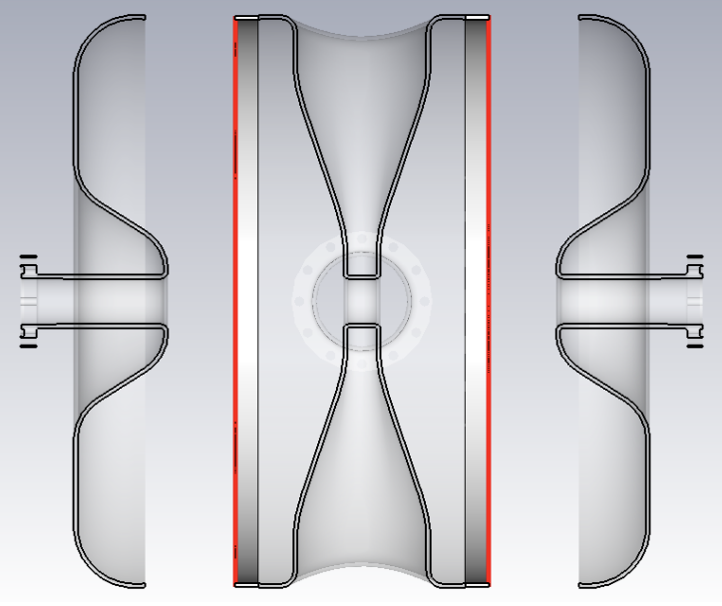
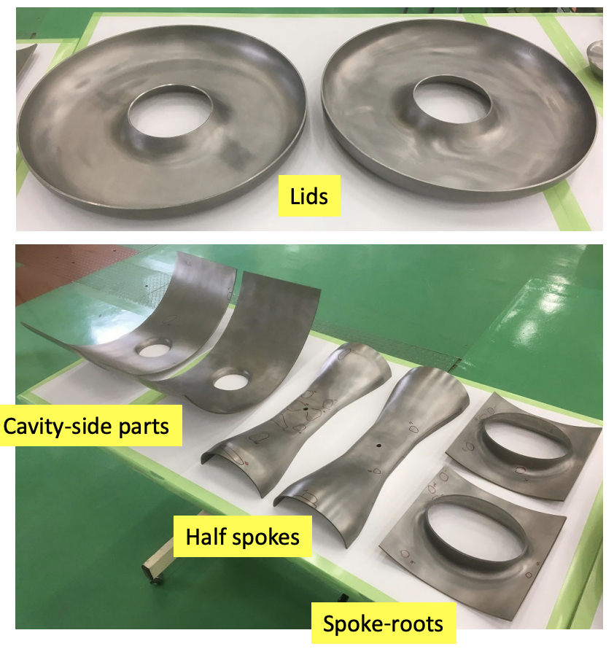
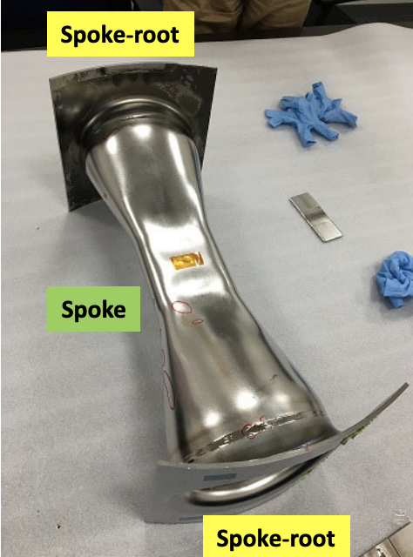


Fabrication Status of the Prototype Spoke Cavity for the JAEA‐ADS Linac by Jun Tamura
Spoke cavity design parameters:
  324 MHz, betag: 0.188, EM model, TTF curve…
Cavity parts
Press forming
Electron beam welding
Frequency measurements:
  Measured: 377.96 MHz
  EM model: 379.15 MHz
  Difference can be corrected by shortening the length of the cavity body
Beam ports next
TTC2022 - WG2 Summary - Low-Beta Machine Commissioning and Operational Experience - B. Laxdal, K. Masuda, Z. Yao, J. A. Rodriguez

Slide 20




LIPAc cryomodule assembly progress and lessons learnt by Janic Chambrillon
Report on the current status:
  Assembly of all cavities with their power couplers completed
  Solenoids leak checked
Discussion on merits and drawbacks of the Helicoflex gaskets
Issues on the superconducting solenoids
  CT scan as a powerful non-invasive diagnostic
Issue with BPM button
TTC2022 - WG2 Summary - Low-Beta Machine Commissioning and Operational Experience - B. Laxdal, K. Masuda, Z. Yao, J. A. Rodriguez

Slide 21




Lessons learned during the HPR of the superconducting solenoids of the LIPAc linac by Takashi Ebisawa
Need for HPR: Distance to the SRF cavities
Description of the HPR procedure
  Visual inspection
  Preparation for cleaning
  Ultrasonic cleaning with alkali detergent
  HPR at MHI facility
  Mounting of BPM and leak checking
Issues with the transport from Europe
  Vibrations, customs inspection…?
Issue with loose screws in two of the solenoids
  Inspection with endoscope
HPR procedure successfully completed
TTC2022 - WG2 Summary - Low-Beta Machine Commissioning and Operational Experience - B. Laxdal, K. Masuda, Z. Yao, J. A. Rodriguez

Slide 22
Conclusion:
Excellent presentations and very interesting discussions
Hadron SRF community is very active with many new projects just completed or in an advanced state and certainly many interesting technical issues
TTC offers an effective forum for discussion
Thank you very much to all the speakers!
TTC2022 - WG2 Summary - Low-Beta Machine Commissioning and Operational Experience - B. Laxdal, K. Masuda, Z. Yao, J. A. Rodriguez

