Slide 1
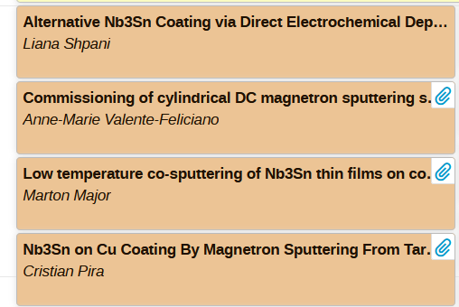
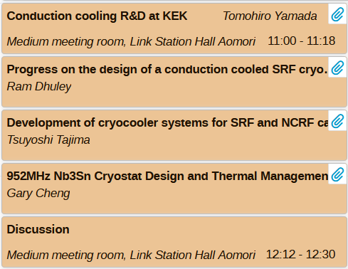
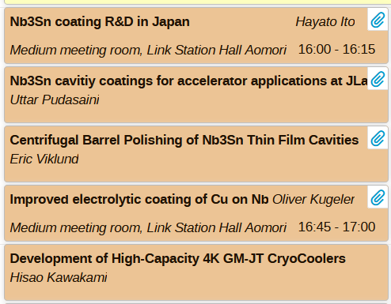
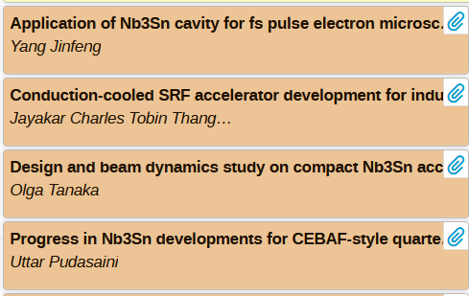
WG3 - Applications and cooling schemes for Nb₃Sn cavities
Co-conveners:
Kensei Umemori
Uttar Pudasaini
Oliver Kugeler
17(20) talks
1(4) dedicated discussion slots

Slide 2
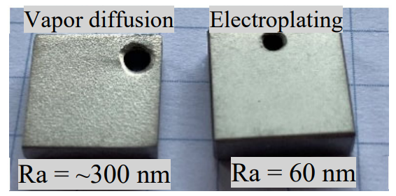
Alternative Nb₃Sn Coating via Direct Electrochemical Deposition
Liana Shpani*, Zeming Sun, Zhaslan Baraissov, Matthias Liepe, Cornell University, Ithaca, NY
Alternative growth method of Nb₃Sn is electroplating:
  (1) Deposit Sn layer onto Nb
  (2) Thermal conversion to Nb₃Sn
Using this method, we have been able to achieve:
Low surface roughness (~4-5 times lower than vapor diffusion)
Stoichiometric Nb₃Sn with little variations in Sn concentration vs depth
This method has been scaled up and tested on a SRF cavity.
First-ever successful alternative growth method!
Promising RF results: low surface resistance => high Q factor
Room for improvement (future work)
Stay tuned: Z. Sun et al. "Design principles for achieving record-low surface roughness of stoichiometric Nb₃Sn superconductors", in preparation.
*ls936@cornell.edu

Slide 3
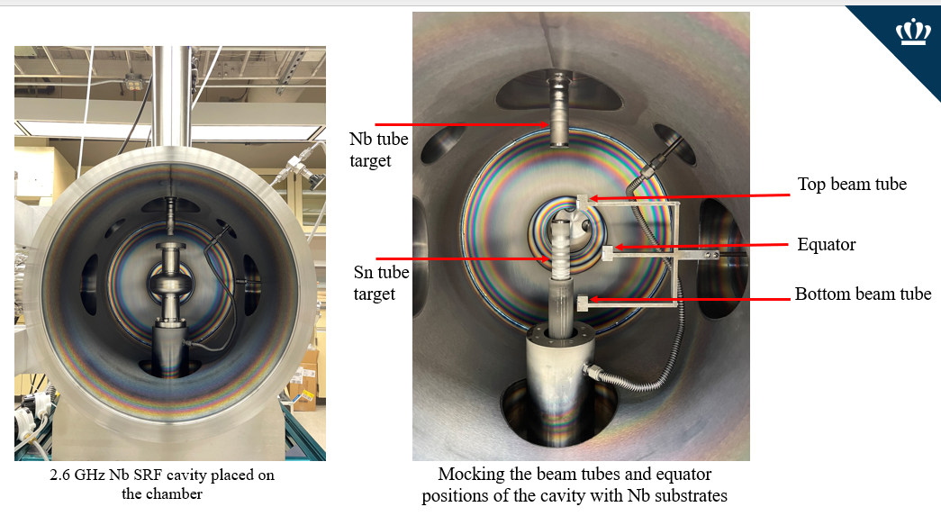
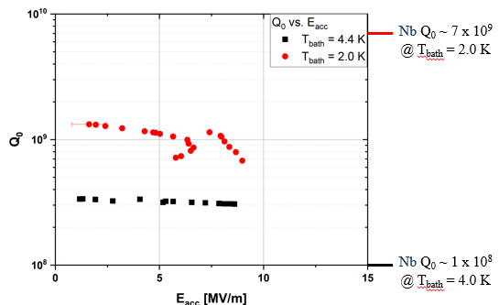
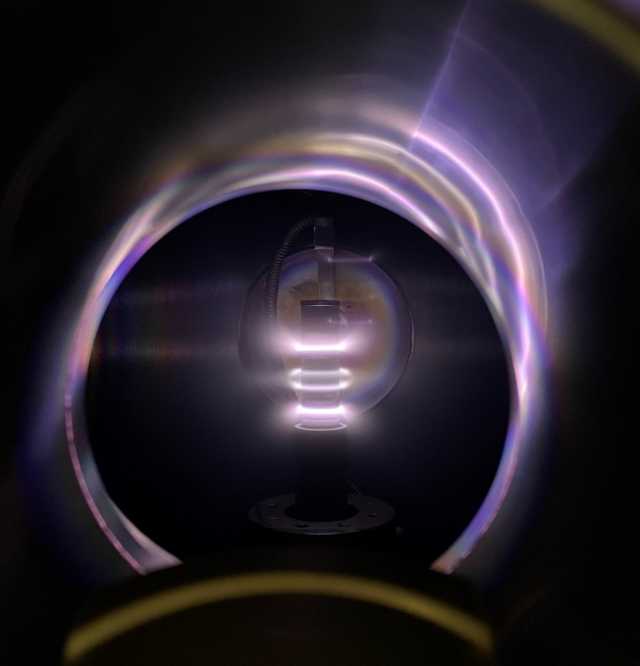
「Nb3Sn coating of a 2.6 GHz Nb SRF cavity using a Cylindrical Magnetron Sputtering System」Anne-Marie Valente-Feliciano(JLab)
Cylindrical magnetron sputtering system was commissioned.
Multilayer sequential sputtering was applied to coat Nb3Sn into 2.6 GHz Nb SRF cavity.
RF test results: Q0=3.2e8 at Eacc = 5 MV/m (@4.4K), Qo=1.1e9 at Eacc = 5MV/m (@2K)

Slide 4
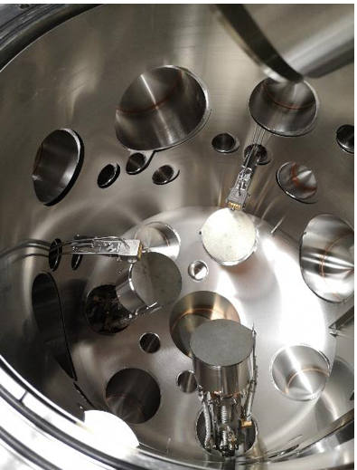
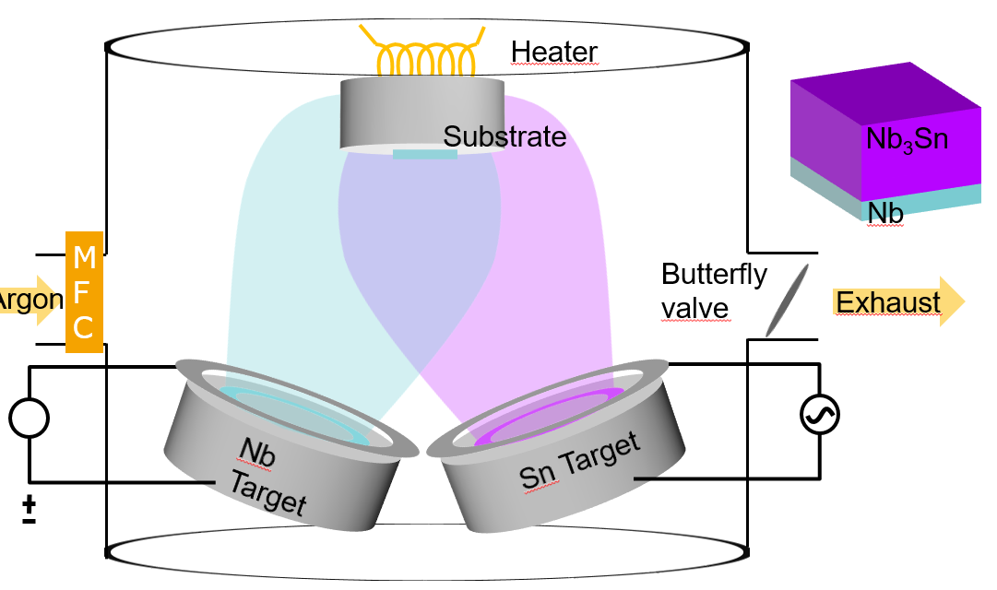
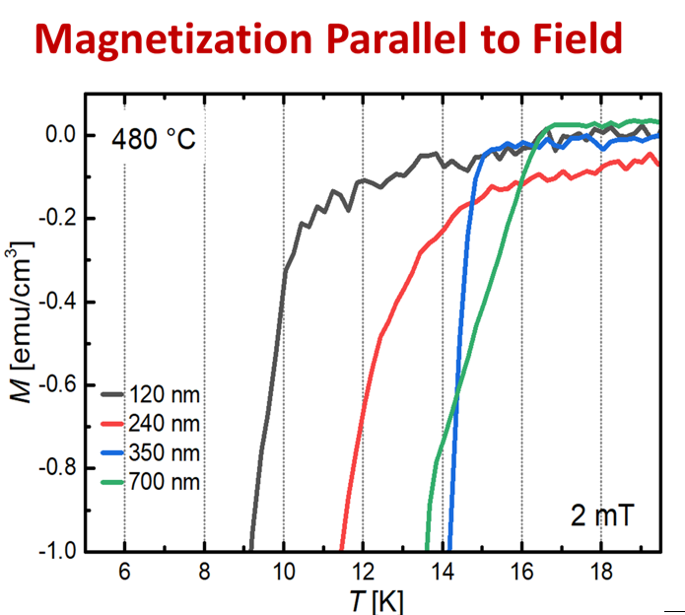
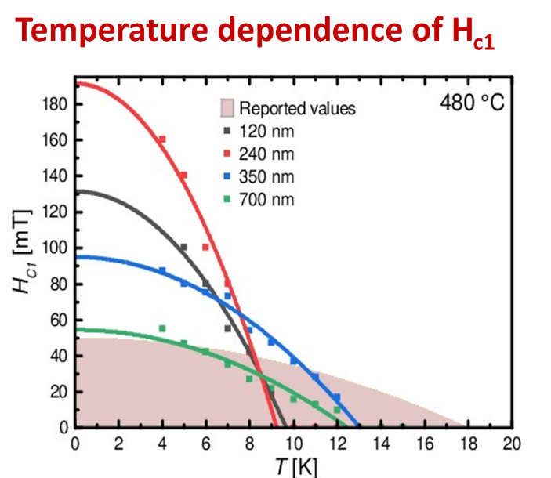
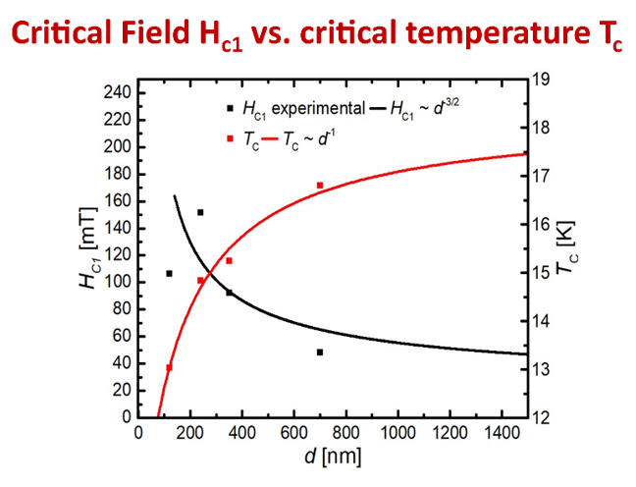
Márton Major, TU-Darmstadt: Low temperature co-sputtering of Nb₃Sn thin films on copper
Co-sputtering technique
Sputtering
chamber
Materials characterisation

Slide 5
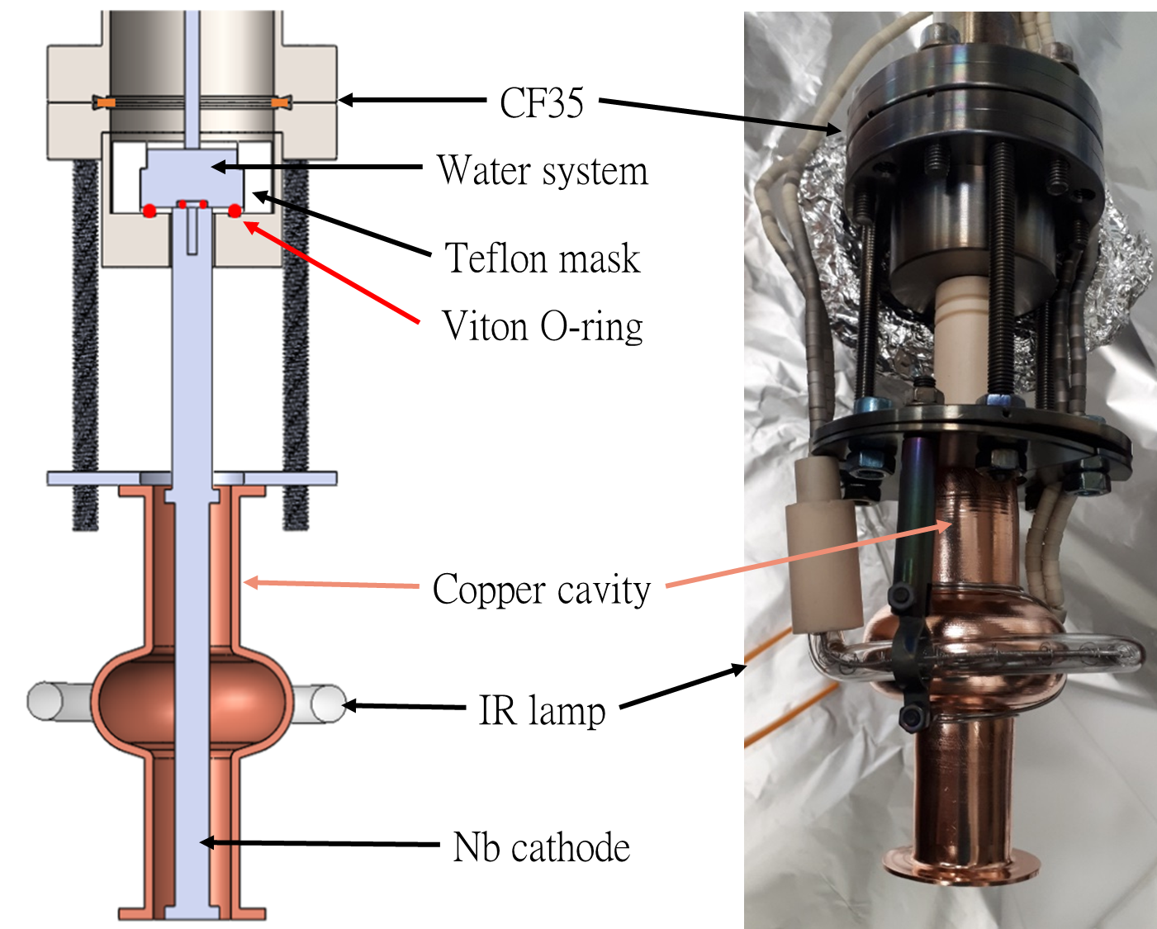
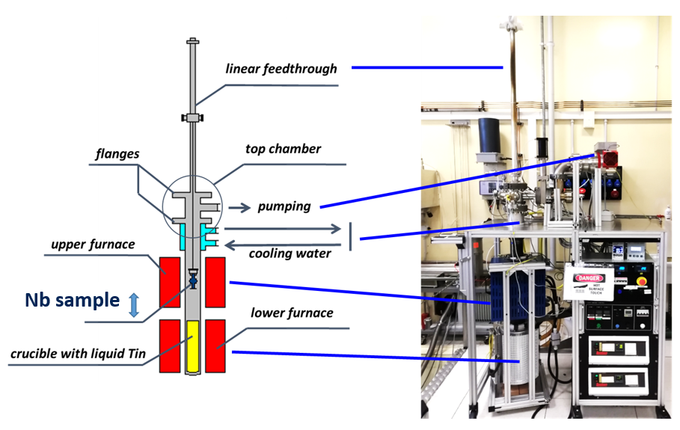
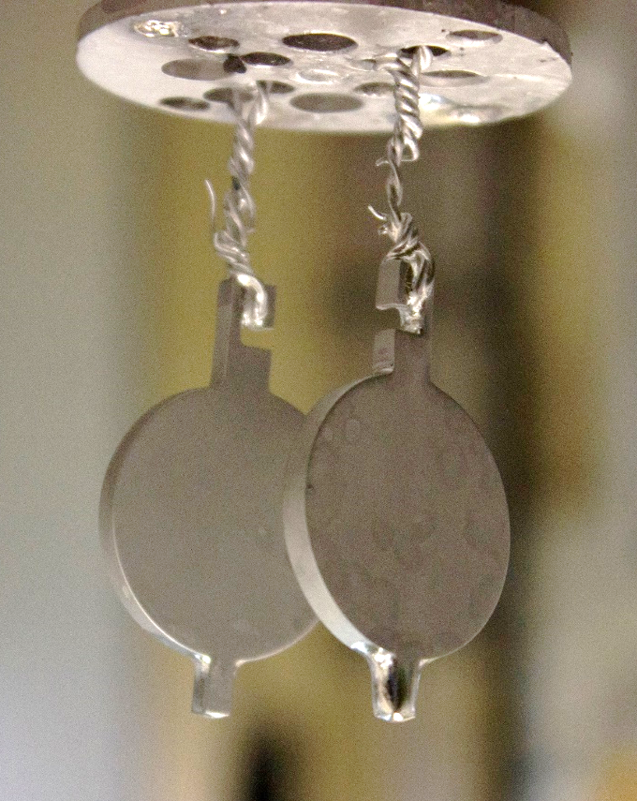
Cristian Pira, INFN Legnaro
Nb₃Sn on Cu coating by Magnetron Sputtering from Target Synthesized via Liquid Tin Diffusion
Use the same Magnetron Sputtering configuration of Nb on Cu 6 GHz elliptical cavity
Replace Nb Cylindrical target with a Nb₃Sn one
Need proper targets (Nb₃Sn is very brittle)
Create targets with liquid tin diffusion technique developed at Legnaro in 2006
Nb on Cu 6 GHz cavity coating system
Next steps:
Resolve contamination issues
Optimize sputtering parameters

Slide 6
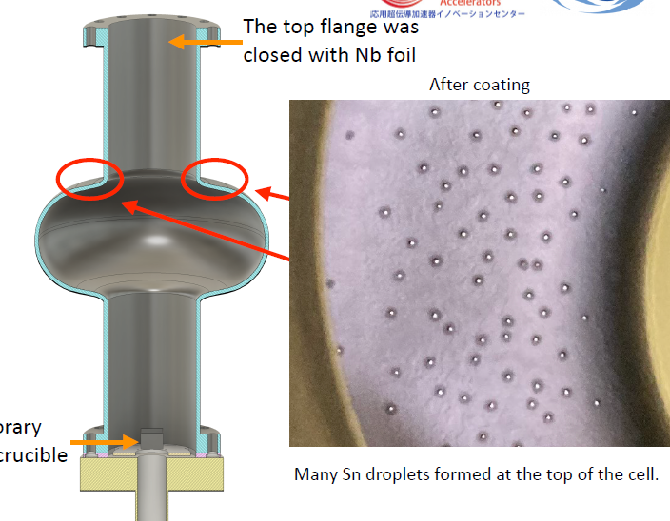
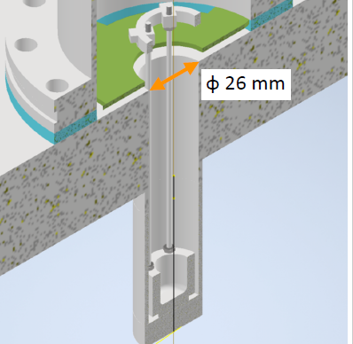
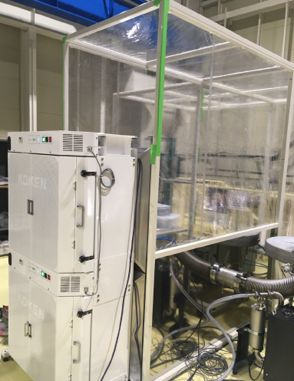
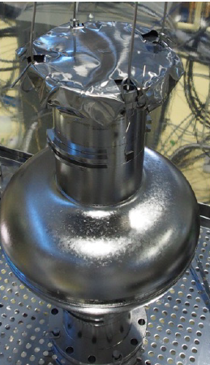
「Nb₃Sn coating R&D at KEK」Hayato Ito(KEK)
Modification of Nb₃Sn coating procedure
New Sn crucible design
Prepare cleanbooth
Applying the Nb cap on the top flange
But… Sn droplet on upper iris region
Discussion about coating procedure.
Need shading to prevent droplet?
Too much Sn source due to Nb cap?

Slide 7
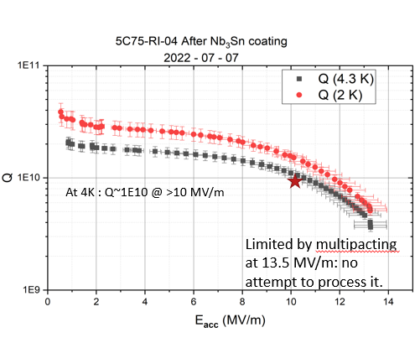
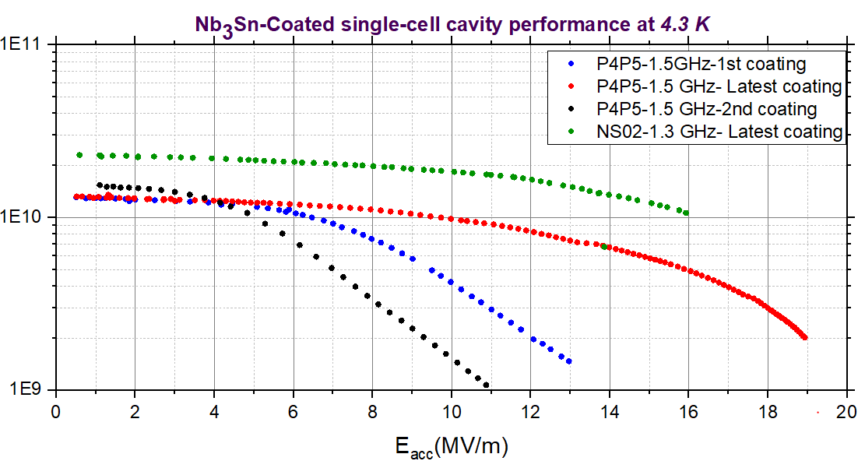
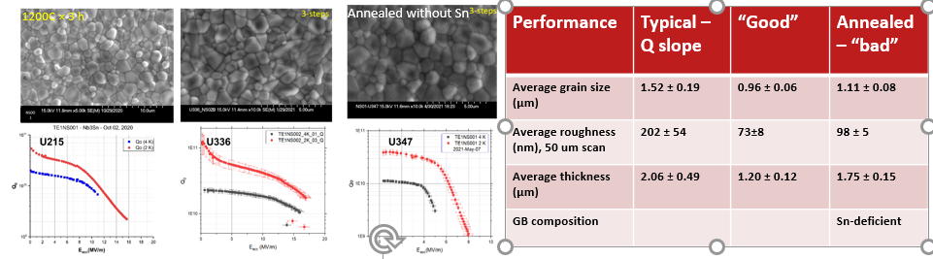
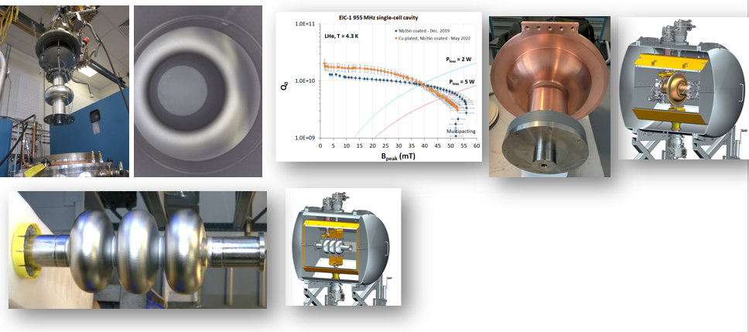
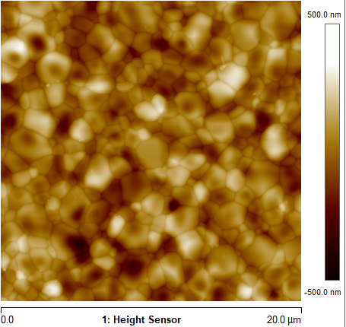
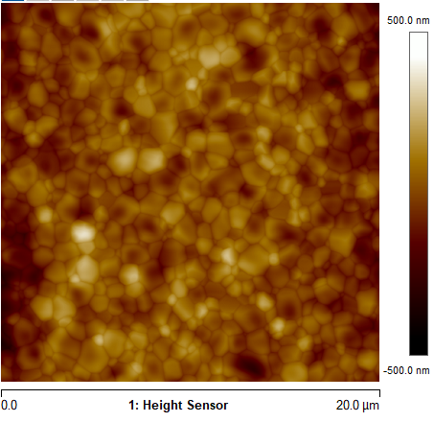
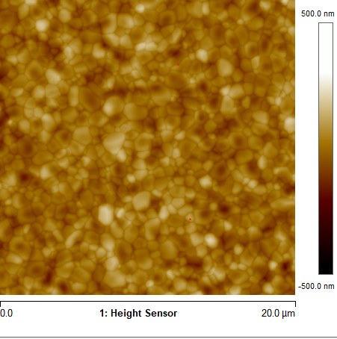
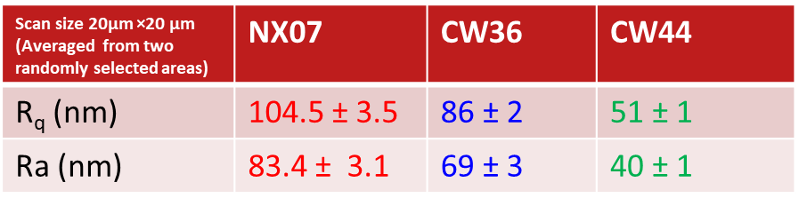
Nb₃Sn cavity coating development for accelerator applications at Jefferson Lab (U. Pudasaini et. al)
Improvement of single-cell and five-cell cavity performance continuing with updating coating process, guided by material analysis.
Five-cell cavities suitable for quarter cryomodule is produced and assembled in a pair.
Correlating RF performance with material properties and/or process parameters are ongoing.
ss
NX07
CW36
CW44
Cavity development aiming at conduction-cooled accelerators are in progress.
952 MHz Multi-metallic cavity will be tested with conduction cooled cryostat soon.
Sample studies to engineer cleaner, thinner and smoother surfaces is in progress.

Slide 8
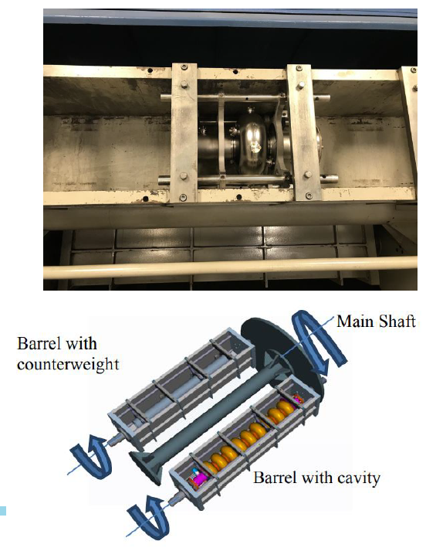
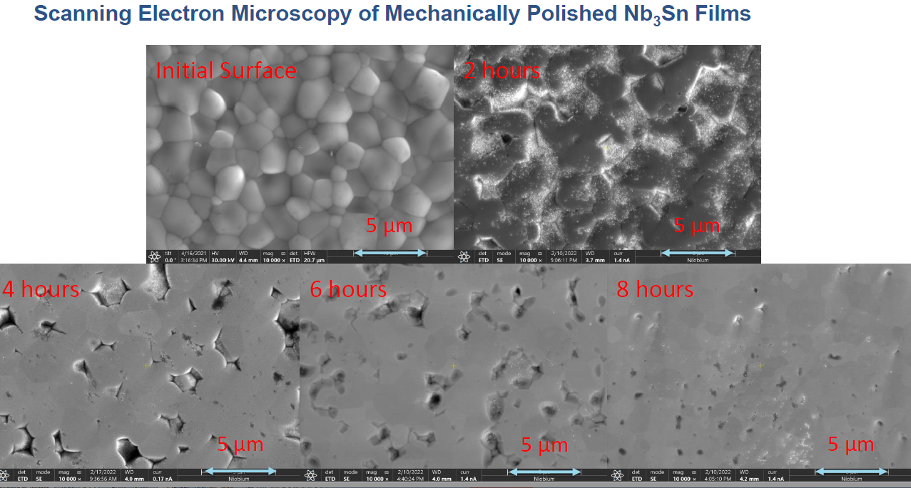
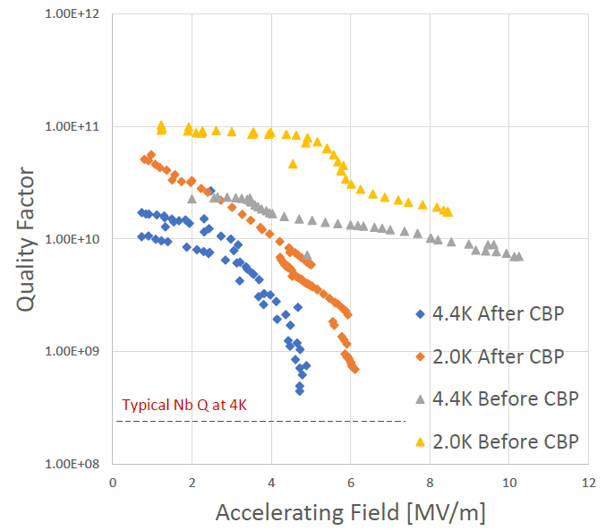
「Mechanical Polishing of Nb₃Sn Thin Films」Eric Viklund (NU/FNAL)
CBP(Centrifugal barrel polishing) was applied to Nb3Sn surface to make smooth surface.
Surface roughness was checked by coupon cavity.
CBP was applied to the Nb3Sn cavity. Degradation of Q-value was observed.
Contamination from alumina was suspected.

Slide 9
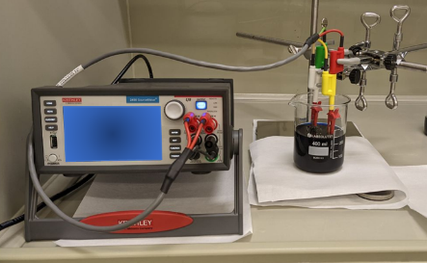
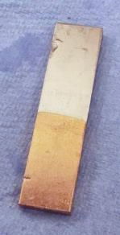

Cu/Nb Film for Cryomodule Application
A. Prudnikava, Y. Tamashevich, O. Kugeler, J. Knobloch
Topic:
Purpose:
Problem:
Develop electrolytic coating technique of copper on niobium
Improve thermal bonding between cryocooler and cavity,
minimize contact resistance
Current procedures either too slow or with insufficient quality
2nd layer
Cu
Strategy:
Results:
2-fold approach
1st Cu-layer (alkaline electrolyte): to be used as a buffer layer
2nd layer (acidic electrolyte): Cu-film of required thickness n∙100 μm
1st layer
Nb
Multiple solutions, addititives and preparation parameters were attempted
☺ Growth rate
☺ Purity
☺ Temperature stability
☺ Scratch test
☺ oxygenation
☹ need conductivity measurements
Nb
Optical image
SEM image
Cu
Notes:
Since the Copper layer currently obtained on Nb is thin – not enough for Cryo-cooler application, there is a need to build-up its thickness. We are planning to uses this Cu-layer as a sub-layer and plate a 2nd thick film on top of it with another electrolyte.
We tested the listed electrolyte compositions (on the left).
(On the right):
We studied the quality of Cu-films obtained using standard Cupric Electrolyte (deposition rate: current density, temperature)
Influence of additives onto Cu-film oxidation (SEM/EDX, XRD)
Quality of films obtained using modified Cupric Electrolytes (deposition rate, uniformity, CuO_{x})
Quality of films obtained using S.Aldrich Electrolyte

Slide 10
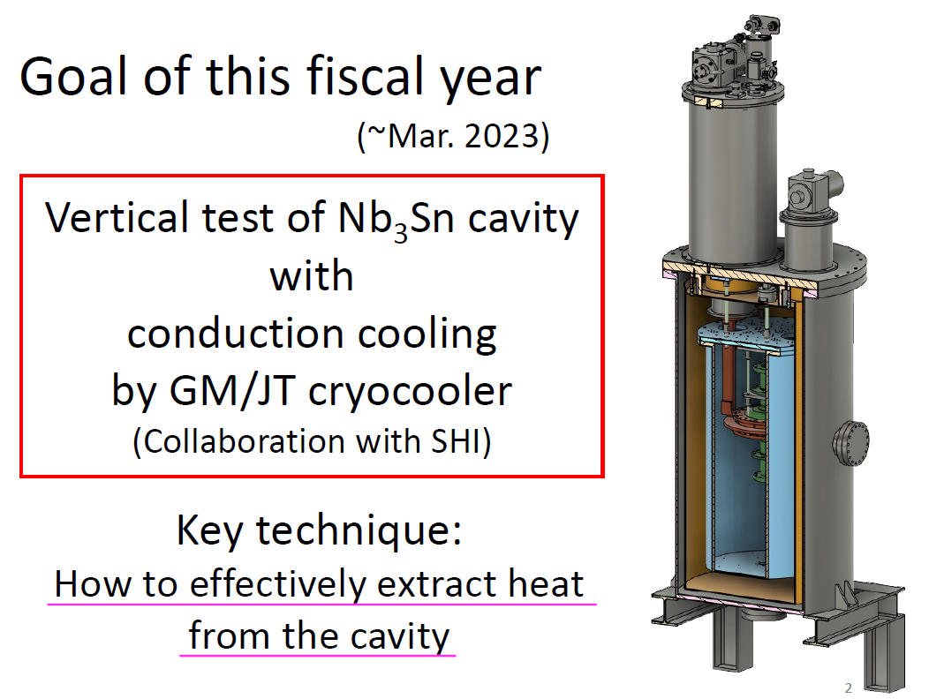
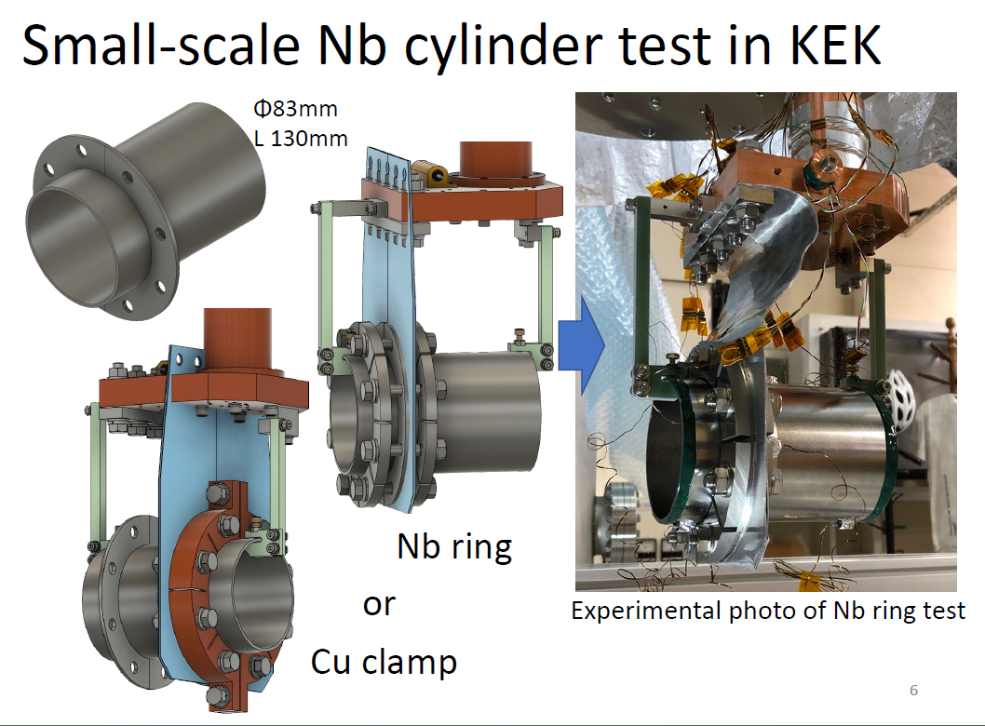
「Conduction cooling study in KEK」Tomohiro Yamada(KEK)
KEK started conduction cooling study for SRF cavity
High power test of Nb3Sn cavity with GM/JT conduction cooling is planned.
Discussion on effective cooling scheme for cavity

Slide 11
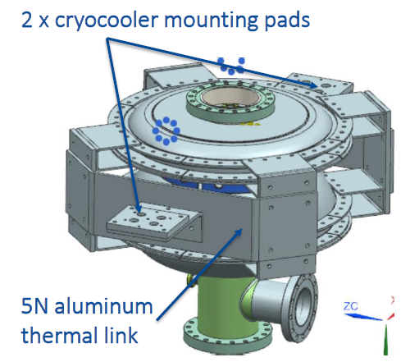
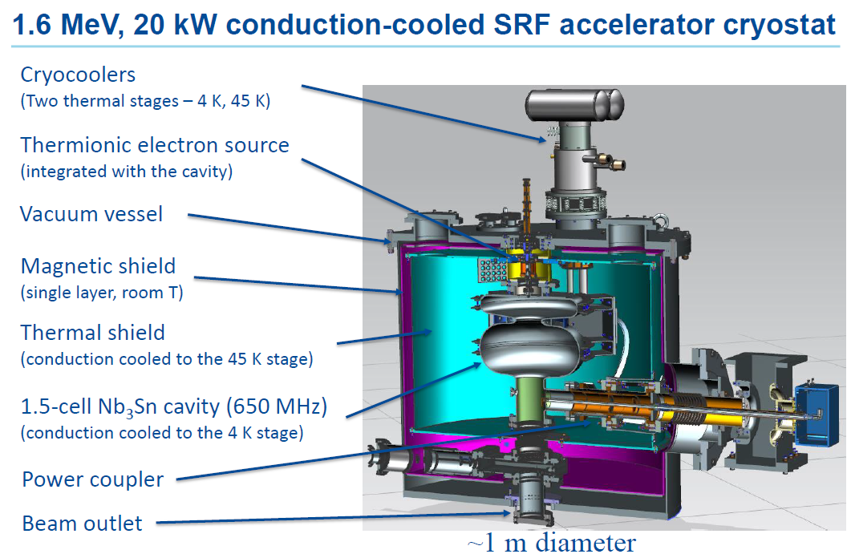
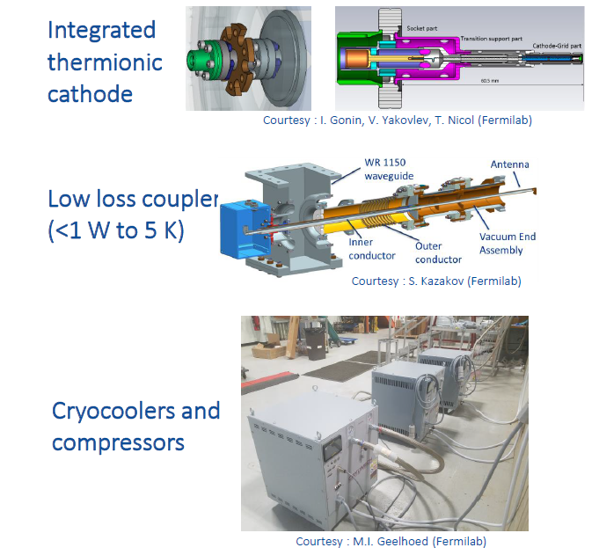
Progress on a conducting cooled SRF cryomodule at Fermilab
Ram Dhuley (FNAL) <- Jayakar Thangaray
1.6MeV, 20kW conduction cooled Nb₃Sn accelerator was designed and is now under preparation.
1.5-cell cavity, power coupler, thermionic gun will be delivered this F.Y.

Slide 12
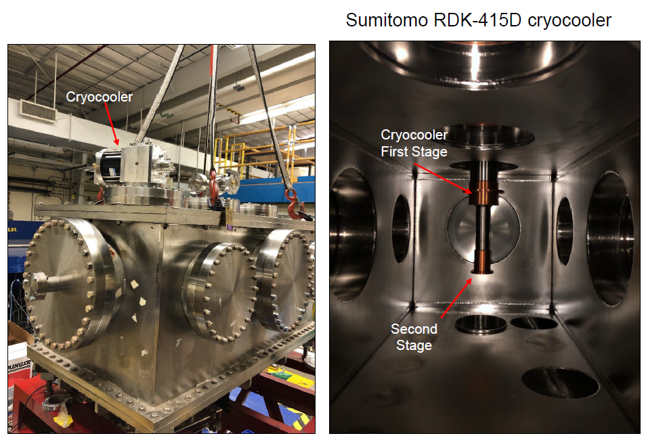
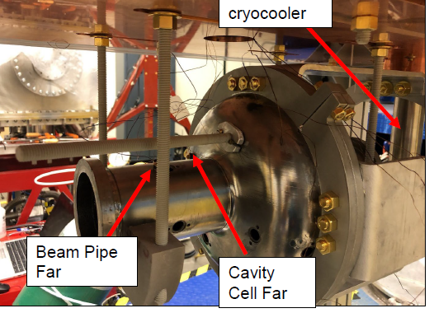
Development of Cryocooler Systems for NCRF and SRF Cavity and Component Tests at LANL
Tsuyoshi Tajima (LANL)
Aim of cryostat: Cooldown 5.1 GHz Cu NCRF cavity(LANL), 5.7 GHz C-band Cu NCRF cavity(SLAC) and 1.3 GHz Nb SRF cavity (LANL) by conduction cooling.
NCRF and SRF cavities were successfully cooled down to less than 4K. Heater test was carried out to learn cooling ability.

Slide 13
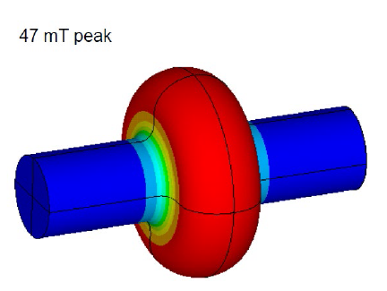
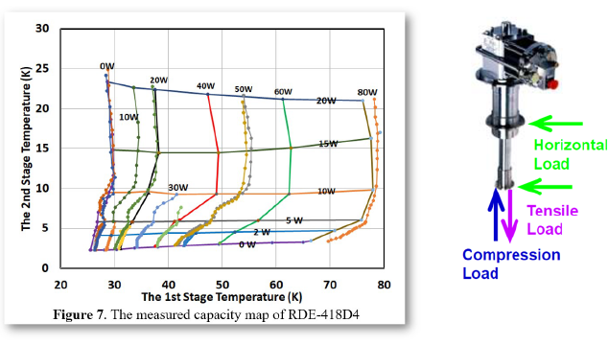
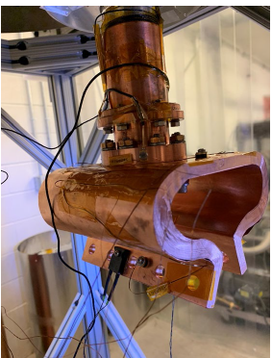
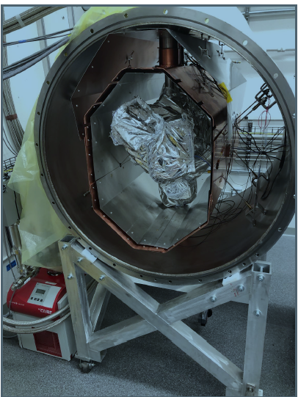
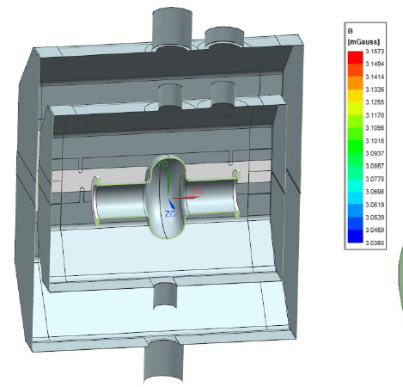
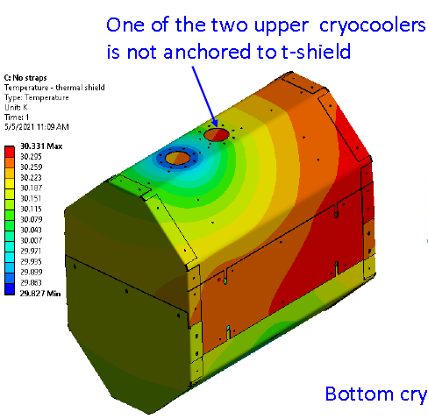
Gary Cheng, JLab - 952MHz Nb₃Sn Cryostat Design and Thermal Management
Cavity heat load at operating conditions
Thermal contacting
Implement Cryo cooler capabilities
Suspension design
Thermal force simulation
Buckling & vibration simulation
Thermal management
The 952 MHz cavity cryostat is at its final assembly stage. Most of the cold mass assembly is complete.
Final testing is planned to happen in late Oct or early Nov.
Magnet shield
Thermal shield

Slide 14
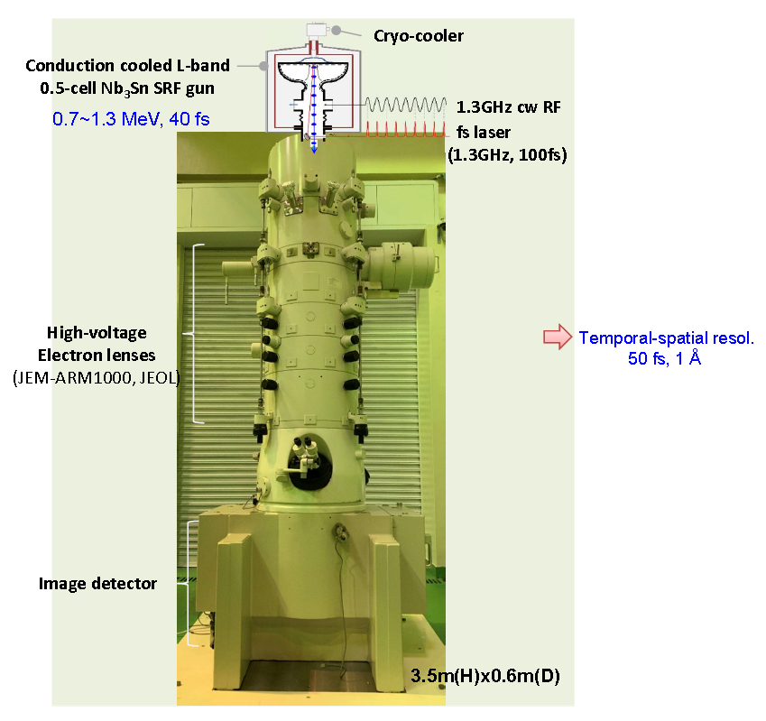
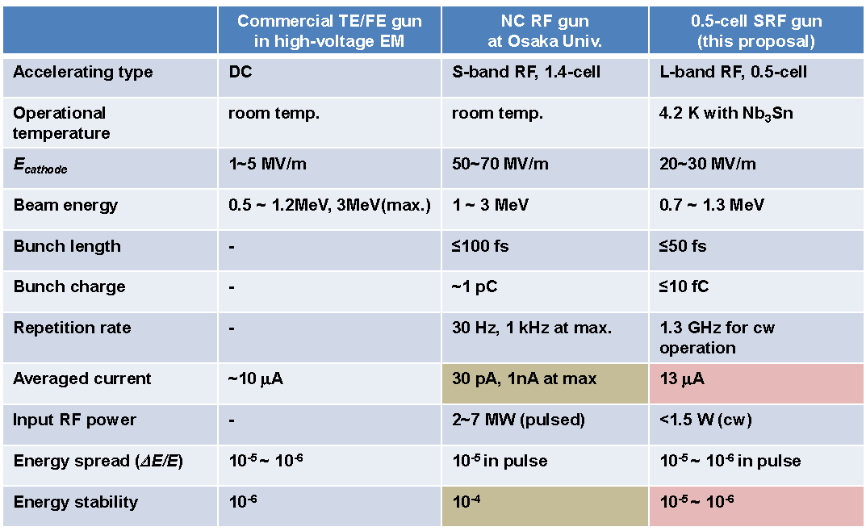
Yinfeng Yang, Osaka University - Application of Nb3Sn cavity for femtosecond-pulsed electron microscope
A functional Nb3Sn SRF gun could serve as a replacement for a huge DC gun in an ultrafast electron microscope

Slide 15
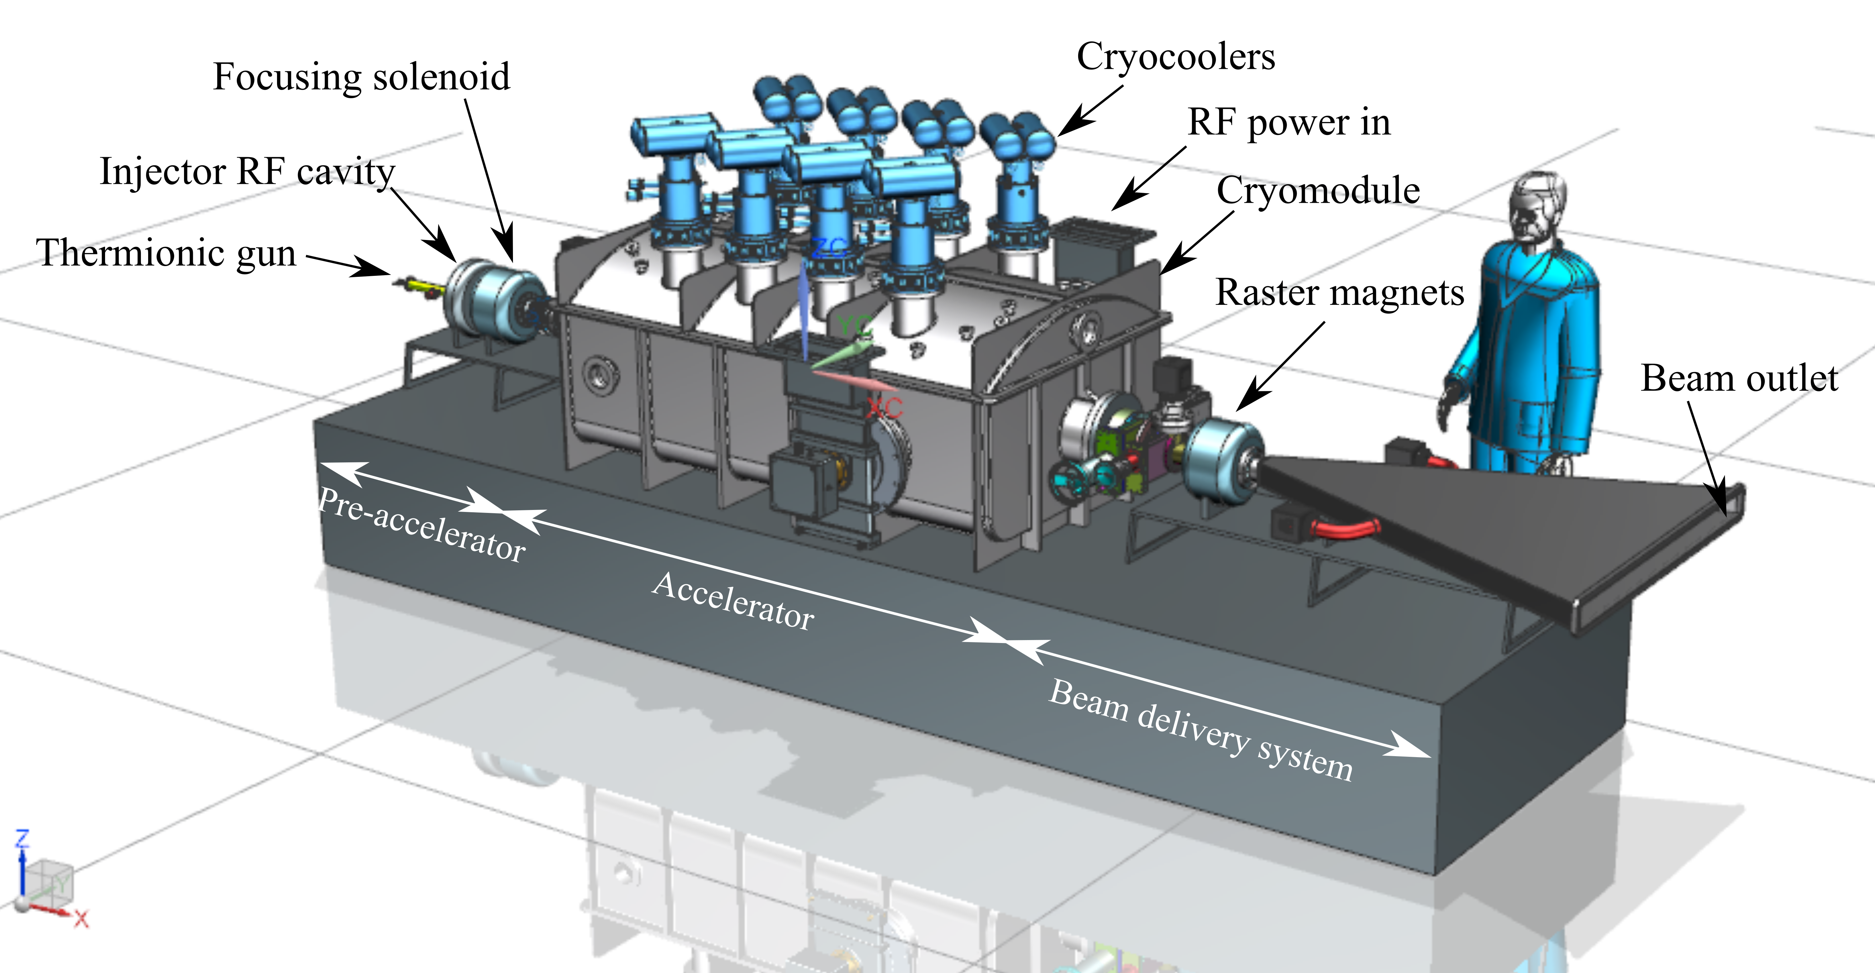
Jayakar ‘Charles’ Thangaraj on behalf of IARC@Fermilab
Conduction-cooled SRF accelerator development for industrial applications at Fermilab
Nb₃Sn based accelerator
Possible layout
Potenatial applications
Energy and Environment
Treat Municipal Waste & Sludge
    Eliminate pathogens in sludge
    Destroy organics, and pharmaceuticals in wastewater
In-situ environmental remediation
Industrial and Security
In-situ cross-link of materials
  Improve pavement lifetime
  Instant cure coatings
Medical sterilization without Co60

Slide 16
Design and beam dynamics study on compact Nb₃Sn accelerator
Olga Tanaka - KEK, Accelerator Laboratory
Design of a 10MeV 50mA accelerator for highly efficient
production of nanocellulose by irradiation of wooden samples.
• use Nb3Sn cavities instead of conventional Nb cavities:
• High-current operation (50mA) without particle loss of beam becomes possible;
• Very compact (8m x 1m x 2m) irradiation accelerator can be designed, since no conventional He refrigerator used;
• Cooling load is reduced to several tens of percent compared to conventional Nb cavities

Slide 17
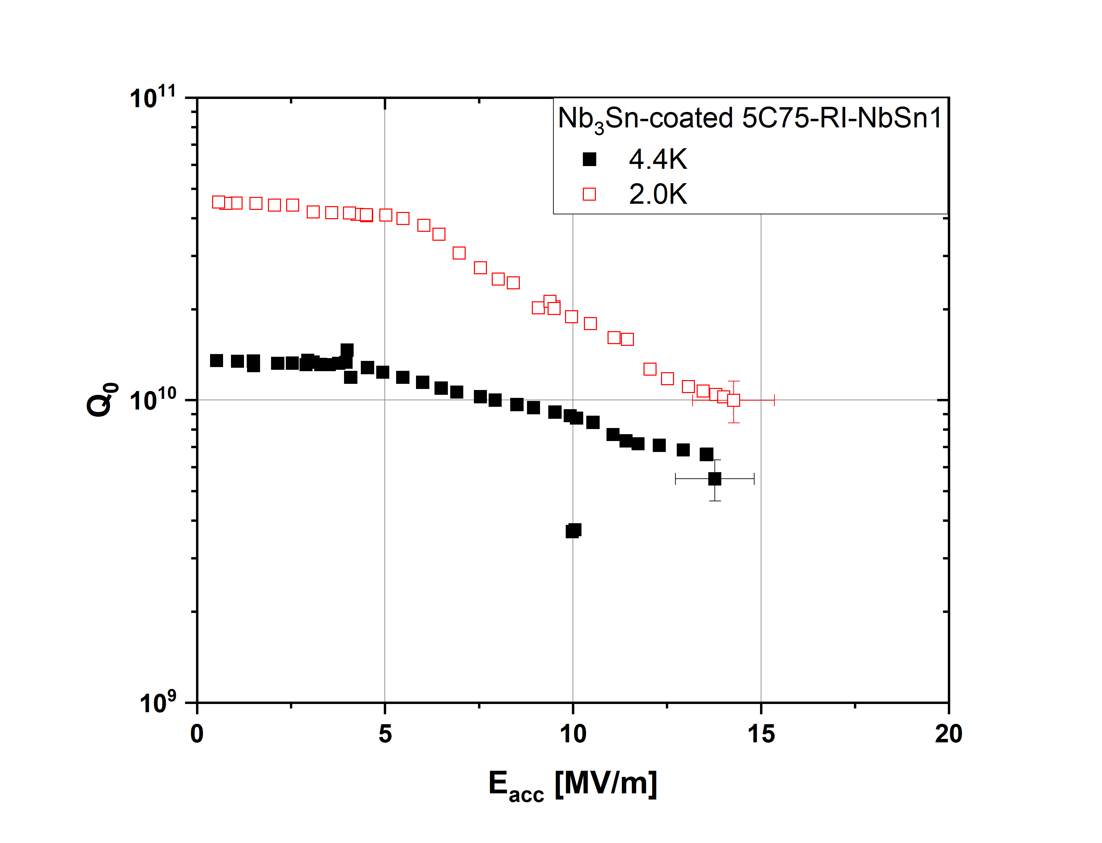





Progress in Nb₃Sn developments for CEBAF-style quarter cryomodule
(G. Eremeev (FNAL), U. Pudasaini (JLab))
Nb₃Sn cavities are extremely sensitive to Room temperature tuning.
Cavities were coated, qualified, and assembled into pair with ultimate goal to install into a QCM and perform a beam test in UITF at JLab.
Nb₃Sn cavities are very sensitive to mechanical deformation
Elimination of tuning and vertical tests as a pair reduced cavity degradation after pair assembly
With the recent change in the CM assembly for Nb₃Sn cavity, the performance is still not fully retained from vertical qualification test to cryomodule assembly.

Slide 18
First session: alternate coating techniques
There is growing interest in developing Nb₃Sn growth using techniques that avoids high temperature technique and compatible with Cu.
What are the currently most prevalent challenges for the development of Nb3Sn with techniques other than vapor diffusion technique?
  Bronze route, electro-plating, Liquid dipping, etc.
  Conventional sputtering techniques?
Where do we stand transitioning from sample studies to cavity coating using techniques other than vapor diffusion?
Can we achieve higher control in resulting film characteristics (stoichiometry, microstructure, roughness..) with alternative deposition techniques?

Slide 19
Second session: Vapor diffused Nb₃Sn and cryocooler
What is the current limitations for vapor diffused Nb₃Sn cavity?
How to reduce roughness of the coating?
  Coating protocol
  Post processing
What capacity of cryocooler do we need to operate Nb₃Sn cryomodules?
Is there any development that produce favorable cryocooler for SRF application?
Pulsed-tube versus Gifford-McMahon type of cryocooler: which one is favored?
  Sensitivity to Microphonics
Are there near-future applications of cryocoolers for SRF?

Slide 20
Third session: conduction cooling and cryomodule
Scheme of conduction cooling?
Challenging aspects of designing and developing Nb3Sn cryomodule for accelerator application?
Cooling method to prevent thermal current?
Flux trapping and its effect to Nb₃Sn cavity performance?
Pre-tuning and operational tuner Nb₃Sn cryomodule?
Design of high power coupler for high current CW accelerator and suppression of heat input to the low temperature region?

Slide 21
Fourth session: Nb₃Sn accelerator applications
How to tune Nb₃Sn cavity safely to operate it?
Optimization of electron gun and beam dynamics for industrial Nb3Sn accelerator.
When will we have first beam test with Nb₃Sn accelerator?
What is the hurdle for that?
When will we realize the prototype for industrial Nb₃Sn accelerator?
What is the difficulty for that?

Slide 22
Many thanks to all contributors to WG3

