Slide 1

Report of TTC-TB meeting hosted by QST
2022, October 12
Co-chairs
Hiroshi Sakai (KEK)
Detlef Reschke (DESY)

Slide 2
Outline
Updated member list
Report from SPC meetings + scientific program
Discussions
Topics for in-depth discussion at the next TTC
Proposal of WG-organization at the next TTC
Others

Slide 3
TTC-TB member reconfirmation
Reconfirmation of TTC-TB members in May 2022
Thanks to resigned members
Ari Palczewski, Andrew Burrill, Hirotaka Nakai, Stephane Berry,
(Kay Jensch)
Welcome to new members after discussion in last TB/CB-meeting:
Serena Barbanotti, Laura Monaco, Martina Martinello,
Laura Popielarski, Pashupati Dhakal, Sebastian Aderhold,
Axel Neumann
(Little) improved gender balance

Slide 4
Present TTC-TB member list (2022, Oct)
Co-chairs
H. Sakai (KEK)
D. Reschke (DESY)
Cavity and couplers
S. Calatroni (CERN)
R.L. Geng (ORNL)
J. Hao (PKU)
A. Romanenko (FNAL)
K. Umemori (KEK)
J.Y. Zhai (IHEP)
D. Longuevergne (IJCLab)
Z. Conway (BNL)
N. Sakamoto (RIKEN)
L. Monaco (INFN Milano)
L. Popielarski (FRIB)
M. Martinello (FNAL,SLAC)
P. Dhakal (Jlab)
RF and tuning
F. Gerigk (CERN)
A. Wheelhouse (STFC)
C. Hovater (JLab)
Cryomodule and cryogenics
S. Aderhold (SLAC)
T. Arkan (FNAL)
S. Barbanotti (DESY)
(K. Jensch (DESY) as backup)
J. Mammosser (ORNL)
A. Neumann (HZB)
Integration and operation
M. Liepe (Cornell)
E. Harms (FNAL)
J. Branlard (DESY)
Honoris causa (observer)
C. Pagani (INFN)
M. Ross (SLAC)
O. Napoly (CEA)
H. Padamsee (Cornell)
W.-D. Moeller (DESY)
P. Pierini (ESS)
Regional representatives
(observer)
C. Madec (CEA Saclay)
H. Weise (DESY)
A. Yamamoto (KEK)
Gao Jie (IHEP)
S. Belomestnykh (FNAL)
C. Ginsburg (JLab)
Total w/o observer = 26
(EU=9, NA=12, Asia=5)
gender balance: 4/26
TTC at Aomori
participation = 8 + 7

Slide 5
Chairs of permanent High-Q/High G WG
New chairs of permanent ‘High-Q/High-G’ WG:
Kensei Umemori
Akira Miyazaki (confirmed by CB in this TTC meeting)
in addition to Martina Martinello
Welcome and thank you!

Slide 6
SPC meetings + program organisation
Scientific Program Committee meeting by remote;
(SPC members: Kondo-san, Kako-san, Masuda-san, Camille, Catherine, Hans, Bob, Jie, Sergey, Akira, Hiroshi, Detlef)
Thirteen SPC meetings held: well-organized by LOC chair
Beginning with 7th meeting participation of WG conveners
Smooth and effective organization of scientific program with 2 parallel WG
Thanks to all WG-convenors for their excellent preparation of the WG-sessions

Slide 7
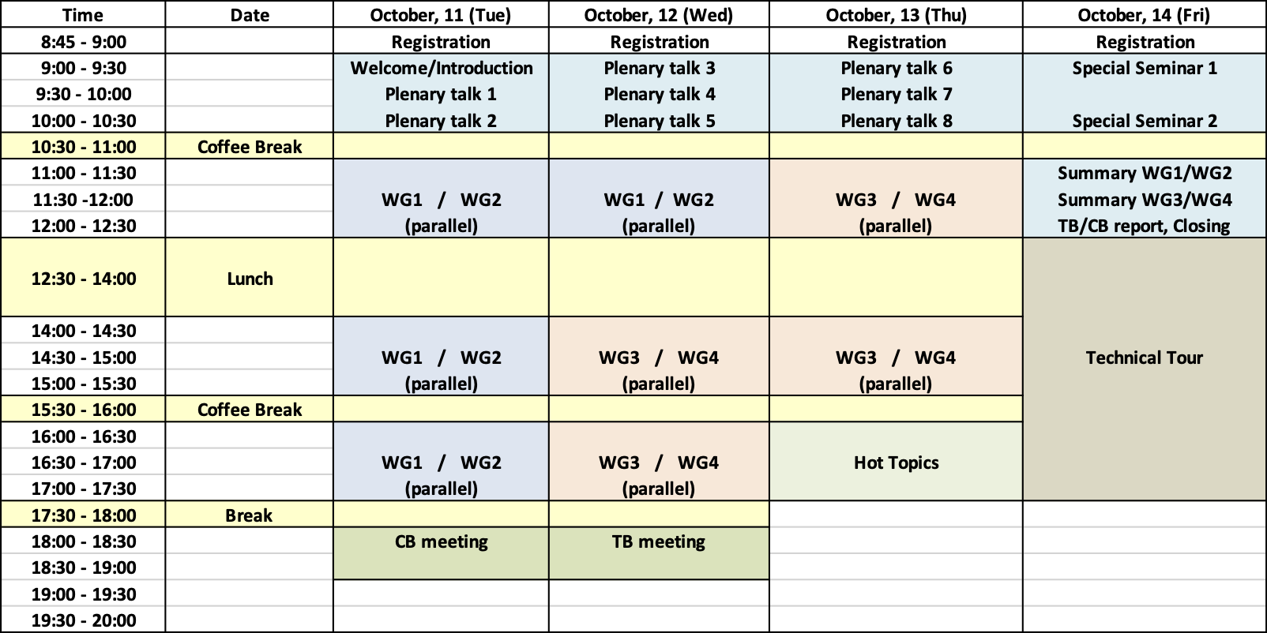
Meeting Schedule
8 plenary talks
Hot Topic
Special Seminar

Slide 8
Participants and WG-organization
Location | Date | Participants | Parallel | WGs
QST | 2022, Oct | ~120 | 2-para | 4 WG’s
QST/KEK (remote) | 2022, Jan. | 304 | 2-para | 2 WGs
DESY (remote) | 2021, Jan. | 260 | 2-para | 2 WGs
CERN | 2020, Feb. | 187 | 2-para | 4 WGs
TRIUMF | 2019, Feb. | 108 | 2-para | 4 WGs
RIKEN | 2018, June | 140 | 2-para | 4 WGs
INFN-Milano | 2018, Feb. | 178 | 2-para | 4 WGs
MSU | 2017, Feb. | 123 | 2-para. | 4 WGs
CEA-Saclay | 2016, July | 127 | 2-para. | 4 WGs
SLAC | 2015, Dec. | 130 | 2-para. | 4 WGs
KEK | 2014, Dec. | 108 | 2-para. | 6 WGs
DESY | 2014, Mar. | 129 | 3-para. | 9 WGs

Slide 9
Outline
Updated member list
Report from SPC meetings + scientific program
Discussions
Topics for in-depth discussion at the next TTC
Decided WG-organization at the next TTC
Others

Slide 10
Short-list of WG’s for TTC in 2023
WG1: Progress of High G, High Q activities (including
i) existing operation experience;
ii) large and medium grain Nb activities incl. fabrication, cavity performance, PED requirements)
WG2: Developments and experiences with Spoke Cavities
WG3: In-situ mitigation or recovery processes (including
installation of “clean” cryomodule to existing “dirty” facilities)
WG4: Cryomodule (cryogenic) operation (including
fast/slow cooldown; low pressure operation experiences with background to avoid PED regulation procedures; safety instrumentation, ….)
& Design and experiences with cw cryomodules and sub-components
Nb3Sn or other high-Tc material with cryo cooler (Hiroshi)
→ for over-next TTC meeting
Robotics, semi-automated procedures
=> to be looked at by SPC; probably one session of a “mixed” WG
High power coupler & HOM damping for high current machine
=> interesting but no decision by TB

Slide 11
Candidates (tbc) for plenary talks for next TTC
ESS cryomodule tests (incl. comparison to tests at CEA) & status of commissioning
Status (and commissioning) of PolFEL
Recent results and status of SHINE (and DALIAN)
Status of CEPC
Status and first operation of PPU at SNS
Status and progress of PIP II
Status of LCLS-II operation experience
Status of RAON operation experience
Report of Thin Film WG
Report of High Q/High G WG

Slide 12
Proposal & short list of plenary talks for next TTC
SRF technology quantum applications => good as special seminar
Axion search with SRF cavity
Novel fabrication techniques for SRF components (e.g. 3D printing, ..
Overview of SRF-gun cavities and dedicated cryomodules
SRF cavities for coming & future lepton colliders (FCC-ee, CEPC, EIC ?, …)
to be decided if HOM damping, input couplers for high currents, high power rf installation and other sub-systems will be included

Slide 13
Hot Topic Session in the next TTC ?
One hot topic session in addition ?
=> to be decided by SPC in summer 23
Possible hot topic
Situation with qualified suppliers for critical components (e.g. Nb material, cavities, valves; etc.) incl. Look-out to next 5-10 years
→ to be decided by SPC

Slide 14
Decided WG-organization in the next TTC
Two parallel sessions
How many WG’s? => 4 WG’s decided
Explicit hope for no further Covid-restrictions
=> in-person meeting strongly preferred
Lessons learned for next meeting(s):
if possible,
- separate large room for plenary talks
- two smaller rooms for discussion of WG’s (no micro necessary)
Recommend less number of talks, more discussion time
=> adequate adjustment & preparation by convenors necessary
One hot topic session in addition ? => to be decided by SPC about 6 months in advance

Slide 15
Thank you very much to the Kondo-san and all the LOC for the warm welcome at Aomori and the excellent organisation of this
TTC meeting!
Thank you for your attention.

