Slide 1
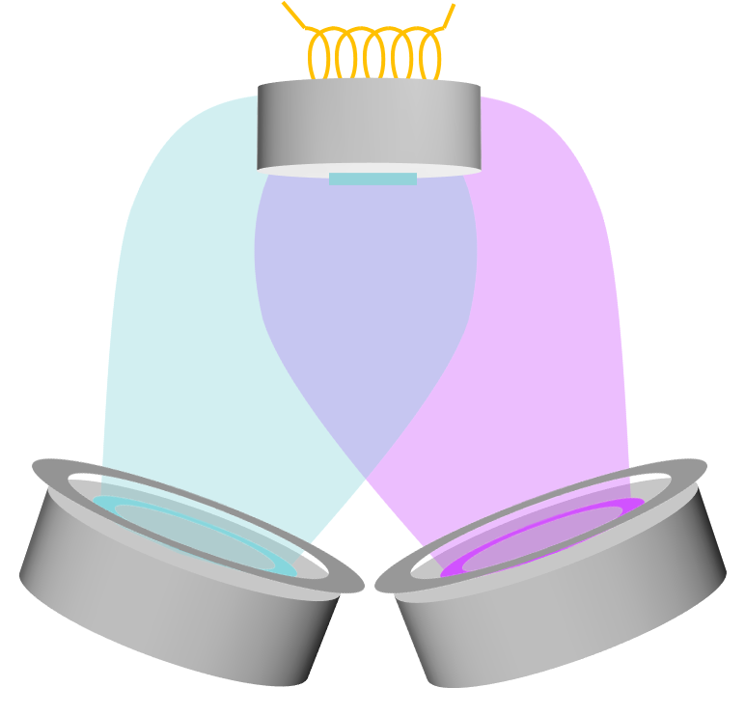
Low temperature co-sputtering of Nb₃Sn thin films on copper
Márton Major, Nils Schäfer, Alexey Arzumanov, Hamidreza Ghasemi and Lambert Alff
Department of Materials Science, Advanced Thin Film Technology Group,
Technical University of Darmstadt, Germany

Slide 2
Possible superconducting materials for RF cavities
Material | Critical Temp. T_{c} [K] | Normal-state resistivity ρ_{n} [μΩcm] | Critical Field H_{c}(0) [T] | Lower Critical field H_{c1}(0) [T] | Upper Critical field H_{c2}(0) [T] | Penetration depth λ(0) [nm] | Δ [meV] | Type
Nb | 9.23 | 2 | 0.2 | 0.18 | 0.28 | 40 | 1.5 | II
Pb | 7.2 |  | 0.08 | N/A | N/A | 48 |  | I
NbN | 16.2 | 70 | 0.23 | 0.02 | 15 | 200-350 | 2.6 | II, B1 comp.
NbTiN | 17.3 | 35 |  | 0.03 |  | 150-200 |  | II, B1 comp.
Nb₃Sn | 18 | 20 | 0.54 | 0.05 | 30 | 80-100 | 3.1 | II, A15
V₃Si | 17 |  |  |  | 24.5 | 179 |  | II, A15
Mo₃Re | 15 |  | 0.43 | 0.03 | 3.5 | 140 |  | II, A15
MgB₂ | 40 | 0.1-10 | 0.43 | 0.03 | 3.5-60 | 140 | 2.3/7.2 | II- 2 gaps
YBCO | 93 |  | 1.4 | 0.01 | 100 | 150 | 20 | d-wave
Pnictides | 30-55 |  | 0.5-0.9 | 30 | >100 | 200 | 10-20
Whistler 2015, SRF Tutorial - Pushing Nb Performance - A.-M. Valente-Feliciano

Slide 3
Possible superconducting materials for RF cavities
Material | Critical Temp. T_{c} [K] | Normal-state resistivity ρ_{n} [μΩcm] | Critical Field H_{c}(0) [T] | Lower Critical field H_{c1}(0) [T] | Upper Critical field H_{c2}(0) [T] | Penetration depth λ(0) [nm] | Δ [meV] | Type
Nb | 9.23 | 2 | 0.2 | 0.18 | 0.28 | 40 | 1.5 | II
Pb | 7.2 |  | 0.08 | N/A | N/A | 48 |  | I
NbN | 16.2 | 70 | 0.23 | 0.02 | 15 | 200-350 | 2.6 | II, B1 comp.
NbTiN | 17.3 | 35 |  | 0.03 |  | 150-200 |  | II, B1 comp.
Nb₃Sn | 18 | 20 | 0.54 | 0.05 | 30 | 80-100 | 3.1 | II, A15
V₃Si | 17 |  |  |  | 24.5 | 179 |  | II, A15
Mo₃Re | 15 |  | 0.43 | 0.03 | 3.5 | 140 |  | II, A15
MgB₂ | 40 | 0.1-10 | 0.43 | 0.03 | 3.5-60 | 140 | 2.3/7.2 | II- 2 gaps
YBCO | 93 |  | 1.4 | 0.01 | 100 | 150 | 20 | d-wave
Pnictides | 30-55 |  | 0.5-0.9 | 30 | >100 | 200 | 10-20
Whistler 2015, SRF Tutorial - Pushing Nb Performance - A.-M. Valente-Feliciano

Slide 4
Possible superconducting materials for RF cavities
Material | Critical Temp. T_{c} [K] | Normal-state resistivity ρ_{n} [μΩcm] | Critical Field H_{c}(0) [T] | Lower Critical field H_{c1}(0) [T] | Upper Critical field H_{c2}(0) [T] | Penetration depth λ(0) [nm] | Δ [meV] | Type
Nb | 9.23 | 2 | 0.2 | 0.18 | 0.28 | 40 | 1.5 | II
Pb | 7.2 |  | 0.08 | N/A | N/A | 48 |  | I
NbN | 16.2 | 70 | 0.23 | 0.02 | 15 | 200-350 | 2.6 | II, B1 comp.
NbTiN | 17.3 | 35 |  | 0.03 |  | 150-200 |  | II, B1 comp.
Nb₃Sn | 18 | 20 | 0.54 | 0.05 | 30 | 80-100 | 3.1 | II, A15
V₃Si | 17 |  |  |  | 24.5 | 179 |  | II, A15
Mo₃Re | 15 |  | 0.43 | 0.03 | 3.5 | 140 |  | II, A15
MgB₂ | 40 | 0.1-10 | 0.43 | 0.03 | 3.5-60 | 140 | 2.3/7.2 | II- 2 gaps
YBCO | 93 |  | 1.4 | 0.01 | 100 | 150 | 20 | d-wave
Pnictides | 30-55 |  | 0.5-0.9 | 30 | >100 | 200 | 10-20
Whistler 2015, SRF Tutorial - Pushing Nb Performance - A.-M. Valente-Feliciano

Slide 5
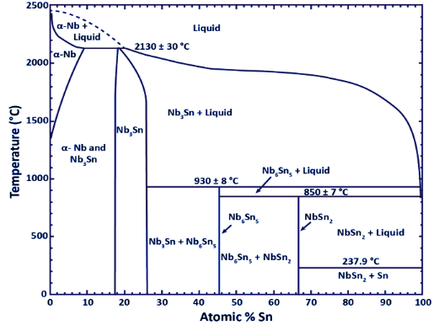
Nb-Sn phase diagram
Charlesworth JP, Macphail I, Madsen PE. Experimental work on the niobium-tin constitution diagram and related studies. Journal of Materials Science. 1970 Jul 1;5(7):580-603.

Slide 6
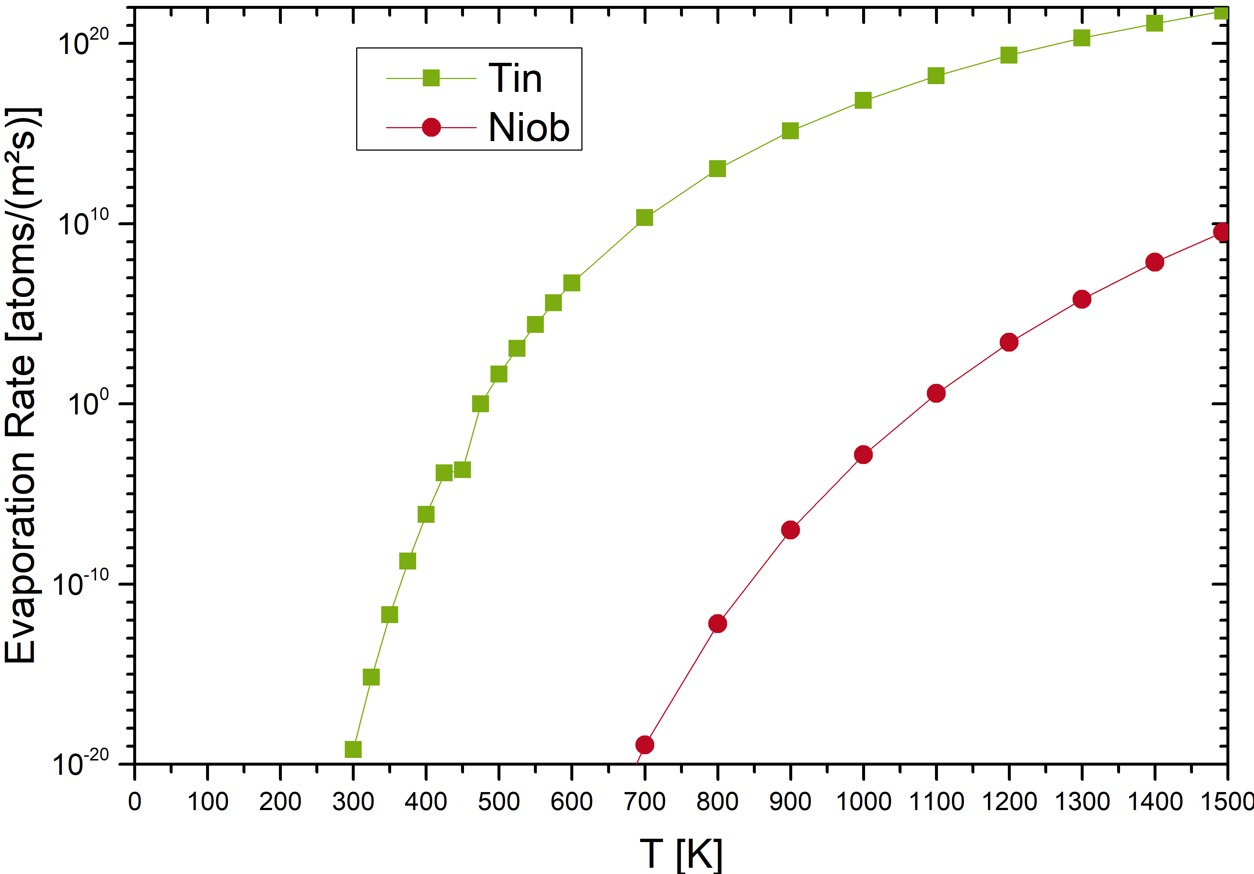
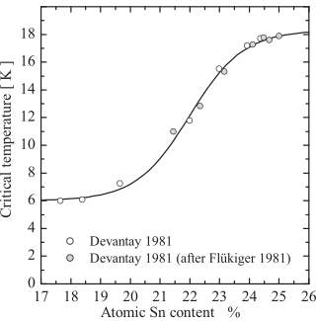
Challenge: Vapor-pressure of Sn

Slide 7
Process routes of thermal Nb₃Sn synthesis
Single target sputtering (amorphous Nb₃Sn on Nb, oxides,…)
Nb₃Sn
Nb
+ 3 – 24 h
800 – 1200 °C
Sn
Nb₃Sn
Nb
Nb
Tin sputtering, tin evaporation, … (Sn layers on Nb)
Nb
Sn
Nb
Multilayer sputtering (Nb/Sn layers on Nb, oxides,…)
Sn
Nb

Slide 8
TUDa approach: Nb₃Sn co-sputtering
Heater
Substrate
Nb₃Sn
Nb
MFC
Butterfly valve
Argon
Exhaust
Nb Target
Sn Target

Slide 9
Nb₃Sn roadmap
Optimization of the sputtering parameters (sputter power, substrate temperature, etc.) on fused silica substrate
Adaptation of the growth parameters (further optimization of growth temperature etc.) for copper substrate
Upscaling of the sputtering process to the cavity geometry

Slide 10
Optimization of growth parameters on fused silica substrate

Slide 11
Stoichiometry vs power ratio
N. Schäfer et al, J. Appl. Phys. 128, 133902 (2020); https://doi.org/10.1063/5.0015376
Tin content measured by EDX plotted as a function of Nb dc magnetron
sputtering power input. Substrate was kept at room temperature. The stoichiometric tin content in Nb₃Sn of 25% is marked by the line.

Slide 12
Stoichiometry vs temperature at P_{Nb}/P_{Sn} = 5.25 (optimized)
Tin content measured by EDX plotted as a function of substrate temperature
at a fixed power ratio of 5.25. The stoichiometric tin content in Nb3Sn of
25% is marked by the dashed line.
(20W Sn / 105W Nb)
N. Schäfer et al, J. Appl. Phys. 128, 133902 (2020); https://doi.org/10.1063/5.0015376

Slide 13
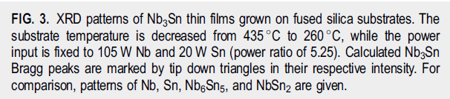
XRD: Temperature Study

Slide 14
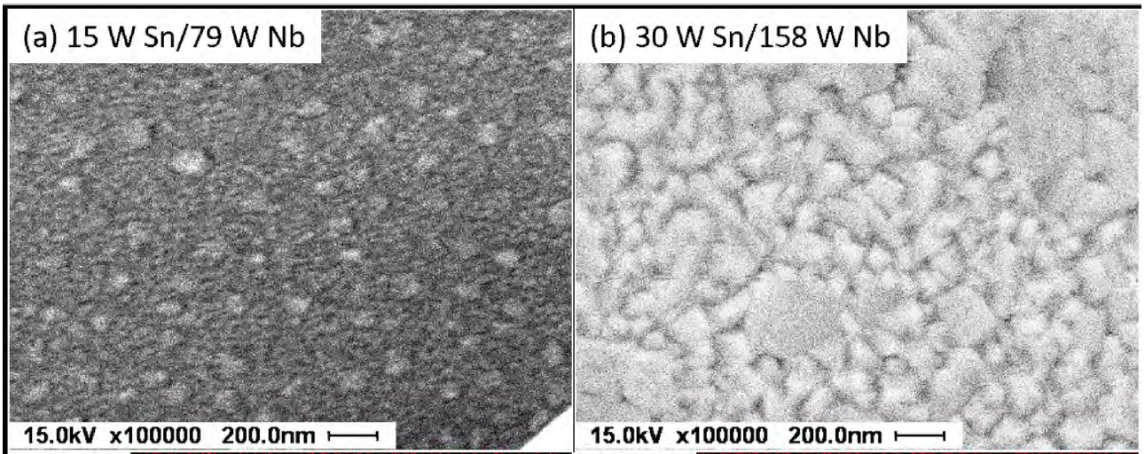
Nb₃Sn morphology on fused silica substrate
Secondary electron images [(a) and (b)] of sputtered Nb₃Sn thin films at a fixed substrate temperature of 435 °C and a power ratio of 5.25, while the power input is increased from 15 W Sn/79W Nb (a) to 30 W Sn/158 W Nb (b).

Slide 15
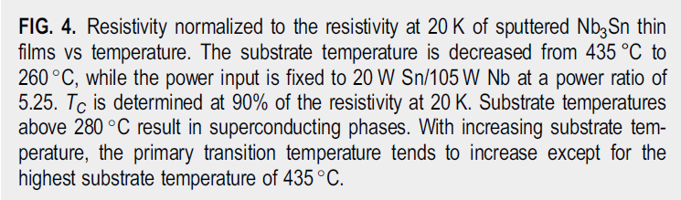
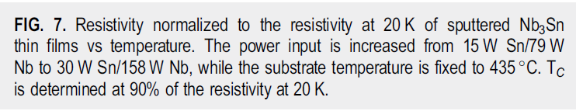
R-T measurements as function of substrate temperature and power input

Slide 16
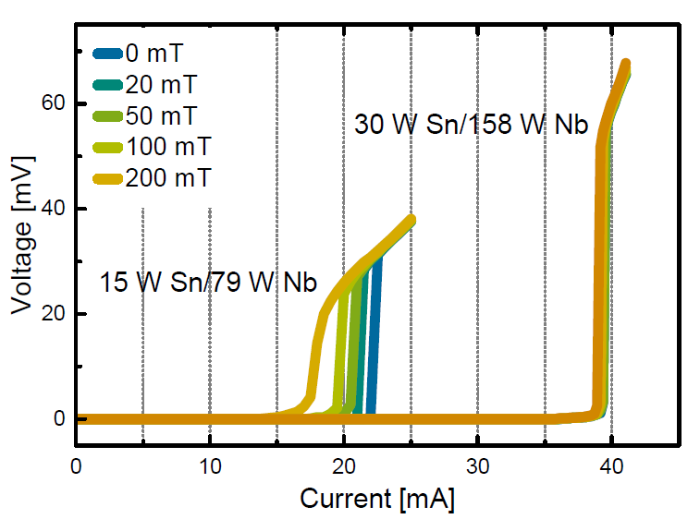
Possible role of grain boundaries (weak links)
Comparison of the voltage versus current pattern of two sputtered Nb₃Sn thin films measured at 4 K. The power input was increased from 15W Sn/79W Nb to 30W Sn/158W Nb while the substrate temperature during growth was fixed to 320 ◦C for both samples. The external field applied during the IV measurement was increased from 0 mT to 200 mT.
N. Schäfer et al., unpublished

Slide 17
Optimization of growth parameters on copper substrate

Slide 18
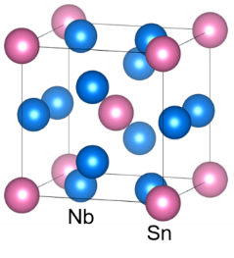
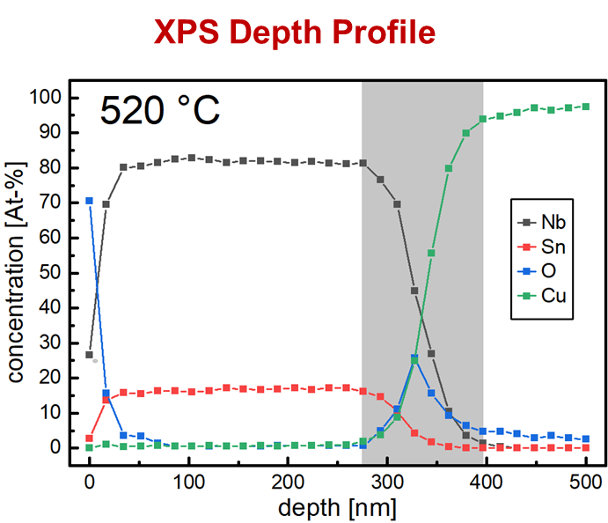

Direct growth of Nb₃Sn on copper
growth
< 520 °C @ 60 min.

Slide 19
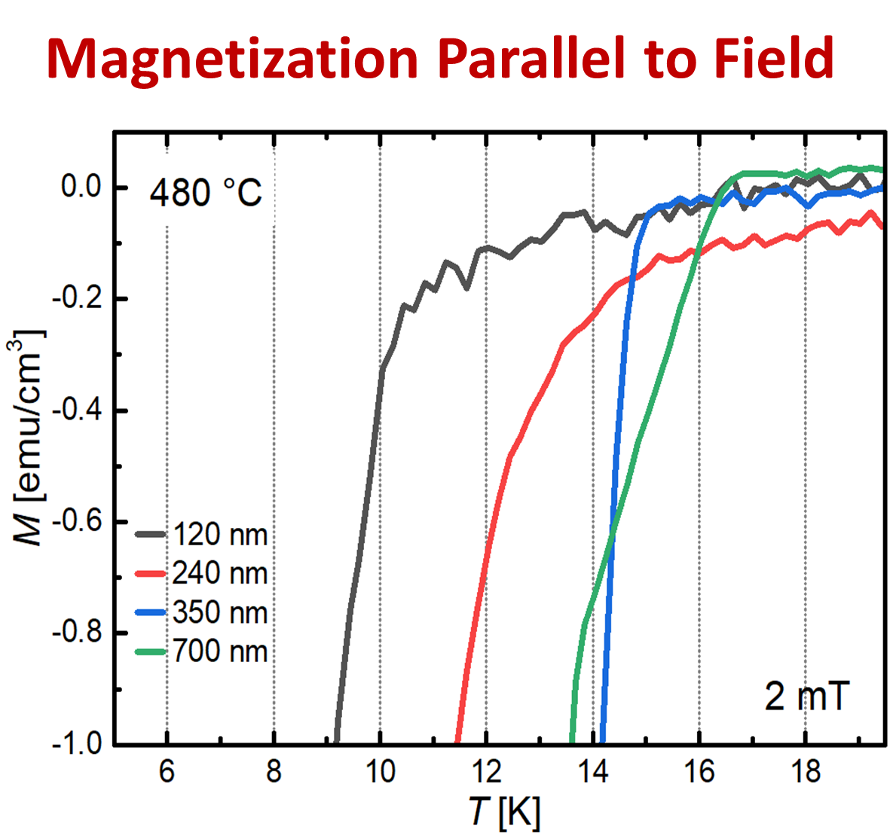
Performance as a function of Nb₃Sn film thickness
Increasing thickness beneficial for critical temperature
T_{c,0}=16.8 K @ 480 °C!
120 nm < λ (140 nm), still shielding

Slide 20
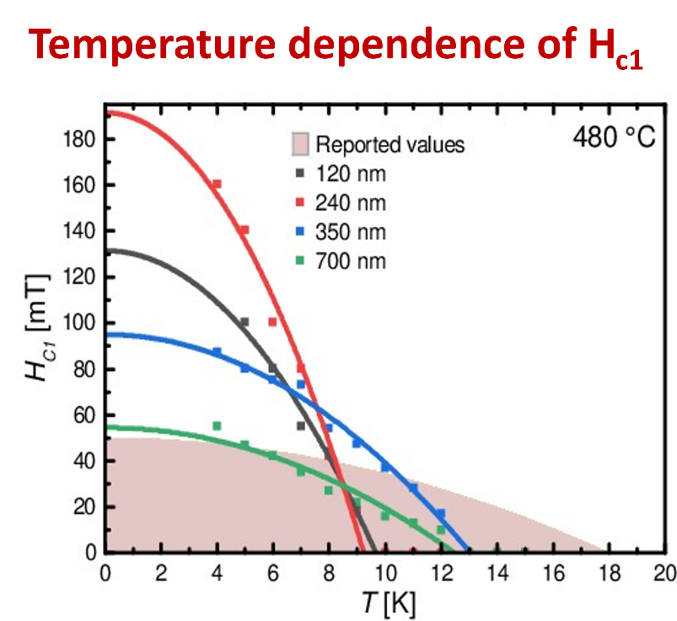
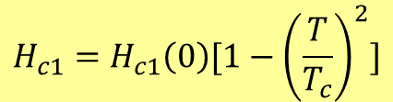
Performance as a function of Nb₃Sn film thickness
Bulk performance for 700 nm thickness.
Below 700 nm enhancement of H_{c1} (known below λ=140 nm)
Decreasing film thickness beneficial for H_{c1}
$$H_{c1}=H_{c1}\left(0\right)[1−{\left(\frac{T}{T_{c}}\right)}^{2}]$$

Slide 21
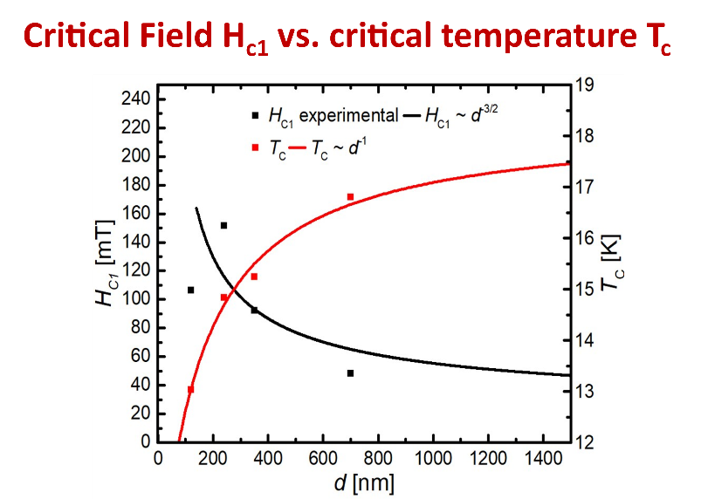

Performance as a function of Nb₃Sn film thickness
Trade-off between T_{c} and H_{c1}
$$µ_{0}H_{c1}= \frac{2ϕ_{0}}{πd^{2}}ln\frac{d}{ε}$$

Slide 22
Adhesion test: scratch test
Measurements by Sebastian Bruns

Slide 23
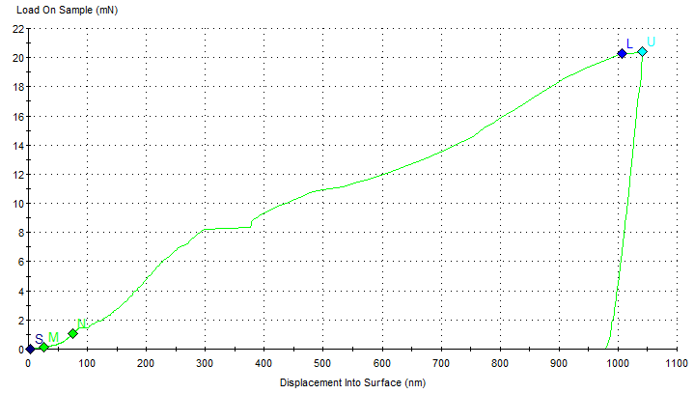
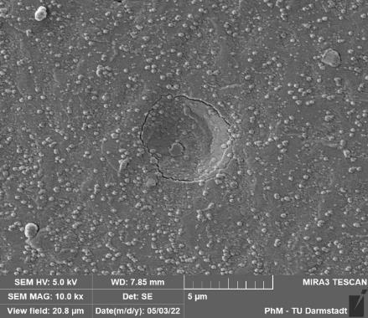
Adhesion test: nano ball indentation
Pop-In: Cracking of the layer
Measurements by Sebastian Bruns

Slide 24
Upscaling to copper cavities

Slide 25
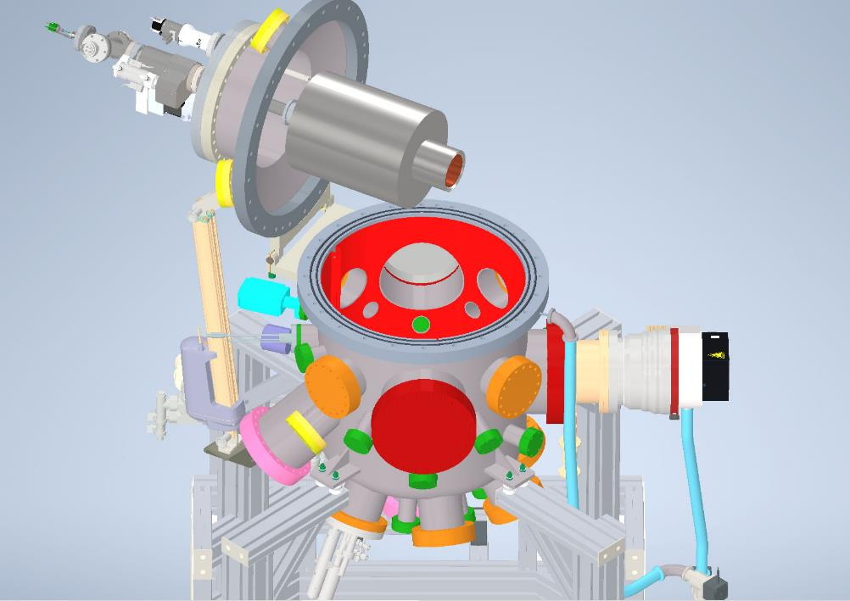
Sputter chamber for cavity and small samples

Slide 26
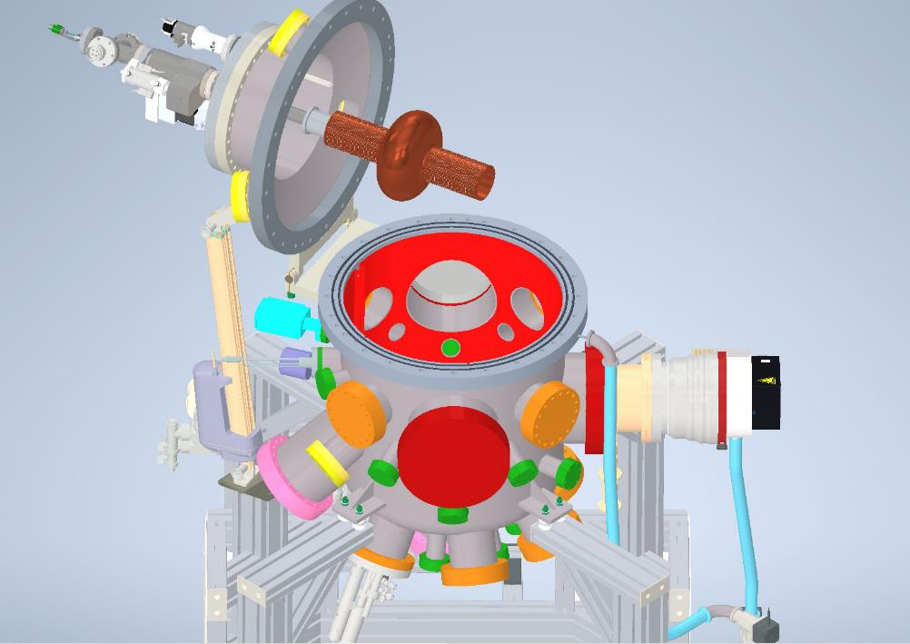
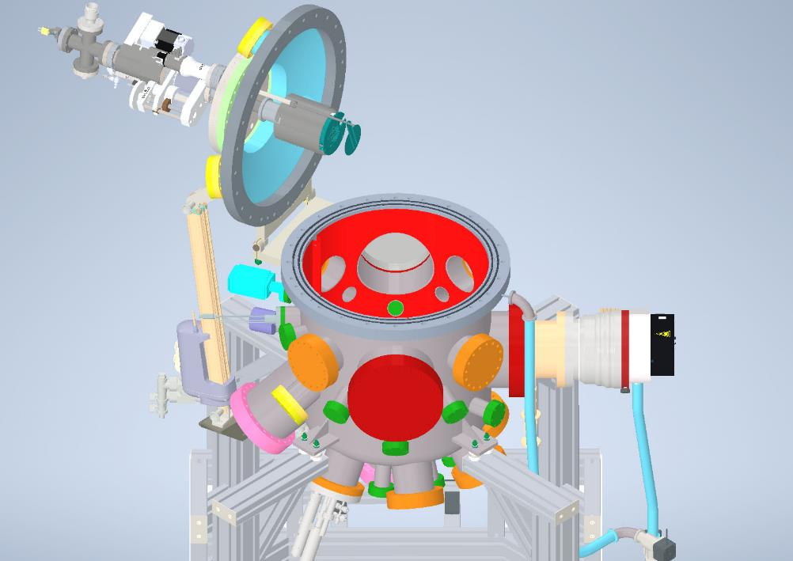
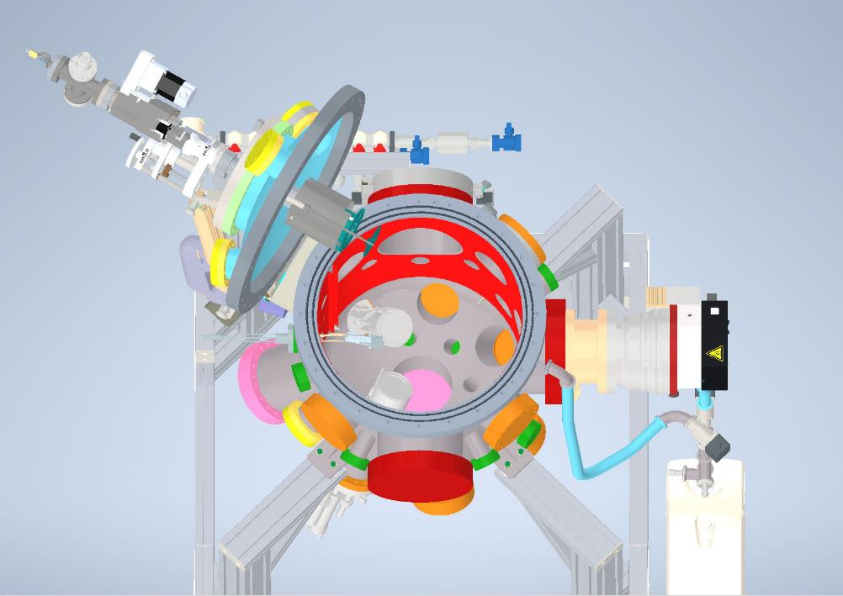
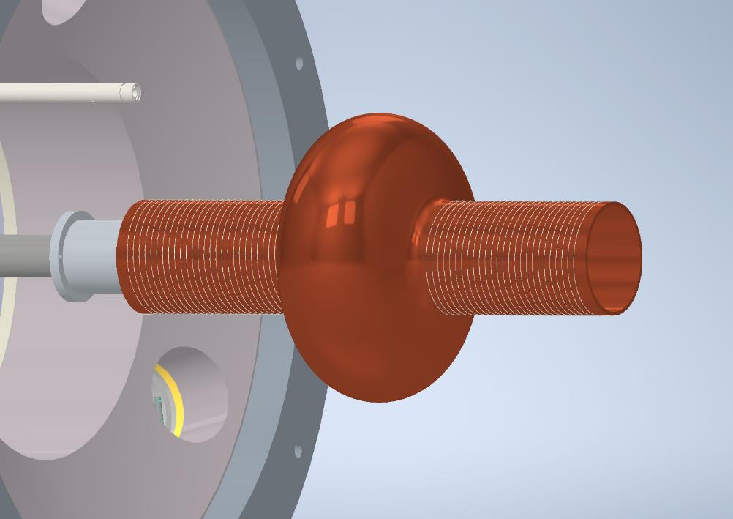
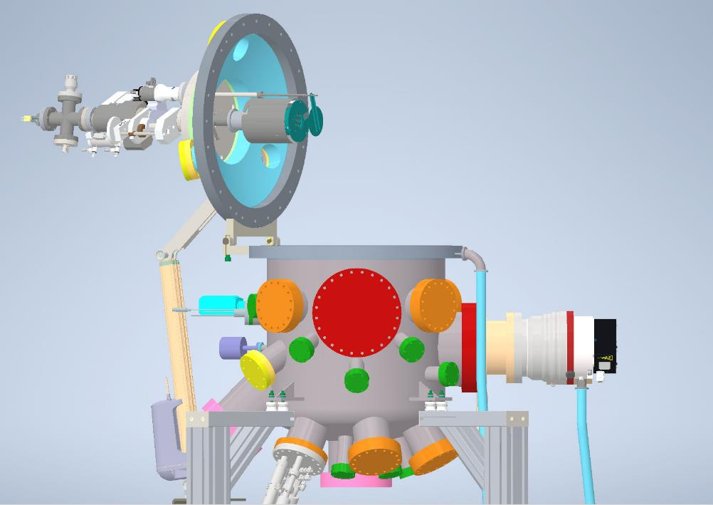
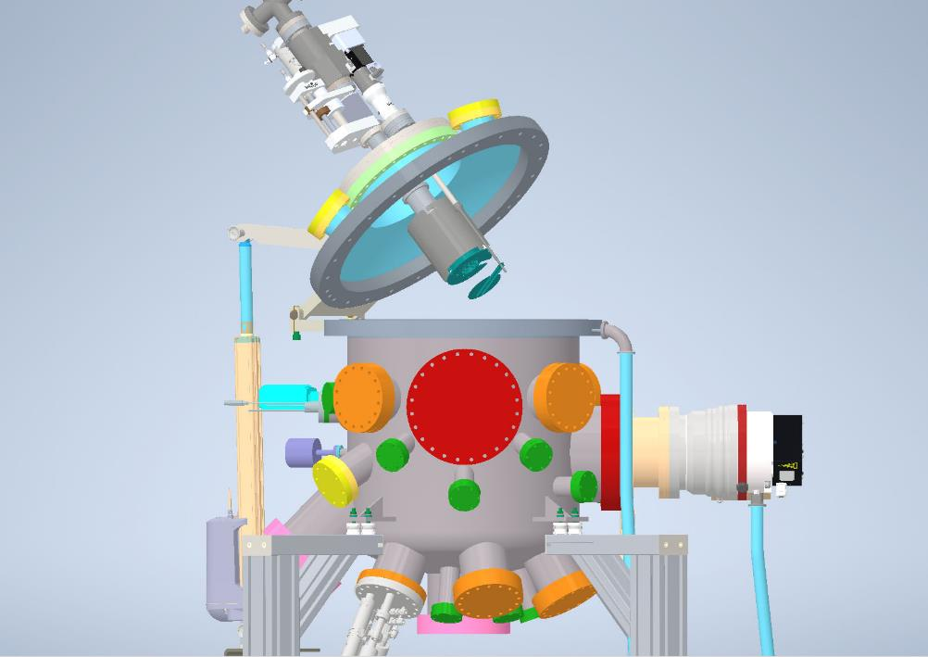
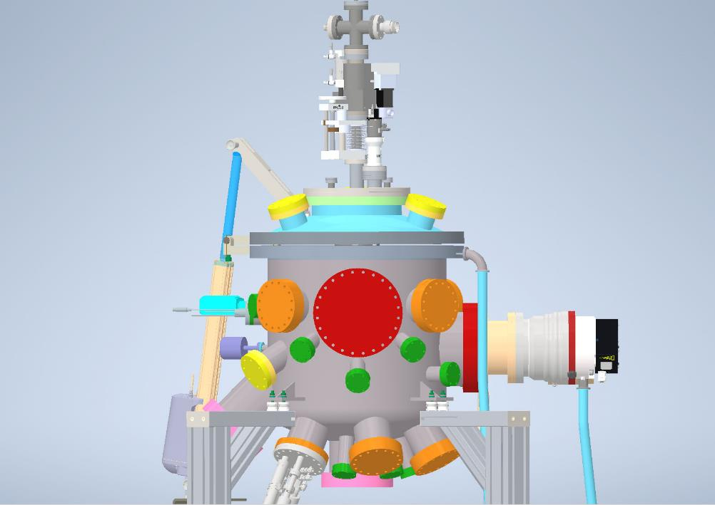
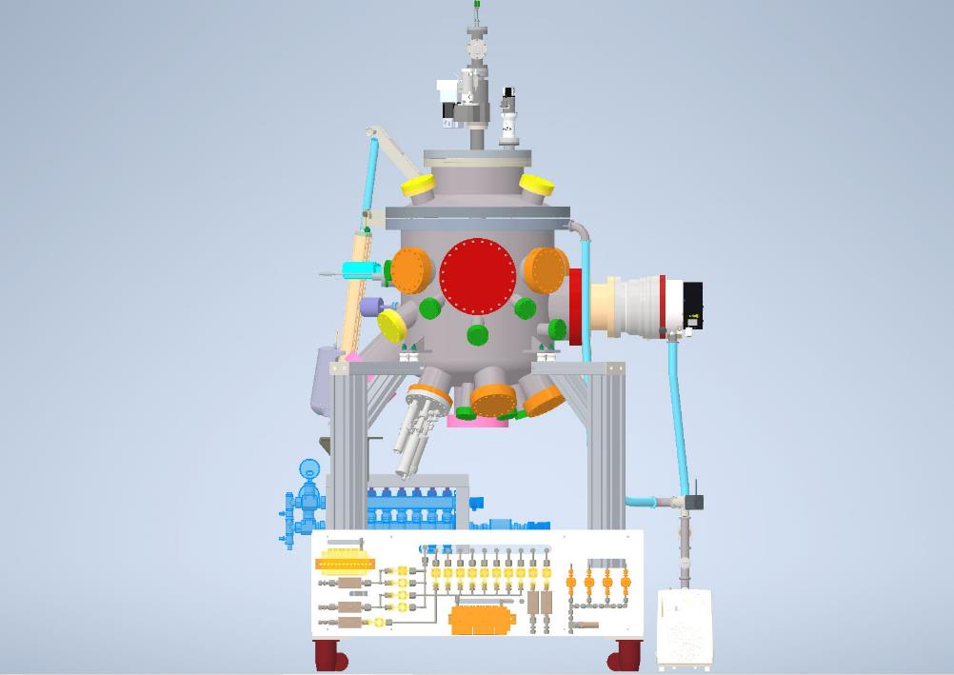
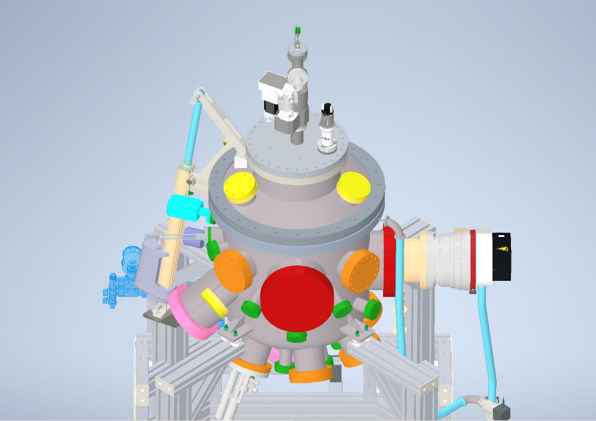
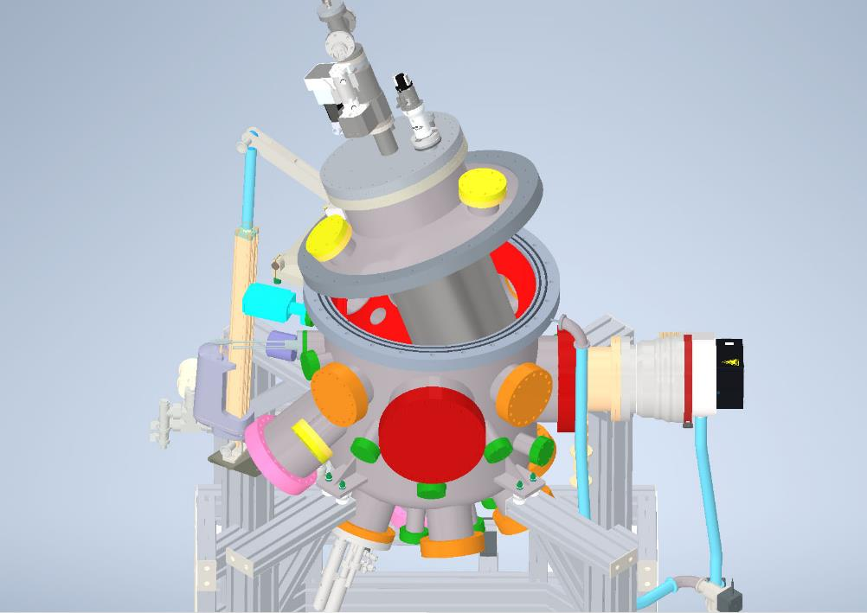
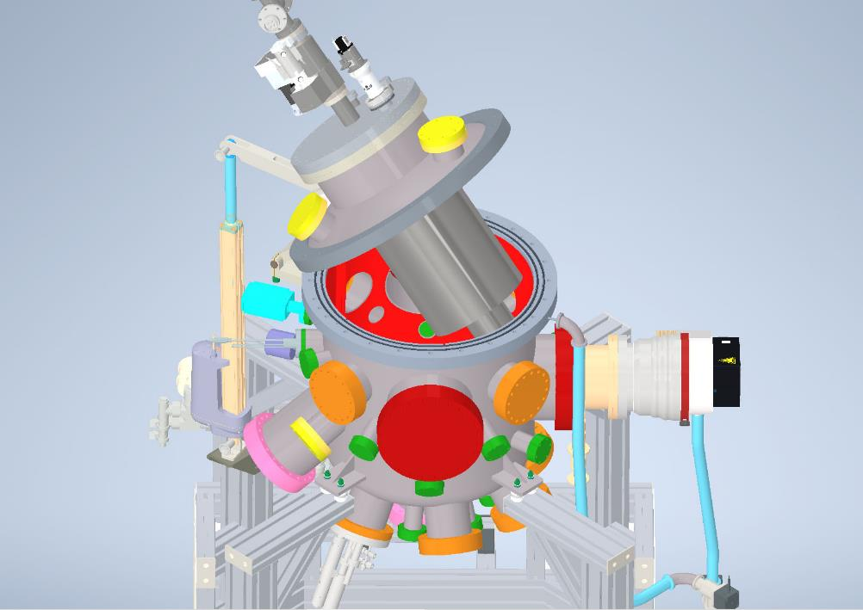
Sputtering system
Sample stage
Double wall shield
Tungsten heating wire
Magnetrons

Slide 27
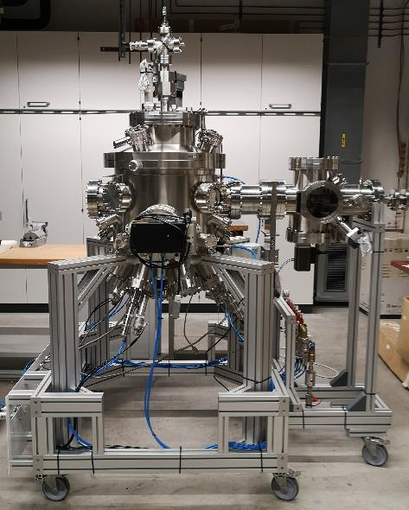
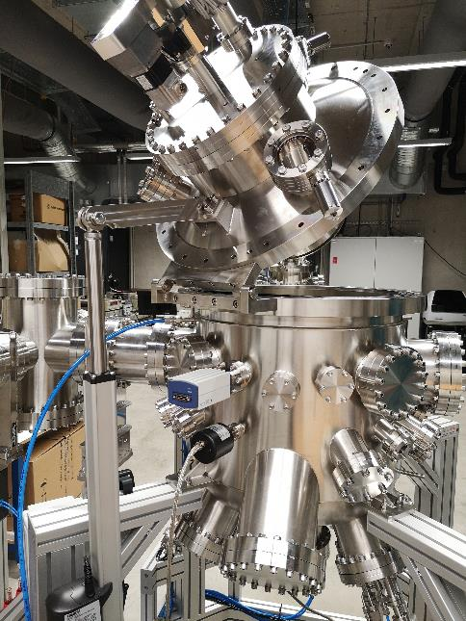
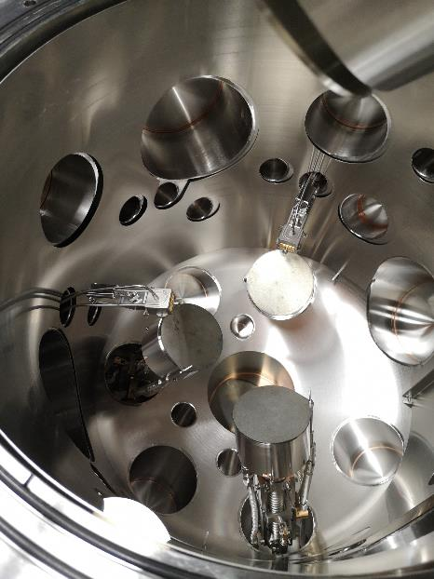
Sputtering system

Slide 28
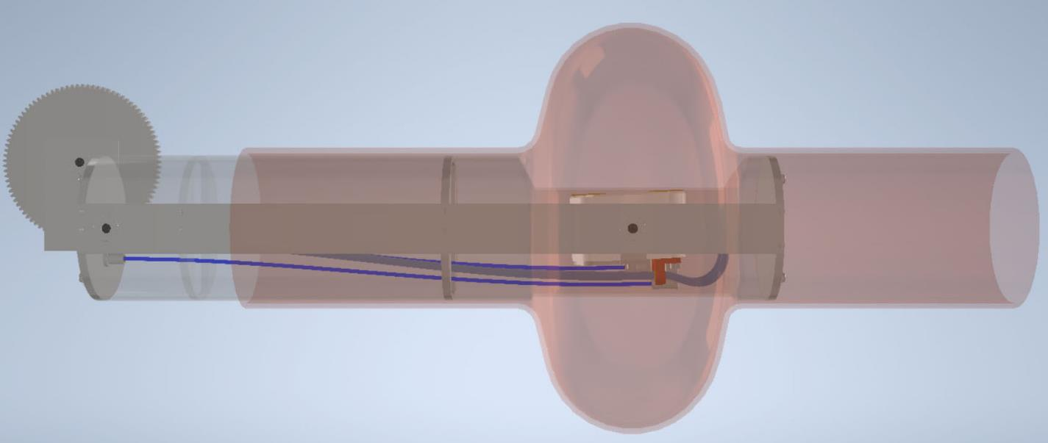
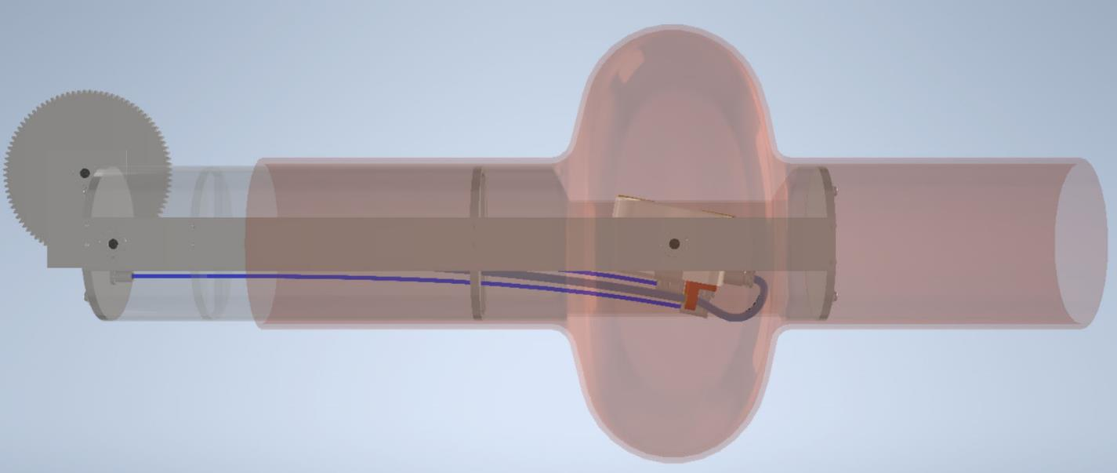

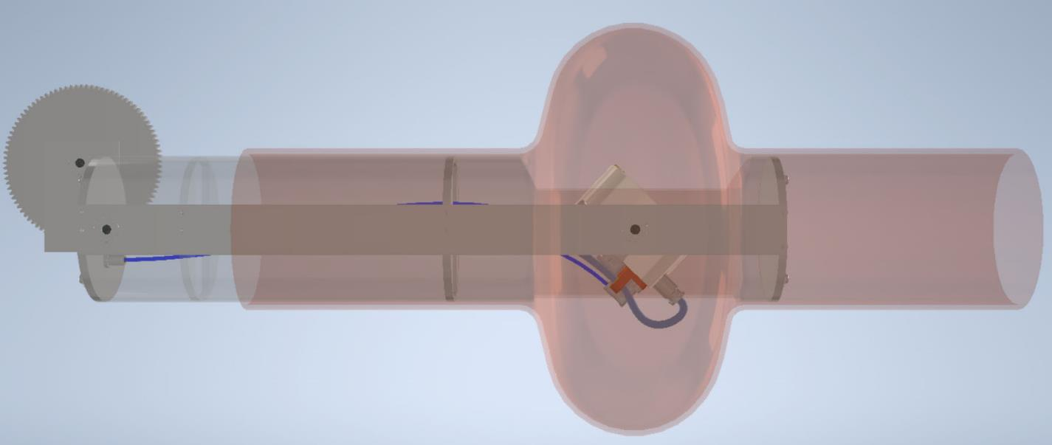
Cavity sputtering
Sputtering spot

Slide 29





Acknowledgement
Jürgen Schreeck
Nail Karabas
Stefan Petzold
Sara Amidi
Sebastian Bruns (PhM)
Norbert Pietralla
Michaela Arnold
Thank you for your attention!
Funded by BMBF Project 05H21RDRB1 and the German Research Foundation (DFG) through grant GRK2128 (AccelencE)

