Slide 1




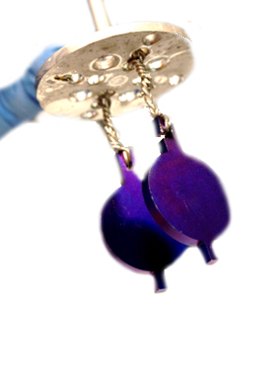
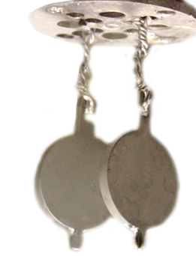

Cristian Pira
CSN5 INFN experiment
On behalf of INFN LNL SRF group
i.FAST has received funding from the European Union’s Horizon 2020 programme under GA No 101004730.
Nb₃Sn on Cu coating by Magnetron Sputtering
from Target Synthesized via Liquid Tin Diffusion
Aomori
October 11-14, 2022

Slide 2
Outline
Project goal and motivations
Liquid Tin Diffusion technique introduction
Target production first results
First sputtering test with LTD target

Slide 3

Goal and motivations

Slide 4
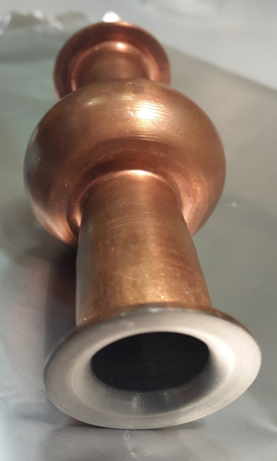
Goal
Produce and test a
Nb₃Sn on Cu
6 GHz elliptical cavity
Motivations:
Cu is a cheaper substrate
Higher thermal conductivity
(important also for applications beyond high energy physics with cryocooler cooling )
6 GHz are a good test bench
(handable, cheap, fast to test, test facility ready @LNL)
Nb on Cu 6 GHz cavity

Slide 5
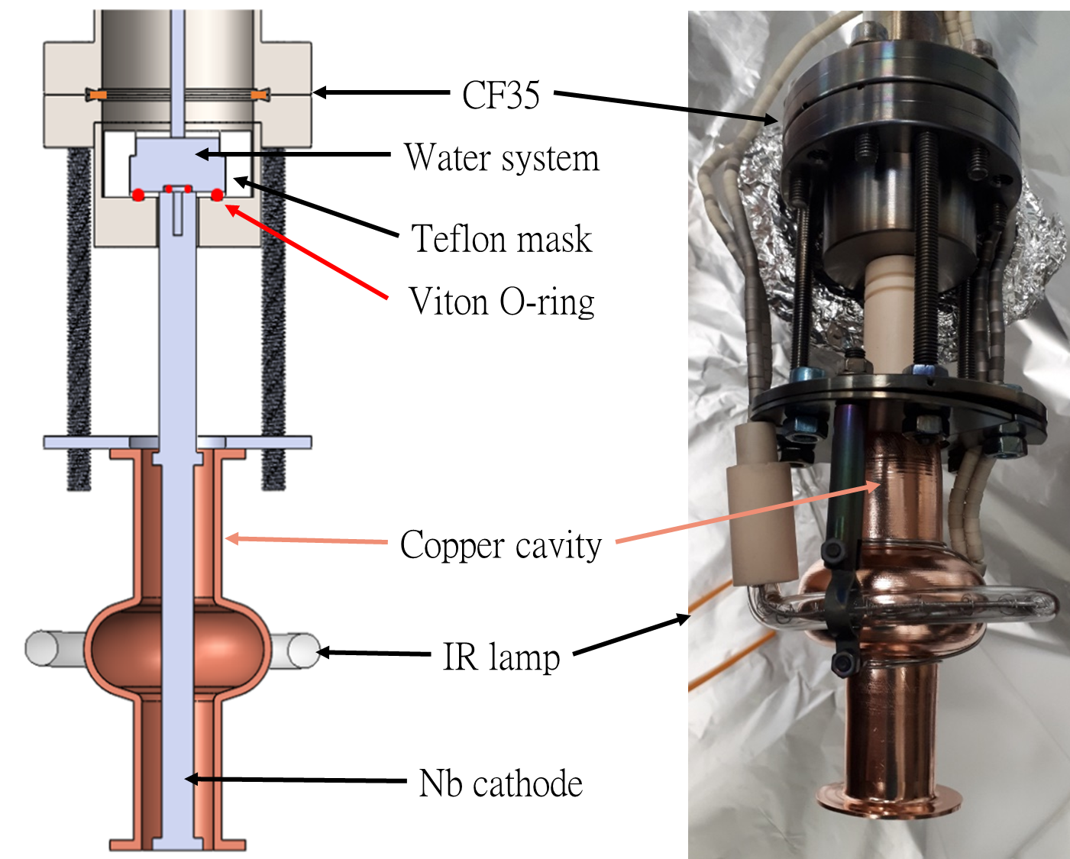
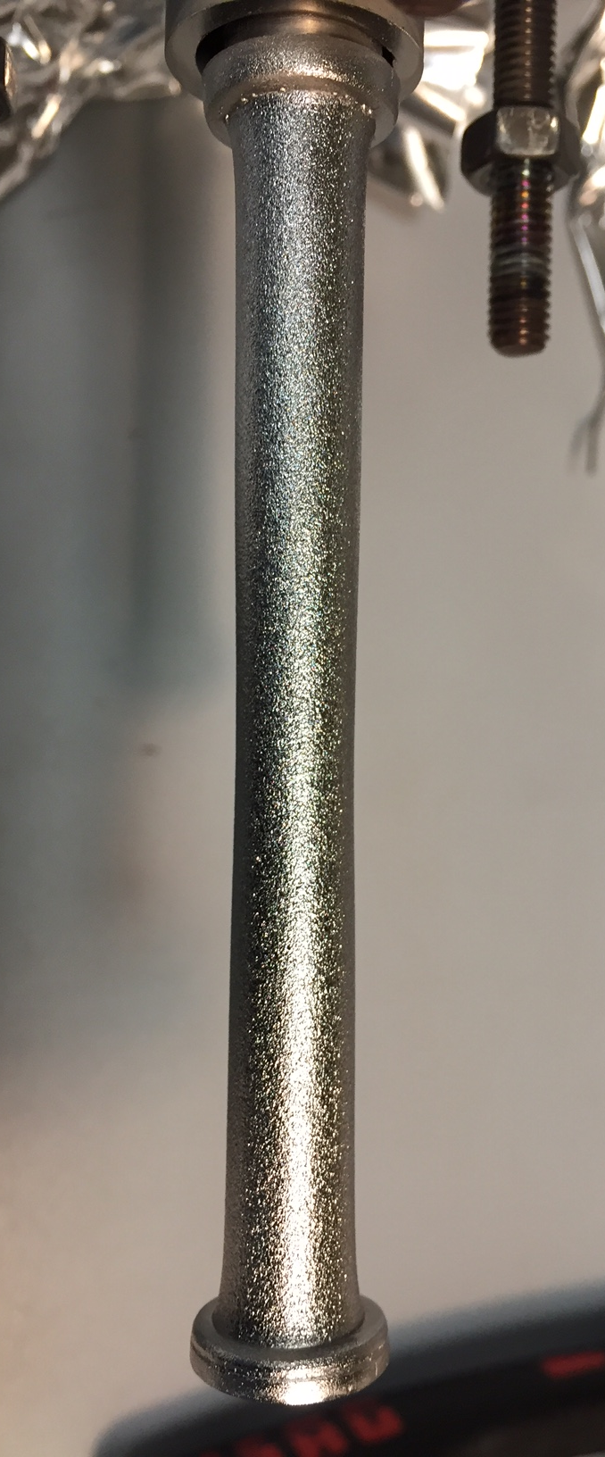

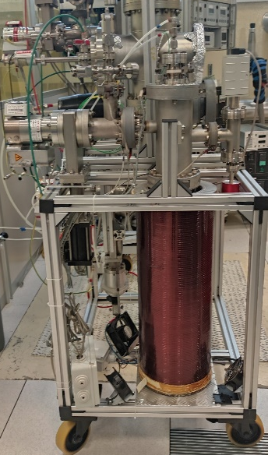
LNL Strategy
Nb on Cu 6 GHz cavity coating system
Use the same Magnetron Sputtering configuration of Nb on Cu
6 GHz elliptical cavity
Replace Nb Cylindrical target with a Nb₃Sn one
Not so easy because
Nb₃Sn is extremely brittle!
Sintered bulk target cannot be used

Slide 6
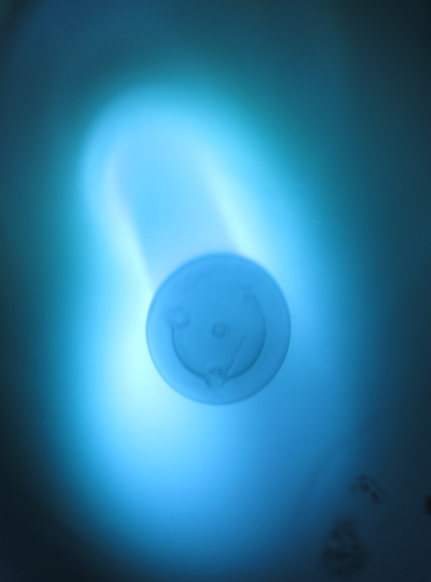

Nb₃Sn on Cu
LNL strategy for 6 GHz cavities
Dipping
in Liquid Tin
+ Annealing
Nb target
Magnetron Sputtering
Nb₃Sn on Nb target

Slide 7
Liquid Tin Diffusion in a couple of slides…

Slide 8

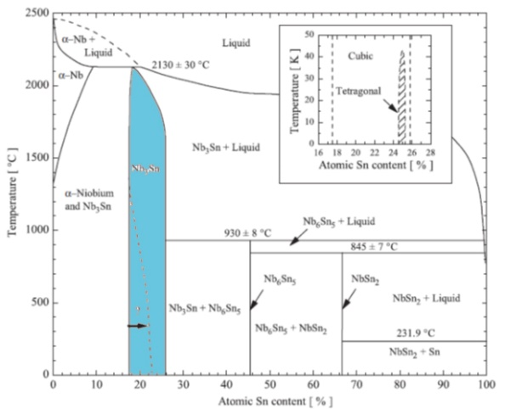
Vapor or Liquid Tin Diffusion
Tin Vapor Diffusion
Liquid Tin Diffusion
(Dipping)
Similar principle: Sn diffuse onto Nb and react at High T
Both suitable to growth Nb₃Sn films on Nb substrates
Liquid Tin diffusion allows coating of thick films
Notes:
Nikuman (ravioli pieni di carne)

Slide 9

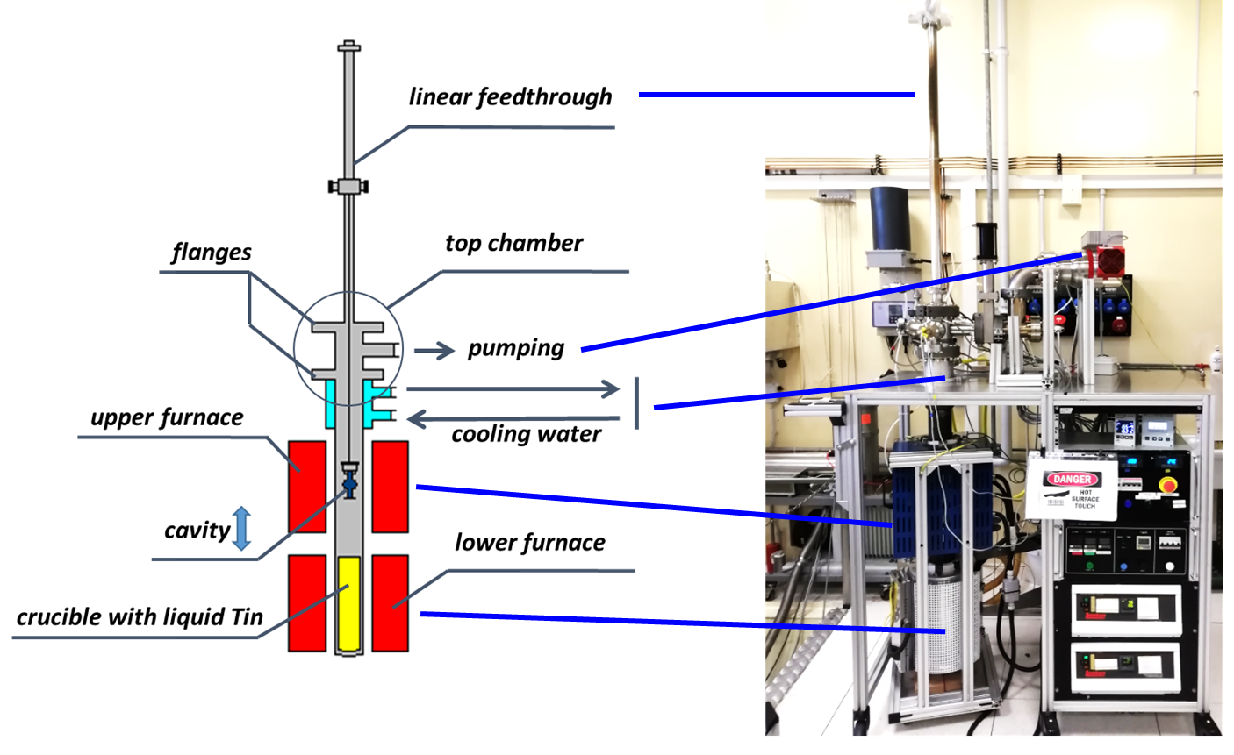
Liquid Tin Diffusion Set Up @
System designed in 2005 for the coating of
6 GHz elliptical cavities
UHV Inconel chamber
2 Separate resistive furnaces
Nb sample

Slide 10
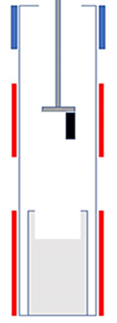
Dipping process (LNL 2006)
S. M. Deambrosis et al., “A15 superconductors: An alternative to niobium for RF cavities,” Physica C, 2006
∼1 h
Cooling
zone
30 °C
dipping
annealing
in Sn vapor
annealing
furnaces heating
cooling
Upper Furnace (Annealing Zone)
1000 °C
Sample temperature
Lower
Furnace
(Liquid Tin)
ΔT ∼ - 100-150 °C
1000 °C
furnace
heating
Temperature furnaces profile

Slide 11
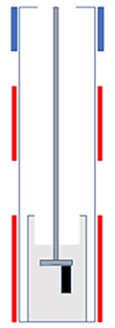
Dipping process (LNL 2006)
S. M. Deambrosis et al., “A15 superconductors: An alternative to niobium for RF cavities,” Physica C, 2006
∼1 h
0.5 h
Cooling
zone
30 °C
dipping
annealing
in Sn vapor
annealing
furnaces heating
cooling
Upper Furnace (Annealing Zone)
1000 °C
Lower
Furnace
(Liquid Tin)
1000 °C
furnace
heating
dipping
Temperature furnaces profile

Slide 12
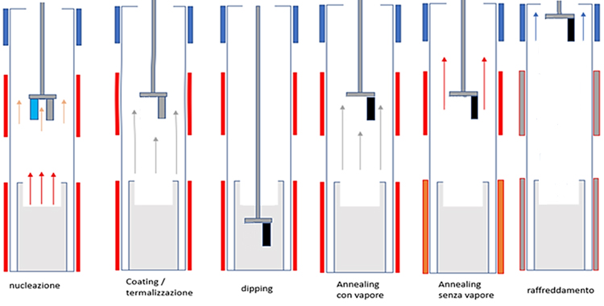
Dipping process (LNL 2006)
S. M. Deambrosis et al., “A15 superconductors: An alternative to niobium for RF cavities,” Physica C, 2006
∼1 h
0.5 h
2 h
Cooling
zone
30 °C
dipping
annealing
in Sn vapor
annealing
furnaces heating
cooling
Upper Furnace (Annealing Zone)
1000 °C
Lower
Furnace
(Liquid Tin)
1000 °C
furnace
heating
dipping
annealing
in Sn vapor
Temperature furnaces profile

Slide 13
Dipping process (LNL 2006)
S. M. Deambrosis et al., “A15 superconductors: An alternative to niobium for RF cavities,” Physica C, 2006
∼1 h
0.5 h
2 h
5 h
Cooling
zone
30 °C
dipping
annealing
in Sn vapor
annealing
furnaces heating
cooling
Upper Furnace (Annealing Zone)
1000 °C
Lower
Furnace
(Liquid Tin)
400 °C
furnace
heating
dipping
annealing
in Sn vapor
annealing
Temperature furnaces profile

Slide 14
Dipping process (LNL 2006)
S. M. Deambrosis et al., “A15 superconductors: An alternative to niobium for RF cavities,” Physica C, 2006
∼1 h
0.5 h
2 h
5 h
∼ 1 h
Cooling
zone
dipping
annealing
in Sn vapor
annealing
furnaces heating
cooling
Upper Furnace (Annealing Zone)
Lower
Furnace
(Liquid Tin)
furnace
heating
dipping
annealing
in Sn vapor
annealing
cooling
Temperature furnaces profile

Slide 15
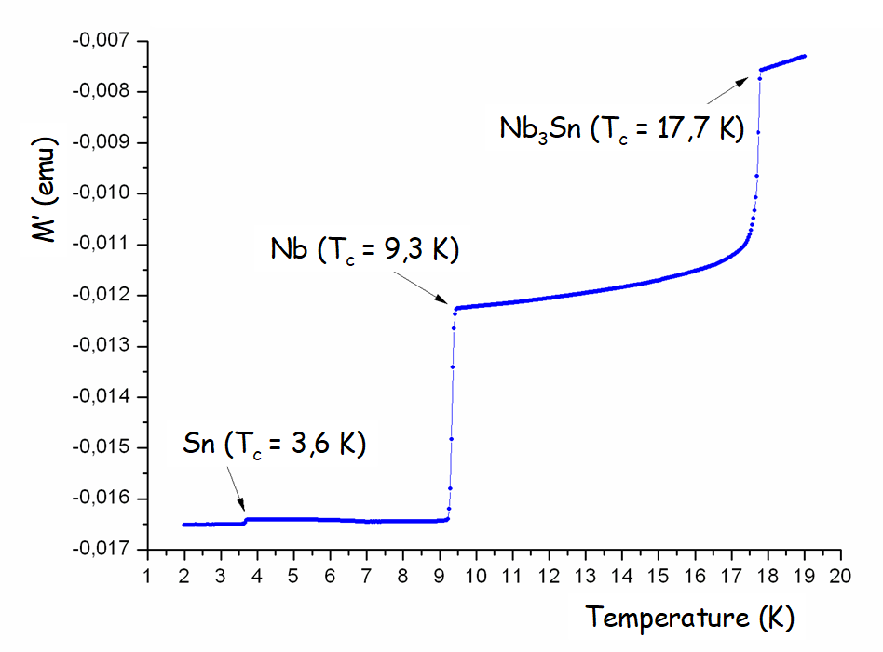
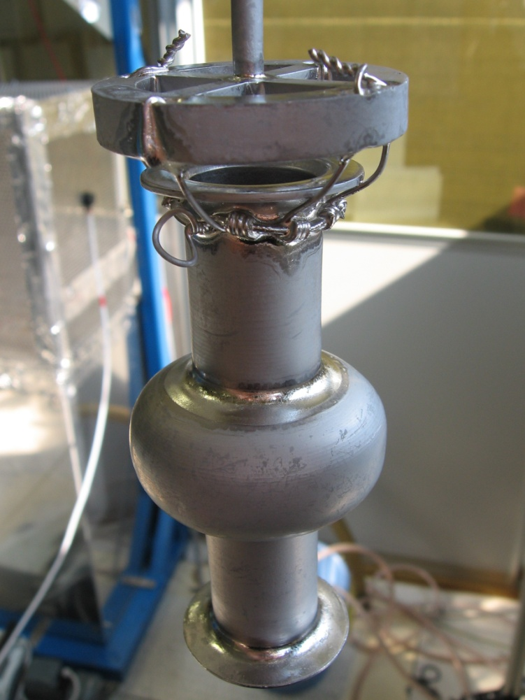
Results (LNL 2006)
S. M. Deambrosis et al., “A15 superconductors: An alternative to niobium for RF cavities,” Physica C, 2006
S. M. Deambrosis, SRF 2009
Nb₃Sn
6 GHz @ 4.2 K
Sn drop
Q_{BCS} Nb = 3 * 10⁷
Good performance on planar samples
Poor performance on 6 GHz cavity

Slide 16
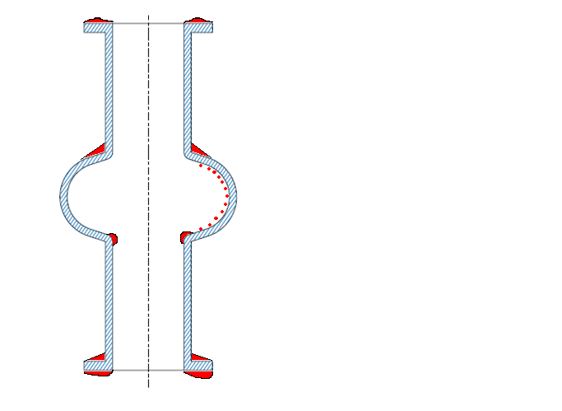
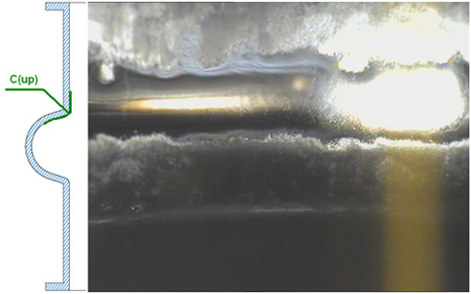
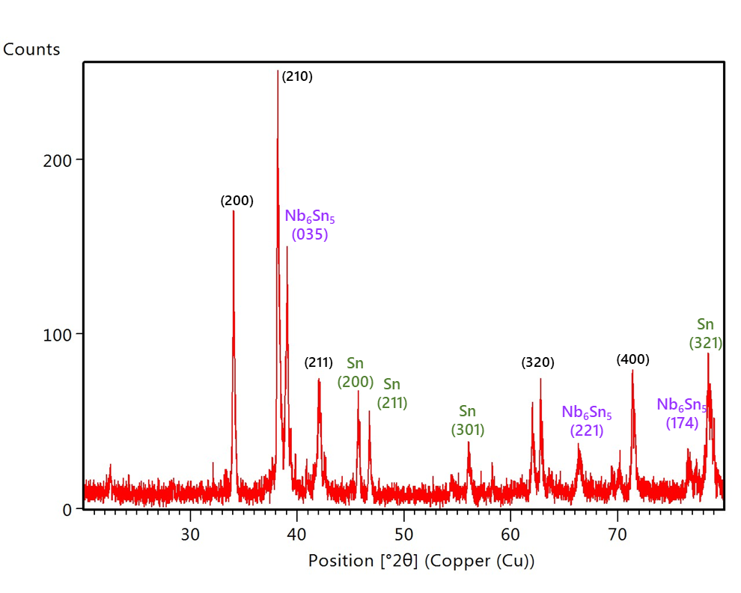
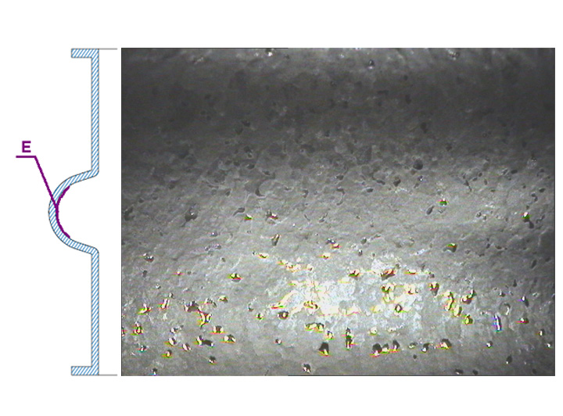
Results (LNL 2006)
S. M. Deambrosis et al., “A15 superconductors: An alternative to niobium for RF cavities,” Physica C, 2006
S. M. Deambrosis, SRF 2019
Drops of
unreacted Tin
on the surface
Sn
cavity
droplets of Sn
Nb₃Sn
Spurius phases
Sn
Sn
External surface
Internal surface

Slide 17
Dipping process optimization and Nb₃Sn target production

Slide 18
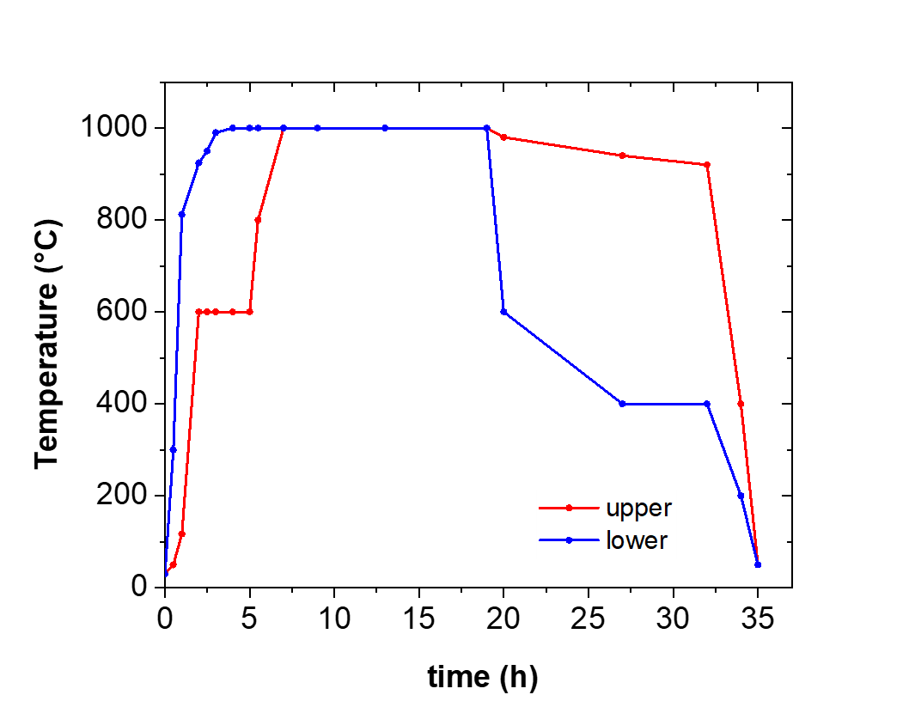
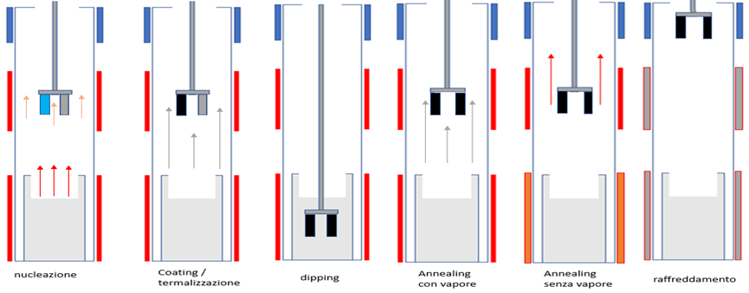
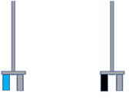
Dipping Optimized Process
M. Zanierato, SRF 2021
3 h
30 °C
cooling
1000 °C
nucleation
600 °C
nucleation
Nucleation improved adding a vapor coating step
on anodized Nb samples
Temperature furnaces profile
Nb₂O₅
Nb
Nb₃Sn

Slide 19
Dipping Optimized Process
M. Zanierato, SRF 2021
3 h
2 h
Vapor
coating
30 °C
cooling
1000 °C
nucleation
1000 °C
nucleation
Vapor
coating
Nucleation improved adding a vapor coating step
on anodized Nb samples
Temperature furnaces profile
Nb₂O₅
Nb
Nb₃Sn

Slide 20
Dipping Optimized Process
M. Zanierato, SRF 2021
3 h
2 h
3 h
dipping
30 °C
Vapor
coating
cooling
1000 °C
nucleation
1000 °C
nucleation
Vapor
coating
dipping
Temperature furnaces profile
Nb₂O₅
Nb
Nb₃Sn

Slide 21
Dipping Optimized Process
M. Zanierato, SRF 2021
3 h
2 h
3 h
6 h
dipping
30 °C
Vapor
coating
Vapor
annealing
cooling
1000 °C
nucleation
1000 °C
nucleation
Vapor
coating
dipping
annealing
in Sn vapor
Temperature furnaces profile
Nb₂O₅
Nb
Nb₃Sn

Slide 22
Dipping Optimized Process
M. Zanierato, SRF 2021
3 h
2 h
3 h
6 h
15 h
dipping
annealing
30 °C
Vapor
coating
Vapor
annealing
cooling
1000 °C
nucleation
400 °C
nucleation
Vapor
coating
dipping
annealing
in Sn vapor
annealing
Temperature furnaces profile
Nb₂O₅
Nb
Nb₃Sn

Slide 23
Dipping Optimized Process
M. Zanierato, SRF 2021
3 h
2 h
3 h
6 h
15 h
1 h
dipping
annealing
Vapor
coating
Vapor
annealing
cooling
nucleation
nucleation
Vapor
coating
dipping
annealing
in Sn vapor
annealing
cooling
Temperature furnaces profile
Nb₂O₅
Nb
Nb₃Sn

Slide 24
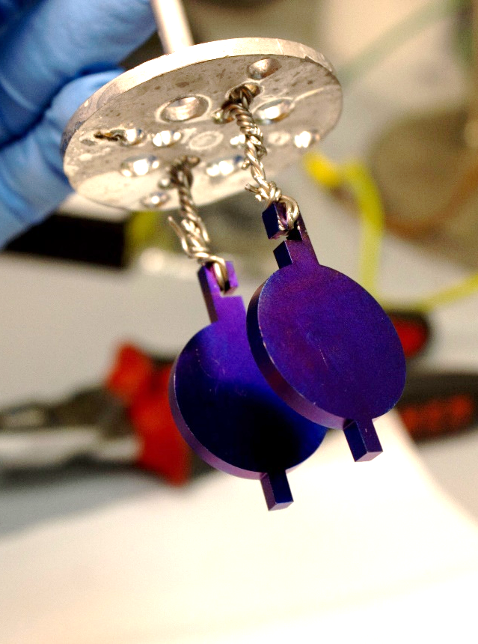
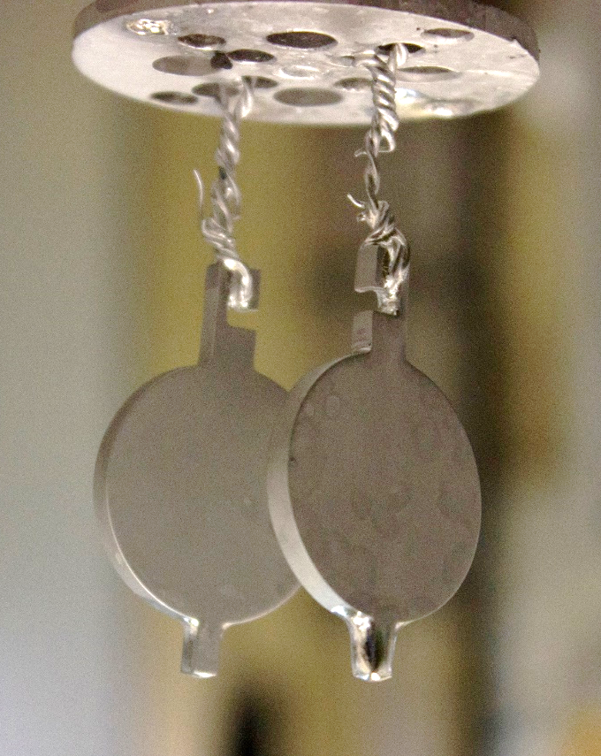
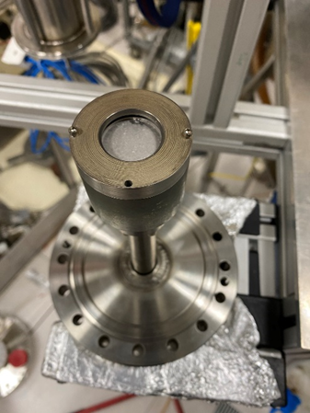


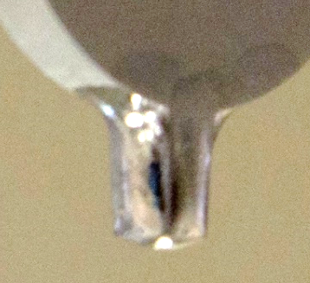
Test with 1” target
Anodized samples
Nb₃Sn coated samples
1’’ Magnetron ready
Shape optimized
to collect and remove Tin excess

Slide 25



Dipping time - thickness
C. Pira, Thin Films Workshop SRF 2021
M. Zanierato, SRF 2021
Nb₃Sn growing rate by dipping is related to the Sn diffusion in Nb and can be described by Fick’ laws of diffusion
35 μm
30 μm
25 μm
x: Nb₃Sn thickness
t: dipping time
k: a costant that takes in account the diffusion coefficient D
$$x^{2}=kt$$
14 μm
100 μm → ∼ 63 hours of dipping!
$$x^{2}\left(\text{μ}\text{m}\text{2}\right)=157∙t\left(\text{h}\right)+130$$
24 hours of dipping → ∼ 62 μm
in progress
$$R^{2}=0.9983$$

Slide 26
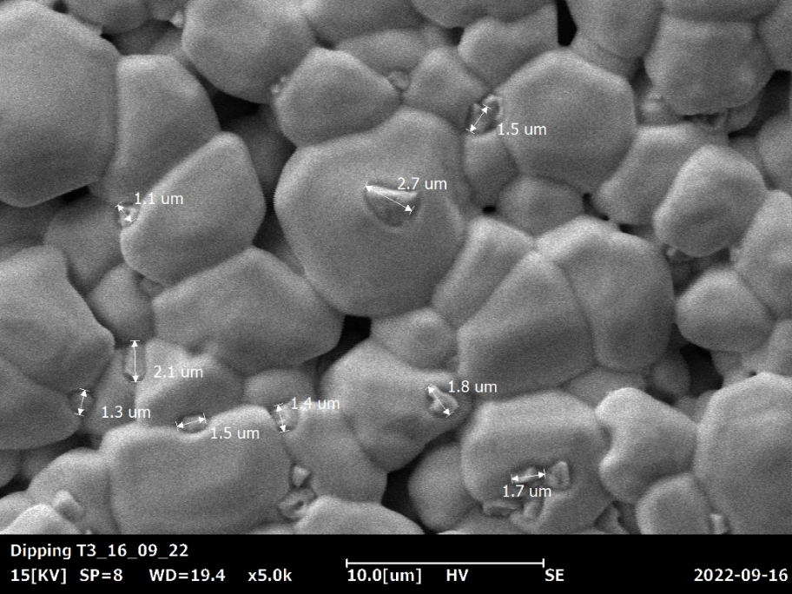

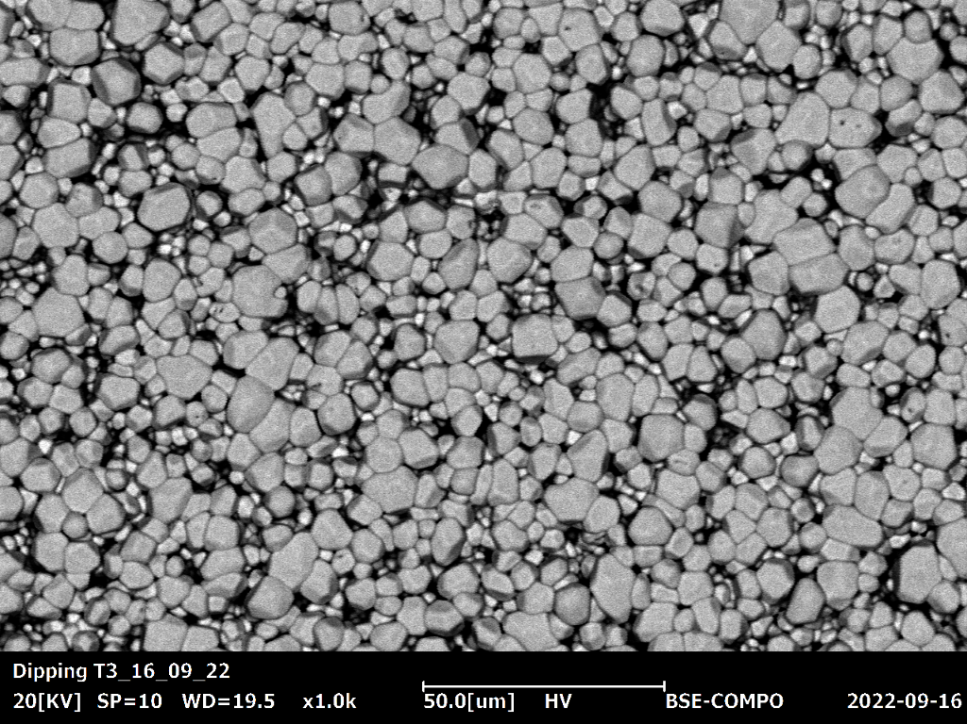
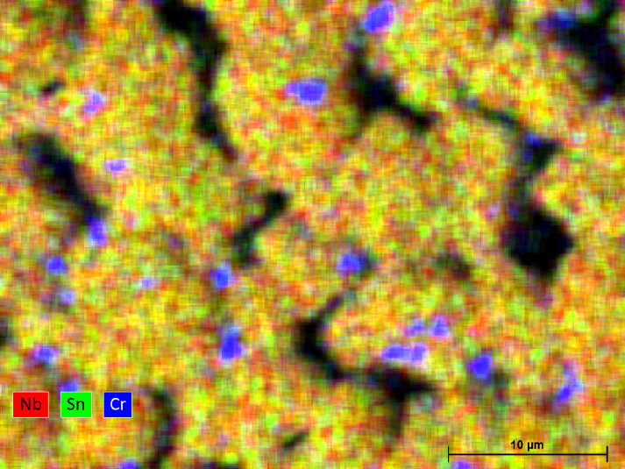
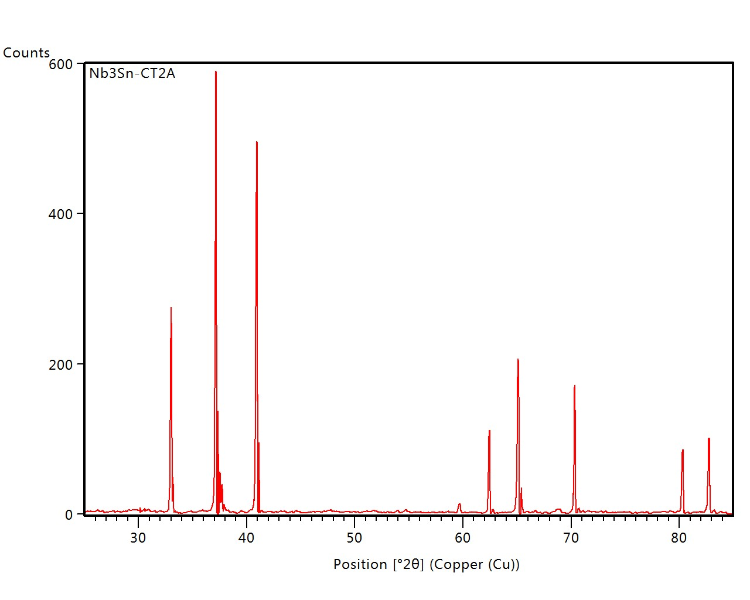
Target Morphology
(SEM + EDS characterization)
Chromium contamination
(10-20% on surface)
Ni and Fe are also present
Stoichiometric
Nb-Sn composition
XRD shows only Nb₃Sn phase

Slide 27
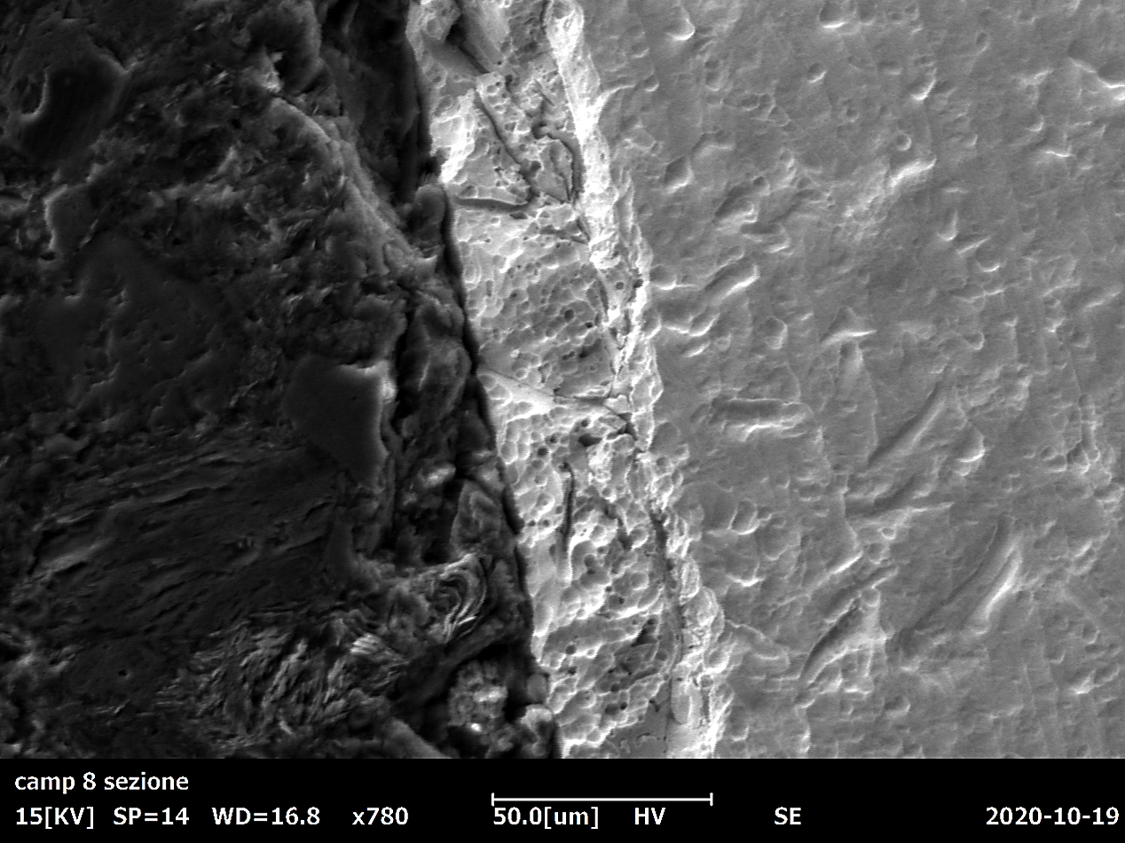
Target cross section
Contamination is superficial
No contamination in Sn crucible
35 μm
Nb3Sn
EDS profile
resin
Main candidate for Cr contamination:
Vacuum chamber made by Inconel Alloy
Nb

Slide 28

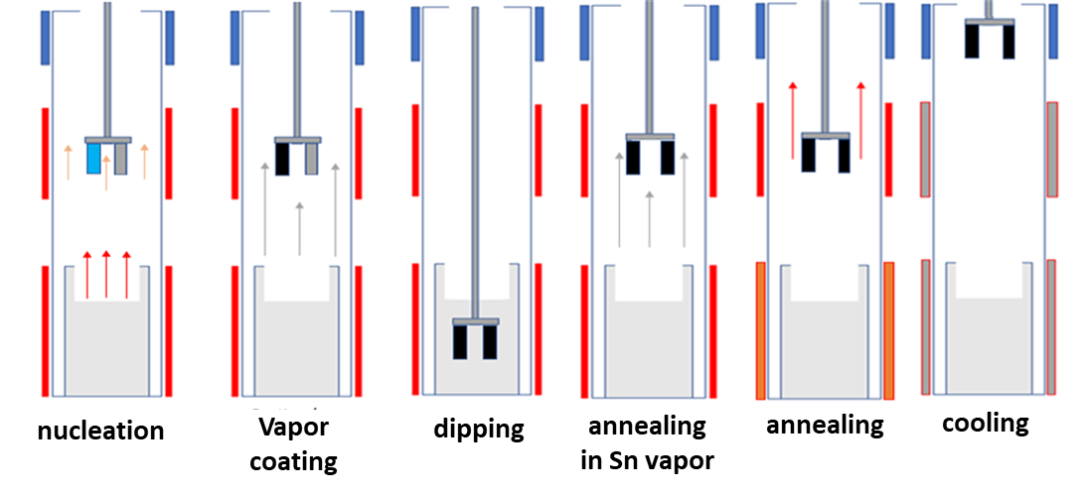
Tin content modulation
With Vapor Annealing Step
Without Vapor Annealing Step
Vapor annealing step
can be used to modulate
Tin content

Slide 29
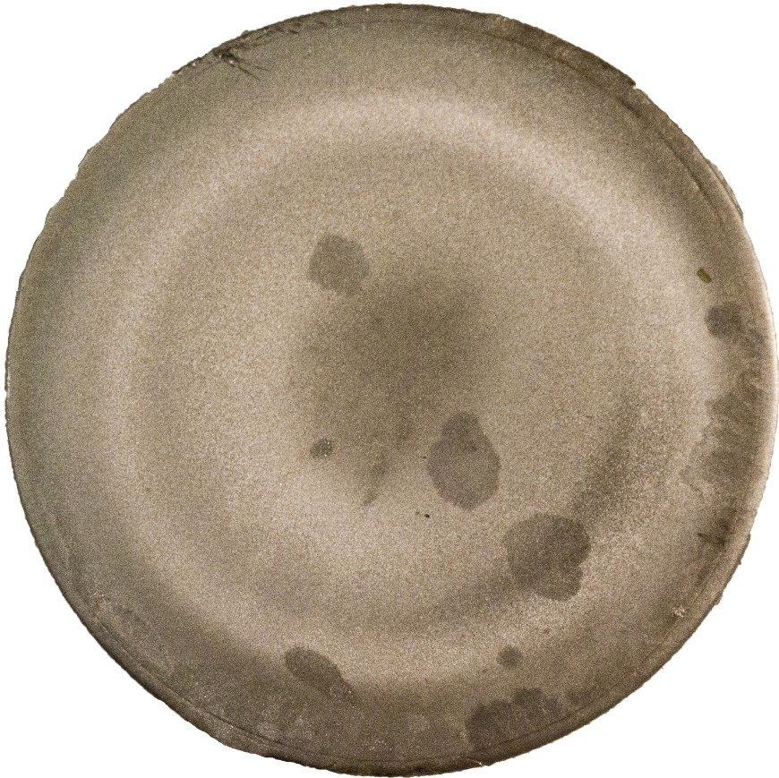
Target surface
Race Track: Sn 22.8%
∼6 microns eroded
700 nm coated
Race Track side: Sn 23.2%
Center: Sn 23.5%
Ext. border: Sn 23.0%

Slide 30
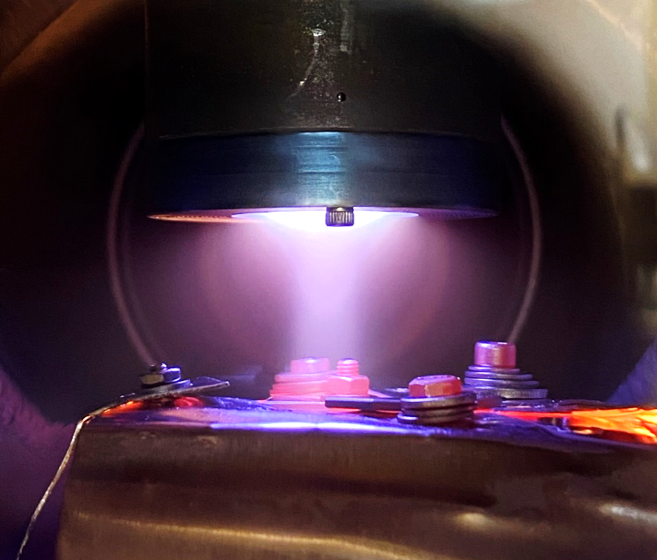
First sputtering test on Quartz
1” target prepared by Dipping (30 microns thick)
Coating on quartz samples by MS
  I = 0.1 A (5 mA/cm²)
  t = 30 min
  T = 750 °C
Process stopped when V started to decrease
Zanierato et al,
SRF Proceedings 2021

Slide 31
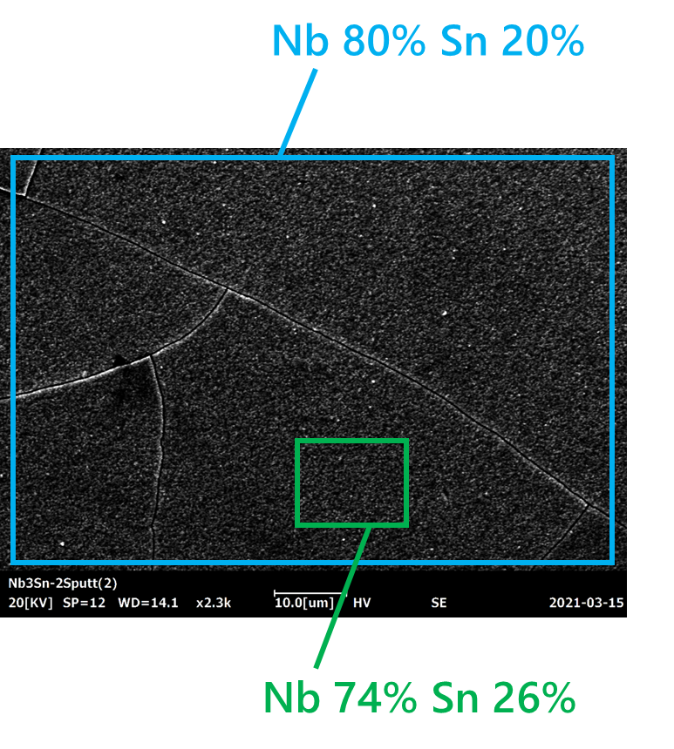
First sputtering test on Quartz
Good composition
No Cr visible by EDS
Cracks due to Quartz substrate
No Tc measured
2 New targets ready for new tests

Slide 32
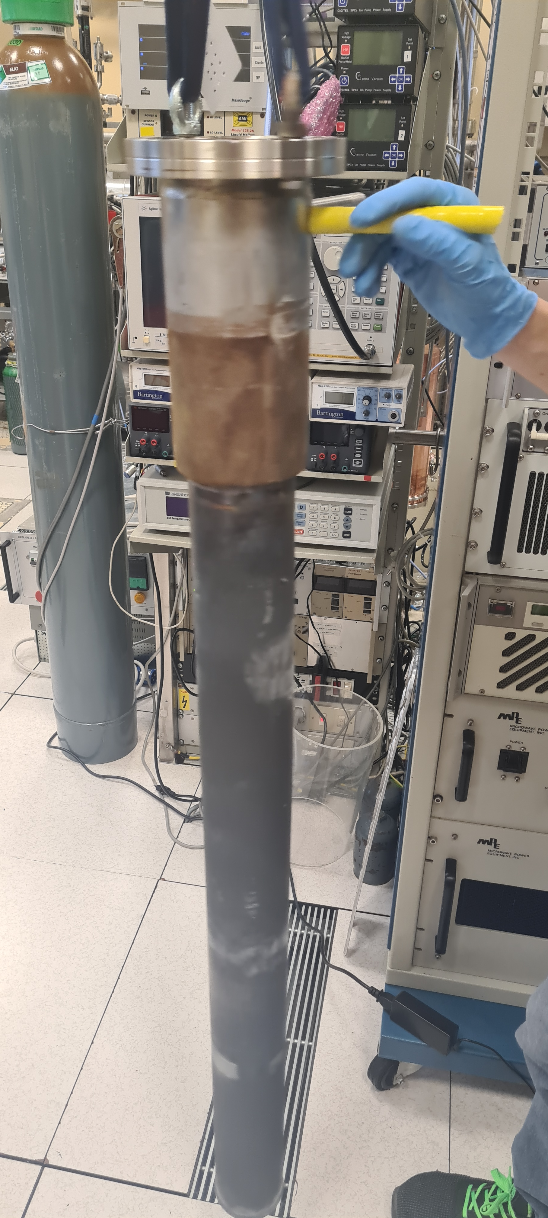
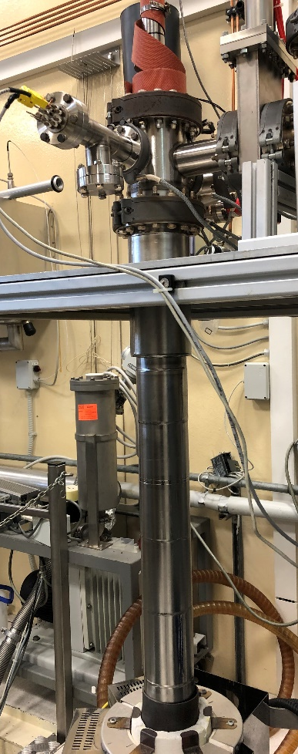
Solution to Cr contamination
Inconel chamber replaced by a
Nb chamber
produced at Zanon

Slide 33
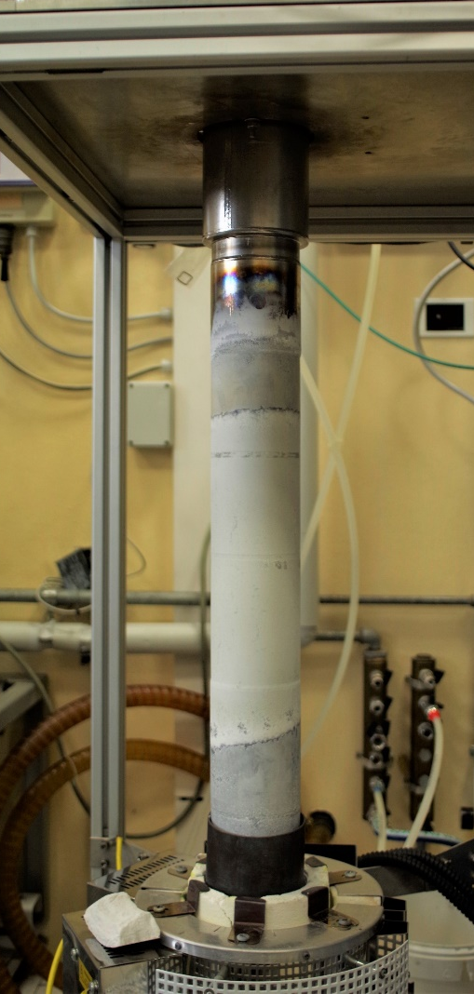
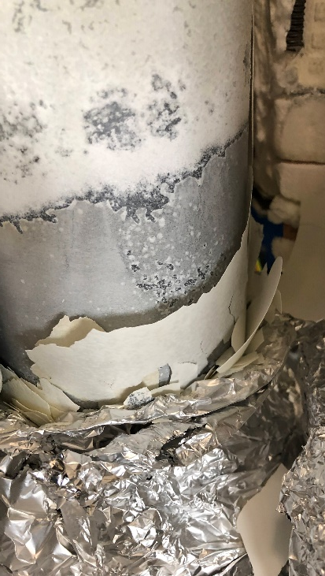
New problems have come…
Nb is not stable as Inconel at high T in air
We tested several solutions without success:
Nb anodization
High T paints
Allumina by HVOF
We are redesigning the system with inductive heating and a double chamber to avoid oxidation of Nb chamber
After the first test
(30 min @ 1000 °C)
a very thick film of Nb₂O₅ growth on the external surface

Slide 34
Conclusions
Proved the possibility of realizing targets via LTD
Easy modulation of target thickness and Tin content
Two main aspect to optimize:
Chromium poisoning
Study the magnetron sputtering
deposition parameters
in progress with commercial sintered Nb₃Sn targets

Slide 35
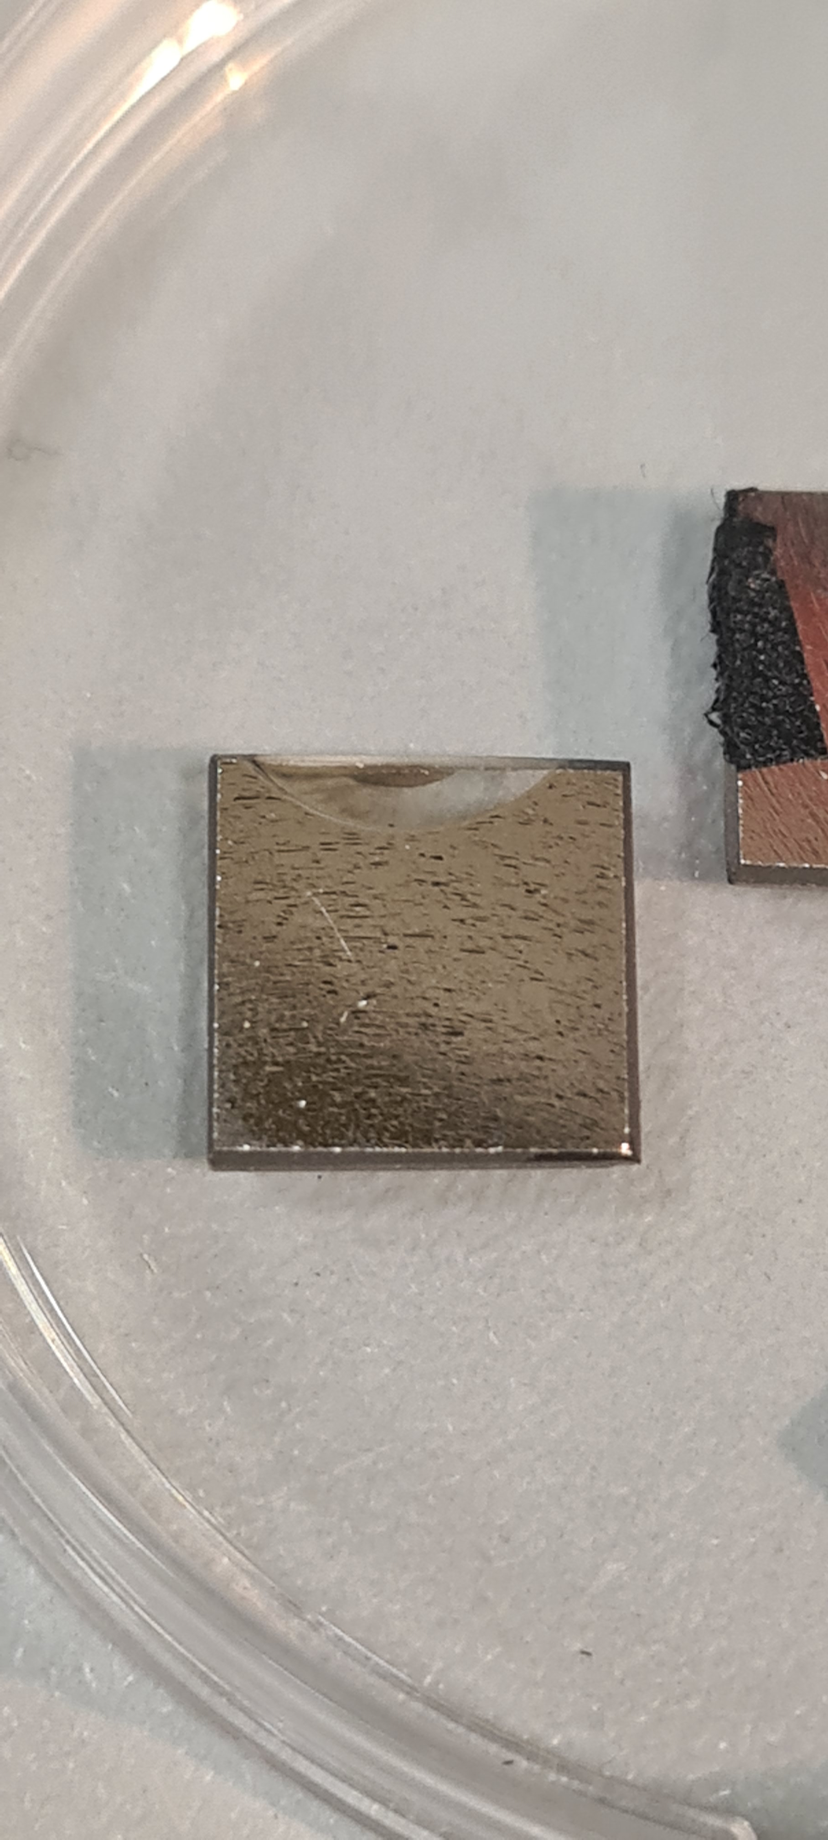
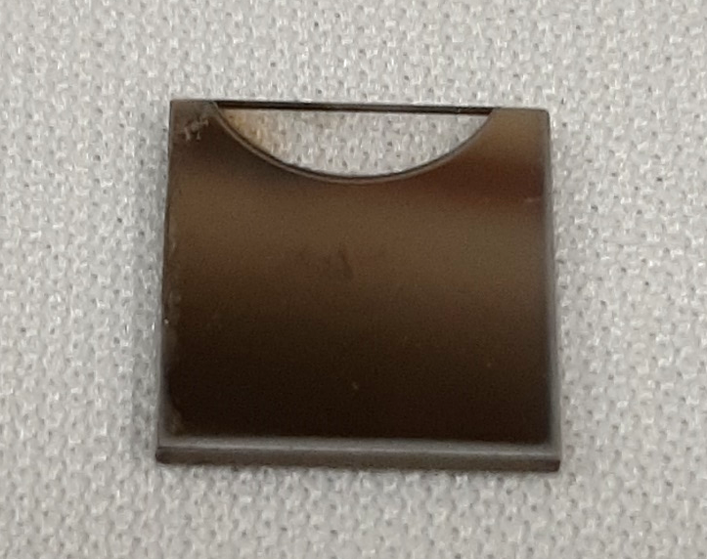
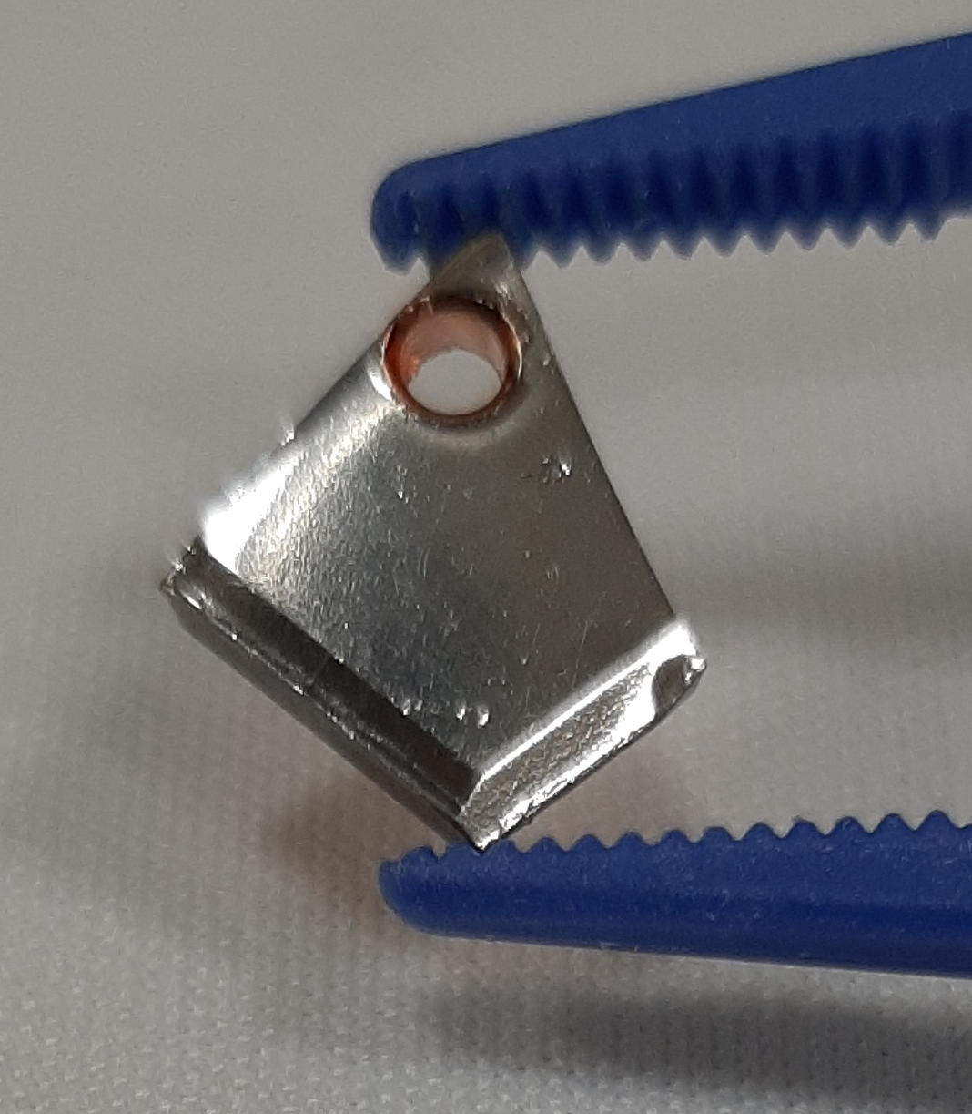
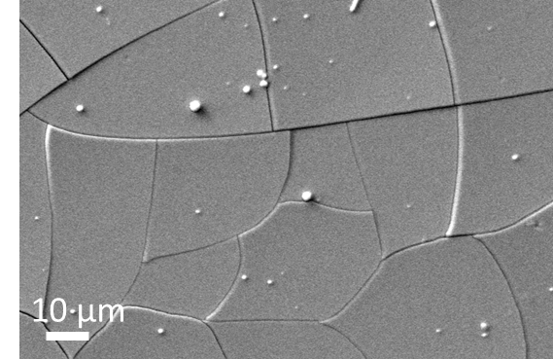
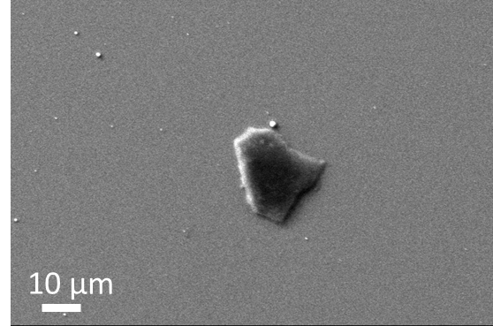
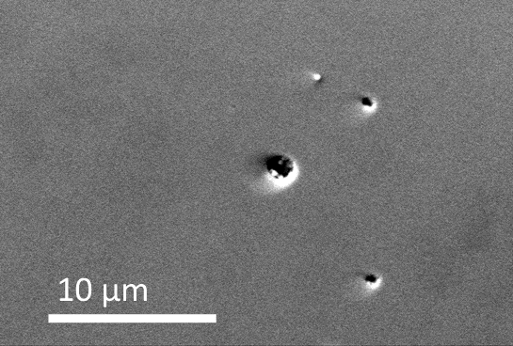
Take home message
Quartz
Sapphire
Copper
Do not use quartz for temperatures above 550 C!

Slide 36
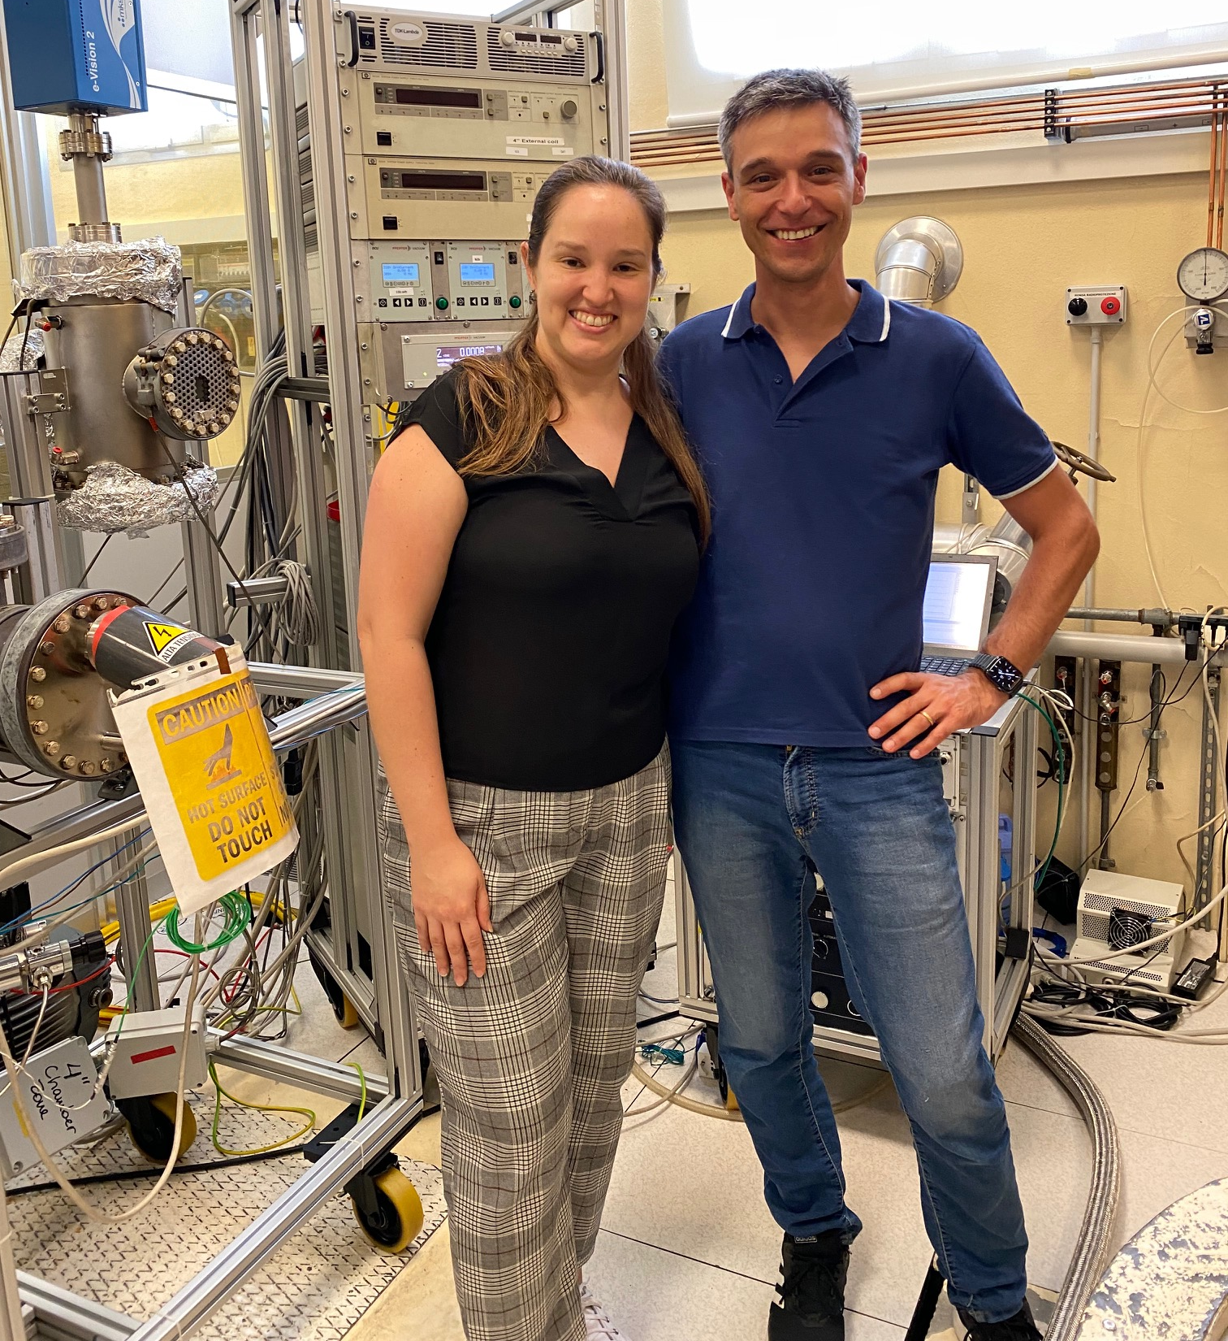

Thanks to the LNL INFN team:
Alessandro Salmaso, Davide Ford, Luca Torrassa, Eduard Chyhyrynets, Fabrizio Stivanello, Giorgio Keppel, Oscar Azzolini
Special thanks to Vanessa Garcia Diaz
Open postdoc position @LNL:
(deadline October 30th)
https://l.infn.it/job
cristian.pira@lnl.infn.it

Slide 37
Thanks for your attention
cristian.pira@lnl.infn.it
Work supported by the INFN CSN5
i.FAST has received funding from the European Union’s Horizon 2020 Research and Innovation programme under GA No 101004730.

Slide 38
Backup slides

Slide 39
How does the new process work in RF?

Slide 40
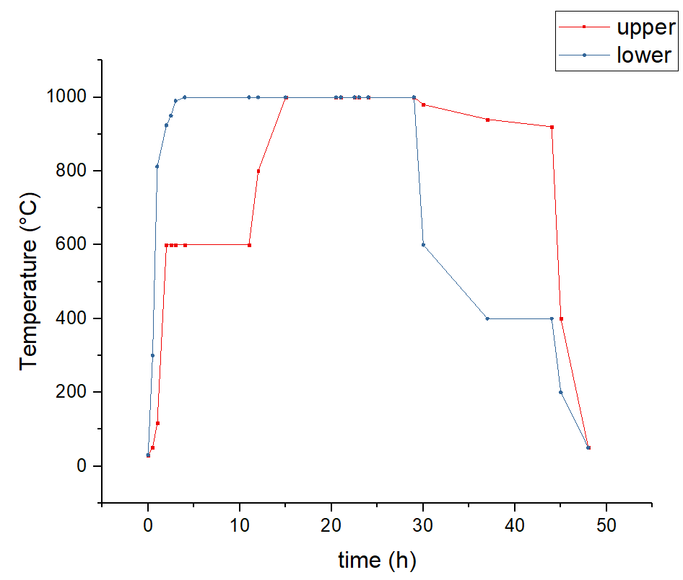
How does the new process work in RF?
Process has been adapted to reduce Nb₃Sn thickness
(5-10 microns as the old cavities)
9 h
9 h
0.5 h
7.5 h
15 h
1 h
nucleation
Vapor
coating
dipping
annealing
in Sn vapor
annealing
cooling

Slide 41
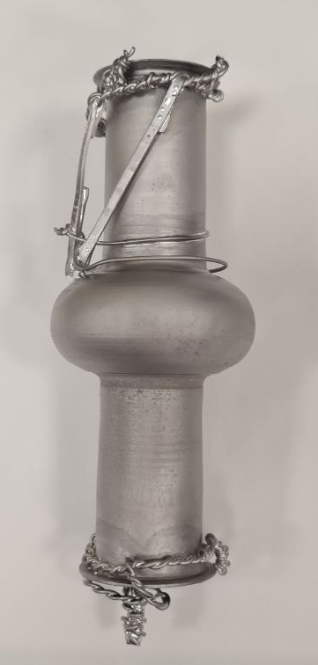
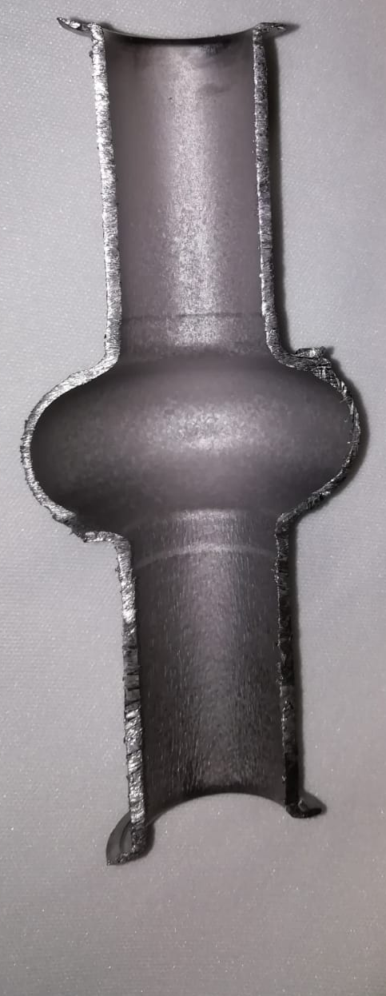
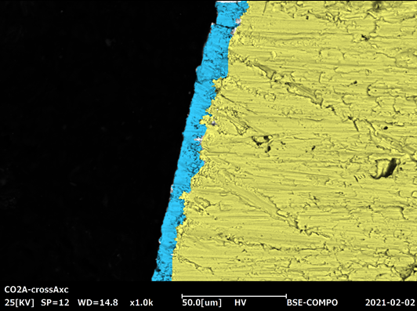
6 GHz cavity #1 (only geometry test)
First test in a broken cavity to test possible geometry effect
No tin drops!
Very good surface
5-10 micron Nb₃Sn thickness

Slide 42
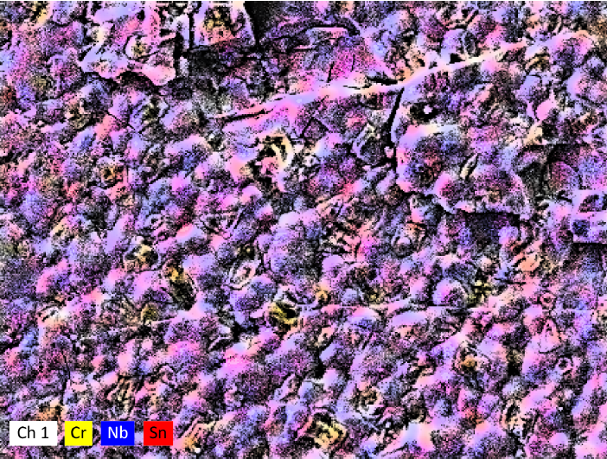

Cr-Ni contamination in 6 GHz cavity
External Surface of a 6 GHz elliptical cavity
Inner Surface of a 6 GHz elliptical cavity
Nb 42% Sn 13% Cr 38% Ni 7.2%
Nb 65% Sn 35% Cr 0%
The cavity geometry preserves the inner surface from contamination

Slide 43
6 GHz cavity #1 (only geometry test)
Inner Surface XRD of a 6 GHz elliptical cavity
(210)
(211)
XRD shows only the
Nb₃Sn phase
(200)
(321)
(400)
(320)
(421)
(420)
(222)

Slide 44



6 GHz cavity #2
Same process of cavity #1
Problem with upper furnace: annealing at 920 °C instead of 940 °C
45 h of annealing instead of 15 h
Metallic tin outside
Dark spots in the inner surface
(signs of tin excess)

Slide 45

Tc and RF Test
Tc ∼ 11.5 K
6 GHz @ 4.2 K
Q_{BCS} Nb = 3 * 10⁷
Flux expulsion measured by a Flux Gate placed in the equator
Poor RF performances comparable to old process
(Sn excess? Cr-Ni contamination? Thick film?)

