Slide 1



medium temperature treatments of SRF cavities at DESY
Based on LINAC 2022 contribution THPOGE22 by Lea
Detlef Reschke for the SRF team of DESY and Uni Hamburg

Slide 2
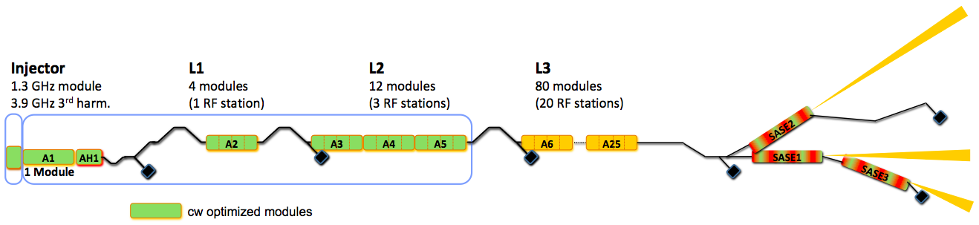
European XFEL cw upgrade requires high performance cavities
motivation
pulsed and cw operation necessary
SRF cavities for 17 new modules needed
  large quality factors for continuous wave mode
  high accelerating gradients for pulsed mode
main linac L3 unchanged
add 17 existing “old” modules to L3
European XFEL performance
  pulsed operation at ~24MV/m @ 1∙10¹⁰ ave. required
  achieved in series production
  Q₀ at 4 MV/m: 2.4 ∙10¹⁰
  Q₀ at 23.6 MV/m: 1.4 ∙10¹⁰
proposal to replace 17 cryomodules
* injector (1 CM),
* L1 (4 CM) and
* L2 (12 CM)
by new cryomodules optimized for cw and pulsed operation
spec to be defined
2

Slide 3
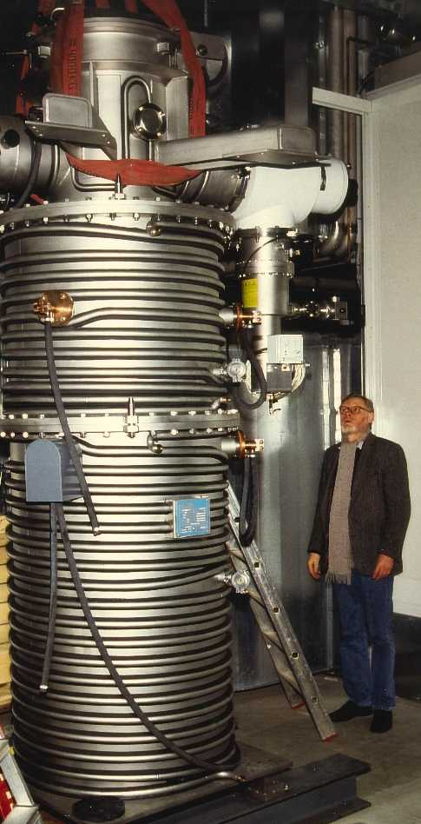
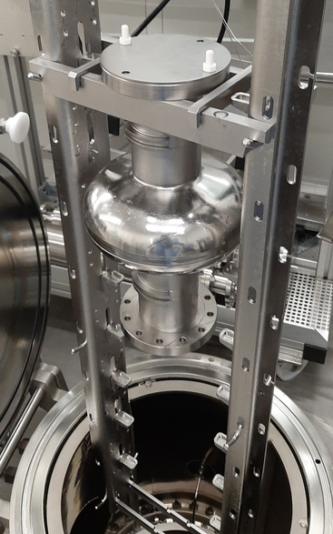
DESY concentrates on medium temperature (mid-T) treatments
infrastructure at Zanon and DESY
DESY mid-T campaign started in 2021
cooperation with Zanon Research & Innovation Srl
  horizontal industrial furnace with common vac system
  molybdenum shields and heaters
  T uniformity ± 5 °C
  start pressure ~ 1x10⁻⁸ mbar
refurbished furnace infrastructure at DESY
  Nb retort furnace attached to ISO4 cleanroom
  vertical assembly of 2x single-cell or 1x nine-cell
  separate cavity vac system; 2x cryo pumps
  start pressure ~ 2x10⁻⁸ mbar; clean vac system
  pressure at 300 °C ~ 1x10⁻⁷ mbar
2

Slide 4
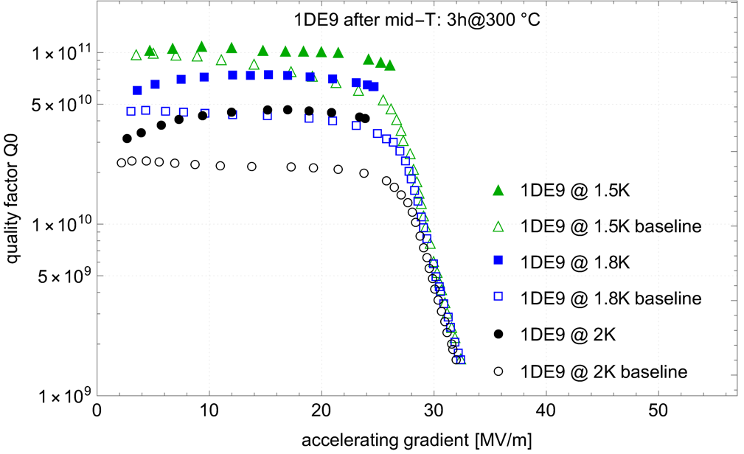
aiming for reproducible procedures
different furnaces and start of physics runs during ongoing commissiong
Zanon
  4x cavities; treated in two furnace runs
  first set without caps; second set with caps
  each set:
  one cavity with prior low T-bake; one without
  all cv’s: 3h at 300 °C
  final HPR & assembly at DESY
  best performance: two caps & without low T-bake
DESY
  4x cavities in single runs; all without low T-bake
  one cavity (1DE19) with two caps;
  others top cap only as dust protection
  final HPR & assembly, only
  1x cv: 20h at 250 °C
  2x cv’s: 3.25h at 325 °C; 4.5h at 335 °C
  1x cv (large grain): 3h at 300 °C
Q(E) of best mid-T cavity at Zanon compared to reference run
after EP treatment
3

Slide 5
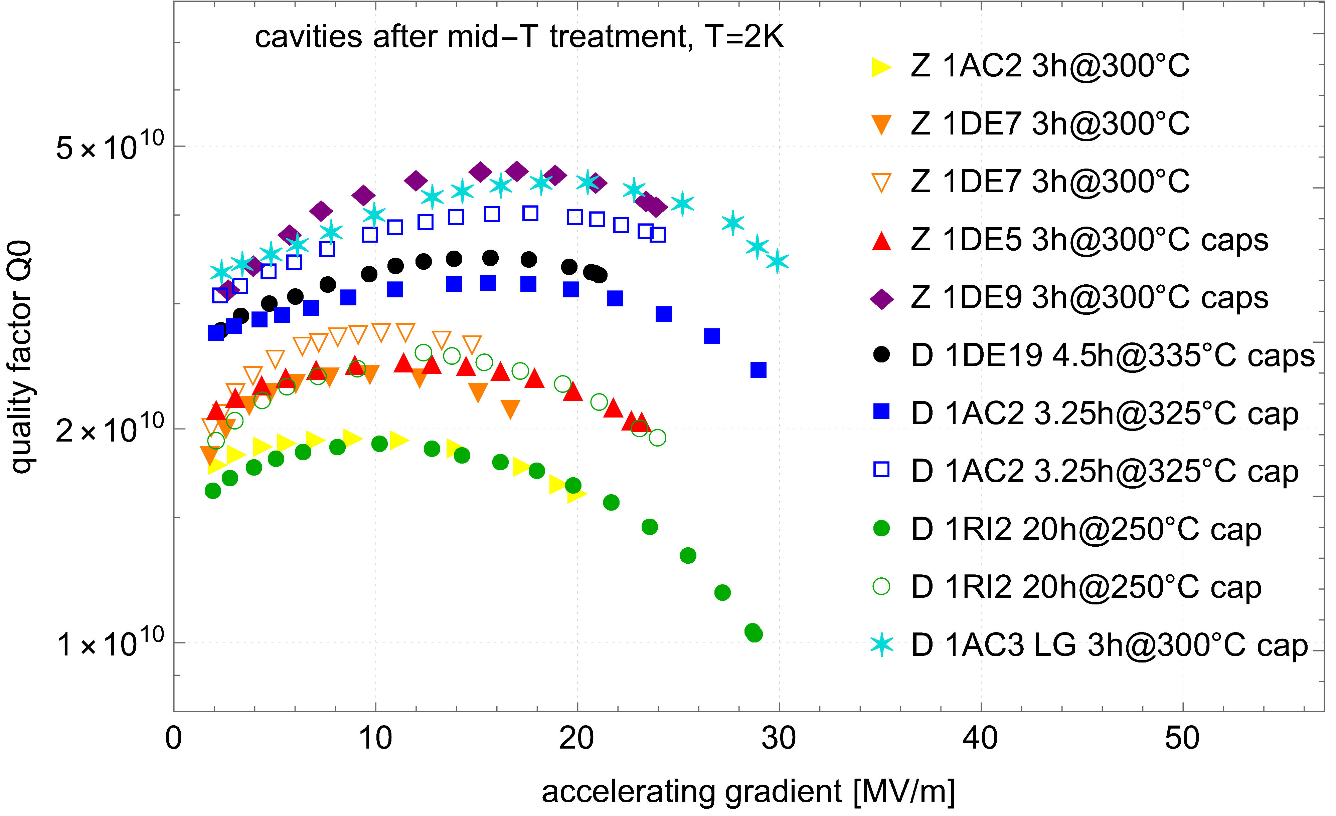
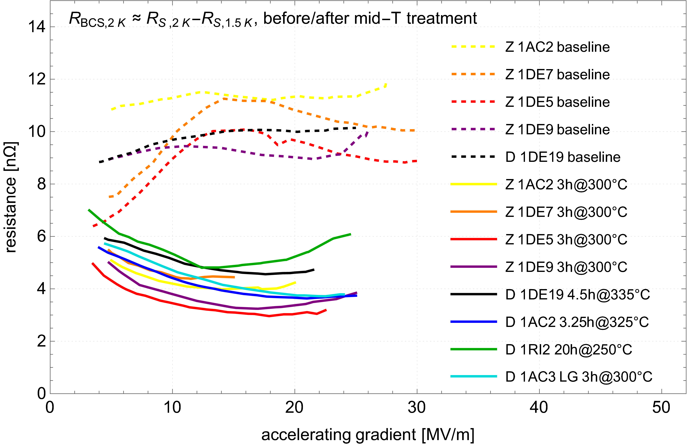
mid-T campaign shows good & typical results
summary of results so far
all results with typical features
  (partially) enhanced quality factors at 2K compared to baseline test
  best: Q₀ @ 16 MV/m = 4.9x10¹⁰ for lg cavity
  anti-Q-slope behaviour
  characteristic reduction of R_{BCS}(2K) to 3-6 nΩ
  (partially) enhanced residual resistances mask the
  reduction of R_{BCS}
  enhanced R_{res} after quenching: flux trapping
  reduced accelerating gradients, but up to 30 MV/m
  remark: R_{BCS}(2K) ≈ R_{s}(2K) - R_{s}(1.5K) used
  => error for low R_{res}
effect of additional HPR
  cure of field emission as usual, but additional HPR’s without effect on cavity performance
3

Slide 6
a successful mid-T campaign…
…to be continued and expanded
successful campaign
  clean furnaces available
  characteristic features observed
  3 cavities with gradients already in region of 30 MV/m
optimisation potential
  recipe adaptions (temperature & duration)
  more single-cell cavities - produced at the moment
  role of caps
additional diagnostics & studies just started
  more sample analysis tomorrow
  => presentation by Rezvan
  flux trapping sensitivity via new B-mapping system
  frequency vs. temperature measurements
  additional SEM and SIMS sample analysis
4

Slide 7
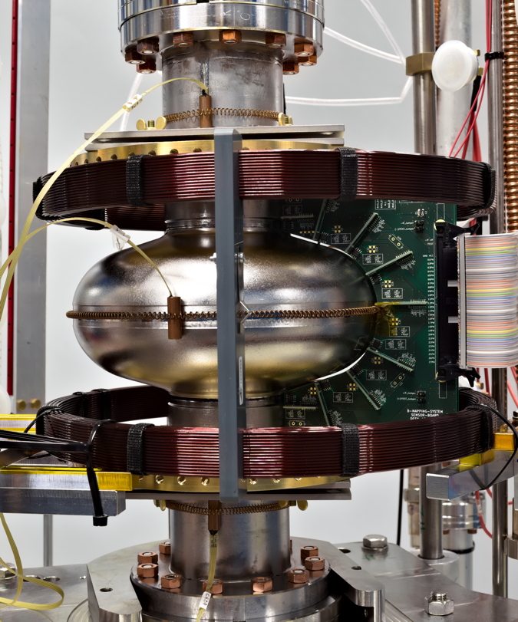
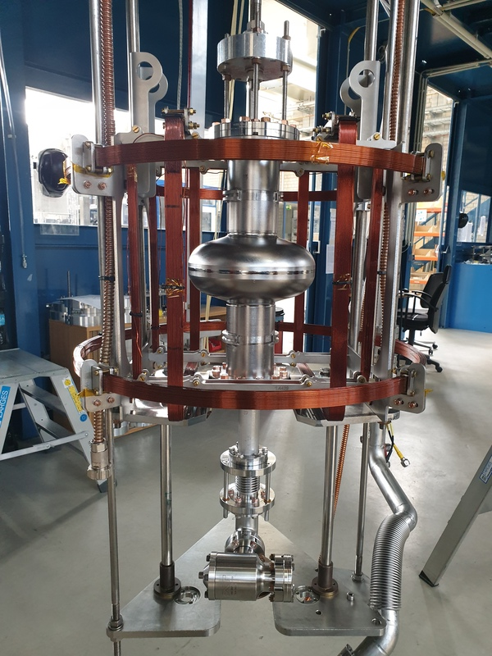
a successful mid-T campaign…
…to be continued and expanded
successful campaign
  clean furnaces available
  characteristic features observed
  3 cavities with gradients already in region of 30 MV/m
optimisation potential
  recipe adaptions (temperature & duration)
  more single-cell cavities - produced at the moment
  role of caps
additional diagnostics & studies just started
  more sample analysis tomorrow
  => presentation by Rezvan
  flux trapping sensitivity via new B-mapping system
  frequency vs. temperature measurements
  additional SEM and SIMS sample analysis
4

Slide 8
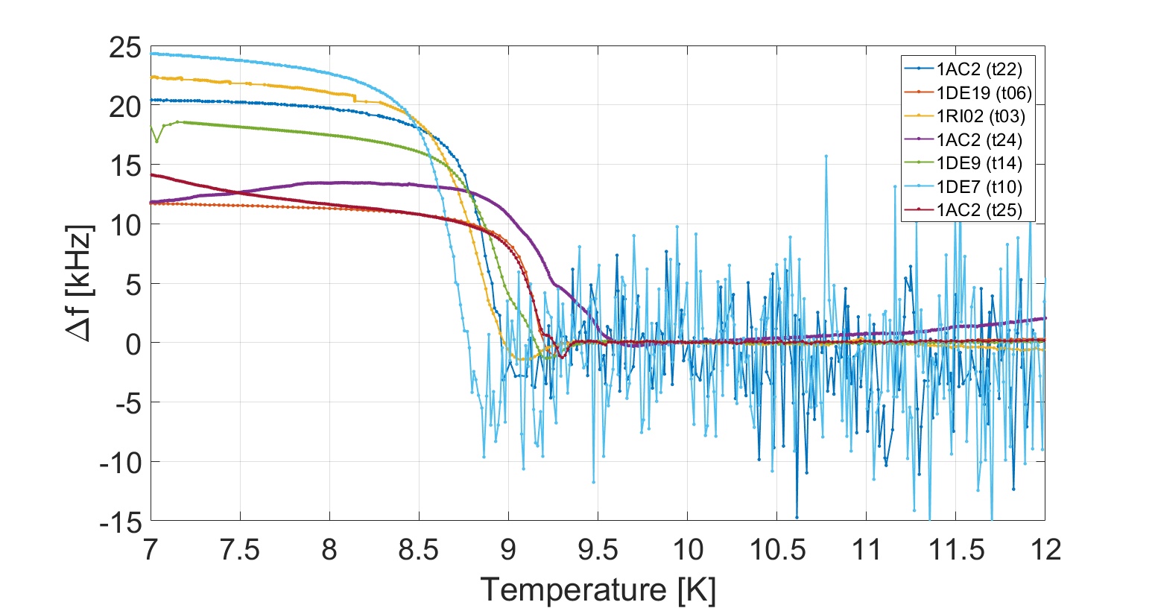
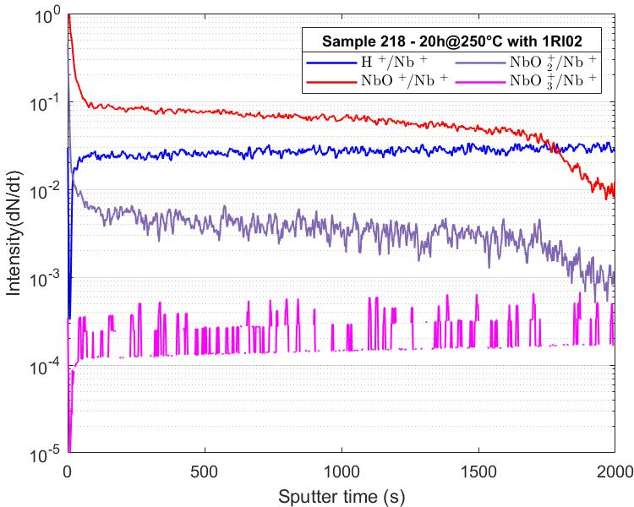
a successful mid-T campaign…
…to be continued and expanded
successful campaign
  clean furnaces available
  characteristic features observed
  3 cavities with gradients already in region of 30 MV/m
optimisation potential
  recipe adaptions (temperature & duration)
  more single-cell cavities - produced at the moment
  role of caps
additional diagnostics & studies just started
  more sample analysis tomorrow
  => presentation by Rezvan
  flux trapping sensitivity via new B-mapping system
  frequency vs. temperature measurements
  additional SEM and SIMS sample analysis
4

Slide 9
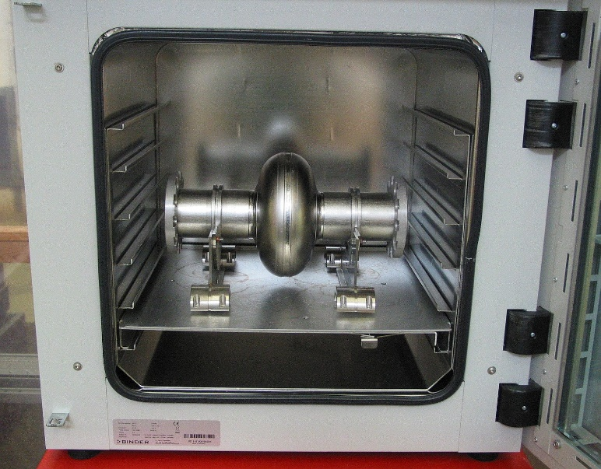
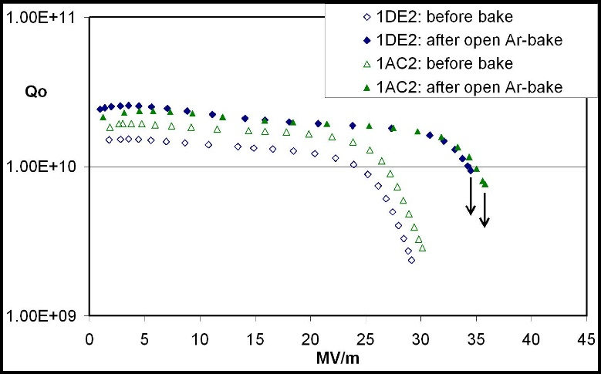
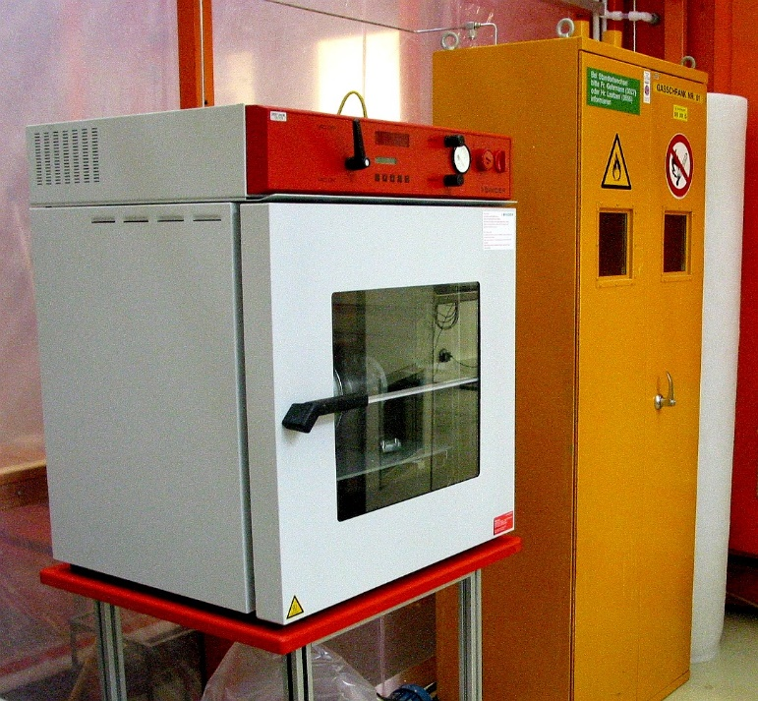
what happens at 200°C in Ar atmosphere?
simplify mid T-bake
successful low T-bake in Argon atmosphere in 2007/2008
  publication: “Open 120°C Bake in Argon
  Atmosphere: A Simplified Approach for
  Q-Drop Removal”, D. Reschke, J. Ziegler,
  THP015, Proc. LINAC08, Victoria, Canada
  (2008)
  Not used for European XFEL series cavity
  production
Infrastructure available:
  commercial drying chamber with programmable temperature control
  (stability ± °3C) and integrated vacuum / venting installation
  dry, oil-free diaphragm pump for initial pump-and-purge cycles
  Ar-gas > 99.999% purity ; flow ~240-250 l/h

Slide 10
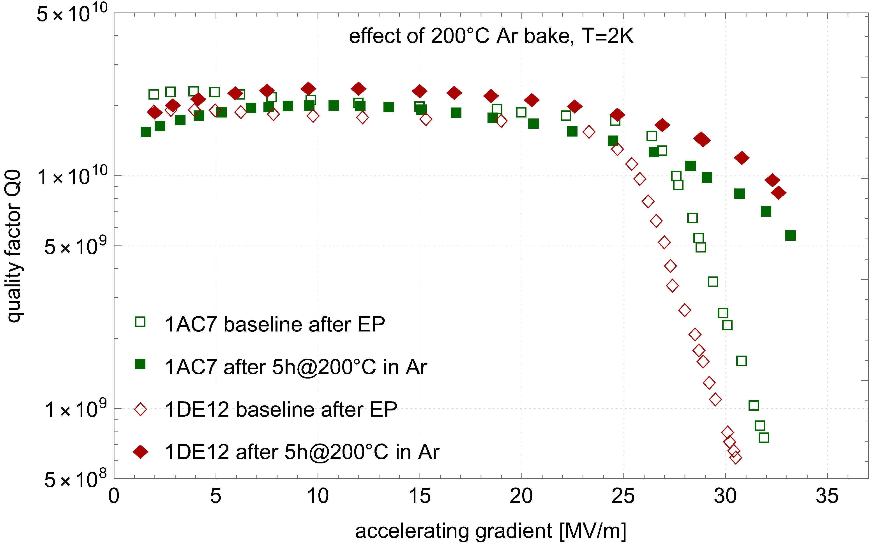
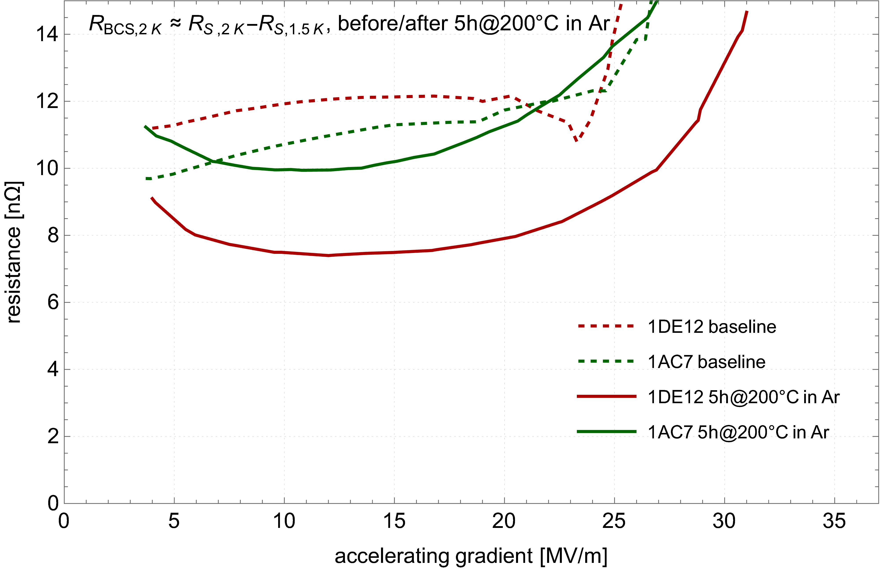
first attempt of 200°C in Ar atmosphere soso…
revive the Ar process at higher temperature
application to two single-cell cavities
  max temperature 200°C of drying chamber applied
  cv’s: 1x fine-grain Nb; 1x large-grain Nb
  baseline test after short EP w/o subsequent low T-bake
  Ar-bake 200°C/5h, HPR + rf test
first results
  characteristic Q-drop cured partially, only
  no/less improvement in Q-value at 2K
  gradient limited by “quench” at 33-35 MV/m
  R_{res} increased by 1-1.5 nΩ
  less reduction of R_{BCS}(2K) compared to mid T-bake
Something in between => to be compared to 200°C in UHV

