Slide 1
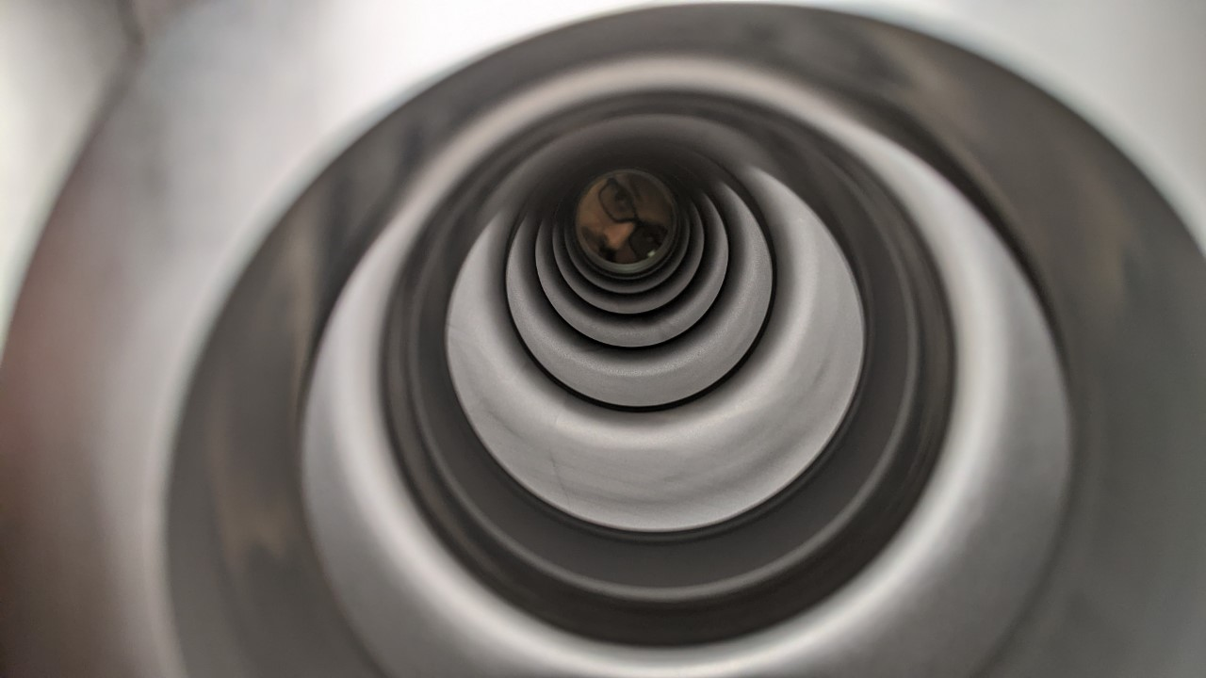

Nb₃Sn cavity coating development for accelerator applications at Jefferson Lab
Uttar Pudasaini
Notes:
Nb3Sn

Slide 2
Acknowledgements
Jefferson Lab
  Charlie Reece
  Anne-Marie Valente
  Bob Rimmer
  Tony Reiley
  Michael Kelley
  Gianluigi Ciovati‬
  John Vennekate
  SRF Technical staffs
Old Dominion University
  Jayendrika Tiskumara
Fermilab
  Grigory Eremeev

Slide 3
Outline
Vapor Diffusion Coating
Cavity coating
  Single-cell Cavity Coating
  Five-cell Cavity Coating
Cavities for conduction-cooled Accelerator Applications

Slide 4
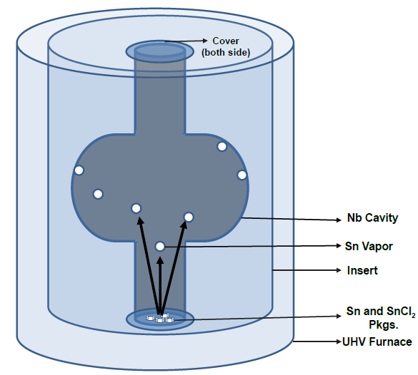
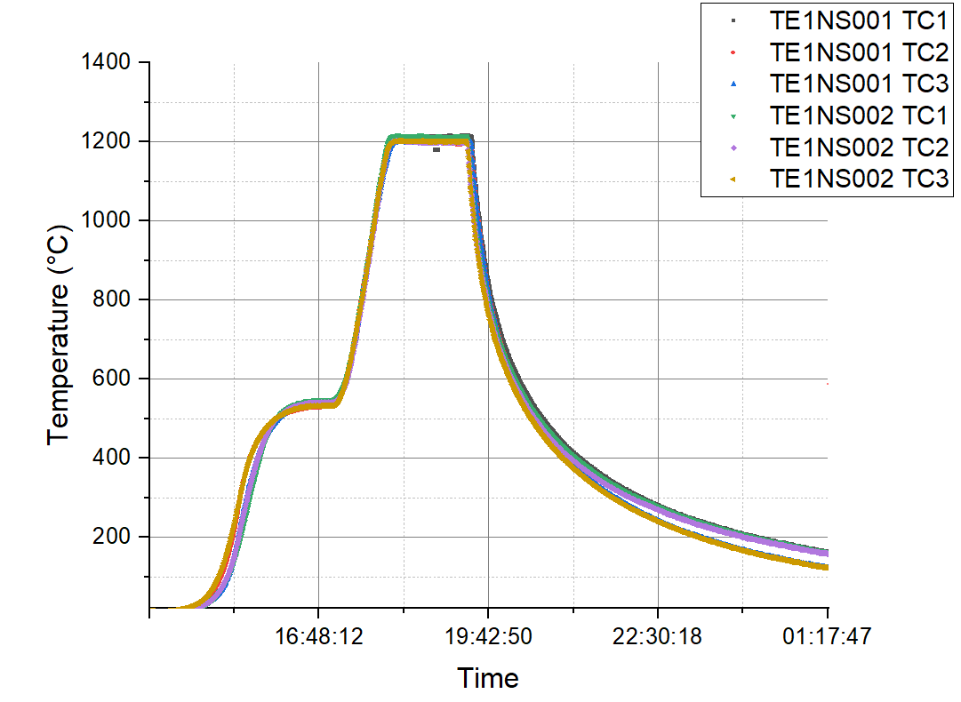
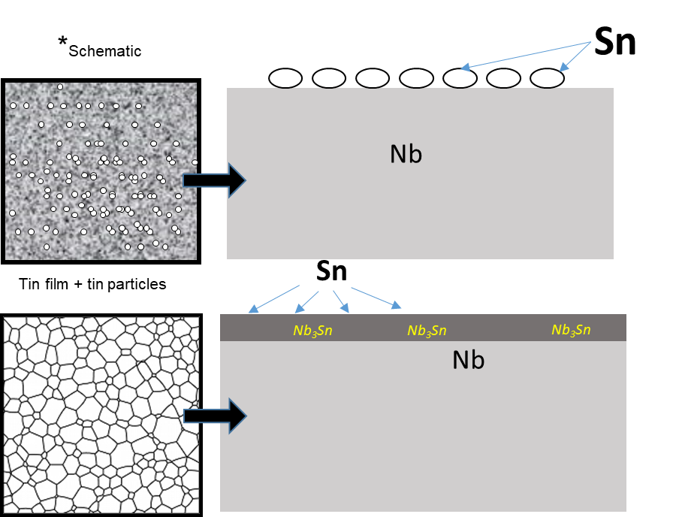
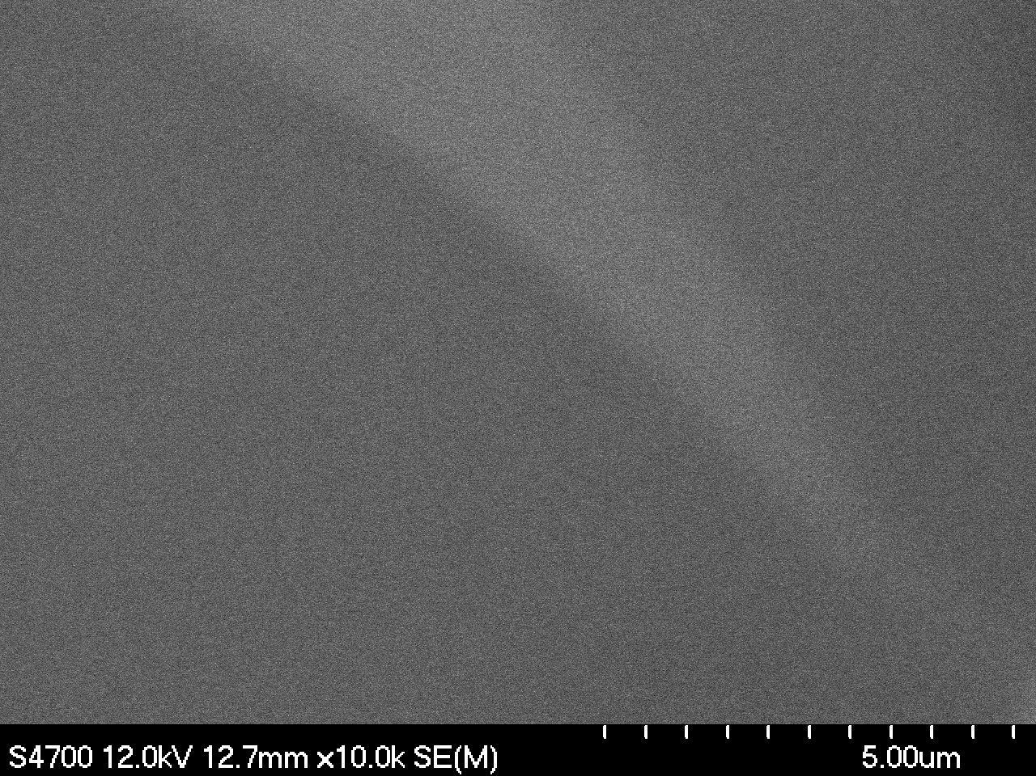
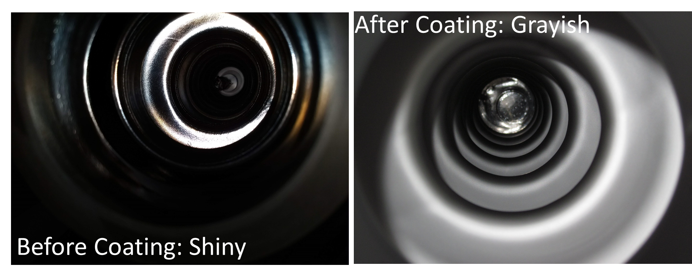
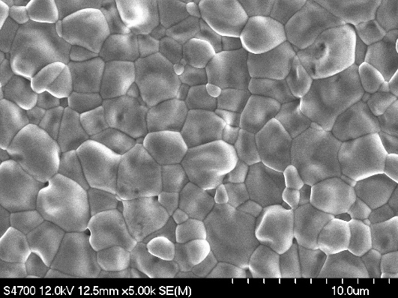
Vapor Diffusion Coating of Nb₃Sn on Nb
Cross-section
Cross-section
Leading coating technique to produce promising cavities
Create Sn-vapor, transfer to the interior surface of Nb cavity
Growth at Nb-Nb₃Sn interface
2-3 µm thick

Slide 5
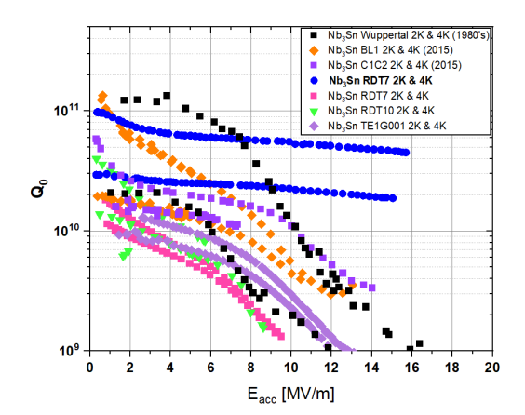
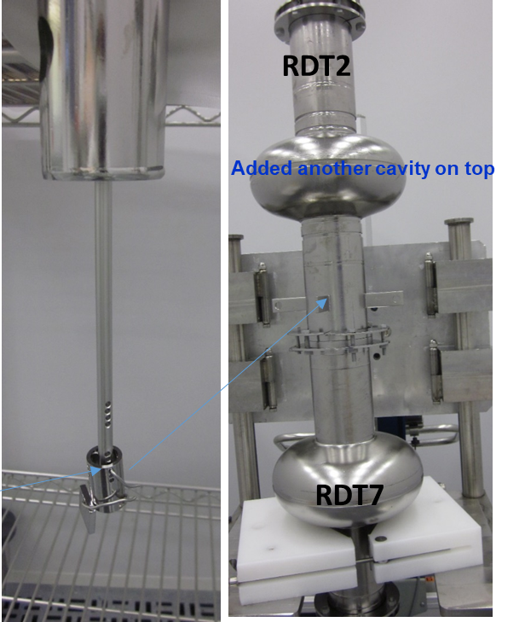
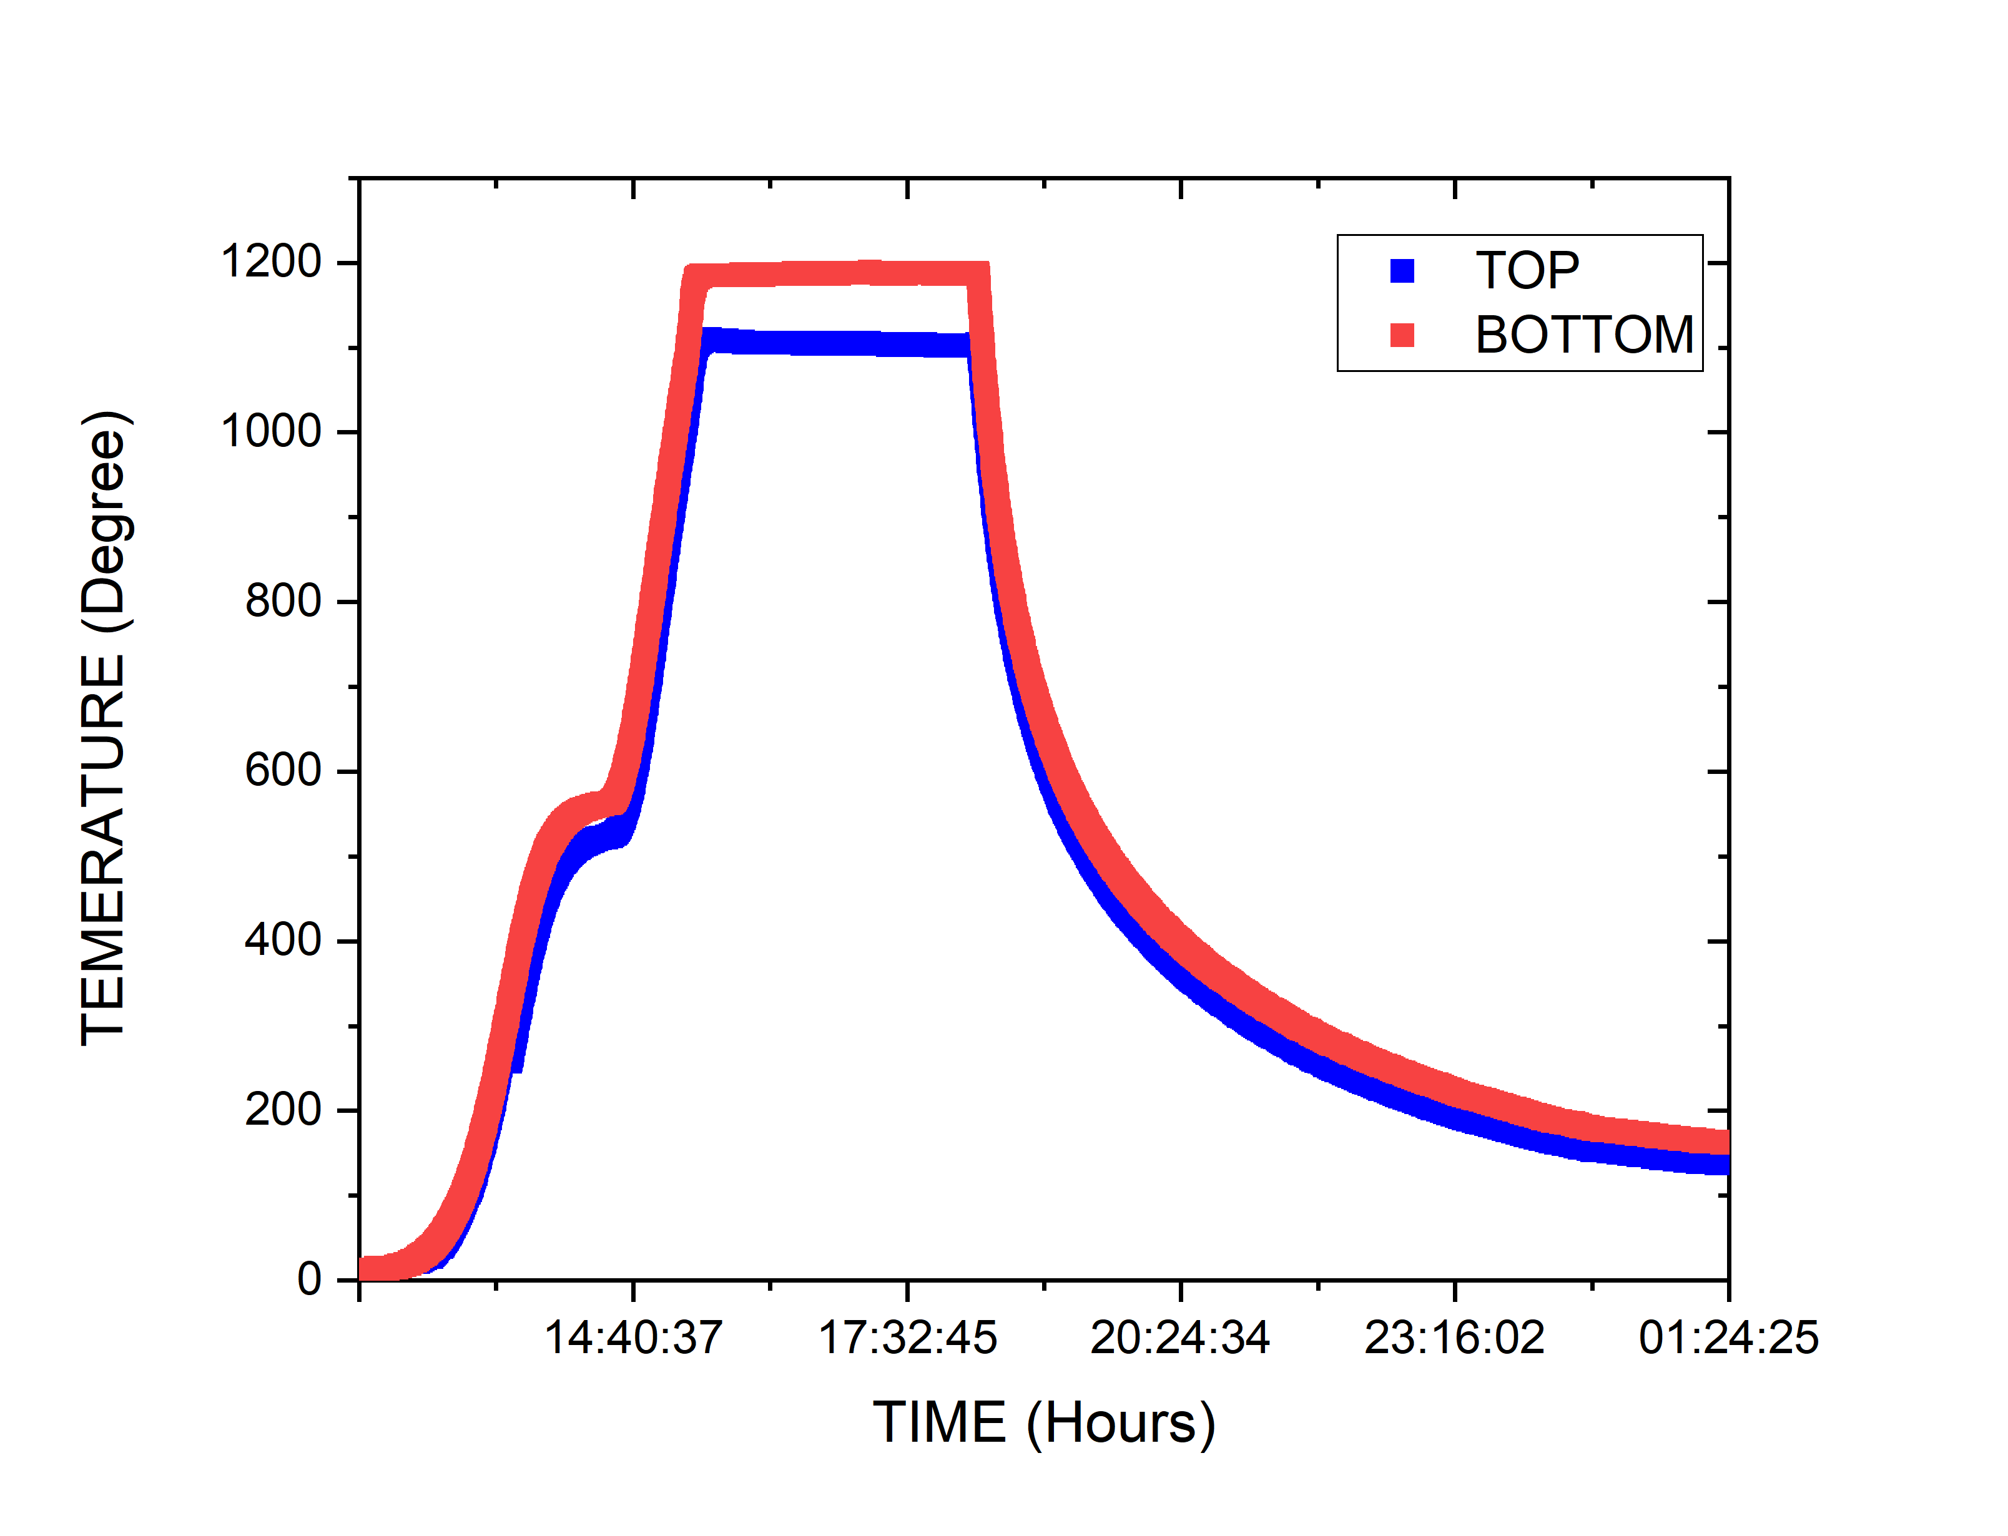
Performance of Single-cell cavity
~85 °C
Pudasaini U, Eremeev G, Reece CE, Ciovati G, Parajuli I, Sayeed N, Kelley MJ. Recent results from Nb3Sn single cell cavities coated at Jefferson lab. InProc. 19th International Conference on RF Superconductivity,(SRF’19) 2019 Jun.
Known limitations:
Non-uniform coating – forming patchy region
Potential Ti-contamination
Sn residues by condensation of Sn vapor
Potential limitations:
Non-uniform coating – forming patchy region
Potential Ti-contamination
Mitigation Sn residues

Slide 6
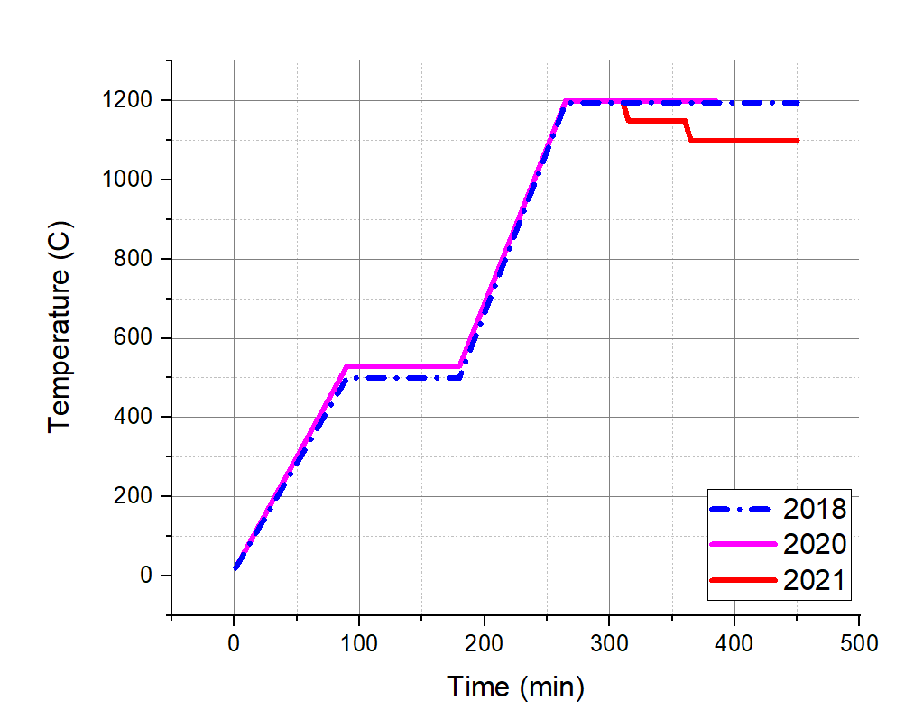
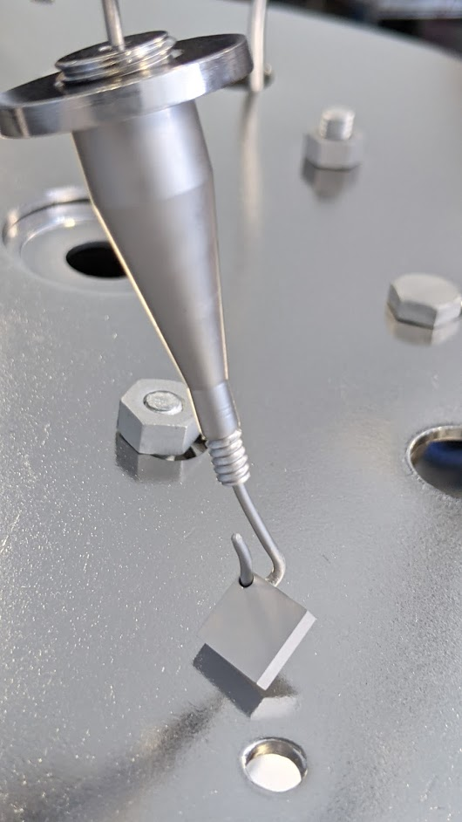
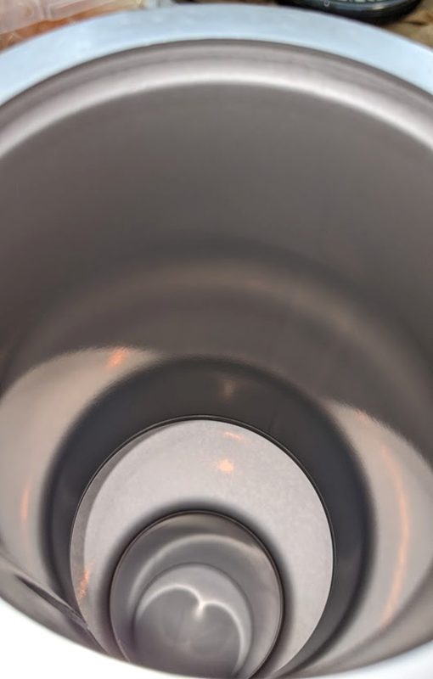
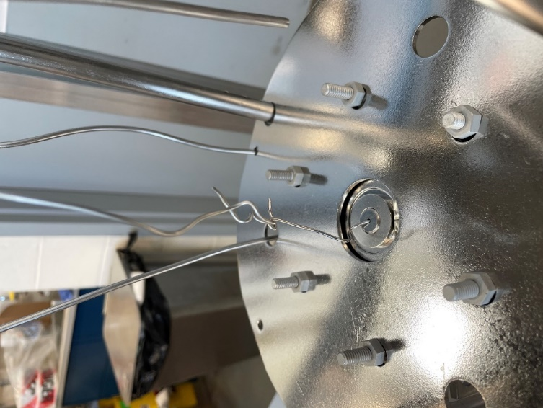
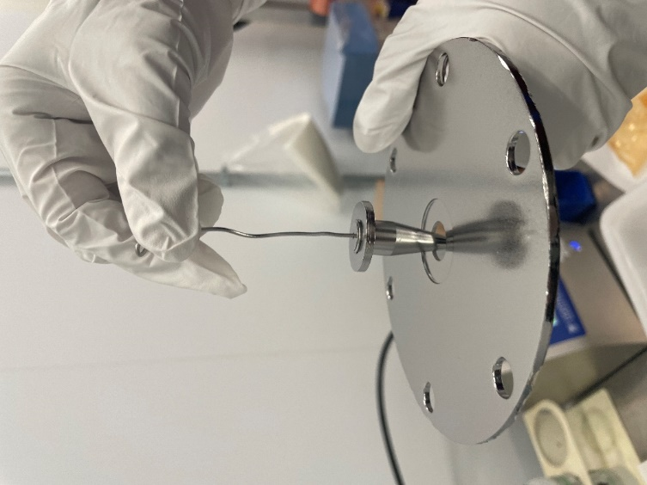
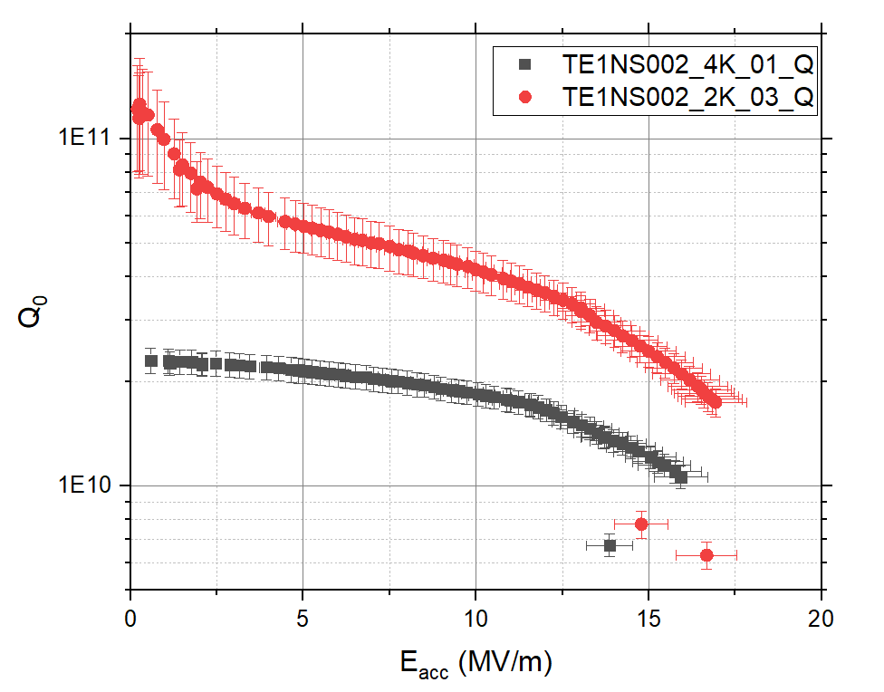
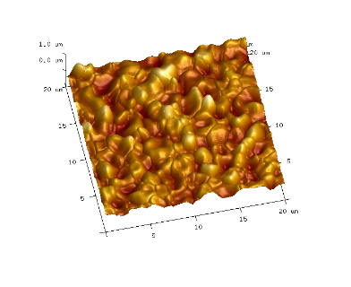
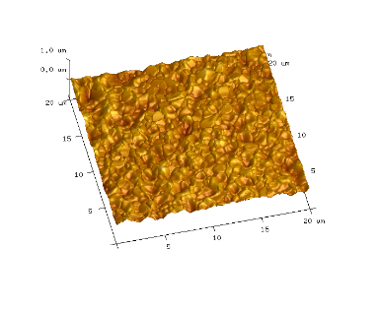
Evolution of coating temperature profile and cavity performance
Single-cavity Setup
Vary Sn-source and/or Temp profile or set up
Pull plug to relieve Sn-vapor
R_{a} = 123 ± 13 nm
R_{a} = 53 ± 4 nm

Slide 7
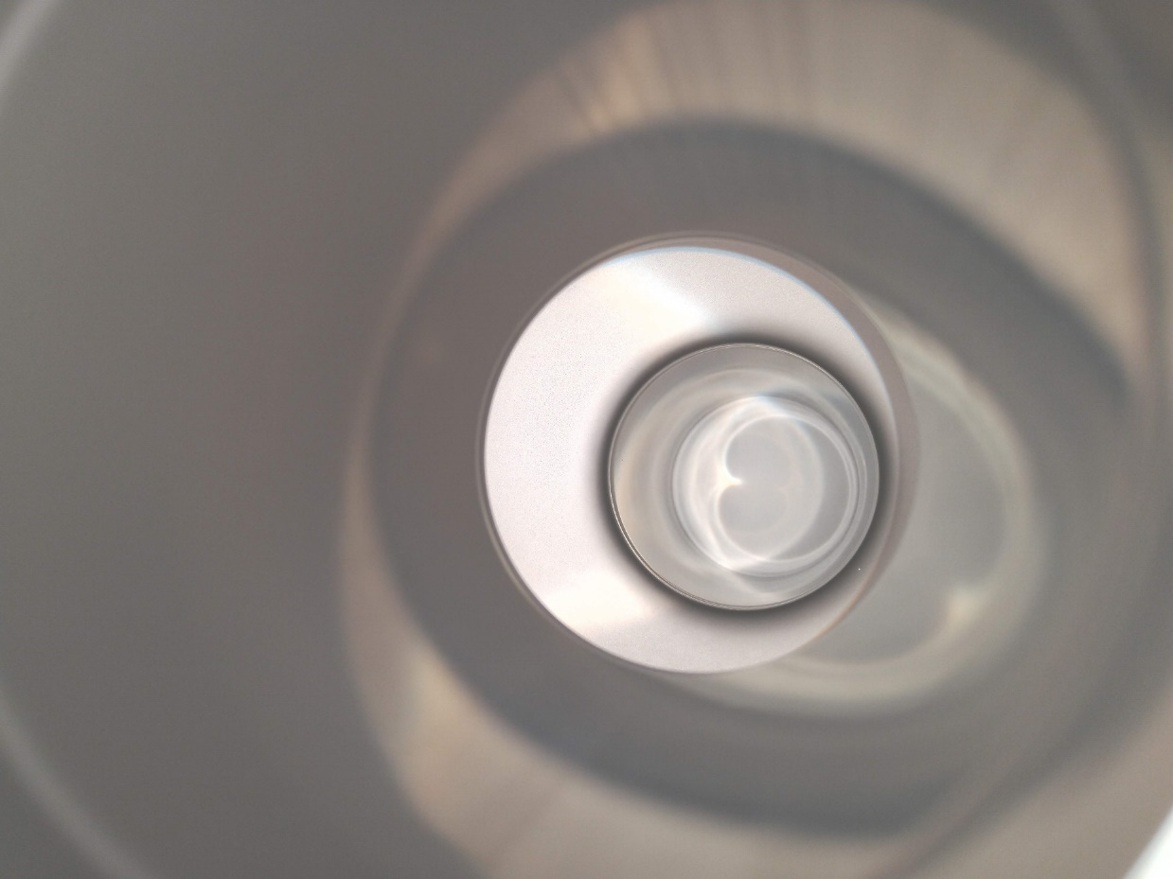
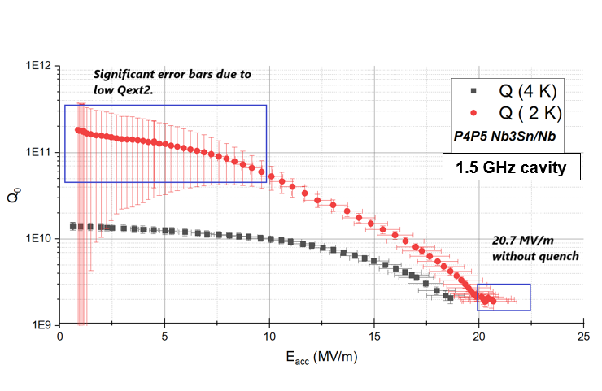
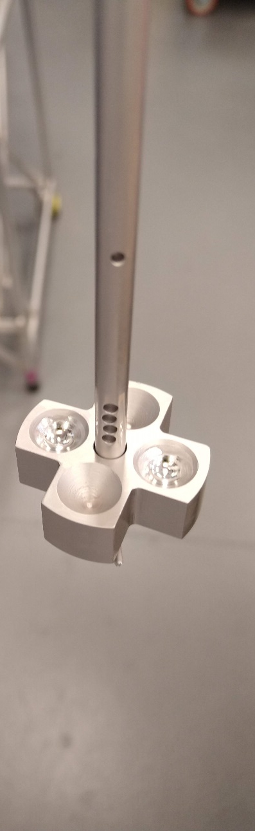
Toward higher gradients
1.5 GHz cavity
Secondary Sn source with conical crucibles

Slide 8
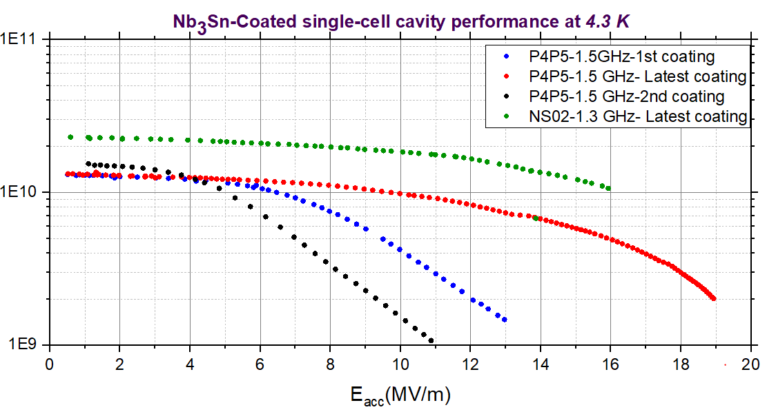
Recent performance of single-cell cavity
The coating profile update was guided by the witness sample analysis.
The coating profile currently followed aims to obtain equivalent coating grown at 1200 °C for ~ 1 h.
Exhausted Sn source
With Sn-residues (Typical Q-slope)
No quench, limited by input power
Notes:
Q-slope

Slide 9
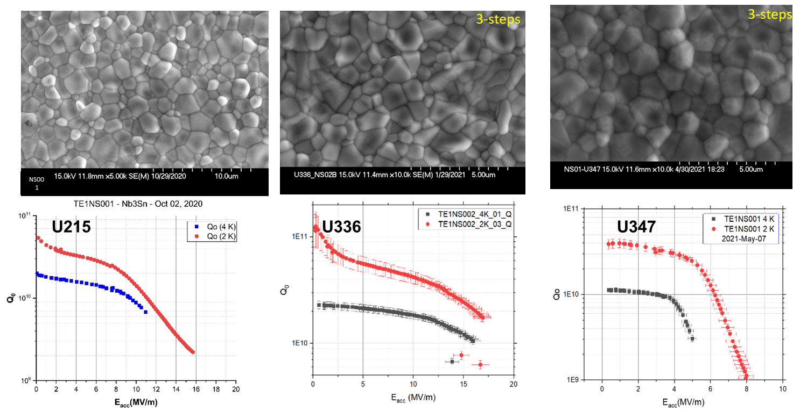
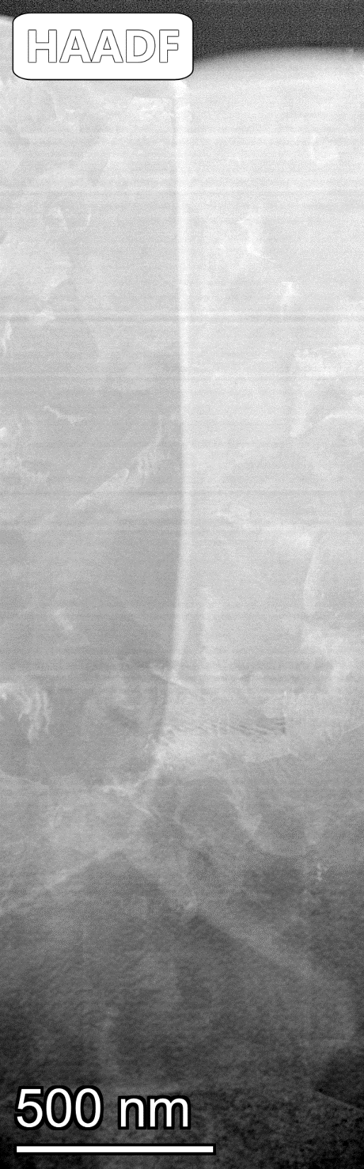
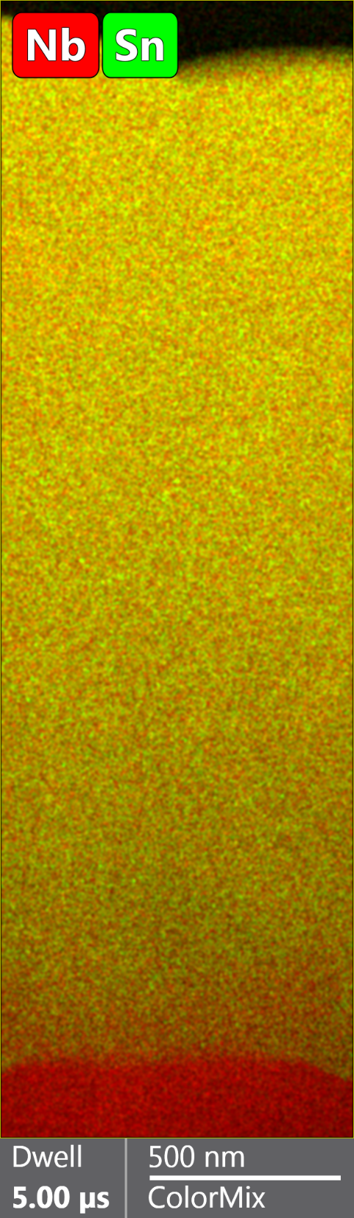
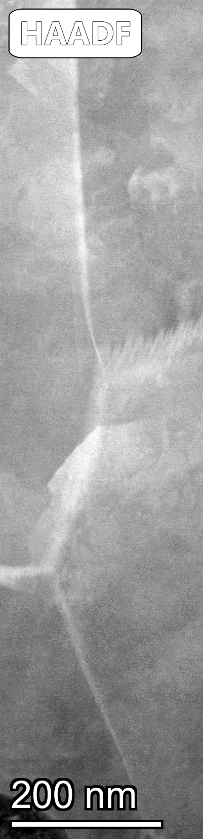
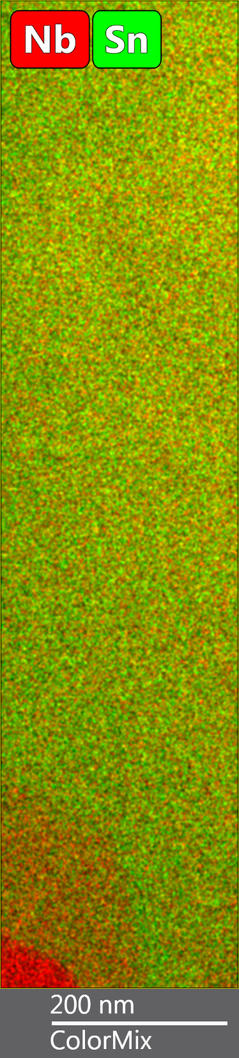
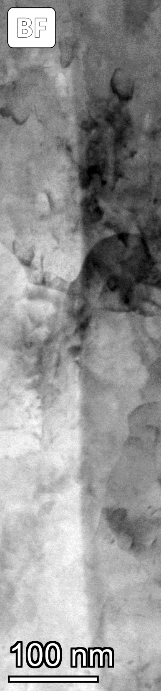
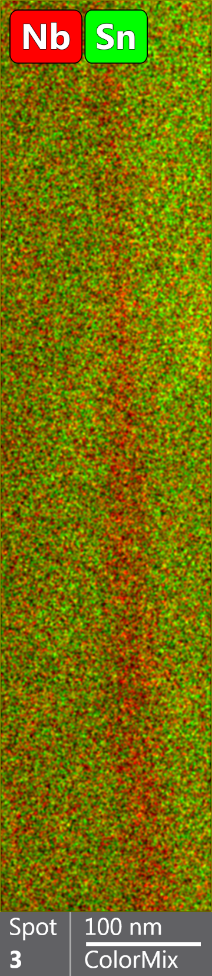
RF performance compared with material analysis
1200C × 3 h
Annealed without Sn
Performance | Typical – Q slope | “Good” | Annealed – “bad”
Average grain size (µm) | 1.52 ± 0.19 | 0.96 ± 0.06 | 1.11 ± 0.08
Average roughness (nm), 50 um scan | 202 ± 54 | 73±8 | 98 ± 5
Average thickness (µm) | 2.06 ± 0.49 | 1.20 ± 0.12 | 1.75 ± 0.15
GB composition |  |  | Sn-deficient
TEM analysis of grain boundaries with and without Q-slope
No Sn-rich GBs.
Sample with annealing features – Sn deficient GBs.
No obvious compositional difference between single-step (thicker) coating and three-step (thinner coating): generous Sn flux?
Sn-deficient regions were observed close to the Nb₃Sn-Nb interface.
Do Q-slope is related to thickness and roughness?
Annealed
Smoother, thinner, uniform coating??
Q-slope
No No Q-slope
Coating with small grain sizes, smoother surfaces, and thinner coating avoiding annealing without Sn correlates with better performing cavities.
Notes:
Q-slope

Slide 10
Management of Sn supply
Changing Sn effusion area for fixed substrate area:
  Larger crucible - higher evaporation - larger grain size and rougher surface.
  Small crucible - insufficient Sn-supply - non-uniform coating like observed during the coating of a larger or longer cavity coating
Changing substrate area for fixed Sn effusion area
  Increasing Substrate surface area - higher Sn-evaporation -microstructure and roughness defined by the Sn supply to the substrate area.
Area of both substrate and source need careful attention during the process design to engineer desired surface properties of the film.
Sn-flux (substrate size, source size, and temperature) at the initial stage and coating stage is crucial.
U. Pudasaini, C. E. Reece, and J. K. Tiskumara, “Managing Sn-Supply to Tune Surface Characteristics of Vapor-Diffusion Coating of Nb3Sn”, presented at the SRF'21, East Lansing, MI, USA, Jun.-Jul. 2021, paper TUPTEV013, unpublished. doi:10.18429/JACoW-SRF2021-TUPTEV013 C

Slide 11
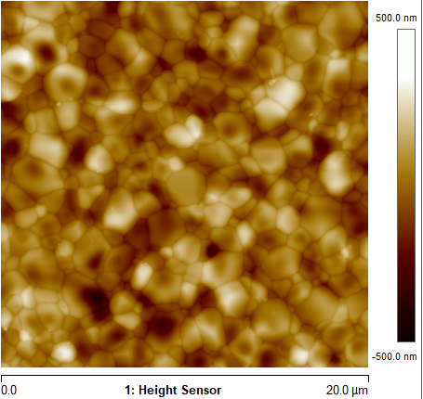
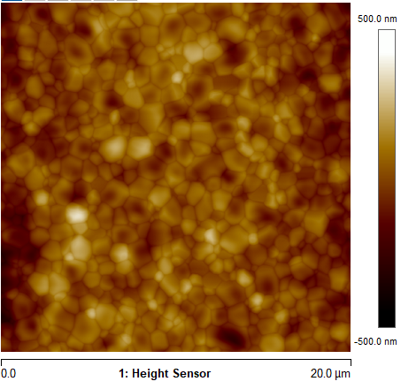
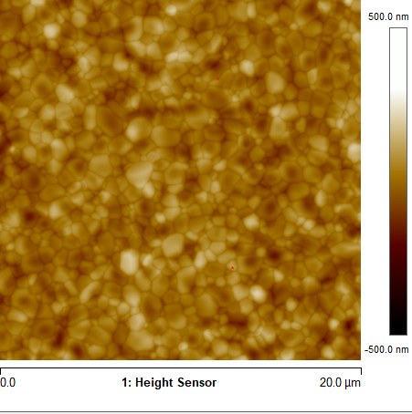
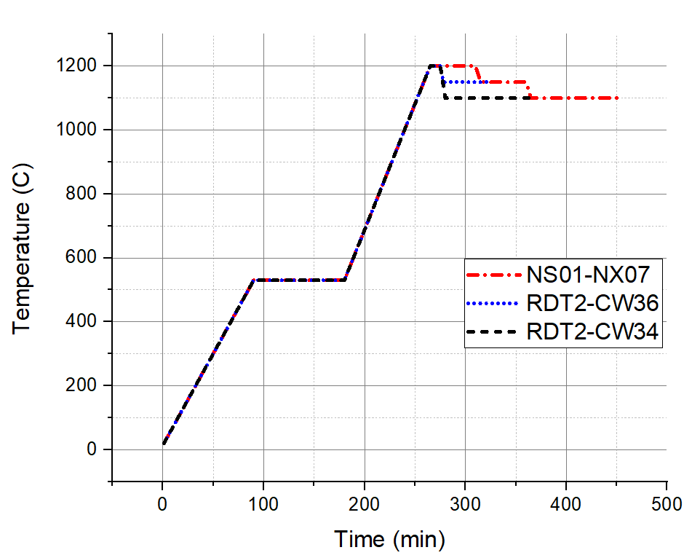
Surface roughness reduction
NX07
CW36
CW44
Scan size 20µm ×20 µm (Averaged from two randomly selected areas) | NX07 | CW36 | CW44
R_{q} (nm) | 104.5 ± 3.5 | 86 ± 2 | 51 ± 1
Ra (nm) | 83.4 ± 3.1 | 69 ± 3 | 40 ± 1
Uniform coating
Sn residues are eliminated or significantly reduced
Thickness needs to be measured.
More experiments are underway.
Cavity coating is planned for RF analysis.

Slide 12
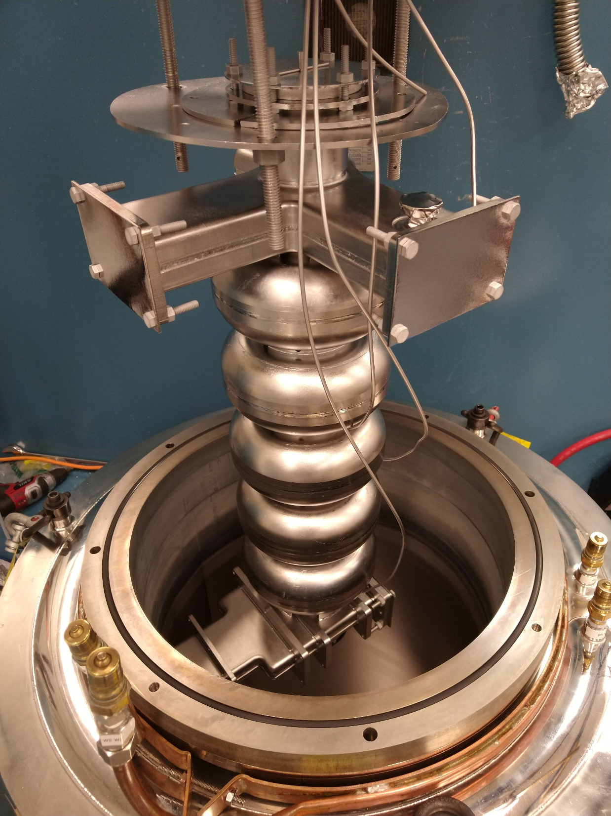
CEBAF Five-cell cavity coating

Slide 13

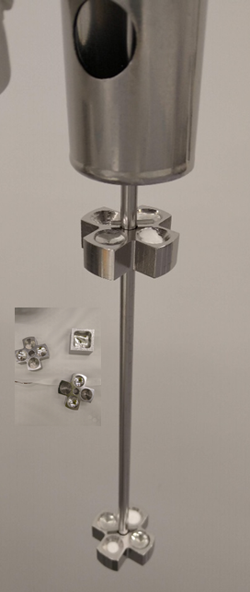
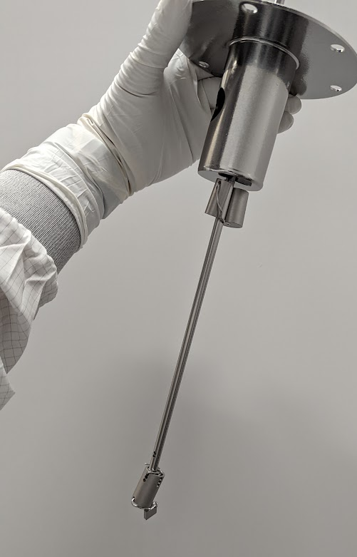
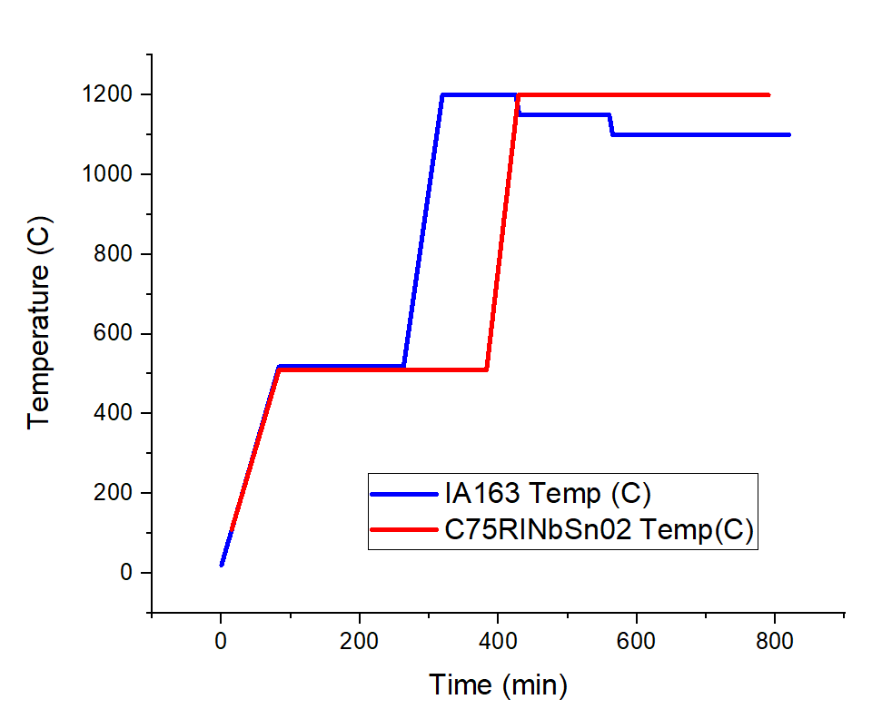
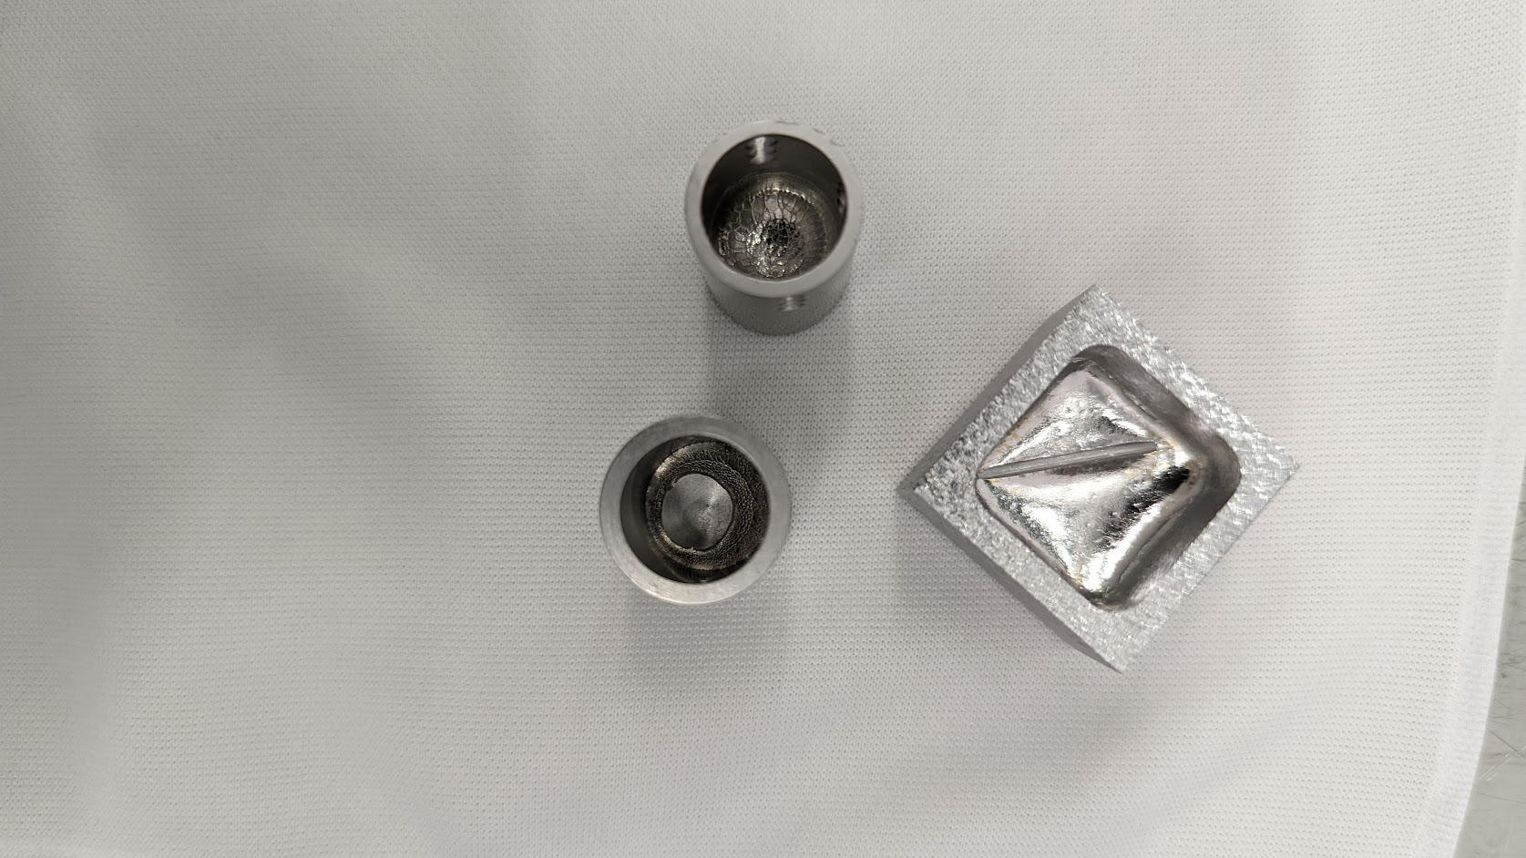
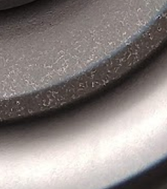
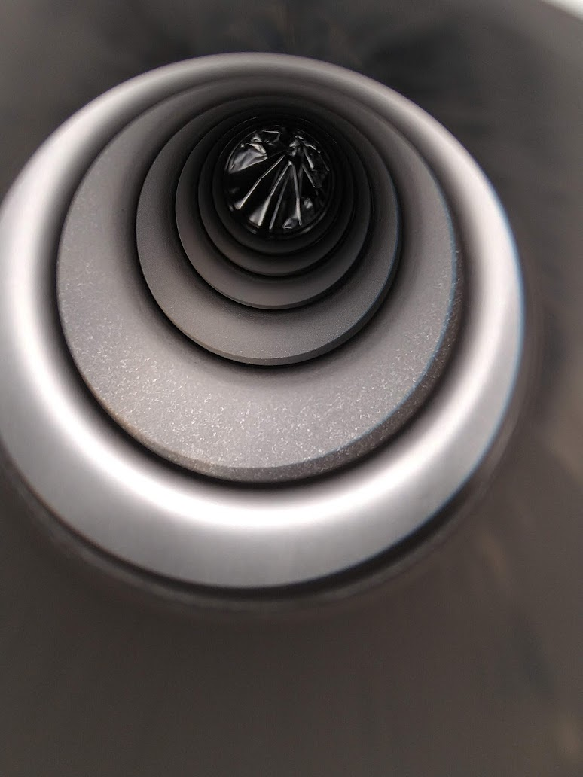
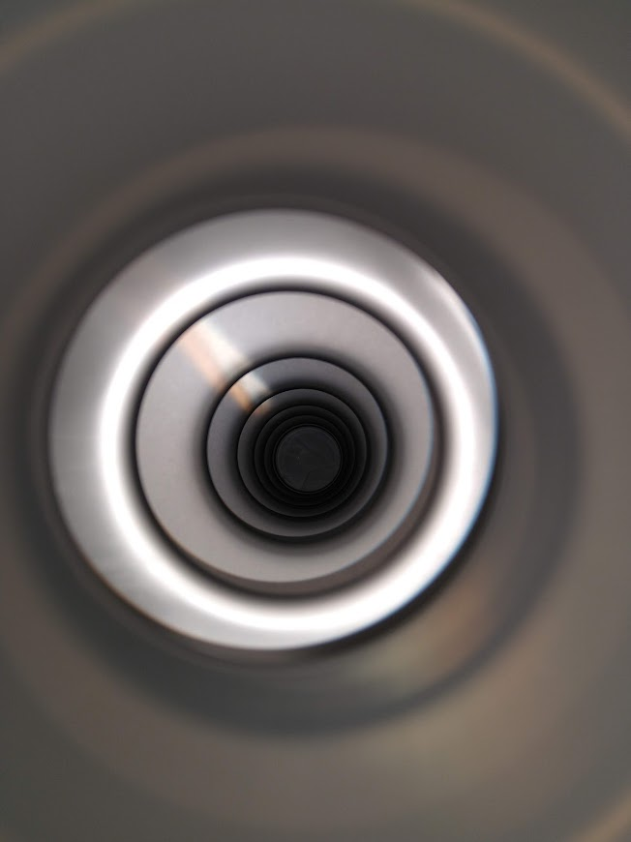
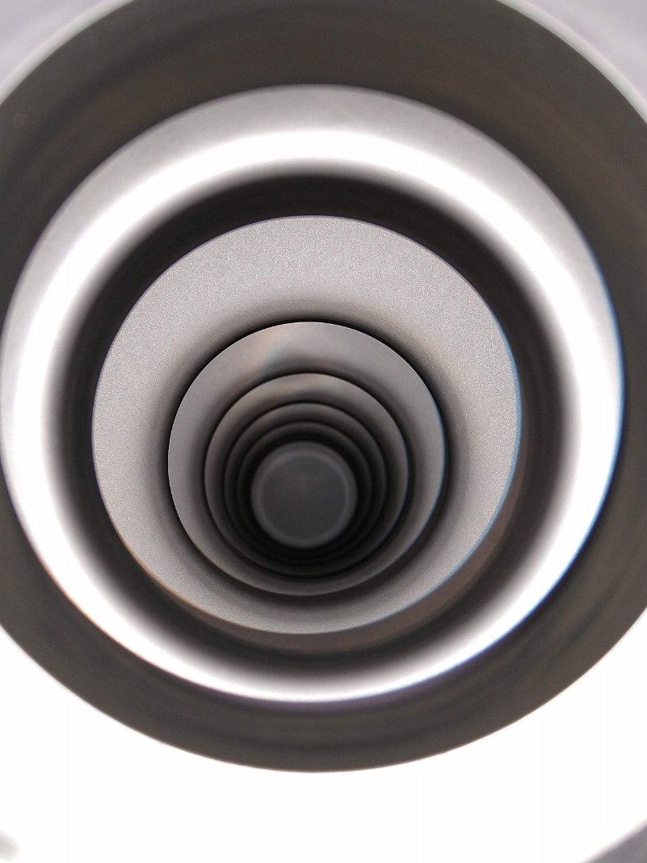
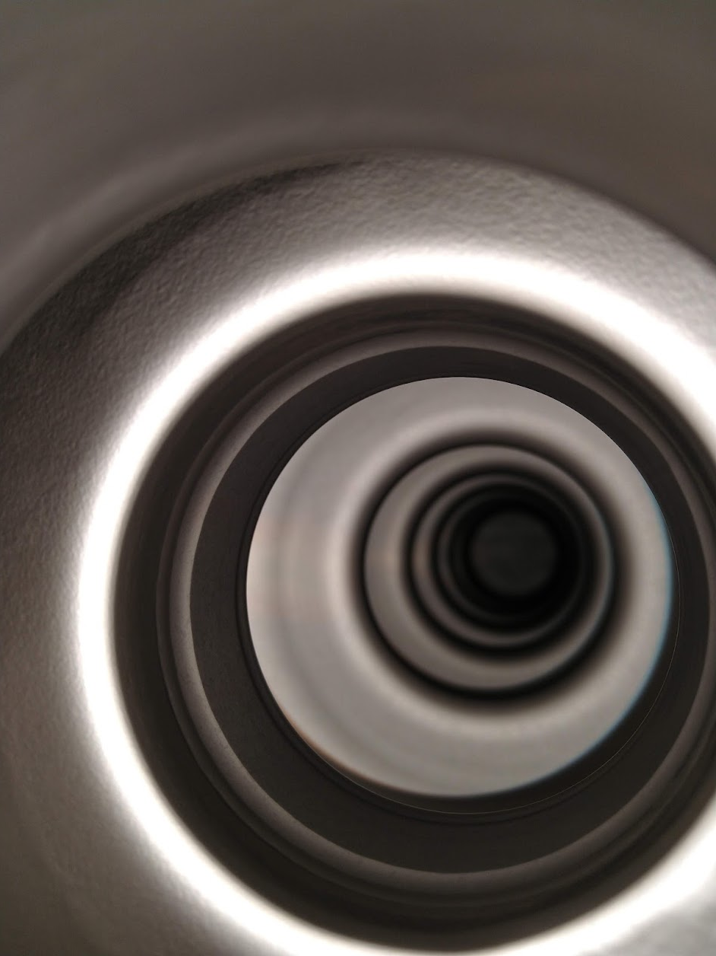
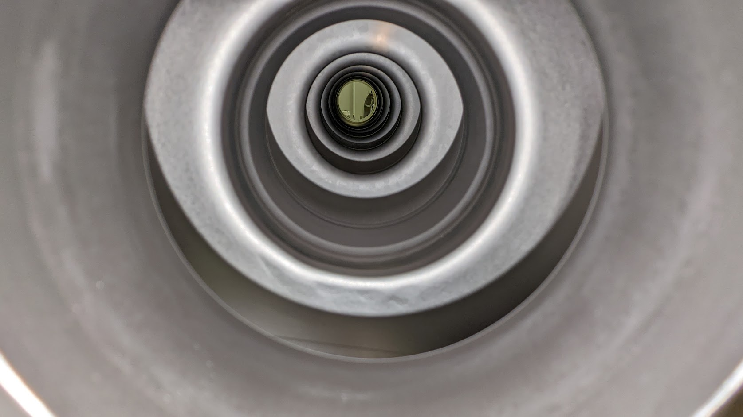
Process design: setup and temperature profiles
S1
S2
S3
T1 T2
Sn consumption (g)
 | IA163 (1st coating) | IA163 (2nd Coating) | IA163 (3rd Coating) | 5C75-RI-NbSn02 02 | 5C75-RI-NbSn02 02
Primary | 3.6 | 2.50 | 2.79 | 3.05 | 2.42
Secondary 1 | 1.7 | 1.50 | 1.42 | 1.50 | 1.48
Secondary 2 | --- | 1.60 | 1.43 | 1.51 | 1.48
Total | 5.3 | 5.60 | 5.64 | 6.06 | 5. 38
Setup | S1-T1 | S2-T1 | S3-T2 | S2-T1 | S3-T2
Witness samples in each run.

Slide 14
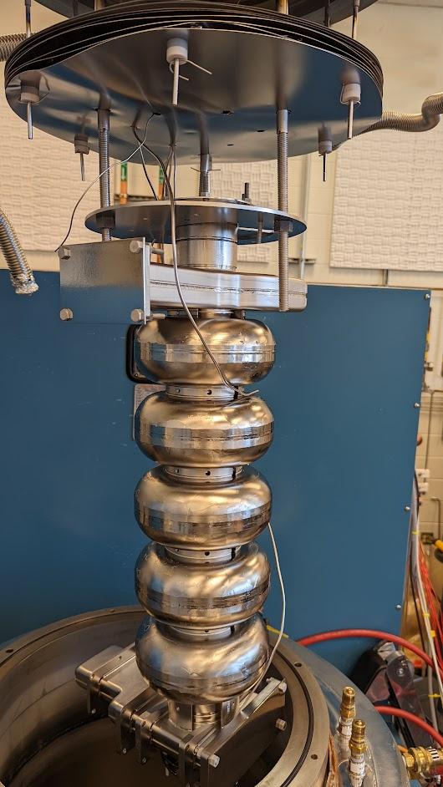
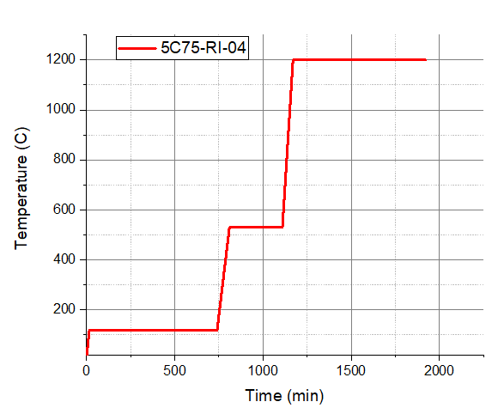
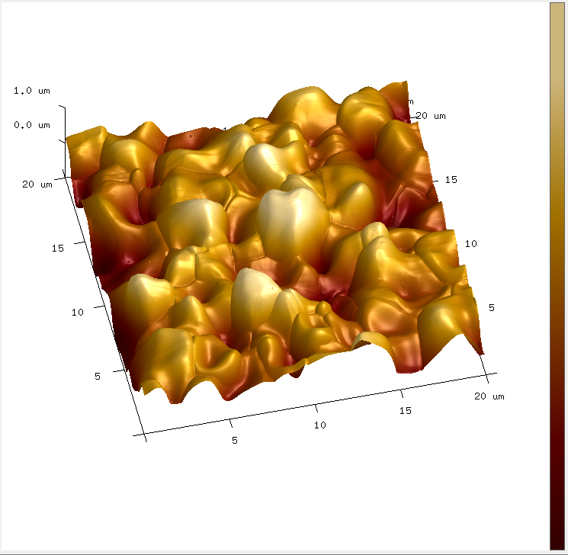
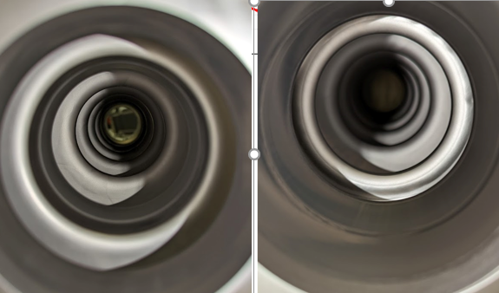
Latest CEBAF Five-cell C75 cavity coating
S3-T2
C75 cavity made from large grain Nb.
Temperature Profile
The Cavity was coated for a Nb₃Sn cavity pair to install in a quarter cryomodule (built on Grigory Eremeev’s ECA).

Slide 15
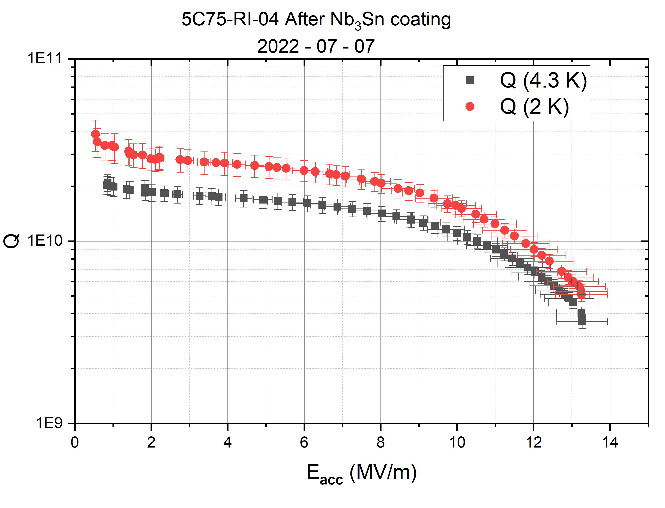
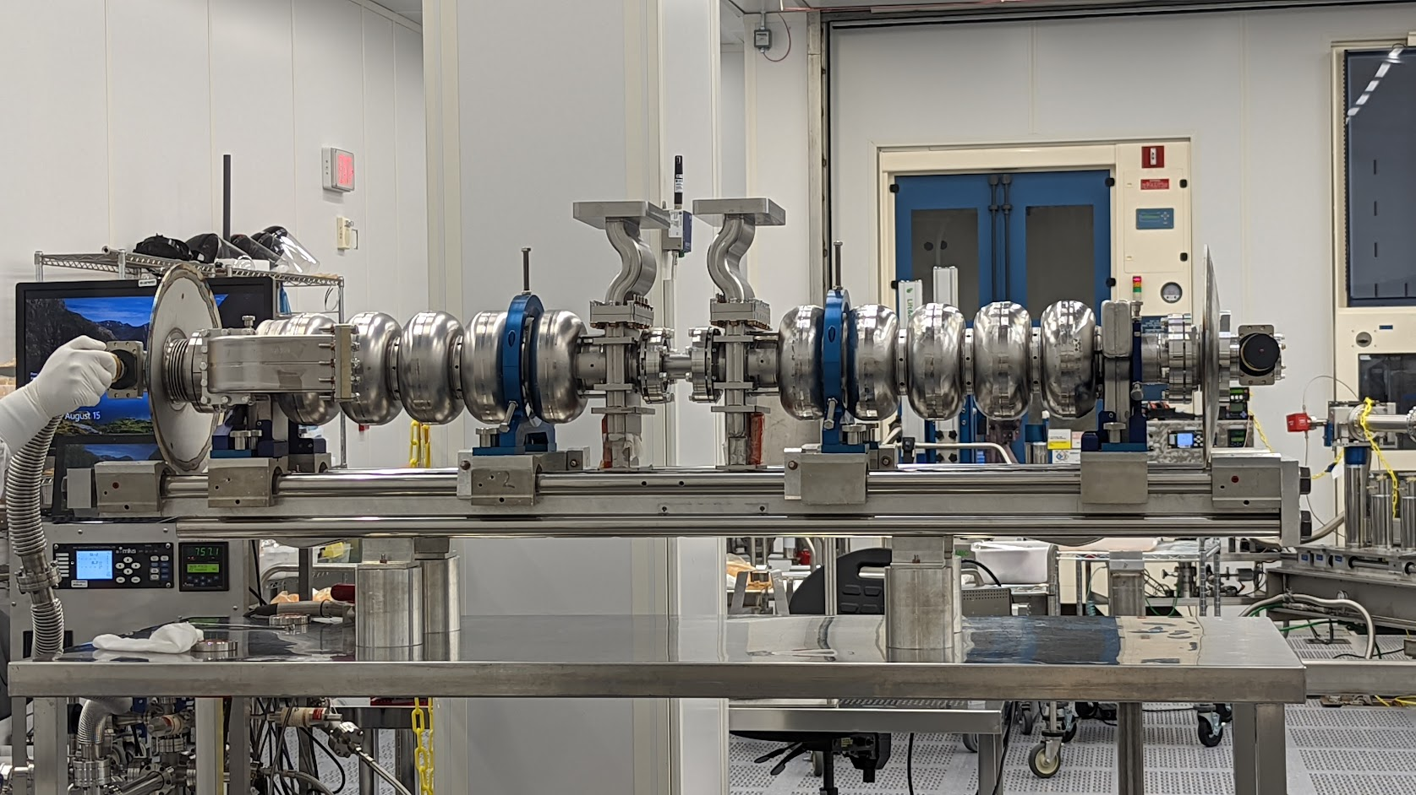

Nb₃Sn pair assembly (Second time)
Coated and qualified at Fermilab (G. Eremeev)
Coated and qualified at Jefferson Lab
At 4K : Q~1E10 @ >10 MV/m
Limited by multipacting at 13.5 MV/m: no attempt to process it.
The goal is to install the QCM and test in JLab UITF (beam test.)
- More details on tomorrow’s talk “Progress in Nb3Sn developments for CEBAF-style quarter cryomodule​”.

Slide 16
-
Cavity Coating for Conduction cooling Accelerator Applications

Slide 17





952 MHz Prototype cavity
PI: Gianluigi Ciovati
Coated for the second time with added Sn-source (3 Sn sources)
After copper plating with ring for conduction cooling, tested with LHe.
Test in a horizontal cryostat at industrial partner, General Atomics, very soon.
More on G. Cheng’s talk “952MHz Nb3Sn Cryostat Design and Thermal Management” tomorrow.
J. Vennekate et. al. LInac 2022
Notes:
Multipacting

Slide 18


Design and Prototyping for a Compact 10 MeV SRF Accelerator
PI: John Vennekate
• Cavity is baselined
(Q >1E10 @ ~ 18 MV/m)
• HW required for the coating is in progress.
• Cavity coating projected to January 2023.
• Collaboration with General Atomics.
J. Vennekate et. al. LInac 2022
1.3 GHz TESLA 3-cell cavity

Slide 19
Summary
The optimization of coating parameters is ongoing to engineer desired surfaces that may enhance single-cell and multi-cell cavity performance.
A generous tin flux is required at the initial stage to grow the coating uniformly.
  Crucible size, substrate surface area, and temperature needs proper management
It is crucial to make sure not to run the coating up to complete Sn exhaustion resulting in Sn-deficient grain boundaries or even loss of Sn from the surface.
Proper management of Sn-supply can result in smoother and uniform surface, which appears to correlate with better performing cavities.
Recurrent Sn condensation is mitigated with the latest parameters, but complete removal is challenging with our coating configuration.
Single-cell and five-cell Nb₃Sn-coated cavities are heading towards other acceleration applications, including conduction cooling.

Slide 20


Slide 21
Backup slides

Slide 22





Nb₃Sn coating of Twin-axis Cavity
Proposed for ERL application in the past
Twin axis cavities were coated and tested.
Mechanical deformation of the cavity
Following witness sample analysis, systematic sample studies are in progress to mitigate identified issues.
Prof. Jean Delayen and Jayendrika Tiskumara (Old Dominion University)

Slide 23


Nb₃Sn Coating deposition system
40’’
17’’
Eremeev, G., et al. "Nb3Sn multicell cavity coating system at Jefferson Lab." Review of Scientific Instruments 91.7 (2020): 073911.
Coating up to the size of CEBAF five-cell cavity (0.5 m long)
Siemens Configuration: No secondary heater(s) (substrate and source both at the same temperature for any time)
Furnace is outside the cleanroom: Need to close the cavity to avoid contamination

Slide 24


