Slide 1

Mechanical Polishing of Nb₃Sn Thin Films
Presenter: Eric Viklund (NU/FNAL)
Contributors: D. N. Seidman (NU),
D. Burk, S. Posen (FNAL)

Slide 2
Nb₃Sn Thin Film Created by Sn-Vapor Deposition
Nb₃Sn cavities produced by Sn-vapor deposition
  Nb cavities are coated by a microcrystalline thin film
  Typically, 2-3μm thick
Resulting in a matte surface finish
  Microscopic surface roughness
  Grain faceting
  Thermal etching at grain boundaries
4 μm
S. Posen, Ph.D. Thesis, Cornell University (2015).

Slide 3
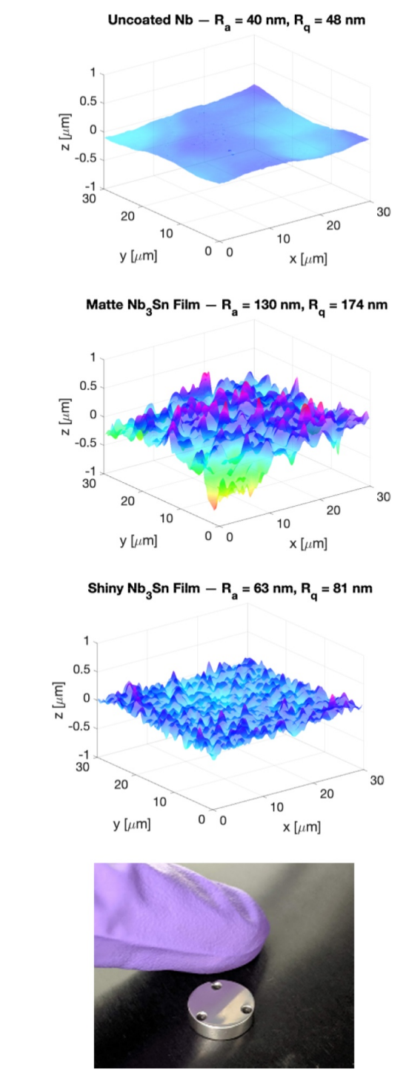
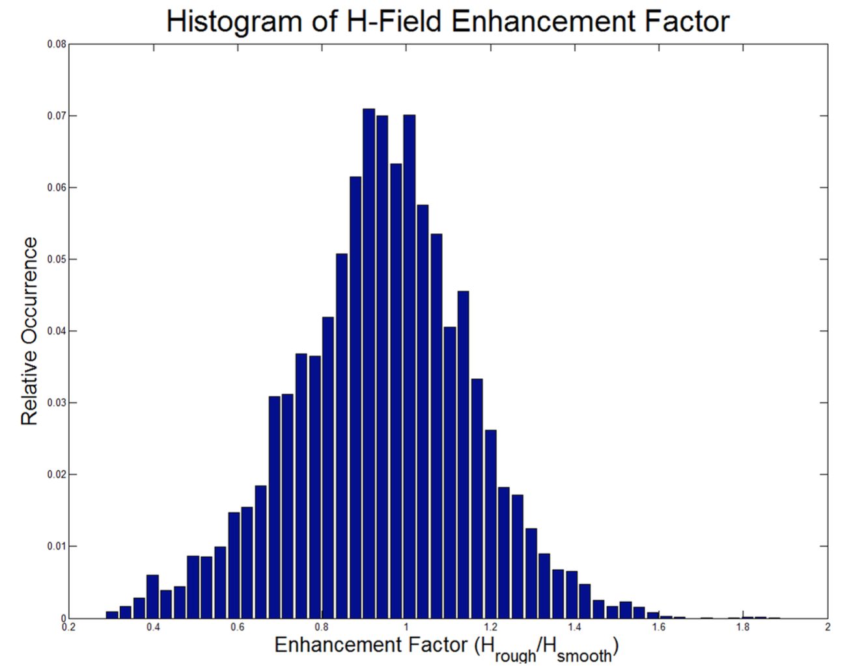
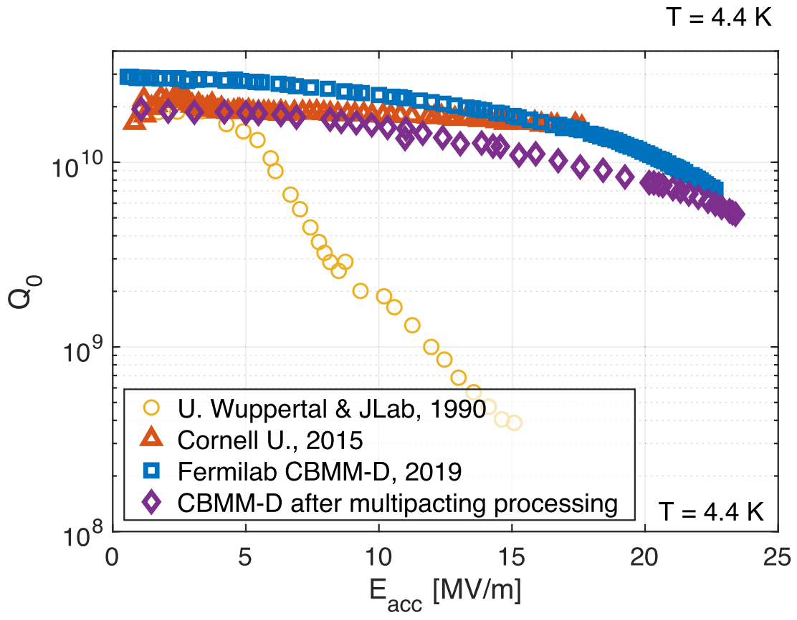
Impact of Surface Roughness on Nb₃Sn SRF Cavity Performance
Surface roughness has been shown to cause a localized increase in magnetic field.^{[1]}
Up to 60% stronger fields in some regions.
Nb3Sn coated cavities produced at Fermilab reach a record accelerating gradient.^{[2]}
Films are thinner and smoother than previous coatings
  Up to 24 MV/m accelerating gradient
Further removal of surface roughness could lead to accelerating fields in the 30-40 MV/m range.
60% Field Enhancement
1. R. Porter, D. L. Hall, M. Liepe, J. T. Maniscalco, Proc. Linac Conference 2016, MOPRC027 (2016).
Shiny thin film coating
2. S Posen et al 2021 Supercond. Sci. Technol. 34 025007

Slide 4
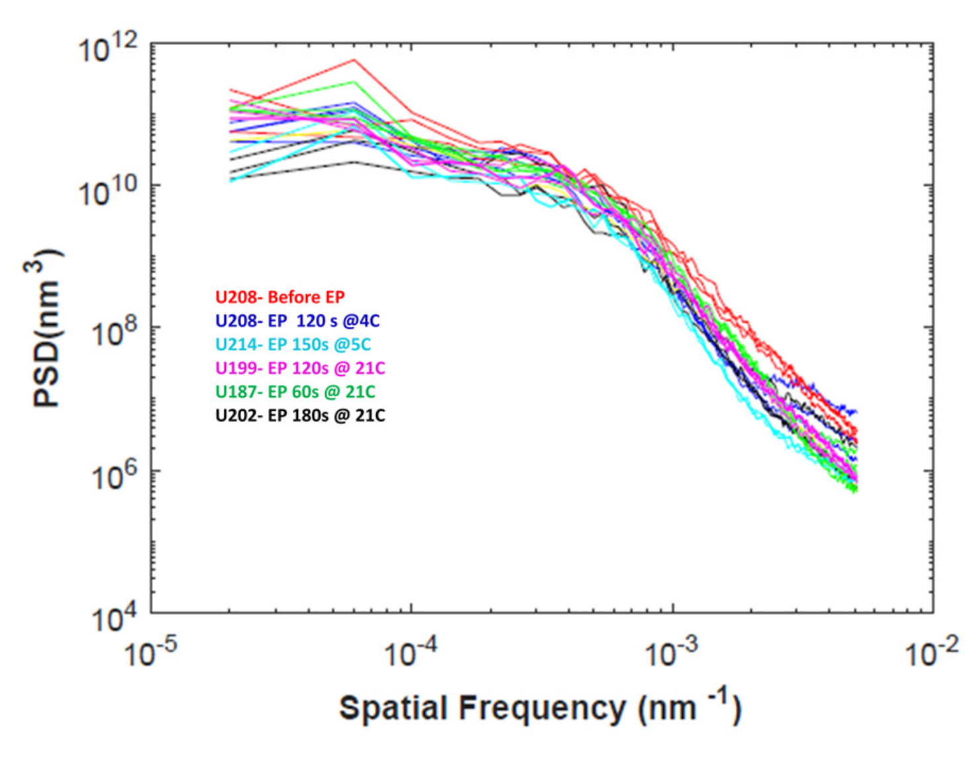
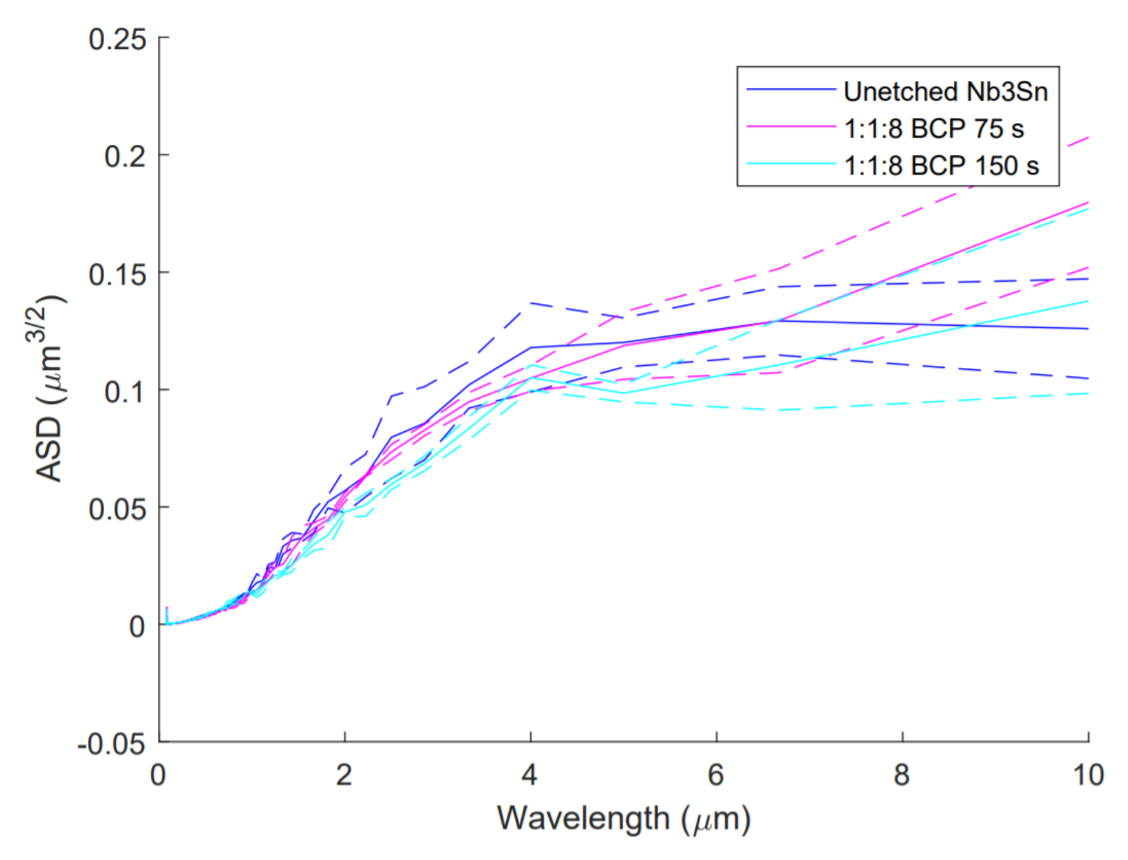
Reviewing Polishing Methods for Nb₃Sn SRF Cavities.
Pudasaini, Uttar, et al. Proceedings of the 18th International Conference on RF Superconductivity,(Lanzhou, China). 2017.
Further reduction in surface roughness requires a method for polishing Nb₃Sn films.
Two main options are available:
Chemical polishing:
  Chemical polishing does not work well on Nb₃Sn.
Mechanical polishing:
  Only limited attempts to mechanical polish Nb₃Sn films have been tried.
Is mechanical polishing a good alternative for polishing Nb₃Sn SRF cavities?
Hu, H. Conference on RF Superconductivity. 2019.

Slide 5
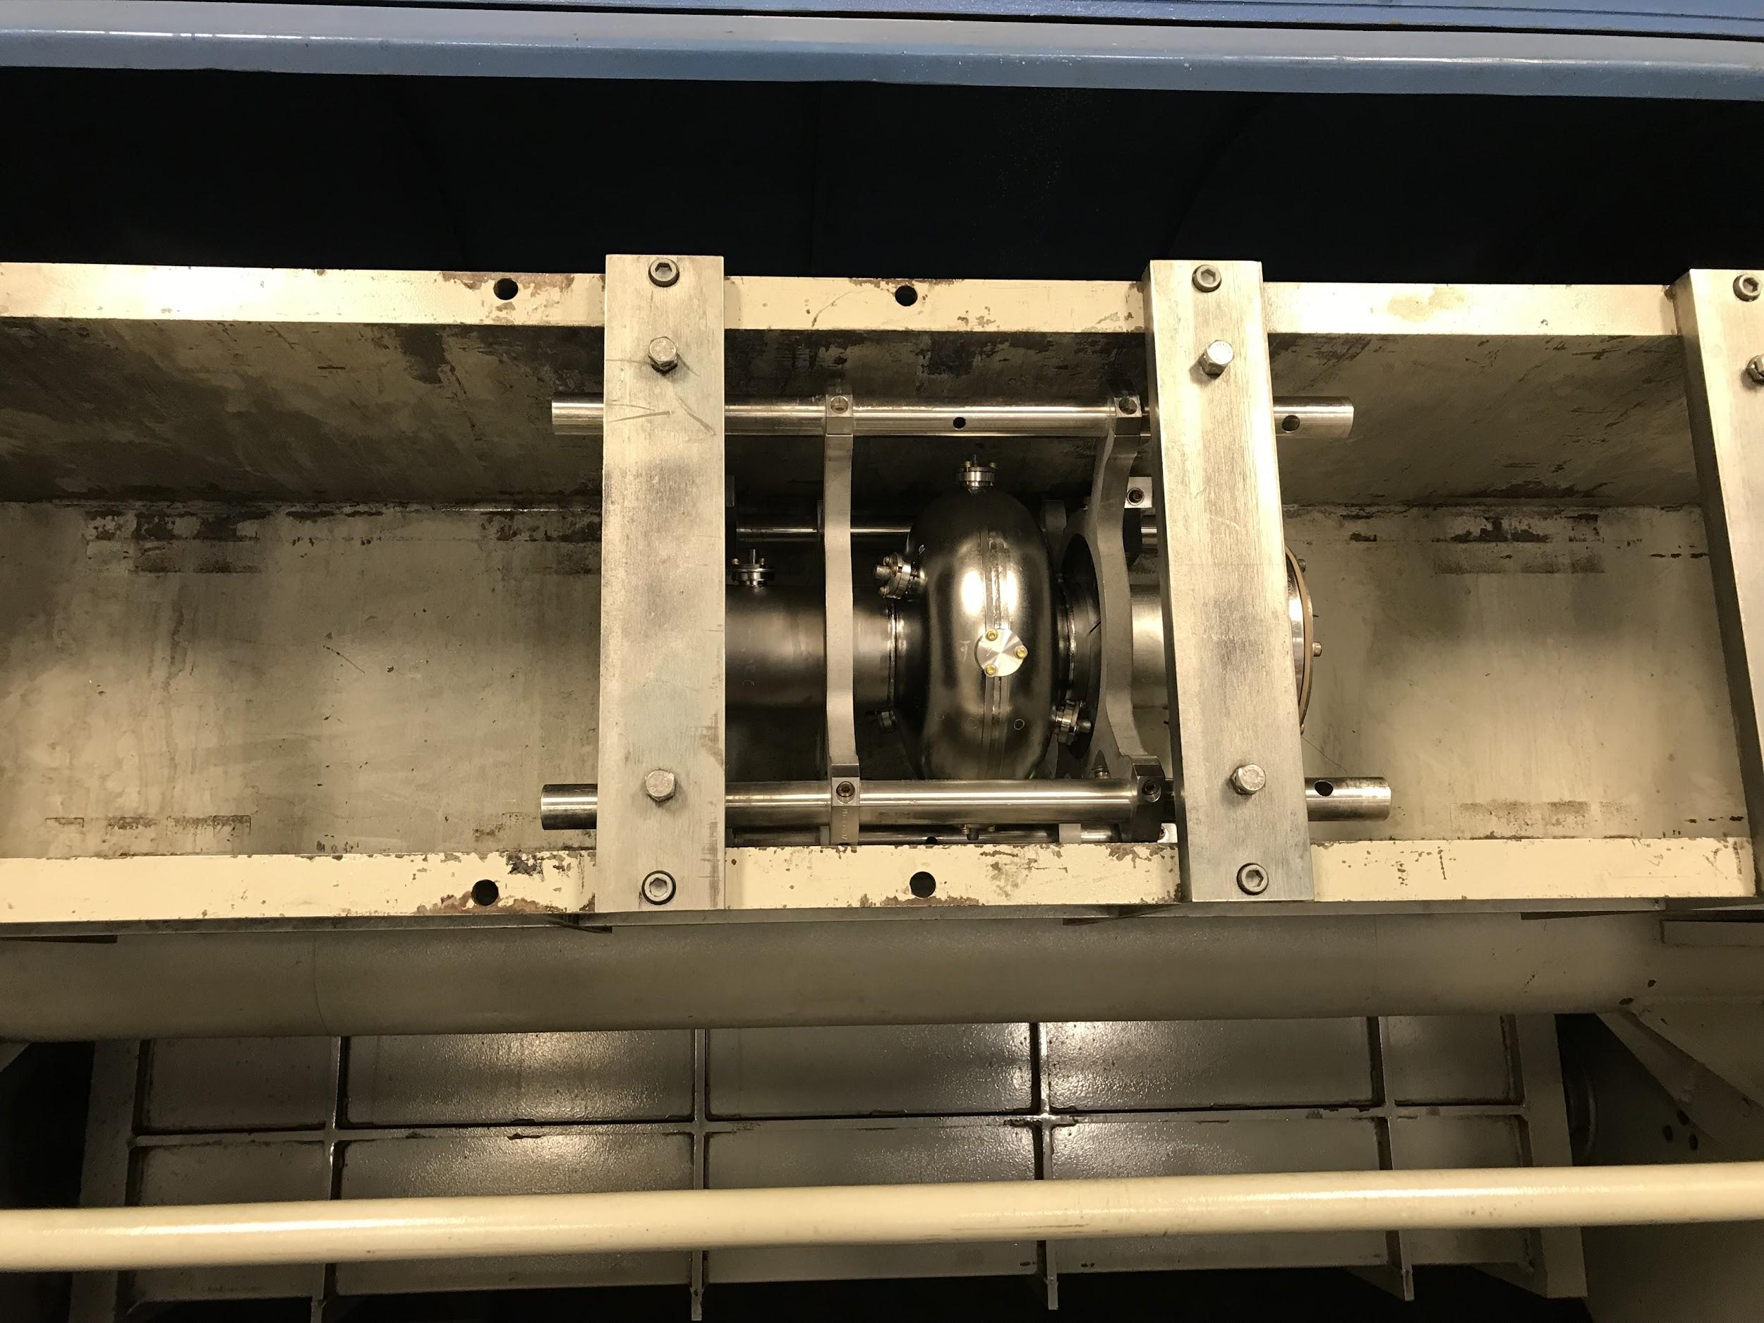
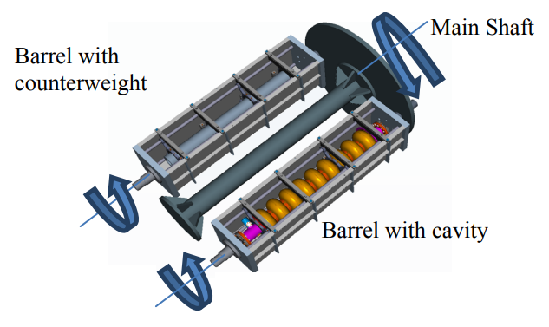
Centrifugal Barrel Polishing
Centrifugal barrel polishing (CBP) was developed to mechanically polish SRF cavities.
Cavities are filled with polishing media
Cavities are rotated at 120 RPM in the barrel polishing machine
Rotating motion pushes polishing media against the cavity surface

Slide 6
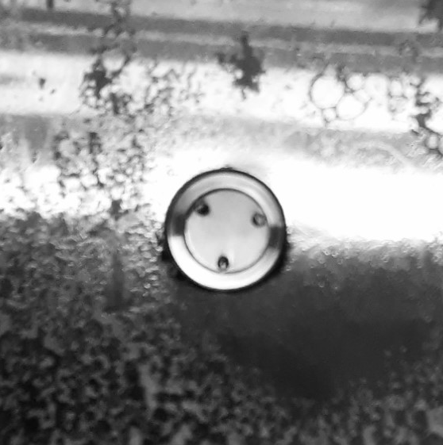
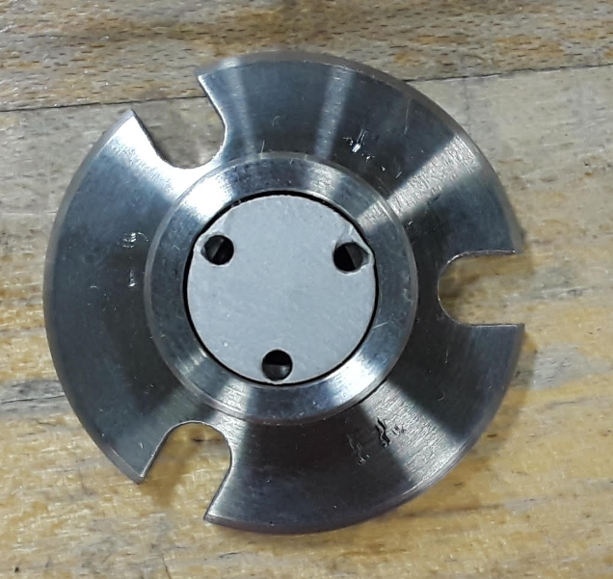
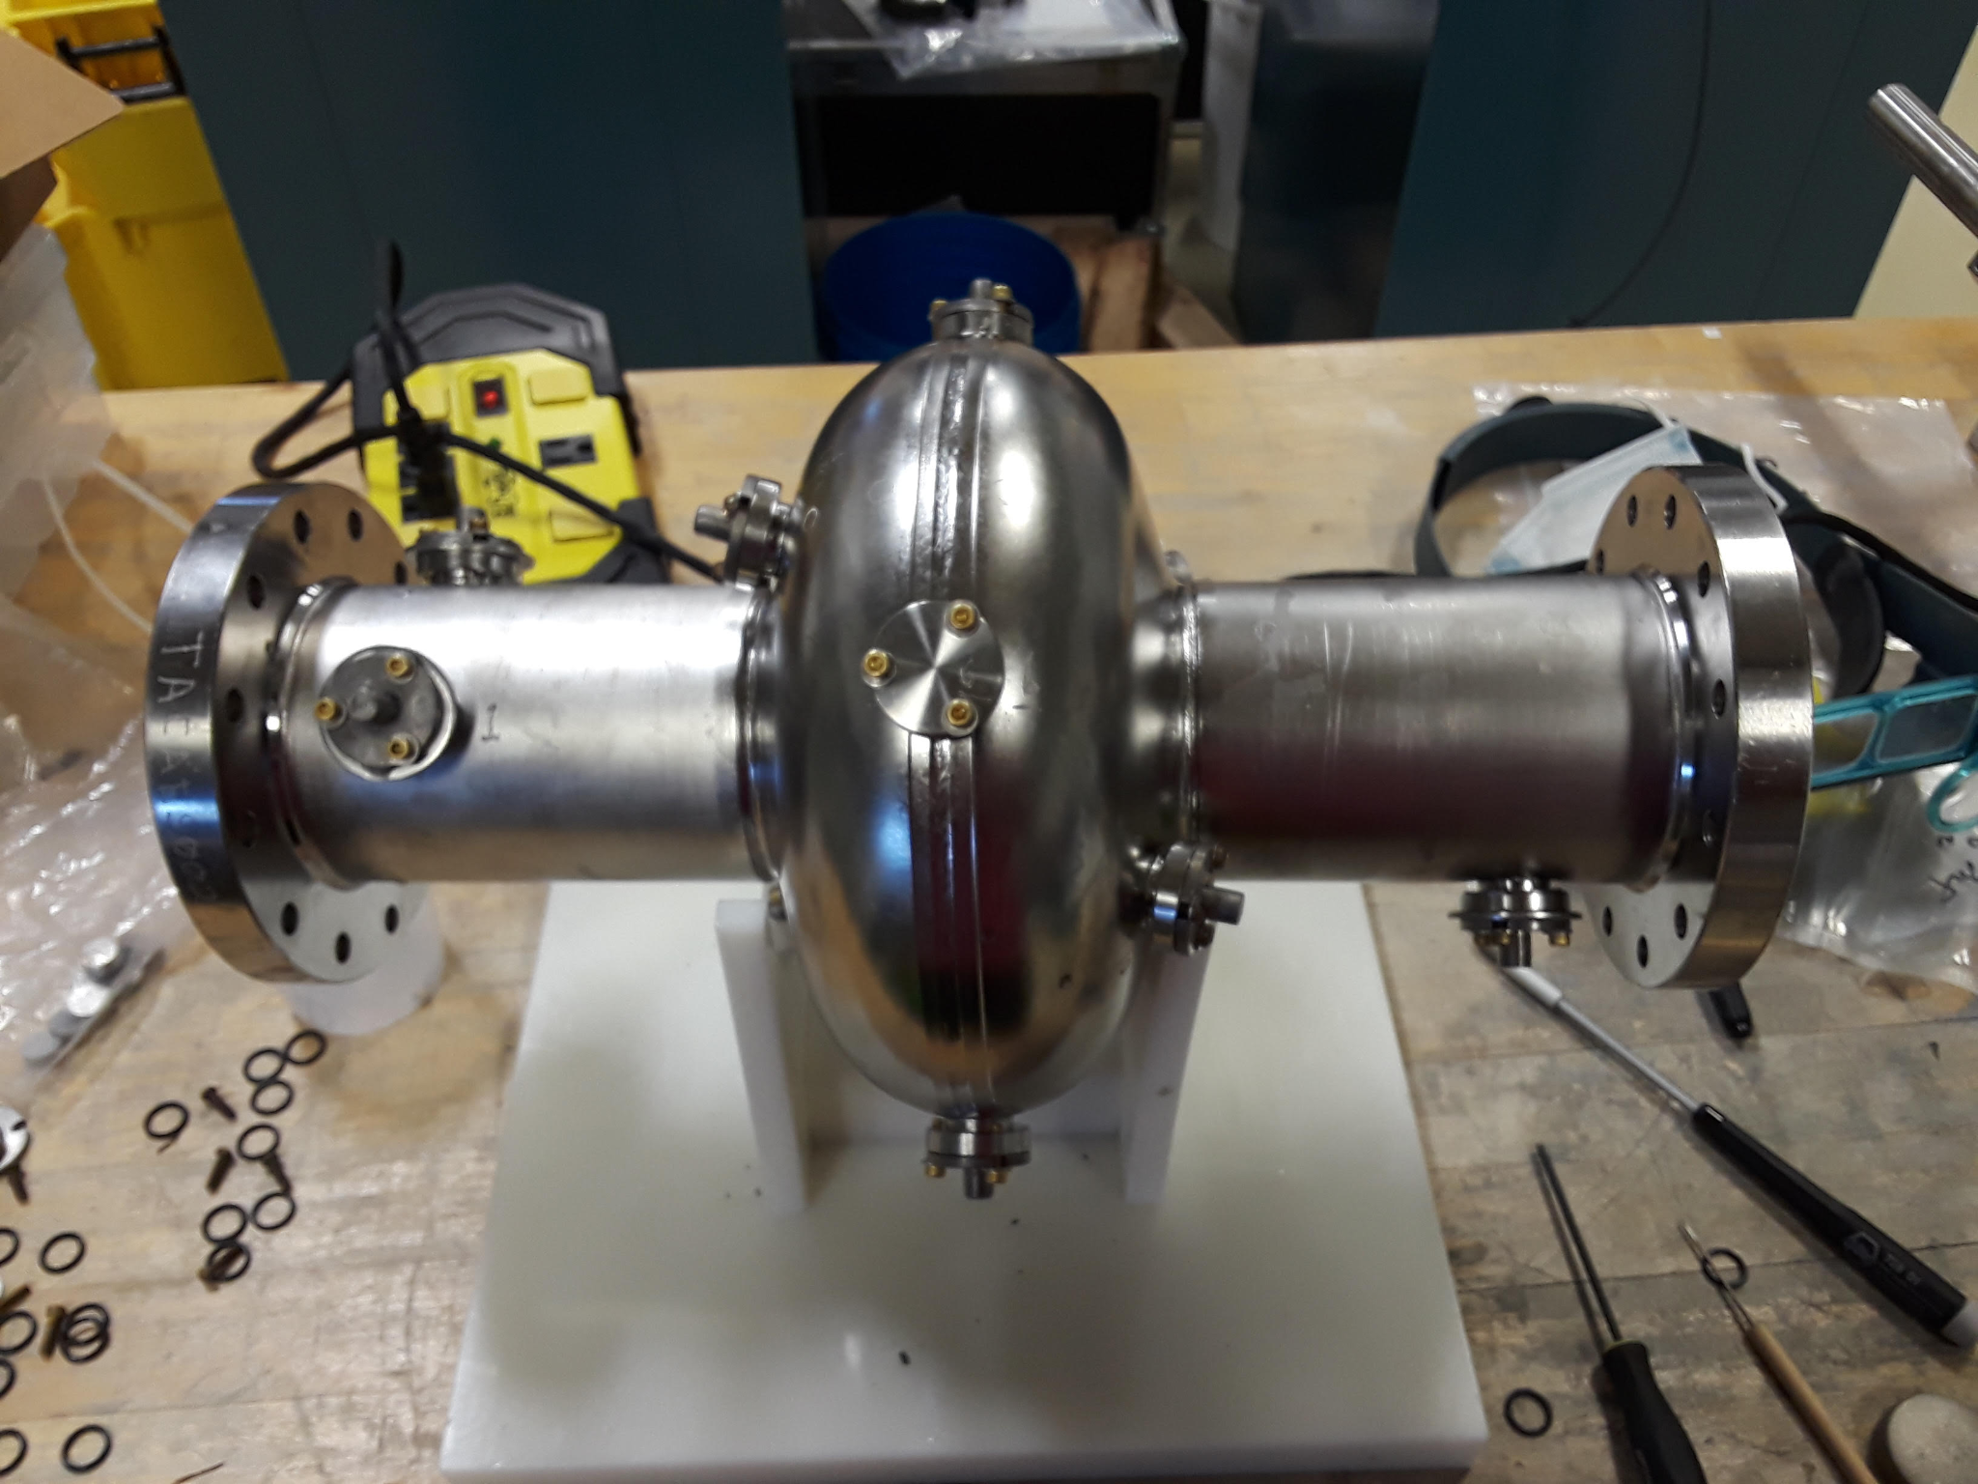
Nb₃Sn Sample Polishing Using a Coupon Cavity
Internal View
This experiment is performed using Nb3Sn samples barrel polished in a coupon cavity.
By using a coupon cavity samples are exposed to realistic polishing conditions
Nb₃Sn cavities must be destroyed for microstructural analysis of the surface
Dozens of small Nb₃Sn samples can be coated at once and analyzed before and after polishing treatments
Minimize trial-and-error for finding polishing parameters

Slide 7
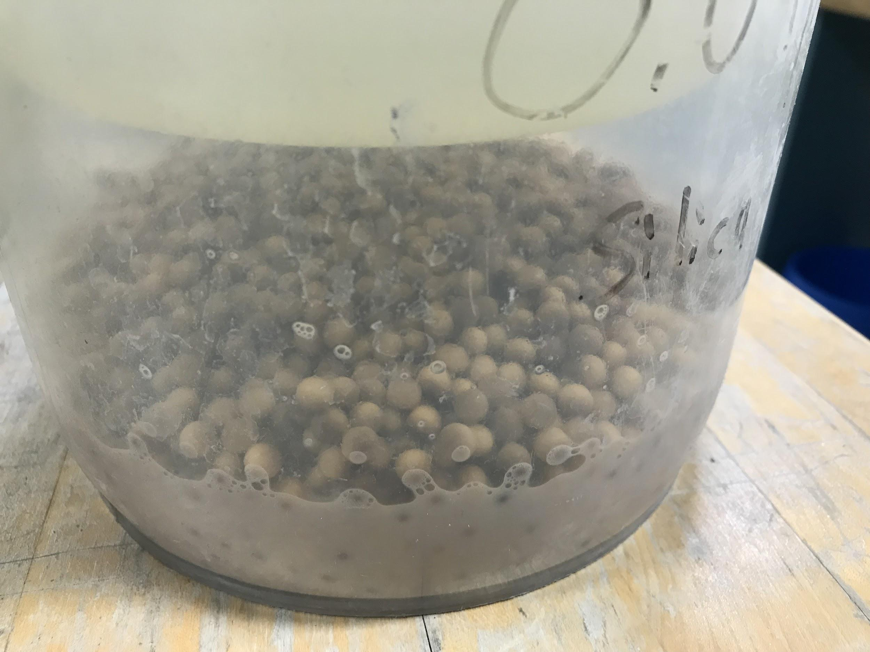
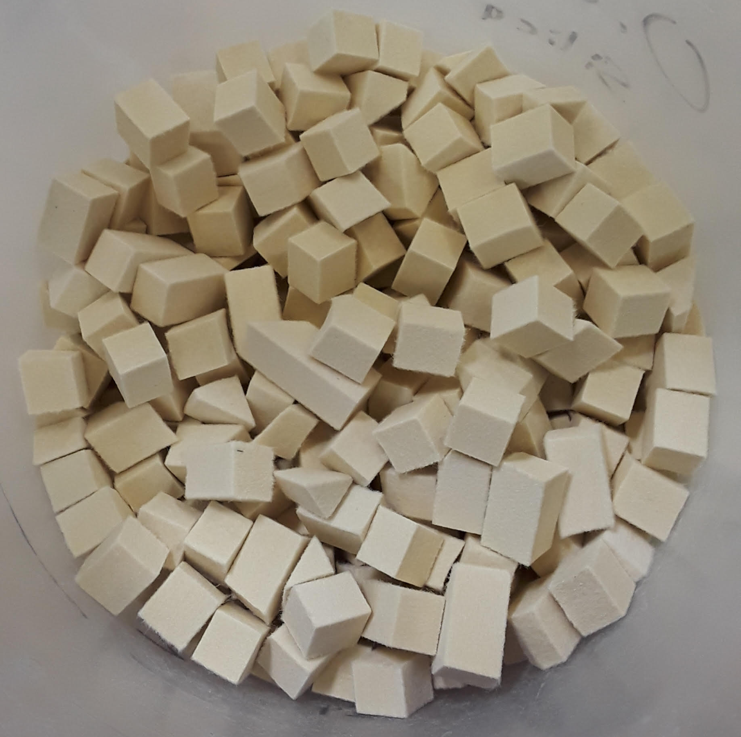
Abrasive Finishing Materials
Only the final nano-polishing step is applied.
Only fine-grit materials
The cavity is filled with two materials:
Nanoparticle abrasive suspension
Solid substrate to carry abrasive
Nanoparticle suspensions tested:
40nm silicate particles
50nm alumina particles
Solid substrates tested:
0.25” wooden balls
0.5” felt cubes

Slide 8
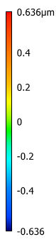
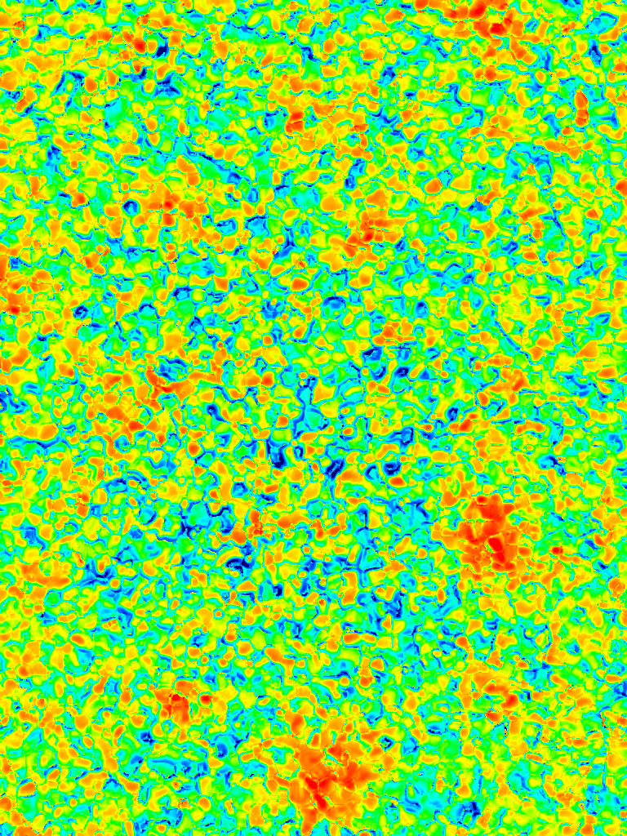
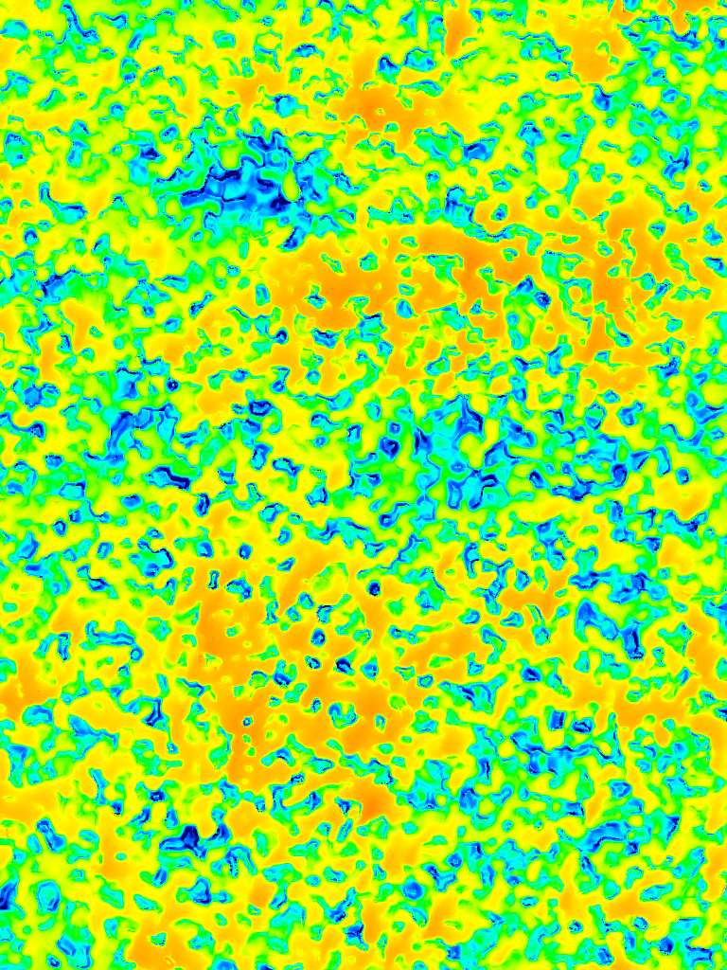
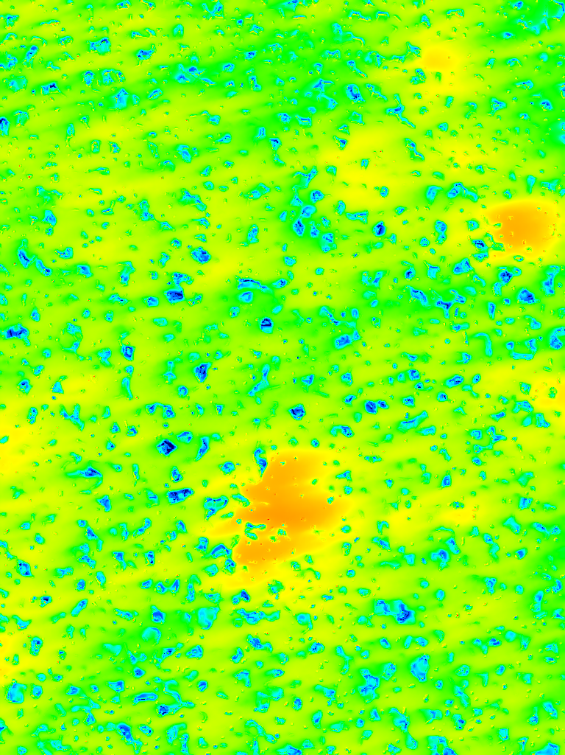
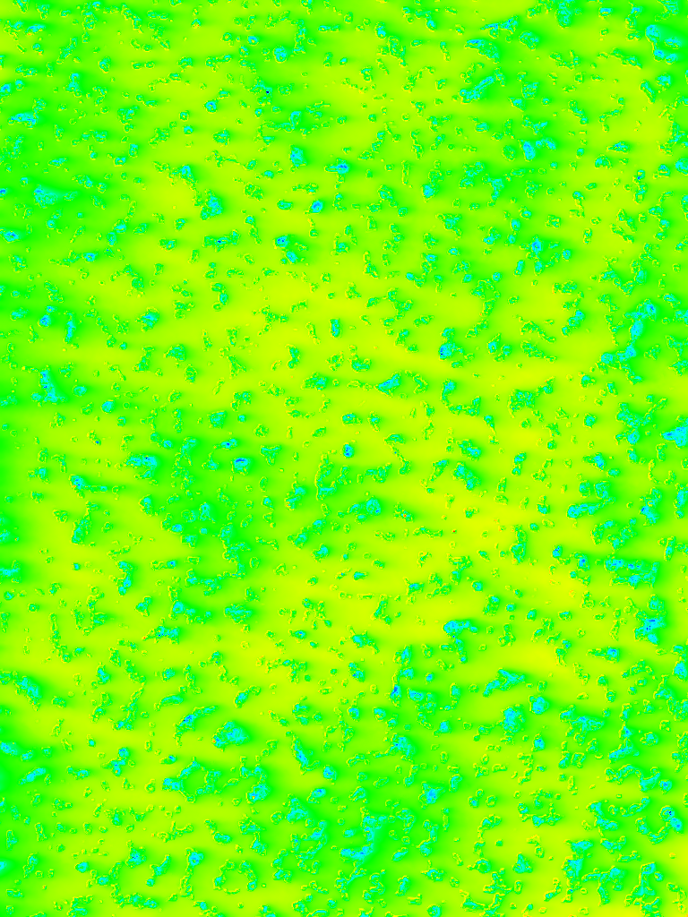
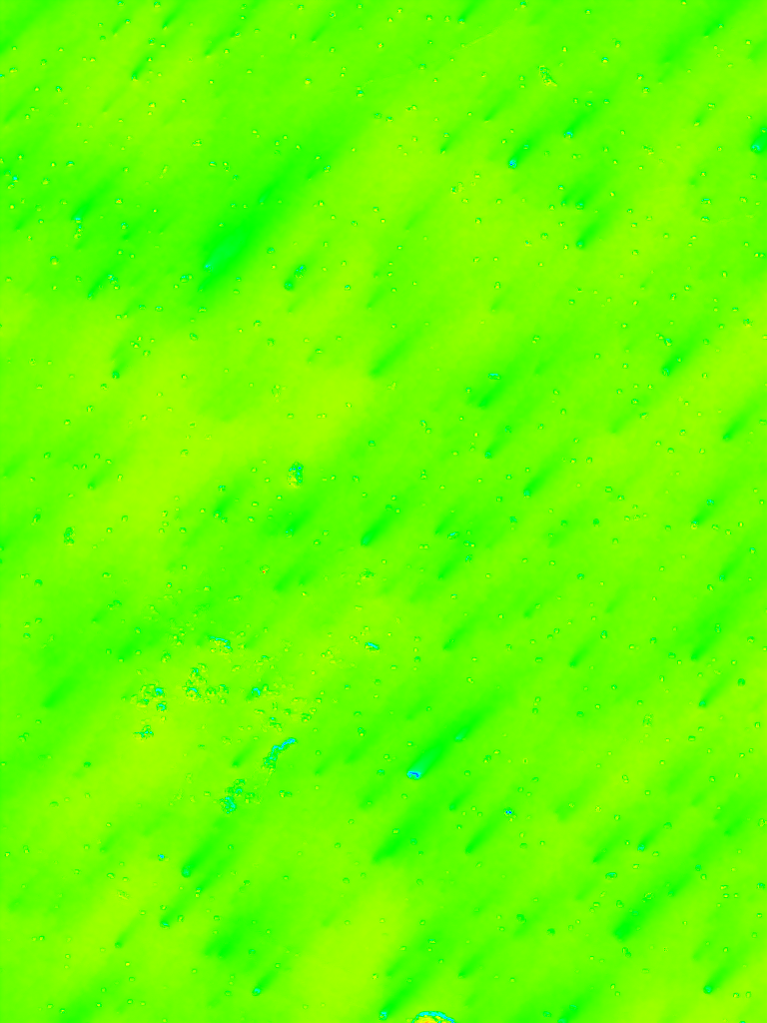
Surface Profile after Progressing Amounts of Mechanical Polishing
0 hours
2 hours
4 hours
6 hours
8 hours
86 μm

Slide 9
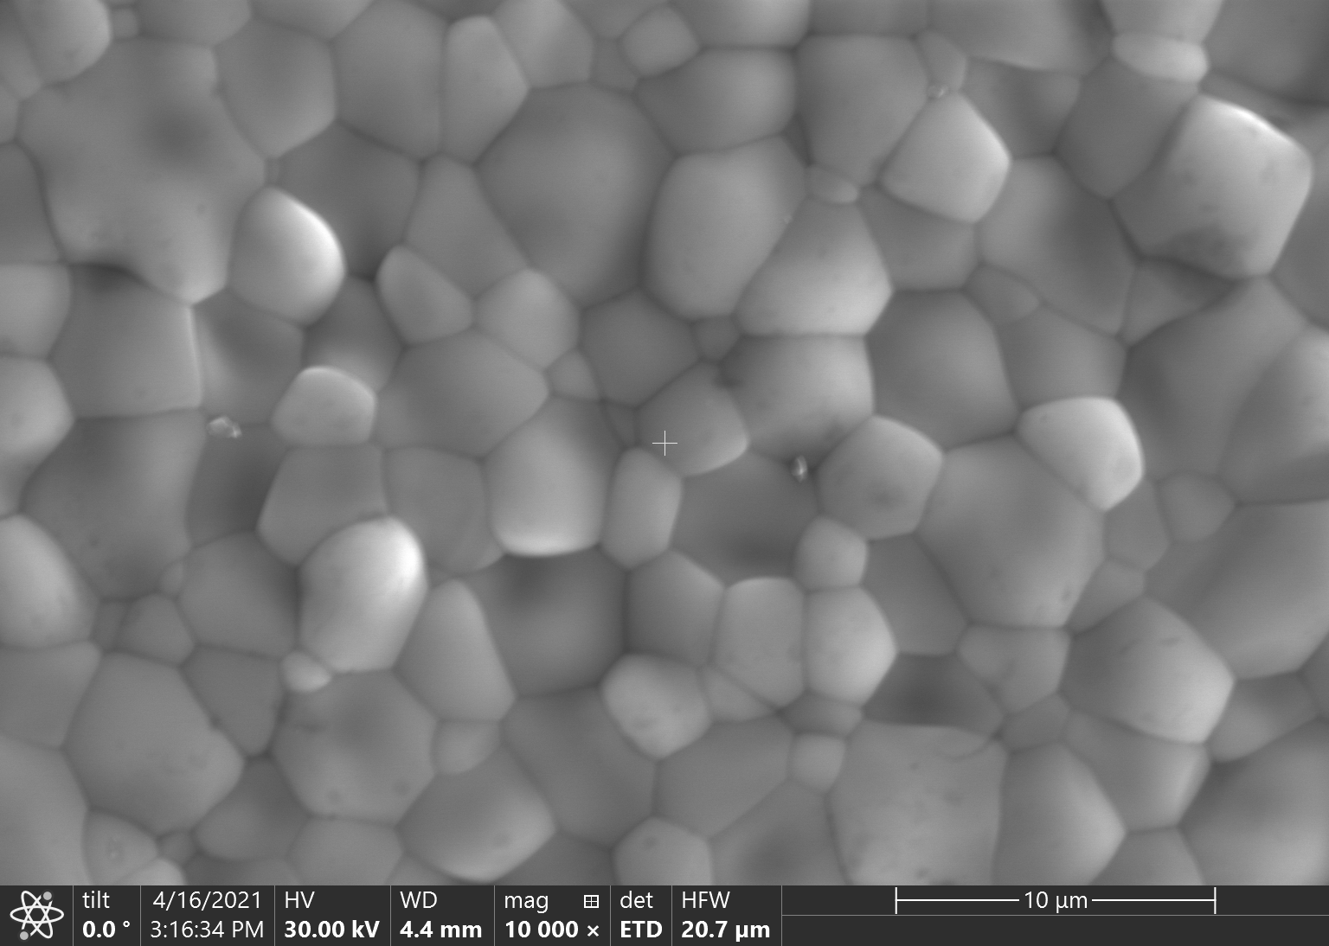
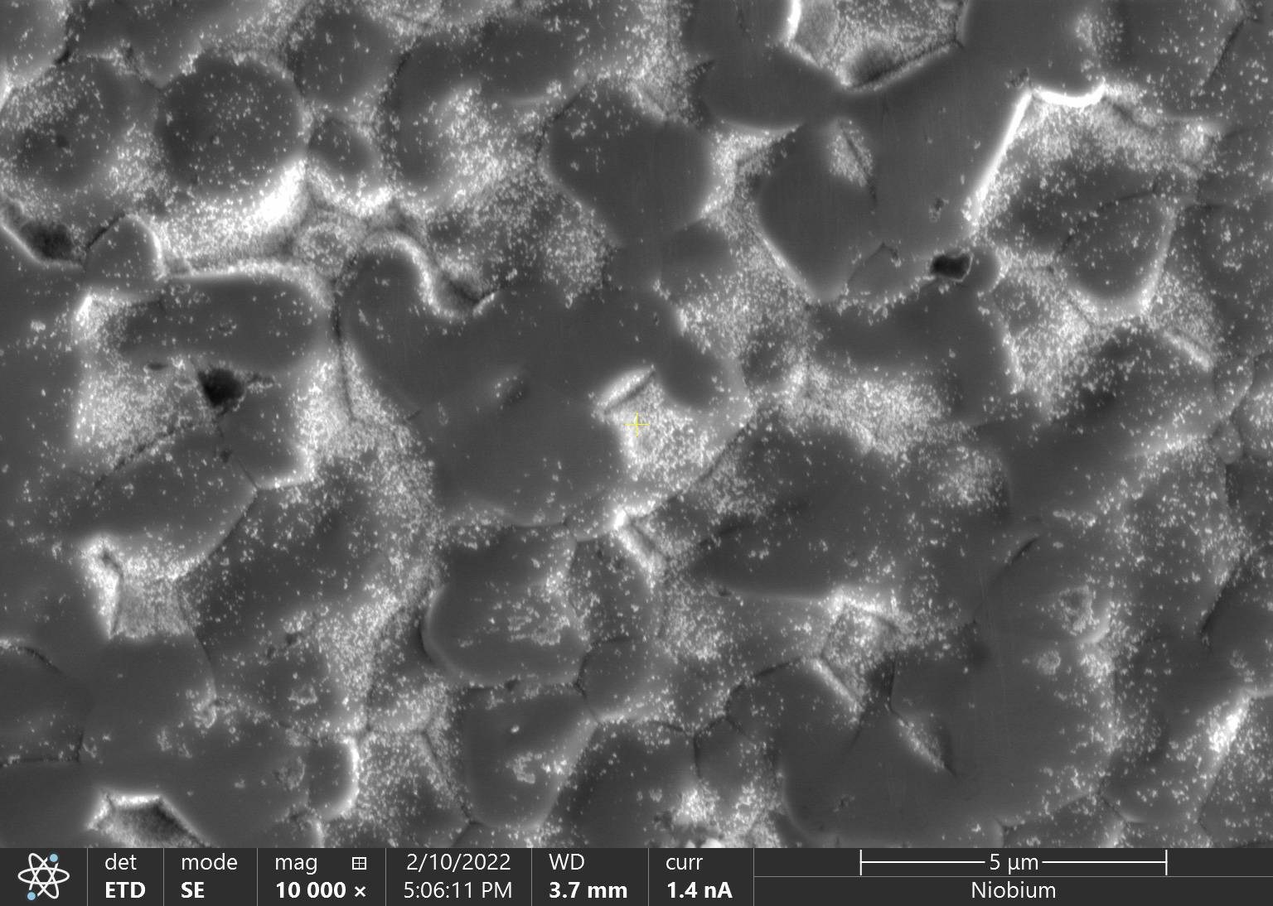
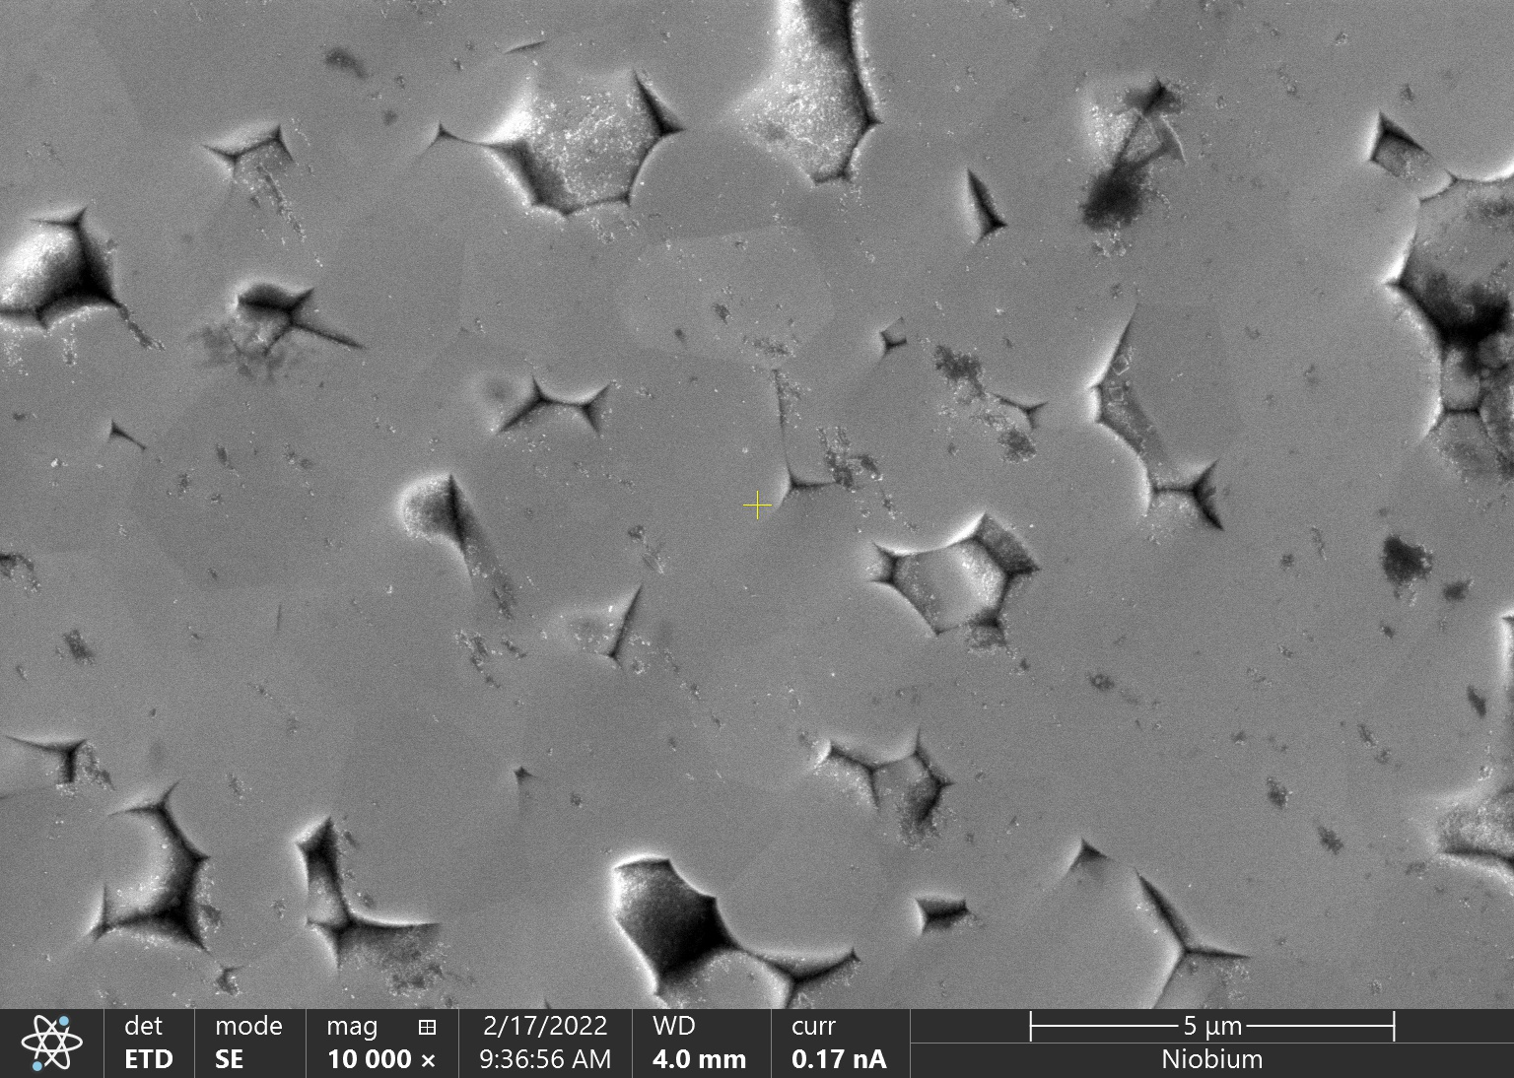
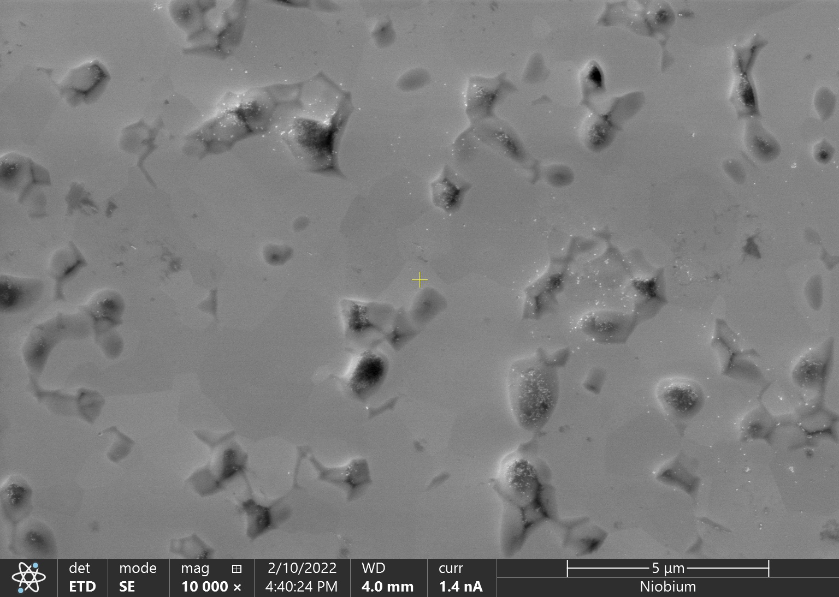
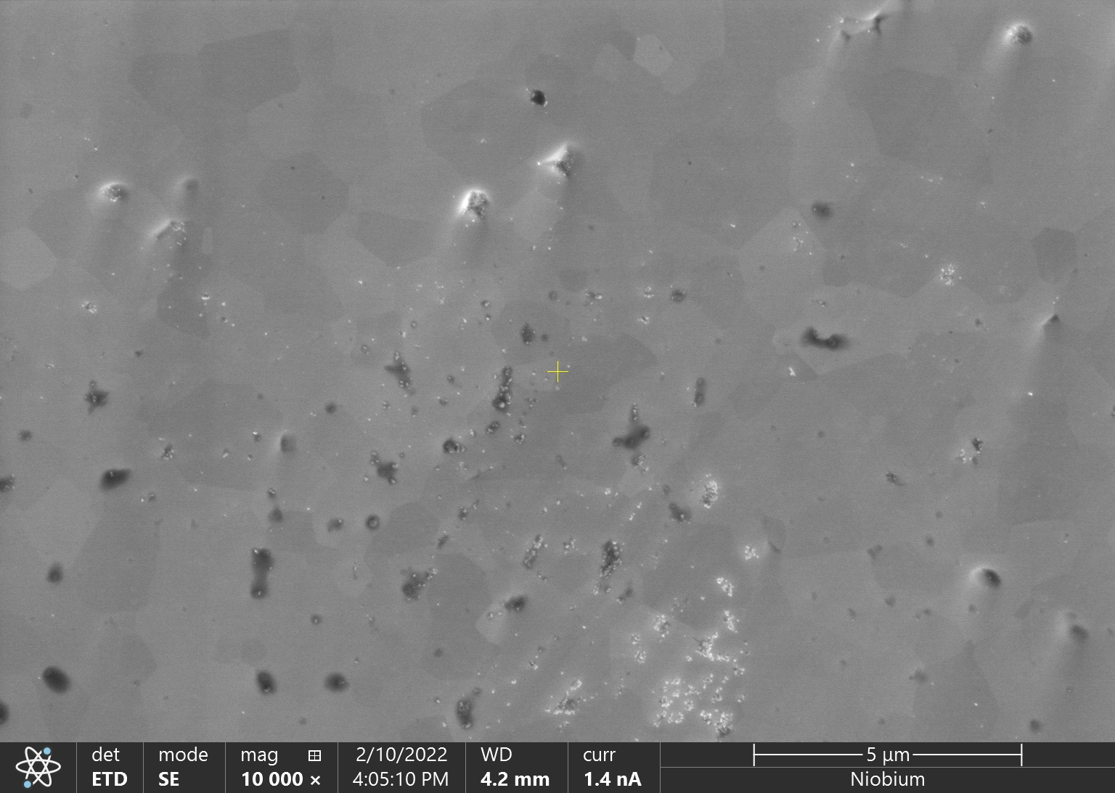
Scanning Electron Microscopy of Mechanically Polished Nb₃Sn Films
Initial Surface
2 hours
5 μm
5 μm
4 hours
6 hours
8 hours
5 μm
5 μm
5 μm

Slide 10
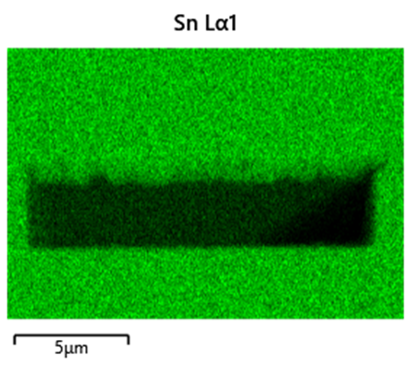
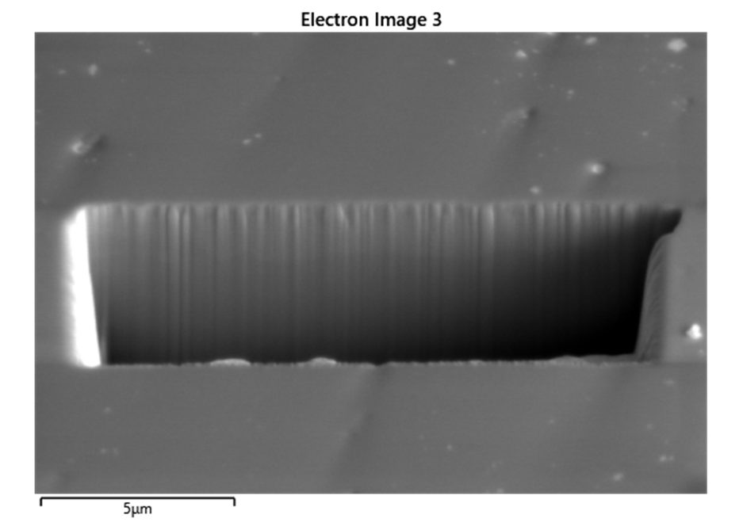
Mechanical Polishing Improves Surface Roughness With Minimal Material Removal
Cross-section analysis using scanning electron microscopy shows film thickness.
Material removed per hour of polishing
~170 nm when using felt
~95 nm when using wood

Slide 11
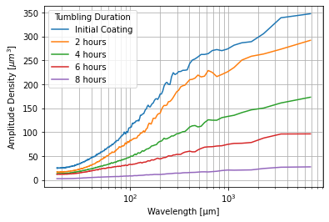
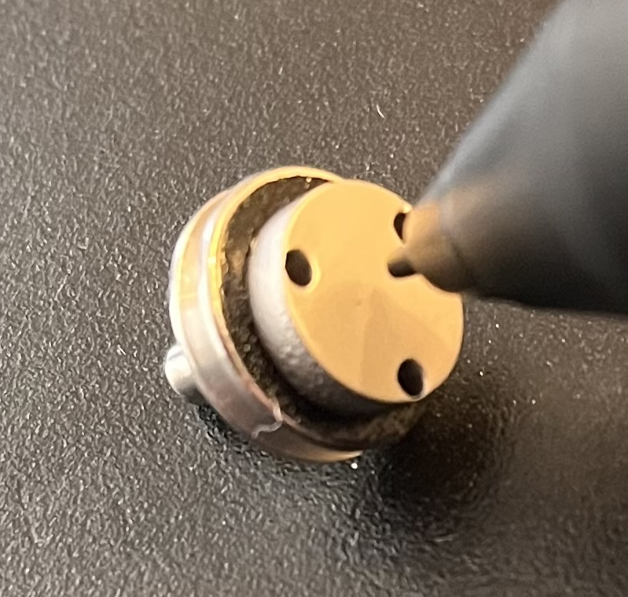
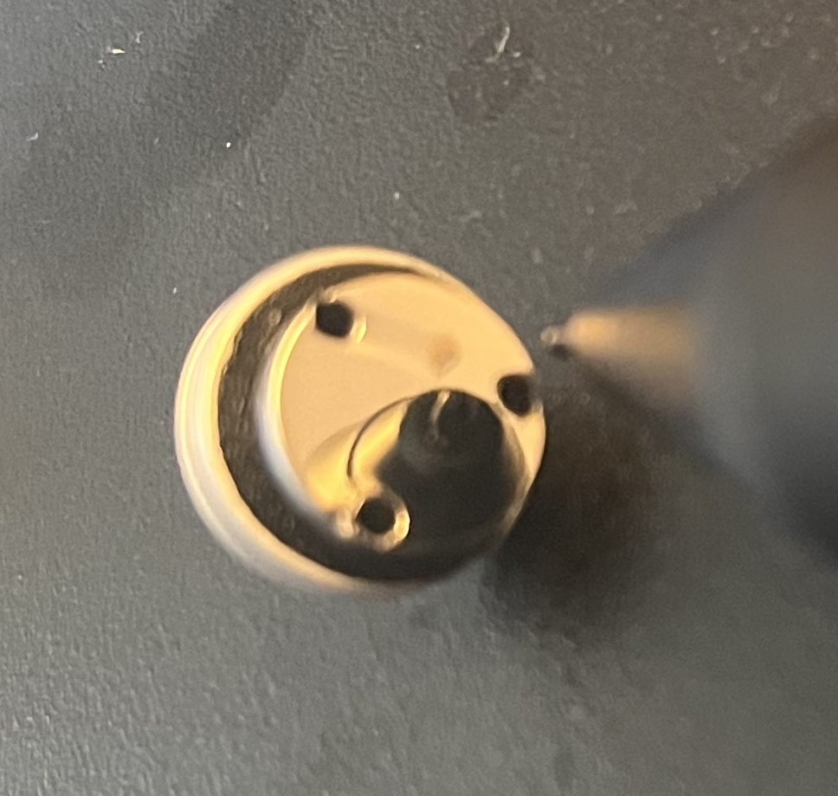
Surface Roughness of Mechanically Polished Nb₃Sn Films
Mirror-like surface finish
10x reduction in surface roughness after 8 hours of tumbling
Mechanical Polishing
Electropolishing
As-coated Nb₃Sn
Nb₃Sn after polishing
Pudasaini, Uttar, et al. Proceedings of the 18th International Conference on RF Superconductivity,(Lanzhou, China). 2017.

Slide 12
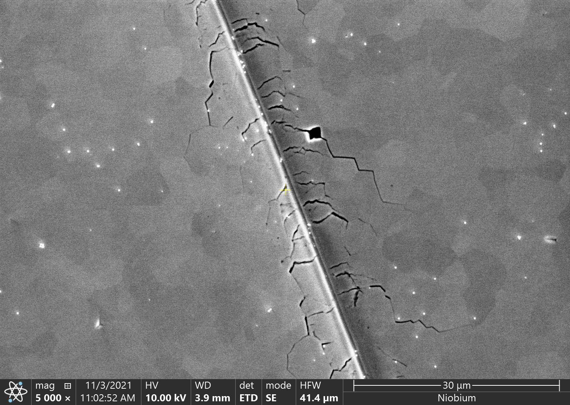
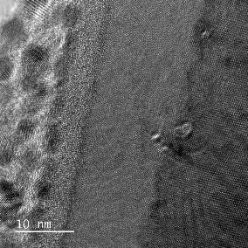
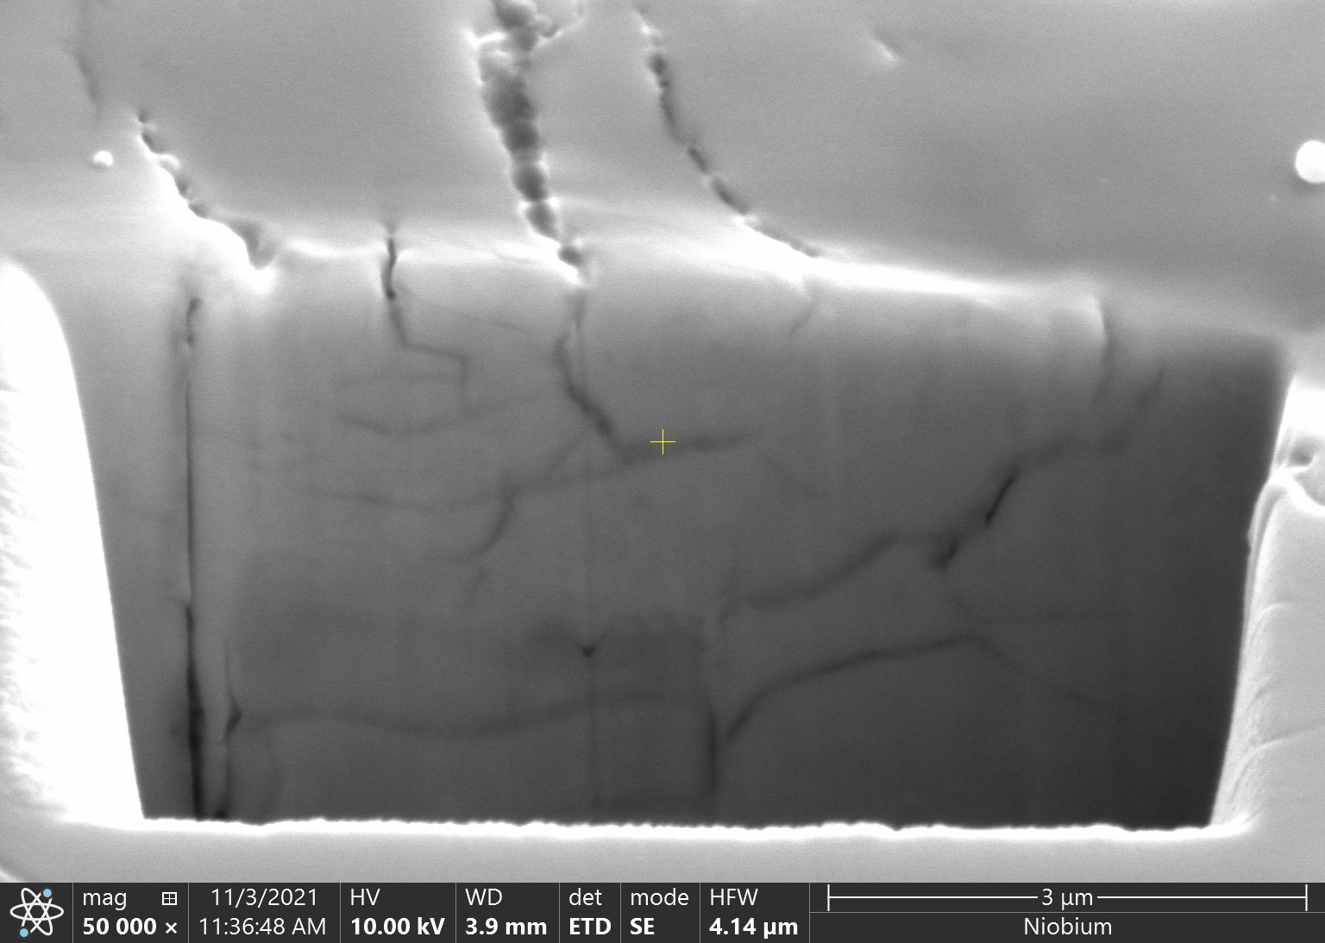
Surface Damage Caused by Wooden Spheres
Scratches
Cracks
Damaged layer
Samples polished with felt media show no surface damage.
Damaged Layer
Nb₃Sn
Platinum Layer
Oxide Layer

Slide 13
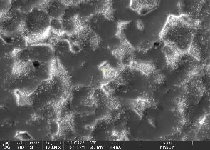
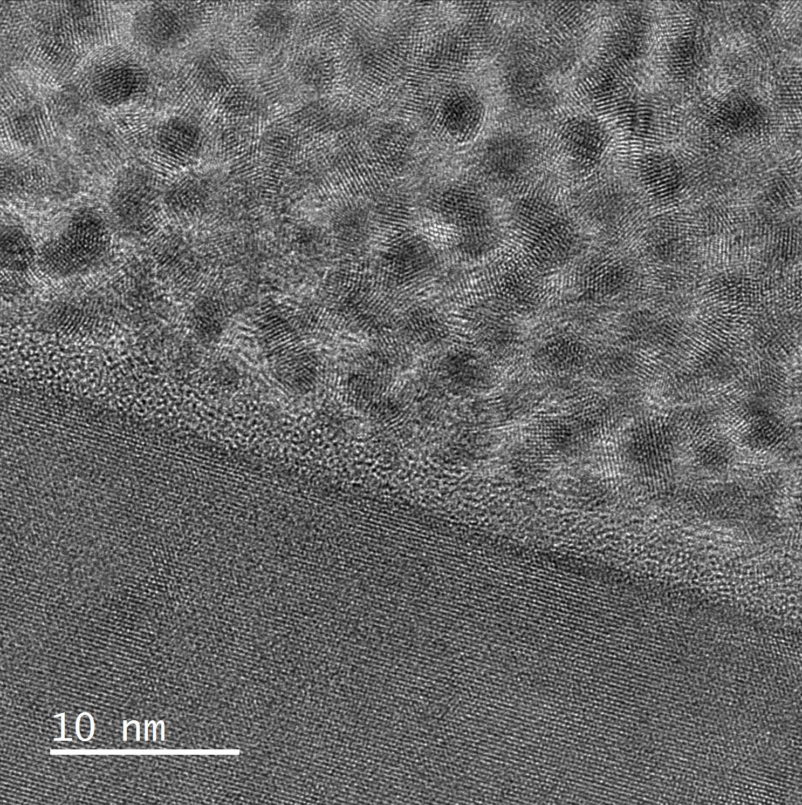
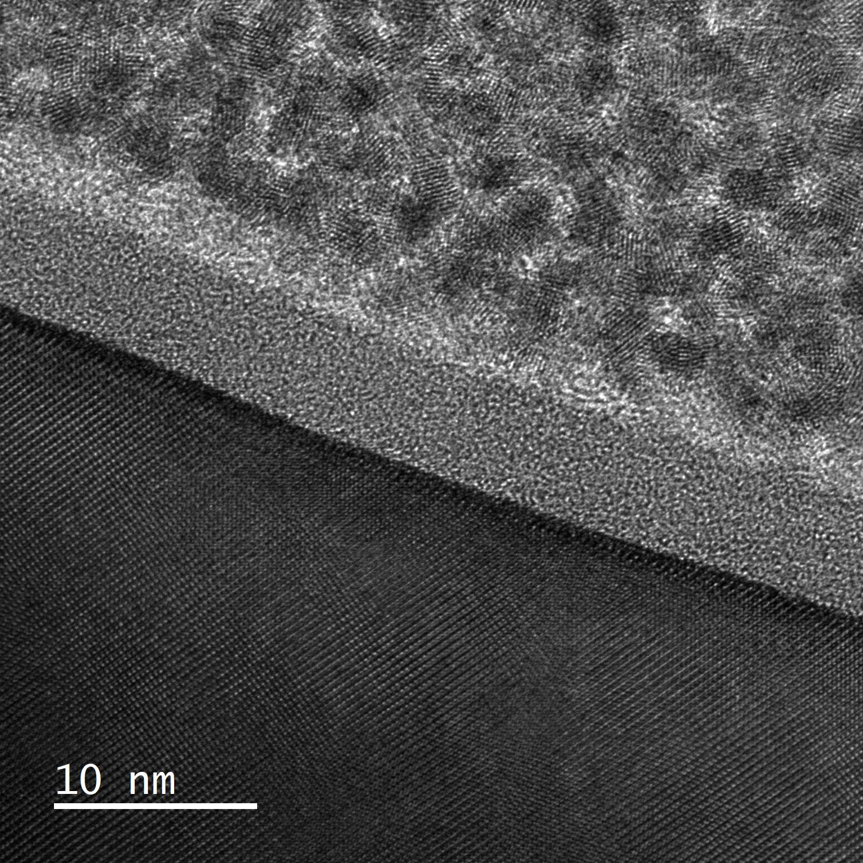
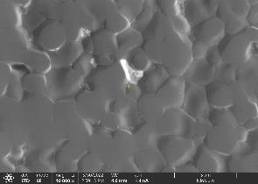
Ultrasonic Cleaning
Before Cleaning
Ultrasonic cleaning removes residual abrasive particles.
Most particles gone after two hours
Some particles remain in crevices
No surface damage caused by ultrasonic cleaning
Before Ultrasonic Cleaning
After Ultrasonic Cleaning
After Cleaning (2hrs)
Platinum Layer
Platinum Layer
Oxide Layer
Oxide Layer
Nb₃Sn
Nb₃Sn

Slide 14
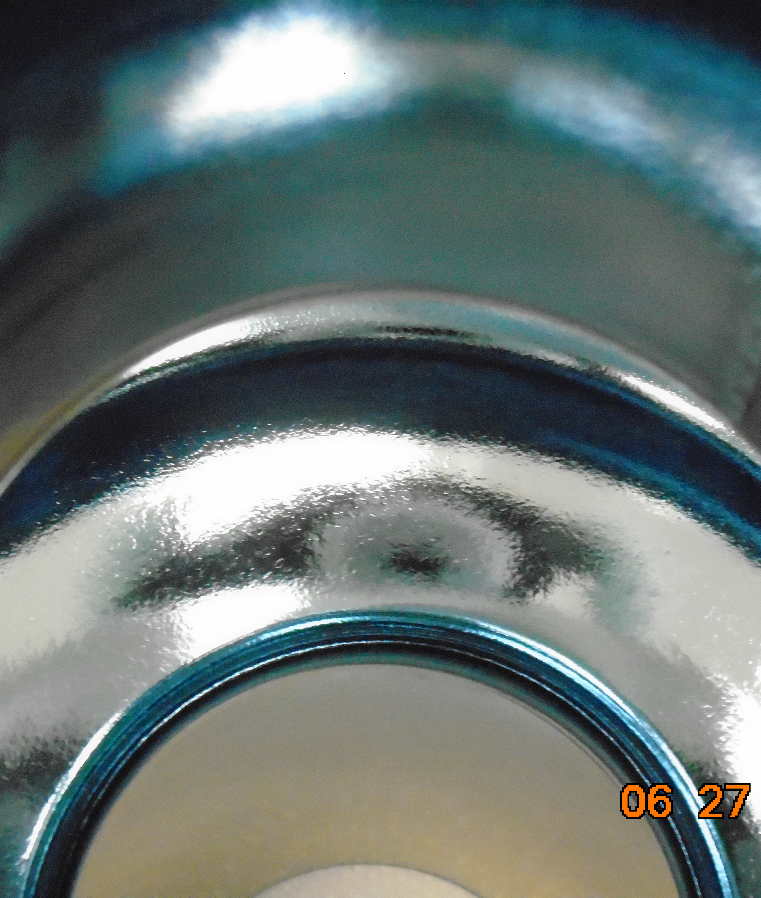
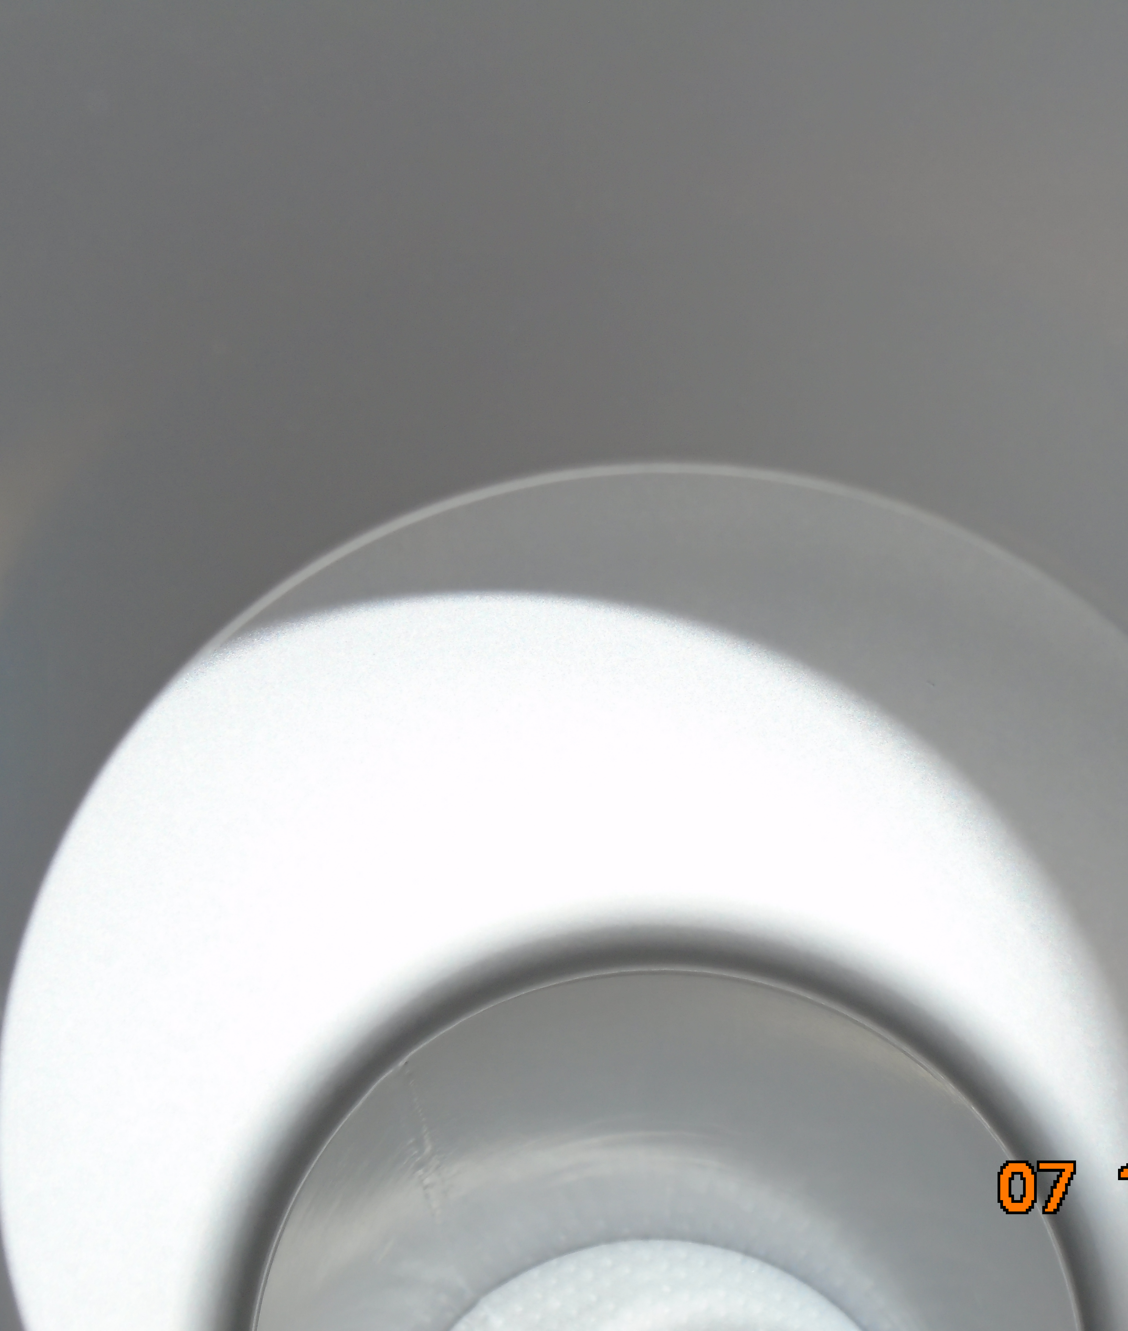
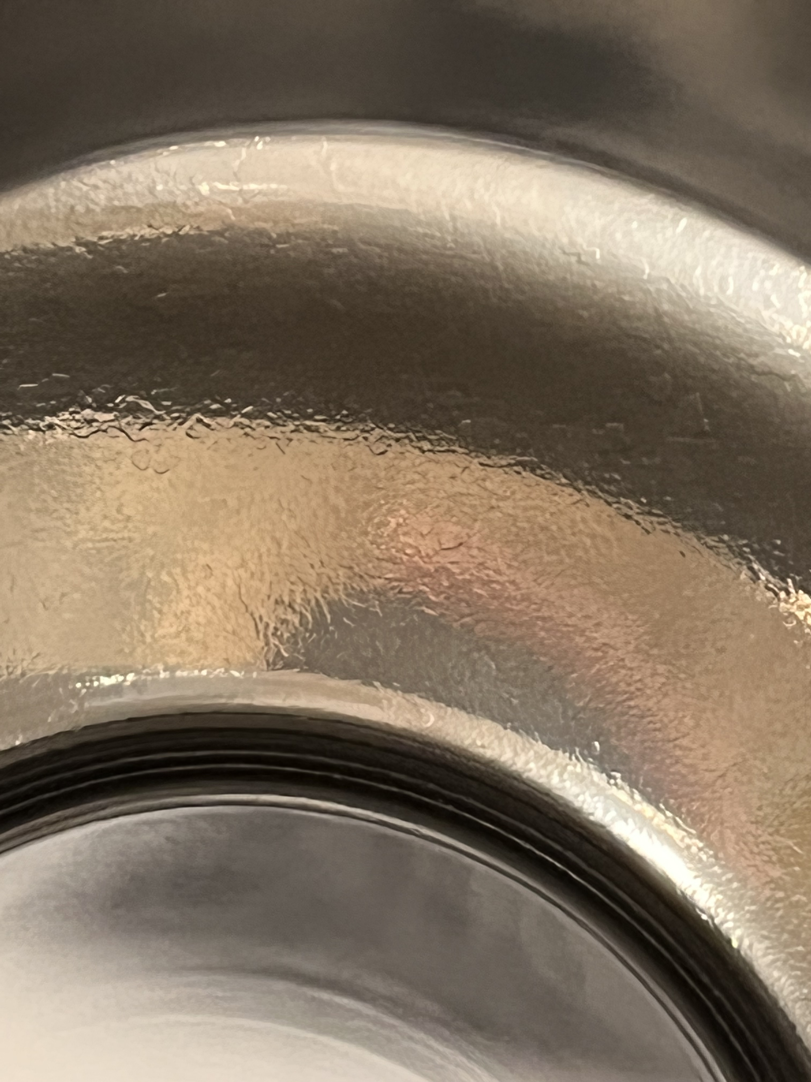
Applying the Polishing Procedure to a Nb₃Sn SRF Cavity
Mechanical polishing was tested on a Nb3Sn-coated single cell 1.3GHz cavity
4 hours of centrifugal barrel polishing
30 minutes of cleaning in an ultrasonic cleaner
Rinsed with a high-pressure (100 bars) water jet
Before Coating
After Coating
After Polishing

Slide 15
Performance of a Mechanically Polished Nb₃Sn SRF Cavity
The accelerating field and quality factor of the cavity was measured after mechanical polishing.
Cavity performance was degraded after CBP.
40% reduction in maximum accelerating field
Severe Q-slope
Possible causes include:
Residual alumina particles and other contaminants
Surface damage caused by barrel polishing
Exposed sub-surface film defects
Typical Nb Q at 4K

Slide 16
Future Research Directions
Determining the cause of performance degradation.
  More cavity testing
  Heat mapping
  Cavity cut-out analysis
Improving post-polishing cleaning.
  Improving ultrasonic and high-pressure rinsing procedures
  Exploring chemical cleaning methods
Characterizing the Nb3Sn surface after mechanical polishing.
  Surface damage
  Surface stoichiometry
  Oxide film
Repairing the surface after polishing by recoating the surface.
  Perform a short additional coating cycle of Nb3Sn after polishing to fill in damaged areas

Slide 17
Key Findings
Using mechanical polishing we can obtain a smooth Nb3Sn surface, comparable to electropolished niobium.
The performance of the mechanically polished cavity was degraded.
Further studies will be done to analyze the cavity surface after mechanical polishing.
As-coated Nb₃Sn
Nb₃Sn after polishing
0 hours
2 hours
4 hours
6 hours
8 hours
86 μm

