Slide 1

TTC Meeting
Copper Plating Research Activities
for Cryocooler Application*
A. Prudnikava, Y. Tamashevich, O. Kugeler, J. Knobloch
*Research funded by the
Helmholtz INNOVEEA program
12 October 2022, Aomori, Japan

Slide 2
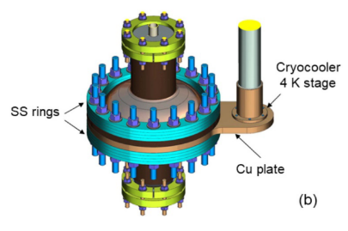
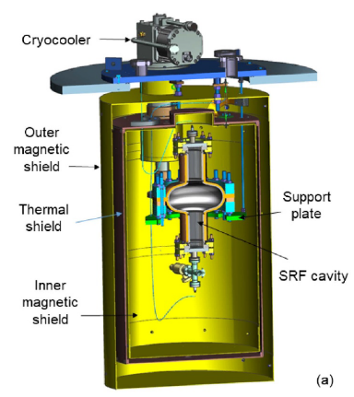

Motivation: Cryocoolers for SRF
Cryocoolers: closed-cycle refrigerators
firstly used for SRF cryomodules for Japan Atomic Energy Research Institute Free Electron Laser*
reliable, compact, easy to operate
Possible Application:
compact low-energy electron accelerators with Nb₃Sn/Nb resonators operating at T > 4.2 K
to maximize the thermal stability of the cavity: Cu-deposition onto a Cavity outer wall
from “G. Ciovati et al. Superconductor Science and Technology 33.7 (2020): 07LT01.”
high-T_{c} SC
Gifford-McMahon (GM) Cryocooler
Nb
Cu
* Kikuzawa N, et al, Performance of compact refrigerators
system for SRF cavities in the JAERI FEL, SRF97C40, SRF’97, p.769
Multi-layer Cavity
Notes:
Recent progress in the development of high-T_{c} SC films makes sub-cooling of cavities and therefore cryoplants unnecessary. The cavity may be cooled using a cryocooler - a reliable, compact, close-cycle refrigerator which is easy to operate. Cryocoolers were firstly used for SRF cryomodules for Japan Atomic Energy Research Institute Free Electron Laser [publication in 1993].
The capacity of cryocoolers has been increasing while the capital cost per Watt of cooling power has been decreasing in the last years.
An example of cooling the cavity using a cryocooler is shown in figure on the right. This picture is taken from the publication of our colleagues from JLab. For better thermal stabilization of the cavity during its operation a copper layer has to be sputtered on the outer surface of a cavity. Unfortunately, at present there is no technique which allows depositing a thin film of Nb3Sn directly onto copper with similar performance as achieved by forming the Nb3Sn layer onto bulk Nb by vapor diffusion.

Slide 3
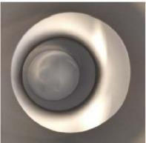
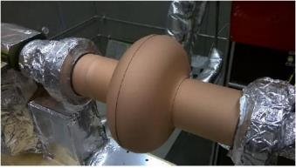
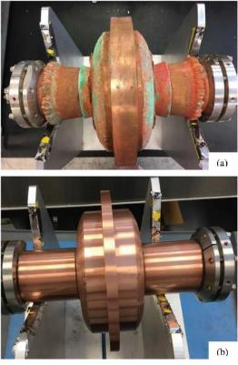
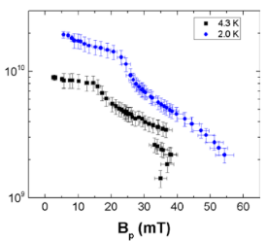
Nb₃Sn (2 um) Cu-cold spraying (~75 um) Cu-electroplating (5 mm)
Preparing a Multi-Layer SRF Cavity
Experience of JLab: Nb₃Sn/Nb/Cu
Steps:
Nb₃Sn by vapor diffusion
1st Cu-layer by cold spraying
2nd Cu-layer by electroplating in multi-steps (~90 days)
1.5 GHz
T_{c}=17.8K
1.5 GHz
Issues:
poor adhesion of copper directly plated onto Nb
сold-sprayed Cu has low thermal conductivity
no FE
machining
G. Ciovati, et al, Proceedings of SRF2019, Dresden, Germany, TUP050
3
Notes:
Steps for cavity production:
Nb₃Sn by vapor diffusion
1st Cu-layer by cold spraying
2nd Cu-layer by electroplating in multi-steps (~90 days)
Regarding the copper coating, the two issues have been faced:
- poor adhesion of the electroplated Cu (plating recipe was not disclosed)
- cold-sprayed Cu, which was tried alternatively, had low thermal conductivity.

Slide 4
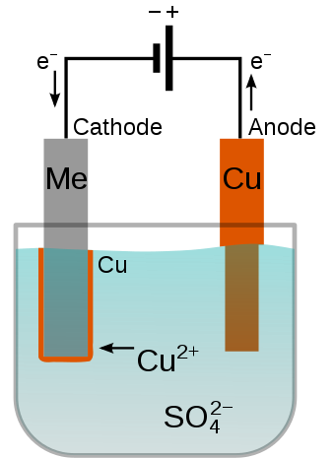
Copper Electroplating onto Niobium
Experimental Approaches:
For Cu-plating onto most metals the water-based acidic electrolytes are commonly used
“less active” Me
(Ni, Sn…)
Cu
Cu
Nb
Nb
Two-step plating:
Step1: pre-plating with less active metal
Step 2: Standard Cu-plating
Direct Cu-plating :
using Electrolytes for Steel (Fe has higher reactivity than Cu)
using Complexing Agents (cyanides, glycols, surfactants etc.)
using Non-aqueous Electrolytes (organic solvents, ionic liquids ( incl. molten salts)
Issues:
Niobium has a higher reactivity than Copper => galvanic displacement reaction:
Nb_{(s)} + Cu²⁺ -> Cu_{(s)} + Nb²⁺
poor Cu-film adhesion
Notes:
In the present Project we have been studying the copper electroplating process. Electroplating uses current to reduce the metal ions dissolved in the solution at the Cathode (Nb) surface. For Cu-plating onto most metals the water-based acidic electrolytes are commonly used.
Issues:
Nb is an active metal: galvanic displacement reaction
Nb_{(s)} + Cu²⁺ -> Cu_{(s)} + Nb²⁺
poor Cu adhesion
No Cu-plating procedure available in the literature
There are several possibilities to coat an active metal with Copper.
the 1st includes an extra step to precoat Niobium with a less active metal, and then apply a suitable electroplating procedure.
- Another way is to try direct plating of Cu onto Nb using electrolytes for other active metals like steel;
try using complexing agents and additives to tune the potential of cathode to less noble direction by complex formation (cyanides, glycols, etc)
Nonaqueous electrolytes (ionic liquids) -> ! stability of electrolyte in air environment (otherwise work under inert gas atmosphere)
We started from electrolytes for steel available on the market and in the literature

Slide 5
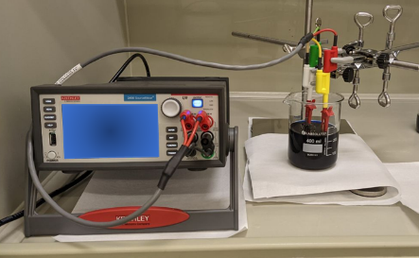
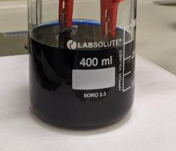
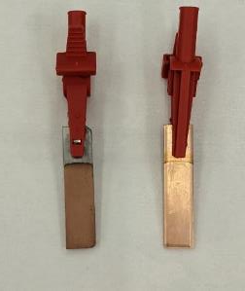
Electroplating onto Niobium using Electrolytes for Steel
Primary requirements to Cu-deposits:
form a continuous film;
no easily detached from Nb (scratch-test with tweezers);
tape test;
thermal shock test.
Electrochemical Cell: two-electrode type (Сu used as Anode)
a) Alkaline Electrolyte for Steel (published in the literature¹ )
Bath A: w/o additives
Bath B: with additives-1
Bath С: with additives-2
K
A
Cu film is matt ☺
Cu anode did not deteriorate ☺
Cu film is not easily peeled off (but did not pass tape test ☹ )
Bath A
¹ R. Sekar et al, 2017
Notes:
requirements to Cu-deposits:
slide text
ELECTROLYTES FOR STEEL:
Alkaline Electrolyte for Steel (published in the literature¹ ) without(Bath A) and with(Bathes B,C) additives
slide text

Slide 6

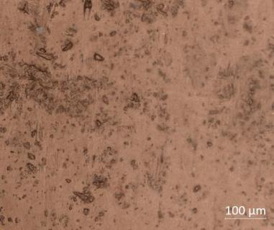
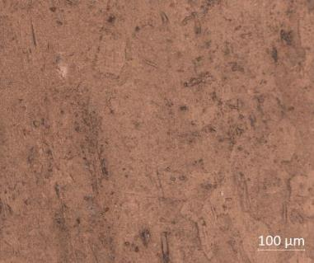
Electroplating onto Niobium using Electrolytes for Steel
Bath A Bath B Bath C
      Cu-deposit thickness 0.8 μm
      ⬄ deposition rate 2.3 μm/h
optical microscopy
x20
Notes:
optical microscopy

Slide 7
SEM images
Electroplating onto Niobium using Electrolytes for Steel
Bath A
Bath B (with additives)
*Bath C looks alike
Notes:
SEM: influence of additives on the film morphology

Slide 8
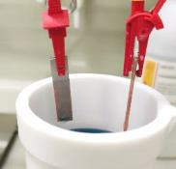
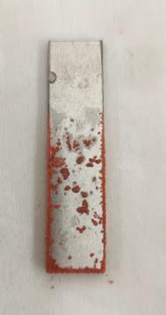
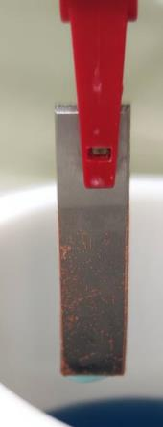
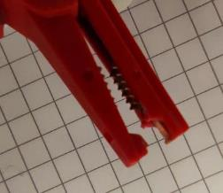
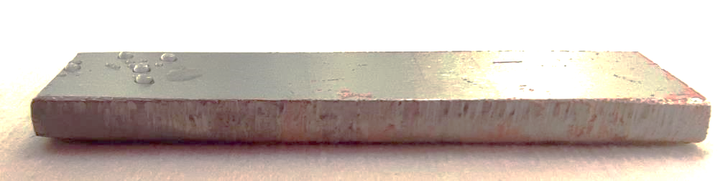
Electroplating onto Niobium using Electrolytes for Steel
Commercial Acidic Electrolytes:
b) μChem 520 (copper (2-30 g/l), sulfuric acid (200-250g/l), chloride (50-70 g/l) );
c) High speed bright copper electroplating solution by Sigma-Aldrich:
40 mg/L chloride basis
600 mg/L (organic additives)
65.0 g/L Cu basis
8.0 g/L H₂SO₄ basis
Primary requirements to Cu-deposits:
form a continuous film;
no easily detached from Nb (scratch-test with tweezers) .
scotch-tape test;
thermal shock test.
μChem 520
=> no continuous Cu-film obtained
Electroplating at:
varied T °C, j mA/cm², with and w/o solution agitation
continuous Cu-film at steel components
500 mA
Nb
50 mA
20 mA
Notes:
ELECTROLYTES FOR STEEL (acidic):
b) μChem 520
c) High speed bright copper electroplating solution by Sigma-Aldrich

Slide 9
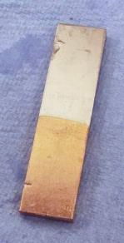
SEM
Modified Alkaline Electrolyte for Steel: Cu/Nb Film
Modified composition, concentration, plating parameters for alkaline electrolyte;
obtained a continuous Cu-film on Nb ☺
Cu-film thickness: ~170 nm ☹;
low deposition rate (0.28 um/h) ☹
Nb
Stable solution ☺ ;
reproducible results ☺
Cu
Notes:
slide text

Slide 10
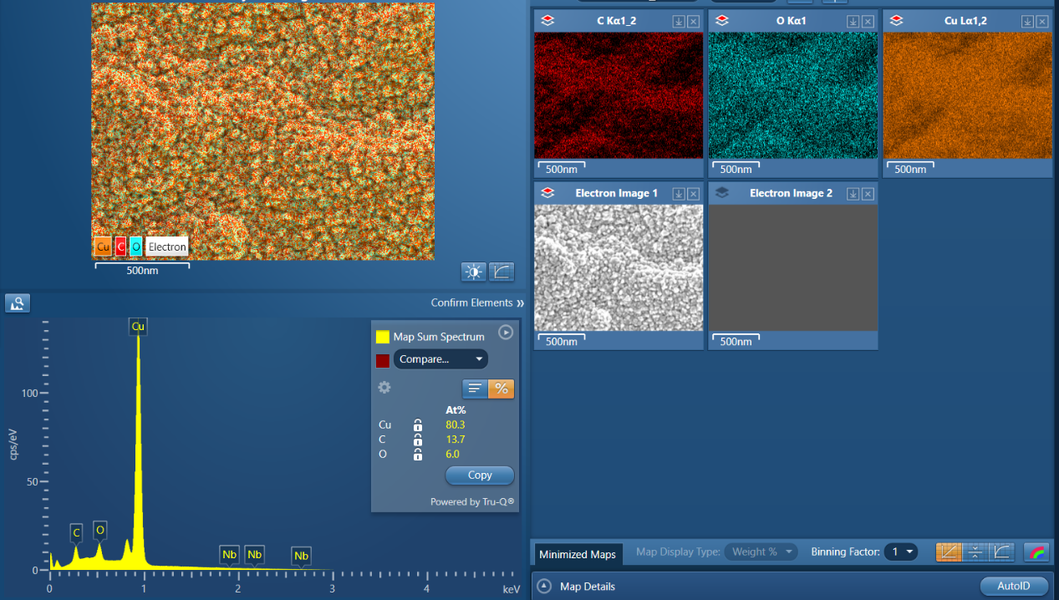
EDX
Notes:
EDX:
deposit is indeed Copper , O and C are present

Slide 11
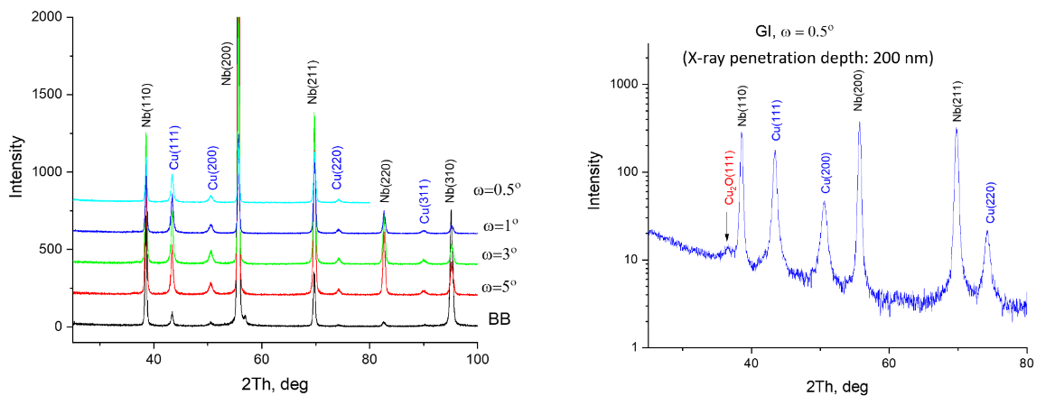
Cu/Nb Film: XRD
XRD measured in Bragg-Brentano (BB) geometry and in Grazing-Incidence geometry (GI) at various incidence angles
Calculated average crystallite size of Cu film is
22.70 nm
In BB geometry only Cu reflexes were observed
Notes:
XRD was measured in different geometries of the set-up.
In Grazing-Incidence geometry (GI) at small incidence angles of X-ray beam the small amount of Cu2O phase revealed.

Slide 12
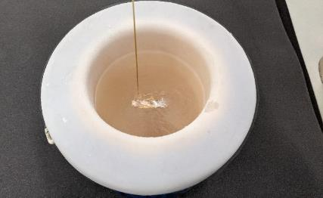
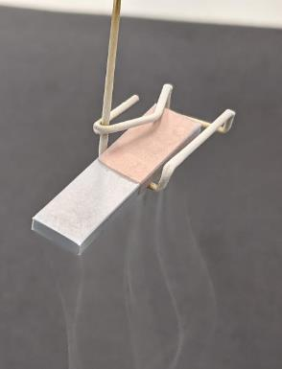
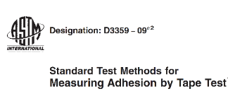
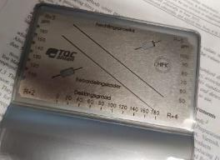
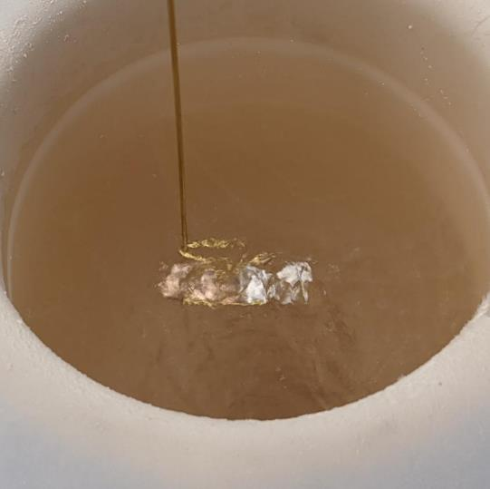
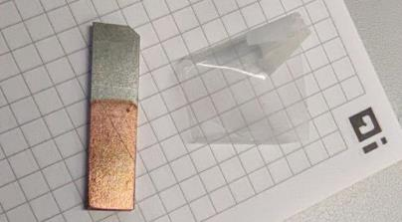
Cu/Nb Film: Liquid Nitrogen Test, Adhesion Tape Test
Cu film passed:
liquid nitrogen test ☺
adhesion tape test ASTM D3359, Test Method A (X-cut Tape Test) ☺
Patent was filed ☺
Notes:
About Film adhesion properties

Slide 13

Cu/Nb Film for Cryomodule Application
Strategy:
2nd layer
Cu
1st layer
1st Cu-layer (alkaline electrolyte): to be used as a buffer layer
2nd layer (acidic electrolyte): Cu-film of required thickness n∙100 μm
Nb
Studying Cu-plating with Acidic Electrolyte (Cu/Cu plating)
Electrolytes:
What was Studied:
Quality of Cu-films obtained using standard Cupric Electrolyte (deposition rate: current density, temperature)
Influence of additives onto Cu-film oxidation (SEM/EDX, XRD)
Quality of films obtained using modified Cupric Electrolytes (deposition rate, uniformity, CuO_{x})
Quality of films obtained using S.Aldrich Electrolyte
1. “Standard” CuSO₄/H₂SO₄/H₂O
2. “Standard” CuSO₄/H₂SO₄/H₂O with various additives (polyethylene glycol, sodium lauryl sulphate, benzotriazole)
3. “Modified” CuSO₄/H₂SO₄/Cl⁻/Janus Green B/(w/MPS or w/a MPS*)
4. Commercial S. Aldrich Cu-plating solution
*MPS: Sodium 3-mercapto-1-propanesulfonate
Notes:
Since the Copper layer currently obtained on Nb is thin – not enough for Cryo-cooler application, there is a need to build-up its thickness. We are planning to uses this Cu-layer as a sub-layer and plate a 2nd thick film on top of it with another electrolyte.
We tested the listed electrolyte compositions (on the left).
(On the right):
We studied the quality of Cu-films obtained using standard Cupric Electrolyte (deposition rate: current density, temperature)
Influence of additives onto Cu-film oxidation (SEM/EDX, XRD)
Quality of films obtained using modified Cupric Electrolytes (deposition rate, uniformity, CuO_{x})
Quality of films obtained using S.Aldrich Electrolyte

Slide 14
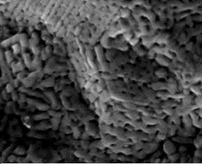
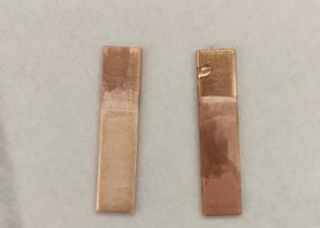
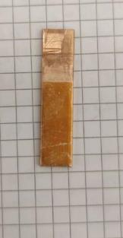
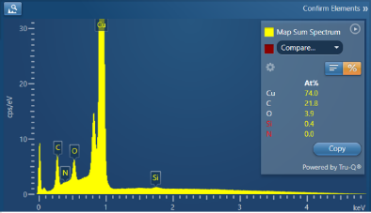
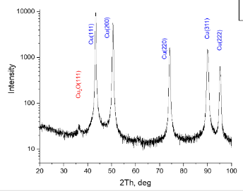
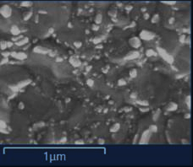
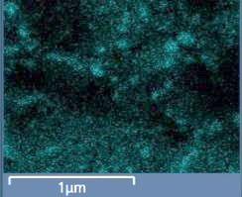
Testing Acidic Electrolytes (1): Cu plating onto Copper
~20 min in air: color change
Cu₂O
200 mA
A
K
100 nm
Electrolyte:
CuSO₄∙5H₂O
H₂SO₄
H₂O
Visible Cu-film post-oxidation
XRD, EDX: Cu₂O agglomerates
E_{acc}= 5 kV
up to 5 at%O
O k_{α1}
Plating parameters:
j=2.7 A/dm²
T=27°C
t=5 min
GI, ω=5°
Cryst. Size
Cu(111): 30.18 nm
Cu₂O(111): 10.89 nm
Notes:
For cupric electrolyte: a visual post-oxidation of Cu-film is observed (color changing of the film in air).
Approved by SEM/EDX, XRD:
We decided to explore whether the electroplating parameters can influence the film oxidation.

Slide 15
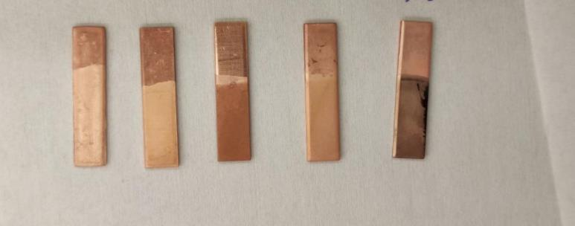
Testing Acidic Electrolytes (2): Cu plating onto Copper
Current density effect
effect of additives
Samples 1-2
CuSO₄∙5H₂O (0.64M)
H₂SO₄ (0.2 mM)
H₂O
Samples 3-5
CuSO₄∙5H₂O
H₂SO₄
H₂O
and various additives:
polyethylene glycol (PEG)
sodium lauryl sulphate (SLS)
benzotriazole
40 mA 80 mA
PEG SLS Benzotriazole
 | I, mA | j, mA/cm² | deposition rate, μm/h | at% O at 5kV | O/Cu at 5 kV | Cryst. Size Cu(111), nm
CuSO₄+H₂SO₄ | 200 | 27.8 | - | 3.9 | 0.05 | 30.18
CuSO₄+H₂SO₄ | 40 | 5.7 | 7.9 | - | - | -
CuSO₄+H₂SO₄ | 80 | 13.2 | 17.4 | 4.5 | 0.06 | 32.76
CuSO₄+H₂SO₄+PEG | 80 | 13.2 | 17.5 | 5.5-5.9 | 0.07-0.08 | 29.86
CuSO₄+H₂SO₄+SLS | 80 | 13.2 | 17.4 | 3.6 | 0.05 | 32.84
CuSO₄+H₂SO₄ + benzotriazole | 80 | 14 | 19.2 | 2-4.3 | 0.03-0.06 | 23.9
Notes:
Thus, The Cu-films were plated at different currents
and various additives. All the samples were checked with SEM, EDX, XRD.
From the table: The maximal deposition rate was provided when benzotriazole was added to the plating bath, at that the crystallite suze was decreased.

Slide 16
80 mA
Testing Acidic Electrolytes (2): Cu plating onto Copper
Cu-film morphology: General view (SEM)
Current density effect
40 mA
Higher current => smaller Cu-grains
Notes:
Current effect on the morphology.
Higher current => smaller Cu-grains

Slide 17
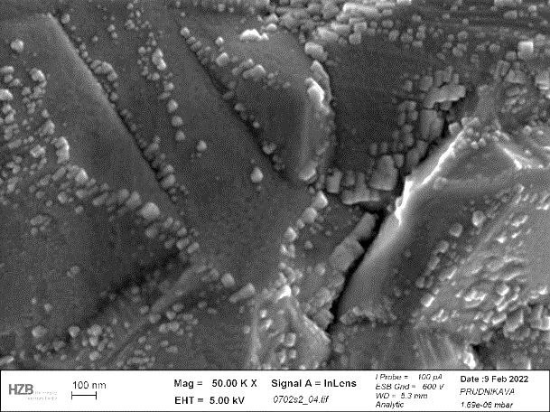
80 mA
Testing Acidic Electrolytes (2): Cu plating onto Copper
Higher current => larger Cu₂O precipitates
40 mA
Surface Oxides (SEM)
Notes:
Higher current => larger Cu-oxide particles

Slide 18
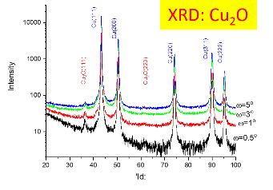

Testing Acidic Electrolytes (2): Cu plating onto Copper
Cu₂O is present
=> no effect on film oxidation
with Polyethyleneglycol
C_{2n}H_{4n+2}O_{n+1}
Notes:
Polyethyleneglycol effect:
film morphology changed
Cu2O still present

Slide 19
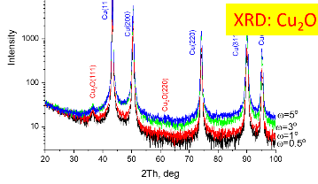

Testing Acidic Electrolytes (2): Cu plating onto Copper
Cu₂O is present
=> no effect on film oxidation
with Sodium Lauryl Sulphate
Notes:
Sodium Lauryl Sulphate :
Cu₂O is present
=> no effect on film oxidation

Slide 20
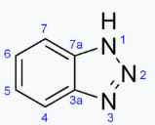
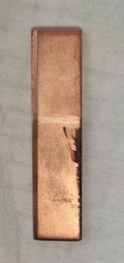
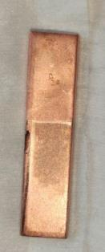
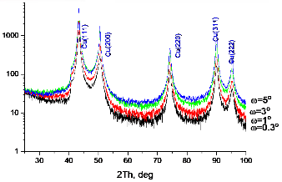

Testing Acidic Electrolytes (2): Cu plating onto Copper
side 1
side 2
with benzotriazole
XRD:
no Cu₂O ☺
C₆H₅N₃ residue ☹ (can be optimized)
Notes:
benzotriazole:
eliminates formation of CuOx,
but benzotriazole residue (agglomerates) is embedded into the Cu film.
-> possible, can be optimized

Slide 21
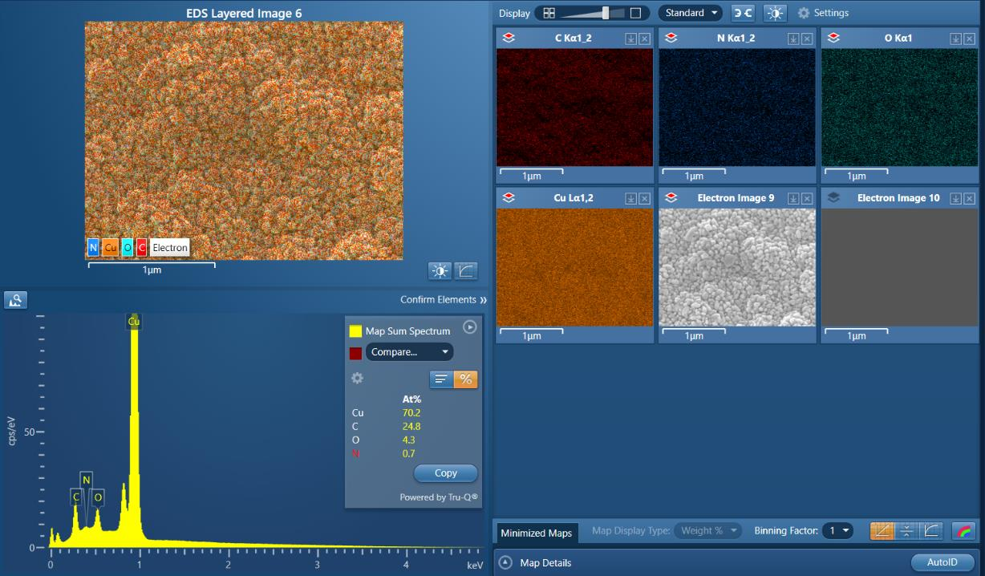
Top area of the
electrode
Notes:
Top of the sample

Slide 22
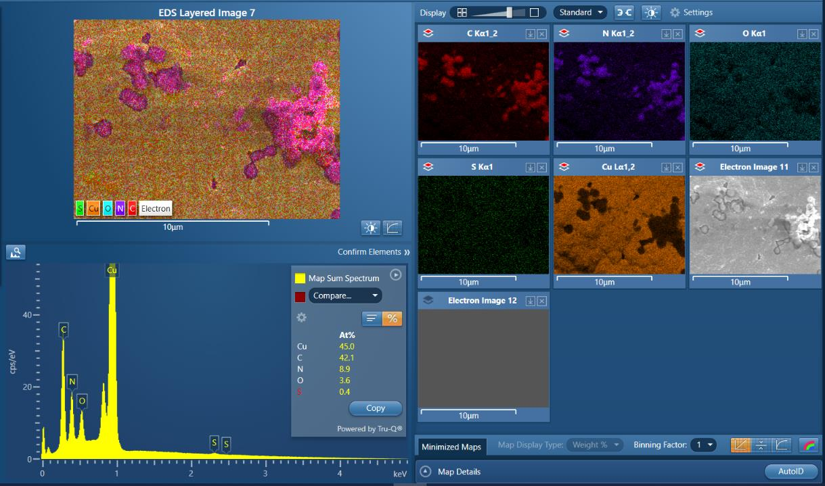

at the middle of the
electrode
Notes:
Dark area of the sample

Slide 23
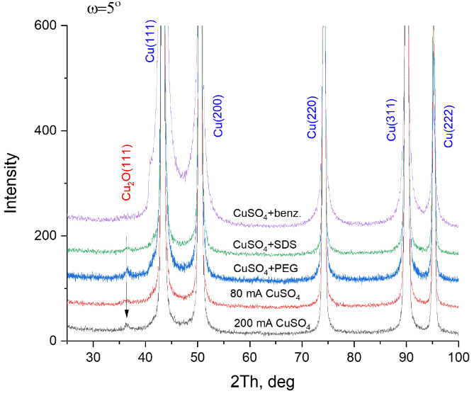
XRD
Testing Acidic Electrolytes (2): Cu plating onto Copper
comparison at ω=5°
only benzotriazole additive affects the Cu₂O formation
Notes:
XRD of all samples: No Cu2O with benzotriazole

Slide 24
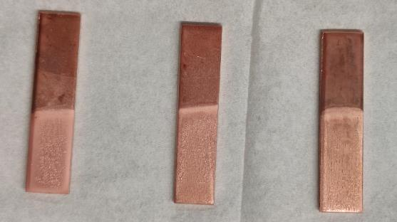
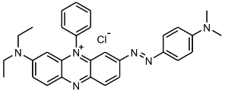

Testing Acidic Electrolytes: Cu plating onto Copper
Testing Acidic Electrolytes (3): Cu plating onto Copper
№1
№2
№3
Modified Electrolyte:
CuSO₄∙5H₂O
H₂SO₄
H₂O
additives:
NaCl
Janus Green B
MPS
 |  | I, mA | j, mA/cm² | deposition rate, um/h | at% O at 5kV | O/Cu at 5kV | Cryst. Size Cu(111), nm
№1 | CuSO₄+H₂SO₄+NaCl +Janus Green B | 80 | 17.6 | 24.5 | 2.1-3.6 | 0.02-0.04 | 29.64
№2 | CuSO₄+H₂SO₄+NaCl +Janus Green B | 50 | 13.2 | 13.5 | 2.7 | 0.03 | 33.28
№3 | CuSO₄+H₂SO₄+NaCl +Janus Green B+MPS | 50 | 13.2 | 12.9 | 3.5-4 | 0.04-0.05 | 33.40
Notes:
Modified electrolyte
additives:
NaCl
Janus Green B
MPS
- Current effect: higher I, higher Cu-deposition rate

Slide 25
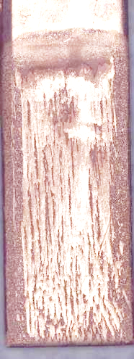
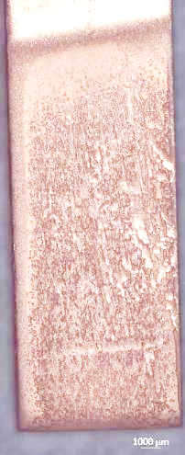
Testing Acidic Electrolytes: Cu plating onto Copper
Testing Acidic Electrolytes (3): Cu plating onto Copper
№1
№2
№3
Electrolyte:
CuSO₄∙5H₂O
H₂SO₄
H₂O
additives:
NaCl
Janus Green B
MPS
Cu-film grooving
(channeling)
 |  | I, mA | j, mA/cm² | deposition rate, um/h | at% O at 5kV | O/Cu at 5kV | Cryst. Size Cu(111), nm
№1 | CuSO₄+H₂SO₄+NaCl +Janus Green B | 80 | 17.6 | 24.5 | 2.1-3.6 | 0.02-0.04 | 29.64
№2 | CuSO₄+H₂SO₄+NaCl +Janus Green B | 50 | 13.2 | 13.5 | 2.7 | 0.03 | 33.28
№3 | CuSO₄+H₂SO₄+NaCl +Janus Green B+MPS | 50 | 13.2 | 12.9 | 3.5-4 | 0.04-0.05 | 33.40
Notes:
Modified electrolyte
Morphology peculiarity: Cu-film grooving (channeling)

Slide 26
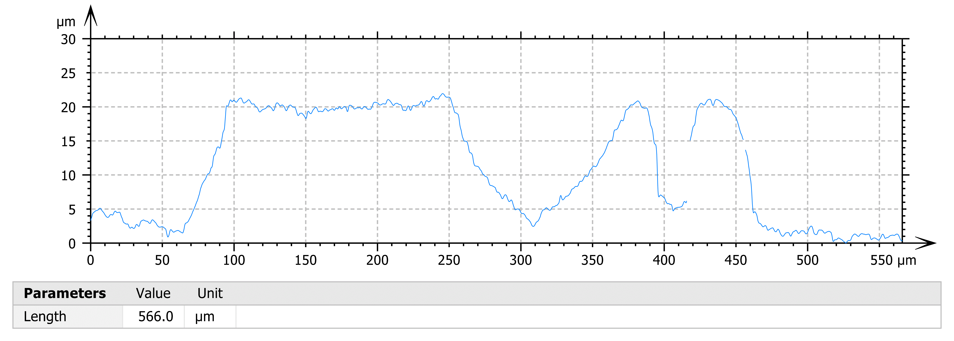
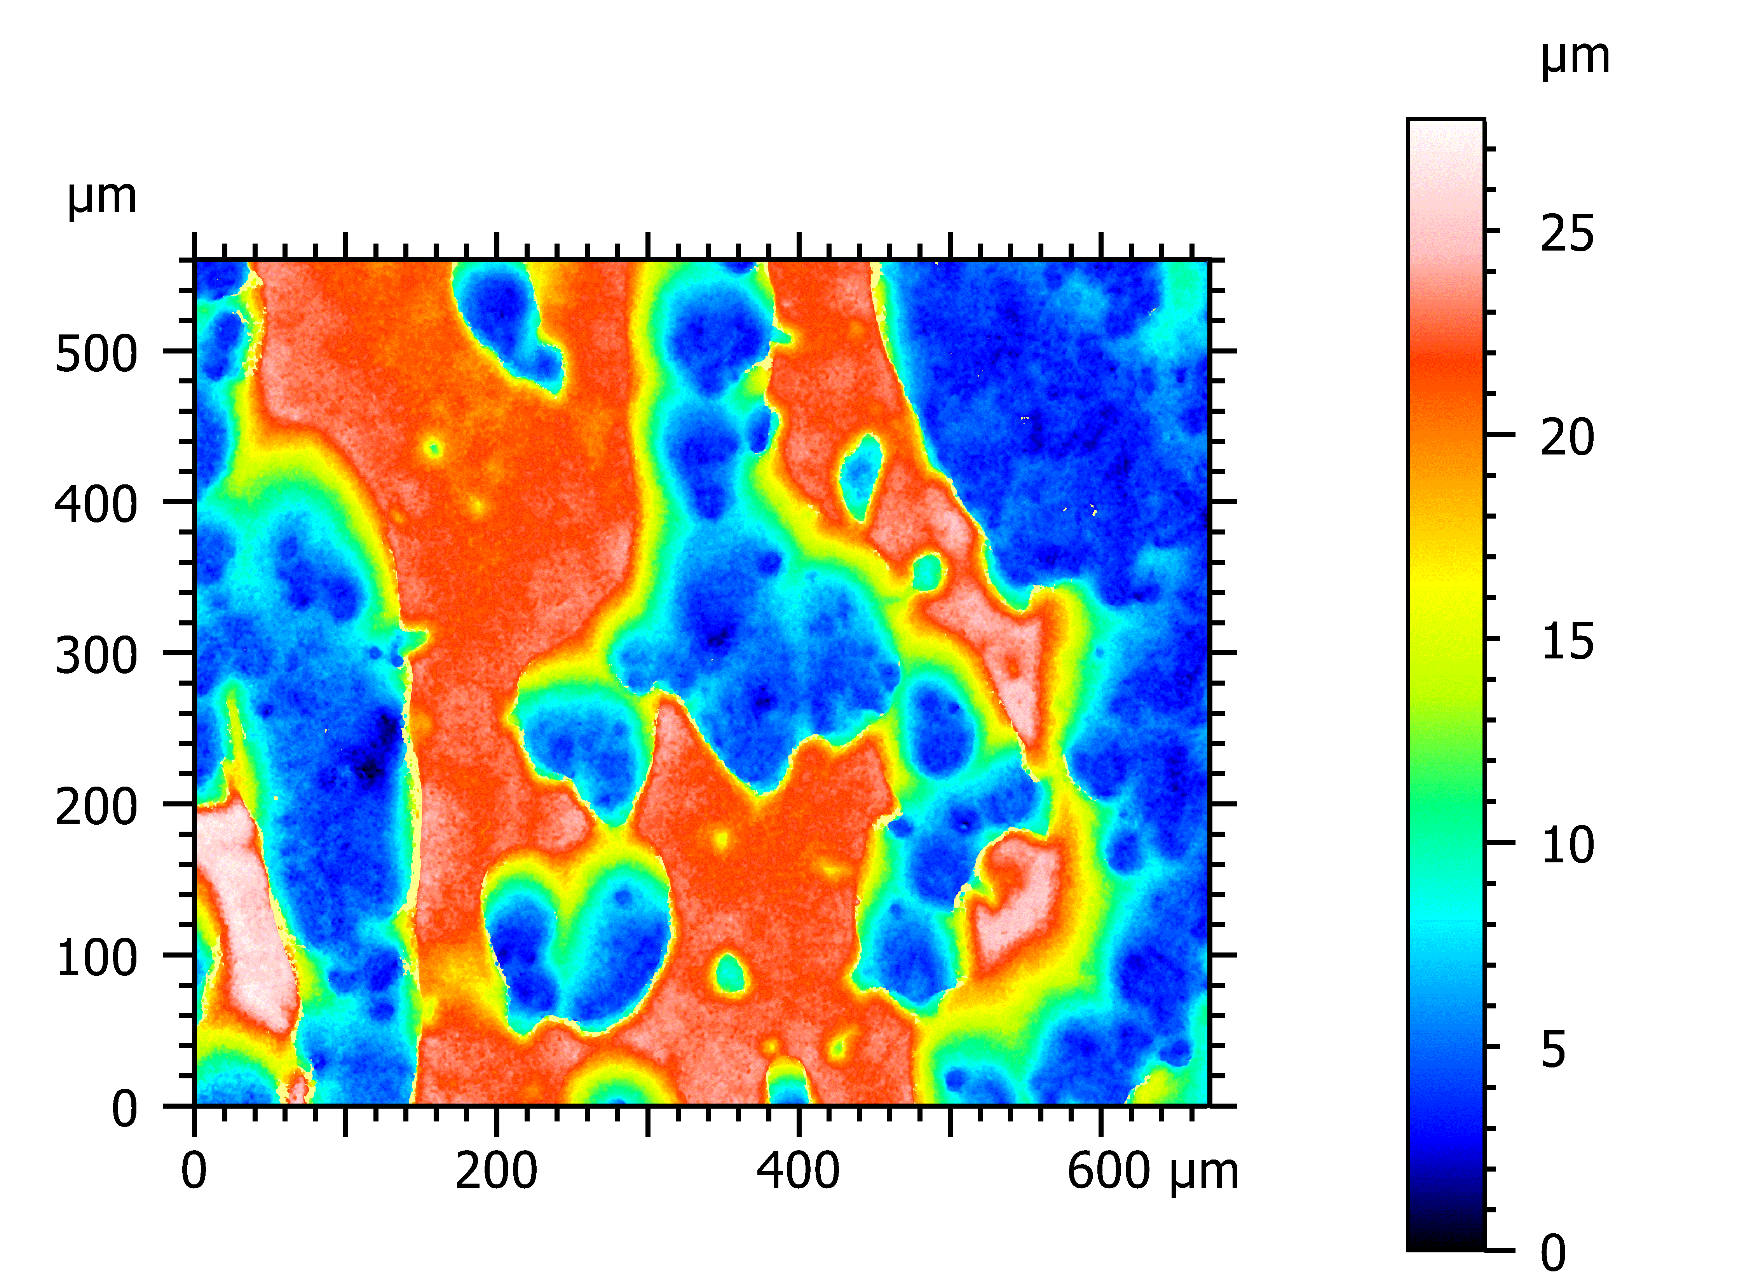

80 mA
Testing Acidic Electrolytes (3): Cu plating onto Copper
Cu-film grooving
(channeling)
50 mA
x 20
Notes:
SEM, laser microscopy profiling

Slide 27
Testing Acidic Electrolytes (3): Cu plating onto Copper
Grooving is owing to preferential growth of the Cu seed along one crystallographic direction
№3 (50 mA, MPS)
Notes:
SEM: film edge (a side-wall of the “channel”).
preferential growth of the Cu seed along one crystallographic direction

Slide 28
Testing Acidic Electrolytes (3): Cu plating onto Copper
Grooving is owing to preferential growth of the Cu seed along one crystallographic direction
№3 (50 mA, MPS)
Notes:
more views

Slide 29
Testing Acidic Electrolytes (3): Cu plating onto Copper
Grooving was not affected by
initial surface roughness of the electrode;
bath temperature;
MPS presence
Cu-film evens off as film thickness builds up (by increasing current density or/and electroplating duration)
Notes:
slide text

Slide 30
Testing Acidic Electrolytes (3): Cu plating onto Copper
Cu-film oxidation? Some crystal planes revealed Cu₂O particles
№2 (50 mA, no MPS)
Notes:
slide text

Slide 31
Testing Acidic Electrolytes (3): Cu plating onto Copper
some - did not (and is valid for recipes №1-3)
№2 (50 mA, no MPS)
Notes:
slide text.
(possible reason? a preferred crystal plane within Cu lattice for copper oxide growth)

Slide 32





Electrolyte: High speed bright copper electroplating solution by Sigma Aldrich (deposition rate declared: up to 5 μm/min)
Testing Acidic Electrolytes (4): Cu plating onto Copper
17.03.22
K
A
SEM/EDX
O kα
Deposition rates ~40 um/h (at j=30mA/cm²)
Strong Cu-film oxidation
Anode degradation
O kα
T = 18°C
j = 13 mA/cm²
t = 1 h
Notes:
Finally, Sigma Aldrich Electrolyte tested on Copper.
Achieved deposition rates ~40 um/h (at j=30mA/cm²)
Strong Cu-film oxidation
Anode degradation (photo)

Slide 33

XRD: Cu films
Testing Acidic Electrolytes (4): Cu plating onto Copper
17.03.22
cubic Сu₂O and CuCl are present
⬄ related to Anode problem?
Notes:
XRD

Slide 34




Cu Anode
Testing Acidic Electrolytes (4): Cu plating onto Copper
17.03.22
EDX
Cu Cl O
cubic Сu₂O and CuCl are present
⬄ Anode degradation (even if smaller current densities are applied to Anode)
Glassy Carbon Anode
to be tested
Anode area was increased x2
XRD
Notes:
Cu Anode:
XRD: Сu₂O and CuCl are present
EDX: Cu Cl O are mapped with color
Action performed: Increased the area of the anode to decrease current density -> still degradation.
Anode made of Glassy Carbon to be tested

Slide 35



Summary and Ongoing Activities
17.03.22
Cu-plating using alkaline electrolytes for steel tested on Niobium. Procedure for direct plating of Cu onto Nb elaborated (“Cu/Nb-plating”). Currently, a thin Cu-film with good adhesion was possible to produce (~200 nm). Patent pending.
Several types of hi-speed Cu-plating baths have been investigated on Cu electrodes (commercial and from the literature) with various additives (“Cu/Cu-plating”). Plating parameters providing the Cu-films at deposition rates up to 40 um/h have been demonstrated (with the decreased amount of CuO_{x}, 20-25 um/h).
Ongoing:
creating Cu/Cu/Nb structure:
The thickness of Cu-film on Nb is planned to be used as “a buffer layer”, it’s thickness is to be increased to ~3-5 um. Currently, it reached ~2.1 um but with poor adhesion.
In parallel, testing other schemes for Cu/Nb plating.
Preparing the four-probe conductivity test setup at cryo-T (Y. Tamashevich)
Electrolyte after 3 months storage reproduced the results on Cu-plating of Niobium
=> Stable solution!
Nb
Newly prepared electrolyte worked as well => reproducible results
Cu
thickness 0.2 um
adhesion problem
thickness 2.1 um

Slide 36
Thank you very much for your attention!

