Slide 1
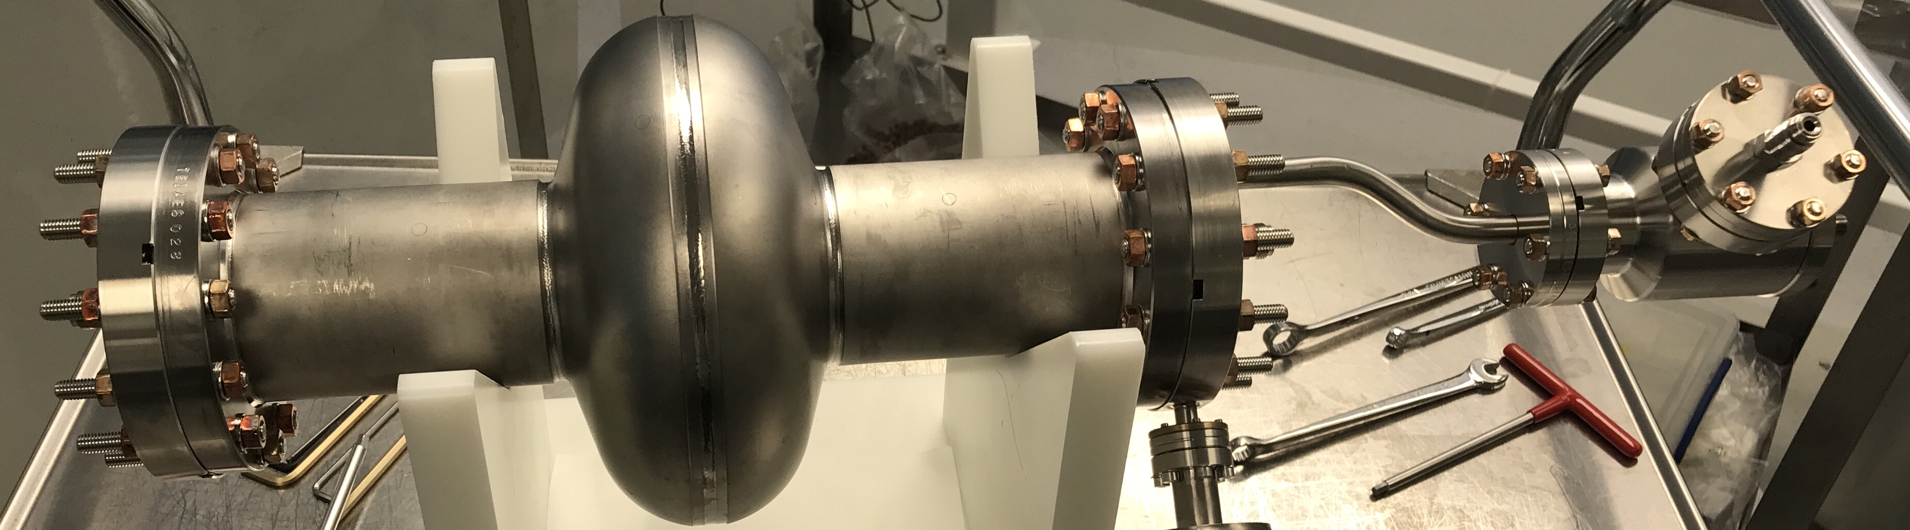

Analysis of Low RRR SRF Cavities
Katrina Howard, Daniel Bafia, Young-Kee Kim, Anna Grassellino
TTC2022 Aomori
11 October 2022

Slide 2
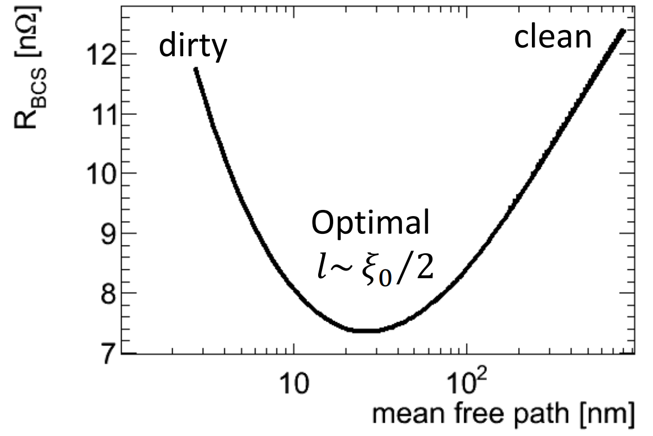
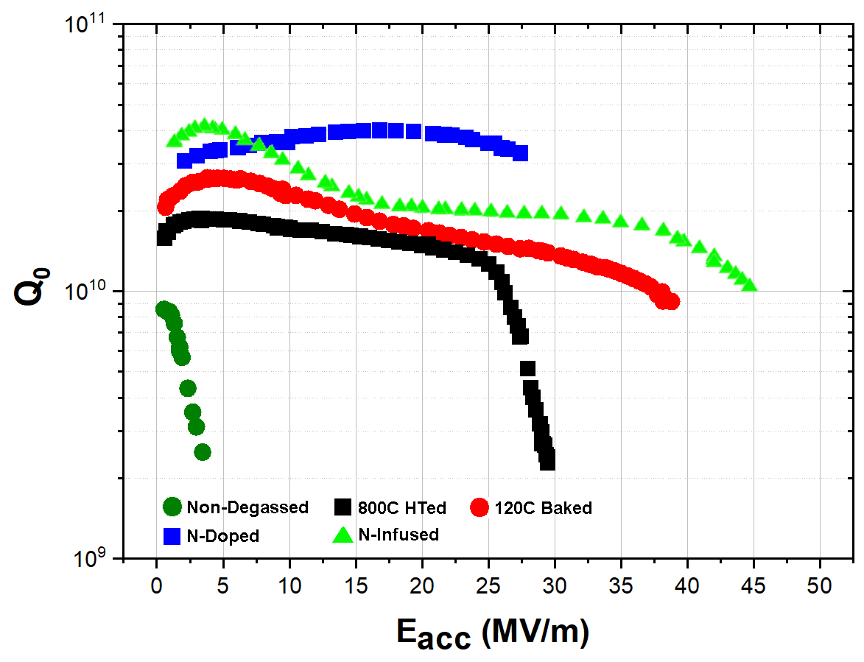
Motivation for Low RRR Investigation
BCS resistance vs mfp
A. Miyazaki SRF2021 Tutorial
Many SRF studies follow a “clean bulk dirty surface” technique to optimize the BCS resistance by adding extrinsic impurities
  Low temperature bake and N-doping are current focus
RRR = residual resistance ratio
  Decreased by impurities in Nb
What role do intrinsic impurities serve?
  Lower the mfp so may experience low BCS resistance behavior
  Might perform similar functions as extrinsic impurities which have been shown to improve performance
Goal: use understanding of intrinsic impurities to design future surface treatments for high gradient and quality factor
Q vs gradient for different surface treatments
N-doped
LTB
A. Grassellino
et al 2013 Supercond. Sci. Technol. 26 102001
EP

Slide 3
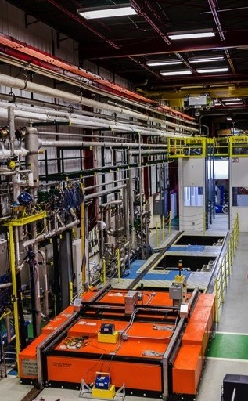
Low RRR Analysis Components
1.3 GHz TESLA-shaped single-cell low RRR (= 61) cavity with primary impurity Ta, according to sheet metal specifications, but not detected on SIMS at Fermilab
Baseline testing in electropolished (EP) condition
  Quality factor vs accelerating gradient at 2 K and low T (< 1.5 K)
  Residual and BCS resistance vs gradient
Repeat testing after surface treatment
  Low temperature bake (120 ℃ x 48 hours)
  N-doping (2/6 recipe with 5 μm EP) required multiple tests due to flux issues
Cavity testing facility at Fermilab

Slide 4
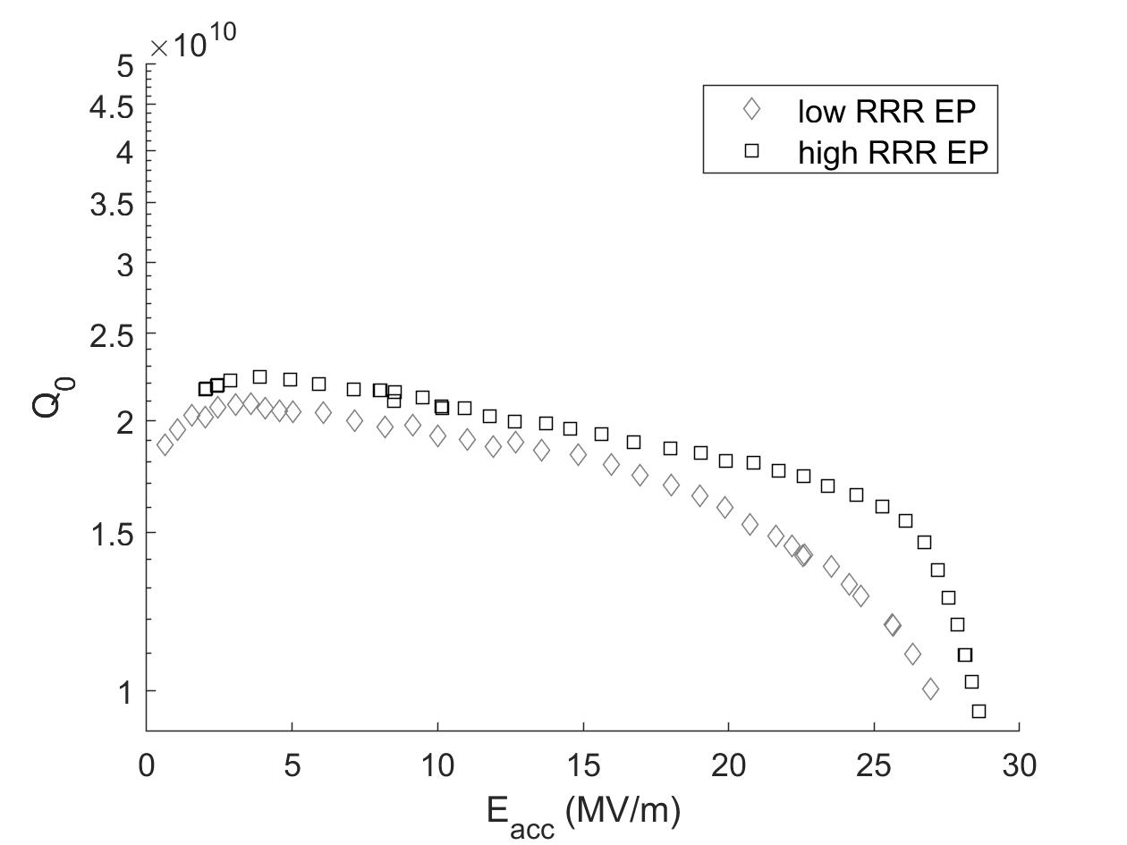
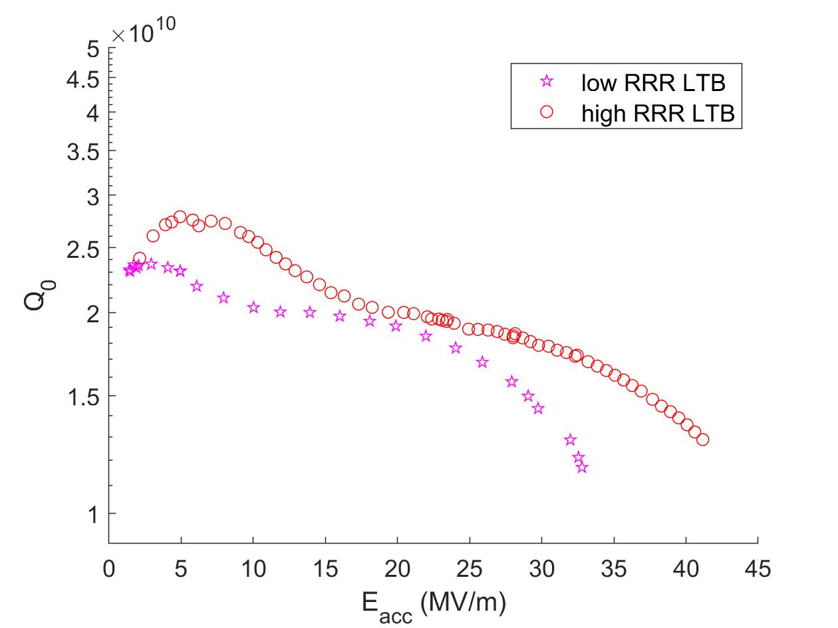
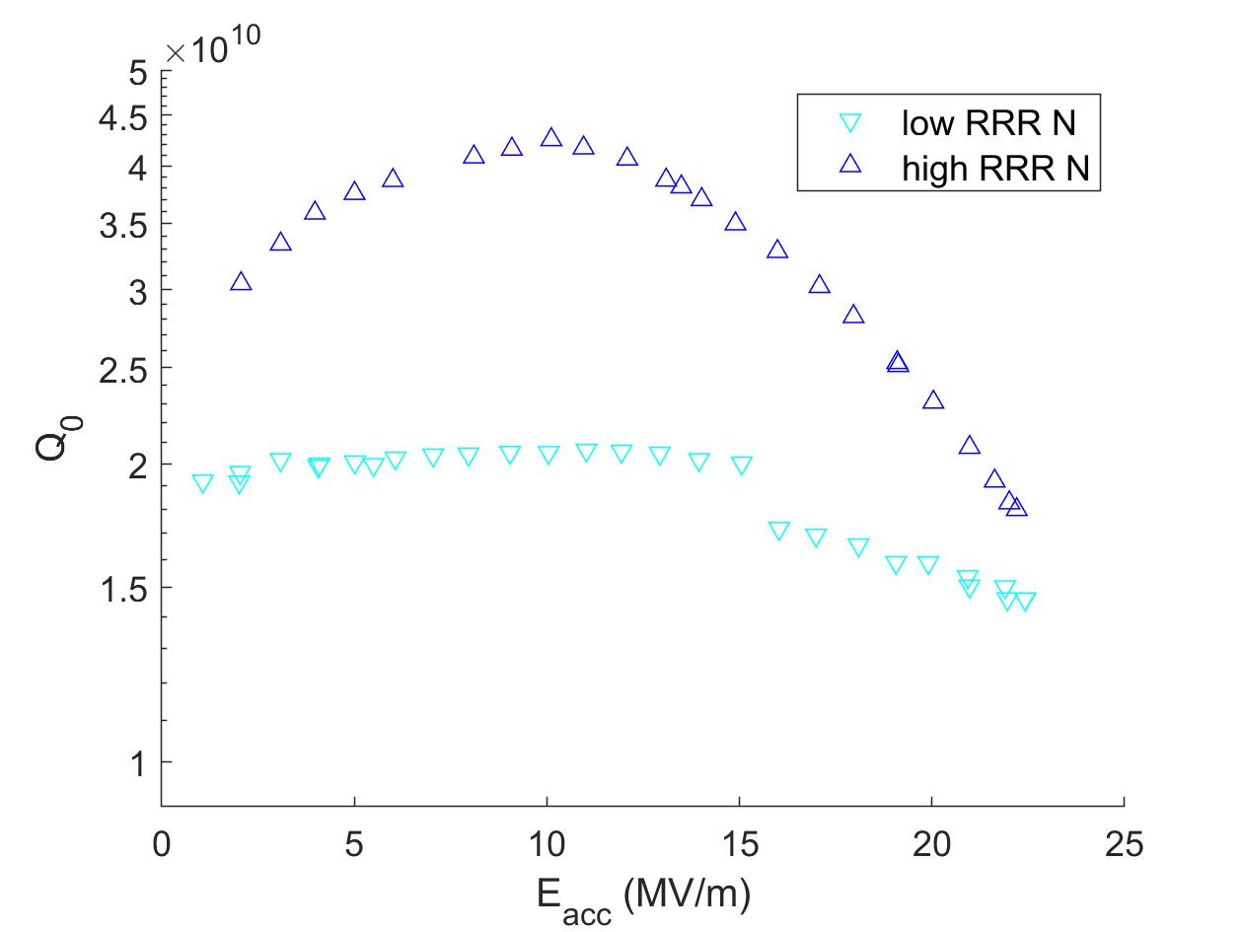
Quality Factor vs Accelerating Gradient at 2 K
Electropolished
Low RRR has slightly lower Q₀ and reaches lower gradient
Q₀ slope begins sooner but less sharp
Low Temperature Bake
Low RRR experiences reduced response to LTB treatment
N-doped
Low RRR has significantly lower Q₀ at low and mid gradients
Experienced multipacting quenches above 16 MV/m

Slide 5
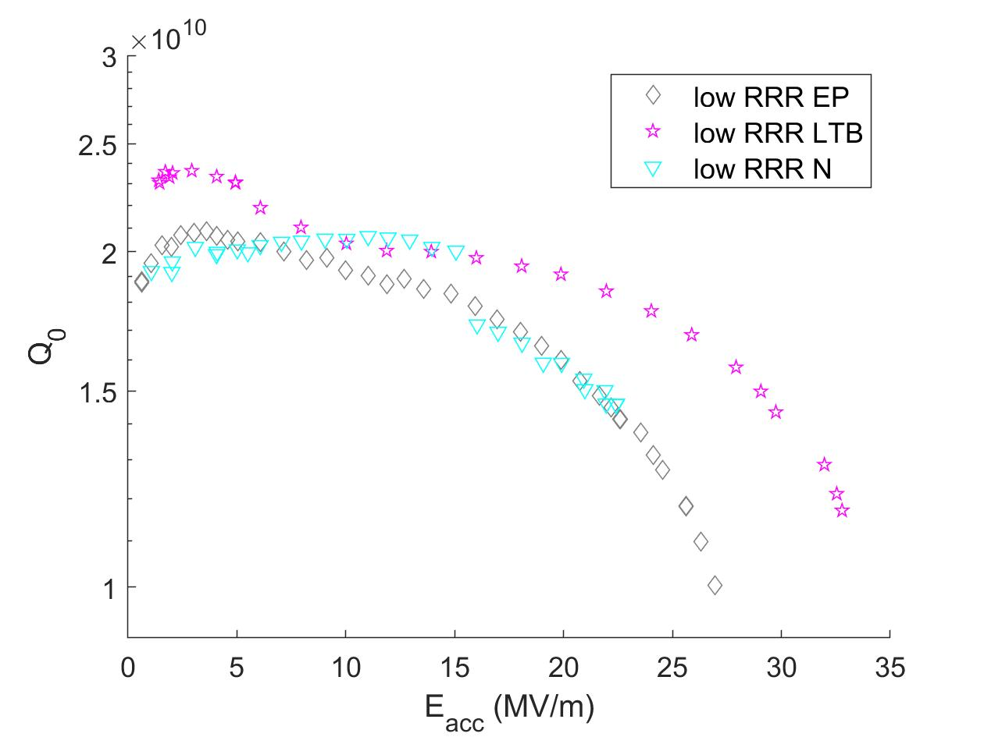
Quality Factor vs Accelerating Gradient at 2 K
Performance of all cavities is similar at medium gradients
LTB delays Q₀ slope and reaches highest Q₀ and gradient
Low RRR does not experience strong anti-Q₀ slope
N-doping reaches lowest gradient

Slide 6
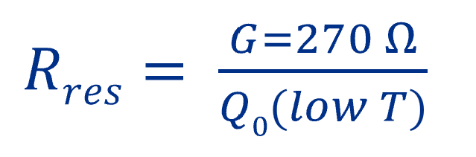
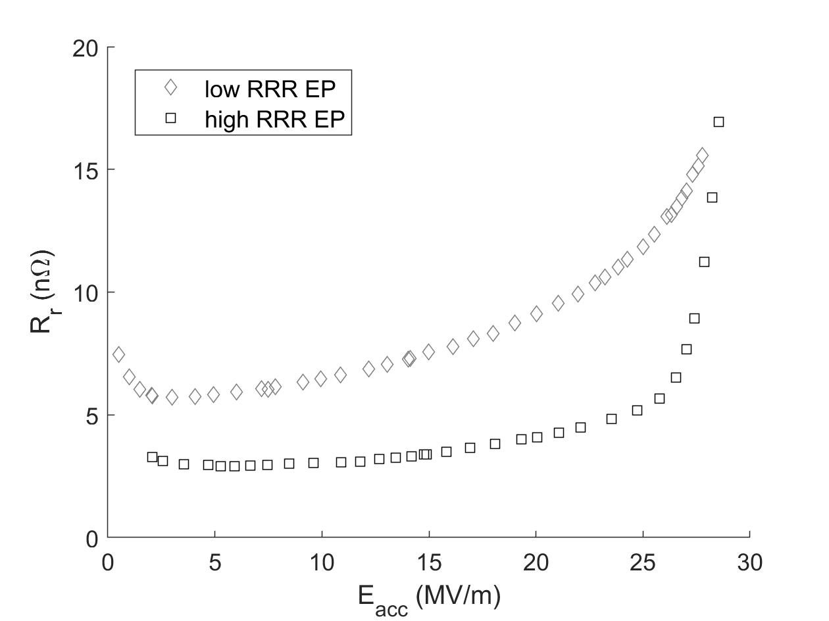
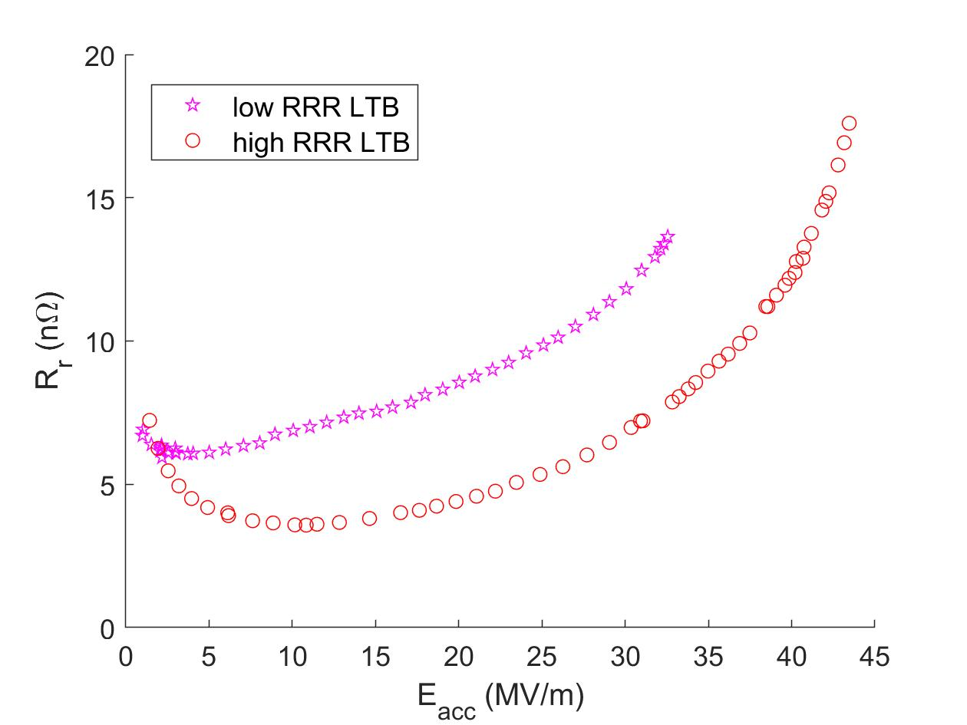
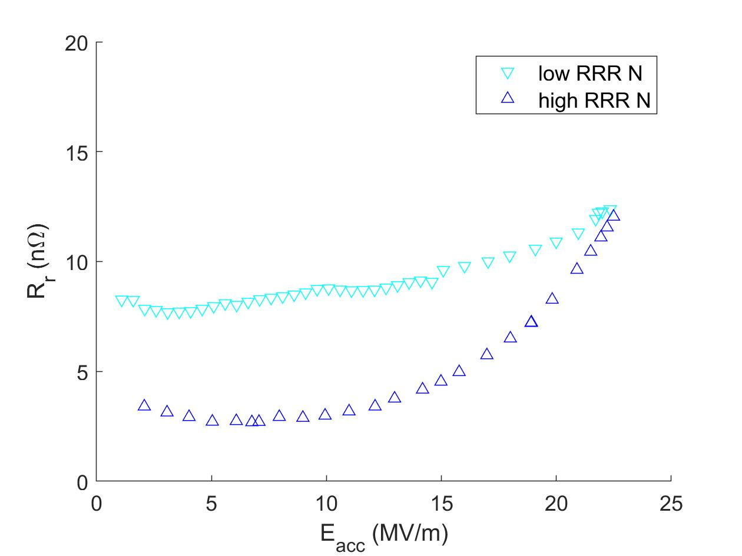
Residual Resistance vs Accelerating Gradient
Electropolished
Low RRR R_{r} larger at low and mid fields
Low Temperature Bake
Low RRR R_{r} larger at mid and high fields
N-doped
Low RRR R_{r} larger at low and mid fields
Low RRR more constant with gradient

Slide 7
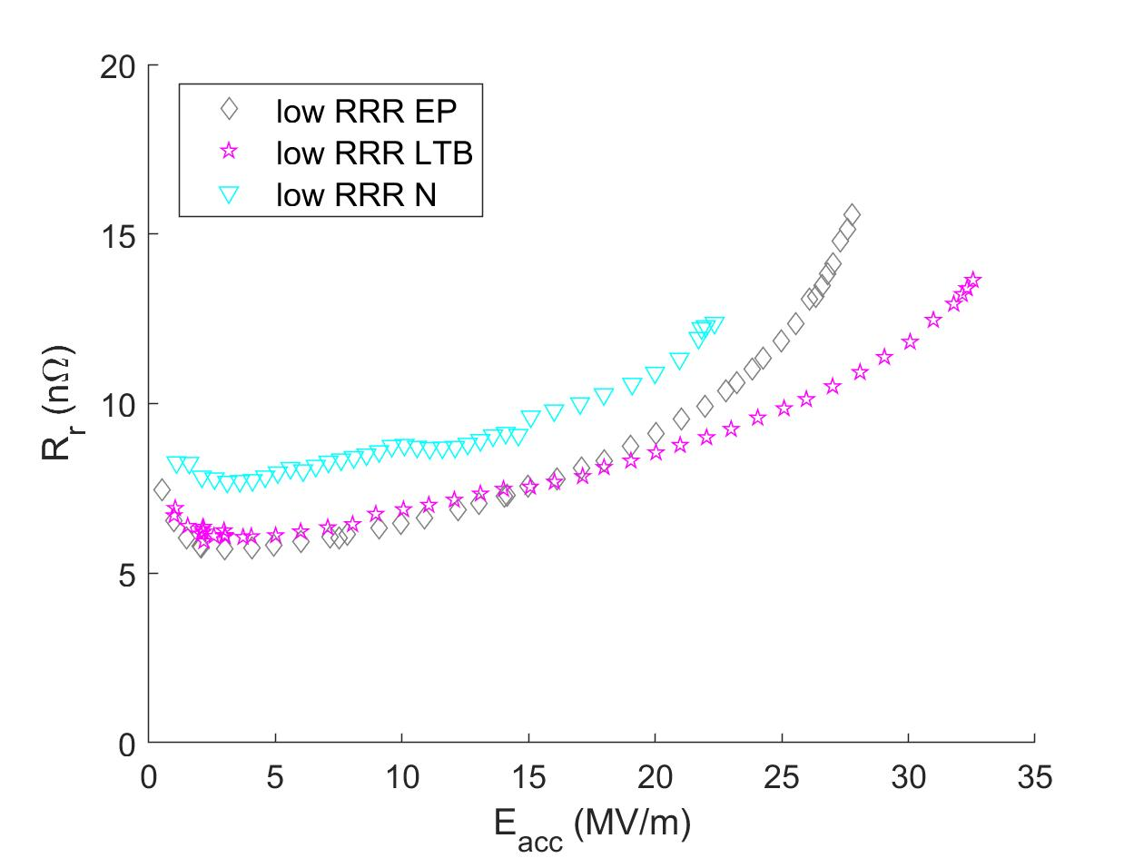
Residual Resistance vs Accelerating Gradient
Low RRR EP and LTB R_{r} equal at low and mid fields
N-doped R_{r} always slightly larger than EP and LTB
LTB treatment enables smallest increase with gradient

Slide 8

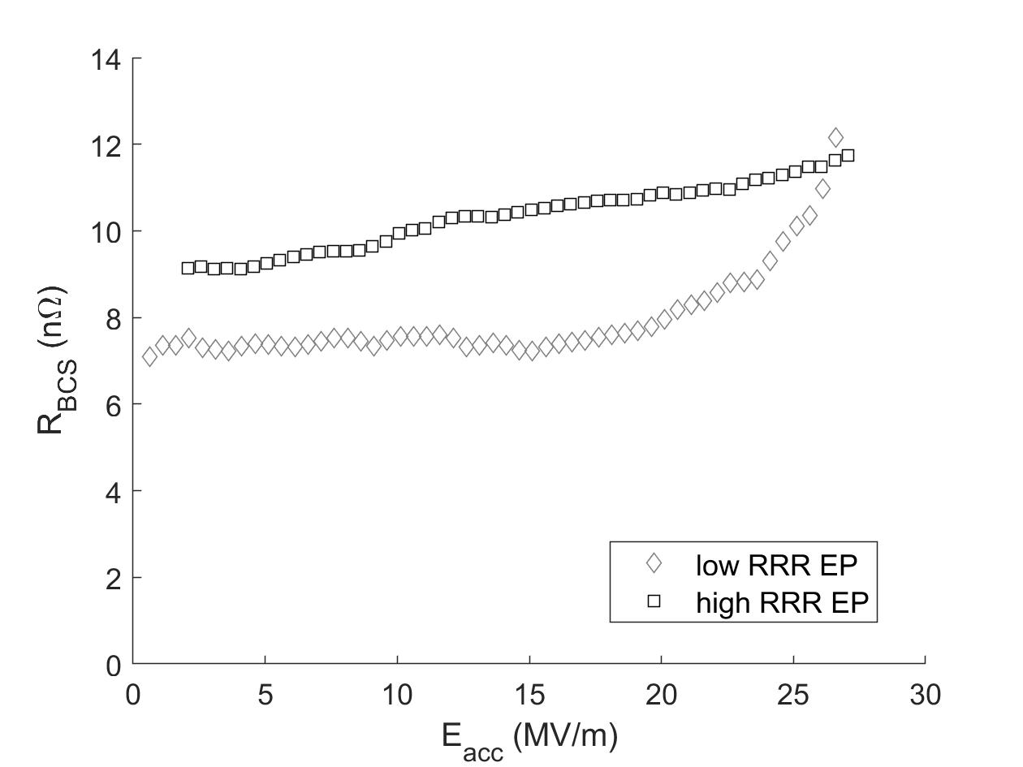
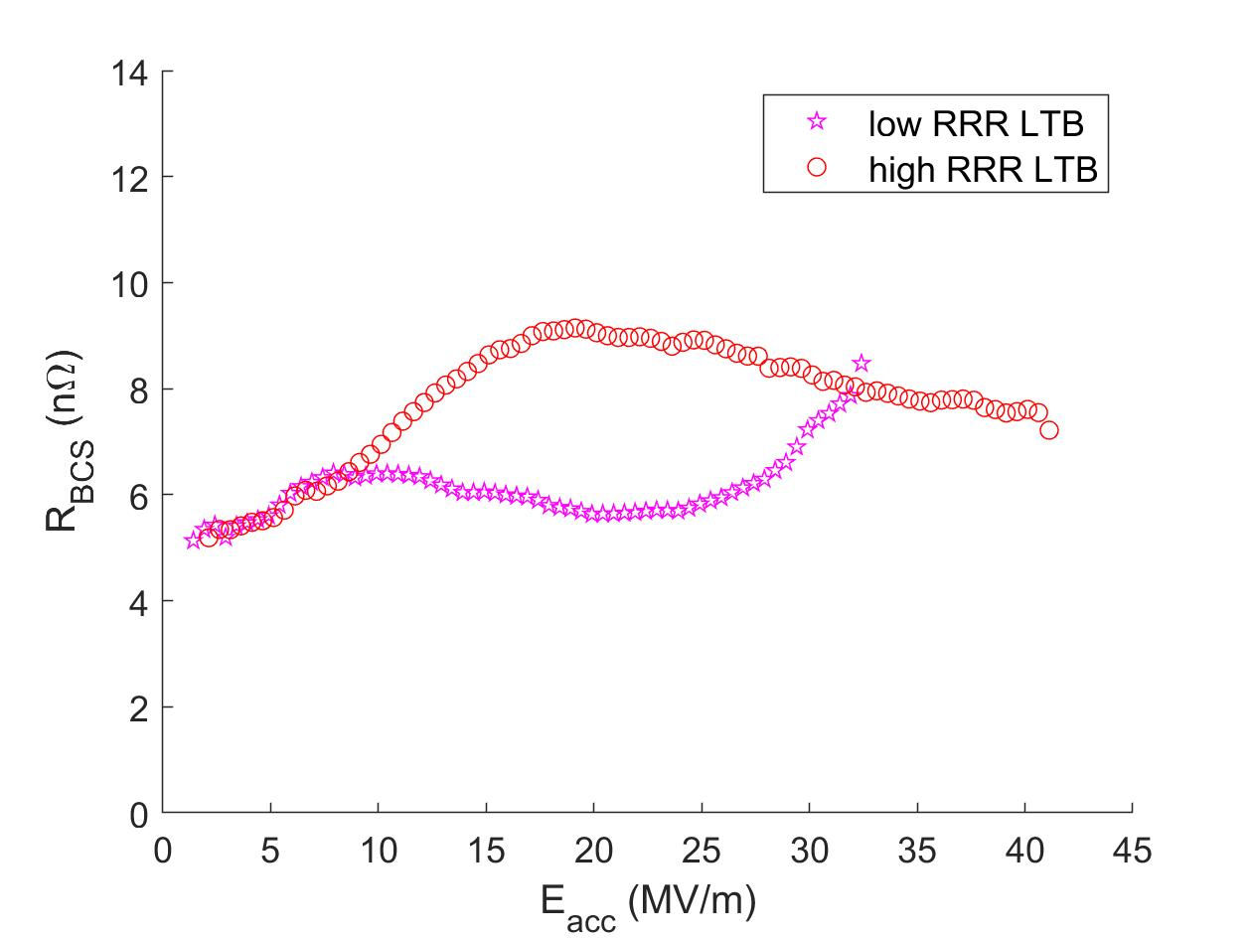
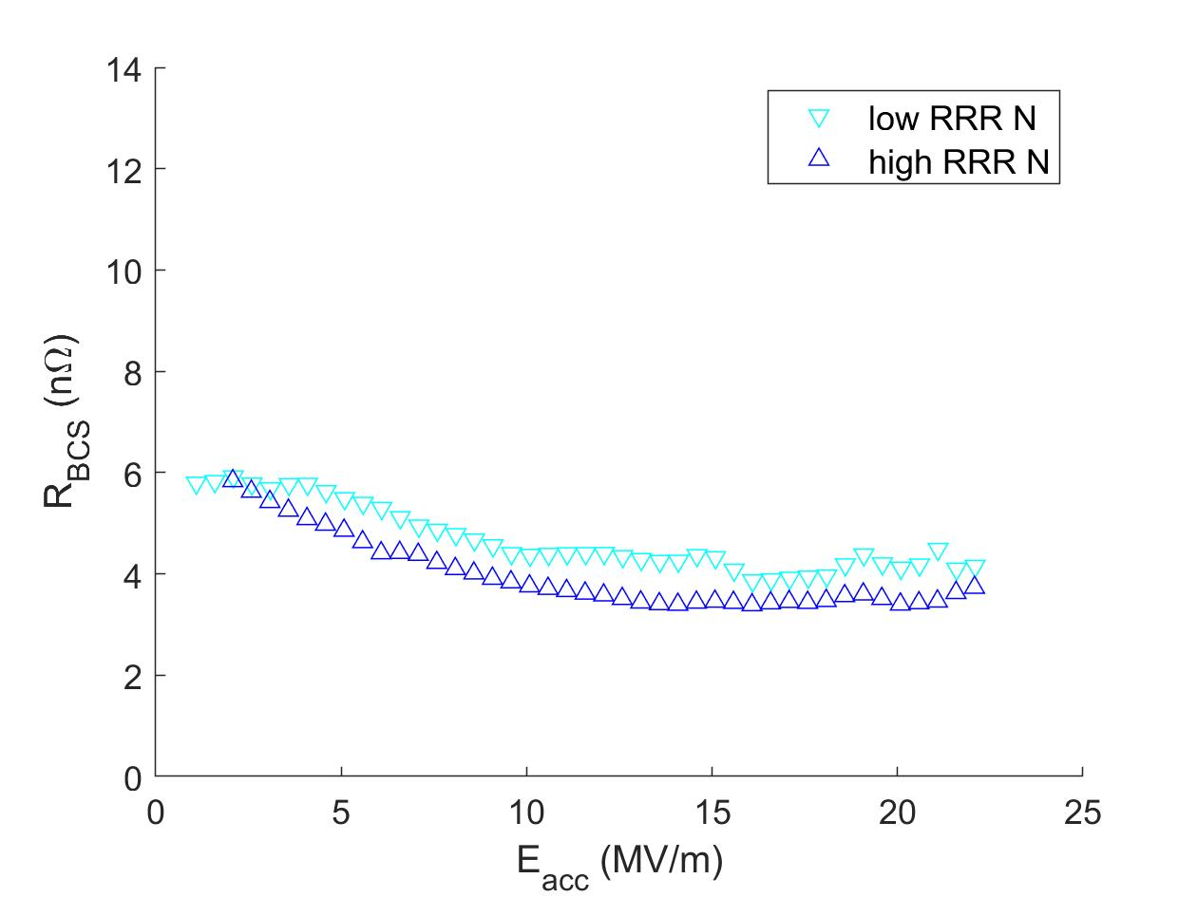
BCS Resistance vs Accelerating Gradient
Electropolished
Low RRR R_{BCS} is lower at low and mid fields
Low Temperature Bake
Low RRR R_{BCS} is lower at mid fields
N-doped
Similar R_{BCS} behavior
Decreasing with gradient suggests anti-Q₀ slope

Slide 9
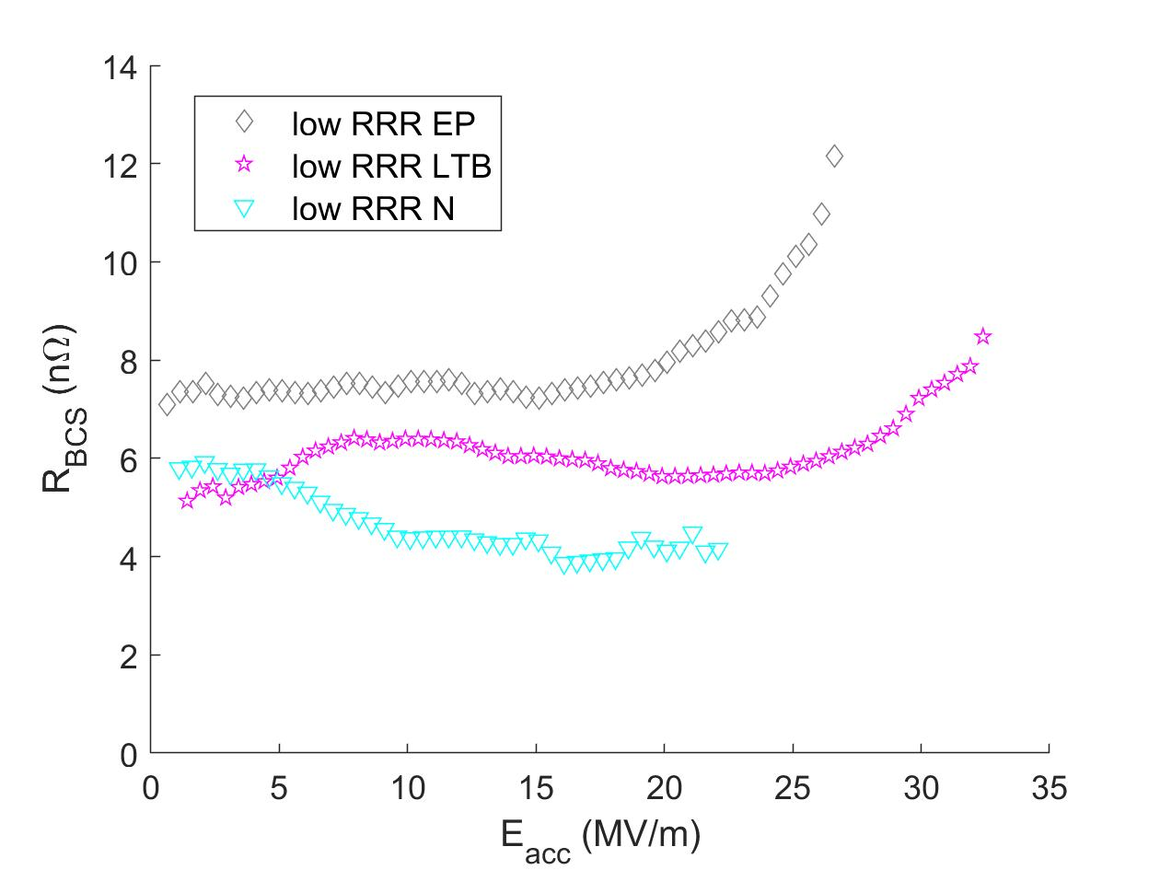
BCS Resistance vs Accelerating Gradient
Low RRR exhibits low BCS behavior
Low RRR R_{BCS} is lowest at mid field
Any benefit of dirty surface is lost at high field in EP and LTB
N-doped has lower R_{BCS} than EP and LTB

Slide 10
Summary
Low RRR shows:
  Consistently high residual resistance
  Low BCS resistance, especially at mid gradient
  Combined effects of intrinsic and extrinsic impurities
Low RRR in EP and LTB conditions behave differently than high RRR
  Intrinsic impurities do have significant impact on RF behavior
  Combination of oxygen and intrinsic impurities enables higher quality factor and accelerating gradients
N-doping is robust in producing similar BCS resistance in different purity SRF cavities
  Low RRR N-doped appears very sensitive to trapped flux

Slide 11
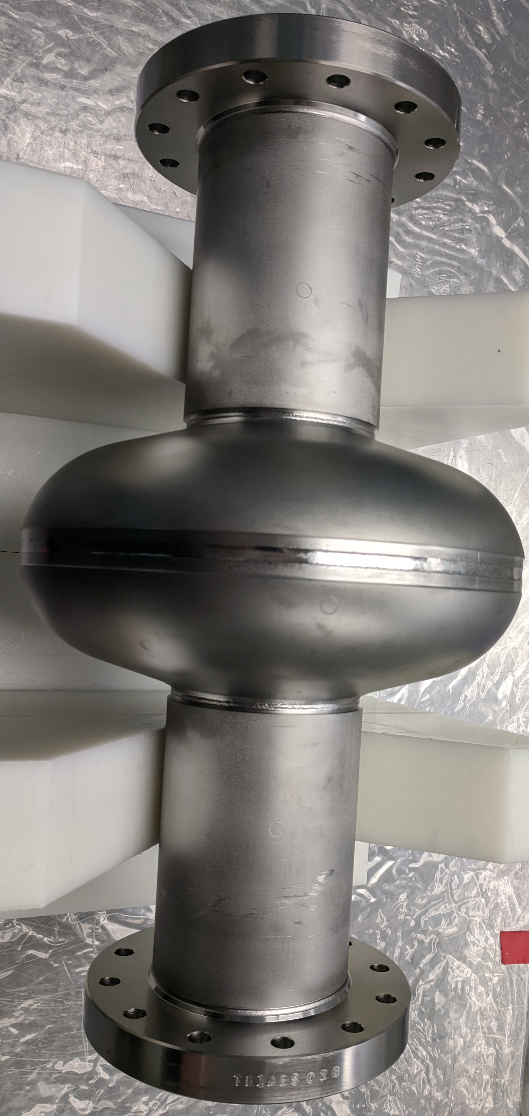
Next Steps
Small EP (2 μm) on N-doped cavity to investigate underdoped behavior
Sample study on low RRR material in EP, LTB, and N-doped conditions
  Secondary-ion mass spectrometry to observe impurity profile
  Microscopy to characterize surface

Slide 12
Discussion Topics
How was RRR and impurity concentration determined when the sheet metal was made?
  Cell material from Tokyo Denkai (Ta Wt % .0193, RRR = 61) and beam tube material from Wah Chang (Ta % .1)
How might oxygen behave differently in a Nb lattice with more impurities?
How can intrinsic impurities affect the sensitivity to trapped flux?
Why is BCS resistance for N-doped low RRR not lower than high RRR, as observed in EP and LTB tests?
This manuscript has been authored by Fermi Research Alliance, LLC under Contract No. DE-AC02-07CH11359 with the U.S. Department of Energy, Office of Science, Office of High Energy Physics. This work was supported by the University of Chicago.

Slide 13
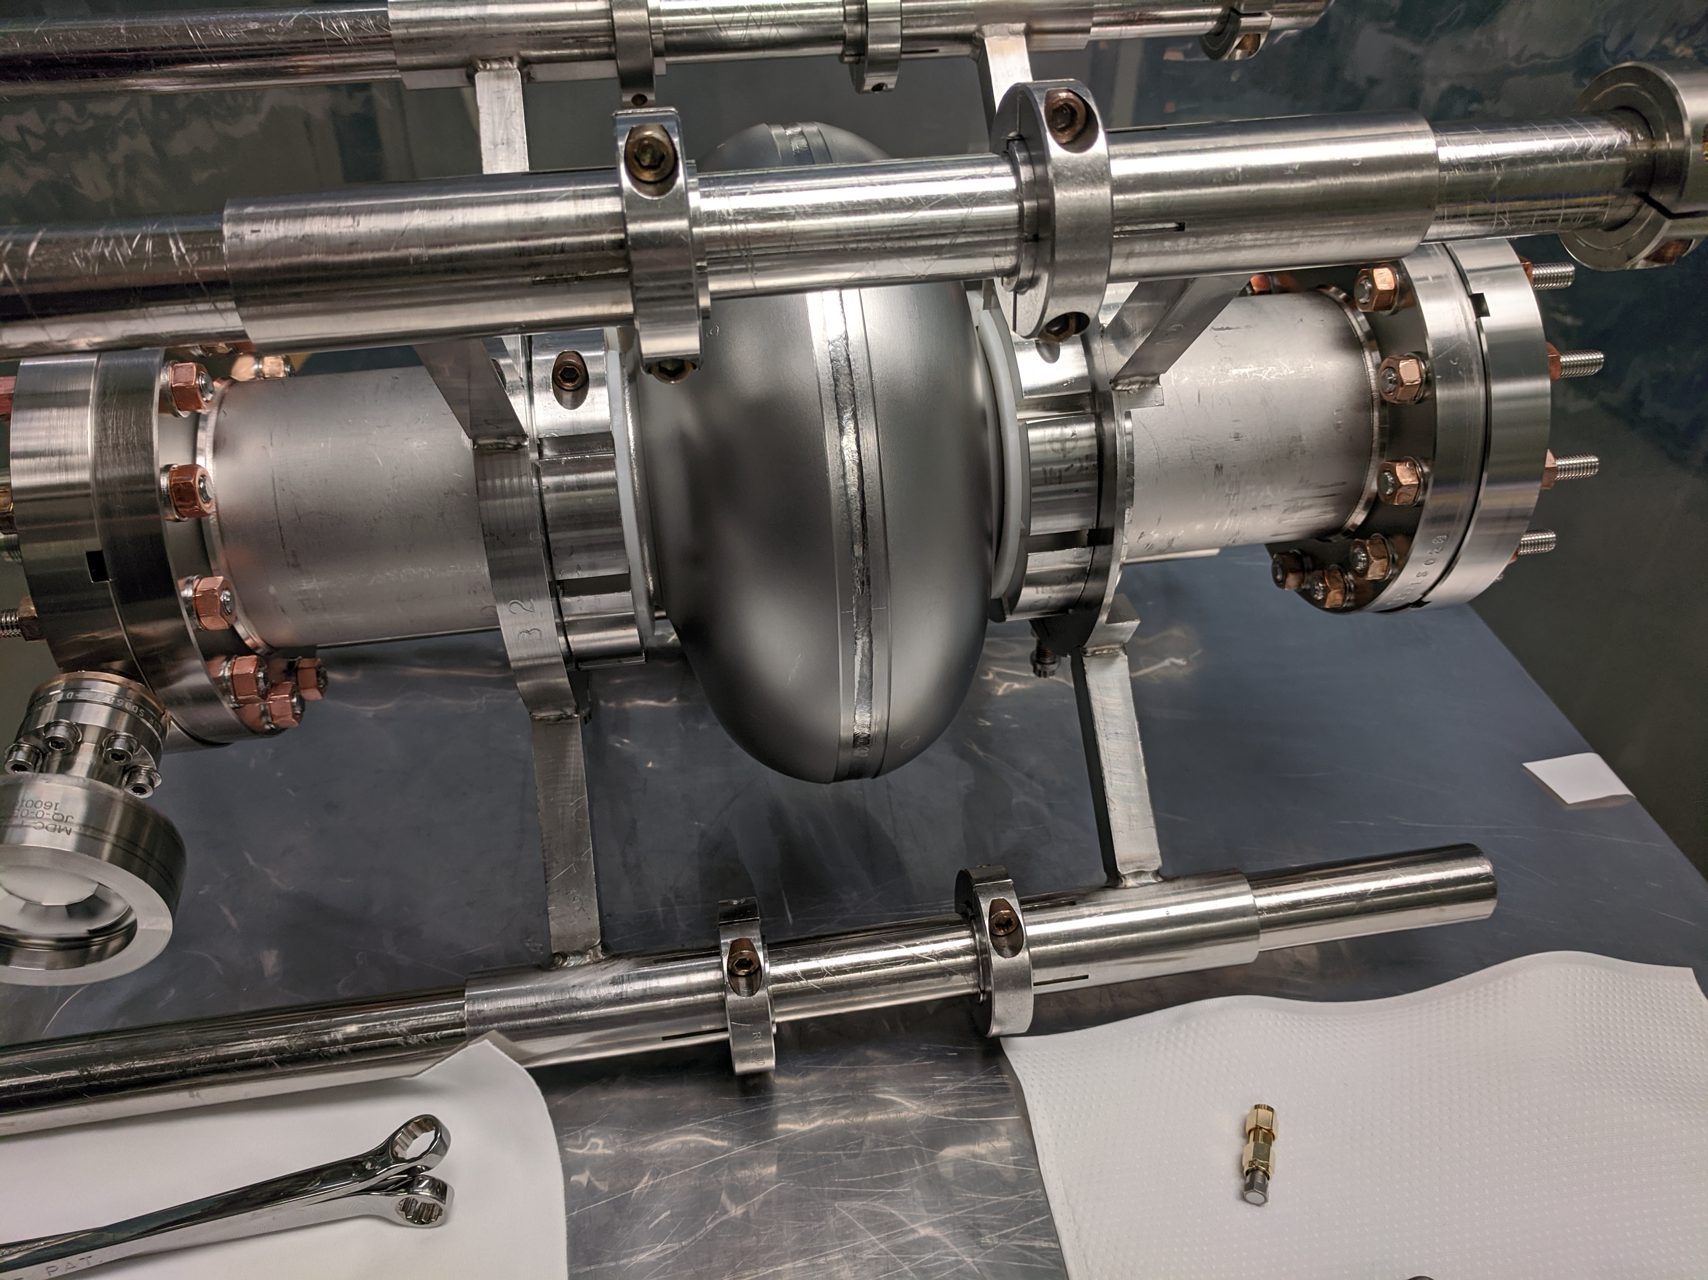
Extra Slides

Slide 14
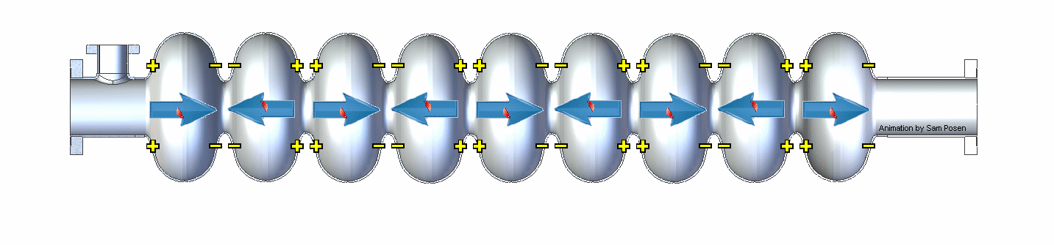
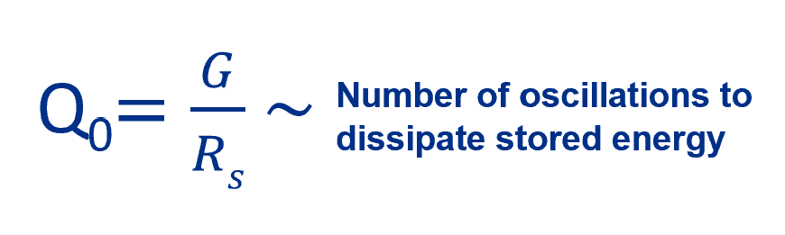
Introduction to Superconducting Radio Frequency (SRF) Cavities
SRF cavities are resonant structures made from high purity niobium that generate the accelerating electric field along the beamline inside particle accelerators
Purity measured by residual resistance ratio (RRR)
Cavity performance determined by first ~100 nm of material
Goals of SRF studies is to design surface profile to increase:
  quality factor (efficiency)
  accelerating gradient
1.3 GHz

Slide 15
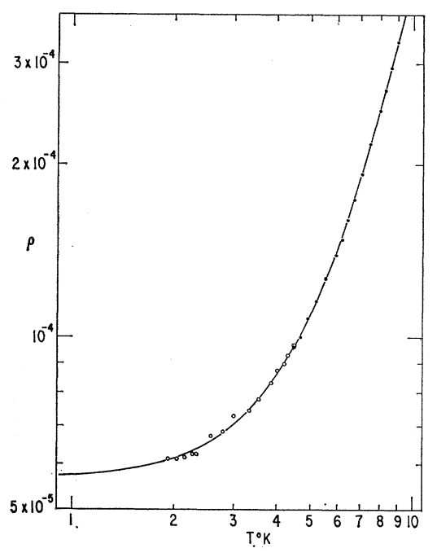
Measurement of Purity of Niobium = RRR
Residual resistance ratio (RRR) is the ratio between DC (not RF) resistivity of material at room temperature to its residual value at low temperature
RRR and mean free path have a direct relationship
  High mfp → high RRR
  Low mfp → low RRR
Theoretical limit of Nb = 35,000
  high RRR for SRF is ~300
RRR is lowered by impurities in the Nb
  grain boundaries
  elements: Ta, N, O, C, H, Zr, etc.
Nb sample with RRR = 16,500
Resistivity versus temperature
G. W. Webb 1969

Slide 16
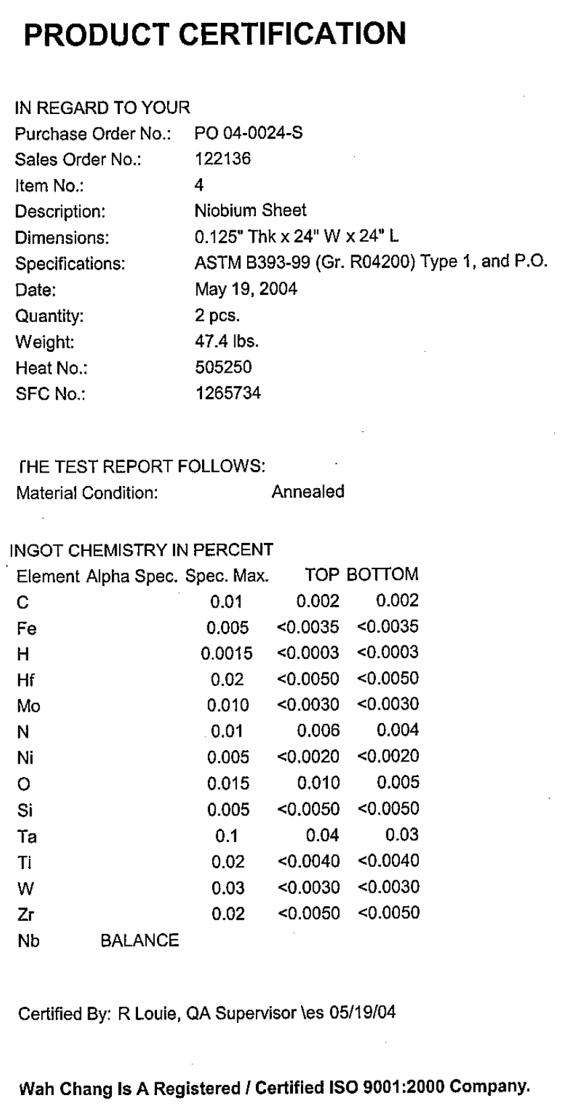
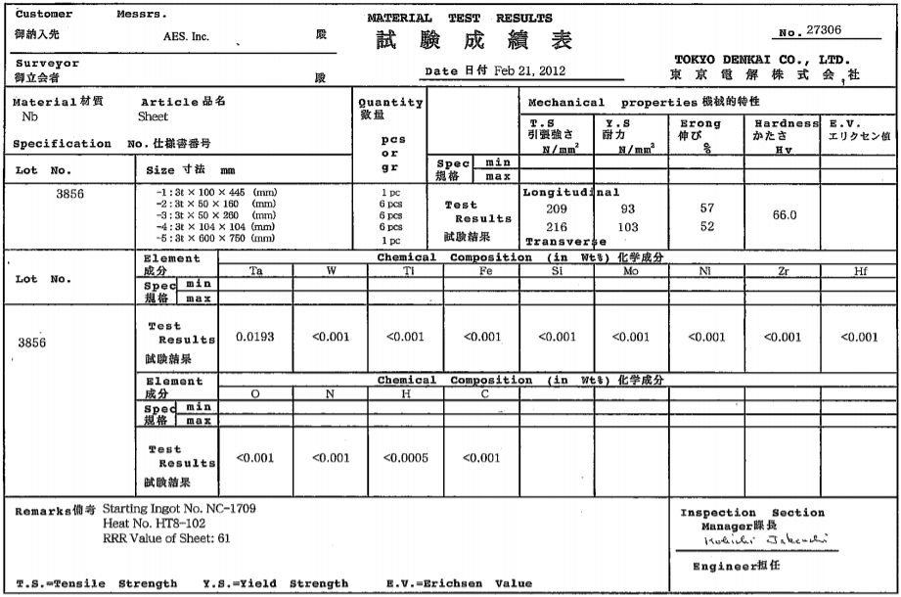
Cavity Material Details
Beam tube material
Cell material

Slide 17
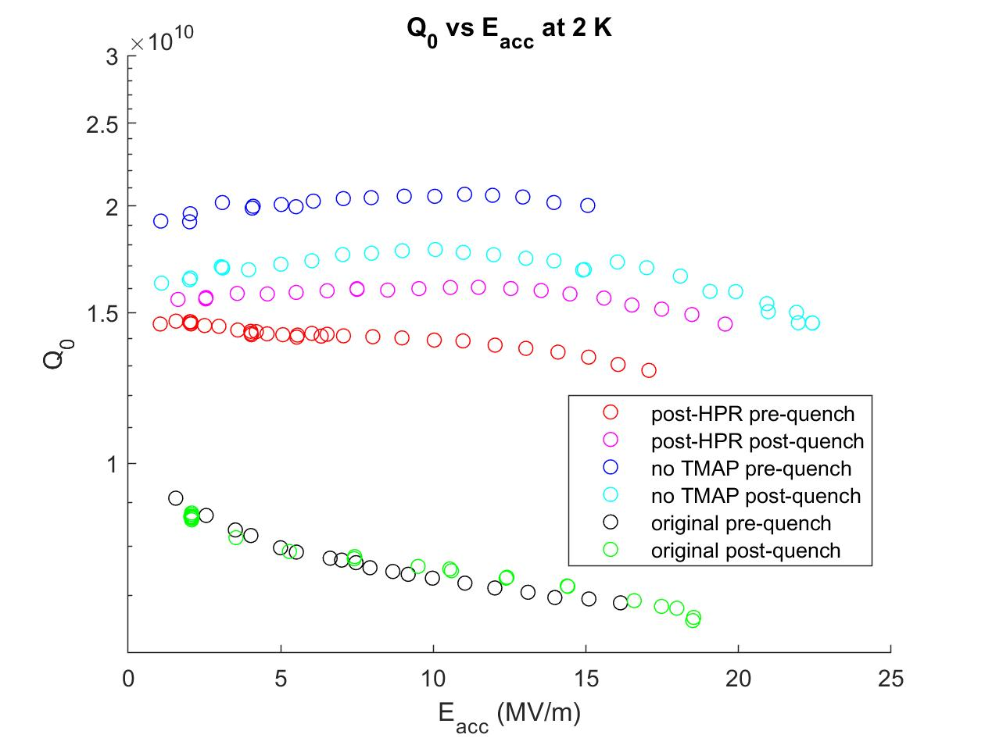
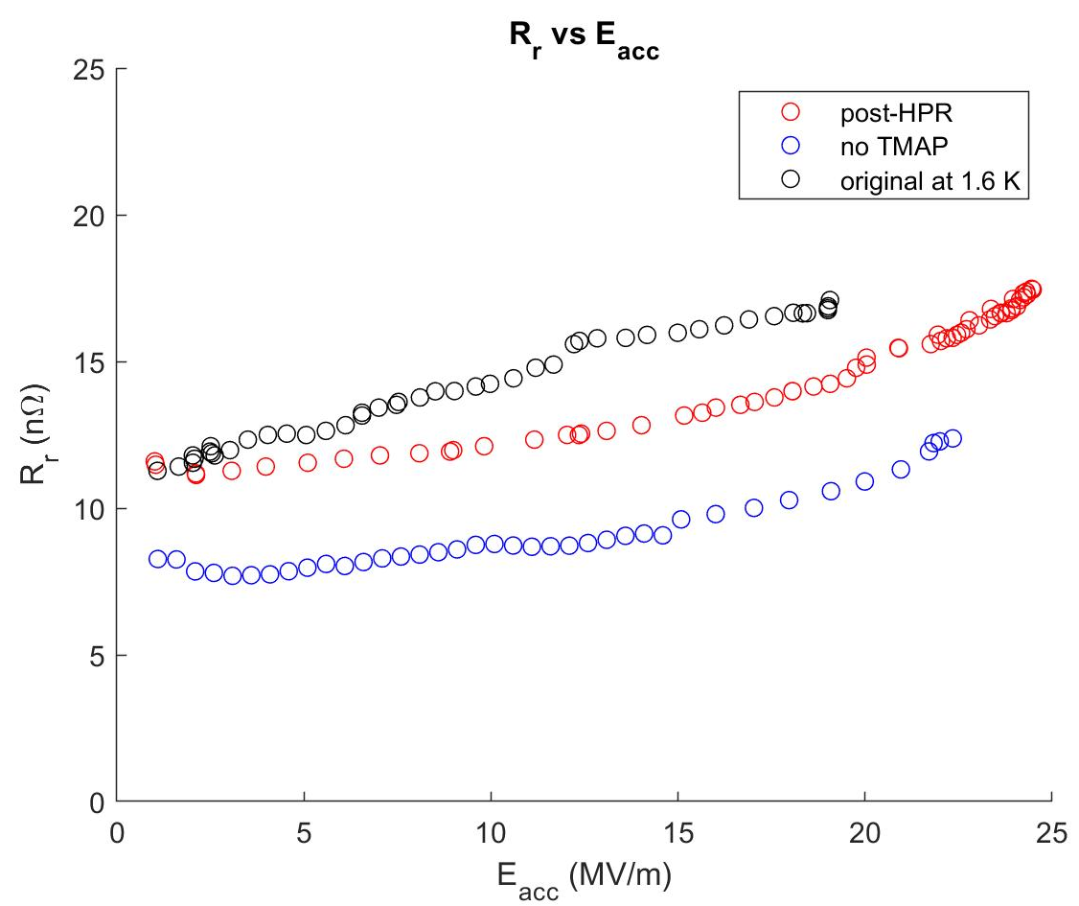
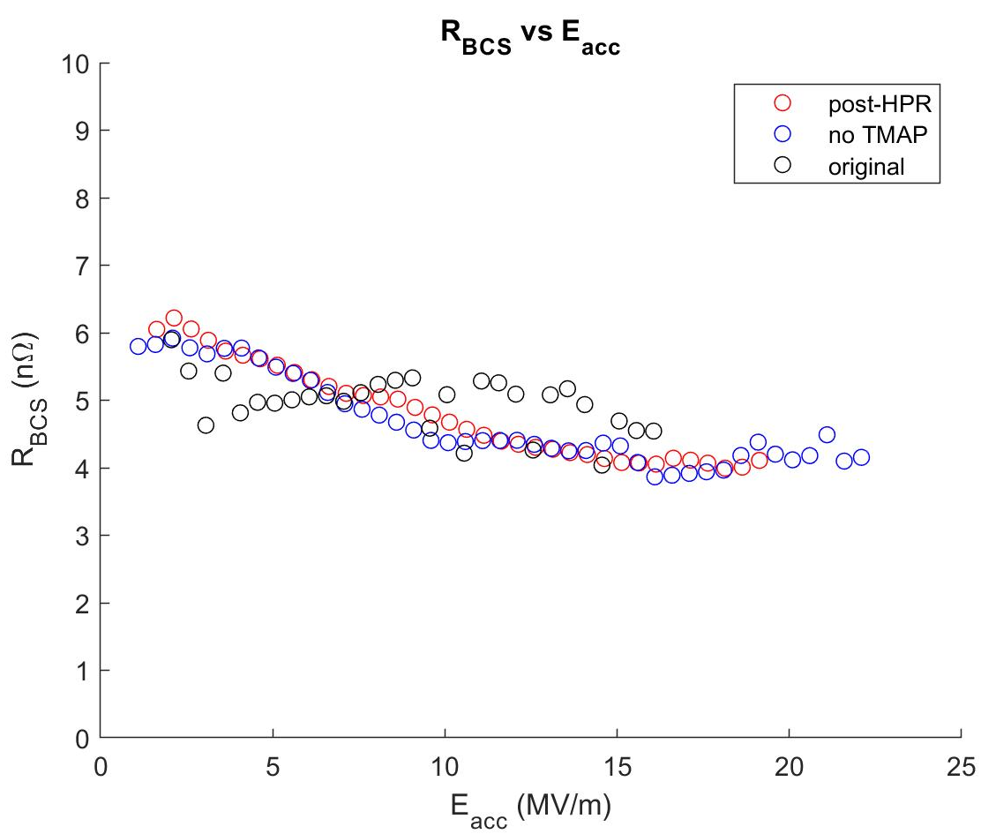
N-doped Tests
Original test with flux peak is outlier
Notice increase in Q after quench in post-HPR test → still having flux issues?
Very large residual resistance
Most trapped flux in original test
Distinct offset between last 2 tests
Same BCS resistance in all tests suggests this is a flux issue!

Slide 18
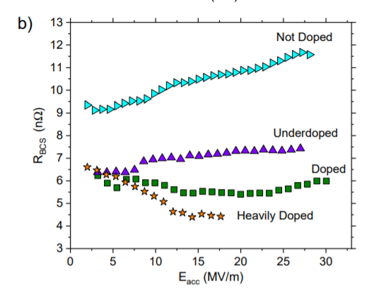
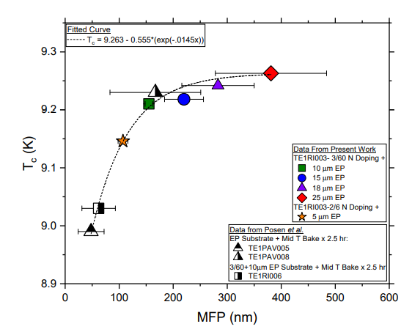
Effect of Doping Severity
N-doping severity effect on BCS resistance
Daniel Bafia’s Thesis Fig 6.7b
N-doping severity effect on mfp and Tc
Daniel Bafia’s Thesis Fig. 6.6

