Slide 1
Conduction-cooled SRF accelerator development for industrial applications at Fermilab
Jayakar ‘Charles’ Thangaraj on behalf of IARC@Fermilab
FERMILAB-SLIDES-22-194-DI

Slide 2
Motivation: Taking SRF accelerator outside the “lab”
SRF for
basic science
SRF for
industry & society
SRF relevant Industrial applications of particle accelerators? (Market pull)
How to make SRF suitable for industrial settings? (Technology push: This talk)
Courtesy: R.Dhuley, FNAL
10/13/2022

Slide 3
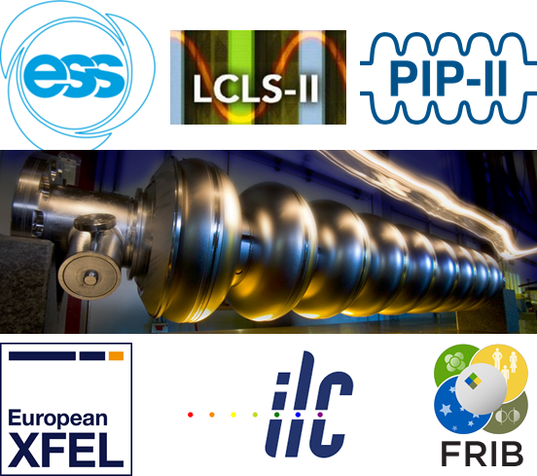
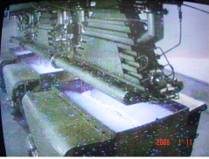
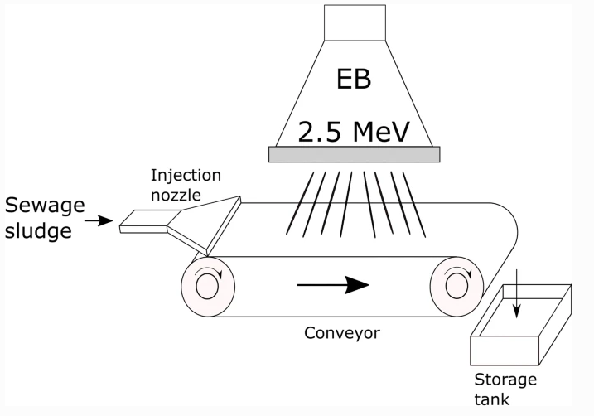
SRF accelerators – applications landscape
Current usage dominated by basic research needs: colliders, FELs, proton and neutron sources
Potential industrial applications: e-beam radiation treatment of flue gases, municipal/industrial wastewater, sewage
https://doi.org/10.1016/j.radphyschem.2012.01.030
Photo: A. Chmielewski/Institute of Nuclear Chemistry and Technology
https://link.springer.com/article/10.1007/s11356-020-10643-0
Notes:
https://www.iaea.org/newscenter/news/scientific-forum-2015-electron-beams-help-polands-coal-driven-power-industry-clean-up-its-air
1 MeV, 400 kW, or treating 10,000 m³ of textile dyeing wastewater per day from Daegu Dyeing Industrial Complex

Slide 4
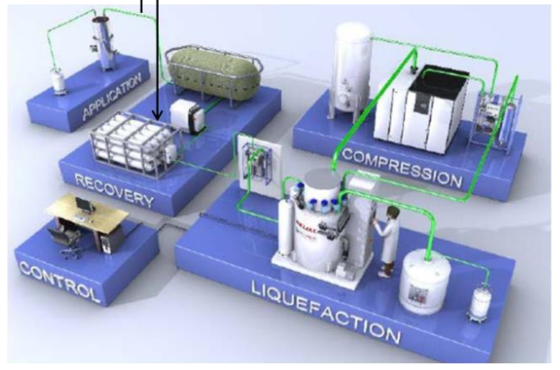
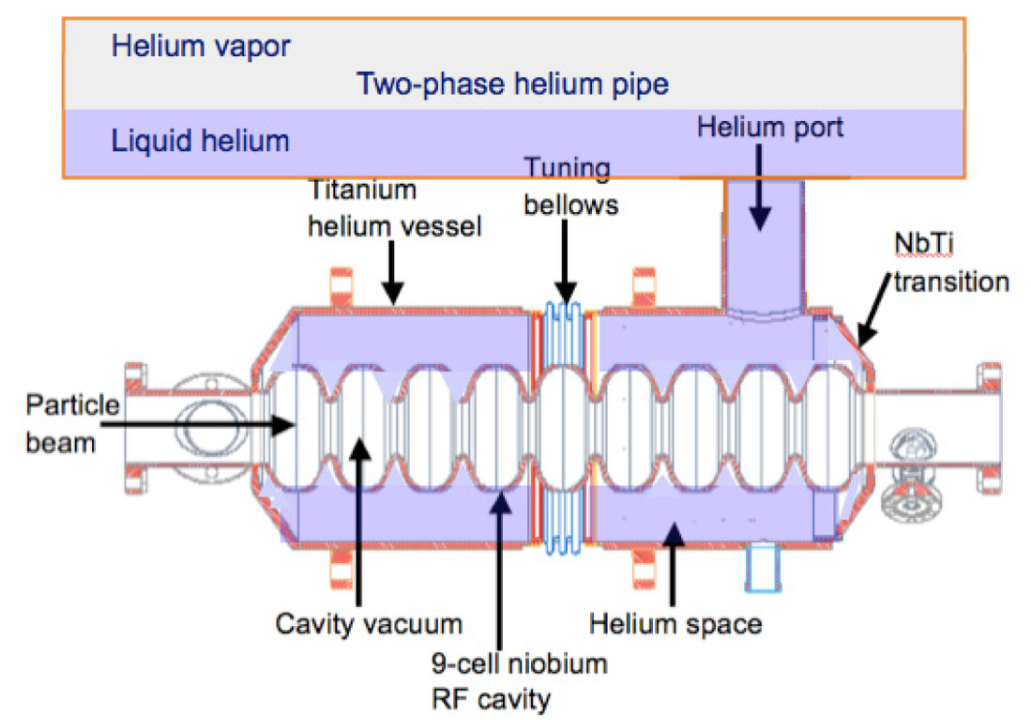
Constraints: Industrial applications and scope of SRF accelerators
1-meter long SRF linac (niobium or Nb₃Sn cavities)
operating at 10 MV/m can provide the required energy
Electron beam radiation processing applications
Water/sludge/medical waste
decontamination
Flue gas cleanup
Medical device sterilization
Strengthening of asphalt pavements
Radiation processing requires:
Beam energy: 0.5-10 MeV
Beam power: >>100 kW
Industrial settings demand:
Low capital and operating expense
Robust, reliable, turnkey operation
Small SRF surface resistance enables continuous wave (cw)
operation, leading to high average beam power
At present, SRF accelerators are designed to operate with complex liquid helium cryogenic systems!
http://accelconf.web.cern.ch/AccelConf/napac2016/talks/thb3io02_talk.pdf

Slide 5
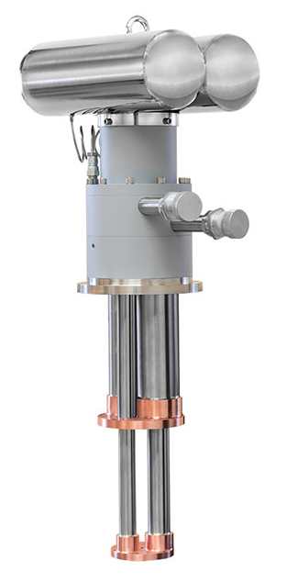
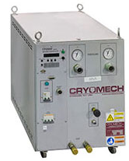
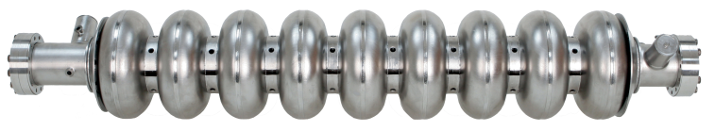

Simplifying SRF cryogenics for industrial settings
Remove cavity dissipation with thermal conduction (“conduction cooling”)
(conventional liquid helium bath not required)
Courtesy: Cryomech
Solid metallic heat conductor
2 feet
Liquid helium plant
Cryocoolers offer
Closed cycle cooling at ~45 K and ~4 K
Compact, small footprint
Reliability (MTBM > 2 years non-stop operation)
Turnkey operation (no trained operator needed,
turn ON/OFF with push of a button)
Compressor
Cryocooler
Absence of cryogenic liquids
Compact, simplified construction
No pressure vessel safety concerns
Facilitates deployment in remote locations

Slide 6
Modern Technology Breakthroughs:
Higher T_{c} superconductors: Nb₃Sn coated cavities dramatically lower cryogenic losses and allow higher operating temperatures ( e.g. 4 K vs 1.8 K)
Cryocooler Conduction Cooling: possible with low cavity losses➔ dramatically simplifies cryostats (no Liquid Helium !) using commercial cryocooler with higher capacity at 4 K enables turn-key cryogenic systems
New RF Power technology: injection-locked magnetrons allow phase/amplitude control at high efficiency and much lower cost per watt
Low RF loss coupler: Couplers that dissipate very low heat while transporting high power
Integrated electron guns: reduce accelerator complexity
Enable compact industrial SRF accelerators at a low cost

Slide 7
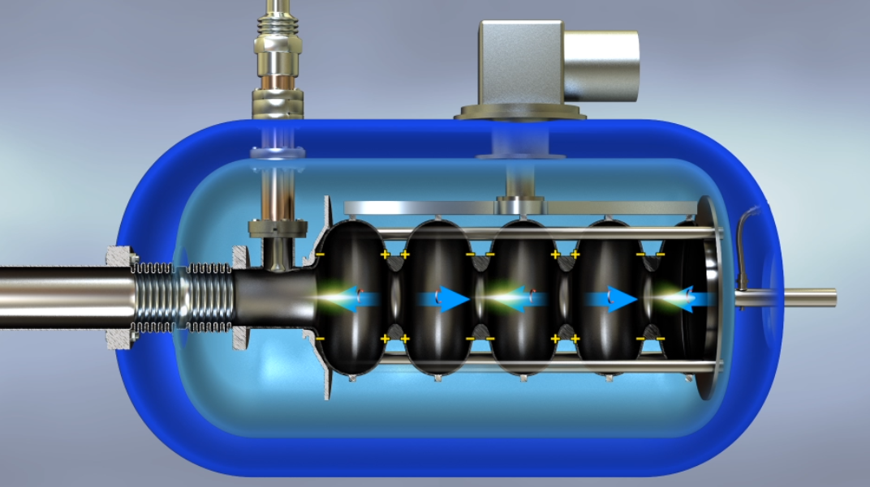
Fermilab’s vision for SRF industrial accelerators
R.D. Kephart, SRF2015. https://accelconf.web.cern.ch/srf2015/papers/frba03.pdf
Patents: US10390419B2, US10070509B2, US9642239B2
Vision: Develop compact, turnkey e-beam source for environmental and industrial applications (~10 MeV, >>100 kW)
Vacuum vessel
4 K cryocooler(s)
Conduction
link
Power
coupler
Beam
Gun
Nb₃Sn cavity (~10 MV/m cw)
~1 m
Thermal shield
Illustration: how it all fits in?

Slide 8
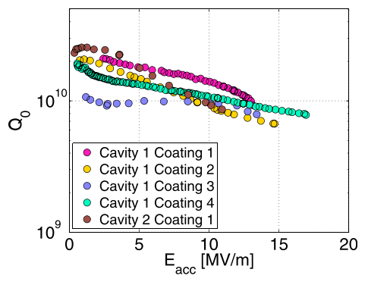
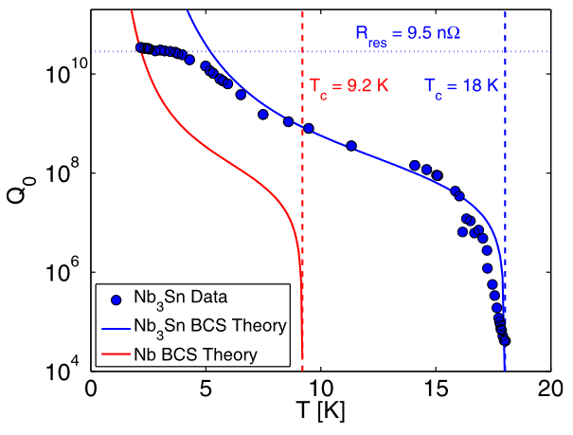
Nb₃Sn cavities dramatically changes the game
Nb₃Sn cavity with 10 MeV dissipates ~10 W @ ~4.5 K ( 1 m x 10 MV/m cw; 650 MHz/1.3 GHz)
Use commercial, off-the-shelf 4 K cryocoolers (helium plant not required)
Nb₃Sn coated Nb cavity at T ≈4.2 K
~1/R_{s}
S. Posen et al., Appl. Phys. Lett. 106, 082601 (2015)
S. Posen et al., Appl. Phys. Lett. 106, 082601 (2015)

Slide 9
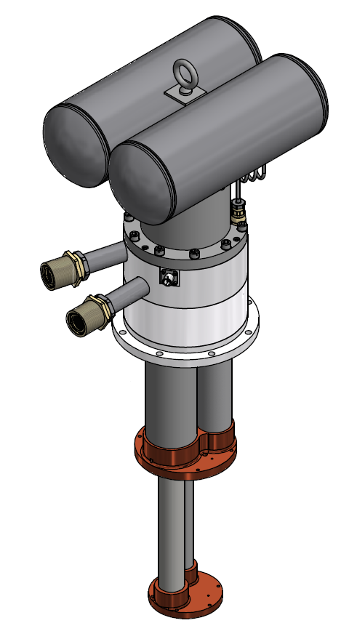
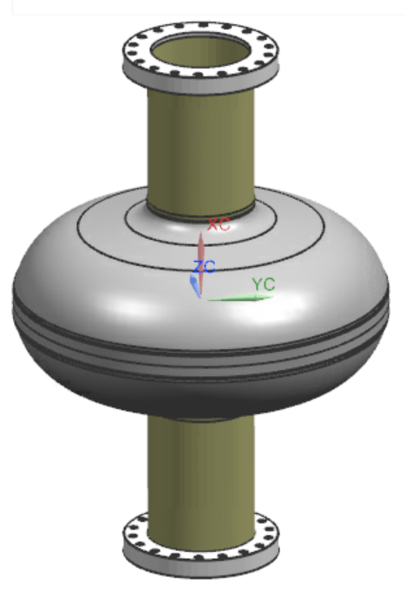
Conduction cooled Nb₃Sn SRF development
Goal: demonstrate 10 MV/m cw on an Nb₃Sn cavity with cryocooler conduction cooling
Cavity
Our choice:
Single cell 650 MHz, Nb₃Sn coated niobium cavity
Cryomech PT420 cryocooler
(2 W @ 4.2 K with 55 W @ 45 K)
High purity aluminum for the conduction cooling link
Courtesy: Cryomech
Cryocooler
Cooling
link

Slide 10
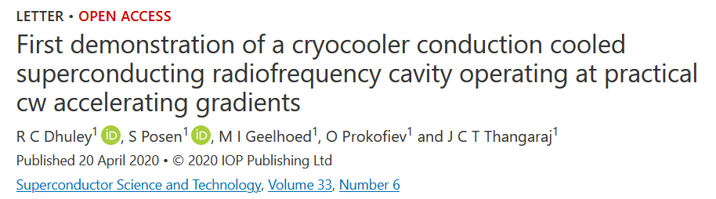
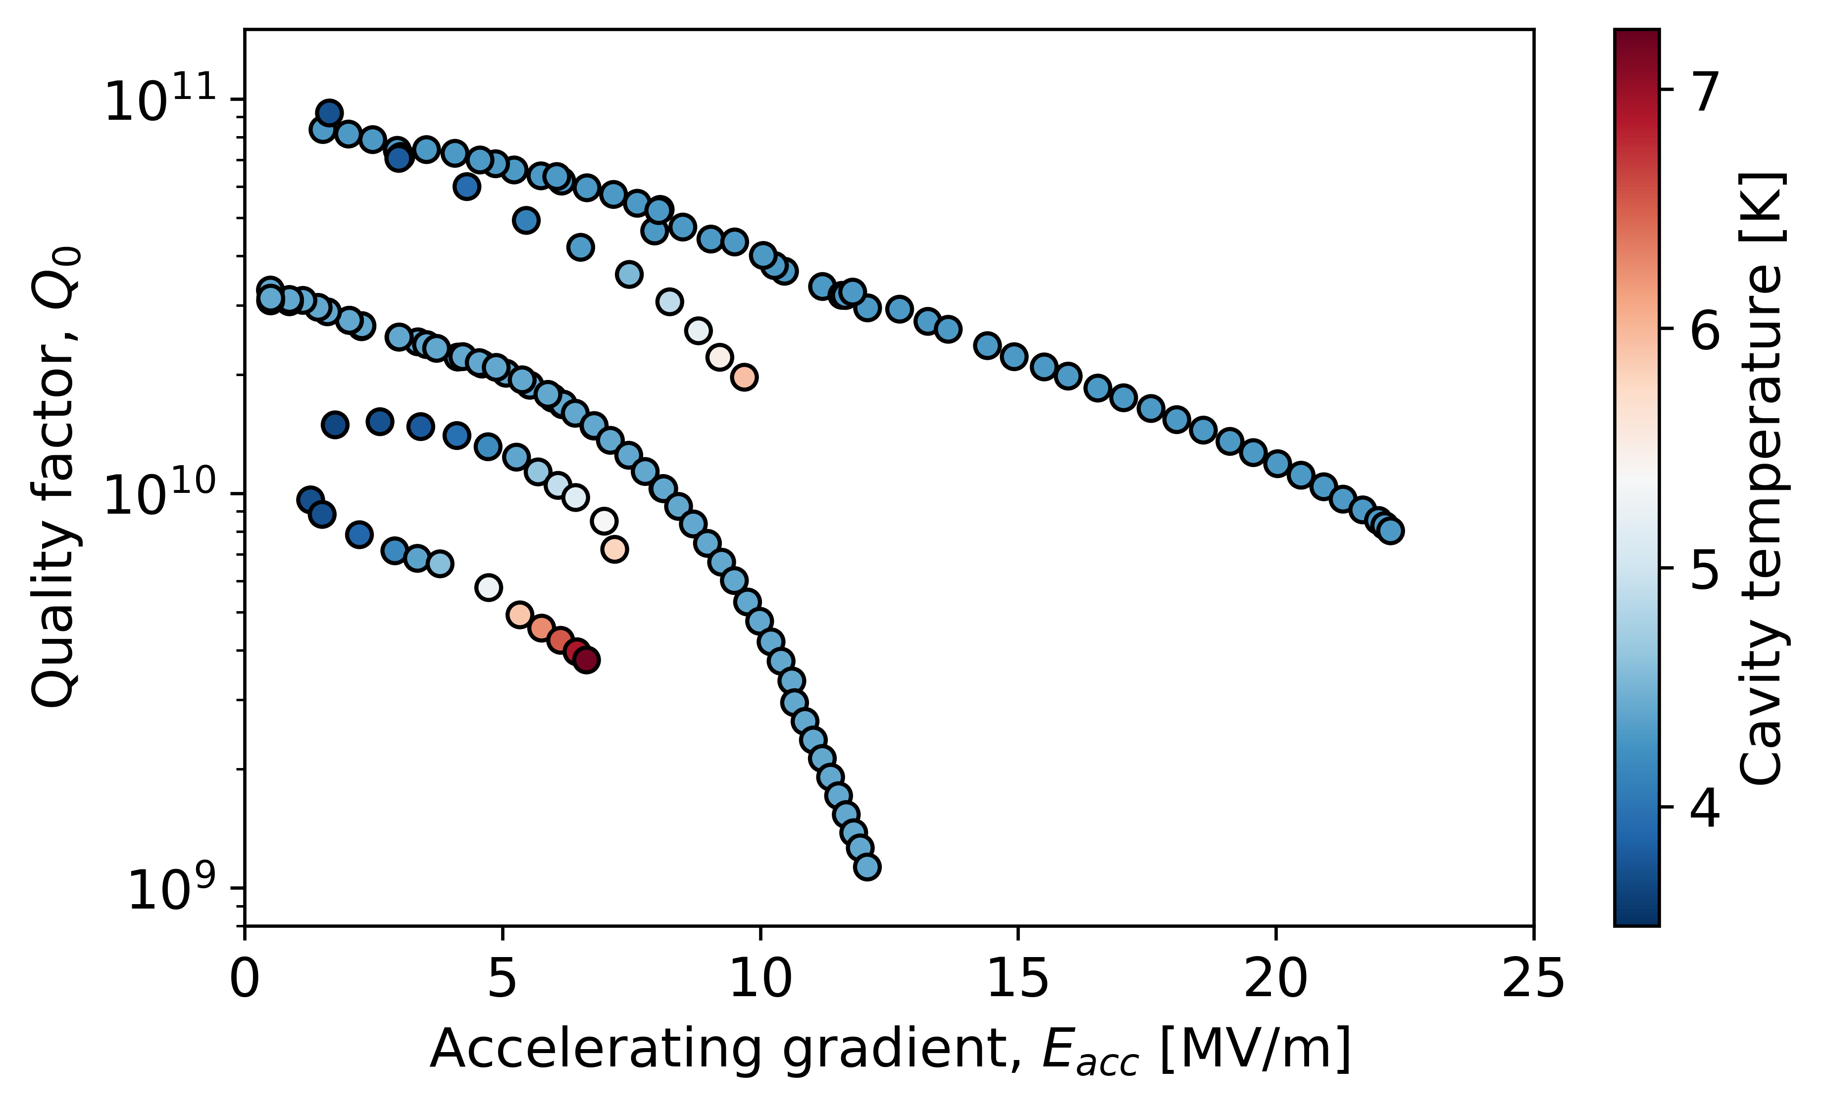
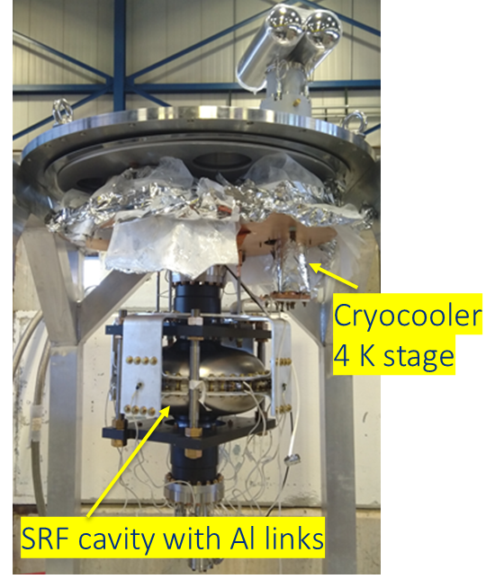
Results with 650 MHz Nb₃Sn coating
Coating 2, LHe
Coating 2, conduction-cooled,
uniform cooldown
~10 MV/m
~7 MV/m
Coating 2, conduction-cooled,
natural cooldown
6.5 MV/m
Coating 1,
conduction-cooled
Coating 1, LHe
Dhuley et. al https://doi.org/10.1088/1361-6668/ab82f0

Slide 11
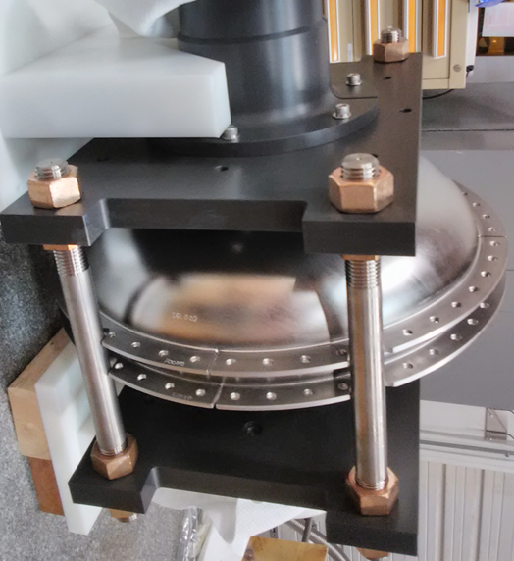
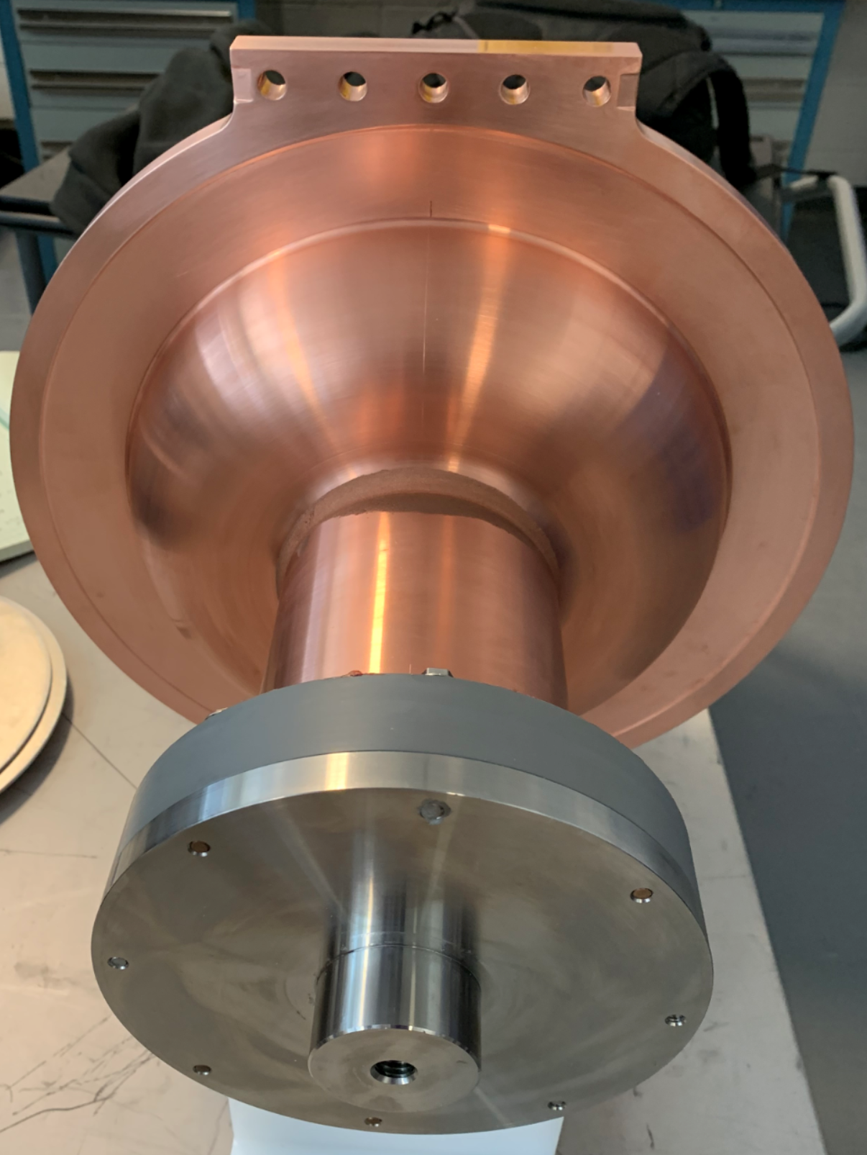
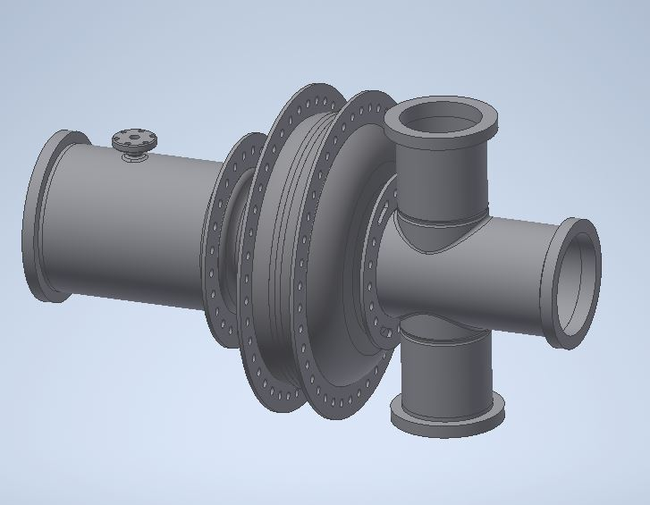
A new frontier in SRF is simplifying the cooling methods!
Fermilab
Jefferson Lab
Cornell University
https://doi.org/10.18429/JACoW-IPAC2022-TUPOTK037
650 MHz
welded niobium rings
copper plating & ring for CC
1.3 GHz multi-cell prototype
Concept 915 MHz multi-cell accelerator
1.3 GHz
Nb rings at equator + irises
Courtesy: John Vennekate
Courtesy: Neil Stilin

Slide 12
Design and development of e-beam accelerator based on conduction-cooled SRF cavities
  Building a prototype of a ~1.6 MeV, ~20 kW accelerator (under construction)
  Building a prototype of a ~ 10 MeV, ~20 kW cryomodule (under construction)
  Design of a 1 MW cryomodule for a wastewater application (Published)

Slide 13
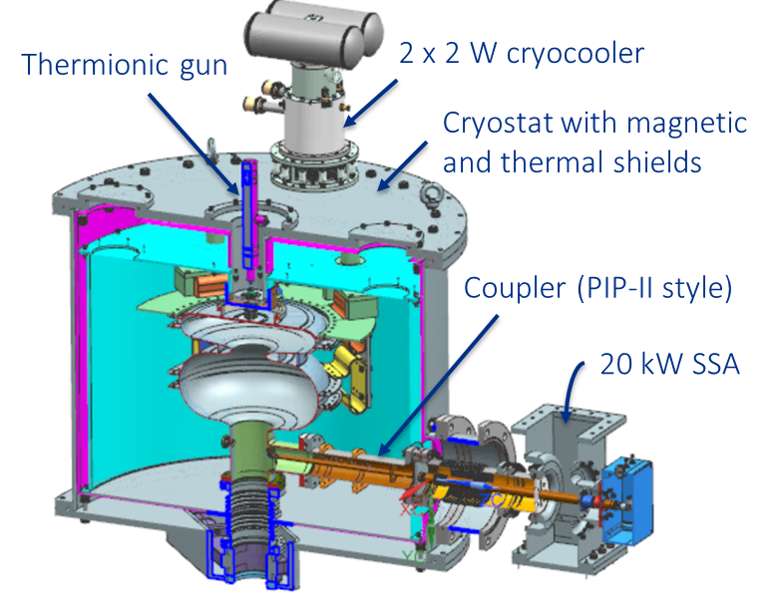
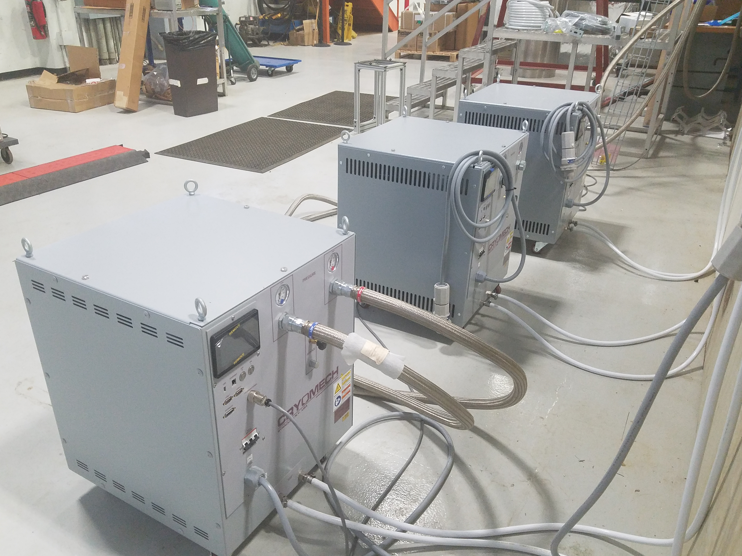
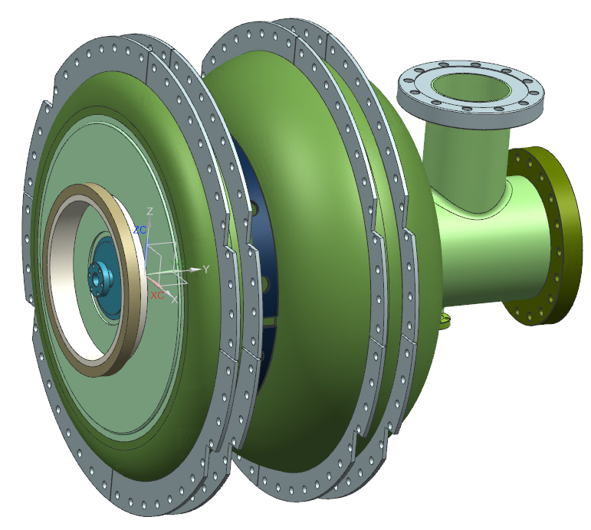
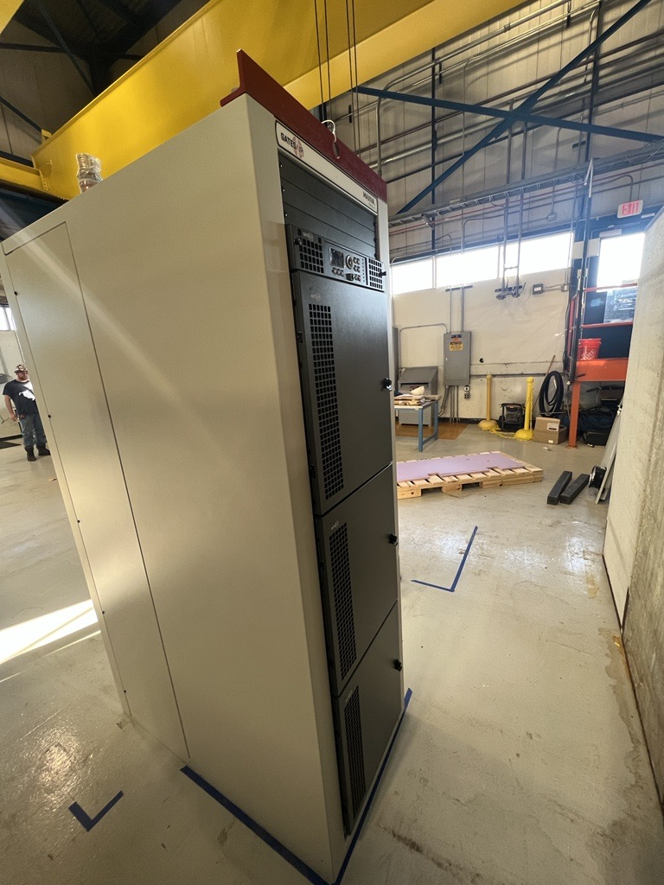
Goal: Component production, integration, and demo of a 1.6 MeV, 20 kW accelerator
Cryostat assembly
20 kW Solid State
RF Amplifier
GatesAir
650 MHz Nb₃Sn cavity
(Cryoload ≈3.8 W @ 5 K)
Cryomech PT420 coolers (2W)
~1 m
4’(D) x 2’ (W) x 6’ (H)

Slide 14
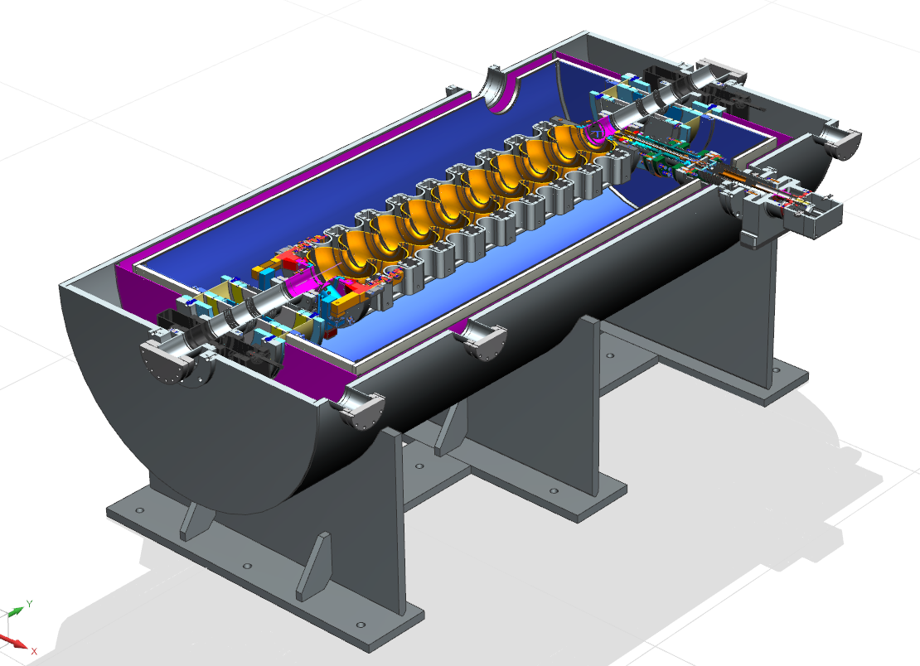
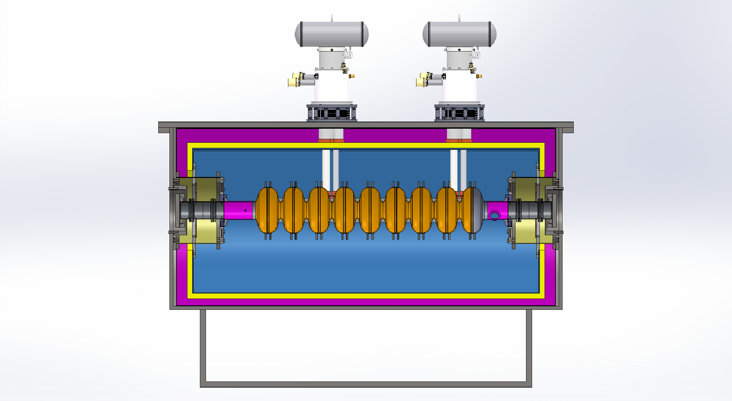
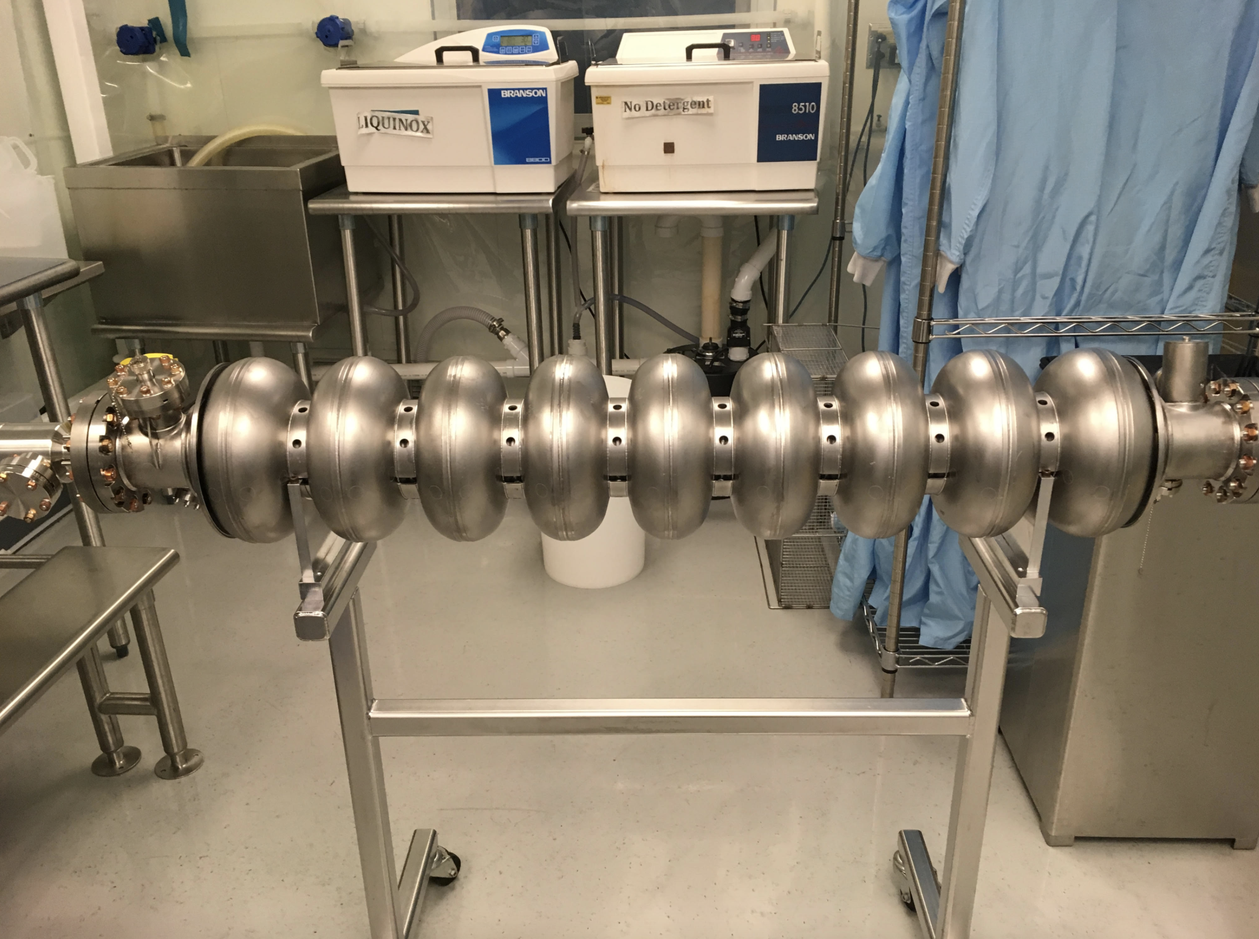
Goal: A stand-alone 1.3 GHz 9-cell cryomodule with an injector
Six cryocoolers
10 MV/m
External injector
Design on-going
Cavity in-hand
36”
48”
72”

Slide 15
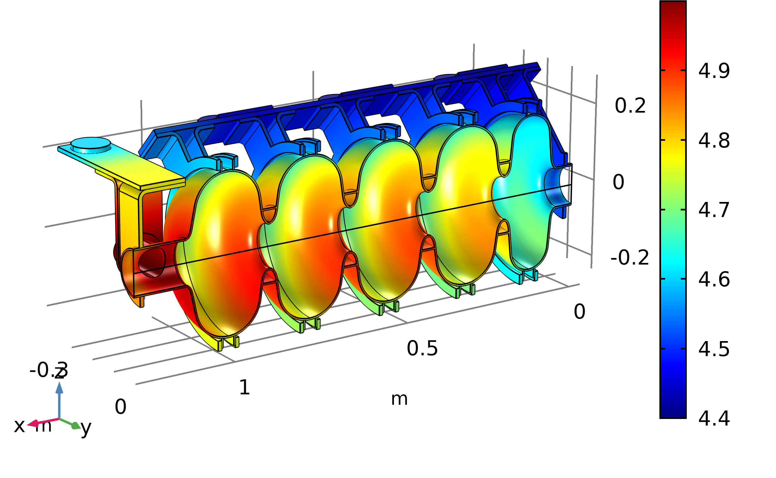
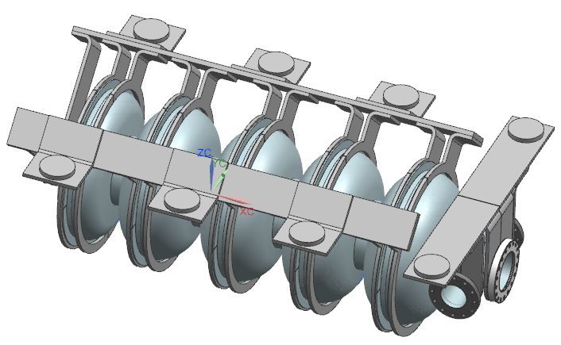
Design of a 10 MeV, 100 mA e-beam accelerator
Design and multiphysics simulation of a conduction-cooled 5-cell SRF cavity
RF design of a 5-cell 650 MHz cavity
Beam transport simulations
(external injection 300 keV → 10 MeV)
Calculation of 4 K heat load, cryocooler selection
Design and thermal simulations of conduction link
Cryostat design and integration (thermal and magnetic shield, vacuum vessel, couplers)
Cost assessment of the 10 MeV , 1 MW accelerating module
Courtesy : R. Kostin (Euclid Techlabs)
Design of the complete accelerator cryomodule
Courtesy : B. Coriton and K. Zeller (GA)

Slide 16
Cost economics for wastewater application
Cost of a SRF module | 5,134
1 MW RF Power Source [13] | 3,200
Cryomodule | 1,554
Cryocoolers w/ He Compressors | 492
650MHz Nb₃Sn Cavity | 402
RF Couplers | 282
Vacuum Vessel | 100
Beamline (HOM, Bellows, Valves) | 104
Auxiliary Hardware (Chillers, Pumps) | 93
Magnetic Shield | 65
Thermal Shield | 16
Electron Injector | 217
Beam Delivery System | 125
Beam Diagnostics & Controls | 38
Capital Investment
Entire SRF accelerator system | $5.13M
Infrastructure | $3.00M
Investment (20%) | $1.63M
Amortization (15 yrs @ 8%) | $760k
Operating Cost
Power ($/W) | $162 /hr
Maintenance | $163k /yr
Total operating cost | $278 /hr
Processing Cost (¢/ton/kGy) | 13.5
Fixed cost: At 1 MW, the fixed cost is dictated by the RF source.
SRF cryomodule cost is $1.55 per watt of beam power
Variable cost: At 1 MW, the processing cost is proportional to the electrical cost.
Efficient RF sources can reduce processing costs. Magnetrons
can bring the cost to <10 (¢/ton/kGy).
Total cost: Dose of 1kGy @ 12 MGD per day. Capital cost=$8/W

Slide 17
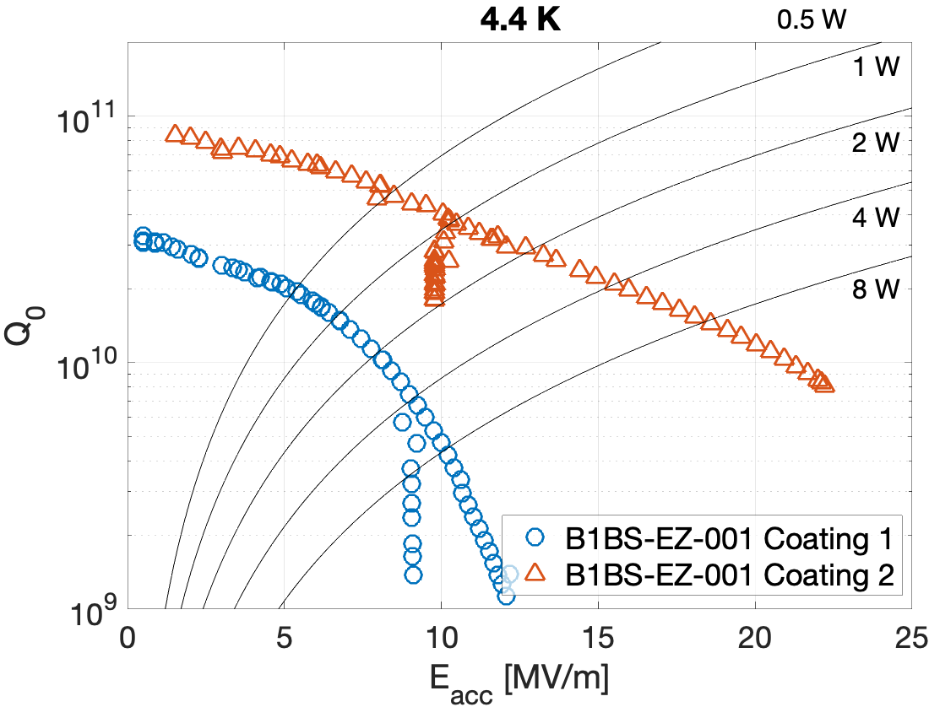
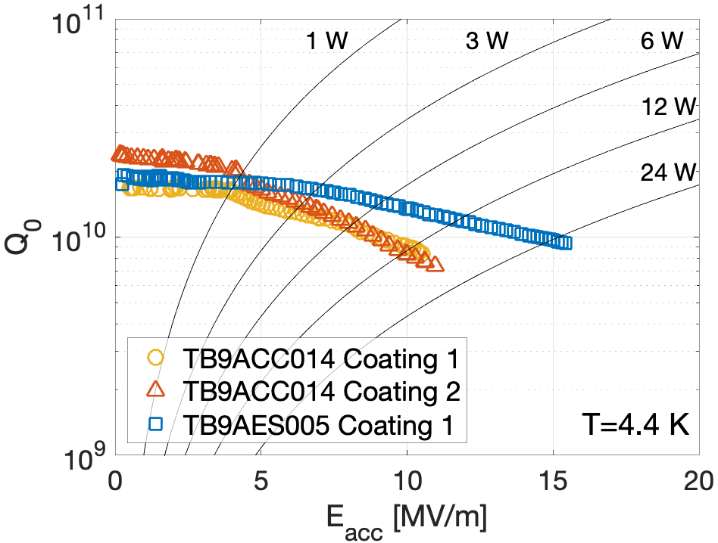
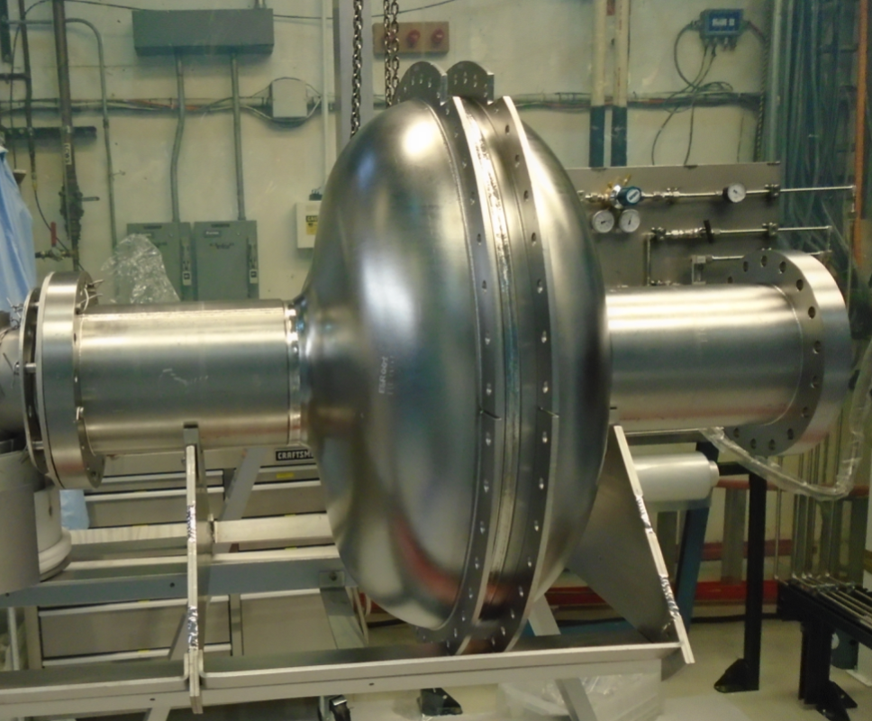
Recent results: 650 MHz 1-cell Cavity with Rings and regular 9-cell
Coated in Feb 2021
Multipacting
Coated in June 2019
Substantial improvement!
Courtesy: S. Posen
17
Jayakar Thangaraj, "SRF accelerator development for industrial applications at Fermilab", TTC 2022, WG1

Slide 18
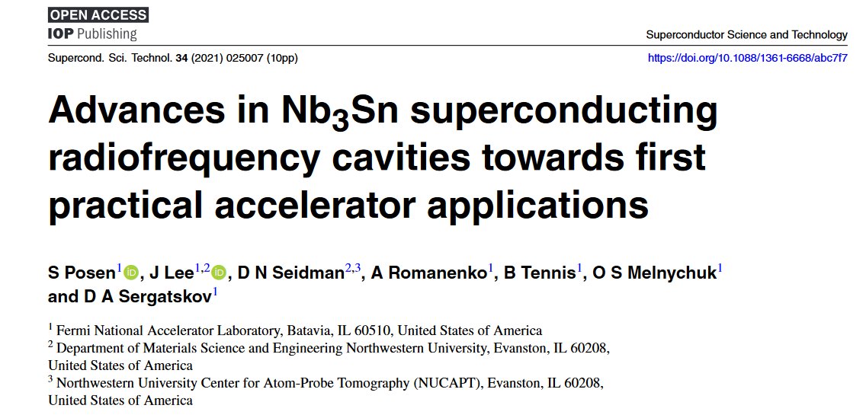
Recent results: 650 MHz 1-cell Cavity with Rings and regular 9-cell
Substantial improvement!
Still early stage of Nb₃Sn coating especially on the 650 MHz geometry
Long-term: Identify a repeatable recipe good enough for specific industrial application need
Notes:
In this slide you can see an image of the 650 MHz single cell cavity with conduction cooling rings welded onto it, sitting on our rail for installation into the coating furnace. This is actually a picture from the first coating back in June 2019. We had reasonable performance but the cavity suffered from Q-slope resulting in pretty low Q above about 8 MV/m. Regardless, the cavity was installed in the conduction cooling setup for some very interesting first studies. But we wanted to do even better, so after these first studies, the cavity was removed from the conduction cooling setup, we removed all the connections to the conduction cooling rings, and we recoated the cavity. We had some suspicions that the reason for the Q-slope might have been thin Nb3Sn regions, so we tried to add extra SnCl2 to improve uniformity. And the coating was much improved, reaching even above 20 MV/m with high Q0. The comparison of the before and after are shown here, with the 4 K curve on the left and the low temperature curve on the right.

Slide 19
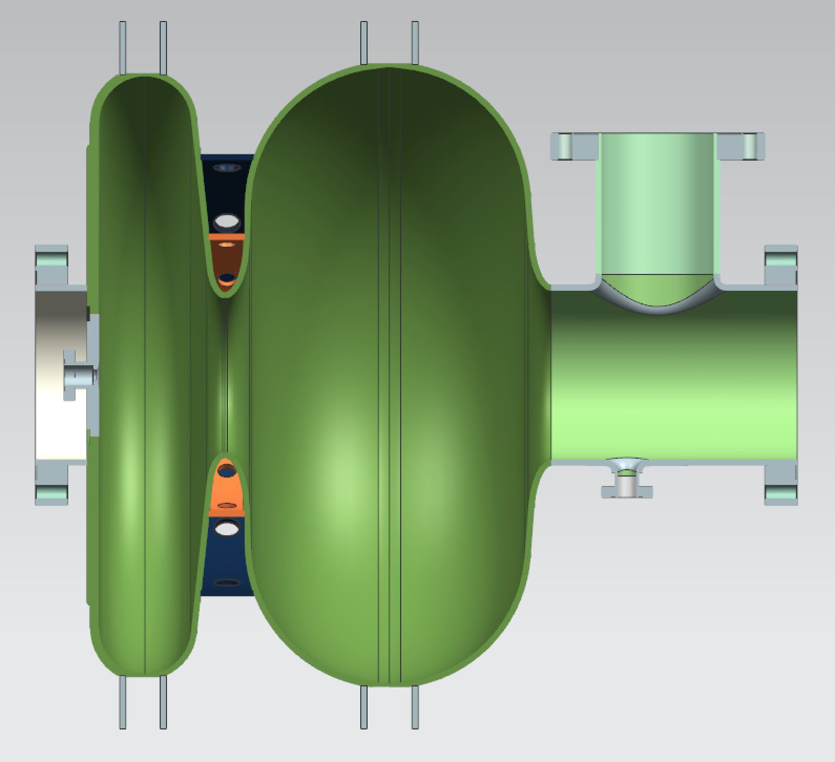
Challenges (or Opportunities?) in the project
Challenging geometry for Nb₃Sn coating (650 MHz)
Managing the thermal budget (RF loss, particle loss)
Tuning the coated Cavity
Microphonics due to cryocooler during operation
Couplers high power and low loss……..
Mobile application
1.5-cell 650 MHz, open on one side only
(A SBIR at 1.3 GHz is looking into this as well)

Slide 20
Future Accelerator Applications
Energy and Environment
Industrial and Security
Treat Municipal Waste & Sludge
    Eliminate pathogens in sludge
    Destroy organics, and pharmaceuticals in wastewater
In-situ environmental remediation
In-situ cross-link of materials
  Improve pavement lifetime
  Instant cure coatings
Medical sterilization without Co60
These new applications need cost effective, energy efficient, high average power electron beams.
New technology can enable new applications (including mobile apps)

Slide 21
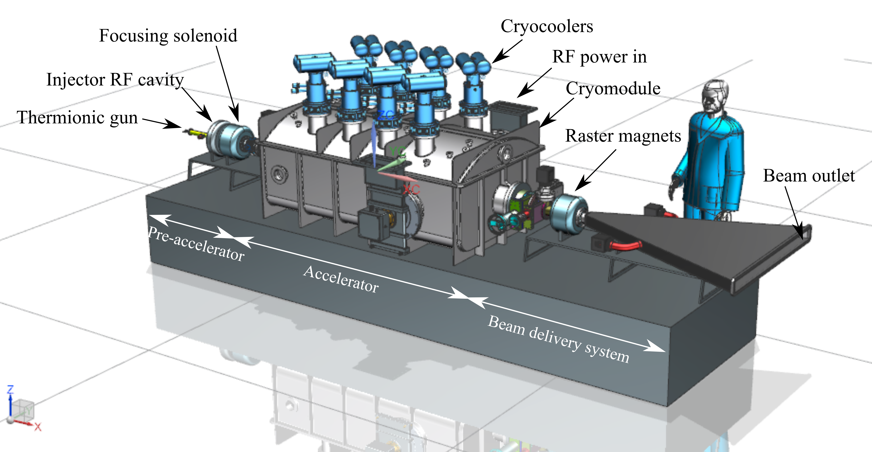
Summary and outlook
SRF accelerators for industrial applications push innovation, open new applications with enormous R&D opportunities
2 m x 2 m x 4 m
This presentation has been authored by Fermi Research Alliance, LLC under Contract No. DE-AC02-07CH11359 with the U.S. Department of Energy, Office of Science, OHEP

Slide 22
Thanks for your attention!
Questions?

