Slide 1
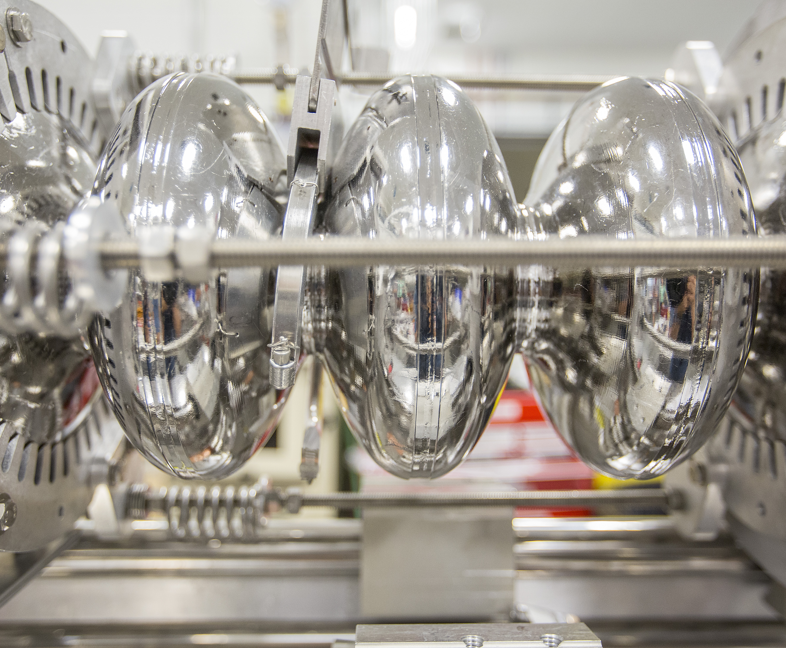
(S)RF Recovery in CEBAF
At Thomas Jefferson National Laboratory
A presentation to the Tesla Technology Collaboration (TTC) meeting; Aomori, Japan
Michael D McCaughan

Slide 2
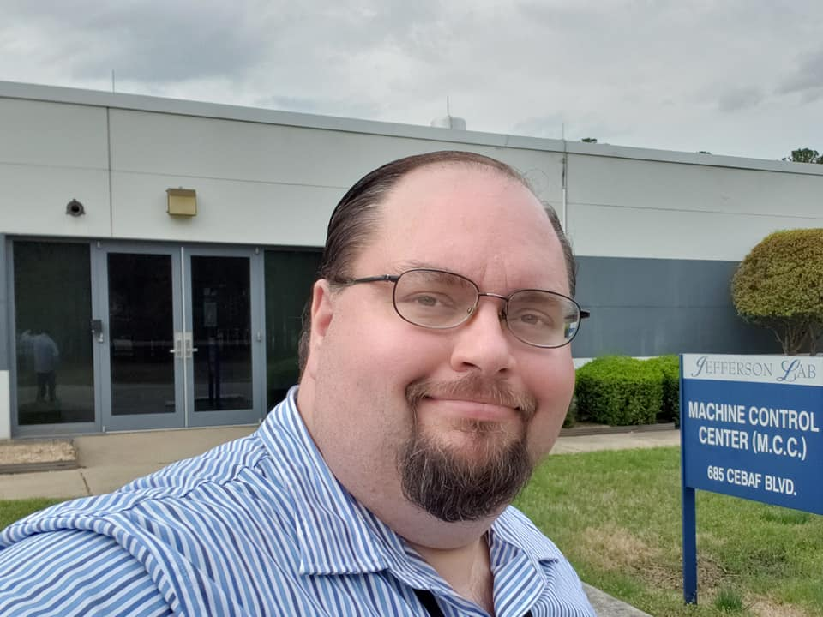

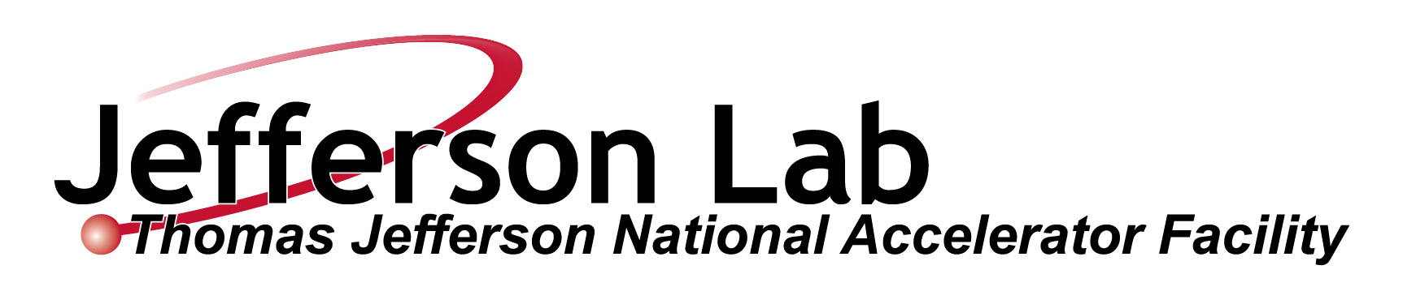
Who am I?
Radford University:
B.S. Physics
B.S. Applied Mathematics
US Particle Accelerator School
MIT: Fundamentals of Accelerator Physics & Technology
Stony Brook University (Grad.): Accel. Physics
Old Dominion University (Grad.):
  - Collective Effects in Beam Dynamics
  -Modern Computational Accelerator Physics
Position:
SRF Operations; Testing & Measurement Eng.
Thomas Jefferson Natl. Acceleration Facility
American Physical Society #61020066
Society of Industrial and Applied Mathematics: 001031668-0
Society of Physics Students/ΣΠΣ ...
arXiv: https://arxiv.org/a/mccaughan_m_1.html
Scholar (Google): https://scholar.google.com/citations?user=RM_9CIAAAAAJ
inSpire(HEP): http://inspirehep.net/author/profile/M.McCaughan.1
M. McCaughan
TTC: Aomori, Japan 13Oct22

Slide 3
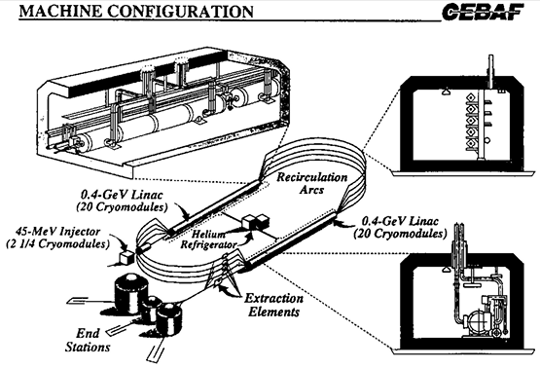
What is CEBAF?
Intermediate energy facility constructed in response to 1979 Nuclear Science Advisory Committee (NSAC) recommendation.
SURA (Southeast Universities Research Association) [consortium of schools] proposed an extensible 4 GeV design utilizing the former site of NASA Space Radiation Effects Lab in Newport News.
SRF technology adopted in 1985 follow project down-selection to SURA. One of first large-scale SRF installations in existence.
C. Westfall, The Founding of CEBAF 1979 to 1987. Michigan State University/Cebaf. Sept 1994.
Accelerator Tunnel subterranean;
recessed ~30 ft below grade and within the water table.
M. McCaughan
TTC: Aomori, Japan 13Oct22

Slide 4
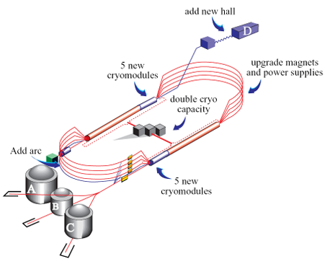
What is CEBAF? (Continued)
Design:
2 anti-parallel SRF linacs
Connected by normally conducting magnetic pi bends
Mixed warm/SRF injection scheme at 11.25% of 1L energy.
Initial 4 GeV energy expanded to 6 GeV with module re-processing (C-50 program), and then to 12 GeV with addition of C-100 modules.
4 GeV Design Energy – 1995
6 GeV C-50 Program – 2000
12 GeV upgrade – 2012-2014
(~1.1 GeV/linac; +5 C-100s each)
M. McCaughan
TTC: Aomori, Japan 13Oct22

Slide 5
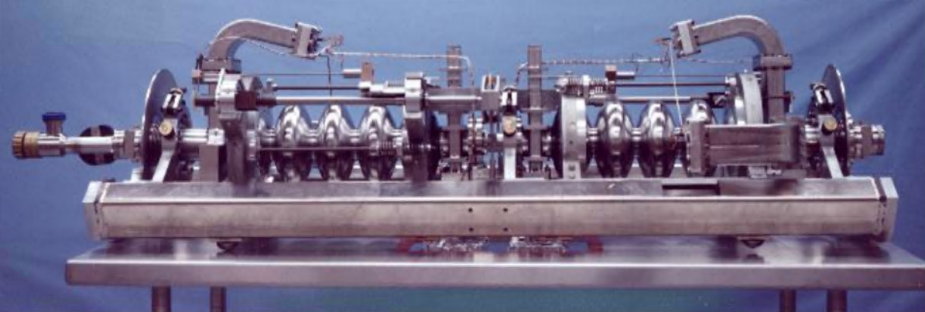
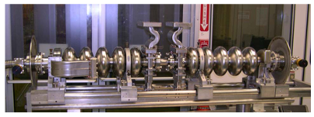
Types of Cavities / Cryomodules:
C-30 String C-50 String
Parameter | Unit | C-20 (Original CEBAF} | C-50 (Refurbished) | C-100 (Low Loss) | C-75 (High Current)
Number of cells |  | 5 | 5 | 7 | 5
L act | M | 0.4999 | 0.4999 | 0.7 | 0.4916
Energy gain/CM (design) | MeV | 20 | 50 | 100 | 75
Eacc/cavity (design) | MV/m | 5 | 12.5 | 17.86 | 19.07
Q0 at 2.07K |  | > 2.4e9 | 4.6e9 | 7.2e9 | 8.0e9
Qext,FPC spec |  | 6.6e6 (± 20%) | 8.0e6 (± 25%) | 3.2e7 (± 20%) | 2.0e7 (± 15%)
R/Q [Ueff^2/(ω*W)] | Ω | 482.5 |  | 868.9 | 525.4
R/Q per cell | Ω | 96.5 |  | 124.1 | 105.1
F. Marhauser et al., "C75 Cavity Specifications and Commissioning of the Prototype Cavity Pair", JLAB‐TN‐17‐055, 12/6/17
M. McCaughan
TTC: Aomori, Japan 13Oct22

Slide 6
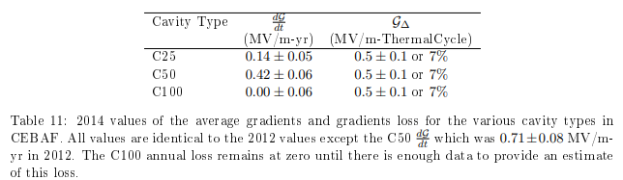
Gradient Degradation
Observed gradient loss per annum:
Rates have been measured since then and levels seem robust. These values are used for planning estimates for gradient needs / refurbishment. Data is being gathered on the High Current Style C-75 cavities, but as of yet results are not statistically significant.
Projected loss: ~17 MeV/linac/year
(+ planned / unplanned thermal cycling losses)
R. Bachimanchi et al., 2014 Update: CEBAF Energy Reach and Gradient Maintenance Needs, JLAB-TN-14-024, 4 Oct 2014.
M. McCaughan
TTC: Aomori, Japan 13Oct22

Slide 7
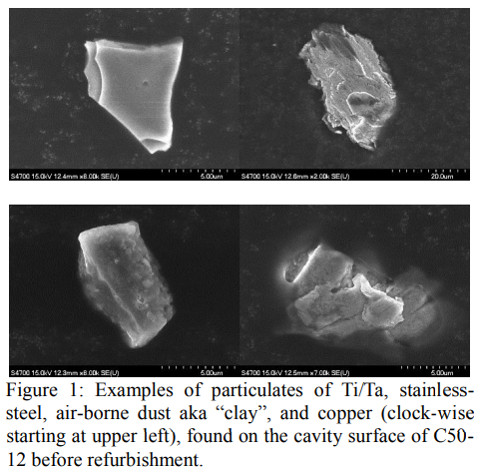
Particulate Contamination
Particulate Species Found:
Ti/Ta (From Vacuum Ion Pumps)
Carbon (from Viton elastomer in O-rings and seals in manual / pneumatic valves)
Clay (Si, Ca, Al, Na, K, Mg, etc.) [~50um]
Stainless Steel (Fe, Ni, Cr, Si, etc.) [~50um]
Catalogue of more than 40 species found in survey assembled so far…
Further amplified by presence of frozen gas species and the gas sharpening of existing emitters / particulates…
R. Geng et al., Nature and Implication of Found Actual Particulates on the Inner Surface of Cavities in a Full-scale Crymodule Previously Operated with Beam, Proceedings of SRF2015, MOPB035, JLAB-ACC-15-2198, Whistler, BC, Canada
C.E. Reece et al., Standardized Beamline Particulate Characterization Analysis: Initial Application to CEBAF and LCLS-II Cryomdule Components, Proceedings of SRF17, TUPB106, JLAB-ACC-17-2620, Lanzhou, China.
R. Geng et al., Understanding and Mitigation of Field Emission in CEBAF SRF Linacs, Proceedings of IPAC19, WEPRB097, JLAB-ACC-19-2988, Melbourne, Australia.
M. McCaughan
TTC: Aomori, Japan 13Oct22

Slide 8
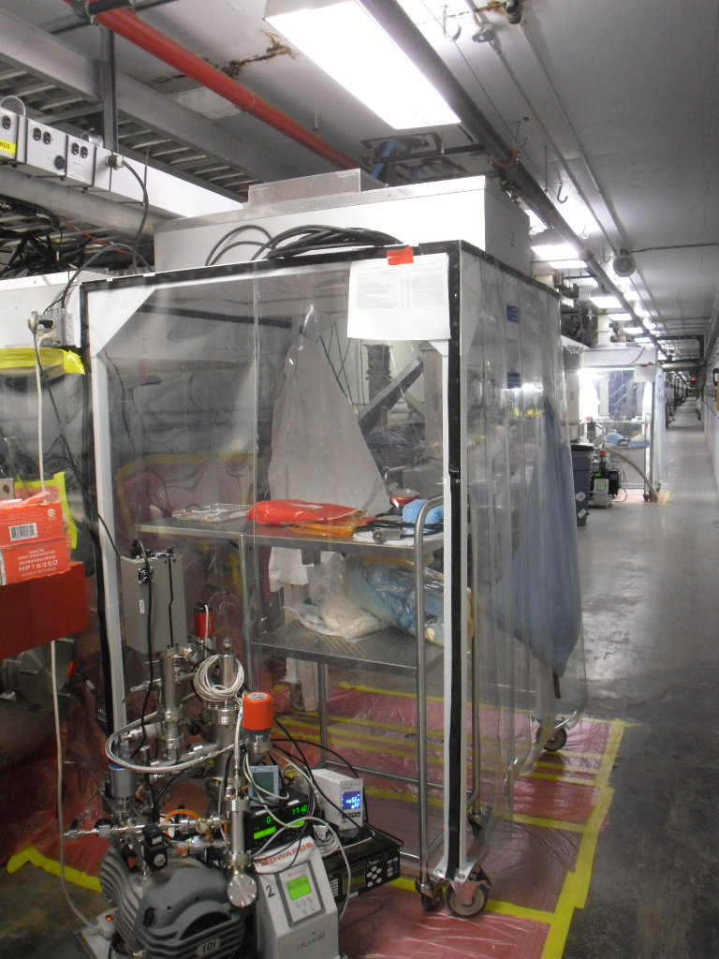
Particulate Contamination (Cont.)
Mitigation:
Updated Vacuum pump operating procedures (Limit # of restart attempts, No Hi-potting, raised closure pressure, Stop pumps before starting warm-ups, etc.)
Improved vacuum work technique: Implement portable clean rooms, cleaning of area, air hood, etc.
Begin move from Ion pumps to NEGs with new installation.
Cleaning of UHV vacuum components in environments where particulate level may be controlled. [Cleaning girders when modules are swapped, blowing down valves, etc.]
Valves in high radiation environments bypassed/jumpered open to limit cycling.
Further details: R. Geng, Particulate Contamination in CEBAF: Sources & Mitigation, Presented at TTC 2018, Riken, Japan.
M. McCaughan
TTC: Aomori, Japan 13Oct22

Slide 9
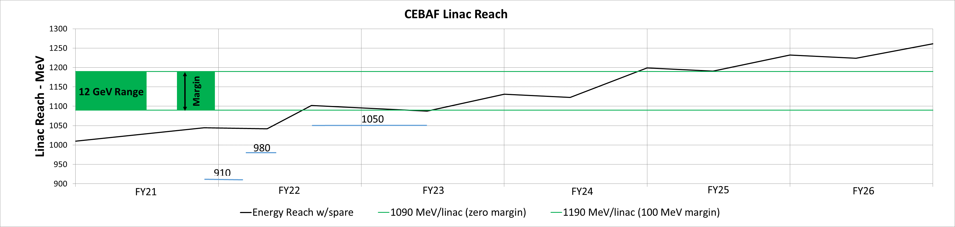
The CEBAF Performance Plan (CPP)
CPP Energy Reach: ~17 cryomodule refurbishments in 6 years
C-50s/100s: Refurbishment; C20s refurbish to C-75s.
New modules as resources allow.
(Schedule/resource availability inform pace of plan)
C100-05R, C100-10R
C100
We are here
Gap analysis in system to determine critical spares required for obsolescence and other issues for example – klystrons.
C. Ginsburg, Accelerator Performance and the CEBAF Performance Plan, Presentation to JSA S&T Committee. 7Oct22
A Freyberger et al., The 12 GeV CEBAF Performance Plan, JLAB-TN-17-022.
M. McCaughan
TTC: Aomori, Japan 13Oct22

Slide 10
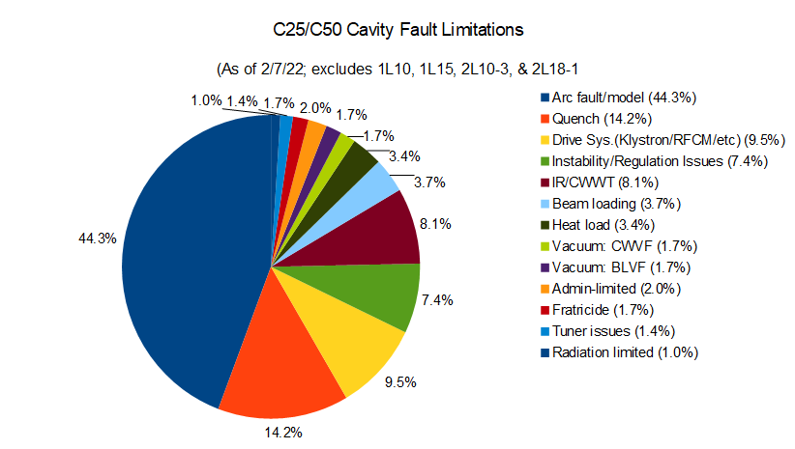
C-20s / 50s (Original and Original refurbished installation)
Primary Limitation: Arc Faults / Field Emission (45.3%) Quenching (14.2%)
Drive system / Regulation (16.9%)
IR Sensor / Window Temperature Faults (8.1%)
M. McCaughan
TTC: Aomori, Japan 13Oct22

Slide 11
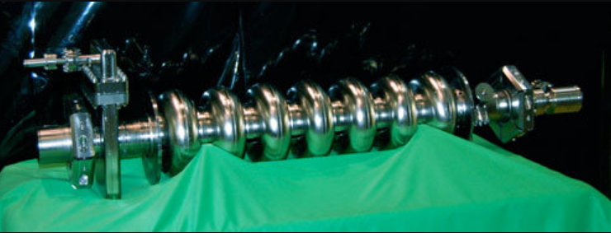
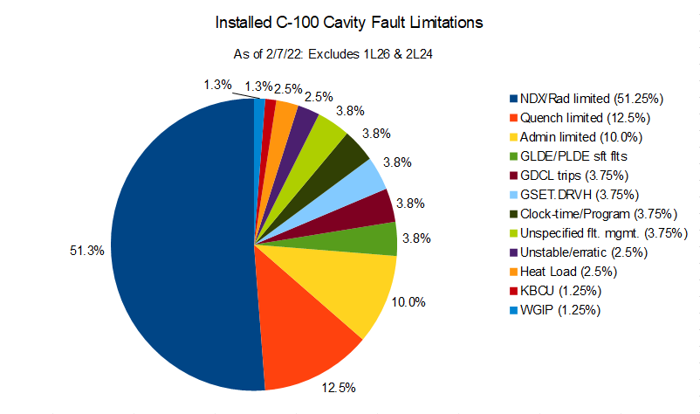
C-100 Gradient Limitations
#1 Gradient Limitation: Neutron / Gamma radiation generate by field emission sites (More than 50% of cavities) [Rough trade-off of 1R / MV/m, but this has been relaxed recently]
#2 Quench limits (12.5%) / #3 Admin limitations (10%)
#4… Various control system limitations / regulation issues (15-20%)
M. McCaughan
TTC: Aomori, Japan 13Oct22

Slide 12
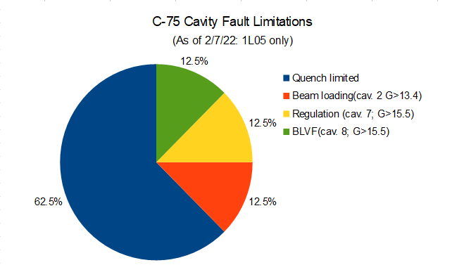
C-75
Second zone recently installed: June 2022
New LLRF 3.0 Controls
Still gaining operational experience with the new cavities and accumulating statistics on their behavior.
M. McCaughan
TTC: Aomori, Japan 13Oct22

Slide 13
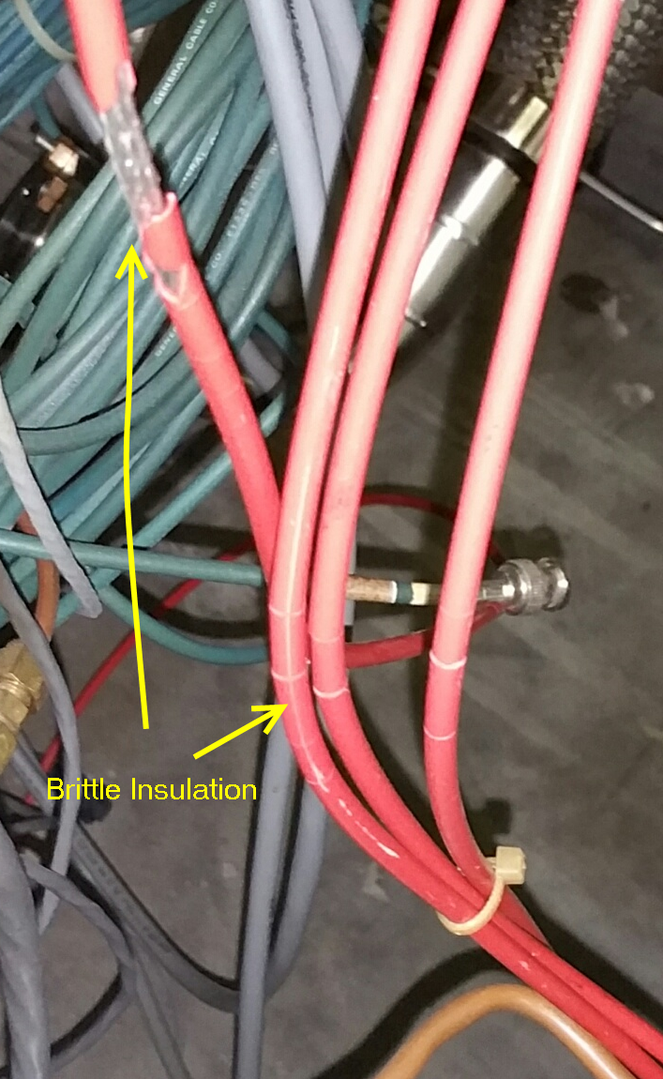
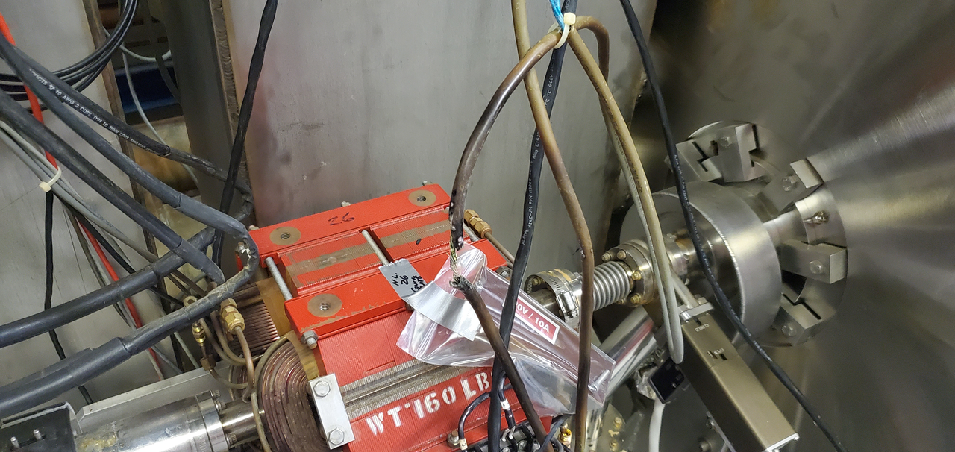
Radiation Damage and Mitigation
Various measures taken:
Removal of electronics on vacuum pump electronics to remote locations.
Move to more radiation hard materials where possible (Poly to Copper air lines, silica high voltage cables, and so on)
Components and electronics which could be removed from path of radiation (say to service buildings or remounting on cable trays) were.
Cables which could not be economically relocated / protected split at patch panels entering enclosure for easier maintenance / replacement.
Most importantly – phenomena more thoroughly studied…
M. McCaughan
TTC: Aomori, Japan 13Oct22

Slide 14
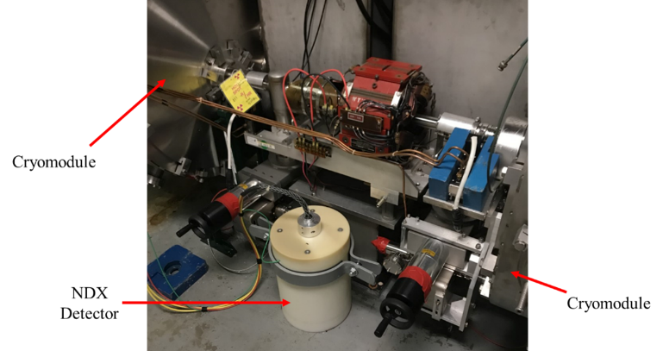
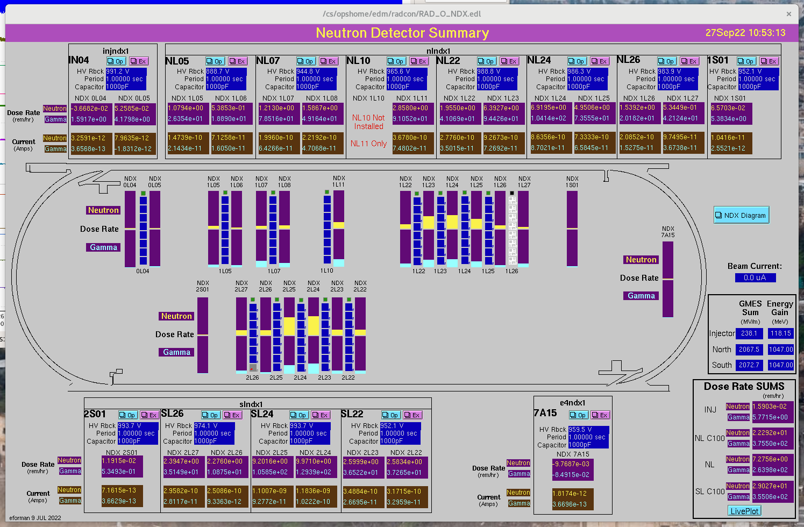
Mitigations: Radiation & Field Emission
NDX Limited: (51.3% C100s)
Gamma / Neutron Detectors on electrometers installed Summer 2020; allowed for direct localized observation of dose rates. (Previously inferred issues with PMTs and vacuum pressures)
This allowed for localization of specific field emitting cavities.
Material study underway for hardness to determine most appropriate limit; present using ~1 MV/m per 1 Rad of neutron dose as a rule of thumb.
M.McCaughan, Selection of Candidate Modules for 2017 Helium Processing, JLAB-ACO-17-2617. 5 June 2017.
K. Ahammed et al., Machine Learning Surrogate Models of Field Emission from SRF Accelerators, Forthcoming JLAB tech note, 6 Sep 22.
M. McCaughan
TTC: Aomori, Japan 13Oct22

Slide 15
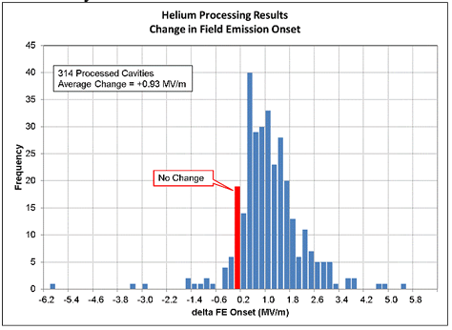
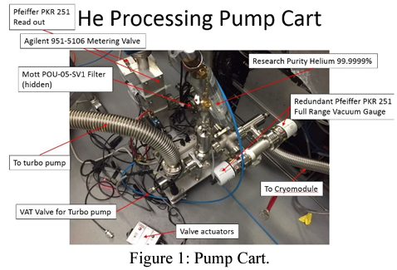
Mitigations: Radiation & Field Emission (Cont.)
Arc Faults / Field Emission / Fratricide: 47.0% O.C. cavities (139)
Solutions:
Module Refurbishment: Effective, but costly in terms of resources and schedule, particularly in context of other repairs.
Helium Processing: He processing campaign indications are that a round of processing should pick up at least ~0.7MV/m/cavity on the 3rd processing of a cavity. (TN17-041) 139 cavities*0.7 = 97.3MV/m (in addition to the radiation / field emission reduction). Cost is minimal, but labor and schedule are still required with schedule being the limiting factor. The average increase in FE free gradient from the 2015 campaign (2nd processing of most modules) was 0.93 MV/m.
Under evaluation for a campaign in FY24; precluded by schedule in FY23
J. Benesch, A longitudinal study of field emission in CEBAF's SRF cavities 1995-2015, arxiv 1502.06877
M Drury et al., Results of the 2015 Helium Processing of CEBAF Cryomodules, Presented at NAPAC16, THAO02, Lansing, MI. USA.
M. McCaughan
TTC: Aomori, Japan 13Oct22

Slide 16
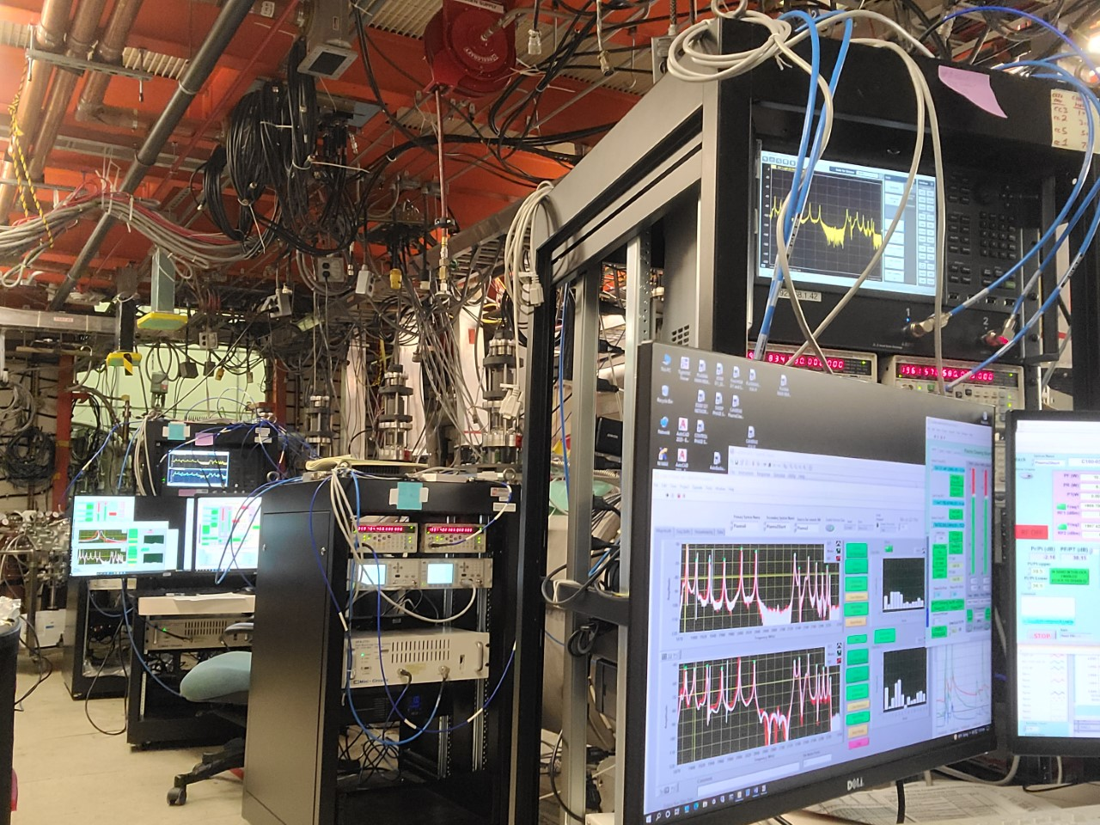
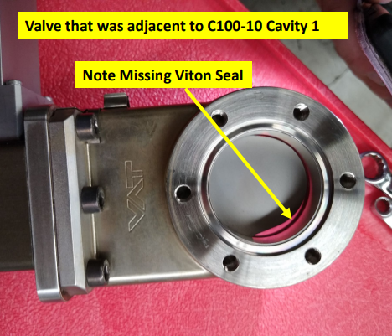
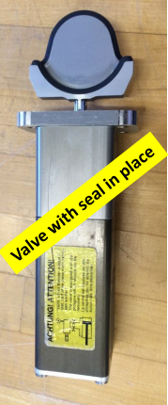
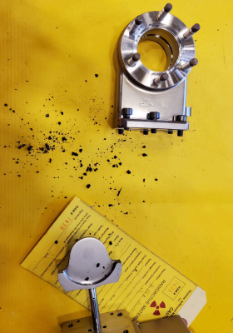
Mitigations: Radiation & Field Emission (Cont.)
Plasma Processing:
Helium processing shown to potentially have deleterious impact on C100s. Process stopped as risk level was too high.
Alternate method developed by T. Powers et al. with an Ar/O gas mixture to remove Hydrocarbons & tested June 2022.
Results promising – attempting in situ processing next down on a few zones.
Per Cavity:
<FEonset>:
+2.1 MV/m (~10 mR/hr)
<FE=100 mR/hr>:
+2.3 MV/m (Avg.)
Further details:
R. Ruber, Plasma Processing at JLAB, This meeting.
T. Powers – Private Communication
M. McCaughan
TTC: Aomori, Japan 13Oct22

Slide 17
Mitigations: C-100 Gradient Limitations [Cont.]
Quench or Admin Limited 22.5%
Verify against commissioning performance, but if it matches it is what it is...
Everything else: 26.2%
Half of these issues require more time to characterize – instabilities, unspecified de-rating, why gradient limits are where they are, recovery deferred when the crew chief said move on...
Other half should be referred to Engineering to understand what we can do about them…
  Limited due to:
  GLDE (Gradient Loop Detector Error)
  PLDE (Phase Loop Detector Error)
  GDCL (Gradient Clamp)
  Etc.
M. McCaughan
TTC: Aomori, Japan 13Oct22

Slide 18
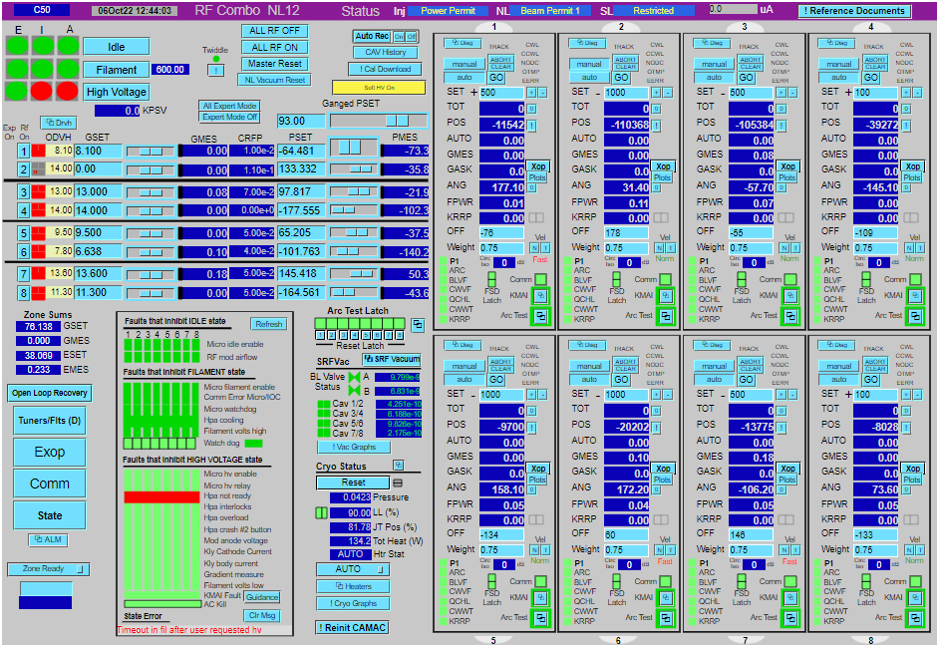
Fault Classification [On-line Analysis] (LLRF 1.0)
Control screens have ‘State Machine’ which contains bits for various interlock faults
M. McCaughan
TTC: Aomori, Japan 13Oct22
M. McCaughan

Slide 19
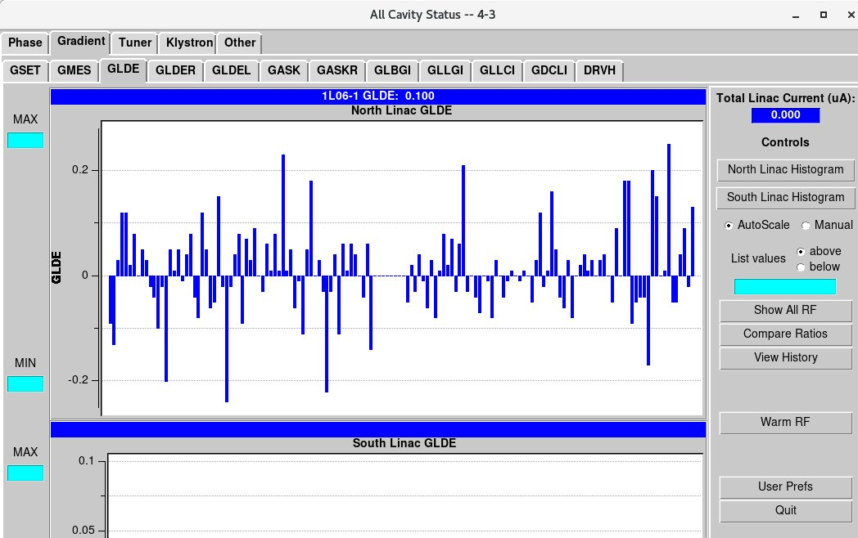
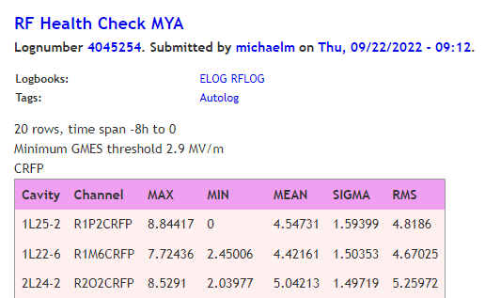
Fault Classification [On-line Analysis] (LLRF 1.0)
‘All-cavity Status’:
Graphically represents dozens of parameters as compared against other cavities / zones so outliers are quickly distinguished.
‘RF Health Check’:
Online and Offline Versions:
Online: Collects over 60s window and carries out analysis
Offline: Definable time scale; nominally 8 hours
Statistics for both exported to the logbook.
M. McCaughan
TTC: Aomori, Japan 13Oct22
M. McCaughan

Slide 20
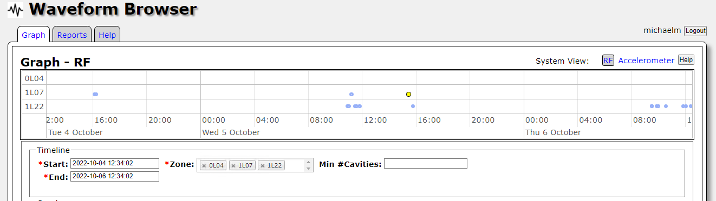
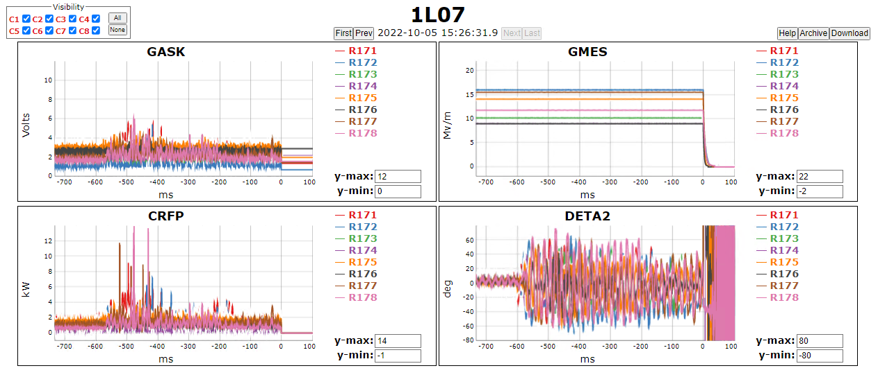
Fault Classification [On-line Analysis] (LLRF 2.0/3.0)
Waveform Browser: At IOC/FPGA level; fast output of waveform records to control system
M. McCaughan
TTC: Aomori, Japan 13Oct22
M. McCaughan

Slide 21
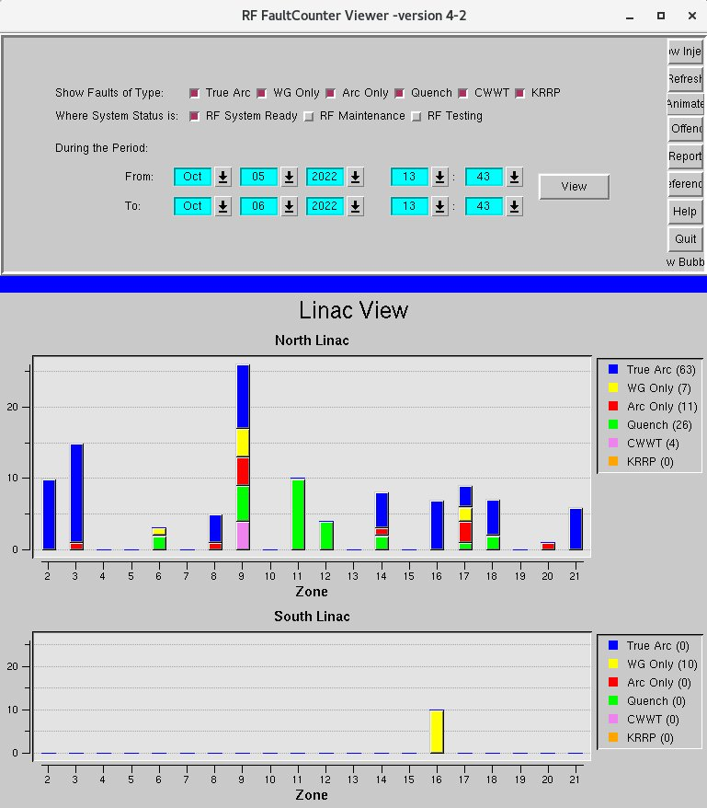
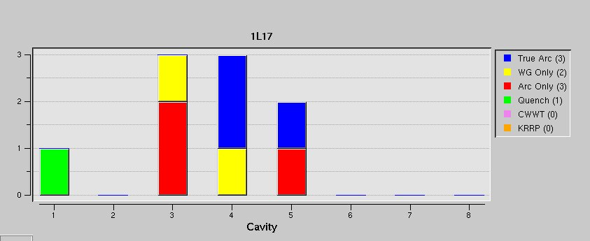
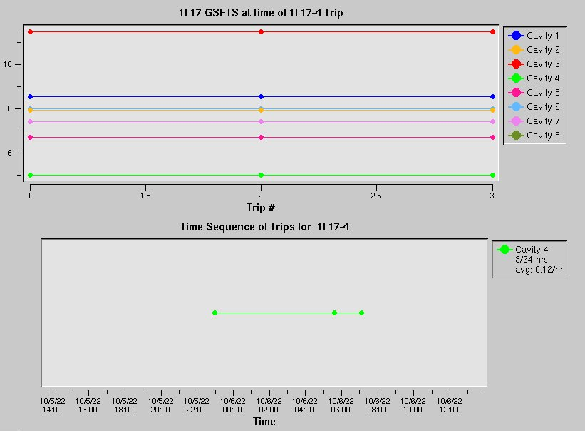
Fault Classification [Off-line Analysis] (LLRF 1.0)
‘RF Fault Viewer’ (Checked Daily)
Counts tripped bits / fault flags from state machine.
M. McCaughan
TTC: Aomori, Japan 13Oct22

Slide 22
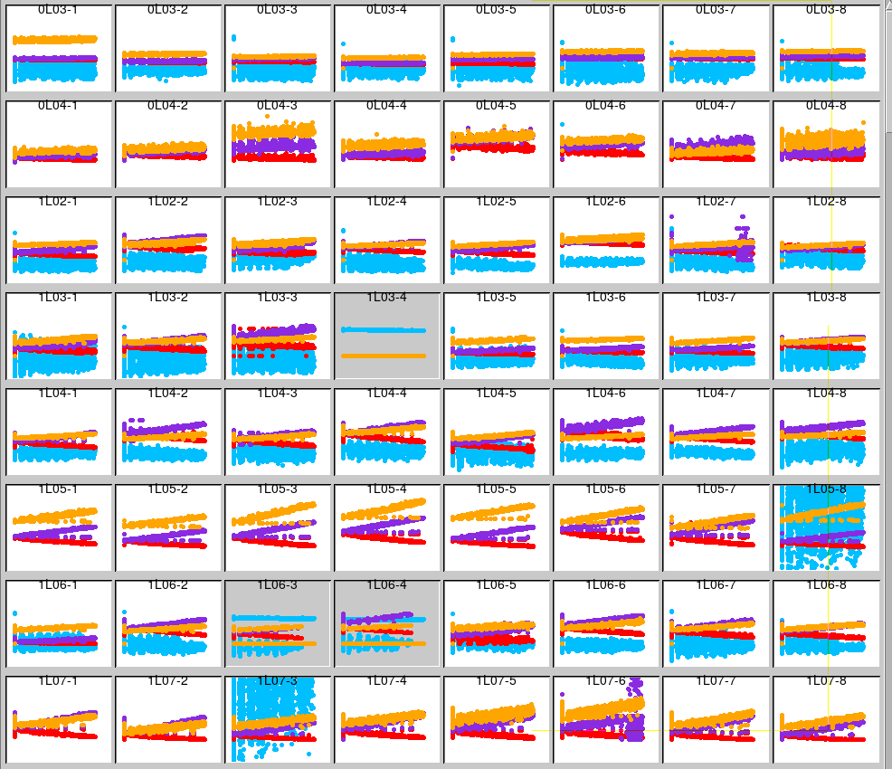
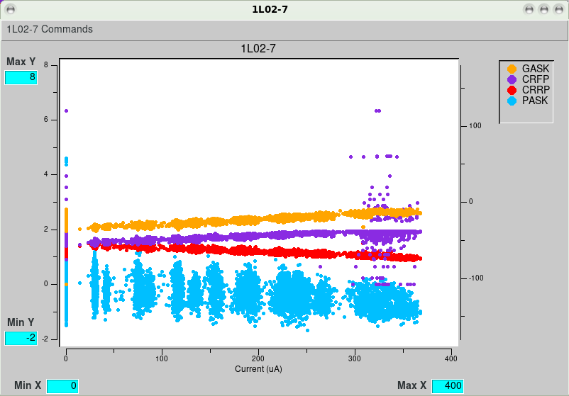
Fault Classification [Off-line Analysis] (LLRF 1.0)
RF Analysis Tool –
(Used As Needed)
Display a fixed set of common signals
(Visually drawn to outliers…)
M. McCaughan
TTC: Aomori, Japan 13Oct22

Slide 23
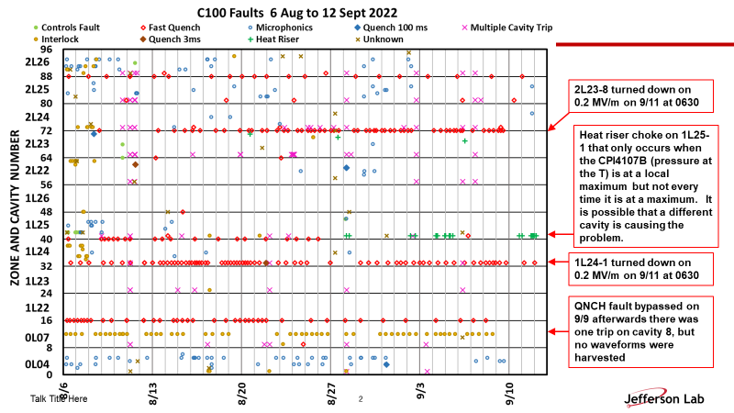
Fault Classification [Off-line Analysis] (LLRF 2.0/3.0)
Fault classification by a Senior Engineer examining waveform data offline. Work to automate the process under way through AI/ML.
M. McCaughan
TTC: Aomori, Japan 13Oct22

Slide 24

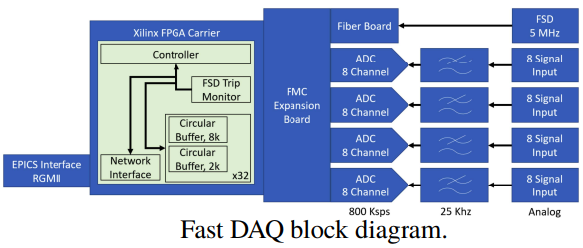
Artificial Intelligence / Machine Learning Applications
SRF-Related AI/ML efforts presently under way:
RF fault prediction (LLRF 2/3): Train model on past fault data to predict future faults from apriori behavior – results thus far encouraging; more effort required.
(L.S. Vidyaratne et al, Initial Studies of Cavity Fault Prediction at Jefferson Laboratory, Presented at ICALEPCS21, WEPV025, Shanghai, China)
Field emission management: NDX data gathered while varying C100 cavity gradient & used to develop FE NL model for cavities which could (theoretically) be used to set gradients. Model results encouraging; tech note forthcoming – plans to incorporate deep learning.
(A. Carpenter et al., Using AI for Management of Field Emission in SRF Linacs, Presented at ICALEPS21, THPV043, Shanghai, China)
Original CEBAF Style cavity (LLRF1) Instability Detection: 5KHz prototype DAQ developed (LLRF reports 1Hz to control system); Python-based autoencoder ML model under development – samples GMES/PMES/GASK/PASK (signal + drive) for each of 8 cavities. Model trains on good data; id’s ‘not good’ with 99% accuracy at .001 threshold. 8k fault buffer recorded on fault; harvesting / interpolation algorithms under development.
(D. Turner et al., SRF Cavity Instability Detection with Machine Learning at CEBAF, Presented at NAPAC22, WEPA232, Albuquerque, NM)
(Model Development)
M. McCaughan
TTC: Aomori, Japan 13Oct22
https://en.wikipedia.org/wiki/File:Spot_the_cow.gif

Slide 25
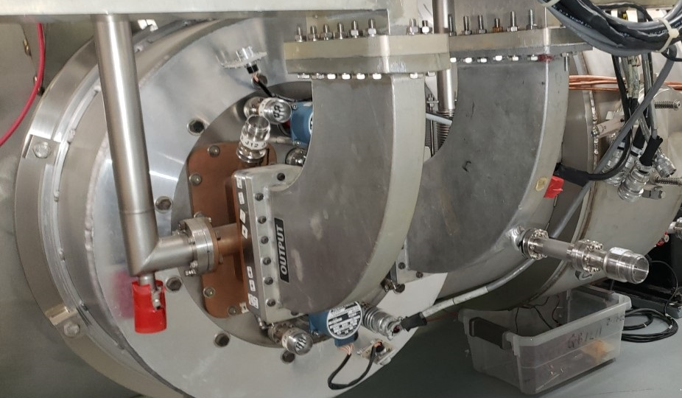
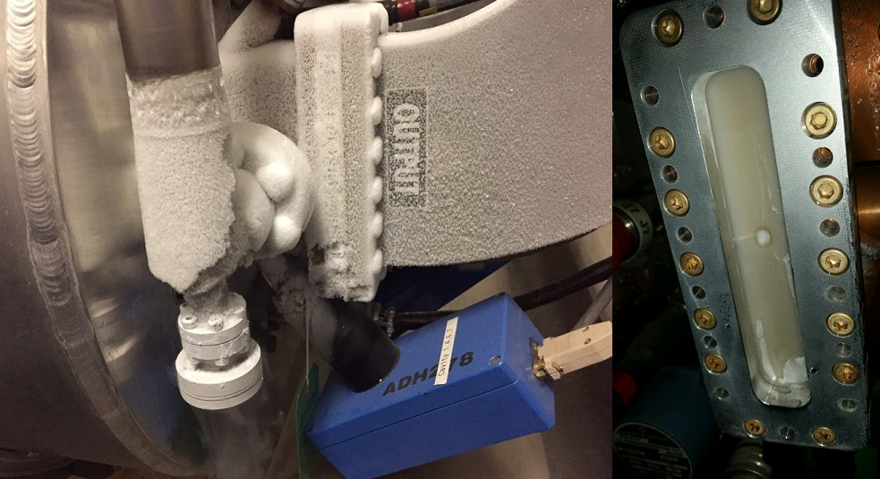
IR sensors / Window Temperature Faults (8.11% OC cavities)
Original polymer windows swapped for ceramics due to radiation embrittlement. [4 zones of 43 remaining]
Settings surveyed annually for instrumental drift; those more than +/- 2σ of mean adjusted.
Bad settings creep into software:
  Files copied with wrong name.
  Set incorrectly due to conditions or inattention (finger slips, setting checked at 4K / liquid level not full / etc.)
  File uploads/downloads did not take
  Failed sensors
Bolometers on waveguide sweeps to look at warm windows of failed sensors until replacement may be scheduled. [Presently 12 / 418 cavs]
(Standard + Warm IR Sensors)
(A failed Poly window in situ at 2L06 11/9/2016)
M. McCaughan
TTC: Aomori, Japan 13Oct22

Slide 26
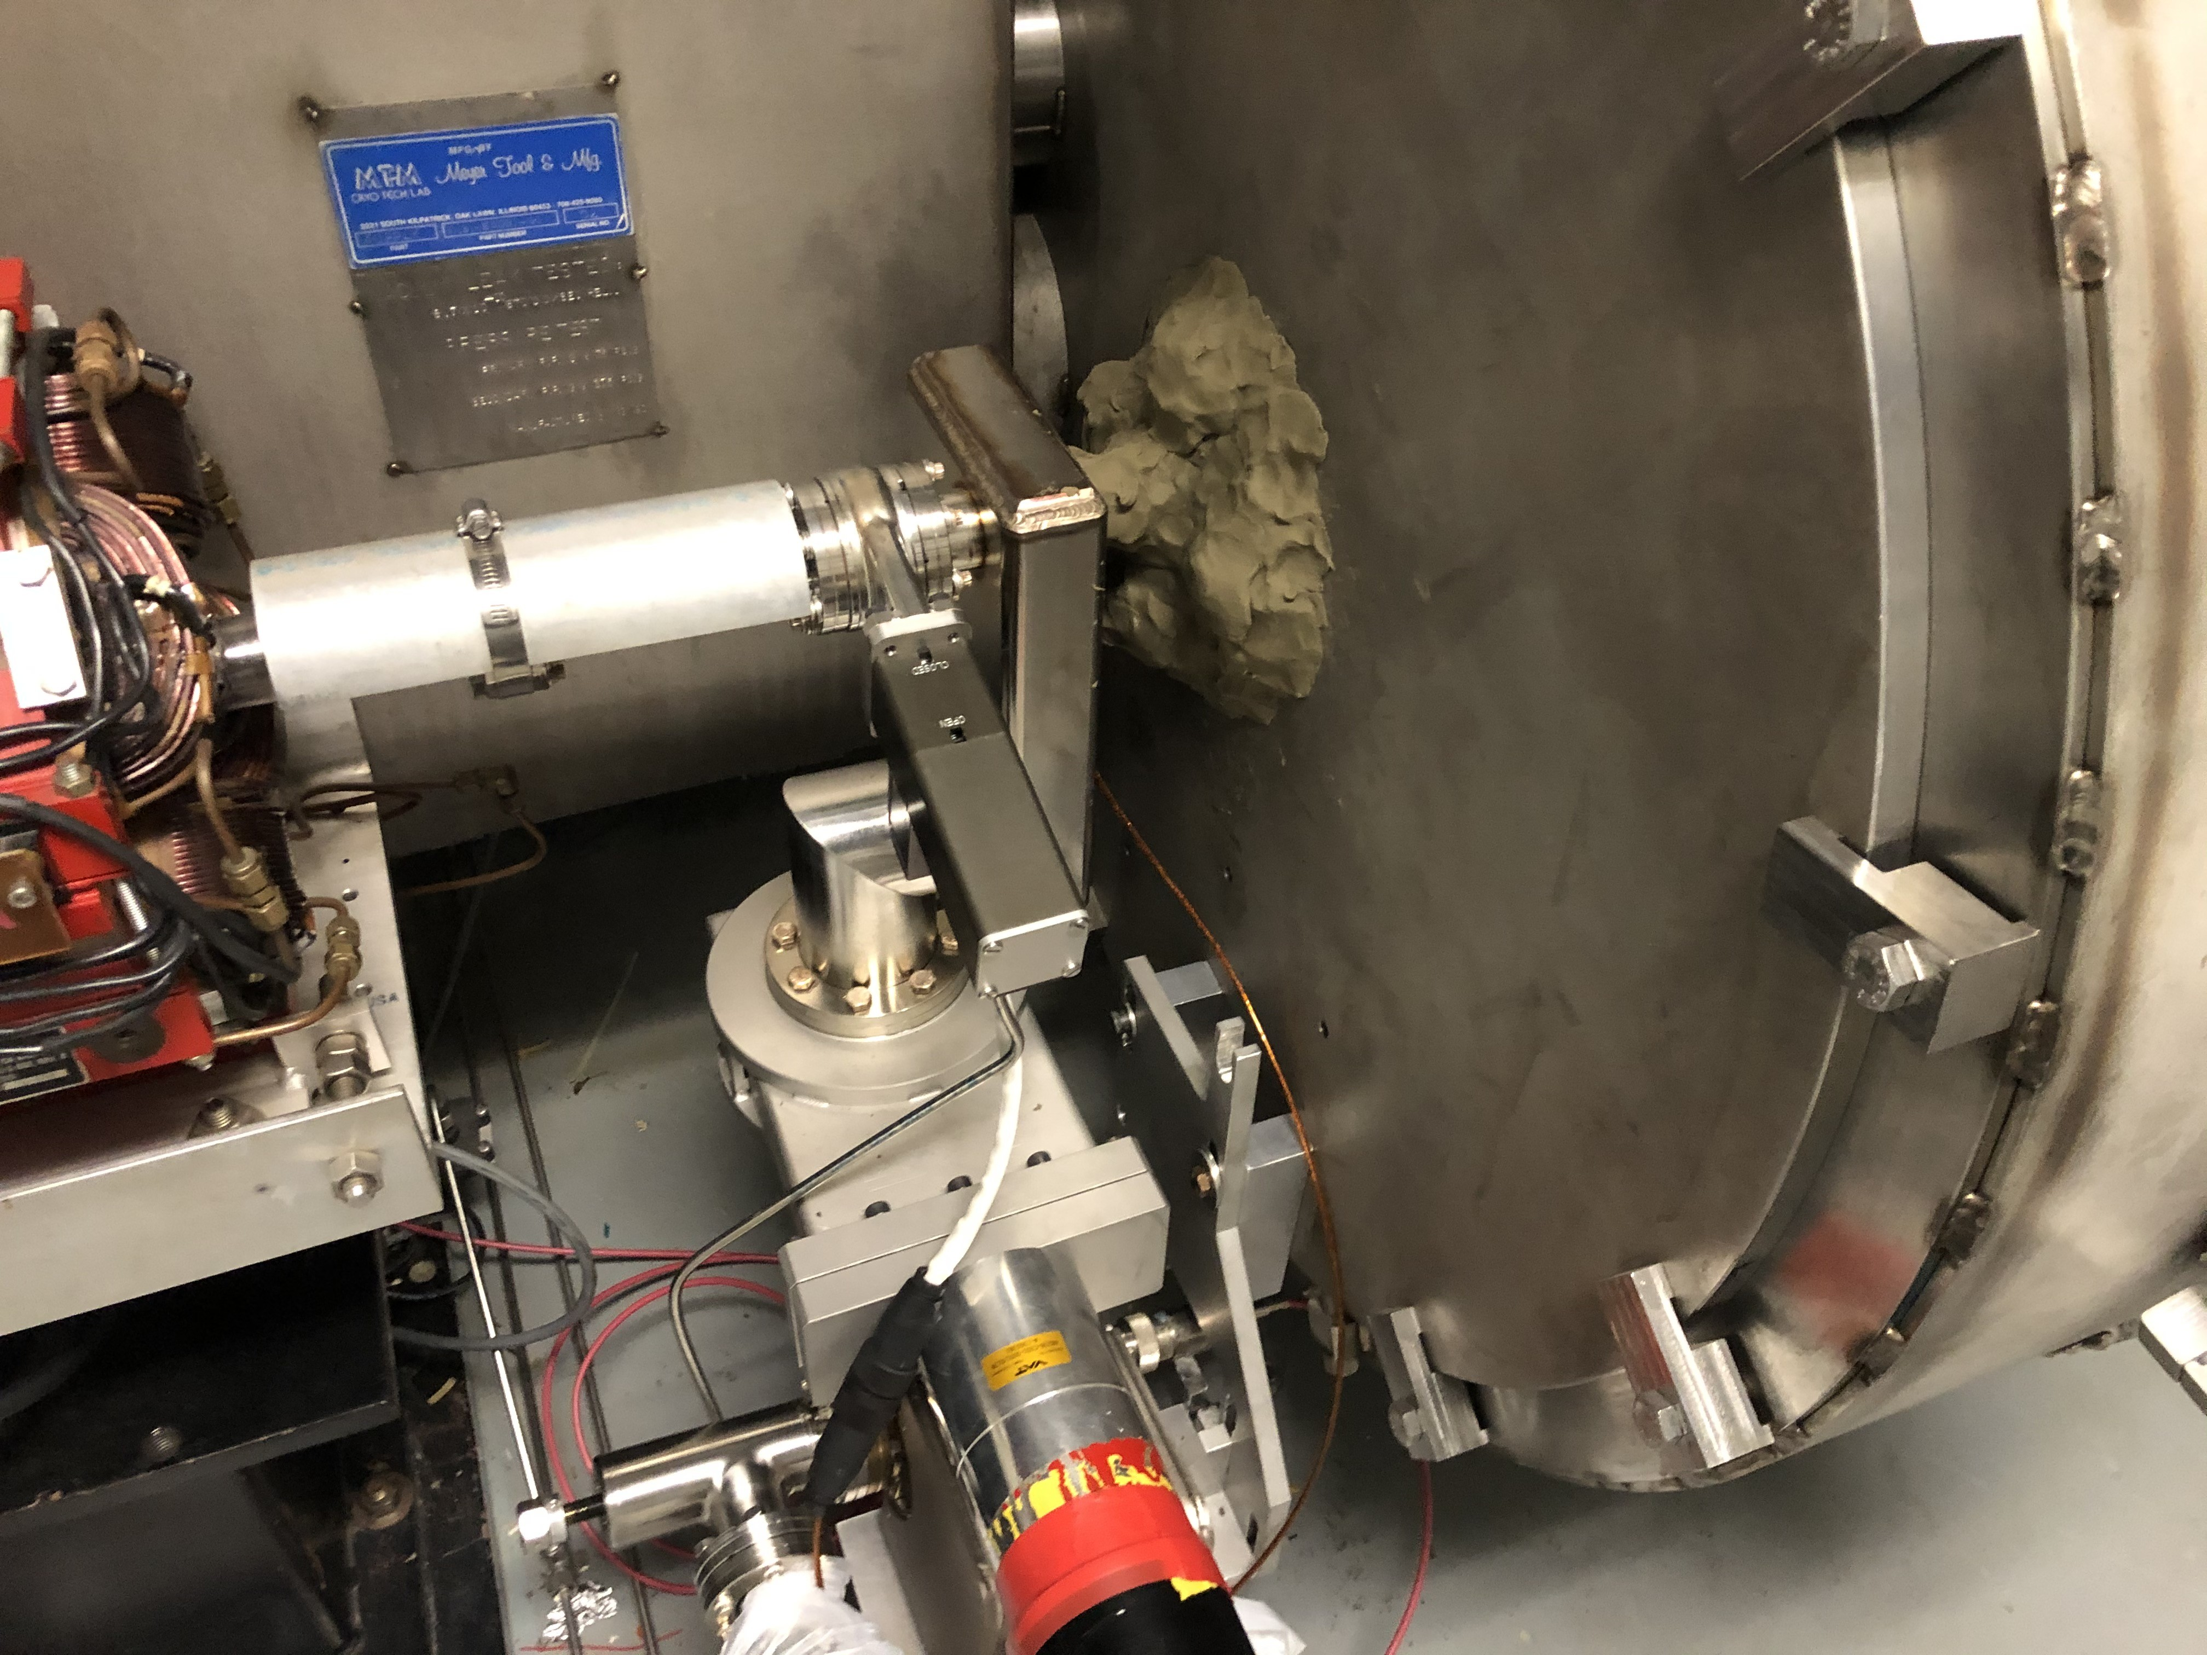
C-25s & 50s [296 cav.]
Quench-limited: 42 cavities (14.19%)
Mitigation: Compare quench gradients against commissioning performance to determine if there has been degradation. Determine if there could be factors that present in quench circuit like multipacting or high frozen gas load and plan accordingly.
Drive system limited (klystron, control module, etc.): 28 cavities (9.46%)
Regulation/Instability limited by ops (RFCMs/2.5W amps?): 22 cavities - none encountering max klystron output power. (7.43%)
Mitigation: List of issues (prioritized for best gradient gain options) transferred to Engineering for evaluation and repair.
Vacuum: 10 cavities (3.38%)
Cavity Waveguide Vacuum Faults (CWVF): 5 cav.
Beam Line Vacuum Faults (BLVF): 5 cav.
Mitigation: Work list kept by SRF to work when
schedule allows. Prompt actions as necessary.
(ex. Insulating vacuum supplementary pumps &
vacuum putty)
Admin-limited: 6 cavities (2.02%)
Mitigation: No change
M. McCaughan
TTC: Aomori, Japan 13Oct22

Slide 27
C-25s & 50s [296 cav.]
Beam loading: 11 cavities limited (3.72%)
Mitigation: Additional study of cavities marked as loaded is required to determine
if the issue is actually beam loading (running out of power) vs. regulation issues
(RFCM not controlling appropriately). Path forward on loaded cavities open to discussion.
Heat load: 10 cavities limited (3.38%)
Mitigation: If pressure sensor is behaving appropriately, cavity gradient may be limited for heat load management. Heat load can be calculated from cryogenic flow changes of
electric heat vs. RF heat and Qs adjusted.
Tuner issues: 4 cavities limited (1.35%)
Mitigation: SRF maintains list of issues; if the tuners shafts (externally accessible) are not frozen in place [necessitating thermal cycle] then action may be taken – higher torque gear boxes, manual tuning with drive box, etc.
M. McCaughan
TTC: Aomori, Japan 13Oct22

Slide 28
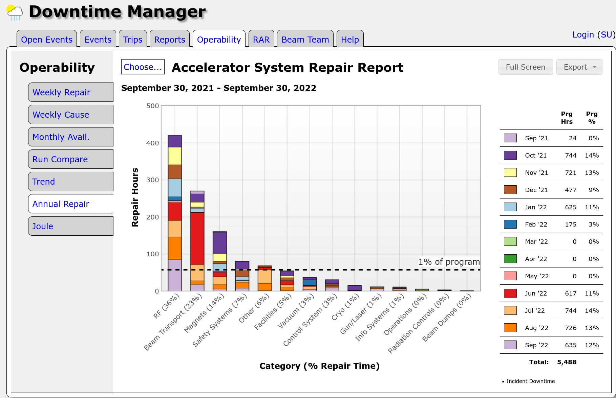
Analyzing Downtime
Downtimes == faults of t > 5 min. Bin by system and look for trends on various time scales to spot problems / repeat offenders. Root-cause analysis for significant downtimes generally executed by Operability group + System Owners
M. McCaughan
TTC: Aomori, Japan 13Oct22

Slide 29
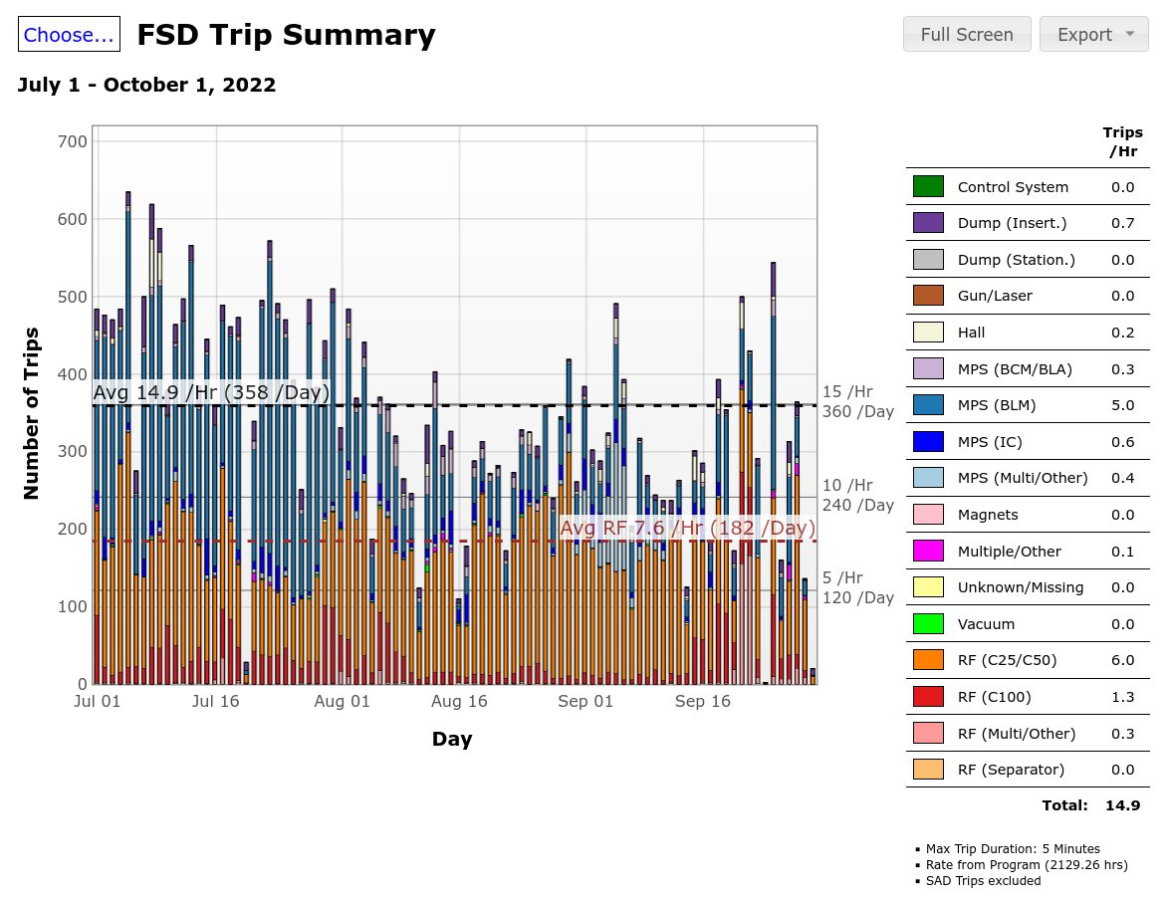
Analyzing Downtime
Fast ShutDown (FSD) faults:
Beam stopped rapidly to protect machine. (i.e. high duty factor beam where it shouldn’t be)
Nominally faults: t < ~1 min.
(Investigation may take longer…)
Some Examples:
RF cavity trips (auto-recovered)
Beam Loss Monitor Trips
Ion Chamber Trips (Near Targets)
Loss accounting system (In >> Out)
Etc.
Binned by system & component; also trends on various time scales to spot problems / repeat offenders. Usually looked at more granularly (hour-scale) online by operators to diagnose immediate problems and tuning issues.
M. McCaughan
TTC: Aomori, Japan 13Oct22

Slide 30
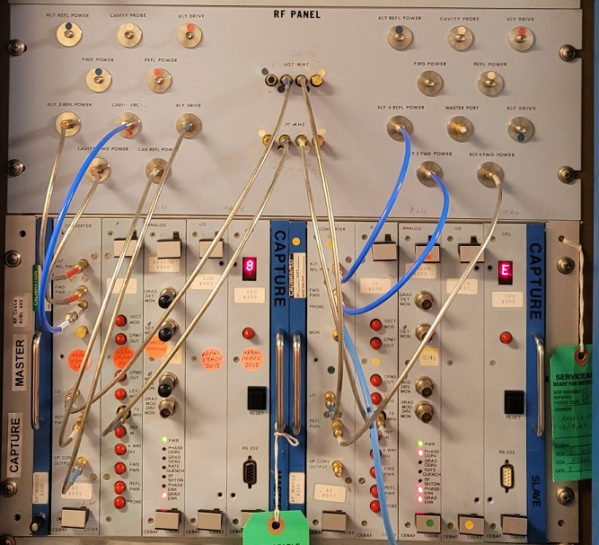
Low-level RF Controls (LLRF)
LLRF 1.0 aka RFCMs:
Original installation: (~35 y.o.)
Obsolescence issues with components are making it hard to maintain them due to availability of legacy parts.
Largely analog but controlled by microprocessor with A/D & D/A converters w/ up to 8kW Klystrons.
Main features:
  Phase-locked loop
  Gradient-locked loop
  Automatic frequency tuning algorithm (based on user input)
  Auto-recovery: ~45 seconds
(LLRF 1.0 aka RF Control Modules)
Still in use on 306 / 418 Cavities
[All the C20/50 (Original Cebaf) Style Cavities]
G. Lahti, Basic RF Control System Tutorial, JLAB-TN-93-101. 15 Dec 93
M. McCaughan
TTC: Aomori, Japan 13Oct22

Slide 31
Low-level RF Controls (LLRF) (Cont.)
LLRF 2.0:
Developed for 12 GeV upgrade (C-100 style cavities; 13 kW klystrons)
Dual FPGA-based Digital heterodyne transceiver with I/Q sampling:
  FPGA #1: Field control chassis (FCC) for each cavity: 1497 MHz down-converted to 70 MHz(IF) & used w/ on-board PLL to make 56 MHz clock. IF sampled at 56Msps to create 14 MHz I/Q sin waves (w/ 56 MHz update rate) which is fed to FPGA for digital signal processing.
  FPGA #2: Resonance Control Chassis: PI-loop controls frequency of all 8 cavities through mechanical tuners. (~800 Hz detuning experienced between 0 and 20 MV/m gradient.)
Main states:
  Tone Mode (Single frequency/variable amplitude to tune)
  Self-Excited Loop (SEL): Detuning level noted, and amplitude ramped as cavity frequency tunes in across the ~800Hz range.
  Generator-Driven Resonance (GDR): Cavity locks to reference once at field; if a cavity trips all cavities in the zone drop to SEL to attempt to maintain gradient.
C-100 (Low Loss)
7 cells
L=0.7 m
100 MeV/CM
17.86 MV/m
Q0@2.07K: 7.2e9
Qe,FPC: 3.2e7 (± 20%)
R/Q: 868.9 Ω
R/Q: 124.1 Ω (per cell)
EPICS interface through PC104 based IOC. (PC104 now also nearing obsolescence)
Many diligent firmware revisions to improve behavior/recovery time. (Presently 1-2 minutes depending on number of cavities)
(Cavity Parameters)
In use on 72 / 418 Cavities
[9 of the 12 Low Loss C-100 zones]
C. Hovater et al., Status of the CEBAF Energy Upgrade RF Control System, Proceedings of LINAC10, MOP095, Tsukuba, Japan.
C. Hovater er al., Operational Experience with CW High Gradient and High QL Cryomodules, Proceedings of LINAC14 , THIOC03, Geneva, Switzerland
R. Bachimanchi et al., CEBAF SRF Performance During Initial 12 GeV Commissioning, Proceedings of IPAC15, THXB1, Richmond, VA, USA.
M. McCaughan
TTC: Aomori, Japan 13Oct22

Slide 32
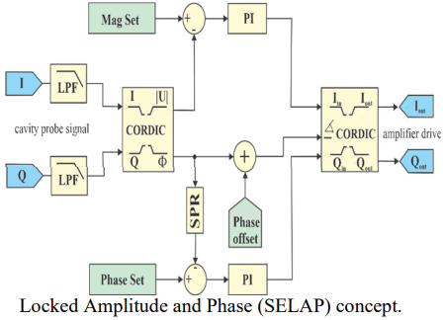
Low-level RF Controls (LLRF) (Cont.)
(Cavity Parameters)
LLRF 3.0:
Replace legacy systems; build on success of LLRF2/LCLS-II LLRF designs.
Modular architecture: Receiver, transmitter, digitizer, & FPGA on separate boards for easy configuration / maintenance.
Improved channel-to-channel isolation (>90dB)
Main states:
  Tone Mode (Single frequency/variable amplitude to tune)
  Self-Excited Loop (SEL): Detuning level noted, and amplitude ramped as cavity frequency tunes in across the ~800Hz range.
  SELA: SEL as before, but with additional amplitude control PI-loop.
  SELAP: SEL Amplitude & Phase locked; system phase-locked when sufficient power is exists.
C-100 (Low Loss) | C-75 (High Current)
7-cell | 5-cell
L = 0.7 m | L = 0.4916 m
E gain/CM: 100 MeV | Egain/CM: 75 MeV
Eacc/cav: 17.86 | Eacc/cav: 19.07 MV/m
Qo@2.07K: 7.2e9 | Qo@2.07K: 8.0e9
Qe,FPC: 3.2e7 (± 20%) | Qe,FPC: 2.0e7 (± 15%)
R/Q: 868.9 Ω | R/Q: 525.4 Ω
R/Q (per cell): 124.1 Ω | R/Q (per cell):105.1 Ω
In use on 40 / 418 Cavities
[3 / 12 Low Loss C-100 zones; 2/2 High Current C-75 zones]
T. Plawski et al., First SELAP Algorithm Operational Experience of the New LLRF 3.0 RF Control System, Proceedings of LINAC22, THPOA241, Liverpool, UK.
T. Plawski et al., JLAB LLRF 3.0 Development and Tests, Proceedings of IPAC21, THPAB271, Campinas, SP, Brazil
M. McCaughan
TTC: Aomori, Japan 13Oct22

Slide 33
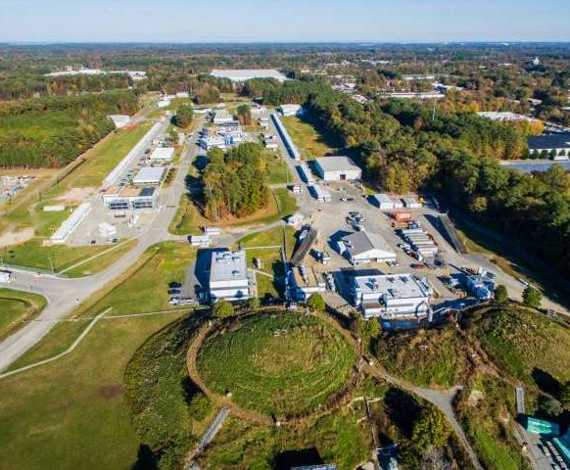
Michael McCaughan
12000 Jefferson Ave. Suite 19
Newport News, VA 23606 USA
O: (757) 269-5572 / michaelm@jlab.org
Thomas Jefferson National Acceleration Facility
-Fin-
CEBAF Particle Accelerator

